Slide 1

E-sports
Presented by: Kyle Brown, Vincent Liang, Wade Schmidt

Slide 2
PROBLEM DOMAIN

Slide 3
THE PROBLEM
MOST PEOPLE DO NOT VIEW PROFESSIONAL GAMING AS A VIABLE CAREER
GENERAL LACK OF KNOWLEDGE OF WHAT PROFESSIONAL GAMING IS

Slide 4
THE PROBLEM
Who: THE GAMERS and THEIR PARENTS
When: IF A GAMER DECIDES TO PURSUE A CAREER IN GAMING
How: LACK OF FUNDING and SUPPORT FROM PARENTS
What: A CAREER IN PROFESSIONAL GAMING IS NOT ALLOWED
Why: LACK OF STANDARDIZATION and KNOWLEDGE

Slide 5
Overview of esports

Slide 6
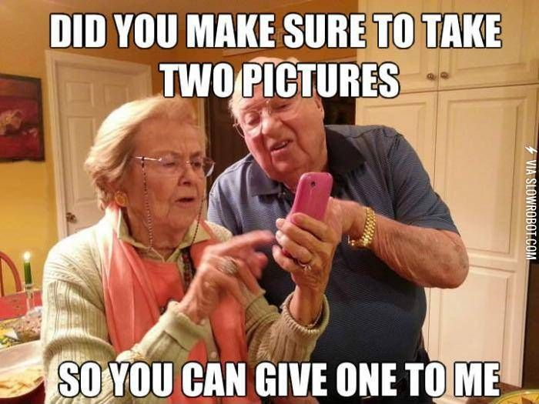
lack of understanding

Slide 7

Lack of understanding
A career based around video games?
A new type of career, but is not viewed as a serious job
Video games have been seen as a waste of time
Has only “really” become huge in the last decade
A lot of players are young adults
Parents don’t understand!

Slide 8

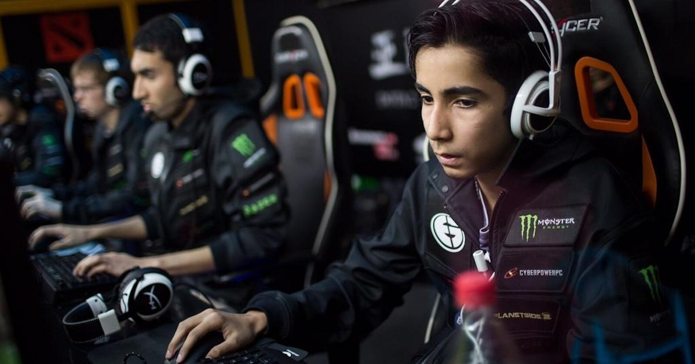

young people?

Slide 9

young people
A career based around video games? Really?
A majority of aspiring e-sports players are young adults that just graduated high school or in their early to mid twenties
They lack the maturity and knowledge to make sound business decisions
Lack funding without assistance from parents

Slide 10
WORRIES
Not a secure career
Lack of standardization
Lack of support from professionals/agents like in traditional sports
The average career of a professional in e-sports lasts around two years
What are they left with after that?

Slide 11

BENEFITS

Slide 12




BENEFITS
Benefits of a pro-gamer
Income/prize money/sponsorships
Global fame
Low commitment, can go back to school
Work from home

Slide 13
USERs

Slide 14
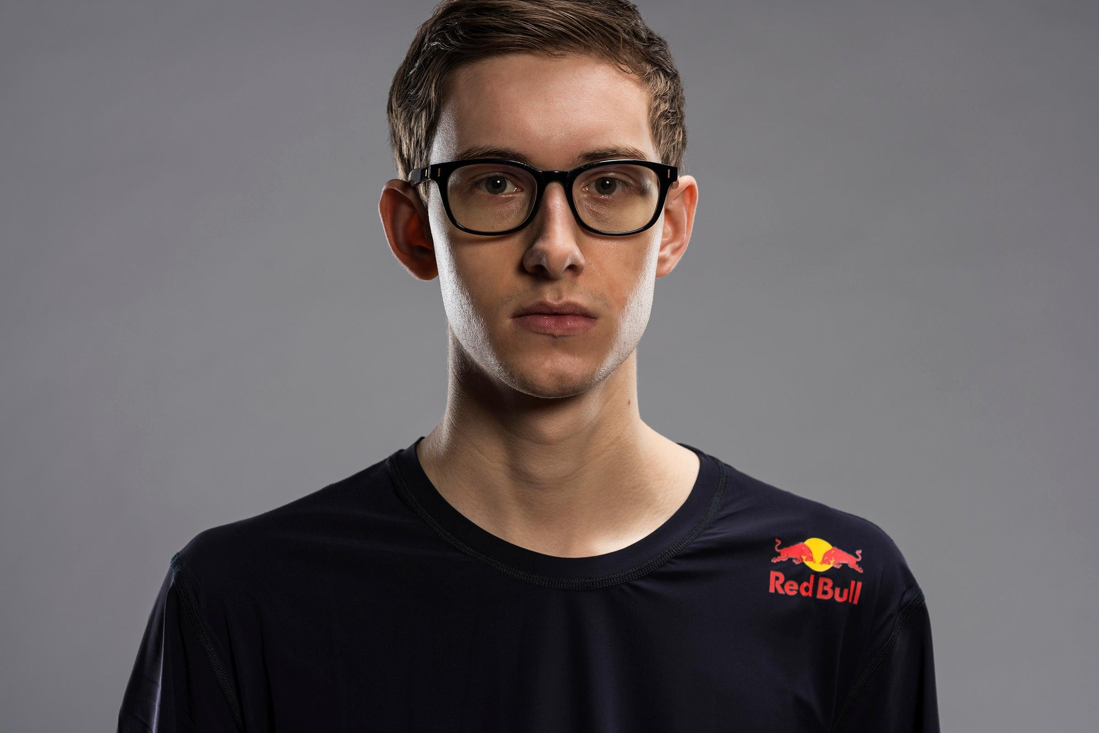
Target: Chris thanos student/gamer

Slide 15
Characteristics
Top gamer
Tech-savvy
Dedicated
Quick decision making skills
Lacks social skills

Slide 16
Frustrations
Does not know how to pursue a career in eSports
Lack of exposure to professional teams
Lacks connections to people in the industry
Deciding between college or eSports career
Parents disapprove career in gaming

Slide 17
Goals
To understand the benefits and drawbacks to an eSports career
To decide if he should pursue a career in eSports
Persuade his parents to accept professional gaming

Slide 18
Needs
Guidance on pursuing an eSports career
A way to connect with someone in the industry
Information explaining why a career in eSports is viable to his parents

Slide 19

Target:
Ms. Joan Thanos
Parent

Slide 20
Ms. Thanos is a busy professional woman.
Ms. Thanos is intelligent, detail and family-orientated.
Ms. Thanos has expertise in office communication.
Ms. Thanos is experienced reading complex and detailed material.
Characteristics

Slide 21
Goals
Primary goals are to advise and help her son pick the right career
Understand the pros and cons of a career in eSports
To create a meaningful dialogue with her child, so that a channel for clear and honest communication is available to deal with any potential issues
To provide helpful legal advice so her son can protect himself and advance in his chosen career
To provide a resource for her son when challenges arise that are outside his career

Slide 22
Needs
Ms. Thanos needs know why a professional gaming career would be right for her son.
Ms. Thanos needs a accessible resource to which she can direct her son.
Ms. Thanos needs a resource that is regularly updated to reflect changes in a new industry.
Ms. Thanos needs important information to be laid out clearly and concisely.

Slide 23
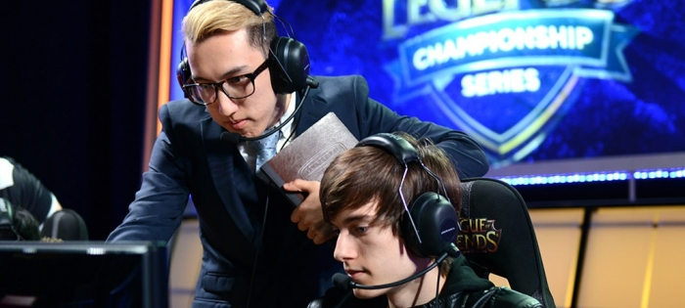
Target:
Gurney Halleck
E-SPORTS PLAYER MANAGER

Slide 24
characteristics
Retired e-sports professional
Leader
Works well in team
Good people skills
Organized
Lacks business/law knowledge

Slide 25
Goals
To understand the business and legal side of esports
To manage an esports team efficiently
To support and take care of his players and support them in their careers

Slide 26
Needs
A resource for labor law information
Technical information regarding business practices in the e-sports industry
Access to professionals in the field of business and law

Slide 27
Frustrations
Rapid growth in the e-sports industry has lead to gaps in information barrier for players and the people running the organization
Was put in a role that he is doesn’t have the required business/ legal know –how
Lack of structure revolving around contracts, lifestyle, and work ethic of players.

Slide 28
SOLUTIONS

Slide 29
Solution 1
A site that provides information on eSports and a legal resource that will contain:
Legal documentation
Attorney contact
Contract aide
Resource for parents

Slide 30
Solution 2
Connect prospective pro-gamers with player managers/agents and other gamers
A way for gamers to build connections
Agents can talk to and explain eSports to parents

Slide 31
Solution 3
Comprehensive step-by-step guide on how to pursue a professional gaming career

Slide 32
THANK YOU!

