Slide 1
E-sports

Slide 2



Problem-rapid growth

Slide 3




Problem-rapid-growth
Why is rapid growth a problem?
Lack of experienced professionals in business and legal.
Leading to mismanaged teams
Poor player lifestyle.
Players taken advantage of. Bad contracts, unreasonable hours, short professional career
General lack of support regarding the business side of esports.

Slide 4

Problem-lack of understanding

Slide 5

Lack of understanding
A career based around videogames?
A new type of career, one which is based around something that is traditionally treated as a leisure.
Historically, videogames have been seen as a waste of time.
Has only “really” become huge in the last decade.
A lot of players are young adults.
Parents don’t understand!

Slide 6

Problem-young people?

Slide 7

Problem-young people
A career based around videogames? Really?
A majority of aspiring e-sports players are young adults that just graduated high school or in their early to mid twenties.
They lack the maturity and knowledge to make sound business decisions.
They get locked into terrible contracts.
Undergo tremendous amounts of stress (sometimes playing for 10 hours or more a day of practice).
On average the career of a professional in e-sports is around two years.
What are they left with after that?

Slide 8
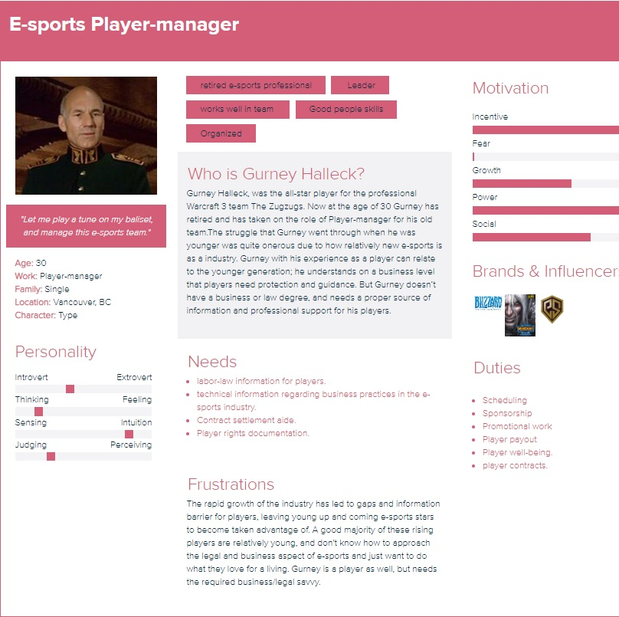
Target
E-sports Player manger:

Slide 9
Talk to your user

Slide 10
Solution 1
Provide a legal resource for player-managers that will contain:
-legal documentation
-labor law documentation.
-Attorney contact.
-contract aide.

