Slide 1

E-sports
Presented by: Kyle Brown, Wade Schmidt, Vincent Liang

Slide 2



Problem:rapid growth

Slide 3




Problem: rapid-growth
Why is rapid growth a problem?
Lack of experienced professionals in business and legal.
Leading to mismanaged teams
Poor player lifestyle.
Players taken advantage of. Bad contracts, unreasonable hours, short professional career
General lack of support regarding the business side of esports.

Slide 4
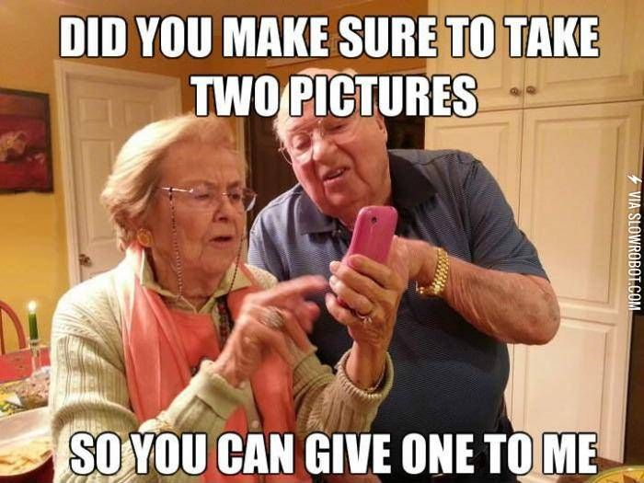
Problem: lack of understanding

Slide 5

Lack of understanding
A career based around videogames?
A new type of career, one which is based around something that is traditionally treated as a leisure.
Historically, videogames have been seen as a waste of time.
Has only “really” become huge in the last decade.
A lot of players are young adults.
Parents don’t understand!

Slide 6
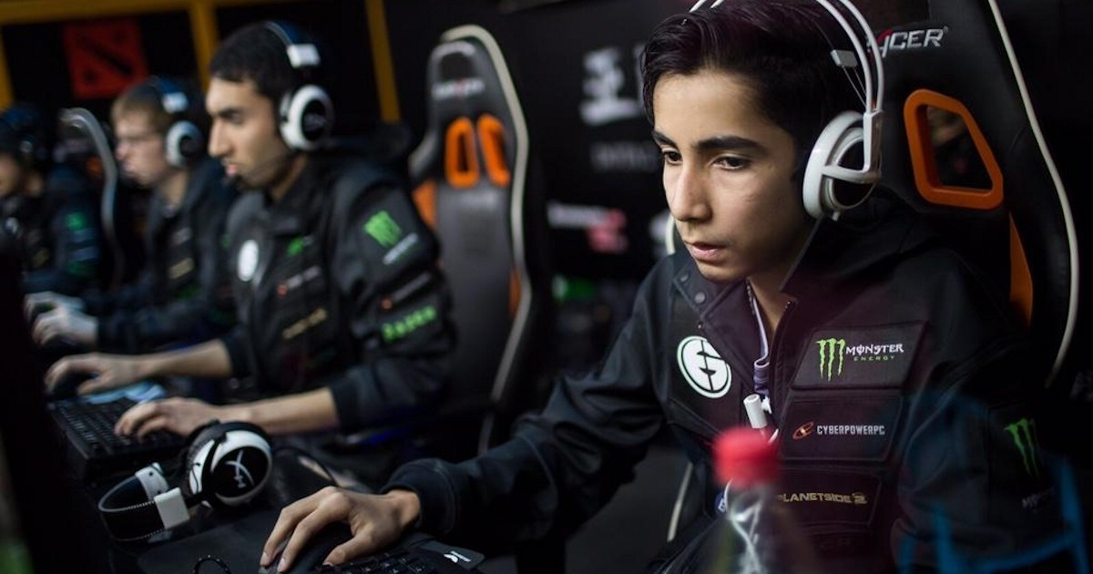
Problem: young people?

Slide 7

Problem: young people
A career based around videogames? Really?
A majority of aspiring e-sports players are young adults that just graduated high school or in their early to mid twenties.
They lack the maturity and knowledge to make sound business decisions.
They get locked into terrible contracts.
Undergo tremendous amounts of stress (sometimes playing for 10 hours or more a day of practice).
On average the career of a professional in e-sports is around two years.
What are they left with after that?

Slide 8
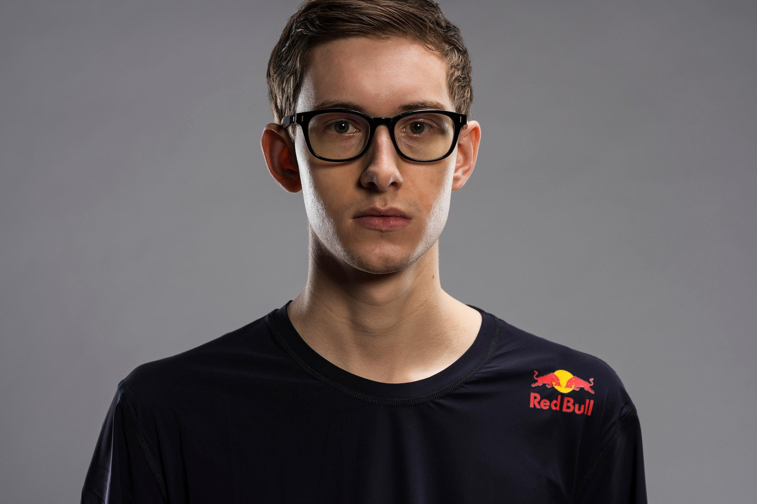
Target student

Slide 9
Characteristics
Top gamer
Tech-savvy
Dedicated
Quick decision making skills
Lacks social skills

Slide 10
Frustrations
Would like to pursue a career in professional gaming, but does not know what steps to take
Would like to show to eSport organizations that he has the skills to join a professional team
Lacks the connections to get in contact with someone in the industry
Has to decide soon if he will go to college or pursue a career in eSports
Parents would disagree with him pursuing a career in video games

Slide 11
Goals
To understand the benefits and drawbacks to an eSports career
To decide if he should pursue a career in eSports
Persuade his parents to let him go into professional gaming

Slide 12
Needs
Guidance on how to pursue an eSports career
A way to connect with someone in the industry
Information explaining why a career in eSports is viable to his parents

Slide 13

Target
Parent

Slide 14
Ms. Thanos is a busy professional woman.
Ms. Thanos is intelligent, detail and family-orientated.
Ms. Thanos has expertise in office communication.
Ms. Thanos is experienced reading complex and detailed material.
Characteristics

Slide 15
Goals
Primary goals are to advise and help navigate her son’s fledgling e-gaming career.
To create a meaning dialogue with her child, so that a channel for clear and honest communication is available to deal with any potential issues.
To provide helpful legal advice so her son can protect himself and advance in his chosen career.
To provide a resource for her son when challenges arise that are outside his career.

Slide 16
Needs:
Ms. Thanos needs important information to be laid out clearly and concisely.
Ms. Thanos needs access to important resources outside the site.
Ms. Thanos needs a accessible resource to which she can direct her son.
Ms. Thanos needs a resource that is regularly updated to reflect changes in a new industry.

Slide 17
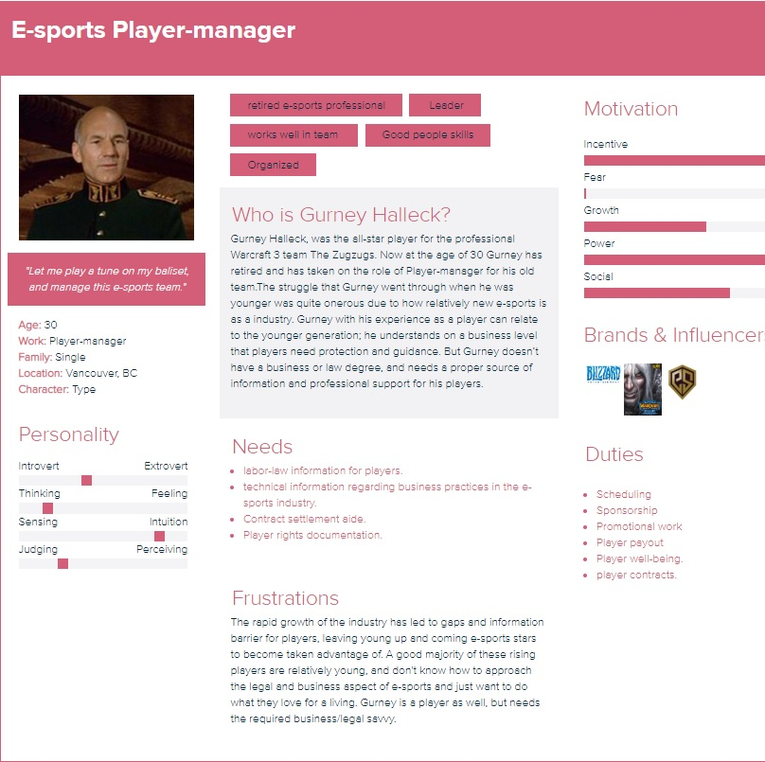
Target
E-sports Player manger

Slide 18
Talk to your user

Slide 19
Solution 1
Provide a legal resource for player-managers that will contain:
-legal documentation
-labor law documentation.
-Attorney contact.
-contract aide.

Slide 20
Solutions 2

Slide 21
Solutions 3

