Slide 1
Dining Philosophers Problem
Four Concurrency Solutions in Java
CPSC 543 · Vince Marinelli

Slide 2
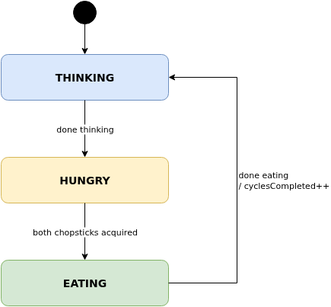
The Dining Philosophers Problem
Originally posed by Dijkstra (1965); reformulated by C.A.R. Hoare — a classic model of resource contention
In ancient times, a wealthy philanthropist endowed a College to accommodate five eminent philosophers. Each philosopher had a room in which he could engage in his professional activity of thinking; there was also a common dining room, furnished with a circular table, surrounded by five chairs, each labelled by the name of the philosopher who was to sit in it. … To the left of each philosopher there was laid a golden fork, and in the centre stood a large bowl of spaghetti, which was constantly replenished. A philosopher was expected to spend most of his time thinking; but when he felt hungry, he went to the dining room, sat down in his own chair, picked up his own fork on his left, and plunged it into the spaghetti. But such is the tangled nature of spaghetti that a second fork is required to carry it to the mouth. The philosopher therefore had also to pick up the fork on his right. When we was finished he would put down both his forks, get up from his chair, and continue thinking. Of course, a fork can be used by only one philosopher at a time. If the other philosopher wants it, he just has to wait until the fork is available again.
— C.A.R. Hoare, Communicating Sequential Processes, (1985), pp 55-56 [2]
Core Constraints
One chopstick between each adjacent pair (5 chopsticks total)
Eating requires both left and right chopstick simultaneously
A chopstick can only be held by one philosopher at a time
Hazards to prevent: Deadlock · Starvation · Livelock · Race Conditions

Slide 3
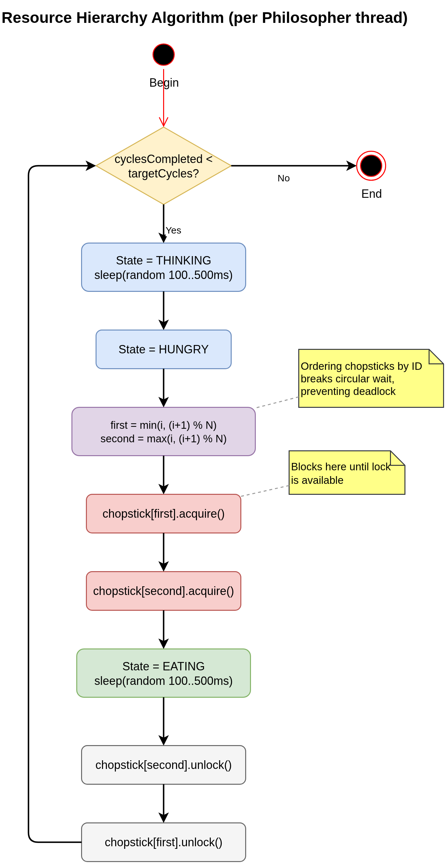
Solution 1: Resource Hierarchy (Dijkstra)
Always acquire the lower-numbered chopstick first — breaks circular wait
1
Chopsticks numbered 0 through N-1
2
Philosopher i acquires min(i, i+1%N) first, then max
3
No circular-wait possible → no deadlock
4
Starvation is still possible — no fairness guarantee
JCIP: @ThreadSafe · lock ordering prevents deadlock (§10.1)
final Chopstick first = chopsticks.get(Math.min(id, (id+1) % n));
final Chopstick second = chopsticks.get(Math.max(id, (id+1) % n));
first.acquire(); // lockInterruptibly()
try {
second.acquire();
try {
transitionTo(EATING);
Thread.sleep(randomSleepMs());
} finally { second.release(); }
} finally { first.release(); }

Slide 4
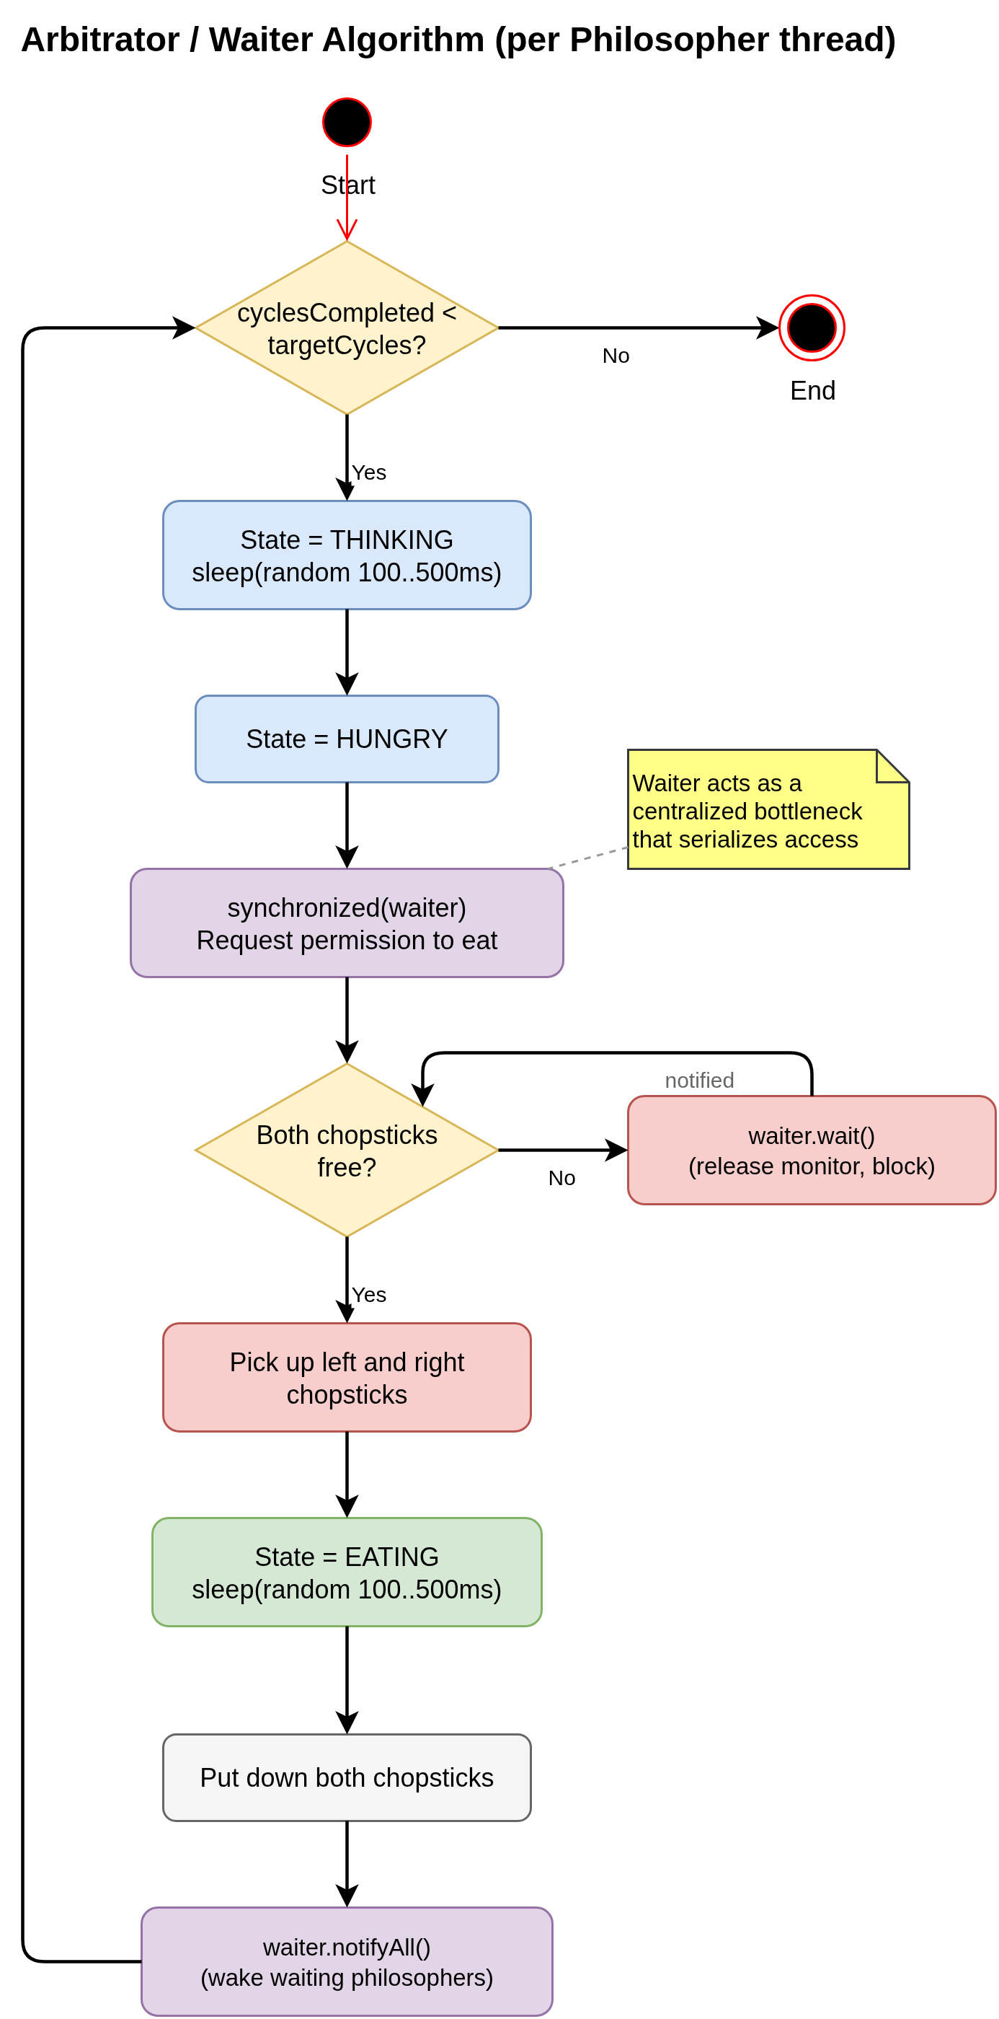
Solution 2: Arbitrator / Waiter
Central Waiter serializes grants via synchronized + wait() / notifyAll()
1
Philosopher asks Waiter before picking up any chopstick
2
Waiter grants only when both adjacent chopsticks are free
3
Waiting threads call wait(); Waiter calls notifyAll() on release
4
Max ⌊N/2⌋ philosophers eating simultaneously
JCIP: @GuardedBy("this") · condition queue (§14.1)
@GuardedBy("this")
synchronized void requestChopsticks(int l, int r)
throws InterruptedException {
while (chopstickInUse[l] || chopstickInUse[r]) {
wait(); // block until notifyAll()
}
chopstickInUse[l] = chopstickInUse[r] = true;
}
synchronized void releaseChopsticks(int l, int r) {
chopstickInUse[l] = chopstickInUse[r] = false;
notifyAll(); // wake all waiting threads
}

Slide 5
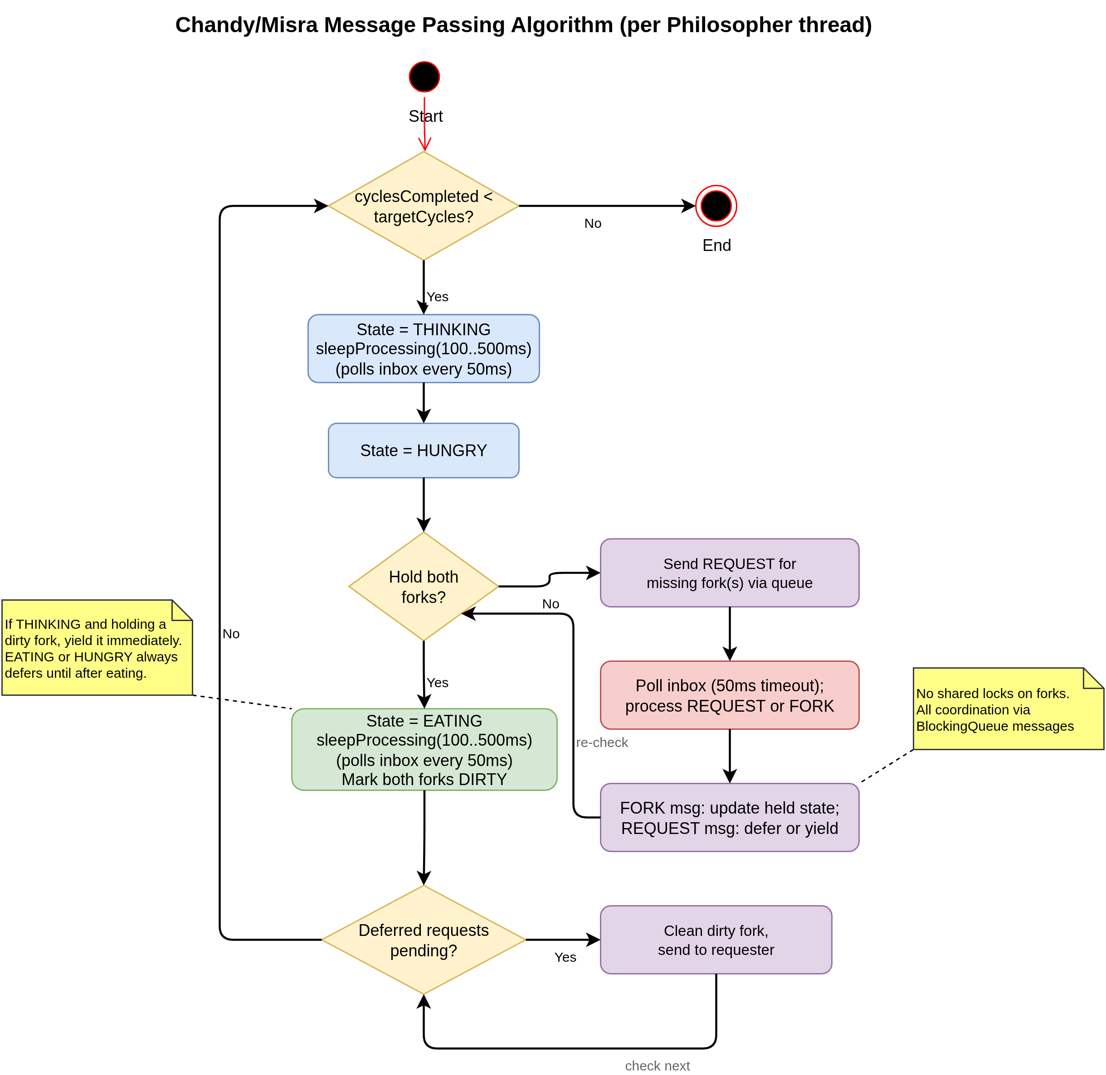
Solution 3: Chandy / Misra (Message Passing)
No shared locks — all coordination through LinkedBlockingQueue inboxes
1
Each chopstick is clean or dirty, owned by exactly one philosopher
2
Initially dirty, held by the lower-numbered neighbor
3
Dirty + requested while THINKING → clean and send immediately
4
EATING or HUNGRY always defers — dirty fork is sent only when THINKING (starvation-free)
JCIP: @Immutable Message · actor-style threading (§5.3)
// Respond to fork requests while thinking or eating
private void sleepProcessing(int totalMs) throws InterruptedException {
long deadline = System.currentTimeMillis() + totalMs;
while (System.currentTimeMillis() < deadline && !stopped.get()) {
Message msg = myInbox.poll(50, TimeUnit.MILLISECONDS);
if (msg != null) processMessage(msg);
}
}
// Give dirty fork to requester immediately
if (dirty && cur == THINKING) {
holdsLeft[0] = false; leftDirty[0] = false;
leftInbox.put(new Message(MsgType.FORK, id));
} else { deferLeft[0] = true; }

Slide 6
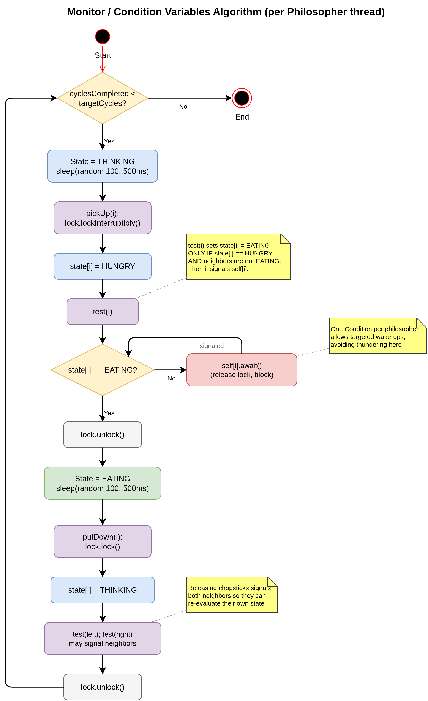
Solution 4: Monitor / Condition Variables
Single ReentrantLock + one Condition per philosopher — most idiomatic Java
1
Global state[] array: THINKING, HUNGRY, or EATING per philosopher
2
A philosopher can only eat when both neighbors are not eating
3
putDown() calls test() on both neighbors — targeted signal(), not broadcast
4
Single lock guards all state; starvation-free through neighbor signaling
JCIP: @GuardedBy("lock") · ReentrantLock + Condition (§14.3)
// @GuardedBy("lock")
private void test(int i) {
if (state[i]==HUNGRY
&& state[(i-1+n)%n]!=EATING
&& state[(i+1)%n] !=EATING) {
state[i]=EATING; self[i].signal();
} }
private void pickUp(int i) throws InterruptedException {
lock.lockInterruptibly(); try {
state[i]=HUNGRY; test(i);
while (state[i]!=EATING) self[i].await();
} finally { lock.unlock(); }
}

Slide 7
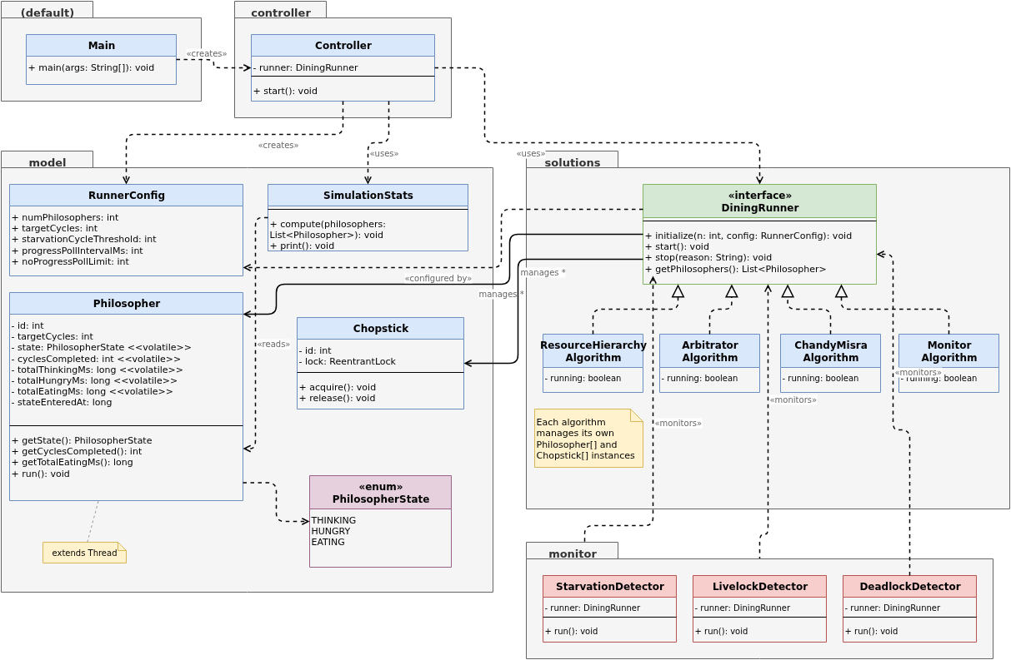
Architecture & Monitoring
Controller knows only DiningRunner · three daemon monitors; first to fire wins via AtomicBoolean
src/
├── controller/ Controller.java
├── model/ Philosopher · Chopstick · SimulationStats
├── solutions/ DiningRunner (iface) + 4 algorithms
└── monitor/ Starvation · Livelock · Deadlock
StarvationDetector
LivelockDetector
DeadlockDetector
Fires when any philosopher falls behind the leader by more than T = max(10, ⌊leader × 20%⌋) cycles. Adaptive: threshold scales with run progress to prevent false positives at large N.
Fires when total cycles stagnate for N polls AND at least one thread is RUNNABLE. Snapshot-diff alone would miss it.
ThreadMXBean.findDeadlockedThreads() + progress-stall check when all threads are BLOCKED/WAITING/TIMED_WAITING.
P2 is 11 cycles behind P0.
0 cycles in 30 polls, active threads.
Circular wait on P0, P2, P4.

Slide 8
Metrics: Jain’s Fairness Index
Quantifying how equitably chopstick access is distributed among philosophers
F = ( Σ eatingTimeᵢ )² ÷ ( N × Σ eatingTimeᵢ² )
Why eating time? A fair algorithm gives each philosopher equal chopstick access. Think-time is self-imposed; hungry-wait-time is a byproduct. totalEatingMs is the primary fairness variable.
F range | Interpretation
0.99 – 1.00 | Excellent fairness — all philosophers ate for essentially equal time
0.95 – 0.99 | Good; minor imbalance
0.90 – 0.95 | Moderate imbalance; one or more philosophers notably disadvantaged
< 0.90 | Poor fairness; starvation likely present or imminent
F = 1/N (e.g. 0.20 for N=5) | One philosopher monopolized all eating time — worst case
Scale-independent: a fast and a slow solution can be directly compared. F ≥ 0.99 is achievable with solutions 3 and 4.

Slide 9
Simulation Results at Scale
Think + Eat ∈ [100 ms, 500 ms] · Starvation threshold T = max(10, ⌊leader × 20%⌋) · All four algorithms prevent deadlock
Algorithm | N=5 · 50 cycles | N=15 · 500 cycles | N=21 · 500 cycles
Resource Hierarchy | STARVATION · 37.5 s JFI 0.987 · 28% hungry | STARVATION · 27.6 s JFI 0.984 · 34% hungry | STARVATION · 32.0 s JFI 0.991 · 33% hungry
Arbitrator / Waiter | ✓ 42.6 s JFI 0.996 · 25% hungry | ✓ 419 s JFI 0.9995 · 25% hungry | ✓ 415 s JFI 0.9995 · 24% hungry
Chandy / Misra | ✓ 50.8 s JFI 0.9955 · 37% hungry | ✓ 469 s JFI 0.9997 · 33% hungry | ✓ ~467 s JFI 0.9997 · 33% hungry
Monitor / Conditions | ✓ 42.7 s JFI 0.989 · 24% hungry | ✓ 415 s JFI 0.9996 · 25% hungry | ✓ ~414 s JFI 0.9998 · 24% hungry
Monitor wins at every scale — starvation-free, lowest hungry-wait, fastest wall-clock at scale (N=15, 21), and JFI ≥ 0.989 across all runs.

Slide 10
Summary: Comparing the Four Solutions
Solution | Deadlock | Starvation | Parallelism | Java Primitive
1. Resource Hierarchy | ✓ | ✗ | High | ReentrantLock (ordered)
2. Arbitrator / Waiter | ✓ | ✗ | ⌊N/2⌋ | synchronized + wait/notifyAll
3. Chandy / Misra | ✓ | ✓ | High | LinkedBlockingQueue
4. Monitor / Conditions | ✓ | ✓ | High | ReentrantLock + Condition
All four approaches eliminate deadlock — but only Chandy/Misra and Monitor guarantee starvation-freedom.
Monitor (Solution 4) is the most idiomatic Java fit — explicit Condition per philosopher enables targeted signal() instead of broadcast.
Jain’s Fairness Index F ≥ 0.99 is consistently achieved by Solutions 3 and 4 at all tested scales (N = 5, 15, 21).
Live Demo →

Slide 11
References
[1] “Dining philosophers problem,” Wikipedia, Jun. 24, 2021. https://en.wikipedia.org/wiki/Dining_philosophers_problem (accessed Apr. 02, 2026).
[2] Hoare, C. A. R. (1978). Communicating sequential processes. Communications of the ACM, 21(8), 666–677. https://doi.org/10.1145/359576.359585 (accessed Apr. 02, 2026).
[3] E. Dijkstra, “Hierarchical Ordening of Sequential Processes,” University of Texas Computer Science Department, Jun. 1971. https://www.cs.utexas.edu/~EWD/ewd03xx/EWD310.PDF (accessed Apr. 02, 2026).
[4] E. Dijkstra, “EWD 123 Cooperating sequential processes,” 1968. Accessed: Apr. 02, 2026. [Online]. Available: https://harrymoreno.com/assets/greatPapersInCompSci/5.1_-_Cooperating_sequential_processes-Edsger_W._Dijkstra.pdf
[5] Chandy, K. M., & Misra, J. (1984). The drinking philosophers problem. ACM Transactions on Programming Languages and Systems, 6(4), 632–646. https://doi.org/10.1145/1780.1804
[6] Hoare, C. A. R. (1974). Monitors: An operating system structuring concept. Communications of the ACM, 17(10), 549–557.
[7] S. Krishnaprasad. (April 2003). Concurrent/Distributed programming illustrated using the dining philosophers problem. J. Comput. Sci. Coll., 18(4), 104–110.
[8] J. Rodleitne, “The Dining Philosophers Problem,” Diningphilosophers.eu, 2025. https://diningphilosophers.eu/ (accessed Apr. 02, 2026).
[9] A. Tanenbaum and H. Bos, “Modern Operating Systems, 4th Edition,” Pearson, New Jersey, 2015. Accessed: Apr. 02, 2026. [Online]. Available: https://os.ecci.ucr.ac.cr/slides/Andrew-S.-Tanenbaum-Modern-Operating-Systems.pdf
[10] R. Jain, A. Durresi, and G. Babic, “Throughput Fairness Index: An Explanation,” 1999. Accessed: Apr. 15, 2026. [Online]. Available: https://www.cse.wustl.edu/~jain/atmf/ftp/af_fair.pdf
[11] A. Silberschatz, P. B. Galvin, and G. Gagne, Operating System Concepts, 10th ed. Hoboken, NJ: Wiley, 2018. Accessed: Apr. 02, 2026. [Online]. Available: https://os.ecci.ucr.ac.cr/slides/Abraham-Silberschatz-Operating-System-Concepts-10th-2018.pdf
[12] B. Goetz, Java Concurrency in Practice. Upper Saddle River, NJ: Addison-Wesley, 2006.

