Slide 1
Dining Philosophers Problem
Four Concurrency Solutions in Java
CPSC 543 · Vince Marinelli

Slide 2
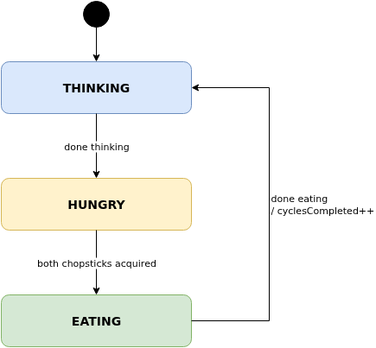
The Dining Philosophers Problem
Originally posed by Dijkstra (1965); reformulated by C.A.R. Hoare — a classic model of resource contention
“Five eminent philosophers… To the left of each philosopher lay a golden fork, and in the centre stood a large bowl of spaghetti… a second fork is required to carry it to the mouth.
— C.A.R. Hoare, Communicating Sequential Processes (1978)
Core Constraints
One chopstick between each adjacent pair (5 chopsticks total)
Eating requires both left and right chopstick simultaneously
A chopstick can only be held by one philosopher at a time
Hazards to prevent: Deadlock · Starvation · Livelock · Race Conditions

Slide 3
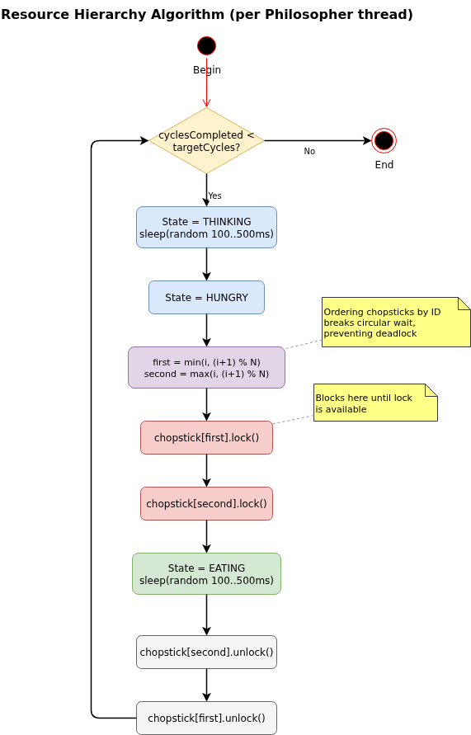
Solution 1: Resource Hierarchy (Dijkstra)
Always acquire the lower-numbered chopstick first — breaks circular wait
1
Chopsticks numbered 0 through N-1
2
Philosopher i acquires min(i, i+1%N) first, then max
3
No circular-wait possible → no deadlock
4
Starvation is still possible — no fairness guarantee
JCIP: @ThreadSafe · lock ordering prevents deadlock (§10.1)
final Chopstick first = chopsticks.get(Math.min(id, (id+1) % n));
final Chopstick second = chopsticks.get(Math.max(id, (id+1) % n));
first.acquire(); // lockInterruptibly()
try {
second.acquire();
try {
transitionTo(EATING);
Thread.sleep(randomSleepMs());
} finally { second.release(); }
} finally { first.release(); }

Slide 4
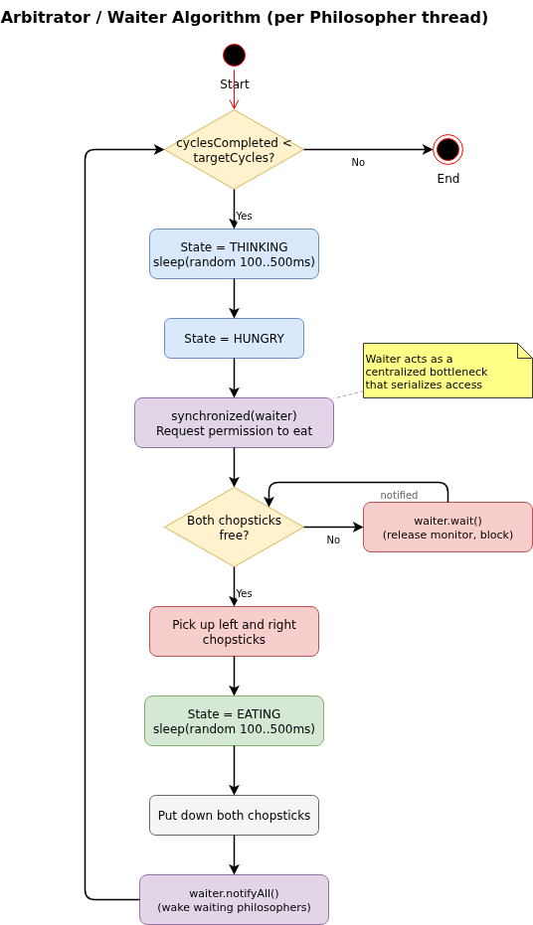
Solution 2: Arbitrator / Waiter
Central Waiter serializes grants via synchronized + wait() / notifyAll()
1
Philosopher asks Waiter before picking up any chopstick
2
Waiter grants only when both adjacent chopsticks are free
3
Waiting threads call wait(); Waiter calls notifyAll() on release
4
Max ⌊N/2⌋ philosophers eating simultaneously
JCIP: @GuardedBy("this") · condition queue (§14.1)
@GuardedBy("this")
synchronized void requestChopsticks(int l, int r)
throws InterruptedException {
while (chopstickInUse[l] || chopstickInUse[r]) {
wait(); // block until notifyAll()
}
chopstickInUse[l] = chopstickInUse[r] = true;
}
synchronized void releaseChopsticks(int l, int r) {
chopstickInUse[l] = chopstickInUse[r] = false;
notifyAll(); // wake all waiting threads
}

Slide 5
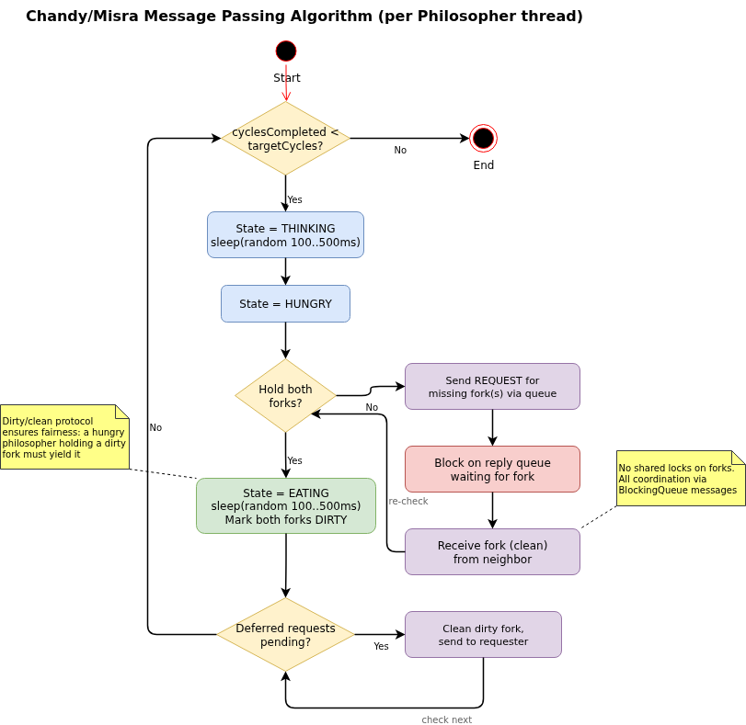
Solution 3: Chandy / Misra (Message Passing)
No shared locks — all coordination through LinkedBlockingQueue inboxes
1
Each chopstick is clean or dirty, owned by exactly one philosopher
2
Initially dirty, held by the lower-numbered neighbor
3
Dirty + requested while THINKING → clean and send immediately
4
Clean, or currently eating → defer until after eating (starvation-free)
JCIP: @Immutable Message · actor-style threading (§5.3)
// Respond to fork requests while thinking or eating
private void sleepProcessing(int totalMs) throws InterruptedException {
long deadline = System.currentTimeMillis() + totalMs;
while (System.currentTimeMillis() < deadline && !stopped.get()) {
Message msg = myInbox.poll(50, TimeUnit.MILLISECONDS);
if (msg != null) processMessage(msg);
}
}
// Give dirty fork to requester immediately
if (dirty && cur == THINKING) {
holdsLeft[0] = false; leftDirty[0] = false;
leftInbox.put(new Message(MsgType.FORK, id));
} else { deferLeft[0] = true; }

Slide 6
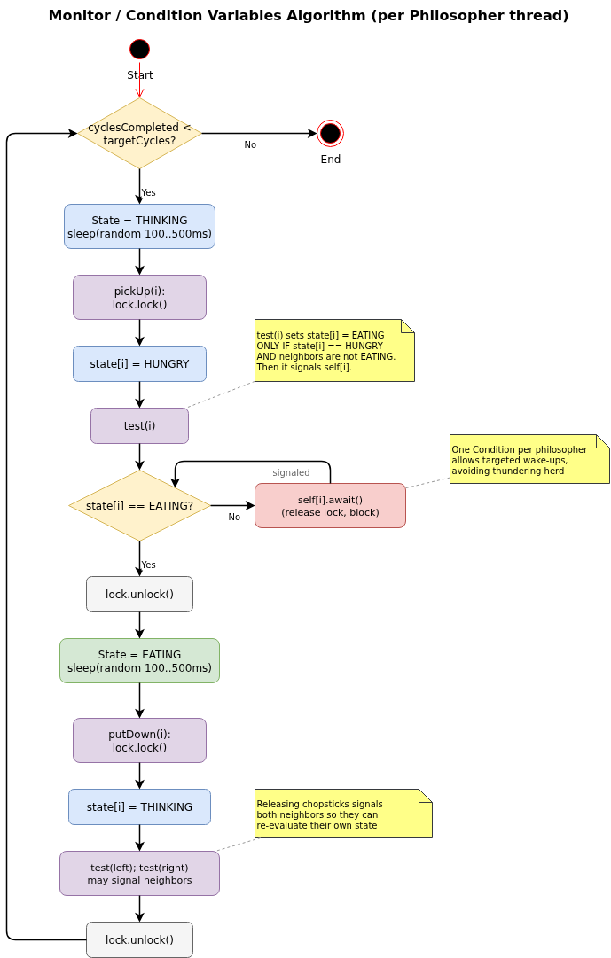
Solution 4: Monitor / Condition Variables
Single ReentrantLock + one Condition per philosopher — most idiomatic Java
1
Global state[] array: THINKING, HUNGRY, or EATING per philosopher
2
A philosopher can only eat when both neighbors are not eating
3
putDown() calls test() on both neighbors — targeted signal(), not broadcast
4
Single lock guards all state; starvation-free through neighbor signaling
JCIP: @GuardedBy("lock") · ReentrantLock + Condition (§14.3)
// @GuardedBy("lock")
private void test(int i) {
if (state[i]==HUNGRY
&& state[(i-1+n)%n]!=EATING
&& state[(i+1)%n] !=EATING) {
state[i]=EATING; self[i].signal();
} }
private void pickUp(int i) throws InterruptedException {
lock.lockInterruptibly(); try {
state[i]=HUNGRY; test(i);
while (state[i]!=EATING) self[i].await();
} finally { lock.unlock(); }
}

Slide 7
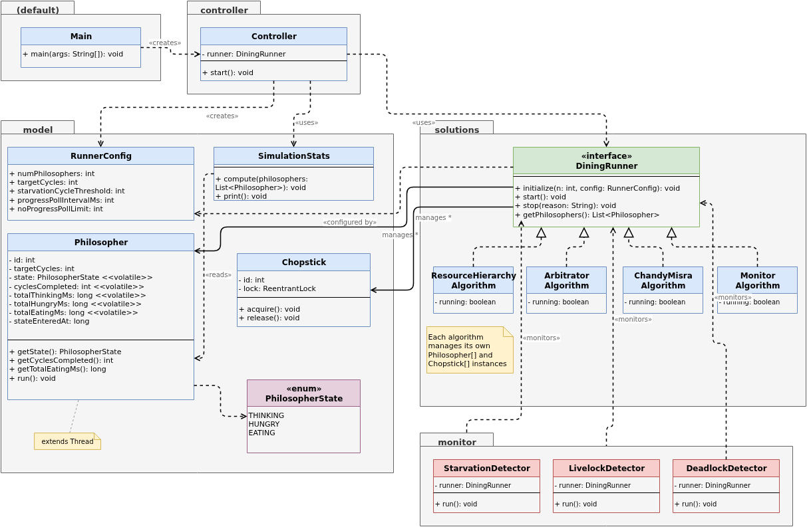
Architecture & Monitoring
Controller knows only DiningRunner · three daemon monitors; first to fire wins via AtomicBoolean
src/
├── controller/ Controller.java
├── model/ Philosopher · Chopstick · SimulationStats
├── solutions/ DiningRunner (iface) + 4 algorithms
└── monitor/ Starvation · Livelock · Deadlock
StarvationDetector
LivelockDetector
DeadlockDetector
Fires when any philosopher's cyclesCompleted is >threshold behind the leader. Cycle-relative — speed-independent.
Fires when total cycles stagnate for N polls AND at least one thread is RUNNABLE. Snapshot-diff alone would miss it.
ThreadMXBean.findDeadlockedThreads() + progress-stall check when all threads are BLOCKED/WAITING.
P2 is 11 cycles behind P0.
0 cycles in 30 polls, active threads.
Circular wait on P0, P2, P4.

Slide 8
Metrics: Jain’s Fairness Index
Quantifying how equitably chopstick access is distributed among philosophers
F = ( Σ eatingTimeᵢ )² ÷ ( N × Σ eatingTimeᵢ² )
Why eating time? A fair algorithm gives each philosopher equal chopstick access. Think-time is self-imposed; hungry-wait-time is a byproduct. totalEatingMs is the primary fairness variable.
F range | Interpretation
0.99 – 1.00 | Excellent fairness — all philosophers ate for essentially equal time
0.95 – 0.99 | Good; minor imbalance
0.90 – 0.95 | Moderate imbalance; one or more philosophers notably disadvantaged
< 0.90 | Poor fairness; starvation likely present or imminent
F = 1/N = 0.20 | One philosopher monopolized all eating time — worst case
Scale-independent: a fast and a slow solution can be directly compared. F ≥ 0.99 is achievable with solutions 3 and 4.

Slide 9
Summary: Comparing the Four Solutions
Solution | Deadlock | Starvation | Parallelism | Java Primitive
1. Resource Hierarchy | ✓ | ✗ | High | ReentrantLock (ordered)
2. Arbitrator / Waiter | ✓ | ✗ | ⌊N/2⌋ | synchronized + wait/notifyAll
3. Chandy / Misra | ✓ | ✓ | High | LinkedBlockingQueue
4. Monitor / Conditions | ✓ | ✓ | High | ReentrantLock + Condition
All four approaches eliminate deadlock — but only Chandy/Misra and Monitor guarantee starvation-freedom.
Monitor (Solution 4) is the most idiomatic Java fit — explicit Condition per philosopher enables targeted signal() instead of broadcast.
Jain’s Fairness Index F ≥ 0.99 is consistently achieved by Solutions 3 and 4 in N = 5 runs.
Live Demo →

