Slide 1
Efficient Predicate Dispatch in Dylan
WORK IN PROGRESS
27Oct00
Jonathan Bachrach
MIT AI Lab

Slide 2
Acknowledgements
Indebted to
  Glenn Burke, 1996-
Based on and inspired by
  Gwydion Dylan Compiler, 1996-
  Ernst, Kaplan, Chambers and Chen, 1998-99
Notes:
Lookup dags dynamically created in harlequin dylan compiler
Gwydion used Statically created lookup dags using binary search restricted to class specializers only and manually specified class ids

Slide 3
Outline
Goals
Dispatch
Predicate Dispatch
Efficient Multi/Predicate Dispatch
Efficient Dispatch in Dylan
Results
Conclusions
Future
Notes:
Ask questions

Slide 4
Goals
Feasibility for predicate dispatch in Dylan
Compilation architecture between separate compilation and full dynamic compilation where space is a factor
Potential speedup with lookup DAG code generation
Produce a dynamic code-generating dispatch turbocharger plugin for Dylan compatible with existing dispatch mechanism
Investigate highest possible performance for dispatch to inform partial evaluation work
Lay foundation for future more advanced work on multiple threads, call-site caching, redefinition, etc
Notes:
Future work includes call site caches and use of call-site static types

Slide 5
Dispatch
Divide procedure body into series of cases
Case selection test for applicability and overriding
Decentralize implementation
  Separation of concerns
  Reuse
  (Re)Definition
Notes:
Methods can be defined in any order and
New methods can be added to existing generic functions without modifying the existing methods or clients
Very powerful idea
Biggest problem is limit to applicability

Slide 6
Single and Multiple Dispatch
Single dispatch uses one argument to determine method applicability
Multiple dispatch uses more than one argument to determine method applicability
In general, think of generic functions with multiple methods specializing the generic function according to multiple argument types
  Define generic \+ (x :: <number>, y :: <number>);
  Define method \+ (x :: <integer>, y :: <integer>) … end;
  Define method \+ (x :: <single-float>, y :: <single-float>) … end;
Notes:
Class based languages use single dispatch
Multiple method dispatch is like dynamic method overloading
Generic functions correspond to all messages with same name in class-based languages
Very powerful mechanism to divide up code this way but unfortunately limited to cases expressible through class-based specialization

Slide 7
Predicate Dispatch
Source: Predicate Dispatching: A Unified Theory of Dispatch, Michael Ernst, Craig Kaplan, and Craig Chambers, ECOOP-98
Generalizes multimethod dispatch, whereby arbitrary predicates control method applicability and logical implication between predicates control overriding
Dispatch can depend on not just classes of arguments but classes of subcomponents, argument's state, and relationship between objects
Subsumes and extends single and multiple dispatch, ML-style dispatch, predicate classes, and classifiers
Notes:
What would they mean by argument’s state – i guess value

Slide 8
Predicate Dispatch Example One
Source of Examples: Predicate Dispatching: A Unified Theory of Dispatch, Michael Ernst, Craig Kaplan, and Craig Chambers, ECOOP-98
type List;
class Cons subtypes List { head:Any, tail:List }
class Nil subtypes List;
signature Zip(List, List): List;
method Zip(l1, l2) when l1@cons and l2@Cons {
return Cons(Pair(l1.head, l2.head), Zip(l1,tail, l2.tail)); }
method Zip(l1, l2) when l1@Nil or l2@Nil { return Nil; }
Notes:
Cecil like notation
Using or makes it easy to define ambiguous method resolving methods otherwise would have to define all combinations

Slide 9
Predicate Dispatch Example Two
type Expr;
signature ConstantFold(Expr):Expr;
-- default constant-fold optimization: do nothing
method ConstantFold(e) { return e; }
type AtomicExpr subtypes Expr;
class VarRef subtypes AtomicExpr { ... };
class IntConst subtypes AtomicExpr { value:int };
... --- other atomic expressions here
type Binop;
class IntPlus subtypes Binop { ... };
class IntMul subtypes Binop { ... };
... -- other binary operators here
class BinopExpr subtypes Expr { op:Binop, arg1:Expr, arg2:Expr, ... };
-- override default to constant-fold binops with constant arguments
method ConstantFold
(e@BinopExpr{ op@IntPlus, arg1@IntConst, arg2@IntConst })
return new IntConst{ value := e.arg1.value + e.arg2.value }; }
... -- more similarly expressed cases for other binary and
-- unary operators here
Notes:
Pattern matching example on slot types
Natural syntax

Slide 10
Predicate Dispatch
Example Three
method ConstantFold
(e@BinopExpr{ op@IntPlus, arg1@IntConst{ value=v }, arg2=a2 })
when test(v == 0) and not (a2@IntConst) {
return a2; }
method ConstantFold
(e@BinopExpr{ op@IntPlus, arg1=a1, arg2@IntConst{ value=v } })
when test(v == 0) and not(a1@IntConst) {
return a1; }
... -- other special cases for operations on 0,1 here
Notes:
Can bind slot values and use them in predicate

Slide 11
Predicate Dispatch Components
class -- x@Point
test -- test(x == 0)
boolean -- not, or, and
pattern matching -- x@Point{x = 0,y = 0}
unification -- when (x == y)
let bindings -- let var-id := expr
predicate abstractions -- x@PointOnXAxis
classifiers -- ...
Notes:
Classifiers allow ordered and exhaustive coverage of domain

Slide 12
Runtime Semantics
Evaluate arguments
Evaluate predicates
Sort applicable methods
Three outcomes
  One most applicable method => ok
  No applicable methods => not understood error
  Many applicable methods => ambiguous error

Slide 13
Static Typechecking
Uniqueness => no ambiguous errors
Completeness => no not understood errors
Caveats:
  Tests involving the runtime values of arbitrary host language expressions are undecidable
    method DoIt (e) when (read(in) = "yes") { ... }
  Recursive predicates are not addressed
Notes:
No way to prove anything about program involving doit except to be conservative and say need more information

Slide 14
Efficient Predicate Dispatch
Source: Efficient Multiple and Predicate Dispatching, Craig Chambers and Weimin Chen, OOPSLA-99
Advantages:
  Efficient to construct and execute
  Can incorporate profile information to bias execution
  Amenable to on demand construction
  Amenable to partial evaluation and method inlining
  Can easily incorporate static class information
  Amenable to inlining into call-sites
  Permits arbitrary predicates
  Mixes linear, binary, and array lookups
  Fast on modern CPU’s
Notes:
Utilize predicated execution to do parallel search on EPIC

Slide 15
Terminology
GF ::= gf Name(Name_1, ..., Name_k) Method_1 ... Method_n
Method ::= when Pred { Body }
Pred ::= Expr@Class
| test Expr
| Name := Expr
| not Pred
| Pred_1 and Pred_2
| Pred_1 or Pred_2
| true
Expr ::= host language expression (e.g., arg, call)
Class ::= host language class name
Name ::= host language identifier

Slide 16
Construction Steps
Canonicalize method predicates into a disjunctive normal form
Convert multiple dispatch in terms of sequences of single dispatches using lookup DAG
Represent each single dispatch as a binary decision tree
Generate code

Slide 17
Canonicalization
GF => DF
  Methods => Cases
  Predicates => Disjunction of Conjunctions
replace all test Expr clauses with Expr@True clauses
convert each method's predicate into disjunctive normal form
replace all not Expr@Class with Expr@!Class
DF ::= df Name(Name1, ..., Namek) => Case_1 or ... or Case_p
Case ::= Conjunction => method_1, ..., method_m
Conjunction ::= Atom_1 and ... and Atom_q
Atom ::= Expr@Class | Expr@!Class
Notes:
DF is dispatch function
Canonicalization converts methods to cases
Disjunctive normal form is one where or’s only appear at topmost level

Slide 18
Canonicalization Example
From Chambers and Chen OOPSLA-99
Example class hierarchy:
  Object A; A C
  Object B isa A; / \ /
  Object C; / \ /
  Object D isa A, C; B D
Example generic function:
  Gf Fun (f1, f2)
  When f1@A and t := f1.x and t@A and (not t@B) and f2.x@C and test(f1.y = f2.y) { …m1… }
  When f1.x@B and ((f1@B and f2.x@C) or (f1@C and f2@A)) { …m2… }
  When f1@C and f2@C { …m3… }
  When f1@C { …m4… }
Assumed static class info:
  F1: AllClasses – {D} = {A,B,C}
  F2: AllClasses = {A,B,C,D}
  F1.x: AllClasses = {A,B,C,D}
  F2.x: Subclasses(C) = {C,D}
  F1.y=f2.y: bool= {true,false}
Canonicalized dispatch function:
  Df fun(f1, f2)
  {c1} (f1@A and f1.x@A and f1.x@!B and (f1.y=f2.y)@true) => m1 or
  {c2} (f1.x@B and f1@B) => m2 or
  {c3} (f1.x@B and f1@C and f2@A) => m2 or
  {c4} (f1@C and f2@C) => m3 or
  {c5} (f1@C) => m4
Canonicalized expressions and assumed evaluation costs:
  E1=f1 (cost=1)
  E2=f2 (cost=1)
  E3=f1.x (cost=2)
  E4=f1.y=f2.y (cost=3)
Constraints on expression evaluation order:
  E1 => e3; e3 => e1; {e1,e3} => e4;

Slide 19
Lookup DAG
Input is argument values
Output is method or error
Lookup DAG is a decision tree with identical subtrees shared to save space
Each interior node has a set of outgoing class-labeled edges and is labeled with an expression
Each leaf node is labeled with a method which is either user specified, not-understood, or ambiguous.

Slide 20
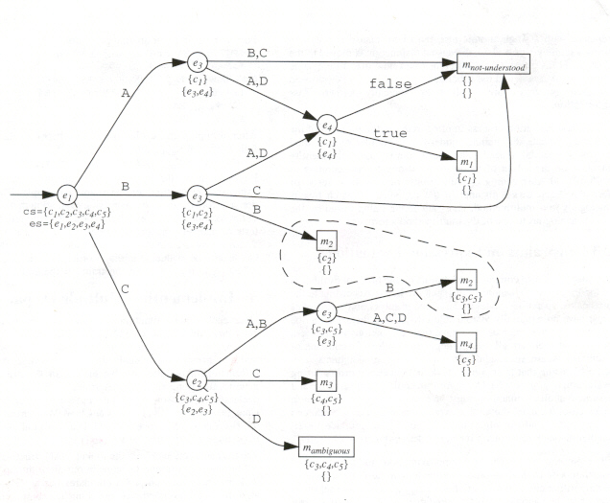
Lookup DAG Picture
From Chambers and Chen OOPSLA-99

Slide 21
Lookup DAG Evaluation
Formals start bound to actuals
Evaluation starts from root
To evaluate an interior node
  evaluate its expression yielding v and
  then search its edges for unique edge e whose label is the class of the result v and then edge's target node is evaluated recursively
To evaluate a leaf node
  return its method

Slide 22
Lookup DAG Evaluation Picture
From Chambers and Chen OOPSLA-99

Slide 23
Lookup DAG Construction
function BuildLookupDag (DF: canonical dispatch function): lookup DAG =
create empty lookup DAG G
create empty table Memo
cs: set of Case := Cases(DF)
G.root := buildSubDag(cs, Exprs(cs))
return G
function buildSubDag (cs: set of Case, es: set of Expr): set of Case =
n: node
if (cs, es)->n in Memo then return n
if empty?(es) then
n := create leaf node in G
n.method := computeTarget(cs)
else
n := create interior node in G
expr:Expr := pickExpr(es, cs)
n.expr := expr
for each class in StaticClasses(expr) do
cs': set of Case := targetCases(cs, expr, class)
es': set of Expr := (es - {expr}) ^ Exprs(cs')
n': node := buildSubDag(cs', es')
e: edge := create edge from n to n' in G
e.class := class
end for
add (cs, es)->n to Memo
return n
function computeTarget (cs: set of Case): Method =
methods: set of Method := min<=(Methods(case))
if |methods| = 0 then return m-not-understood
if |methods| > 1 then return m-ambiguous
return single element m of methods
Notes:
Exprs are expressions that are mentioned in cases
Input that determines subtree is cases x expressions
Assume all classes are known so can compute real subclasses
^ is intersection
Can use constraints to order expressions
Can be smart about choosing next expression based on cost and discriminating power

Slide 24
Single Dispatch
Binary Search Tree
Label classes with integers using inorder walk with goal to get subclasses to form a contiguous range
Implement Class => Target Map as binary search tree balancing execution frequency information
Notes:
Now we have lookup DAG that converts multiple dispatch into single dispatches
we want to implement interior node’s single dispatch efficiently

Slide 25
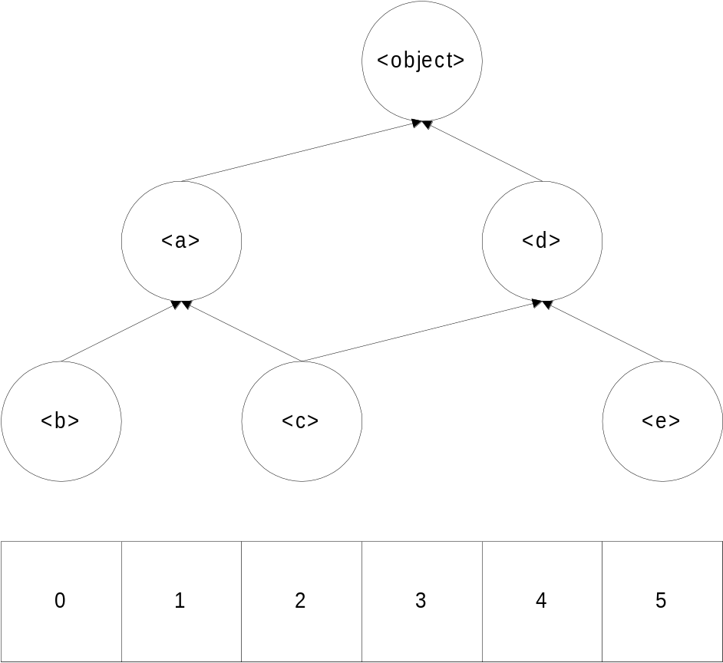
Class Numbering
Notes:
Subclasses of <a> is range [0 .. 2]
Subclasses of <c> is range [2 .. 2]

Slide 26
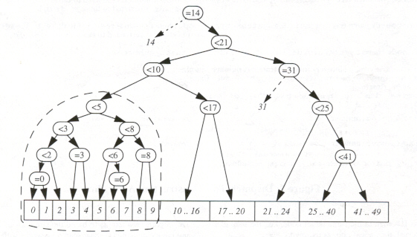
Binary Search Tree Picture
From Chambers and Chen OOPSLA-99
Notes:
Can mix = with < to combine linear and binary search favoring particular high frequency cases for example

Slide 27
Efficient Predicate Dispatch
Lots more details
Consult the papers or talk to me
Notes:
Now moving on to predicate dispatch in dylan

Slide 28
Dylan Dispatch
Goals
  Dispatch turbo charger plugin
  Remove as many indirections as possible especially jump through data slots
Requirements
  Is compatible with existing dispatching mechanism
  Is competitive with current implementation
  Requires no special compilation
Architecture
  Load plugin
  Find all generics using GC
  Replace dispatch mechanism with dynamically generated lookup DAG code

Slide 29
Dylan Challenges
Built-in Types:
A class type restricts its argument to be an instance of that class.
  X :: <point>
A singleton type restricts its argument to be a specific object.
  x == $point-zero
A subclass type restricts its argument to be a class object that is a subclass of a given class.
  x :: subclass(<point>)
A union type restricts its argument to be an instance of one of a number of other types.
  x :: type-union(<point>, <complex>)
A limited collection type restricts its argument to be an instance of a collection with additional restrictions on size and collection contents.
  x :: limited(<vector>, of: <point>)
A limited integer type restricts its argument to be within a subset of the range of whole numbers.
  x :: limited(<integer>, from: 0)
Ordered Methods to support next-method
Complex Slots
  Same slot can occur at various offsets in subclasses
  Class slots
  Repeated slots
Separate Compilation
Multiple Threads
Redefinition
define method initialize
(x :: <point>, #key all-keys)
next-method();
...
end method;
Notes:
Ordered methods -> sorted applicable methods returns sortable methods and unsortable
Method to call uses next-methods then setup up next-methods register
Not addressing multiple threads redefinition
Separate compilation requires that dispatch code be created only when whole program is present
dylan helps by allowing programmers to seal off parts of programs

Slide 30
Engine Node Dispatch
Glenn Burke and myself at Harlequin, Inc. circa 1996-
  Partial Dispatch: Optimizing Dynamically-Dispatched Multimethod Calls with Compile-Time Types and Runtime Feedback, 1998
Shared decision tree built out of executable engine nodes
Incrementally grows trees on demand upon miss
Engine nodes are executed to perform some action typically tail calling another engine node eventually tail calling chosen method
Appropriate engine nodes can be utilized to handle monomorphic, polymorphic, and megamorphic discrimination cases corresponding to single, linear, and table lookup
Notes:
Very similar to lookup dag work but specialized to dylan’s types
Sharing was very limited
Incremental growing dispatch techniques has a long history in CLOS and Flavors

Slide 31
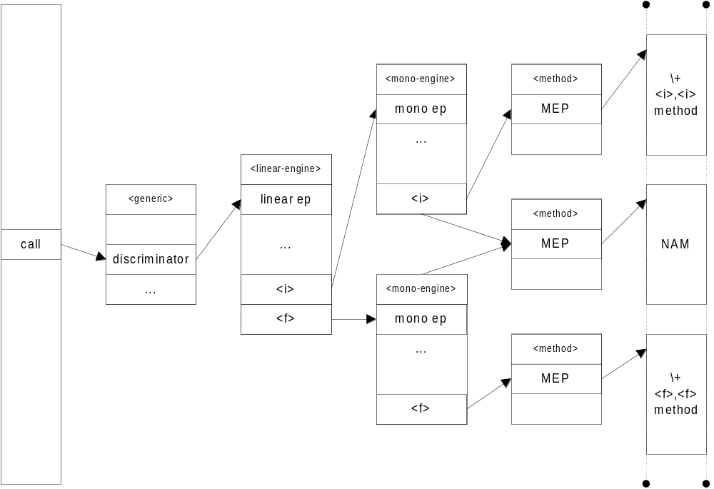
Engine Node Dispatch Picture
Define method \+ (x :: <i>, y :: <i>) … end;
Define method \+ (x :: <f>, y :: <f>) … end;
Seen (<i>, <i>) and (<f>, <f>) as inputs.
Notes:
Nam is handled as default

Slide 32
Pros Cons of Engine Dispatch
Pros:
Portable
Introspectable
Code Shareable
Cons:
Data and Code Indirections
Sharing overhead
Hard to inline
Less partial eval opps
Notes:
Works with c back end
Worst problem is all the jump through data slots which kill the pipeline on modern cpu’s
Hard to imagine how to inline \+(<I>, <I>) for example
Must call through slots etc to get sharing
More interpreted so can’t as often create folded computations

Slide 33
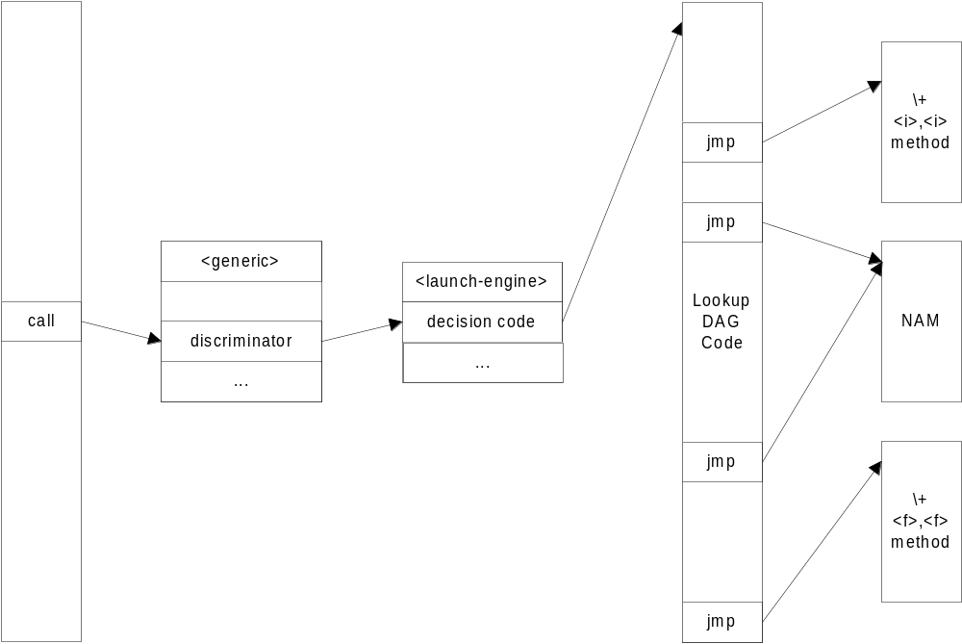
Turbo Charger Plugin
Notes:
Get rid of indirections by hard coding constants into code
Obviously could do better if it didn’t have to be backward compatible

Slide 34
Type union
Uses cartesian product algorithm for getting rid of type-union specializers and turning cases into disjunctive normal form.

Slide 35
Subclass
Use binary search class-id range checks to perform the subclass specializer.
Instead of taking object-class(x) use x itself which become a new kind of expression
First ensure though that x is a class:
  Instance?(x, <class>)
  & subclass?(x, subclass-class(t))
Notes:
Call this a class arg expression
Use constraints to ensure x is a class before subclass expression

Slide 36
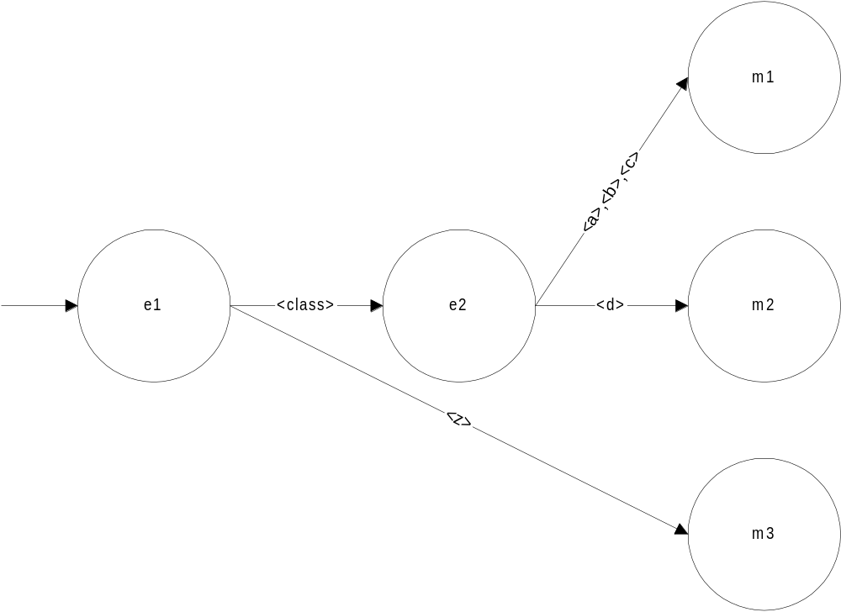
Subclass Example
Class <a> isa <object>;
Class <b> isa <a>;
Class <c> isa <a>;
Class <z> isa <object>;
Method (x :: subclass(<a>)) …m1… end;
Method (x == <d>) …m2… end;
Method (x :: <z>) …m3… end;
E1 = arg x
E2 = class arg x

Slide 37
Singleton
Use instance of class combined with efficient id check (optimized for non-value pointer type comparisons).
  instance?(x, object-class(singleton-object(t))) & x == singleton-object(t)
  Rationale: instance? can be mostly folded into parallel search categorizing x can then make \== significantly faster
When singleton-object(t) is a class then use subclass type trick but for singleton classes
Notes:
In dylan must know that are not boxed value type objects like floats in order to do simple pointer comparison for == otherwise must compare contents of float

Slide 38
Limited Collections
Instance of collection limited followed by either fast id check for type-equivalence of element-types or punt to instance?
  instance?(x, limited-collection-class(t))
  & element-type(x) == limited-collection-element-type(t)
  or
  Instance?(x, t)
Notes:
Actually this is just a simplification

Slide 39
Limited Integers
Instance of <integer> followed by range checks
  Instance?(x, <integer>)
  & x > limited-integer-min(t) // if min exists
  & x < limited-integer-max(t) // if max exists

Slide 40
Slot Value
Concrete subclass expansion for different slot offset iff offsets differ because of multiple inheritance
  Rationale: merges method dispatch and slot-offset computation into one class-id based binary search
Notes:
Create leaf nodes with accessor-method / offset

Slide 41
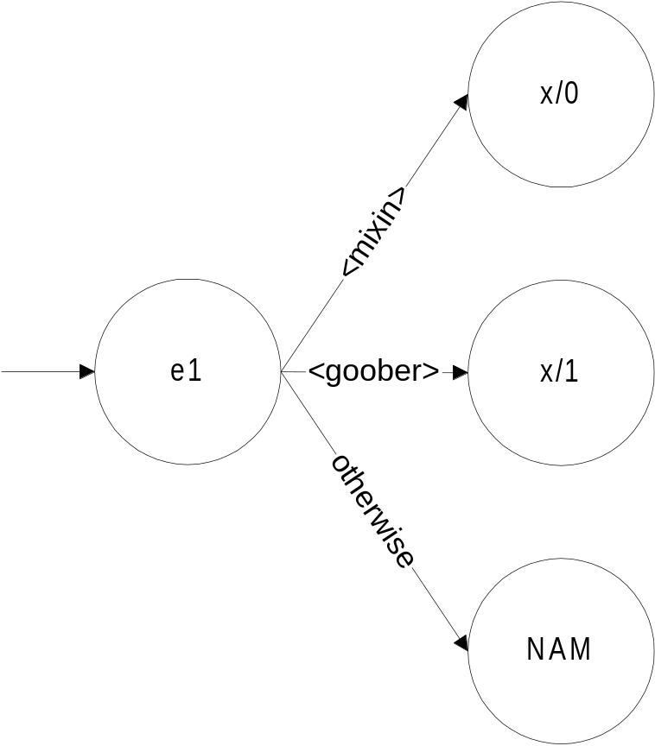
Slot Value Example
  Define class <mixin> (<object>) slot x; end; // x at 0
  Define class <thing> (<object>) slot y; end;
  Define class <goober> (<thing>, <mixin>) end; // x at 1
Notes:
DAG methods

Slide 42
Enhanced Memoization
Memoization allows sharing of equivalent subtrees.
Sharing based on DAG methods instead of cases
  Where DAG methods are either the methods or method/slot-offsets
  Rationale: DAG methods could be used as input to construction process instead of cases and cases could be regenerated based on remaining expressions
30% space savings in large application
Removes need for ad hoc merging process
Notes:
Want quick test to determine whether an equivalent subtree has already been built
Only input is cs,es so that conservatively will guarantee same subtree
Turns out can do better by using ms,es
Working on proof

Slide 43
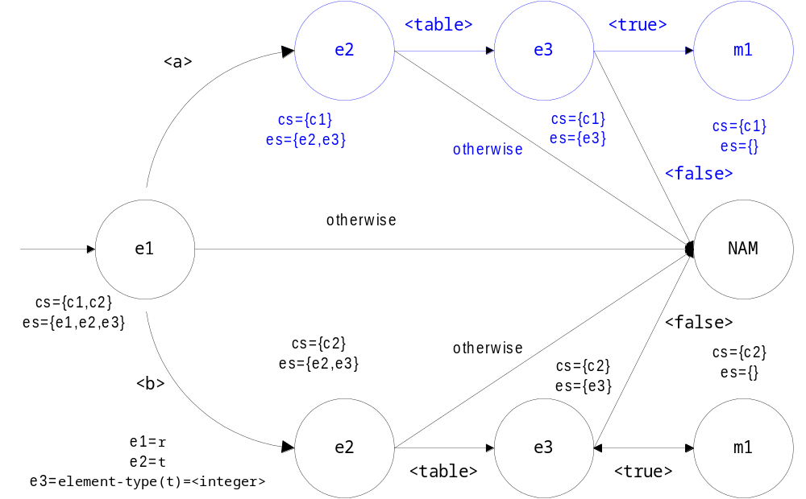
Enhanced Memoization Example
Define constant <ref>
= type-union(<a>, <b>);
Define constant <it>
= limited(<table>, of: <integer>));
Define method lookup
(r :: <ref>, t :: <it>)
…m1…
End method;
Define dispatch-function (r, t)
{c1} r :: <a>, t :: <it> => m1 , or
{c2} r :: <b>, t :: <it> => m1
Notes:
Doesn’t matter which path was taken for future discrimination
Can do better by using comparison using ms

Slide 44
Ad hoc METHOD Memoization
From Chambers and Chen OOPSLA-99
Notes:
This is completely subsumed under previous method-set based memoization

Slide 45
Partial Evaluation
Prune subtrees based on implied types from successfully or unsuccessfully testing a decision tree node expression.
This is necessary to prune away the exponentially growing number of test combinations in a decision tree.

Slide 46
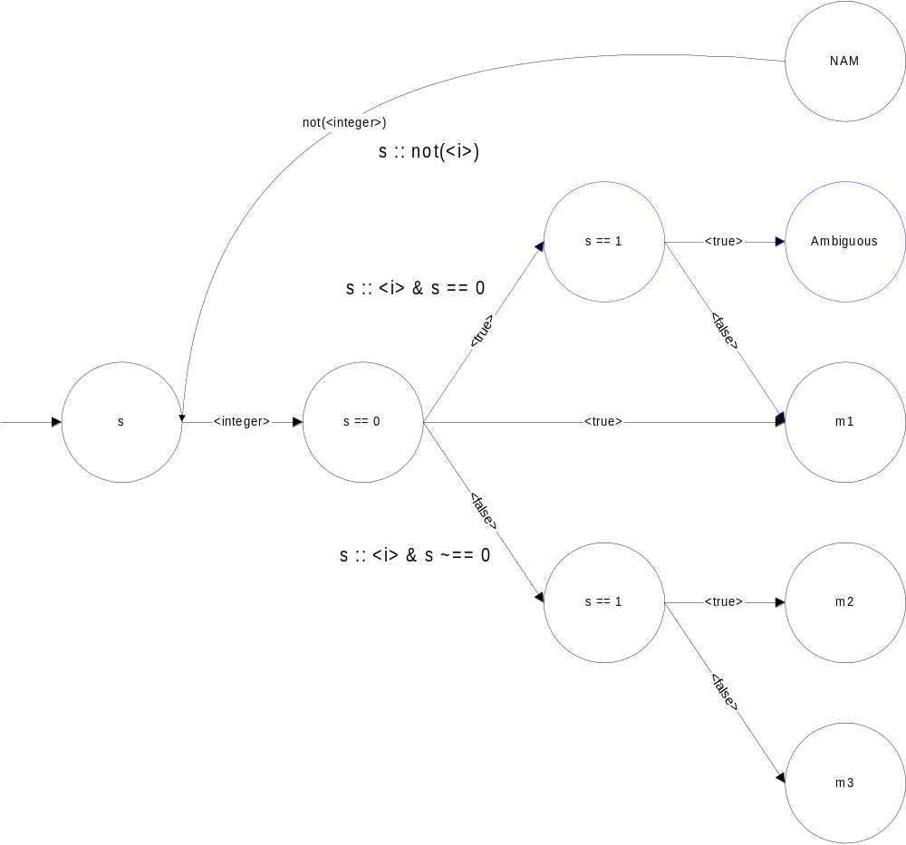
Partial Evaluation Example
Methods:
Define method scale (x, s == 0) …m1… End;
Define method scale (x, s == 1) …m2… End;
Define method scale (x, s :: <i>) …m3… end;
Canonicalized Expressions and Implied Types:
E1=s
E2=s=0 s == 0
E3=s=1 s == 1

Slide 47
Other Optimizations
Use default edges to avoid computation
Use bitsets everywhere
…

Slide 48
DYNAMIC Code Generator
Tailored for decision DAG code gen
Tiny size – 1327 lines
Easy to port – 450 lines of x86 specific code
Manual register allocation
Extensible code generators
Some jump optimizations
GC friendly

Slide 49
Code Generation Example
GF: round (x) => (…)
Methods: round (x :: <machine-number>) => (…)
round (x :: <integer>) => (…)
Eax = first argument
Ebx = function register
mov esi,eax
mov edx,esi
and edx,3
je L1
mov esi,offset $immediate-classes
mov esi,dword ptr [esi+edx*4]
jmp L2
L1: mov esi,dword ptr [esi]
L2: mov esi,dword ptr [esi+4]
mov edx,dword ptr [esi+18h]
cmp edx,2534h
jl L4
cmp edx,2538h
jl L3
jmp L6
L3: mov esi,offset round-1-I
jmp esi
L4: cmp edx,2524h
jl L5
jmp L6
L5: cmp edx,2514h
jl L6
mov esi,offset round-0-I
jmp esi
L6: push eax
push ebx
push ecx
push edx
mov esi,eax
push esi
mov esi,offset round
mov eax,esi
mov ebx,offset not-understood-error
mov ecx,2
mov esi,offset not-understood-error-I
call esi
Notes:
Tag detection
Method notation
IEP notation
Hideous not-understood code 45 bytes should just be a jmp
Jmp around jmps could be cured with peephole optimizer

Slide 50
Results
Work in progress so very preliminary
Fully operational implementing all Dylan types
Can replace dispatch under its feet
Instruction sequences appear to be at least 2x smaller as compared to engine traces

Slide 51
TurboCharging Compiler Results
Fun-O Dylan Compiler
  Libs 100K lines
  Front-End 150K lines
  Back-End 050K lines
  Total 300K lines
  Memory Use 12.7MB
General Statistics
  NUMBER CLASSES 2388
  TOTAL NUMBER 6605
  TOTAL SIZE 1125076 bytes
  AVERAGE SIZE 170.34 bytes
  NAM EXTRA SIZE 244385 bytes
  NORMALIZED SIZE 880691 bytes
  ENGINE NODE SIZE 354844 bytes
  RATIO 2.48 x
Timings
  TIME TO BUILD 079.13 secs
  Engine node 100.61 secs
  Lookup DAG 092.18 secs
  Speedup 9.15 %
Caveats
  No profile guided info
  No call site info
  Extra overhead for plugin
  No smart expression / class choices
Notes:
Lots of styles of code incorporated into compiler
Size numbers are for all generics and methods used or not

Slide 52
Comparison to Other Work
Dujardin et al => compressed dispatch table
  Hard to handle predicate types
  No inlining of methods
  Hard to incorporate partial evaluation
  Fixed constant overhead
  Hard to incorporate profile information
  Perhaps could be incorporated to merge steps

Slide 53
Conclusions
Predicate dispatch is feasible in Dylan
Code generation does improve performance
Space usage seems to be on track

Slide 54
Future Work
Multiple threads
Redefinition
Demand generated
Call-site trees
Partial dispatch
Profile guided construction
Inlining of small methods
Full Predicate Dispatch
Improved Code Generator

