Slide 1
Pizza Sales Performance Analysis - 2017
Understanding what drives pizza sales performance through Revenue, Orders, Quantity, and AOV
Bootcamp Data Analyst with Excel
Vincent Colin Tionando

Slide 2
Executive Project Summary
Dataset Summary
Business Problem
Business Objectives
A year's worth of sales from a fictitious pizza place, including the date and time of each order and the pizzas served, with additional details on the type, size, quantity, price, and ingredients.
Source:
https://mavenanalytics.io/data-playground/pizza-place-sales
The lack of structured sales performance analysis makes it difficult to identify sales trends, customer ordering patterns, and opportunities to improve pizza sales performance.
The business also needs to evaluate which pizza products should be retained, improved, or potentially removed based on their sales performance.
Analyze Revenue, Orders, Quantity, and AOV performance.
Identify sales trends and ordering patterns.
Evaluate the performance of individual pizza products.
Identify high-performing and underperforming products.
Provide recommendations for menu portfolio optimization.

Slide 3
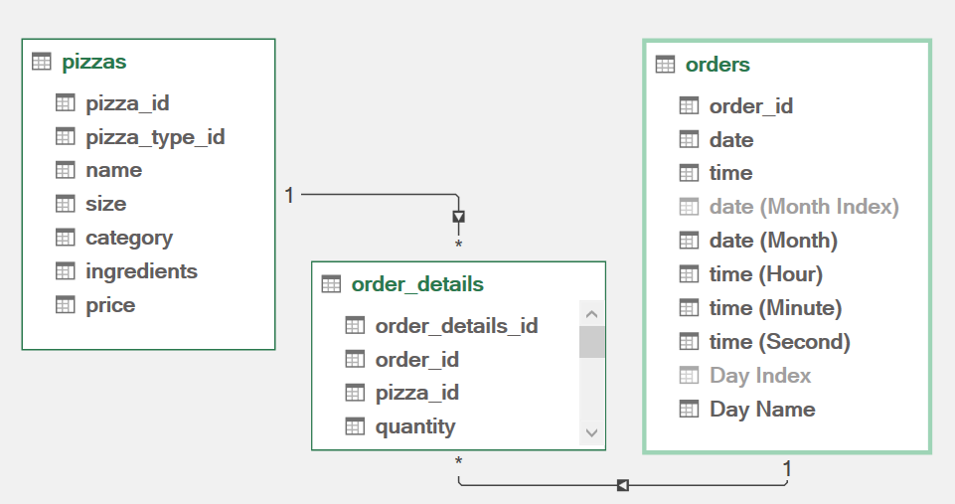
Intro to Data and its Model Relationship
pizzas
  Pizza details data (pizza_id, pizza_type_id, name, size, category, ingredients, price)
order_details
  Line-item details per order (order_details_id, order_id, pizza_id, quantity)
orders
  Order-level data (order_id, date, time, Day Name)

Slide 4
KPI Metrics
$817.9K
21.4K
49.6K
$38.31
TOTAL REVENUE
TOTAL ORDERS
TOTAL PIZZA SOLD
$16.50
2
REVENUE PER ORDER (AOV)
REVENUE PER PIZZA
PIZZAS PER ORDER

Slide 5
Key Findings
Revenue was driven by order volume
  21.4K orders generated approximately $817.9K in annual revenue.
Customers purchased multiple pizzas per order
  49.6K pizzas across 21.4K orders indicates roughly 2 pizzas per order.
July was the strongest month
  July generated the highest monthly revenue and order volume.
Friday and lunch hours were key demand periods
  Friday was the strongest day, while the lunch period showed a pronounced sales peak.
Key insights drives pizza sales performance through KPI based on
Revenue
Orders
Quantity
AOV

Slide 6
Monthly Performances

Slide 7
Monthly Performances – Key Insights
July was the best-performing month overall
  July generated the highest monthly revenue at $72.6K and an order volume of 1.9K, with 4.4K pizzas sold..
October was the lowest-performing month overall
  October generated the lowest monthly revenue at $64K and an order volume of 1.6K, with 3.9K pizzas sold. Despite this, October achieved a fairly high AOV of $38.9.
The months in the 4th Quarter had the highest AOV
  From October to December, average order revenue peaks at $38, driven by holiday sales like Black Friday, Christmas, and New Year’s Eve, when customers are more willing to spend on premium items like pizza.
June was the month with the highest Revenue per Pizza
  June generated the highest monthly revenue per pizza at $16.61 where the generated revenue at $68.2K and and order volume of 1.8K, with 4.1K pizzas sold. It even lower than July as the best-performing month.

Slide 8
Daily Performances

Slide 9
Daily Performances – Key Insights
Friday was the best-performing days in a year overall
  Friday generated the highest daily revenue at $136.1K and an order volume of 3.5K, with 8.2K pizzas sold..
Sunday was the lowest-performing days in a year overall
  Sunday generated the lowest daily revenue at $99.2K and an order volume of 2.6K, with 6K pizzas sold.
Daily AOV and Revenue per Pizza remain constant
  Customer spending remains constant throughout the week, averaging $38 per order and $16.50 per pizza. Consequently, neither Daily Average Order Value (AOV) nor Revenue per Pizza drives changes in overall sales performance.

Slide 10
Hourly Performances

Slide 11
Hourly Performances – Key Insights
Lunchtime, peaking at 12 PM, was the best-performing time overall
  Lunchtime at 12 PM generated the highest peak revenue at $111.9K and an order volume of 2.5K, with 6.8K pizzas sold
In the evening at 6 PM, performance peaked again, though not as high as at 12 PM.
  The secondary peak at 6 PM generated a strong revenue of $89.3K and an order volume of 2.4K, with 5.4K pizzas sold.
Hourly AOV and Revenue per Pizza Remain Steady Across Peak Hours
  AOV and Revenue per Pizza reach their peak at 9 AM due to low order volumes and pizza quantities during opening. Across the rest of the operating hours, customer spending stabilizes at $37-$40 per order and $16.50 per pizza, showing no impact on overall sales performance.

Slide 12
Top 5 Pizza Performance

Slide 13
Top 5 Pizza Performance – Key Insights
Thai Chicken Pizza was the best-performing pizza by revenue overall
  Thai Chicken Pizza generated the highest overall revenue at $43.4K and an order volume of 2.2K, with 2.4K pizzas sold and a Revenue per Pizza of $18.32
Classic Deluxe Pizza generated the highest order volume and quantities sold
  Classic Deluxe Pizza generated the highest order volume at 2.3K and 2.5K pizzas sold, with an overall revenue of $38.2K.
Barbecue Chicken Pizza was the second best-performing pizza overall
  Barbecue Chicken Pizza generated a strong revenue of $42.8K and an order volume of 2.3K, with 2.4K pizzas sold.
Brie Carré Pizza was the pizza with the highest Revenue per Pizza
  Brie Carré Pizza generated the highest Revenue per Pizza at $23.65, despite having the lowest overall revenue at $11.6K and an order volume of 480, with 490 pizzas sold, likely due to its higher price point.
Chicken and meat pizzas were the best-performing categories overall
  Chicken and meat pizzas accounted for most of the top-performing positions, with chicken-based pizzas leading overall revenue and sales performance across the menu.

Slide 14
Bottom 5 Pizza Performance

Slide 15
Bottom 5 Pizza Performance – Key Insights
Vegetable-based pizzas dominated the bottom 5 performance group
  Vegetable-based pizzas dominated the bottom 5 performance group, indicating lower overall consumer demand compared to meat-based options.
Brie Carré Pizza was the lowest-performing pizza overall
  Brie Carré Pizza generated the lowest overall revenue at $11.6K and an order volume of 480, with 490 pizzas sold. However, it generated the highest Revenue per Pizza overall at $23.65, placing it in the first of Top 5 rank for Revenue per Pizza due to its higher price point.
Spinach Supreme Pizza and Mediterranean Pizza were consistently among the bottom-performing pizzas overall
  Both Spinach Supreme Pizza and Mediterranean Pizza consistently ranked near the bottom in total revenue, order volume, and unit sales, reflecting lower overall customer preference within the menu.
. Green Garden Pizza was the second-lowest revenue generator
  Green Garden Pizza generated a revenue of $14K while ranking 5th lowest in Revenue per Pizza at $14.
Pepperoni Pizza and Hawaiian Pizza maintained low Revenue per Pizza despite high order volumes
  Pepperoni Pizza ($12.47 per Pizza) and Hawaiian Pizza ($13.33 per Pizza) maintained low Revenue per Pizza despite high order volumes

Slide 16
Business Recommendations
Prioritize high-demand products and peak periods
  Focus inventory, staffing, promotions, and menu placement on Chicken/Meat pizzas, Friday, 12 PM, and 6 PM, where demand is strongest.
Increase order volume during weaker periods
  Target October, Sundays, and off-peak hours with specific promotions, bundles, and traffic-driving campaigns rather than relying mainly on price increases or upselling.
Maximize high-value sales opportunities
  Leverage Q4 holiday promotions, premium bundles, and Brie Carré’s premium positioning, while testing modest price increases or premium variants for high-volume products like Pepperoni and Hawaiian.
Replicate proven performance
  Use July’s sales patterns and June’s product/pricing mix as benchmarks, applying successful products, pricing, promotions, and timing to improve weaker months
Optimize the menu portfolio using multiple performance metrics
  Maintain and expand high-volume/high-revenue products such as Thai Chicken, Barbecue Chicken, and Classic Deluxe, while reviewing vegetable-based and consistently weak pizzas, reducing inventory or promotional investment where appropriate, while testing repositioning, bundling, or selective removal before making final menu decisions.

Slide 17
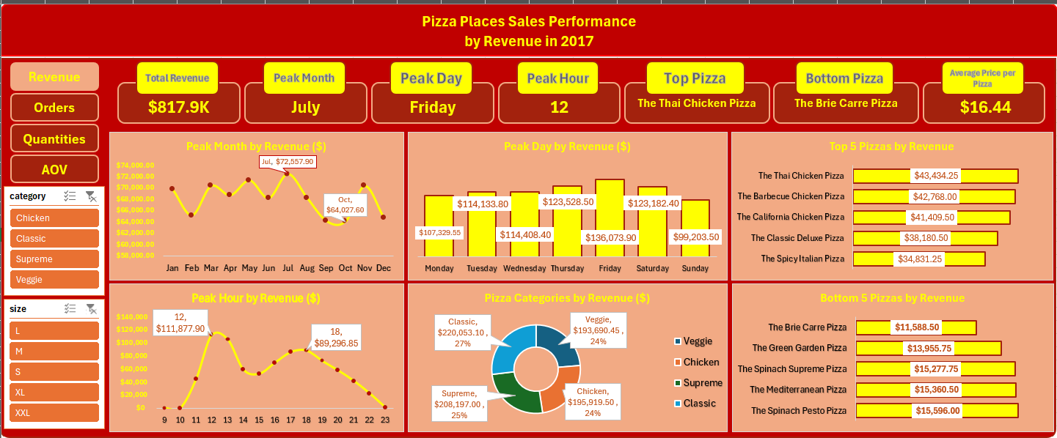
Interactive Dashboard
Interactive dashboard allows stakeholder to find out the sales performance by revenue, orders volume, pizza sold quantities, and AOV. The dashboard also allows to filter segments by category and size bracket using dynamic slicers. Link Source:

Slide 18
TERIMA KASIH
谢谢

