Slide 1
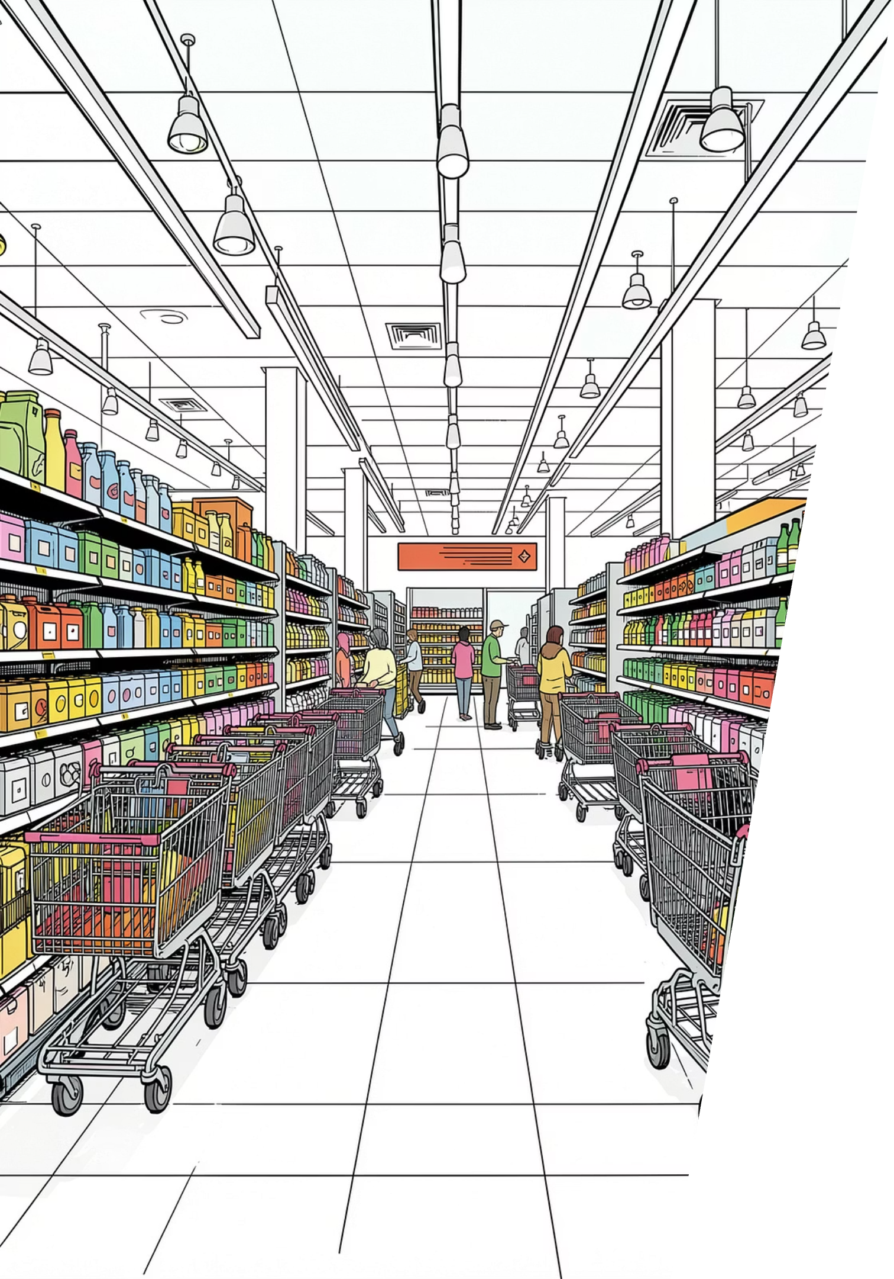
Regional Sales Performance Analysis
Identifying underperforming branches across the US supermarket chain through multi-level data analysis.
9,800 TRANSACTIONS
4 US REGIONS
REGION → STATE → CITY

Slide 2
Dataset at a Glance
9,799
18
Cleaned Rows
Columns
After removing 1 duplicate
Orders, Customers, Products
11
$459
Missing Values
National AOV
Postal Code (imputed)
Average Order Value benchmark

Slide 3

Data Preparation in Python
01
Load & Explore
pandas: df.info(), .describe()
02
Clean
Imputed Postal Codes; removed duplicates
03
Standardize
Renamed columns to snake_case
04
Load to DB
Connected to PostgreSQL for SQL analysis

Slide 4
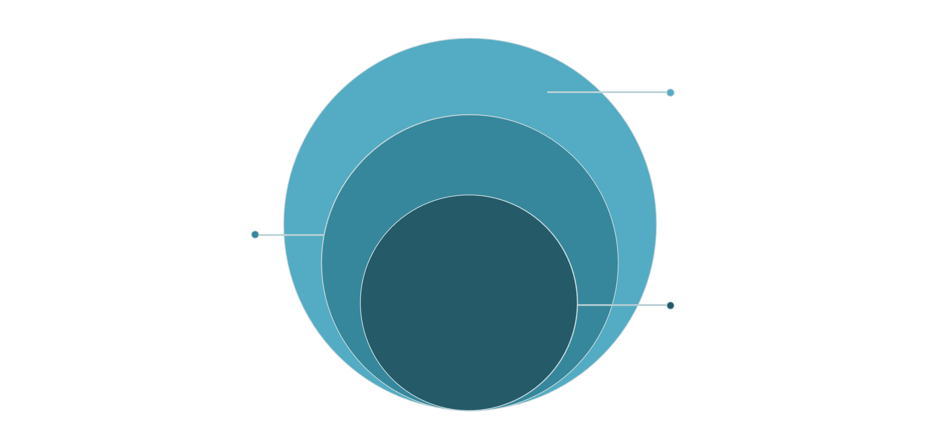
3-Layer Drill-Down Approach
Region
Compare AOV, SPC, OPC; flag Critical/Warning
State
Drill into South; benchmark vs national averages
City
Identify worst-performing cities in TN, NC, FL
Each layer filters the next — from broad regional KPIs down to specific underperforming cities.

Slide 5
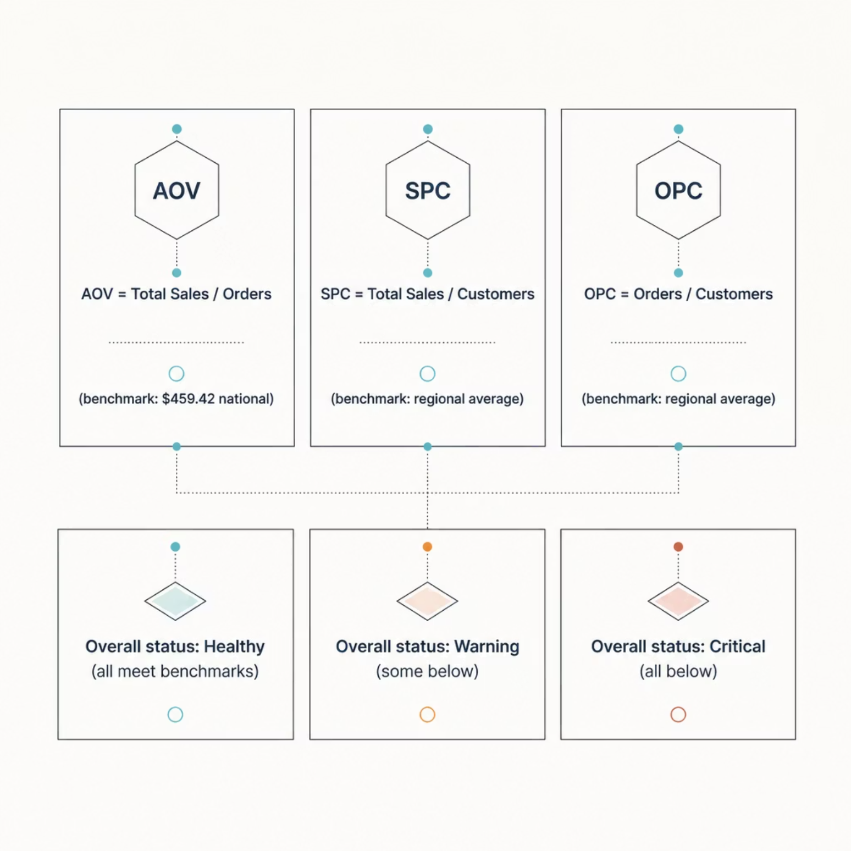
KPI Framework
Overall Status
Healthy — All KPIs meet benchmarks
Warning — Some below benchmark
Critical — All below benchmark

Slide 6
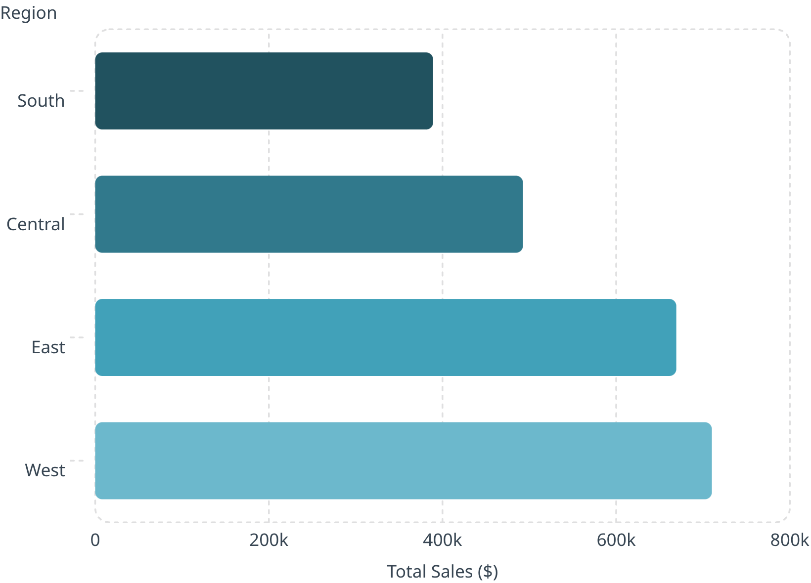

Layer 1 — Regional Performance
Key Insights
South — Lowest sales ($389K), Warning
Central — All 3 KPIs below benchmark, Critical
East — Only Healthy region — best-practice benchmark
West — Highest sales, but AOV below national
South selected for drill-down — lowest total sales.

Slide 7
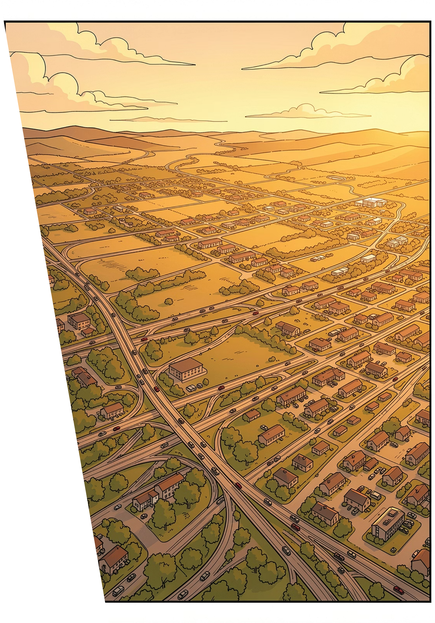
Layer 2 — South Region States
🔴 Tennessee
AOV $336.94 — largest gap (-$122.48)
🔴 Florida
22.7% of South sales ($88K) — still Critical
🔴 North Carolina
134 orders, AOV only $411.69
⚠️ Louisiana & Arkansas
OPC = 1.00 — near-zero repeat purchases
6 of 11 states are Critical — South's issues are widespread.

Slide 8


Layer 3 — City-Level Findings
Top Priority Cities
Miami, FL
Highest Critical sales ($8,647), AOV $262.06
Jacksonville, NC
23 orders, AOV $242.60 — top NC priority
Tennessee (all cities)
Every city below national AOV — structural issue

Slide 9
Priority Action List
1
Miami, FL
33 orders, AOV $262.06 (gap -$197.36)
2
Jacksonville, NC
23 orders, AOV $242.60 (gap -$216.82)
3
Tennessee — All Cities
Structural low-AOV statewide
4
Hialeah & Hollywood, FL
Large AOV gap, low volume — medium priority
5
Wilmington, NC
Largest AOV gap (-$376.85), only 9 orders

Slide 10
Recommendations & Next Steps
Business Recommendations
Next Steps
TN: Audit product mix — low-value dominance
Miami & Jacksonville NC: Boost AOV at high-volume branches
LA & AR: Launch customer retention programs
East Region & Jacksonville FL: Replicate best practices
Analyze product categories by city
Refine SPC/OPC benchmarks to avoid cross-state double-counting
Limitations: Cross-state customers may slightly skew SPC/OPC. AOV remains fully accurate.

