Slide 1
MaBoSS Ecosystem
Gautier Stoll
Laurence Calzone
Vincent Noël
Basel, BC2, 9 Sept. 2019

Slide 2
Outline
What is MaBoSS
MaBoSS with WebMaBoSS
MaBoSS environment with unix
MaBoSS with Jupyter notebook
  UPMaBoSS for population modeling
  Ensemble models
PhysiBoSS for agent-based spatial population modeling

Slide 3

What is MaBoSS? Markovian Boolean Stochastic Simulator
A(nother) tool for pathway modeling
Boolean:
Boolean node state: 0 or 1 for node i.
Boolean network state: vector of Boolean node state for a given network. For each node i, .
Stochastic:
Probability space over network state space (not on Boolean state): give a probability for each network state.
Stochastic process: time dependant probabilities.

Slide 4
What is MaBoSS? Markovian Boolean Stochastic Simulator
Markov:
Markov process: stochastic process defined by
Transition rates: In MaBoSS, define rate value (time⁻¹) and condition for activation and inhibition of nodes
Node A {
rate_up = (C AND B OR NOT D) ? 1.0 : 0.0;
rate_down = (C AND B OR NOT D) ? 0.0 : 4.5;}
2) Initial condition:
p[(A,B,C,D)=(0,0,0,0)]=0.7
p[(A,B,C,D)=(1,0,0,0)]=0.2
p[(A,B,C,D)=(1,1,1,1)]=0.1
C
B
A
D

Slide 5
What is MaBoSS? Markovian Boolean Stochastic Simulator
Simulator:
Simulation algorithm (Gillespie algorithm) for estimating probabilities from transition rates and initial condition.
Simulation parameters: time length, number of trajectories.
C++ software:
Inputs: bnd (Boolean Network Descriptor) file and cfg (Configuration) file
Outputs: csv files for probabilities and asymptotic states.

Slide 6
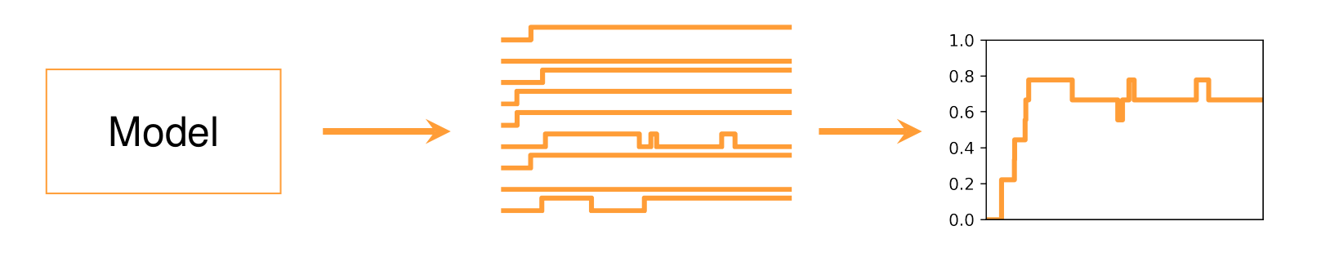
What is MaBoSS? Markovian Boolean Stochastic Simulator
Uses logical model skeleton to simulate dynamical models
Produces stochastic trajectories
Allows population interpretation
SBML package being developed (annotations !)

Slide 7
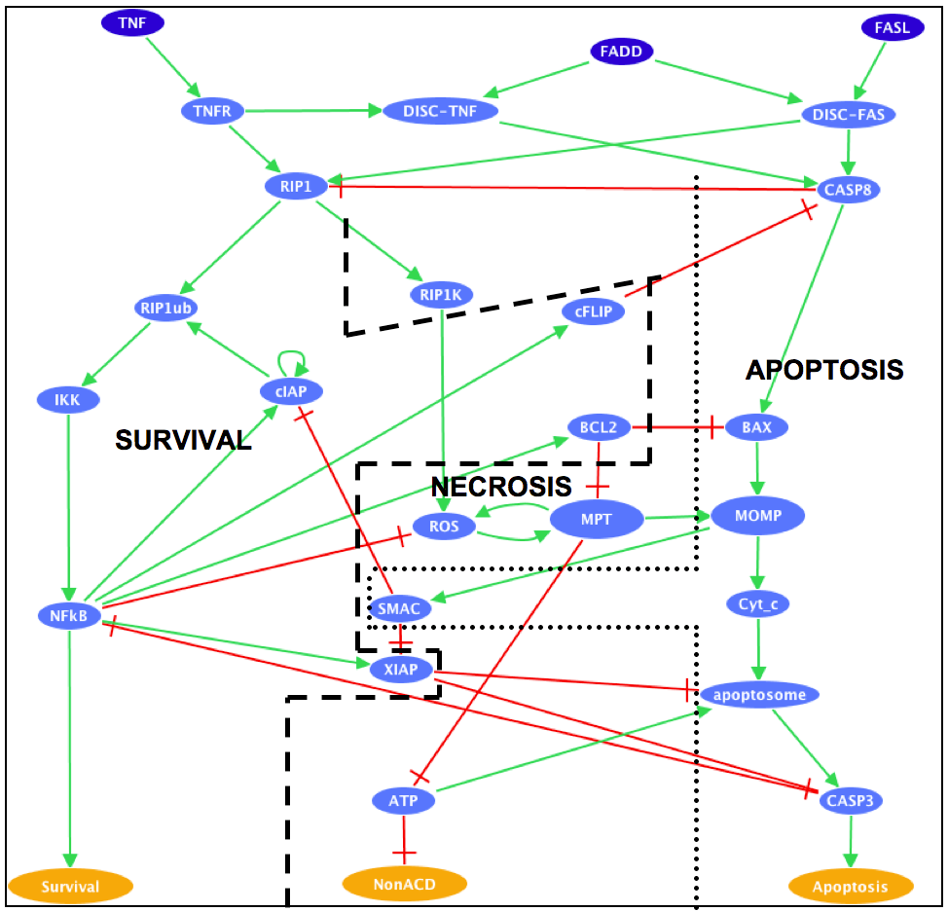
Example with TNF -> cell fate
Use published cell fate model (GINsim/MaBoSS), available on MaBoSS web page,
https://maboss.curie.fr

Slide 8

Different MaBoSS environments
MaBoSS 2.0 env
WebMaboSS
MaBoSS notebooks
WebMaBoSS Frontend
WebMaBoSS API
Jupyter notebooks
Perl, Python
pyMaBoSS
pyMaBoSS
MaBoSS
MaBoSS
MaBoSS

Slide 9


WebMaBoSS
User friendly, no need to fully understand MaBoSS inputs-ouputs,
interactive figures
Web interface (remote computation)
Database to store models/results
Multiple pipelines implemented
(eg mutations)
WebMaBoSS Frontend
WebMaBoSS API
pyMaBoSS
MaBoSS
Demo version available at :
https://webmaboss.vincent-noel.fr
Docker

Slide 10
MaBoSS 2.0 environment
Multiples post-processing scripts
(plotting, analysis, ...)
Multiples batching scripts
(sensitivity analysis, mutations, …)
Light to install, multiple batch processing, computation on server
Perl, Python
MaBoSS
Unix

Slide 11

MaBoSS notebook
Reproducible data analysis, multiple simulation within python coding,
with access to a variety of libraries
Jupyter notebook
pyMaBoSS
Pandas
Numpy
Matplotlib
Colomoto
MaBoSS
Data
management
Computation
Visualisation
Logical modeling
Docker or Conda

Slide 12
UPMaBoSS
Use a signalling pathway(s) inside each cell -> MaBoSS model.
Specify, in the new upp file
Node for cell death,
Node for cell division,
Inter-cell communication (ligand -> receptor for instance), by defining update of external variable(s) according to probabilities and population size
Outputs:
size of cell population over time,
probabilities of “network states” over time
MaBoSS run
Step 0
MaBoSS run
Step 1
MaBoSS run
Step 2
MaBoSS run
Step n
…
Update population,
Create a new cfg file
Update population,
Create a new cfg file
Update population,
Create a new cfg file
Update population,
Create a new cfg file

Slide 13
Example with TNF -> cell fate
Use published cell fate model (GINsim/MaBoSS), available on MaBoSS web page,
https://maboss.curie.fr
Production of TNF induced by NFkB
Cell Division / Proliferation
Cell Death

Slide 14
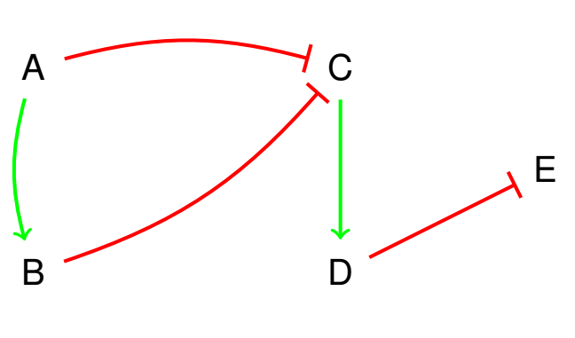
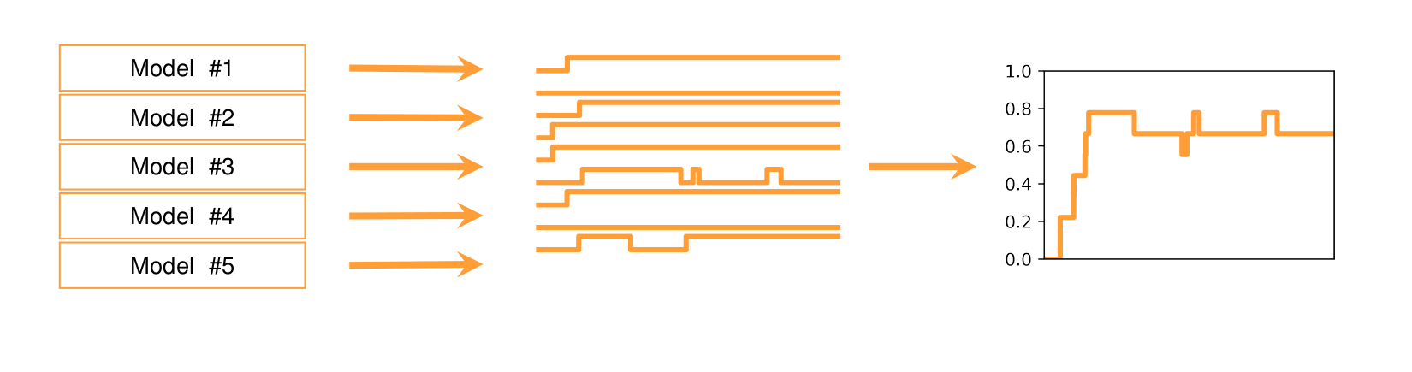
Ensemble models
From a set of constraints, produces a set of valid models,
and treats them as an ensemble of models.
Constraints :
- Fixpoints
- Reachability
- Biological knowledge
+
-> Allows diversity of mechanisms within the model, to represent single cell
variability, modeling uncertainty.

Slide 15
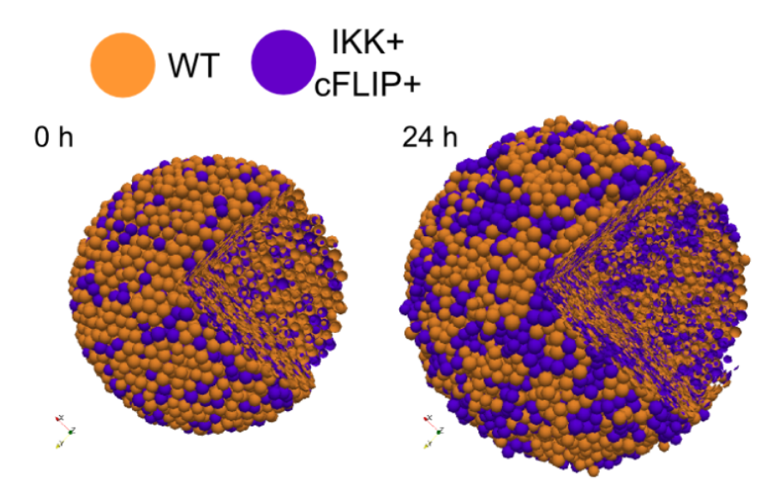
PhysiBoSS
Flexible and computationally efficient framework
to study heterogeneous cell population growth
=> Agent-based model, with every cell running a MaBoSS model. Allows cell-cell
communication, diffusion.

Slide 16





Acknowledgments
MaBoSS early team
Eric Viara
Gautier Stoll
Laurence Calzone
MaBoSS ecosystem team
Vincent Noël
Aurélien Naldi
Denis Thieffry
Loïc Paulevé
Nicolas Levy
Emmanuel Barillot
Gaëlle Letort
Stéphanie Chevalier
Andrei Zinovyev
https://github.com/vincent-noel/MaBoSS-Ecosystem
https://maboss.curie.fr
https://webmaboss.vincent-noel.fr

