Slide 1
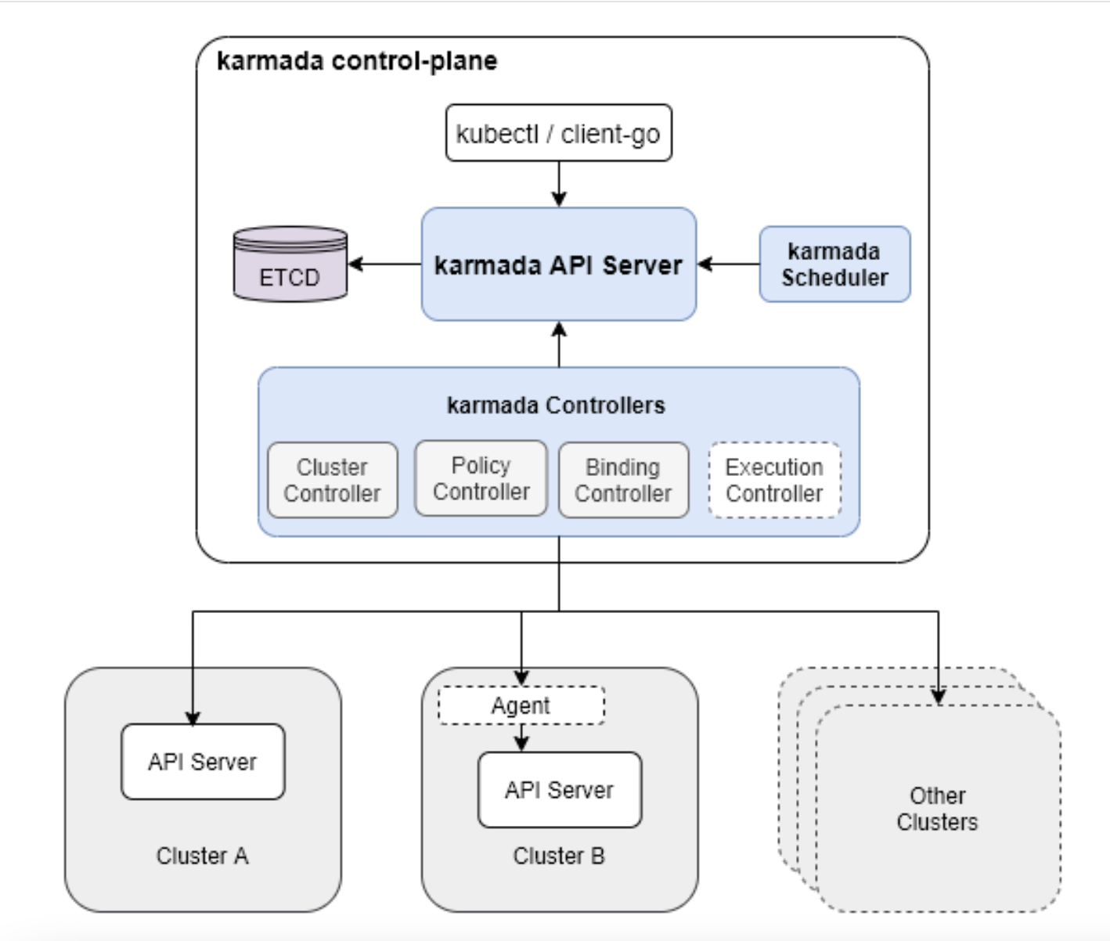
Karmada arch

Slide 2
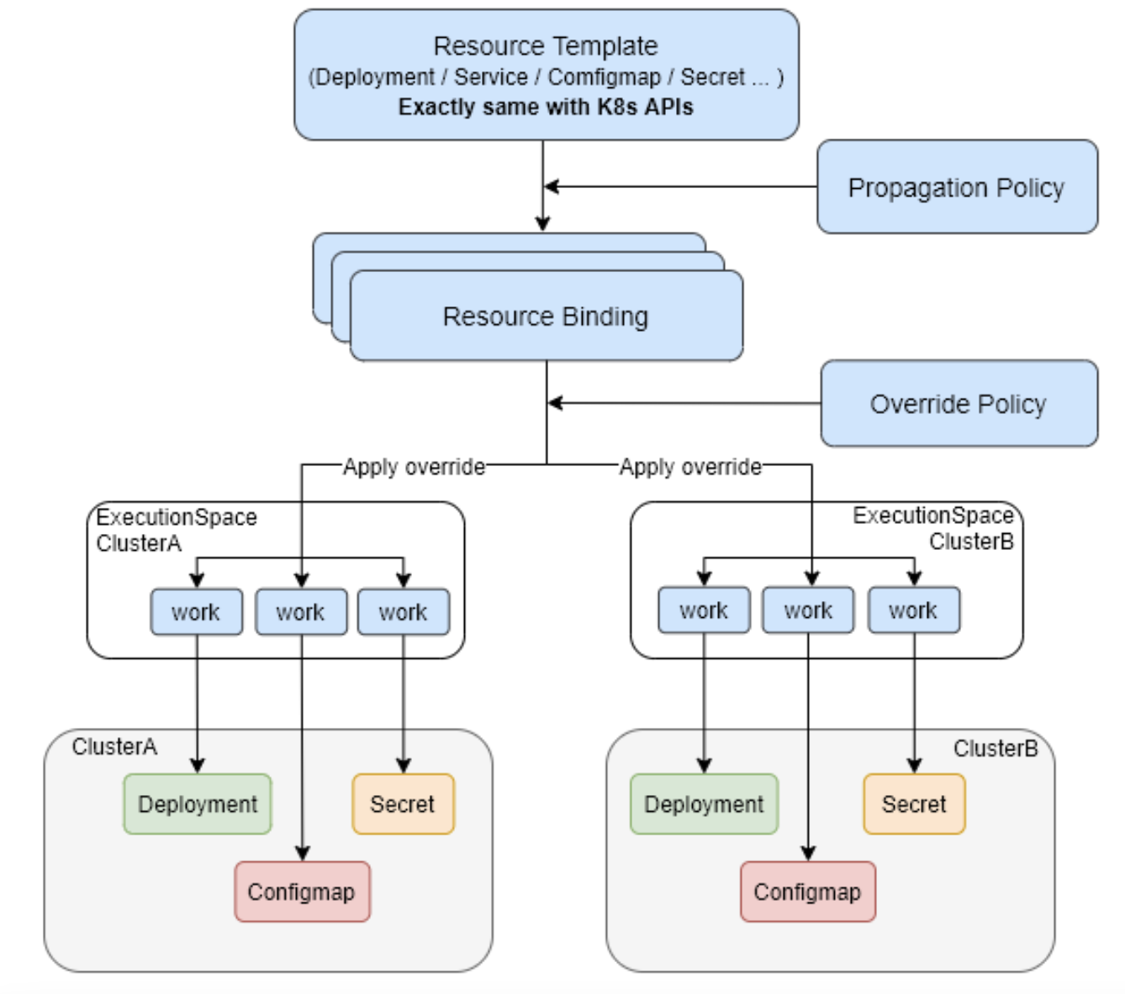
Karmada concept

Slide 3
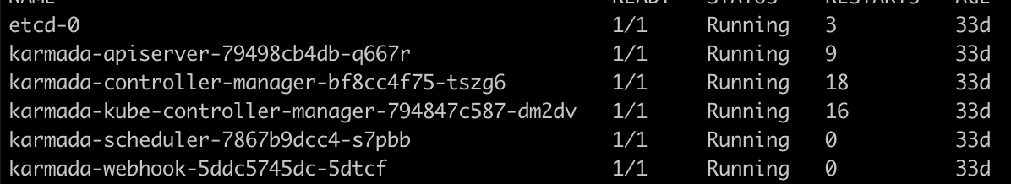
Install
Create standard k8s cluster
Install Karmada to the cluster, include:
See, it include a “apiserver”, “kube-controller-manager” and “etcd”, means is installed a control planeStill have no idea why it need a “api-server” but for “kube-controller” I guess it for remove the unnecessary controller for ”super” cluster:

Slide 4

Install
3. Join a member cluster
With cli: karmadactl
karmadactl join member1 --cluster-kubeconfig=$HOME/.kube/karmada.config
Then will get a CR: Cluster:

Slide 5
Karmada Controllers – Resource detector
Informer
Policy/cluster policy controller
Policy
Informer
Resource discovery
Informer
Enqueue
Informer
Informer
Wait queue
Create
Informer
Processer queue
ResourceBinding/ClusterResourceBinding controller
Binding
Resource Controller
Binding

Slide 6
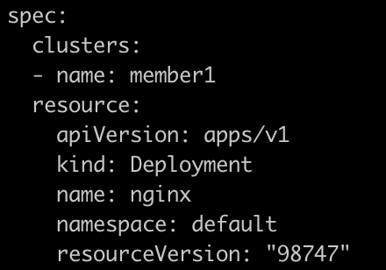
Scheduler
Scheluder try to find a fit ”Cluster” for “ResourceBinding” and “ClusterResourceBinding”:
See the “clusters”, think about the ” nodeName” in pod

Slide 7
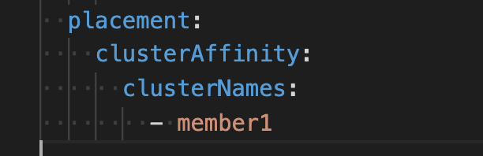
Scheduler
The algorithm for scheduler is design as plugin, for now, there are only 3 plugins:
TaintToleration
ClusterAffinity
APIInstalled
Every plugin will implements two functions:
Filter
Score

Slide 8
Karmada Controllers – Binding
Binding is a controller watch “Resourcebinding” and create “work”
The ”Cluster” controller(one of Karmada Controllers) will create one namespace(called execution space) for each Cluster, name format is “karmada-es-” +Clustername
The Binding controller will create “Work” in related namespace and with target source in it. That menas if a resource fit to 5 cluster(by scheduler), there will be 5 work in different execution space.

Slide 9
Karmada Controllers – Work
Syncer Work to target cluster

Slide 10
Karmada Controllers – Status
The controller will sync status of resource back to the super cluster
I will watch Work and build informer to the target cluster
Resource
Super cluster
Member cluster
Resource
Status Conteroller
Informer
Work
Work
Create
Work
Resource
Member cluster
Informer
Resource
Resource
Resource

