Slide 1
ThoughtWave: an OCD & Intrusive Thought AI assistant
By: Vincenntius Patrick Tunas

Slide 2
Project Description
ThoughtWave is a support AI tool for adults that experience distressing Intrusive thoughts and urges to seek repeated reassurance.
ThoughtWave is an AI application that is built as an adaptive, LLM-Integrated adaptive conversational support system. Its core engineering problem is to be able to recognize when a conversation is beginning to function as a reassurance loop and be able to change its response policy before the AI assistant starts to reinforce the repeated certainty seeking.

Slide 3
Proposed MVP
ThoughtWave MVP
At the start the MVP uses a normal first policy.
Client sends a new/isolated question and receives an ordinary, useful answer
However as evidence accumulates across conversation turns, The system uses and combines methodologies such as semantic repetition, certainty seeking language, prior reassurance, emotional escalation and user feedback.
The system identifies and move through 4 internal states:
    Normal – the user is asking normally, the system does not detect any meaningful signs of repetitive reassurance-seeking
    Monitor – A few mild pattern is being detected by the system, but the system will keep observing and respond briefly.
    Possible Loop – Repitition, doubt or reassurance-seeking behavior is becoming noticeable from the user, the system will avoid feeding the cycle
    Strong Loop – The system detects a clear repeated reassurance/checking pattern., it will stop giving repeated certainty answers and starts redirecting the user towards tolerating the uncertainty and disengaging from the loop.

Slide 4
The Research: OCD and intrusive thoughts
Two different measures of how common an experience is
3.6%
94%
OCD in Australia
Intrusive thoughts
Aged 16–85, in the previous 12 months
ABS national survey, 2020–2022
At least one in the previous 3 months
International study of 777 university students
The 94% figure includes an Australian study site, but it is not an Australian population estimate.
Sources: Australian Bureau of Statistics, National Study of Mental Health and Wellbeing (2020–2022); Radomsky et al., Journal of Obsessive-Compulsive and Related Disorders (2014).
Notes:
OCD estimate: Australian Bureau of Statistics, National Study of Mental Health and Wellbeing, 2020–2022, 12-month OCD prevalence among people aged 16–85: 3.6%. https://www.abs.gov.au/statistics/health/mental-health/national-study-mental-health-and-wellbeing/2020-2022
Intrusive thoughts: Radomsky et al. (2014), Part 1—You can run but you can’t hide: Intrusive thoughts on six continents. 777 university students in 13 countries; about 94% reported at least one unwanted intrusive thought, image, or impulse in the prior three months. University author summary: https://www.concordia.ca/cunews/main/releases/2014/04/08/obsessive-compulsive-thinking.html
The two estimates use different populations, periods, and definitions, so they should not be compared as rates for Australia.

Slide 5
Problem Statement
People may ask an assistant about morality, faith, health, identity, relationships, or safety for many legitimate reasons. The same topic can later become a repeated attempt to obtain complete certainty. A generic chatbot typically treats every message independently and keeps giving increasingly confident reassurance. That may provide brief relief while teaching the user to return whenever doubt reappears.
ThoughtWave addresses the function of the interaction, not the topic itself. The system asks: Is this a new information request, or is the conversation repeatedly trying to neutralize the same uncertainty? This distinction is essential because intrusive thoughts can occur outside OCD, repeated behavior is not automatically a compulsion, and diagnosis requires clinical assessment and functional context. [1][3]

Slide 6
Research
OCD is characterized by recurring obsessions, compulsions, or both, and symptoms may cause significant distress or interfere with daily life. A single unusual thought is therefore not sufficient evidence for diagnosis. [1]
ERP (Exposure & Response Prevention is a strongly supported and widely used first-line psychological treatment for OCD. ThoughtWave should not independently deliver exposure treatment; however, it can avoid repeatedly neutralizing uncertainty with stronger reassurance. [2]
Digital reassurance seeking can become repetitive and may be especially relevant to always-available search engines and AI assistants. The function of reassurance, not just the topic, matters. [3]
A systematic review of LLMs in mental health found substantial potential but also concerns involving inconsistent content, hallucination, interpretability, privacy, over-reliance, and insufficient clinical evidence. The assistant should remain a support tool rather than a substitute for professional care. [4]

Slide 7
Approach
ThoughtWave product concept is based on the research with the established OCD knowledge:
  obsessions can involve recurring intrusive thoughts
  compulsions are repetitive behaviors
  reassurance seeking can function as a compulsion
CBT with exposure and response prevention is the evidence-based treatment. The product does not attempt to provide ERP or diagnose OCD, instead the app focuses on detecting repeated certainty-seeking pattern and avoid providing the user with escalating guarantees and providing mindfulness/CBT approach to the user such as reminding the user to just accept the thought, don’t fight the thought, improving the user’s tolerance of uncertainty and bring the user back to the present.

Slide 8
Solutions
ThoughtWave, the OCD & Intrusive Thought AI assistant will be implemented inside a single streamlit application with a small deterministic policy layer, a structured language model analysis call, Local semantic similarity and a lightweight SQLite history store.

Slide 9
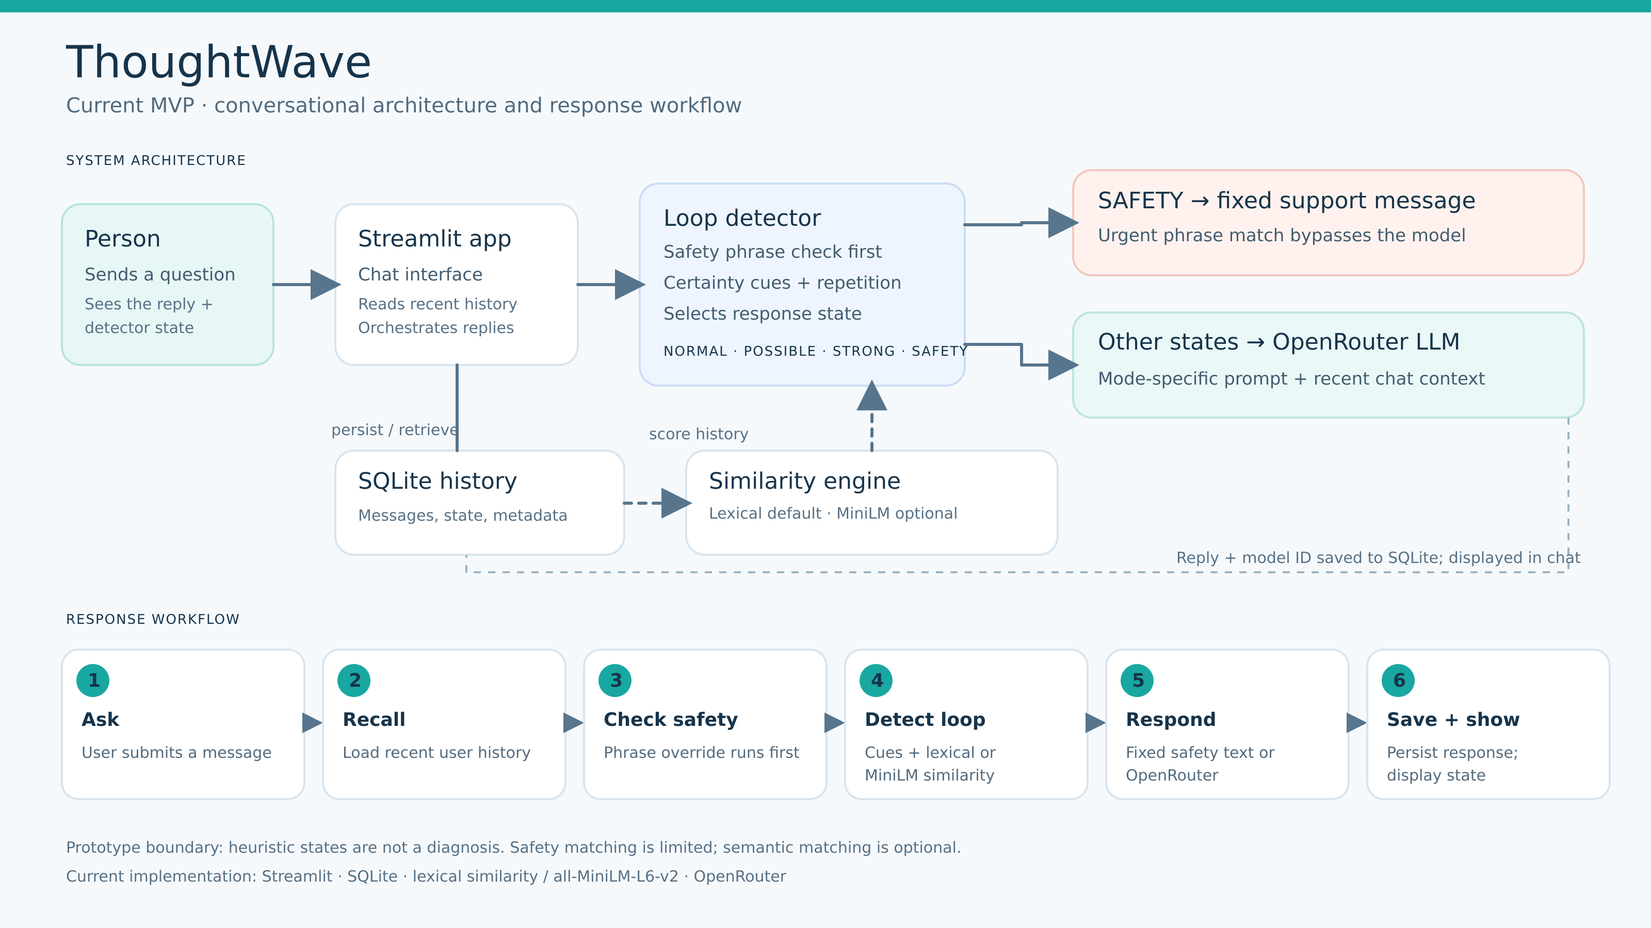

Slide 11
Solutions: ThoughtWave Product Feature
Chat: User can send text input and the AI assistant can provide a response to the user question
Chat history / Session Persistence: User’s chat history will be stored in order for the user’s behaviour to be able to be monitored.
Semantic search: The chat history will be rebuilt in a vector DB as embeddings vector. When after a few turns, the chat embeddings are similar, than the system will take note of the behaviour state as possible reassurance seeking loop.
User’s Behaviour State analysis: based on the user’s conversation history with the AI assistant, the user will use semantic search to detect similarity between the user’s responses.
AI Adaptive Policy: The AI assistant’s response will adapt based on the user’s behavior

Slide 12
User Experience
The user opens the Streamlit application and starts or resumes a conversation.
The user sends a message. The message is sent to the LLM and the LLM provides an answer
The User’s message is saved in SQLite as a chat history. From SQLite, the application extracts the chat history and embeds the text locally. After the first turn finished, the messages will be compared with previous user messages as a vector embedding using semantic search
The system detects the user’s behaviour state, it uses a combination of semantic repetition with simple certainty-seeking phrases and assigns NORMAL, MONITOR, POSSIBLE or STRONG_LOOP. The user’s behaviour state will lead to different response mode for the LLM.
The LLM receives the core ThoughtWave system prompt, the LLM’s response mode, recent chat context, and a few semantically related prior user messages.

Slide 13
User Experience
The ai assistant’s response mode corresponds to the detected user’s behavioural state mode:
Mode | Typical MVP evidence | LLM response policy
NORMAL | Low repetition score; isolated or genuinely new question | Answer naturally and proportionately. Do not introduce OCD framing.
Monitoring | Some semantic similarity and/or certainty wording | Answer briefly; avoid unnecessary guarantees; collect more evidence.
REASSURANCE_LOOP | Multiple semantically similar past concerns plus certainty/repetition signals | Acknowledge distress, note repetition tentatively, avoid stronger reassurance, and invite a return to the user’s activity/value.

Slide 14
6. Both the user message and assistant response are stored in SQLite.Only user messages are inserted into semantic memory to prevent the assistant’s own wording from contaminating repetition detection.
7. When the app process restarts, the in-memory vector store is rebuilt from persisted user messages in SQLite.

Slide 15
AI & Architecture
The components used for the MVP:
Components | Implementation method. | Future production direction
UI | Streamlit chat | React/mobile client after UX validation
Persistence | SQLite | PostgreSQL with encrypted sensitive fields
Semantic memory | In-memory vectors rebuilt from SQLite | pgvector/Qdrant/managed vector store if scale requires it
Embeddings | SentenceTransformers all-MiniLM-L6-v2 | Benchmark multilingual/domain models; version embeddings
LLM | OpenRouter-hosted configurable model | Provider adapter; privacy-reviewed hosted or self-hosted model
Policy | Rules + similarity score -> 3 modes | Calibrated temporal policy engine with hysteresis and user correction
Safety | Prompt-level emergency override language | Independent high-recall safety triage + output guard + locale resources
API | No separate API layer | FastAPI orchestration service

Slide 16
Build Process
Streamlit UI → SQLite history → SentenceTransformer embedding → in-memory cosine search → deterministic detector → adaptive system prompt → OpenRouter LLM → SQLite persistence
Component | MVP implementation | Purpose
Frontend | Streamlit | Chat UI, session selection, lightweight debug visibility.
Database | SQLite | Persistent sessions, messages, timestamps, detector metadata, response modes.
Embedding model | sentence-transformers/all-MiniLM-L6-v2 | Convert user messages into normalized semantic vectors.
Vector store | Python in-memory list of vectors | Keep the MVP dependency-light; rebuild from SQLite on startup.
Similarity | NumPy dot product on normalized vectors | Equivalent to cosine similarity for normalized embeddings.
Rule detector | Python regex + heuristic scoring | Detect certainty wording and combine it with semantic repetition.
LLM adapter | OpenAI-compatible OpenRouter client | Generate natural responses while keeping the model configurable.
Prompt policy | Single system prompt + injected RESPONSE_MODE | Keep behavior consistent and separate generation from detection.
Notes:
Show how AI accelerated you, where your judgement mattered and anything important you changed.

Slide 17
Collaboration
Assume you have a Product Manager, Designer and another Developer. How would you divide the work, collaborate and keep delivery moving?
  Product Manager:
    I will assign product manager to talk to existing users regarding their mental health struggle and ask for insight on what they can use to improve their AI application.
      when they use the app, what they hoped it would help with, and where a response felt helpful, confusing, or unhelpful. Keep questions focused on their experience with the product; they should not have to describe distressing thoughts in detail.
    Evaluate existing feature, ask existing user’s what part of the product feature is helpful to the user
      Find out whether users understand the Normal, Monitor, Possible Loop, and Strong Loop states, and whether a loop notice helps them move on or makes them feel judged. Ask for examples of where the app interrupted an ordinary question.
    I will ask product manager to do research on the mental health issue and collaborate with a licensed psychiatrist, let them know the product we are developing and ask them to test our product and ask for ways we can help our product improve.
      to review the product’s wording, response examples, false alarms, and safety handling.
      Invite them to test fictional scenarios before asking real users to test sensitive cases.
    Use the research for the product designer to turn into a feasible feature, give developers a ranked list of problems, evidence from interviews and tests, a proposed change, and a way to check whether it helped.

Slide 18
Collaboration
  Product Designer:
    Redesigns the chat flow, wireframes and prototype showing how users start a chat, read an answer, revisit history, and recover when LLM fails or takes time.
    Improve the loop notice: Several wording and layout options for Monitor, Possible Loop, and Strong Loop. The notice should explain the app’s observation without implying a diagnosis or shaming the user. Research more on how to respond to user properly based on its detected loop.
    Design user controls: Update the UI to make it more understandable to the user
    Designer should work together with the product manager and the clinicians in regards to the wording.
      How to use the AI to redirect the user back to mindfulness
      To not try to fight the thought and just accept the thought,
      How to make the user understand that you and your thoughts are disassociated, and not the same? If its not the same with your value, its alright.

Slide 19
Collaboration
  Developer:
    The developer will take insight developed by product managers and system design from solution architect
    In the future, the developer will have to work with PostgreSQL database to store the user accounts, conversation history, access control and backups
    The developer needs to implement a larger vector DB for the application.
    A FastAPI integration service for the application to the PostgreSQL database.
      Enable the same logic operation to be used across web apps, mobile apps or other clients
      User accounts and saved conversation flows through a consistent api.
    The developer needs to use a server that can match the workload demand.
      Determine effective ways to host this application. Whether cloud deployment, the hosting architecture, in a container, etc.

Slide 20
References
1. National Institute of Mental Health. Obsessive Compulsive Disorder. Reviewed December 2024. Source
2. International OCD Foundation. Research and evidence for CBT and exposure and response prevention. Source
3. Institute of Mental Health, Castle Peak Hospital. Obsessive Compulsive Disorder. Includes reassurance seeking, contextual interpretation, and CBT with ERP. Source
4. Guo Z, Lai A, Thygesen JH, et al. Large Language Model for Mental Health A Systematic Review. 2024. Source
5. Gong J, Wen X, Tao F, et al. Evaluating Text based Conversational Agents for Mental Health A Systematic Review of Metrics Methods and Usage Contexts. 2026. Source
6. World Health Organization. Ethics and governance of artificial intelligence for health. 2021. Source
7. National Institute of Standards and Technology. Artificial Intelligence Risk Management Framework and Generative AI Profile. Source

