Slide 1
AFSIM User Training
21 – Behavior and Agent Modeling Training
AFRL/RQQD
Notes:
This version of the training has been tested with version 2.7

Slide 2
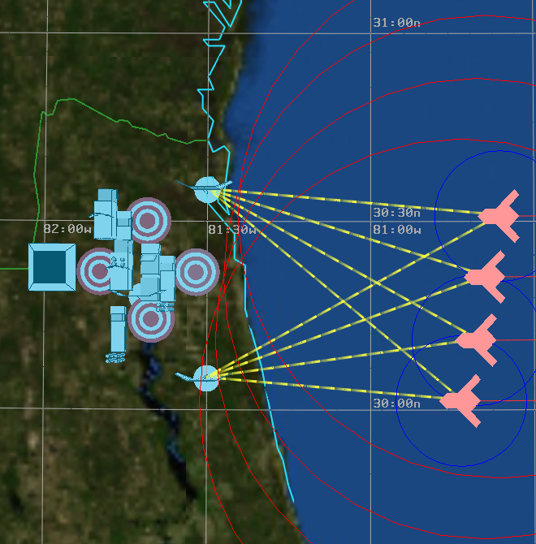
Starting Scenario
Targets
Red players
UAV’s with Weapons
SOJ’s
Blue Players
SAM systems
Acquisition Radars
Target Track Radars
Missile Launchers
SAM commanders
Airborne Interceptors
Early Warning Radars
Command/Control nodes
Notes:
These are the players that we have in the simulation now.

Slide 3
Agenda
Review
Perception Processors and Quantum Tasker Processors
Behavior Trees / Pursue Behavior / Weapons / Engage Behavior
Route Finder
Go Home / Escort Behaviors
Threat Processor / Evade Behavior
Clustering / CC2 / decomposing tasks
AIR integration with IADS
Notes:
This is the agenda.
This part of the course will have a different structure. I will show you what has changed in the model, and then there will be an exercise at the end, to apply what has been added to the model.
Review: inheritance, flow of information
Perception/quantum tasker: different view of information, optimization
Behavior trees: different approach to controlling platforms
Route finder: move around avoidance zones
Go home / escort: finish tree, modify variables
Threat processor: new processor to identify threats
Clustering: grouping tracks for better decisions
Integration: make the air and ground forces work together

Slide 4
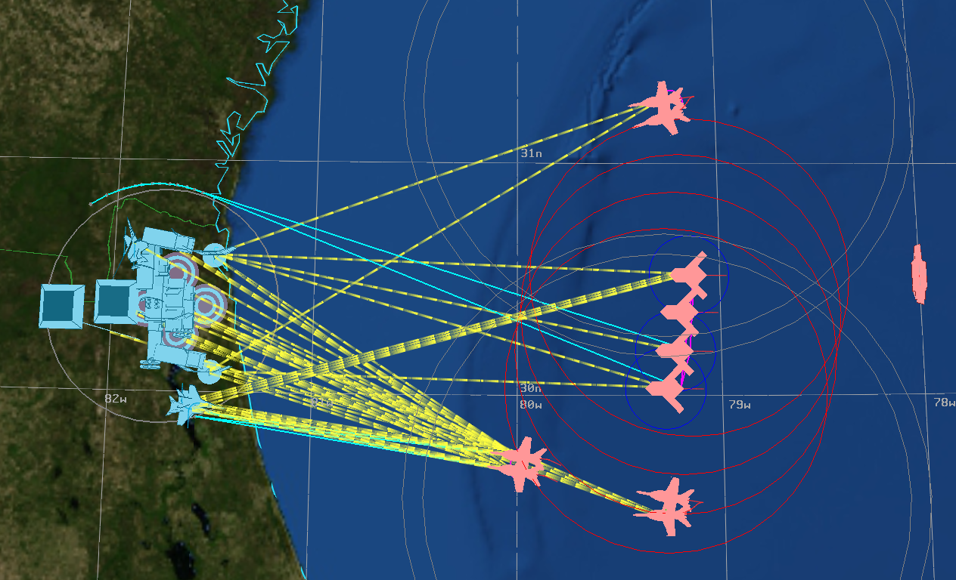
Completed Scenario
Notes:
Completed scenario

Slide 5
Basics
Theory
Overview of Platforms and Components as AFSIM objects
Processor example
Overview of AGENT function & flow
Application
Add in SOJ platforms and their commander ship
Show the beginnings of an AFSIM artificially intelligent agent
Notes:
This is a review

Slide 6
AFSIM Components
Platforms and components defined by AFSIM input definitions
AFSIM Example:
input definition: WSF_SCRIPT_PROCESSOR
script object: WsfProcessor
User can define more types and derive from given types
Example:
processor MY_TYPE WSF_SCRIPT_PROCESSOR
//do special stuff inside
end_processor
WsfScriptProcessor is key as many types derive from it:
WsfTaskManager
WsfQuantumTaskerProcessor
WsfPerceptionProcessor
etc…
Notes:
Example: the script processor is a basic processor. The script object type is just WsfProcessor. But the derived processor types have those script functions too.
Yes, the word script is used here too many times.

Slide 7
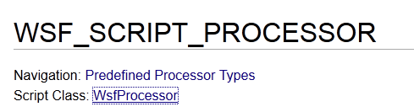
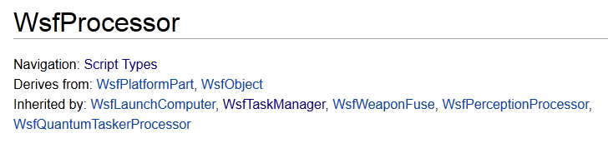
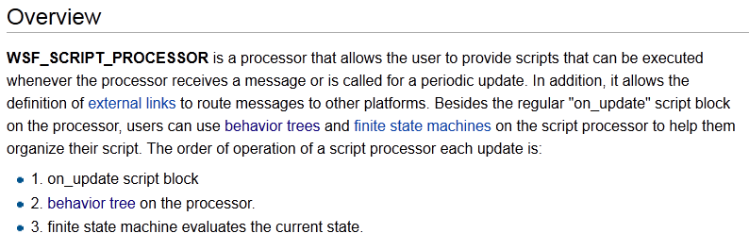
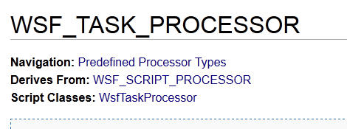
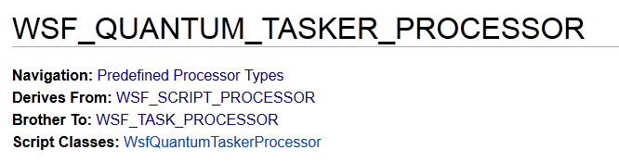
Script Processor

Slide 8
Inheritance
What is the take-away from all these derived types?
Anything that derives from a type has all the features and script methods that the parent type has.
For example, the WSF_QUANTUM_TASKER_PROCESSOR has all the stuff that a WSF_SCRIPT_PROCESSOR has
on_update script block
behavior_tree
state blocks (finite state machine)
Notes:
This is the point of inheritance.

Slide 9
Agents
What is an artificially intelligent agent?
Sense
World
Knowledge
/ State
Agent components
Operates in an environment
Has an understanding of that world, and an internal state of its own
Makes decisions
Carries out decisions
Affects the environment
Feedback Loop
Action
Decision
Making
Notes:
AI agent senses, develops knowledge, makes decisions, acts.
This is what the task processor is doing too.

Slide 10
Agent Flow
What the agent flow looks like on an
AFSIM platform with AFSIM components
Sense
Knowledge
Decide
Act
Platform
Other Platform(s)
Sensor
Comm.
Misc.
Track Processor
talks with
Track Processor
Task Processor
reads
Task Processor
controls
Mover
Weapons
Misc.
Notes:
This is what we’ve been doing so far

Slide 11
Agent Flow
What the agent flow looks like on an
AFSIM platform with AFSIM components
Sense
Knowledge
Decide
Act
Platform
Other Platform(s)
Sensor
Comm.
Misc.
Track Manager
Perception Processor
talks with
Quantum Tasker
reads
Perception Processor
Quantum Tasker
controls
Mover
Weapons
Misc.
Notes:
This is what we are going to do next – using the perception processor and the quantum tasker.

Slide 12
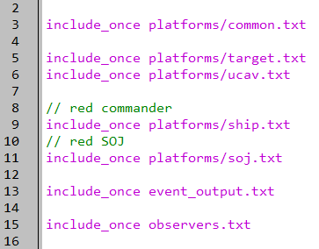
New Platforms
setup.txt
Notes:
New platforms – ship and soj. They are both basic platforms.

Slide 13
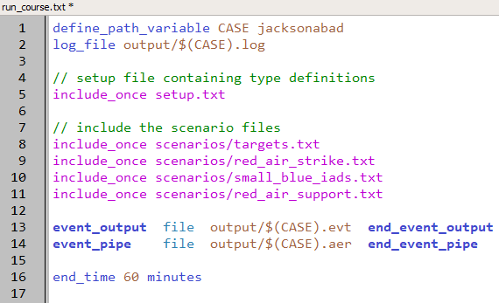
New Scenario
run_course.txt
Notes:
They are in the red air support scenario.

Slide 14
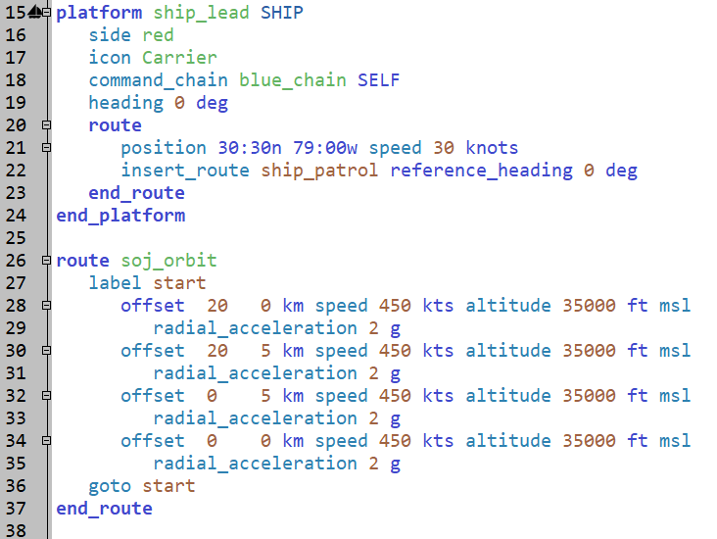
Stand Off Jammers
red_air_support.txt
Notes:
This is a relative orbit, that is used by the SOJ. The SHIP has one too.

Slide 15
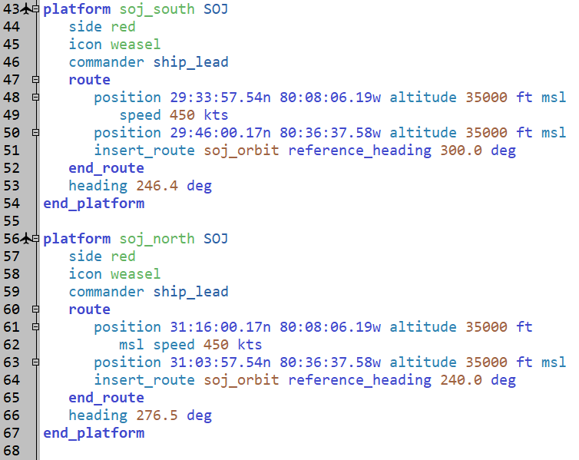
Stand Off Jammers
red_air_support.txt
Notes:
Notice how the SOJ’s use the transformed route to define an orbit.

Slide 16
Execution
RUN IT!!!
Notes:
Run it, should see ship & SOJs out off the coast

Slide 17
Exercise
On the Blue IADS commander, at regular intervals:
Print the track ID and target name of every track on the platform’s master track list.
Hints:
Regular intervals produced by execute or on_update blocks
Accessing the Master Track List is a PLATFORM script method
Suggestion:
To improve clarity, indicate current simulation time in the output
Notes:
Should take 15-20 minutes.

