Slide 1
AFSIM User Training
22 – Perception & Quantum Tasker Processors
AFRL/RQQD
Notes:
This version of the training has been tested with version 2.7

Slide 2
Learning Objectives
You gain hands-on knowledge about:
Perception Processor
Quantum Tasker Processor
Notes:
These two go together.

Slide 3
Perception / Quantum Tasker Processors
Perception Processor
Derived from Script Processor
Mechanism to represent operator perception
Functions:
Status reporting, asset perception modelling, track perception modelling
Quantum Tasker Processor
Derived from Script Processor
Task generation based on threat perception
Evaluation of task / asset pairs
Task assignments
Utilizes threat perceptions and asset perceptions
Notes:
The perception processor represents “skill” or experience. My analogy – experienced drivers can perceive and remember more traffic than a 16 y/o.
The quantum tasker uses the information from the perception processor. It has three main parts:
The generator creates tasks, from the perceived tracks.
The evaluator looks at every asset / task pair, and gives each pair a value. Positive values imply it can be done. Zero or negative values mean that pair won’t be considered
Assignments are made based on the “optimization” scheme chosen.

Slide 4
Perception Processor
Represents agent’s perception of environment
Different from system perception (radar / comm buffer)
Brain perception of threats, peers, etc..
Expert agents can manage more info in their head, and update it regularly without much cognitive load
Perception Processor tunable (represent different cognitive abilities)
Bandwidth – how much information is held
Frequency – rate at which information is updated
Notes:
This is representing the pilot’s capability.

Slide 5
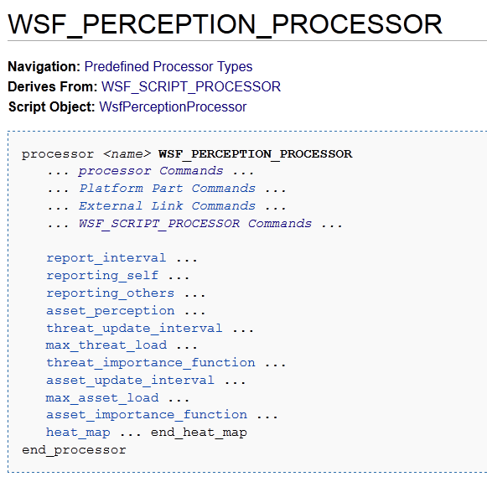
Perception Processor
Notes:
The perception processor documentation page. Derived from script processor. WsfPerceptionProcessor is the script object type.
Notice the reporting methods – specify what you will report – self, others.
This has external link commands, which is how it reports.

Slide 6
Perception Processor Parameters
Parameter | Description | Default values
threat_update_interval | time between agent glances at radar screen | 0 sec (no delay)
max_threat_load | how many threats the agent can remember at a given time | 0 (no max limit)
asset_update_interval | time between agent glances at asset/peer status info | 0 sec (no delay)
max_asset_load | how many assets/peers the agent can remember at a given time | 0 (no max limit)
Notes:
These are the primary parameters that you can set. The default values produce the same results as “machine data”.

Slide 7
Perception Processor Parameters
Parameter | Perfect (default) | Expert | Average | Novice
threat_update_interval | 0 sec | 5 | 7.5 | 10
max_threat_load | Unlimited | 16 | 8 | 4
asset_update_interval | 0 sec | 5 | 7.5 | 10
max_asset_load | Unlimited | 16 | 8 | 4
Notes:
Here are some examples of different values.
I don’t have a source for these, but they represent different values for a pilot in a single seat aircraft.

Slide 8
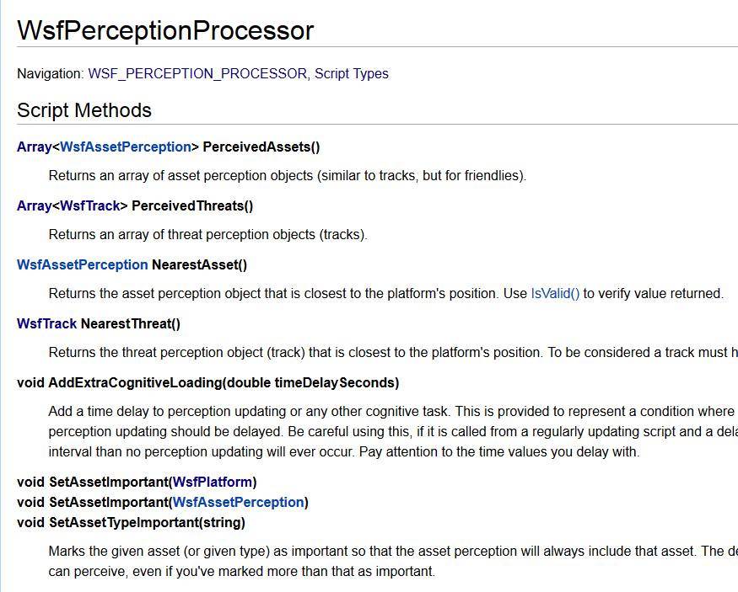
WsfPerceptionProcessor
Notes:
The WsfPerceptionProcessor documentation page.
Since the perception processor is a script processor, you can have script in the processor. This enables you to make decision and/or tweak the perception. For example, you can set some threats as “important”, and they will always be in perception.

Slide 9
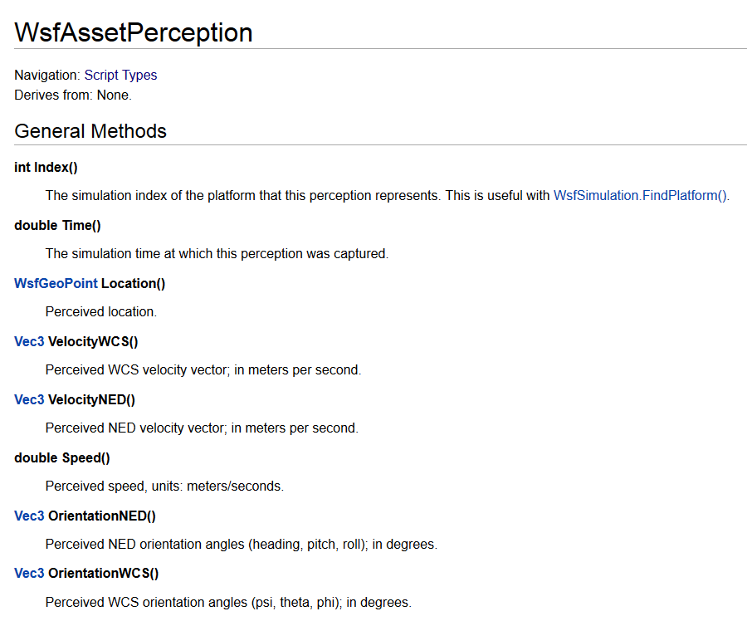
WsfAssetPerception
Notes:
The WsfAssetPerception documentation page. Asset perceptions can be accessed using the WsfPerceptionProcessor script object.
This is how we can get the subsystem information that is sent.

Slide 10
Quantum Tasker
Commander tasking broken into logical pieces:
Task generation
Task-asset pairing evaluation
Task allocation
Each component is pre-defined or custom scripted
Compatible with task managers (both ways)
Various re-allocation strategies available
Notes:
Quantum tasker generates tasks, evaluates pairs, and creates allocations.

Slide 11
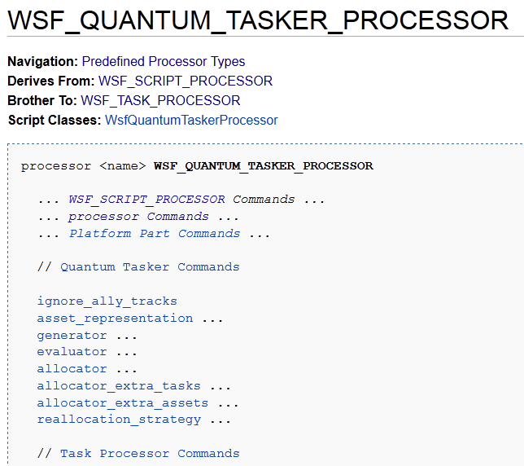
Documentation Page
Notes:
Documentation page. Notice this is derived from script processor.

Slide 12
Assignment Problem
Assets
 | Joe | Bob | Tim
Wash Car | $1 | $3 | $5
Paint Fence | $2 | $3 | $7
Mow Grass | $3 | $3 | $9
Build Shed | $4 | $3 | $11
Tasks
Evaluations
Allocation:
“Greedy” for computation time? In one pass:
Joe Washes Car, Bob Paints Fence, Tim Mows Grass
Total Cost = $13
Min Cost (optimal profit)? In multiple passes:
Joe Paints Fence, Bob Mows Grass, Tim Washes Car
Total Cost = $10
Notes:
This shows pictorially the various parts. The tasks are the vertical column. The assets are across the top. The evaluations are the contents of the array.
There are different ways you can pick who does what.
The optimization minimizes the overall cost. This is important – the evaluations need to produced minimized numbers.
Note that “greedy” in the algorithm name refers to calculation expediency (greedy in time or CPU cycles), and doesn’t always give the “optimal” solution (greedy in $$$).

Slide 13
Available Components
Generators
simple_weapon
simple_jammer
simple_sensor
custom (script)
Evaluators
simple
distance
intercept_time
custom (script)
Allocators
greedy_isolated
greedy_value
greedy_priority
greedy_profit
optimal_profit**
custom (script)
**Assignment problem, Hungarian Algorithm, O(n^3)
Notes:
There are built in components.
You can also built custom scripts. Making custom allocator is hard.

Slide 14
Quantum Tasker
Method of operation:
Perception Processor provides perception
Generator creates tasks
Evaluator considers task-asset pairings
Allocator finds best asset for each task
Re-allocation strategy effects:
Previously assigned tasks
Rejected tasks
New tasks
Task assignment/handshaking over comm
commander
Perception Processor
assets
threats
quantum tasker
…
Agent
script
matrix
generator
evaluator
asset-task pairings
allocator
 | Asset 1 | Asset 2 | Asset M
Task 1 | value | value | value
Task 2 | value | value | value
Task 3 | value | value | value
Task N | value | value | value
Example
Matrix
Notes:
This is what it looks like on a platform.

Slide 15
Reallocation Strategies
Strategy | Description
Dynamic | All assets could theoretically be re-tasked every update, as the evaluator & allocator find the most optimal tasking possible.
Static | Once a task is assigned, it is NEVER reassigned.
Response | Only tasks that are rejected or cancelled by subordinates are re-assigned to somebody else.
Event | Recalculates best allocation upon one of three impetus: 1. New task appears 2. Asset disappears 3. Task rejected
Notes:
There are reallocation strategies.

Slide 16
Notes on Operation
The generator must generate all tasks each query
If a task is no longer generated, a task cancel message is sent to all assignees
If a task allocation changes
A task cancel is sent to the previous assignee
A task assign is sent to the new assignee
If a task complete message is received, the task won’t be re-assigned unless the perception it was created from becomes more recent than the complete message
If a task reject message is received from a particular asset, then that task is never re-assigned to that asset. It is assigned to another asset if possible
If asset perception is “systems”, then each asset system receives separate tasks
E.g. missile_type_1 can receive task_4 and missile_type_2 can receive task_7
WsfQuantumTasks are constructed with resource type (“weapons”, “sensor”, etc)
Tasks of a custom type need to use SetTaskType() and SetUniqueId()
All persistent tasks (not just one-time events) need a track when constructed
Notes:
You need to remember these items when using a quantum tasker.
Never reject tasks if you can avoid it.
Luke’s notes:
Most simulations are stateful -> don’t provide events of interest to AI agents, so agents must generate those on their own
Look at whole state each update -> generate desired tasks -> quantum tasker detects changes in task list, handles that “event” appropriately

Slide 17
“Extras”
What happens if we have more tasks than assets?
Default operation: leave tasks unassigned until assets free up
If a task was not evaluated positively by any asset, it will not be assigned
allocator_extra_tasks <allocator_type>
Performs an allocation pass with remaining tasks & all assets
Performs more iterations as long as a new assignment is found each time
Some assets will be given multiple tasks
What happens if we have more assets than tasks?
Default operation: leave assets idle (no tasks assigned)
If an asset did not evaluate any tasks positively, it will not be assigned
Allocator_extra_assets <allocator_type>
Performs an allocation pass with remaining assets & all tasks
Performs more iterations as long as a new assignment is found each time
Some tasks will be given to multiple assets
new allocation found
allocate extra
Notes:
There are ways to handle extras.

Slide 18
Jammer Function
The function of a Jammer agent
Put EM emissions onto targets at proper frequencies
Stand-alone design (functions independently)
On-board ESM triggers WSF_TASK_MANAGER
Task manager TRACK state controller script finds 1st available compatible on-board jammer weapon & assigns jamming task
SOJ
5 mghz jammer
beam 1
Enemy Radar
beam N
What conditions cause problems?
X mghz jammer
Enemy Radar
beam 1
Enemy Radar
beam N
Notes:
An enemy radar shows up, what does your script do? (find compatible jammer, start jamming)
Another enemy radar shows up, it’s the same frequency as other jamming & no beams are left, what now?
An enemy radar goes away, there are less important targets available, what now?
A friendly SOJ is ready to help jamming, what does your script do now?

Slide 19
Jammers & ESMs
Issues:
Too many systems to jam / not enough jamming resources
Coordinated jamming / deconfliction
Time / power commutation
SOJ
?
5 mghz jammer
?
SOJ
5 mghz jammer
beam 1
Enemy Radar
beam 1
beam N
?
beam N
?
Enemy Radar
X mghz jammer
?
X mghz jammer
beam 1
Enemy Radar
beam 1
beam N
beam N
?
Notes:
An enemy radar shows up, what does your script do? (find compatible jammer, start jamming)
Another enemy radar shows up, it’s the same frequency as other jamming & no beams are left, what now?
An enemy radar goes away, there are less important targets available, what now?
A friendly SOJ is ready to help jamming, what does your script do now?

Slide 20
Jammer Problem
What are the issues with allocating jamming assignments?
How to coordinate between two or more assets
How to respond to unplanned events
Pop-up threats
Malfunctioning equipment
Lost protected entity
Difficulty of the standalone design
Each platform (script) must consider all of these conditions
Each platform needs complete knowledge
Notes:
A summary of the previous pages

Slide 21
Solution
Quantum Tasker provides a tool to address issues like this
General Tool, used in many ways for many task types
User provides a single script describing jammer beam on a target
Value can be: 1 / distance
Value can be: power required
Other modifications: less value if we are already jamming a lot
Quantum Tasker allocates beams on targets
Notes:
The quantum tasker is one way to solve this.

Slide 22
Specific Application
Method of operation, Jamming Example:
Perception Processor provides perception
ESM tracks of enemy radar
Generator creates tasks
Jammer task for each target
Dynamic Re-allocation strategy best here
Evaluator considers task-asset pairings
User script to score each beam-target
Allocator finds best asset for each task
Optimal Profit Allocator usually best
Task assignment/handshaking over comm
Task assigns/cancels sent automatically
SOJ agents simply jam their task list
commander
Perception Processor
assets
threats
quantum tasker
…
Agent
script
matrix
generator
evaluator
asset-task pairings
allocator
Notes:
This is how we are going to do this.

Slide 23
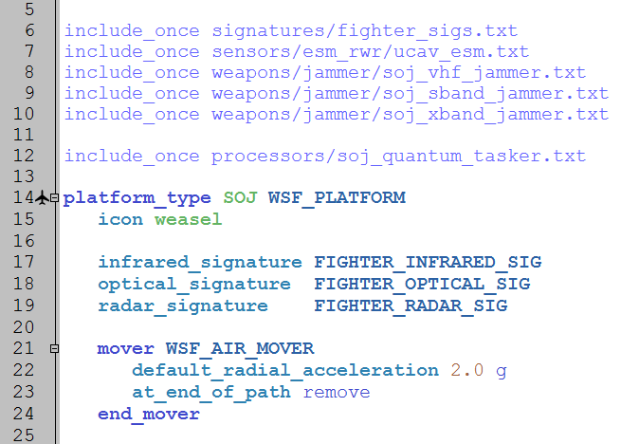
Updating SOJ
platforms/soj.txt
Notes:
These files are now included on the SOJ. Adding jammers, sensor and a quantum tasker.

Slide 24
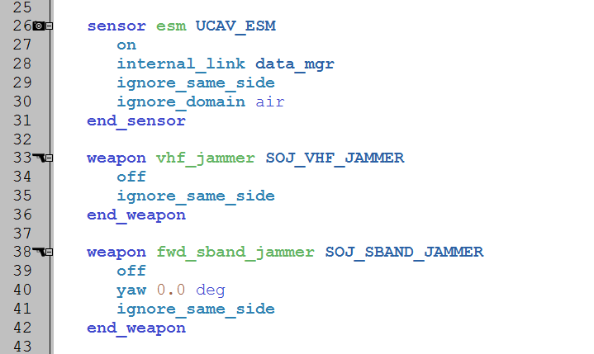
Sensor and Weapon
platforms/soj.txt
Notes:
Sensors and weapons on the SOJ.

Slide 25
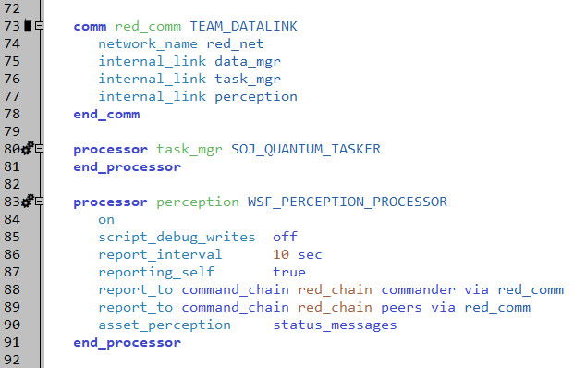
New Processors
platforms/soj.txt
Notes:
The quantum tasker and perception processors are new. The internal link is necessary to get other perception data to the processor.

Slide 26
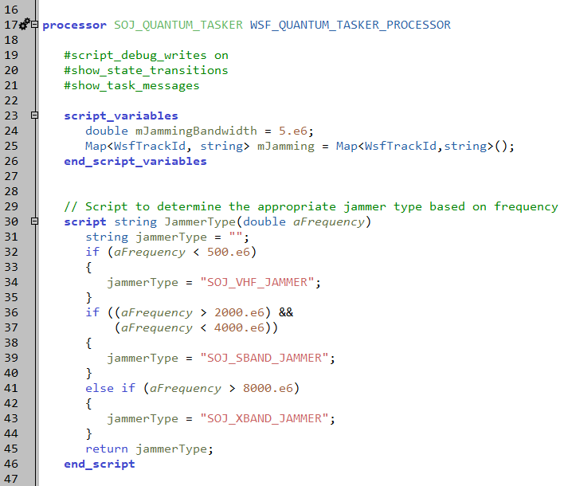
SOJ Quantum Tasker Processor
processors/soj_quantum_tasker.txt
Notes:
This just does the assigned tasks.
It does not have the “normal” three parts on a quantum tasker.

Slide 27
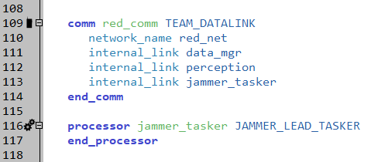
Processor Instantiation
platforms/ship.txt
Notes:
On the ship, adding perception and quantum tasker processors. The quantum tasker processor is in the same file.

Slide 28
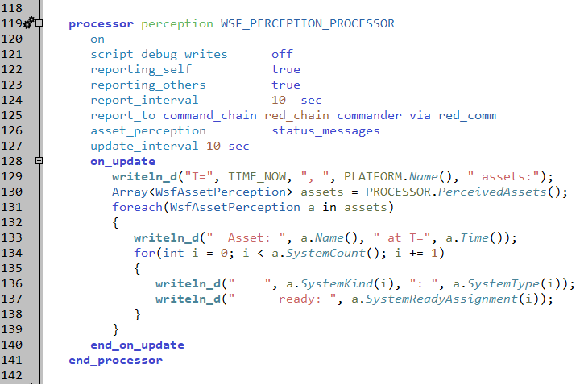
Perception Processor
platforms/ship.txt
Notes:
This reports to the commander. It can also write out perceived assets, using writeln_d.

Slide 29
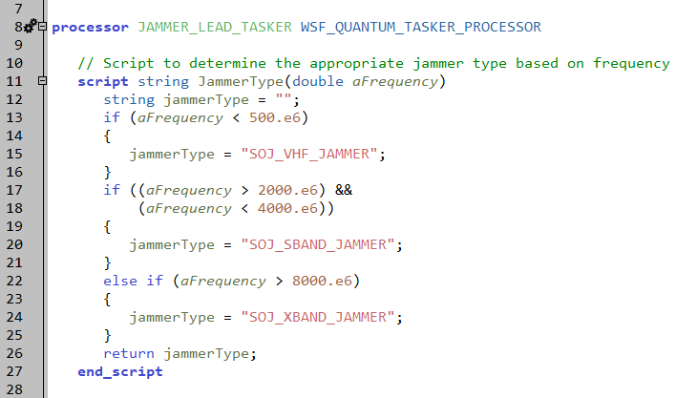
Quantum Tasker Processor
platforms/ship.txt
Notes:
The quantum tasker does the allocations.
This script helps the commander choose the right jammer weapon for a target frequency.

Slide 30
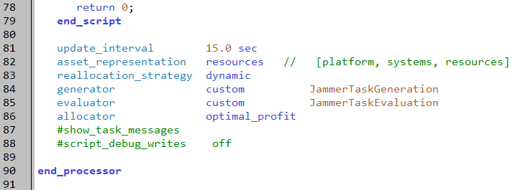
Quantum Tasker Instantiation
platforms/ship.txt
Will allocate specific jamming resources
Notes:
The generator and evaluator are both custom.

Slide 31
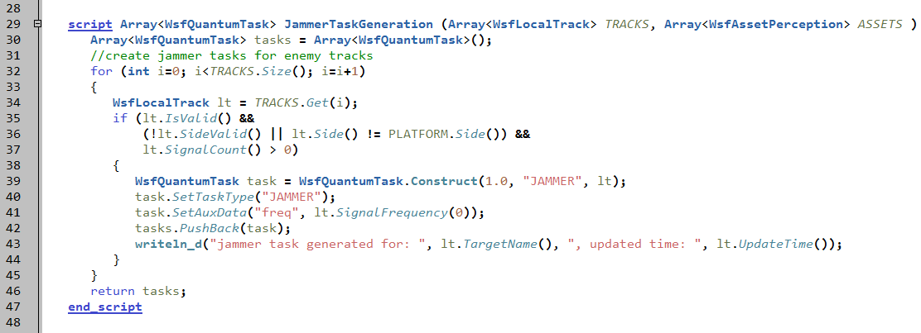
Generator
platforms/ship.txt
 | Asset 1 | Asset 2 | Asset M
Task 1 | value | value | value
Task 2 | value | value | value
Task 3 | value | value | value
Task N | value | value | value
Notes:
Generator creates jammer tasks for each track.
Yes, line 39 & 40 are redundant. Also note: the Task Type is only checked if we tell it to in script.

Slide 32
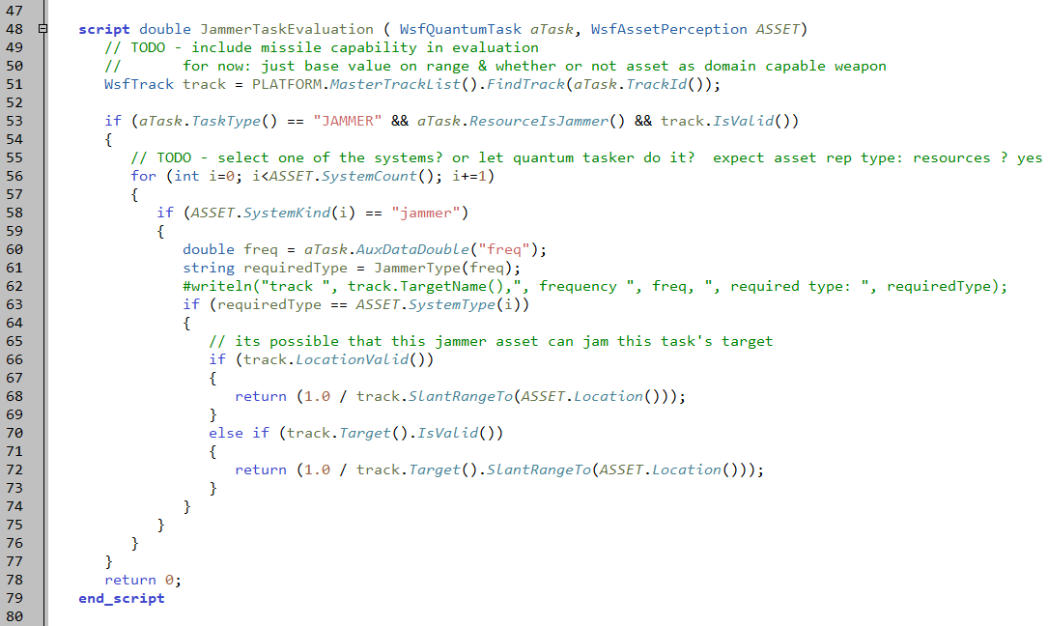
Evaluator
platforms/ship.txt
 | Asset 1 | Asset 2 | Asset M
Task 1 | value | value | value
Task 2 | value | value | value
Task 3 | value | value | value
Task N | value | value | value
Notes:
The evaluator produces 1/range. If the range is perceived, then it uses that. Otherwise, it uses truth.

Slide 33
Execution
RUN !!!
Now we have ESM detections and jamming!
Notes:
Should see extra output from perception processor printing all asset systems:
VHF jammer and ESM sensor should show up now

Slide 34
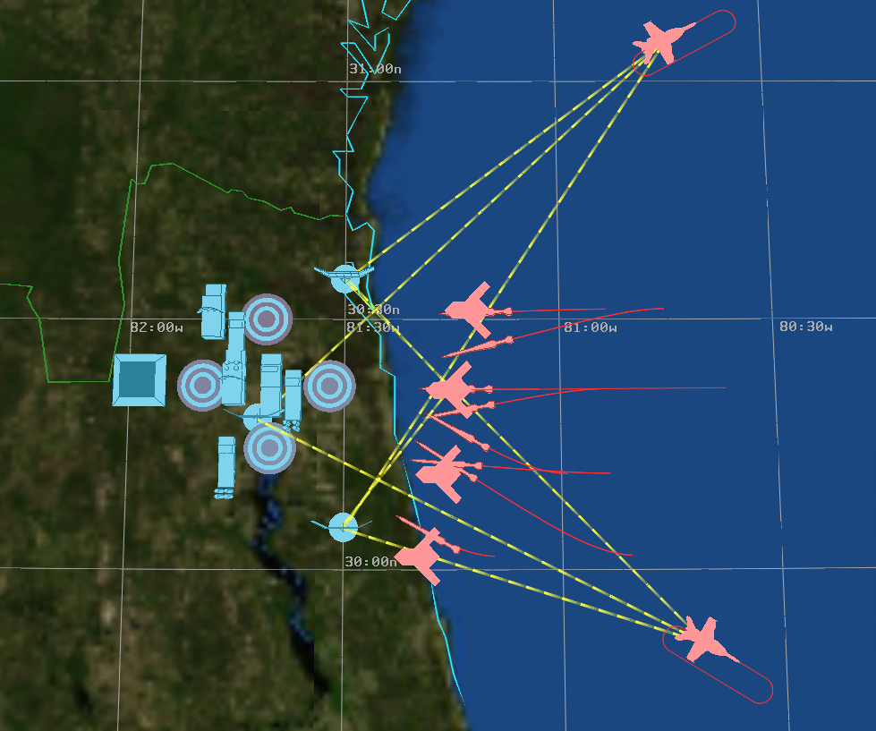
ESM Detections
SOJ’s have ESM hits
Note: strobes go from SOJ (ESM) to transmitter
Notes:
ESM strobes go from the sensors to the radars. This can confuse people at times.
This might be a good time to remind how to control which ones are on or off.

Slide 35
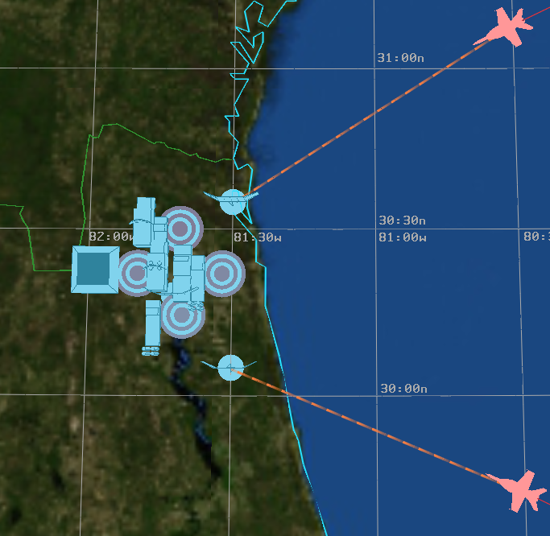
Jamming Strobes
Notes:
And jamming strobes.

Slide 36
Exercise
Print out information about received tasks on the SOJ
Print the task type, resource, assigner, assignee, etc.
Add more EW radars to see what happens to the assignments
Hints:
Received tasks is a PROCESSOR script method
Tasks have their own methods
Separate the new radars, to be able to see the jamming strobes in Mystic

Slide 37
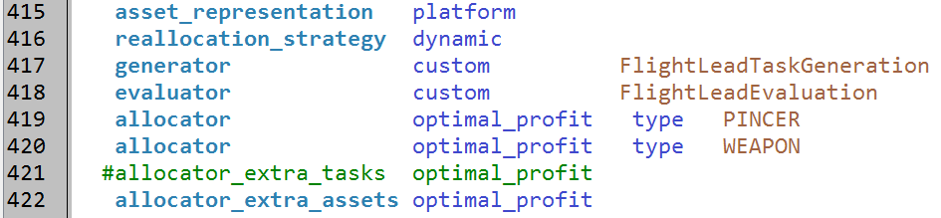
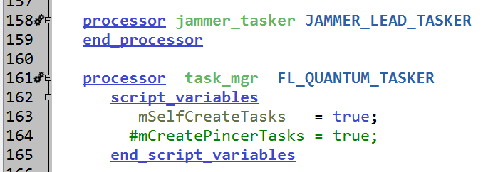
Different Types of Tasks
Do I have to tune the evaluation between different task types?
NO: you can use separate allocators for different task types
OR: use different quantum taskers
Notes:
You don’t have to try tune different types of tasks.

Slide 38
Learning Objectives
You gain hands-on knowledge about:
Perception Processor
Quantum Tasker Processor

