Slide 1
AFSIM User Training
23 – Behavior Trees and Pursue Behavior
AFRL/RQQD
Notes:
This version of the training has been tested with version 2.7

Slide 2
Learning Objectives
You will be able to:
Describe behavior trees in AFSIM
Build a behavior node
Modify a behavior tree
Notes:
Not too bad

Slide 3
Behavior Trees
Theory
Behavior Trees
Application
Add blue CAP (combat air patrol) agents (strikers)
Use behavior tree for planned route / pursue target behaviors
Add blue flight lead
Uses same Quantum Tasker as ship
Simple WEAPON tasks
Will build on this to control behavior
Notes:
Going to put a behavior tree on airplanes, to control their behavior.
Will need flight leads to give them orders.

Slide 4
Behavior Tree Concepts
Behavior Trees
Defines behaviors as bite-size pieces
Defines the branches that hold behaviors together in relation
Defines the process that determines which behaviors are executed
Invisible “root” node at the top
Behaviors
Define some specific action to perform
Self-aware of what conditions are required to perform their action
Manifested in RIPR as a script definition
Branches (or intermediate nodes)
Each node can have child nodes, through a type of branch
Types: parallel, sequence, & selector
Notes:
Explain basics of behavior tree, including its purpose and typical use.
It relies on the ability to break items into relatively self-contained bite-sized pieces.

Slide 5
Behavior Tree Concepts
Behavior Tree
Root Node
Goal is to decide what leaf node(s) are to be executed.
Logic starts at the root node.
Each node will evaluate its child nodes sequentially.
Intermediate nodes may not evaluate all of their children.
Intermediate Node
Intermediate Node
Intermediate Node
Leaf Node
(Behavior)
Leaf Node
(Behavior)
Leaf Node
(Behavior)
Leaf Node
(Behavior)
Leaf Node
(Behavior)

Slide 6
Behavior Tree Operation
Each node has two required pieces:
precondition – Block of script that returns a bool (true/false).
execute – Block of script that runs only if the precondition returned “true”.
A node can only be executed if:
It is visited by the tree
Its precondition passes (returns true)
For behavior nodes (leaf nodes)
They have unique names, and can be referenced by name
Their preconditions are explicit, defined by the user through script
Their execution/action is explicit, defined by the user through script
Notes:
It will try to go to every node.
Leaf nodes will return true or false. If it returns true, then it executes.

Slide 7
Behavior Tree Operation
For intermediate nodes
They pass their preconditions by default
They “execute” by simply running [none, some, or all of] their children
There are three types of intermediate nodes
A parallel node tries to run all children
A selector node tries to run its children until one runs
A sequence node tries to run its children until one fails
For nesting purpose, an intermediate node returns true if any of its children ran (precondition returned “true”)
A Behavior tree starts execution at the invisible root node
This root node is a parallel node type
Notes:
The only way for an intermediate node to return “false” is if all of its child nodes’ preconditions returned “false”.
We will use the parallel root node to our advantage.

Slide 8
Intermediate Node Examples
Selector nodes try to run only one child.
Evaluates one child’s precondition at a time.
Stops at first success.
Returns true if any children PASS their precondition.
Great for choosing one action among many.
Put most important choices first!
Selector
Fail
Pass
Not Considered
Not Considered
Sequence nodes try to run all children.
Evaluates one child’s precondition at a time.
Stops at first failure.
Returns true if any children PASS their precondition.
Great for specifying dependent behaviors.
Sequence
Pass
Pass
Fail
Not Considered
Notes:
Selector only runs one.
Sequence goes until a failure.

Slide 9
Intermediate Node Examples
Parallel nodes try to run all children.
Every child’s precondition is evaluated, independent of others’ return values.
Returns true if any children’s preconditions PASSED.
Great for grouping any behaviors together.
Parallel
Fail
Pass
Fail
Pass
Notes:
Mention that behavior trees have an invisible root node that is a parallel node

Slide 10
Intermediate Node Examples
Weighted Random
weighted_random nodes randomly select one child, probability of selection is given by child’s precondition return value.
Good for choosing when any action will do.
Good when used with “run_selection”
Good when used with “make_selection”
Not Chosen
Chosen
Not Chosen
Not Chosen
4
3
5
1
Priority Selector
priority_selector nodes select the child with the highest precondition return value.
Good for choosing when order not known.
Good when used with “run_selection”
Good when used with “make_selection”
Not Chosen
Not Chosen
Chosen
Not Chosen
4
3
5
1
Notes:
OK, we lied. The precondition can return a value. These intermediate nodes use those values.
run_selection - Specify how long a selected child will be executed
make_selection - Specify how many selections will be made, rather than the default: continuous

Slide 11
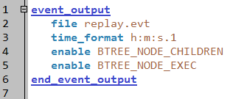
Behavior Tree Events
Event log output:

Slide 12
Event Output Examples
BTREE_NODE_CHILDREN
Outputs once at initialization
Example:
00:00:00.0 BTREE_NODE_CHILDREN red_3 324 selector 2 325 326 "d:/CoDev/projects/fuel_mgmt_test/red_fighter.txt” 1326920272
BTREE_NODE_EXEC
Outputs for every change in state and on regular interval
Example:
00:04:02.0 BTREE_NODE_EXEC agent_4 395 engage-target 0 "no acceptable target to shoot at!"
Notes:
Children builds the tree structure.
Exec shows each change.
**For 2.0.1** Ensure there are no spaces in the full path to the .evt file or GRIT may fail to launch.

Slide 13
Behavior Trees – QUIZ 1
Sequence
Selector
Selector
Sequence
Sequence
TRUE
FALSE
FALSE
TRUE
Selector
C
D
E
F
TRUE
FALSE
FALSE
TRUE
GRAY leaf nodes show precondition return value
Hypothetical (if visited)
What nodes are executed?
A
B
G
H
Notes:
Pop quiz!

Slide 14
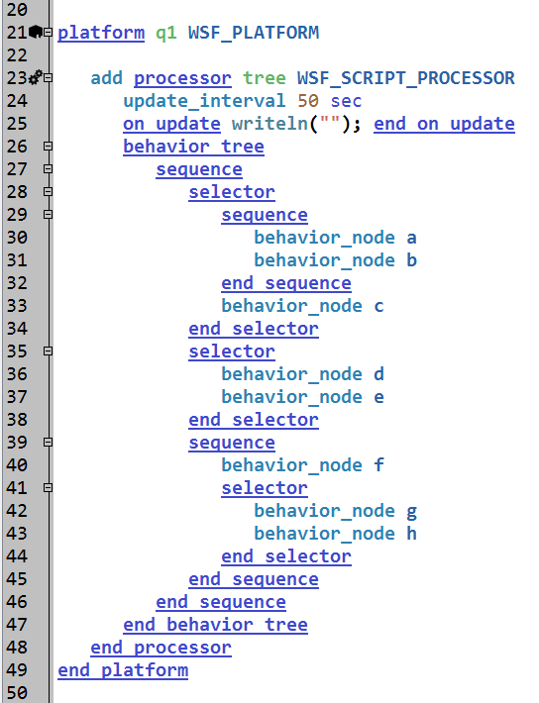
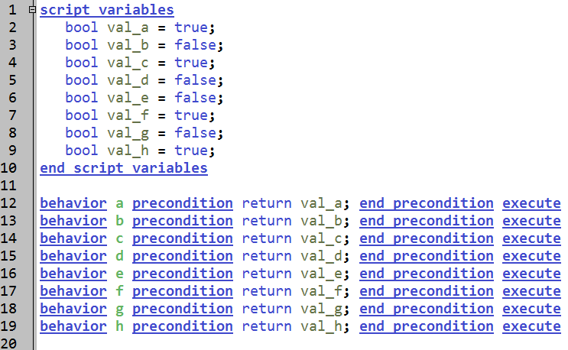
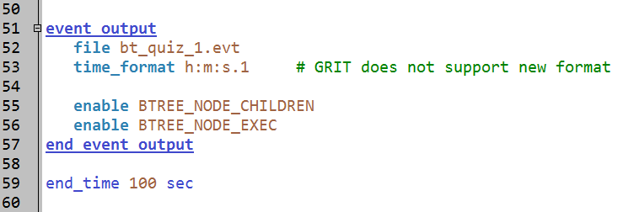
Behavior Trees – QUIZ 1 Program
Notes:
A model that is the pop quiz.

Slide 15
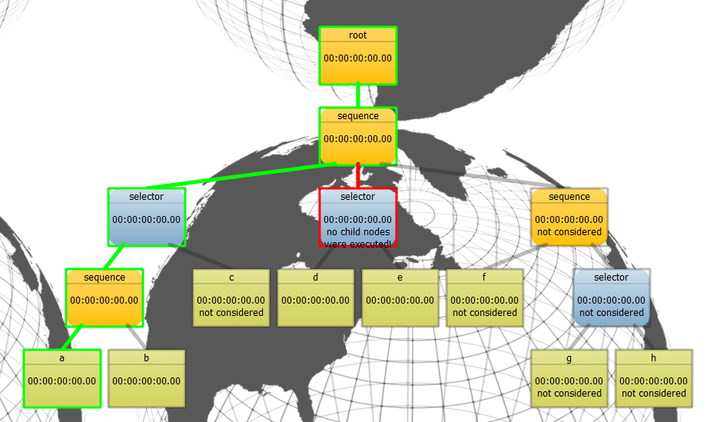
Behavior Trees – Answer 1
Notes:
The answer – only A.

Slide 16
Behavior Trees – QUIZ 2
Parallel
Sequence
Selector
Sequence
Selector
TRUE
FALSE
FALSE
TRUE
Selector
C
D
E
F
TRUE
FALSE
FALSE
TRUE
GRAY leaf nodes show precondition return value
Hypothetical (if visited)
What nodes are executed?
A
B
G
H
Notes:
Different version.

Slide 17
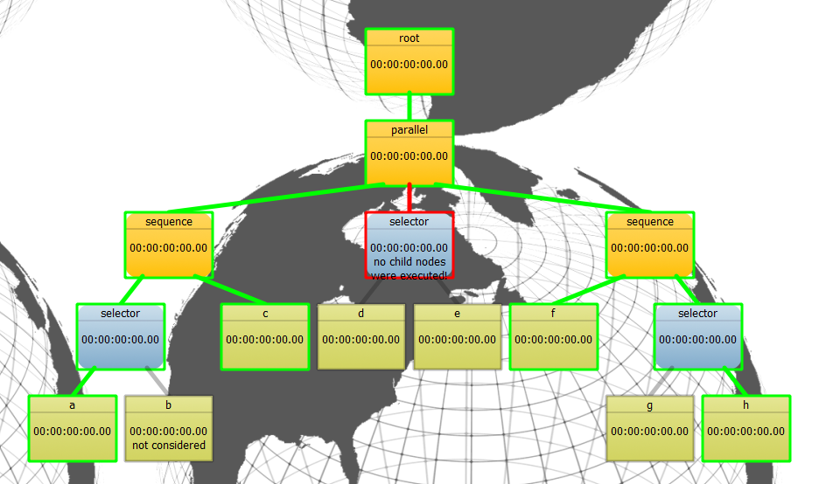
Behavior Trees – Answer 2
Notes:
ACFH.

Slide 18
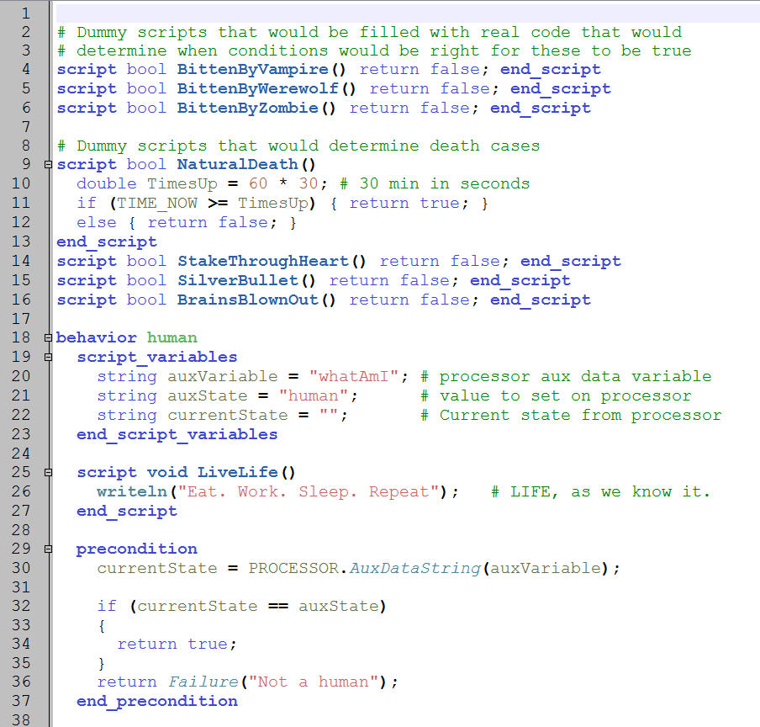
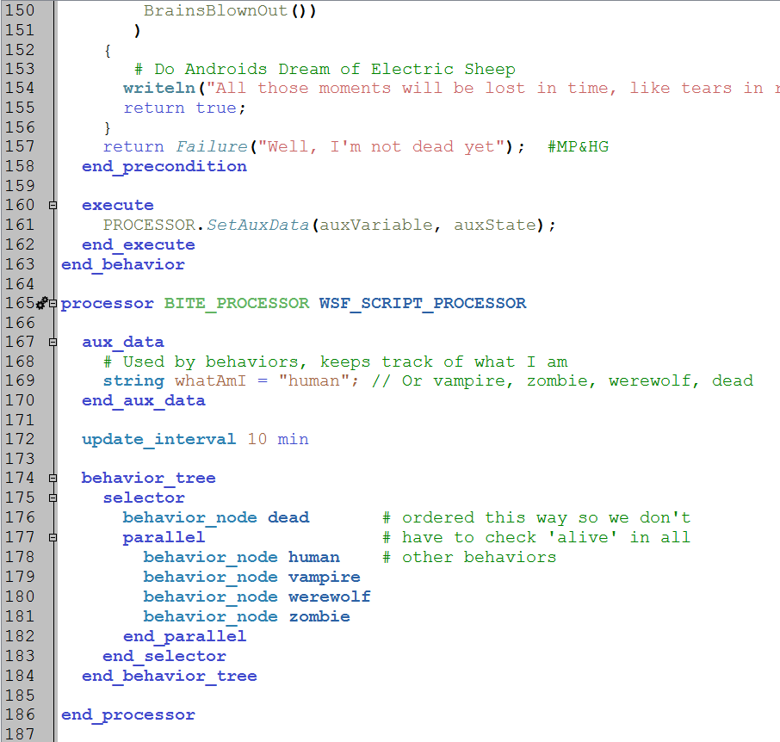
Bites Processor
Notes:
This is in the examples folder too. It does the same thing as the bites processor. However, because of this structure, it appears the answer here would be Piña Colada.

Slide 19
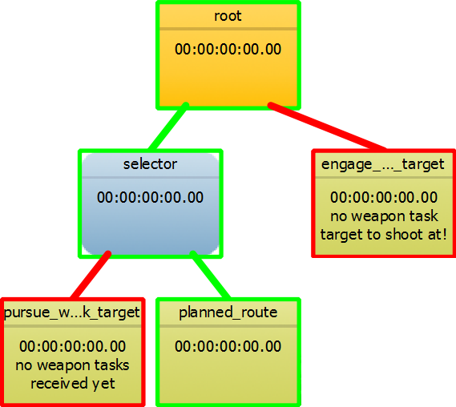
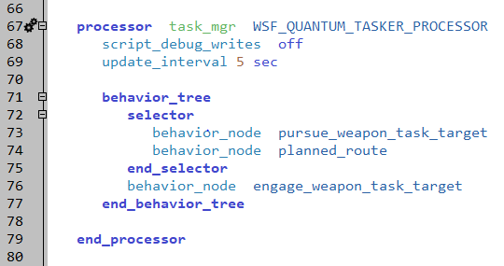
Simple Behavior Tree
Behavior Tree Example:
striker.txt
Notes:
This is the tree that we are going to use this module.
The selector drives the platform. The other node shoots at things.

Slide 20
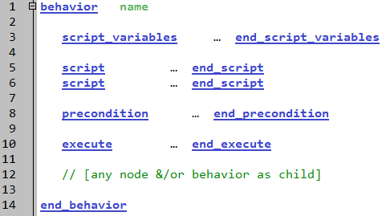
Behavior Template
Unique by name; a behavior can be
referenced from any tree by name
Support precondition and execute
Most important parts – Required!
Notes:
These are the components of a behavior node. The only required parts are the precondition and the execute blocks. The rest are “nice to haves”.

Slide 21
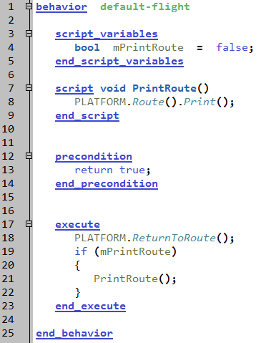
Behavior Example
Every behavior must have unique name
Behaviors can have local variables and scripts
Brief note on script context and extern:
simulation ← platform ← processor ← behavior
This one will always run, unless the tree prevents it
Behaviors SHOULD do something when they execute,
usually with the platform
Notes:
This is a very simple node.

Slide 22
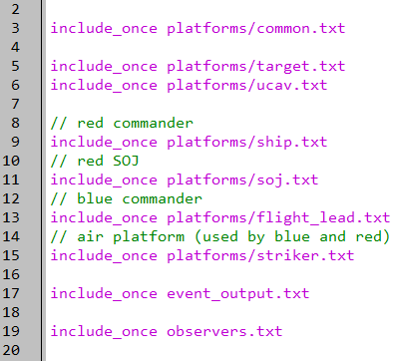
Flight Lead and Striker Platforms
setup.txt
Notes:
Two new platforms – a flight leader and a striker.

Slide 23
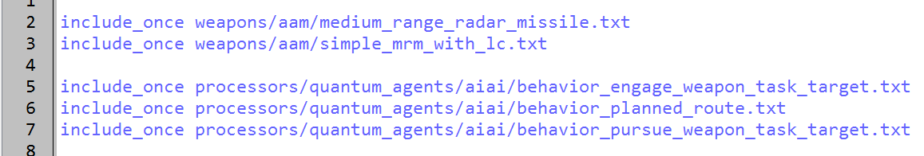
Additional Files
platforms/striker.txt
Notes:
The striker uses these files. In particular, it uses three behavior nodes.

Slide 24
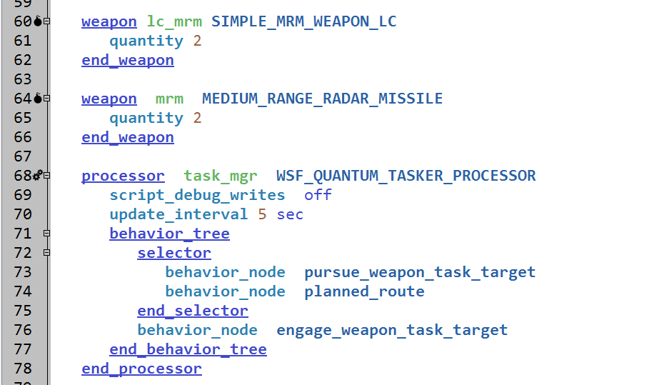
Weapons and Behavior
platforms/striker.txt
CRUCIAL!!!
Notes:
The striker has two weapons – we’ll talk about them later.
It also has a quantum tasker processor. This contains the behavior tree. It could just as easily been on a task processor, or even a script processor.

Slide 25
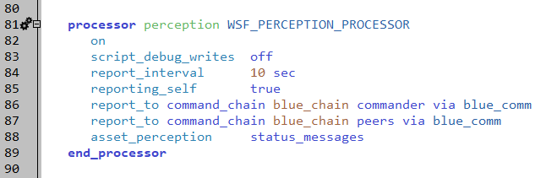
Perception Processor
platforms/striker.txt
CRUCIAL!!!
Notes:
Reports its status, including weapons, to its commander. The commander will use this information to make decisions.
“report_interval” should be specified if other “report” commands are used; the default is 0 (never reports)

Slide 26
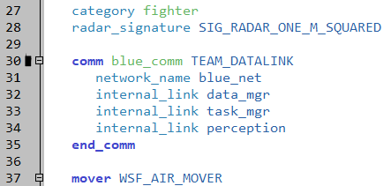
Link COMM Device to Behavior Tree
platforms/striker.txt
Notes:
The messages need to go to the quantum tasker.

Slide 27
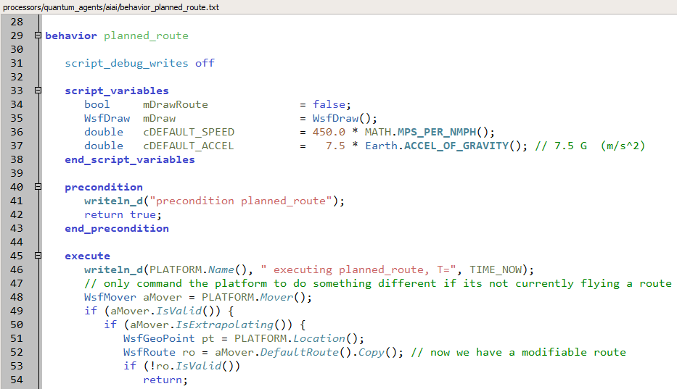
Behavior: Planned Route
processors/quantum_agents/aiai/behavior_planned_route.txt
Named for behavior
Notes:
This behavior always evaluates to true – make sure you put it in the right place!
The execute relies on the concept of “extrapolating”. The other behaviors can only change heading, altitude and speed. If a “go to location” command is used, the mover won’t extrapolate anymore.
Also, there aren’t any “else” items on the “if”s. so you don’t know why it doesn’t do anything.

Slide 28
Pursue Target Behavior Parameters
pursue-target behavior parameter examples
All parameters are related to choosing who to pursue and how to fly
debugging parameters
bool mDrawSteering = false;
target point
WsfTrackId mTargetId;
WsfGeoPoint mTargetPoint;
double mTargetSpeed;
flying parameters
double mMatchSpeedDistanceMin = 5 * 1852; # 5 miles
double mMatchSpeedDistanceMax = 30 * 1852; # 30 miles
double mWaitSpeed = 250 * MATH. MPS_PER_NMPH();
double mInterceptSpeed = 600.0 * MATH.MPS_PER_NMPH();
double mDefaultAccel = 7.5 * Earth.ACCEL_OF_GRAVITY();
etc.
off-limit variables (not for user editing)
WsfDraw mDraw;
double mLastTime;
Notes:
There are parameters that control how it approaches the target.
Note that some parameters are optional and commented-out by default.

Slide 29
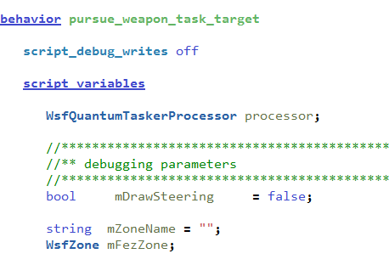
Behavior: Pursue Weapon Task Target
processors/quantum_agents/aiai/behavior_pursue_weapon_task_target.txt
Notes:
This drives towards the target.

Slide 30
Engage Target Behavior Parameters
engage-target behavior parameter examples
All parameters are related to choosing & limiting the shot of a weapon on a threat
platform / agent specific
bool mCoopEngageOne= false;
double mMaxFiringRollAngle = 10.0;
threat specific
ThreatTypeRequiredTrackQuality["bomber"] = 0.49;
ThreatTypeSalvo["sam"] = 2;
weapon + threat specific (complex types)
double DefaultPercentRangeMax = 0.80;
double DefaultPercentRangeMin = 1.20;
WeaponThreatRmaxMap["base_weapon"].Set("fighter", 0.80);
Notes:
There are parameters to control how it shoots.

Slide 31
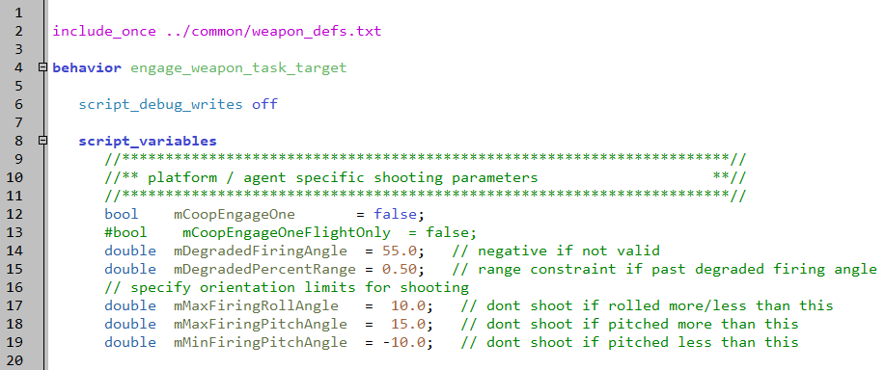
Behavior: Engage Weapon Task Target
processors/quantum_agents/aiai/behavior_engage_weapon_task_target.txt
Notes:
Open it up and look through it. There is a Fire command buried in there somewhere.

Slide 32
Review: Explicit Weapon
A weapon platform is created of “launched_platform_type”
It is given the target track in its current state
The weapon platform is added the simulation
It can update its own target track by:
Its own sensors (if it has any)
Receiving track messages from off-board supplier (uplink)
Or it can use a WSF_PERFECT_TRACKER
If a target track is not updated after the weapon is fired:
The weapon will continue to extrapolate the target forward in time based on the original track information
Notes:
Quick review of explicit weapons in AFSIM

Slide 33
Launch Computer
Ideal use case for launch decision:
Weapon already has a launch computer
WSF_AIR_TO_AIR_LAUNCH_COMPUTER
WSF_ATG_LAUNCH_COMPUTER
Etc…
A Launch Computer uses preprocessed launch tables / LARs
Tables generated by released weapon_tools.exe
Notes:
Launch computers will prevent a weapon from firing, even if you tell it to do so.

Slide 34
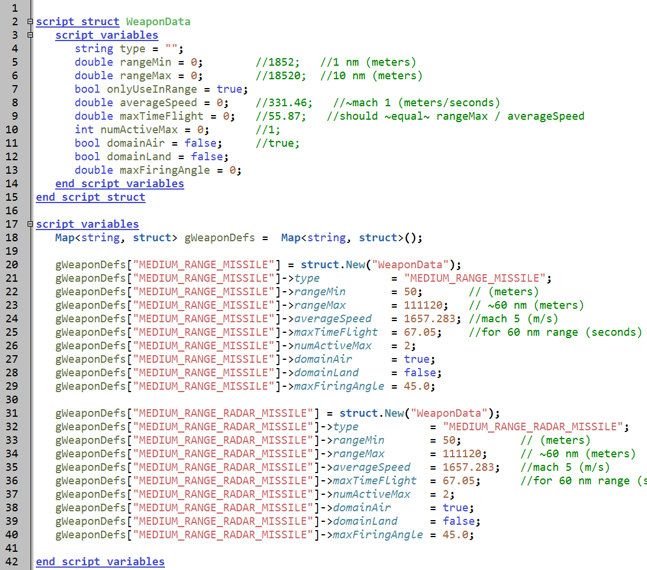
Weapon Data Struct
Create weaponData struct.
Will contain info about the weapon.
Map weapon name to weaponData struct.
Inform behavior scripts with this user defined data
Lower fidelity, but fast turn-around for users
Not required, but used in the AFSIM demos.
processors/quantum_agents/common/weapon_defs.txt
Notes:
This is another way to define weapon limits. It uses a “struct” to hold the data. The flight leader uses this data to make weapon assignments.
Warning – if you add a new weapon on a platform, but don’t put this data in here, then the flight leader will NEVER tell the aircraft to use that weapon!!!!!

Slide 35
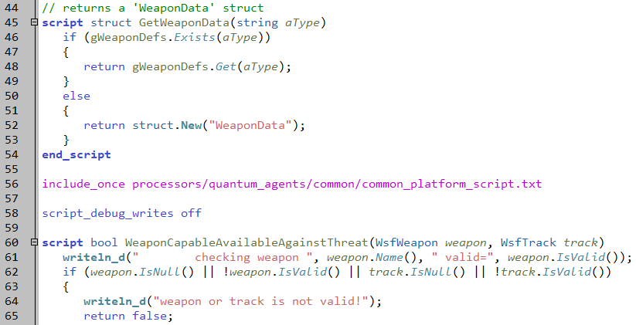
Also Contains Scripts
Notes:
There are also utility scripts in the file.

Slide 36
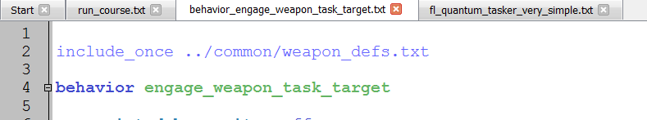
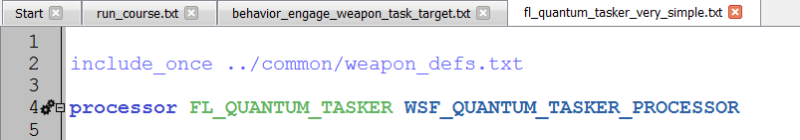
weapon_def.txt File Included Twice
The weapon_def.txt file is “included” twice:
Why?
The behavior and the processor both need the data and the scripts
The include_once causes it to only be referenced one time
Notes:
It is included twice – the behavior needs it to get data about employing the weapon. The flight leader needs it to make assignments.

Slide 37
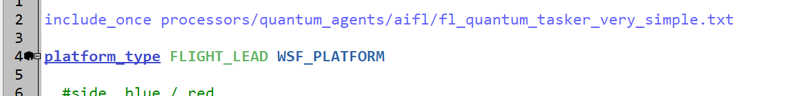
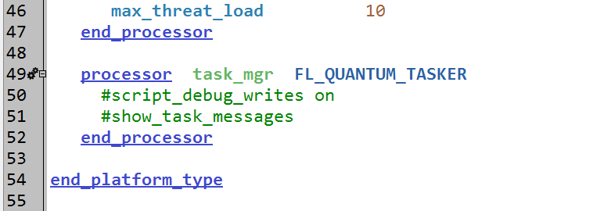
Processor on Flight Lead
platforms/flight_lead.txt
Notes:
The flight leader is new. It uses a quantum tasker.

Slide 38
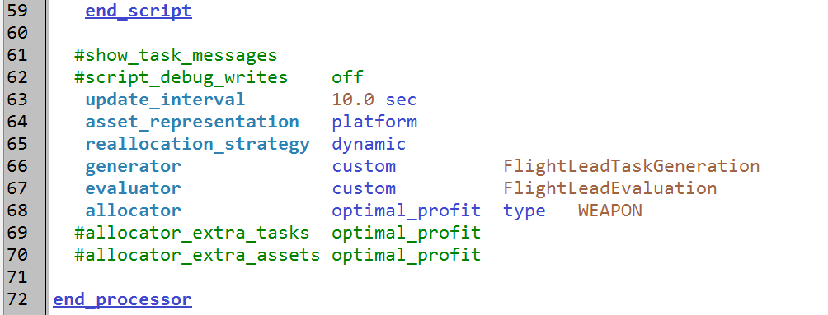
Flight Lead Quantum Tasker Processor
processors/quantum_agents/aifl/fl_quantum_tasker_very_simple.txt
Notes:
Just notice what is there → look at generator & evaluator

Slide 39
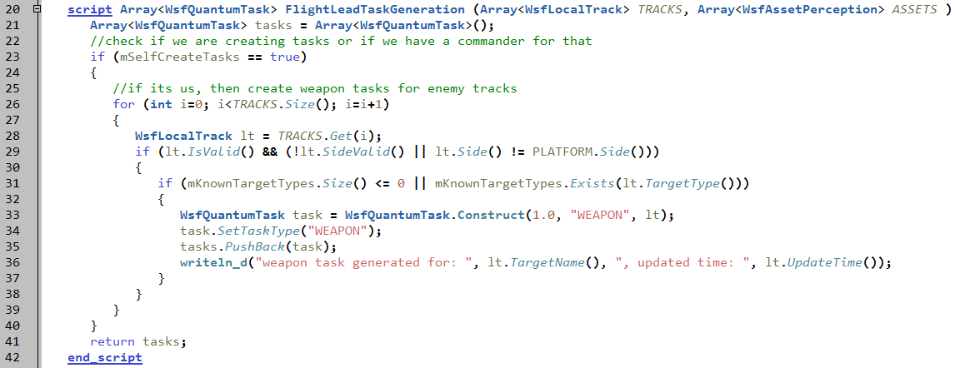
Flight Lead Task Generation
processors/quantum_agents/aifl/fl_quantum_tasker_very_simple.txt
 | Asset 1 | Asset 2 | Asset M
Task 1 | value | value | value
Task 2 | value | value | value
Task 3 | value | value | value
Task N | value | value | value
Notes:
This turns all of the tracks into WEAPON tasks.

Slide 40
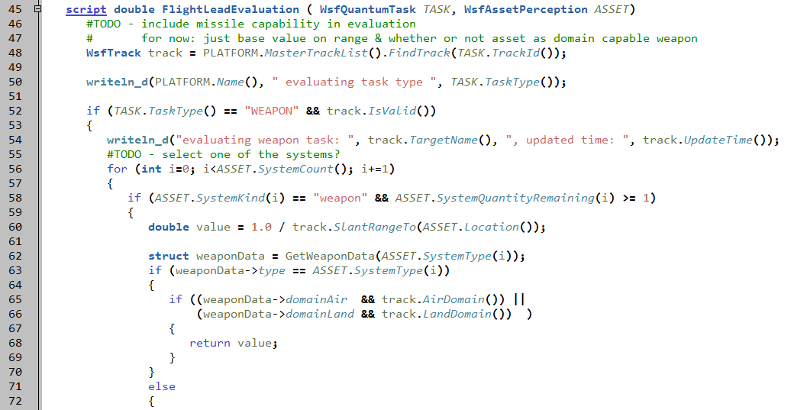
Confirm Weapon Capability
processors/quantum_agents/aifl/fl_quantum_tasker_very_simple.txt
checks if weapon is capable (WeaponData)
Notes:
This checks to see if the weapon is capable, using the weapon data struct.

Slide 41
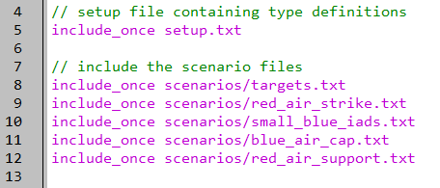
New Scenario File
run_course.txt
Notes:
These new platforms are in this new scenario file.

Slide 42
Execution
RUN IT!!!
Now we have shots
Notes:
The CAPs shoot at the SOJ’s and the UCAV’s

Slide 43
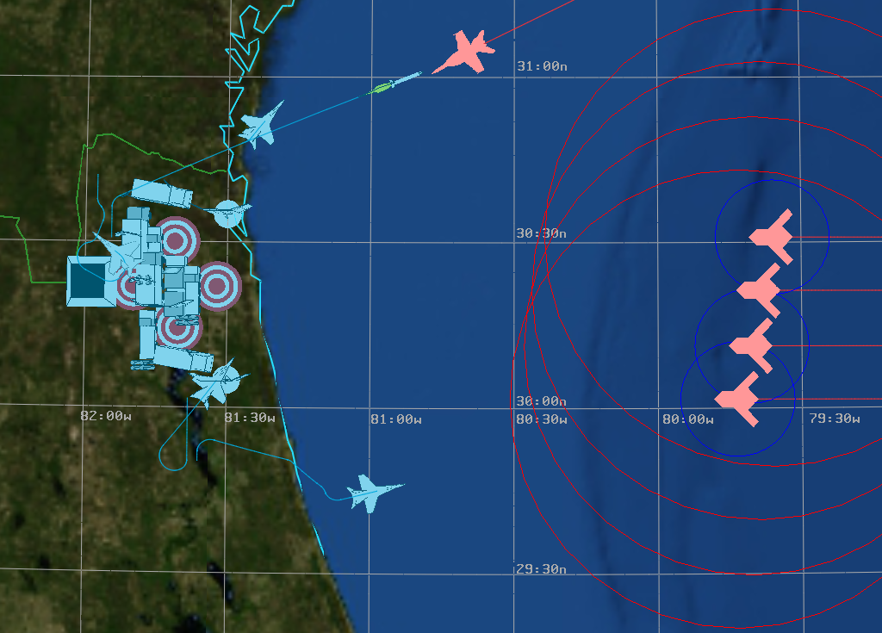
Shooting!
Notes:
It’s just ugly for Red.

Slide 44
Exercise
Create two new behavior nodes:
“fail” that always fails
“pass” that always passes
Put a writeln or comment in the precondition and execute blocks, to show what does / does not execute
Add additional nodes to the striker behavior tree
Use a sequence node, with a few pass & fail children, any order
Use a selector node, with a few pass & fail children, any order
Use a parallel node, with a few pass & fail children, any order
Nest one of these intermediates as the first child of another
Hints:
The top level node is an implicit parallel node

Slide 45
Learning Objectives
You will be able to:
Describe behavior trees in AFSIM
Build a behavior node
Modify a behavior tree
Notes:
This looks like a bunch, but it all goes together.

