Slide 1
AFSIM User Training
24 – Route Finder
AFRL/RQQD
Notes:
This version of the training has been tested with version 2.7

Slide 2
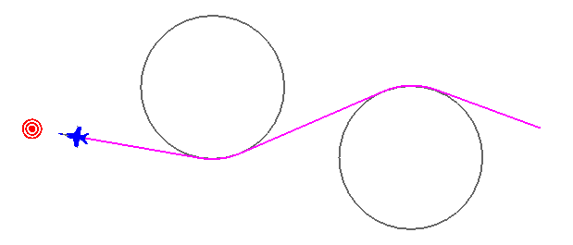
RouteFinder
Plan static routes
Use dynamically with moving targets/avoidances
Notes:
The route finder lets us build route around avoidances. We can do this against static items or dynamic ones.

Slide 3
Route Finder
Theory
Fast & Simple Route Finder
Application
Globally define an avoidance zone
Anybody that wants to can avoid it
Swap pursue behaviors on striker
Use behavior that utilizes the WsfRouteFinder
Notes:
It is fast and simple – relies on the shapes being circles. Actually, they are cylinders.

Slide 4
Application
The use case
Use anytime you want to avoid an area
Like a Surface to Air Missile (SAM) site
Or an enemy Combat Air Patrol (CAP)
Or an enemy territory
(abstract it with one large circle or overlapping circles)
Supports pathing around complicated combinations of avoidances
Under the hood
Light-weight quick calculations
Leverages the fact that all avoidances are circles
Generates graph between all avoidances, agent, & target location
Depth-First-Search algorithm used to choose best path from the graph
Notes:
You can do it for many applications.

Slide 5
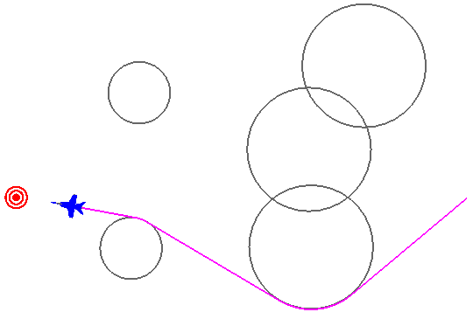
RouteFinder Script Object
WsfRouteFinder
Avoid static & dynamic (attached to platforms) regions
Simple interface
Can use once for dumb platforms (demo 1)
Ie: one time planning
Can use with agents & tasks (demo 2)
Dynamically, replan as desired
Documentation: WsfRouteFinder
Notes:
The script object is WsfRouteFinder.

Slide 6
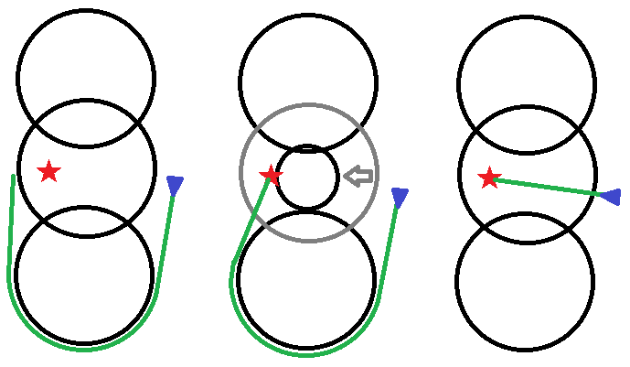
Impossible Route Response Options
SHIFT SHRINK IGNORE
Notes:
There are some impossible cases – the destination is inside of an avoidance zone.
In this case, there are three possible solutions. SHIFT is the default.

Slide 7
Special Cases
SHIFT stops after several attempts
Usually cannot find a solution
Notes:
The case on the left used to be a problem, but not any more. It used to create an infinite loop. Now it stops after a while.
The circle is bad – it doesn’t know which zone to shift / shrink / avoid.

Slide 8
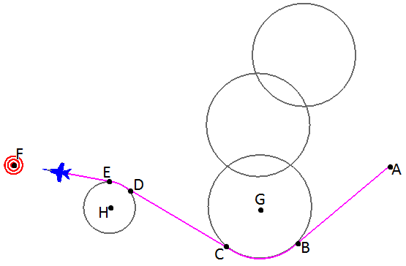
RouteFinder Produces a Mover Route
WsfRoute constructed with radial acceleration limit (for long turn)
WsfRoute RouteAvoidances() == { G, H, F }
Not a route to fly, just useful for the avoidance points
Final “avoidance” is target point (zero radius)
# of points = half of route size
WsfRoute Route() = { A, B, C, D, E, F }
Real AFSIM WsfRoute to fly
Route size is an even # of points
Notes:
The route finder produces a route. If the mover can do radial turns, then the route goes to the tangential points.

Slide 9
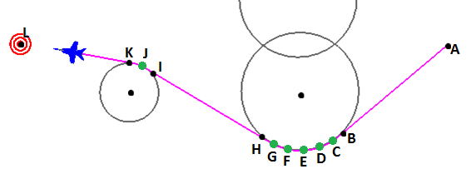
Arc Length Parameter
What if my mover isn’t good at radial accelerations?
User WsfRouteFinder.SetMaxArcLength( meters )
WsfRoute RouteAvoidances() == { harder to use now, so don’t }
WsfRoute Route() = { A, B, C, D, E, F, G, H, I, J, K, L }
Inserts waypoints along long turns at max arc length specified
Route size depends on long arcs now as well
Notes:
If the mover can’t do radial turns, then it does many short segments.

Slide 10
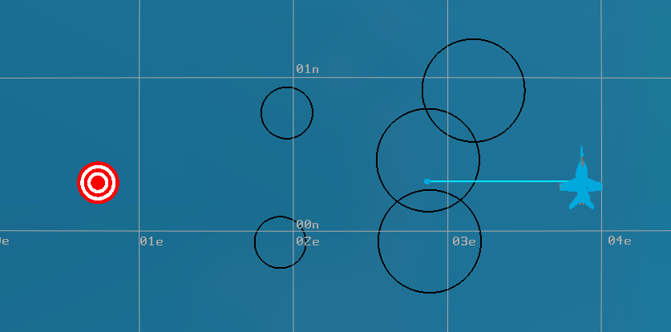
Route Finder Example #1 - Static
1
4
2
5
3
# corresponds to entry in code
Notes:
Example 1 – there are five avoidance zones, and a target. The platform does have a short route.
These numbers correspond to the numbers in the actual code.

Slide 11
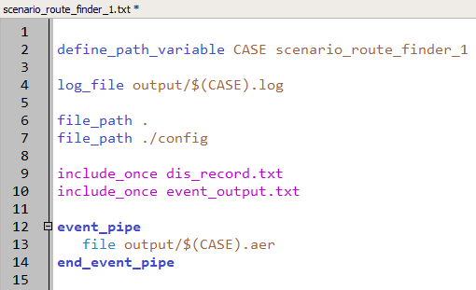
Route Finder Example
Notes:
This is what is looks like. Notice that everything is in one file.

Slide 12
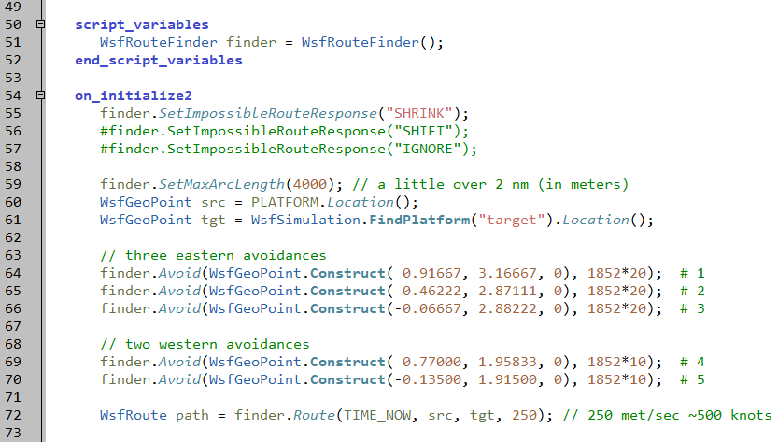
Defining Avoidances
scenario_route_finder_1.txt
Notes:
The avoidances are set at initialization. Then it creates a route, and flies it.

Slide 13
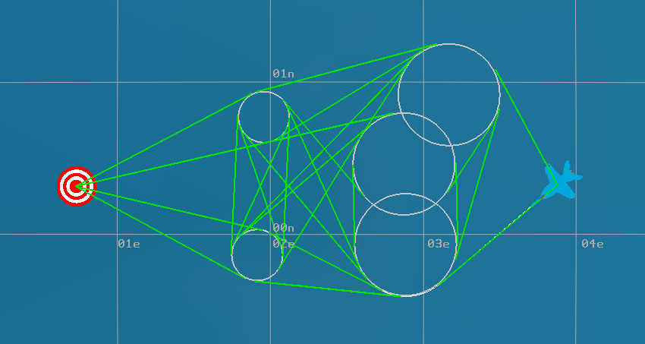
Possible Routes
Notes:
This shows the network of all of the possible routes around every zone. It then picks the shortest one.

Slide 14
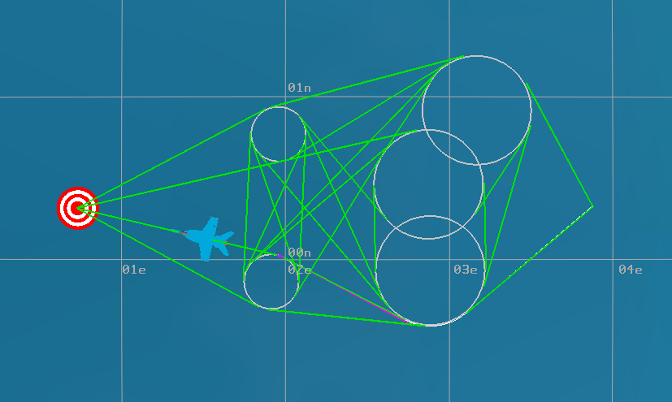
Selected Route
Notes:
As shown here.

Slide 15
Exercise route_finder_examples/scenario_route_finder_1.txt
Change the avoidance zones
Force aircraft to go north
Create “impossible” route, see how it resolves it
Try different resolutions
Notes:
The exercise.

Slide 16
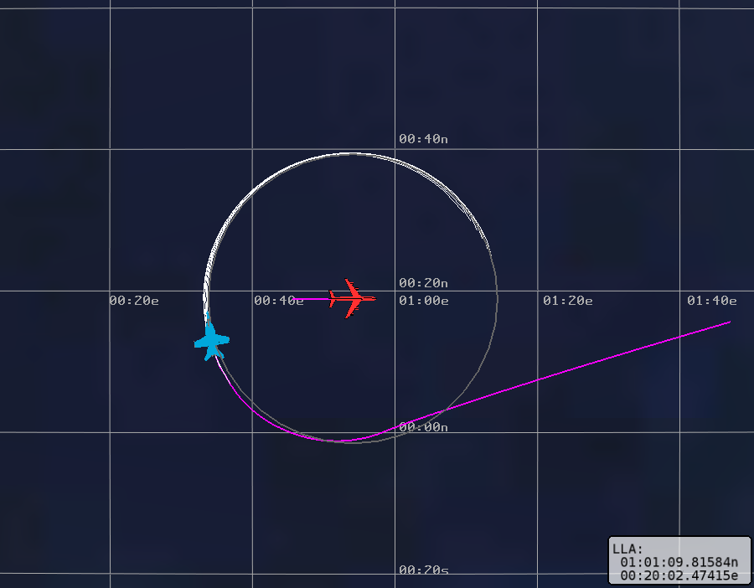
Route Finder Example #2 - Orbit
Notes:
The second example is a dynamic avoidance.

Slide 17
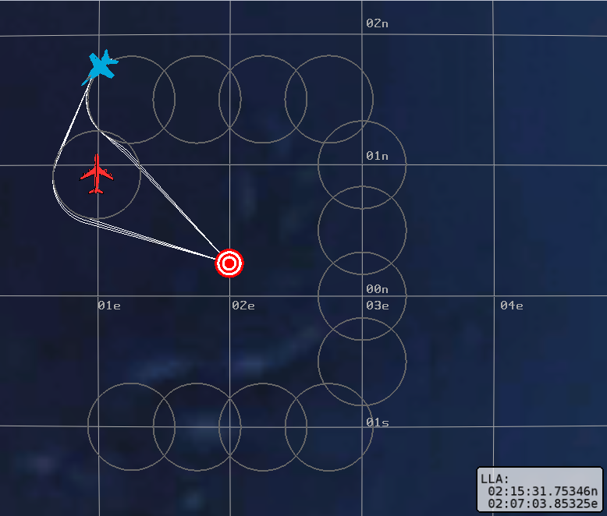
Route Finder Example #3 - Dodge

Slide 18
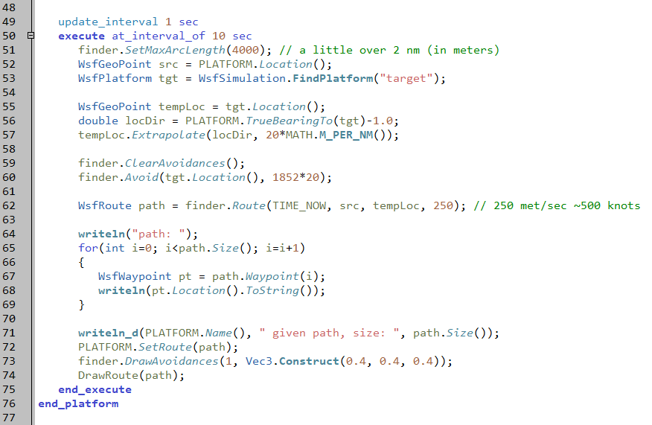
Updates Avoidance Route Dynamically
scenario_route_finder_orbit.txt
Notes:
This is the part that does it. It finds the current location of the target, extrapolates to a point opposite that (off by one degree), and then goes to that point.
Updating every second.
It needs to offset the point by a degree, or it ends up vacillating back and forth.

Slide 19
Scenario Application
Theory
Fast & Simple Route Finder
Application
Globally define an avoidance zone
Anybody that wants to can avoid it
Swap pursue behaviors on striker
Use behavior that utilizes the WsfRouteFinder
Notes:
So this is what we are going to do here. Swap out the current pursue behavior for a new one.

Slide 20
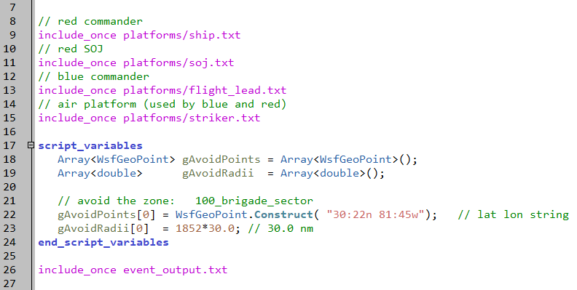
Global Avoidance Point Defined
setup.txt
Notes:
The avoidance point is global, at the SAM location.

Slide 21
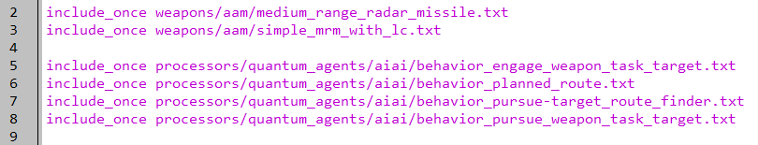
New Behavior for Striker
platforms/striker.txt
Notes:
New behavior.

Slide 22
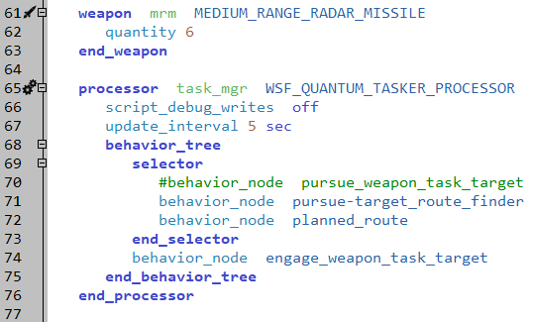
Behavior Replaced
platforms/striker.txt
NOTE: other missile removed
Notes:
Replaces the old pursue.
Some other changes happened too, but they don’t influence us….

Slide 23
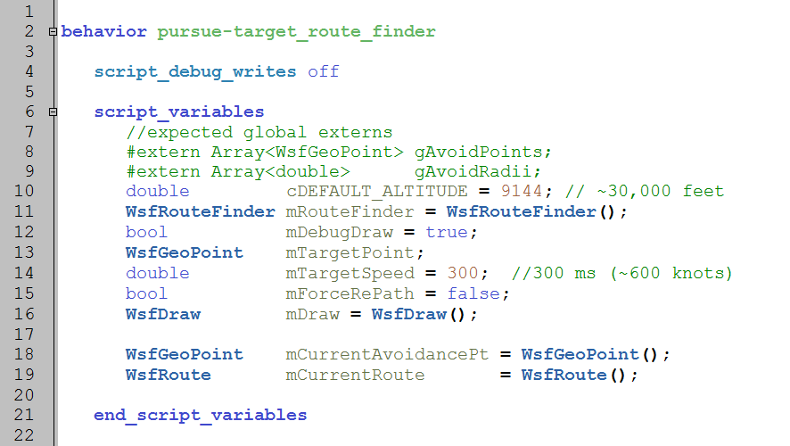
Behavior Details
processors/quantum_agents/aiai/behavior_pursue-target_route_finder.txt
Notes:
This behavior has some global variables.

Slide 24
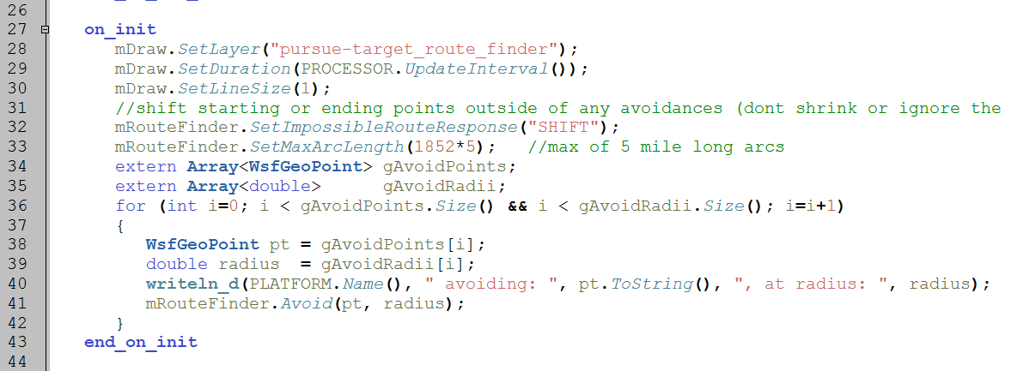
Define Avoidance Zone
processors/quantum_agents/aiai/behavior_pursue-target_route_finder.txt
Notes:
It creates the avoidance on initialization.

Slide 25
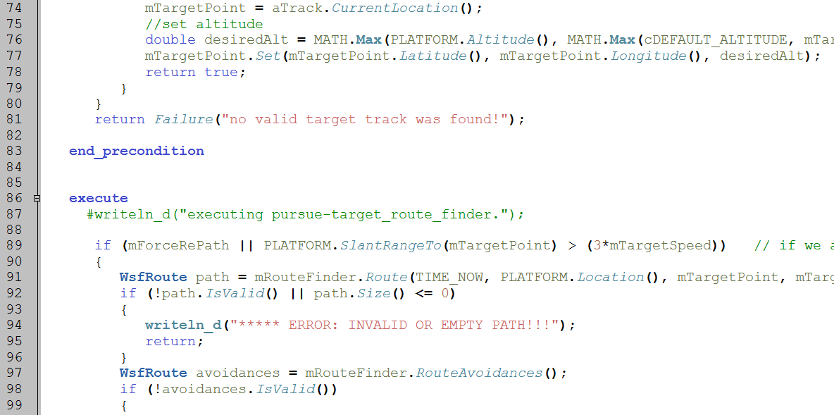
Create Route
processors/quantum_agents/aiai/behavior_pursue-target_route_finder.txt
Notes:
It sets the destination in the precondition.
The route is created in the execute.
Note: this behavior sets the maximum turn radius. This can cause problems, which we will see later.

Slide 26
Execute
RUN IT!!!
Now avoids SAM
Notes:
The CAP aircraft will leave the zone, and then try to stay out of it.

Slide 27
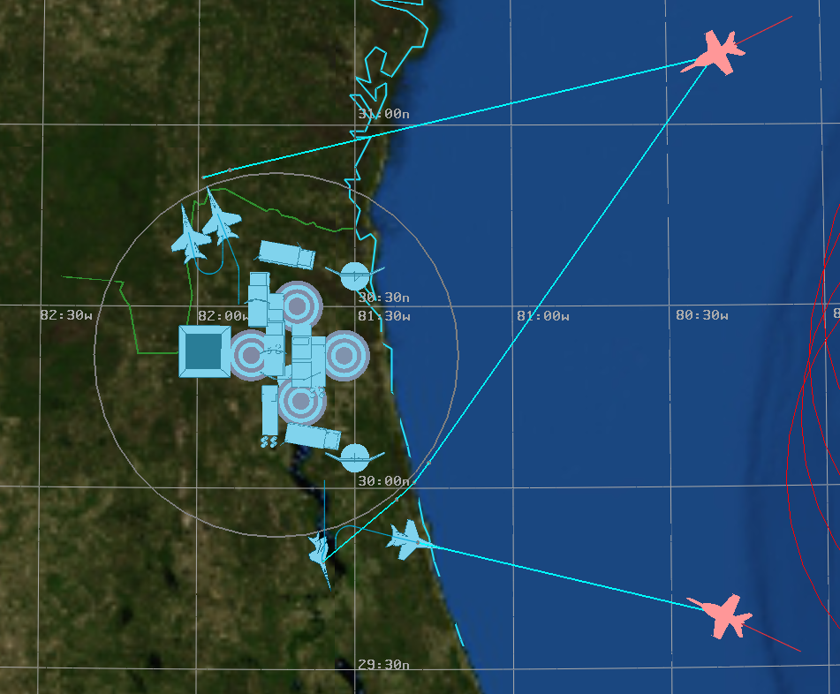
Avoidance Zone
Notes:
Notice that the aircraft immediately leave the zone, before doing anything else.
Also, notice that there are two aircraft going after the same target.

