Slide 1
AFSIM User Training
25 – Go Home and Escort Behaviors
AFRL/RQQD
Notes:
This version of the training has been tested with version 2.7

Slide 2
Fuel Object
WsfFuel
WSF_FUEL, WSF_TABULAR_RATE_FUEL, WSF_VARIABLE_RATE_FUEL
Existing Methods:
Mode, Refuel, QuantityRemaining, ConsumptionRate, XXXQuantity, TimeToXXX
Notes:
Open go-home behavior, show multiple reasons, and explain it could be an aggregate behavior
Explain script variables: Check fuel, check weapons,check escorts, mMainWeapon, mRouteName
Open Documentation for WsfFuel
Note Fuel Management methods
Mode, Refuel, QuantityRemaining, ConsumptionRate, XXXQuantity, TimeToXXX
Upcoming methods – QuantityRequired, specify altitude and speed
Scenario File has edits that modify the amount of fuel and weapons

Slide 3
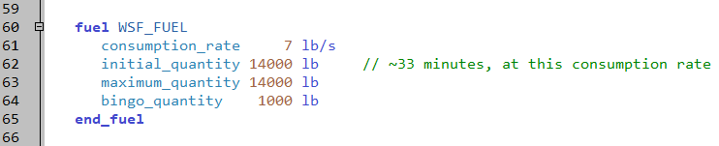
Added Fuel to Striker
platforms/striker.txt
Notes:
The go home behavior will activate on bingo fuel.

Slide 4
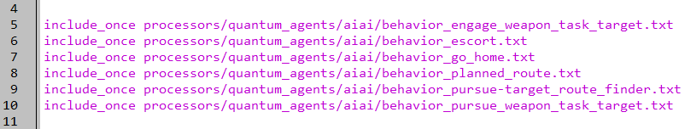
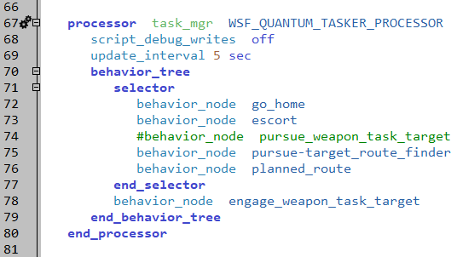
Escort Node in Behavior Tree
platforms/striker.txt

Slide 5
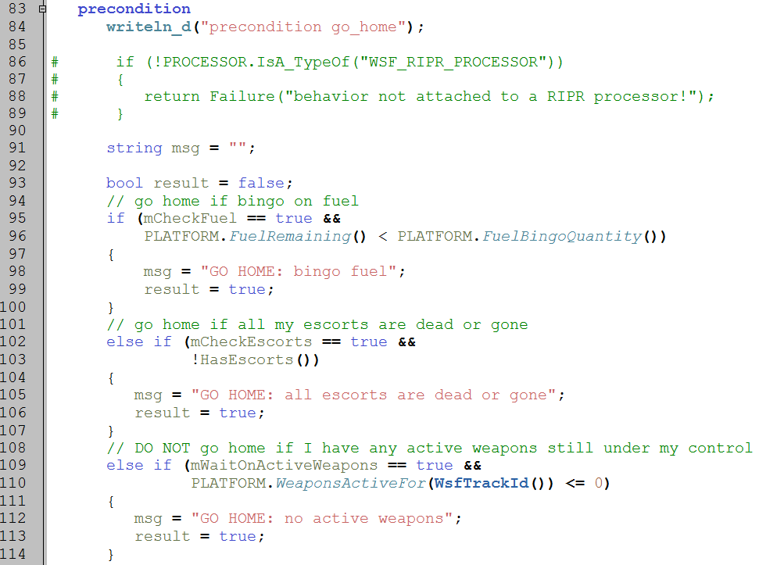
Behavior Precondition
processors/quantum_agents/aiai/behavior_go_home.txt
Notes:
The precondition works great. It checks various conditions, and decides that it is time to go home.
The first time the precondition runs, it also sets a “I’m here” point, to go back to.

Slide 6
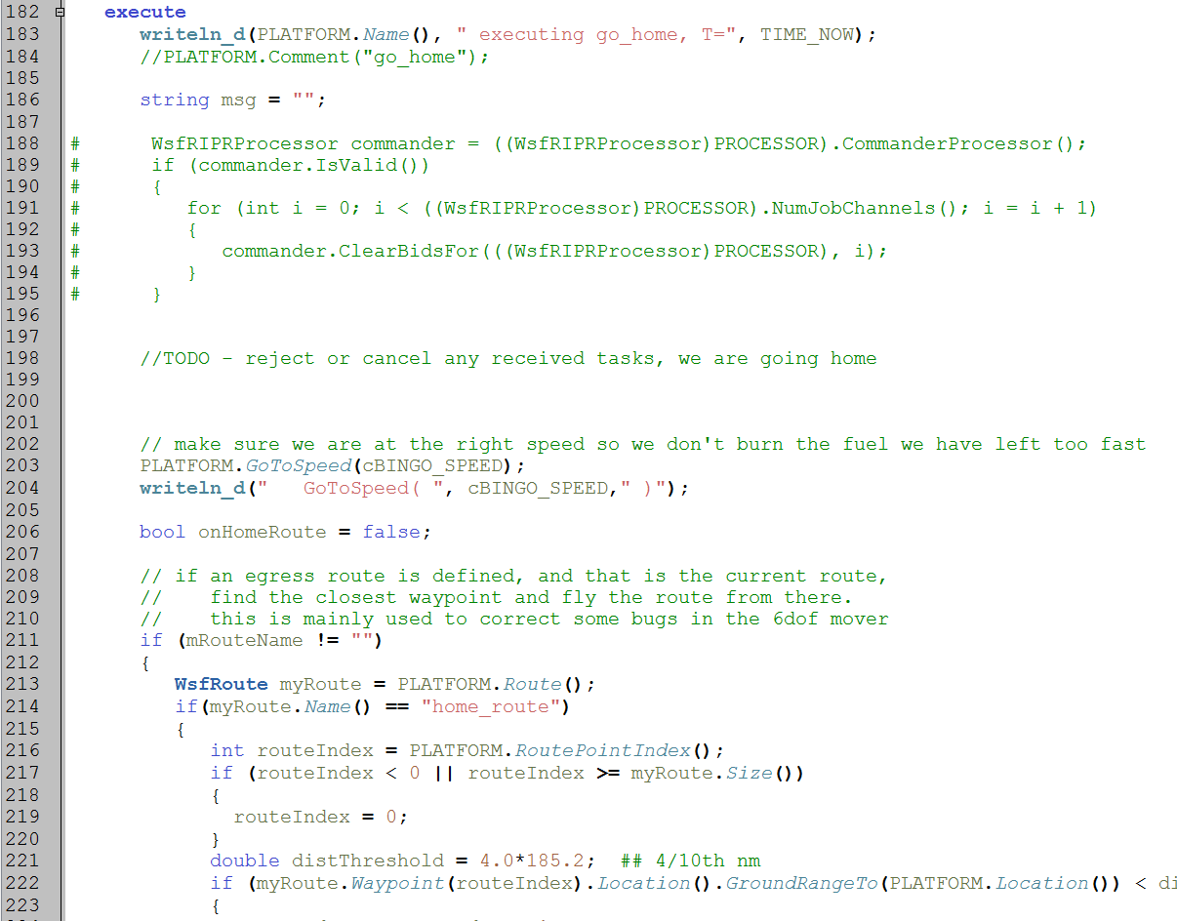
Behavior Execute
processors/quantum_agents/aiai/behavior_go_home.txt
Notes:
The execute has a small problem. It drives straight back. It then goes all “Spirograph” at the initial point.
Analytically it’s OK, but visually it can be distracting.

Slide 7
Package-Escort Behavior Operation
Executes if package specified
Flies formation offset
Ignores tasks that aren’t a threat
Could fail and break out of formation if either:
Escort has weapon task for a threatening track
Escort has a threatening track
Escort can chase threats out of protected region
Bottom Line: escort stops escorting when a threat is around
Notes:
This is how the escort behavior works. Basically, it will fly formation unless something happens.

Slide 8
Package-Escort Parameters
package-escort behavior parameter examples
All parameters are related to who to escort, protection ranges, & flying formation
debugging parameters
bool mDrawEscortData = false;
mode / control parameters
bool mCheckOnlyTasks = true;
bool mCheckMasterTracks = false;
escort parameters
Array<string> mEscortNames;
double mEscortProtectDistance = 100.0 * MATH.M_PER_NM();
flying parameters
double mFormationPositionX = 0; #meters in front of package
double mFormationPositionY = 0; #meters off right wing of package
off-limit variables (not for user editing)
WsfDraw mDraw;
bool mLastInPosition;
Notes:
These are the parameters for the behavior.

Slide 9
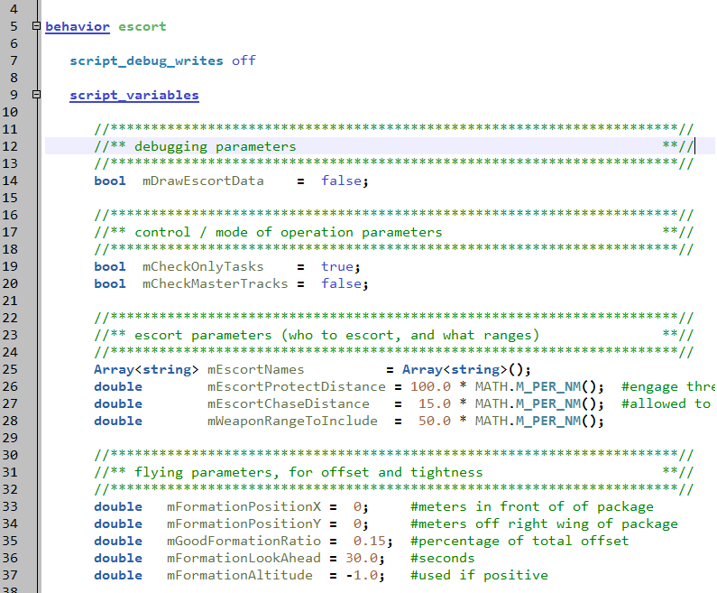
Behavior: Escort
processors/quantum_agents/aiai/behavior_escort.txt
Notes:
This is the behavior. It basically tries to fly to the specified point. There is a parameter that says how close it has to get to that point.
Also, it does a short “look ahead” when driving to the point.

Slide 10
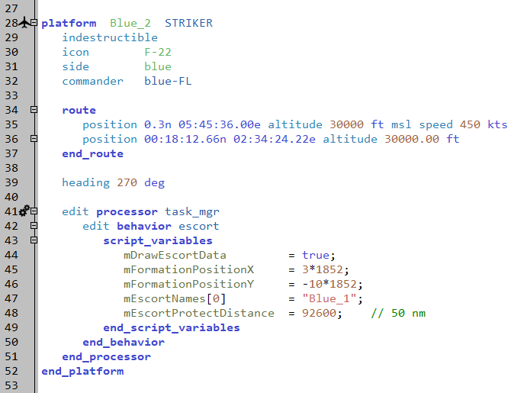
Defining Escort Parameters
scenario_escort.txt
Notes:
This is an example of how it works.

Slide 11
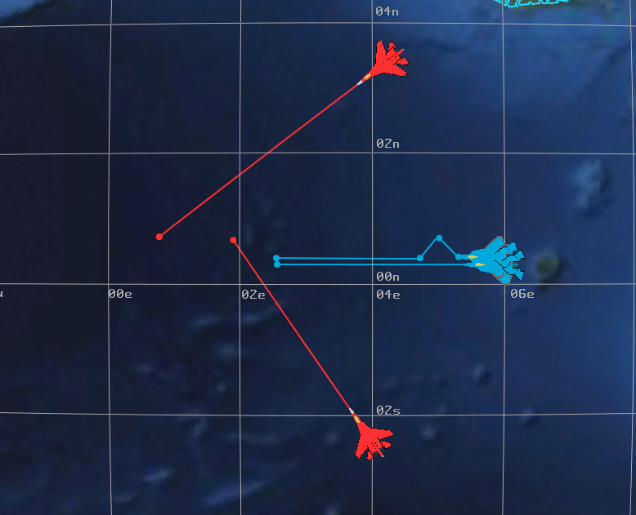
Package-Escort Example
Notes:
Notice what happens. Just as the escort gets into position, the package turns, and he has to catch up. You can see some of the effect of the look ahead in the second turn.
Then the red platforms get in the circle of trust, and things get exciting.
There is some issue with the circle and the second red aircraft – it looks like it’s in the circle for a while before breaking formation.

Slide 12
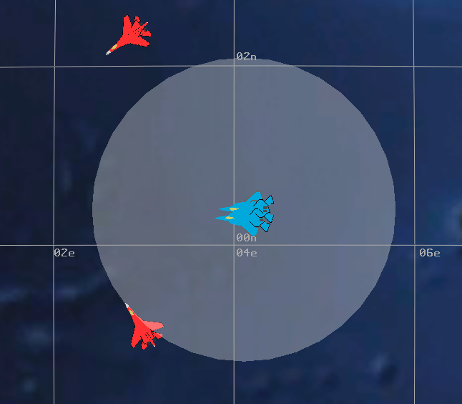
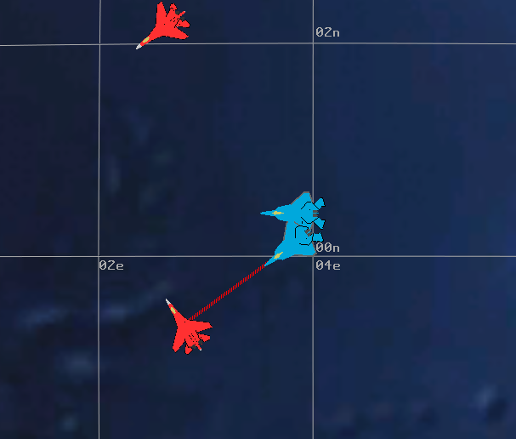
Escort Responds
Notes:
Execution of the model.

Slide 13
Exercise
Add two more blue platforms
One that escorts the current escort
Give it a smaller protect radius
Another that escorts the original care package
Give it a different formation offset
Hints:
Escorts will try to move into position – consider starting in different locations

Slide 14
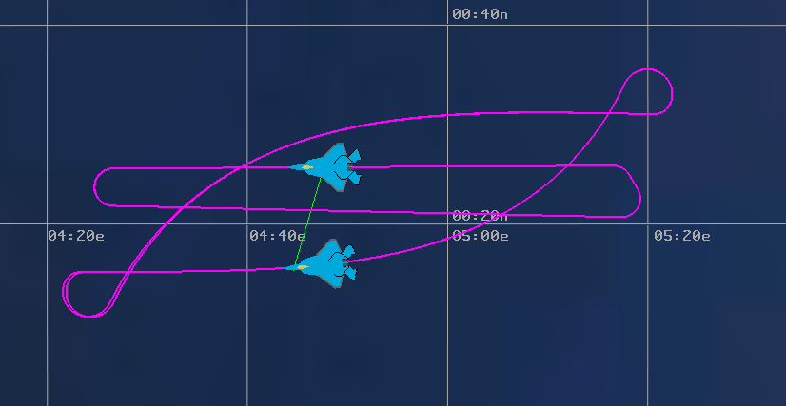
Escorting an Orbiting Package
Notes:
The package is flying an orbit. The escort makes this weird flight path, trying to keep up.
Analytically, this is not a problem. But it looks awful on the screen.

Slide 15
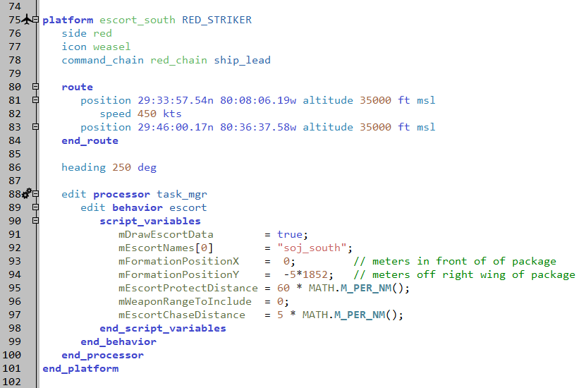
Specific Application
scenarios/red_air_support.txt
NOTE: added north AND south escorts!!!
Notes:
Added escorts to the SOJ’s. yes, there could be issues with them flying orbits. They’re not going to stay escorting that long.

Slide 16
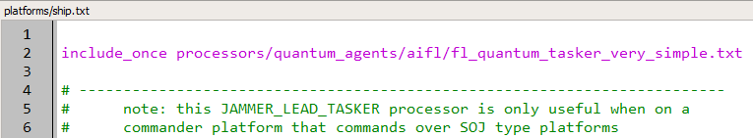
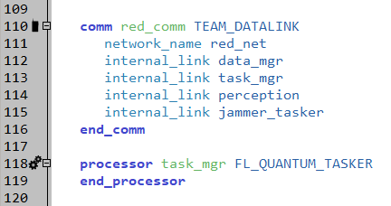
Red Controller
platforms/ship.txt
Notes:
The red ship needs a quantum tasker to enable it to produce weapon tasks for the escorts. It is the same one that is being used by the blue flight leads.

Slide 17
Execution
RUN IT!!!
Now Red SOJs have escorts
Notes:
The SOJ’s have escorts. There is now much carnage.

Slide 18
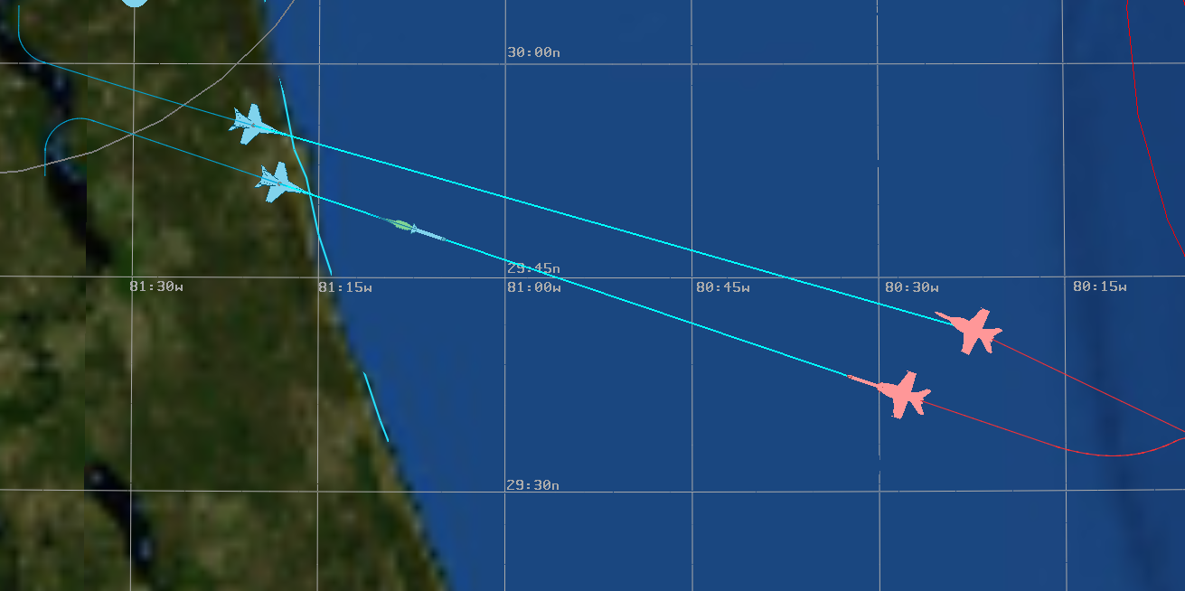
Red Escorts

