Slide 1
AFSIM User Training
26 – Threat Processor & Evade Behavior
AFRL/RQQD
Notes:
This version of the training has been tested with version 2.7

Slide 2
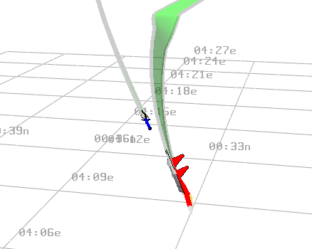
Evade Behavior
Notes:
Module 4 objectives
Add a WSF_THREAT_PROCESSOR to striker
(to detect incoming threats)
Add “evade” behavior node to tree
(to evade the threats)

Slide 3
Evade Concept
Theory
Evasion considerations
Cumulative vector math fleeing
Take wingmen into consideration
Never help threat lead you
Application
Add WSF_THREAT_PROCESSOR to striker
Add evade behavior to striker

Slide 4
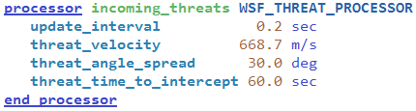

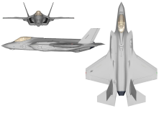
Threat Processor
Evade behavior queries the WSF_THREAT_PROCESSOR
Threats classified by:
30°
10s
20s
30s
Notes:
The threat processor takes information from the master track list, and determines which ones might be “threats”.

Slide 5
Summing Vectors
Closer threats weighted more
Option to weight allies
Sum of vectors gives direction
Overriding factor:
Never help the nearest threat lead you
Notes:
The concept behind the evade behavior – try to figure out where to go, based on the incoming threats.
Vector math is the approach, with closer threats weighted more. And it will go away from friendlies, if desired.

Slide 6
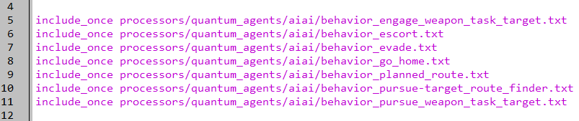
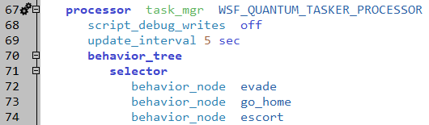
Evade Behavior Added
platforms/striker.txt
Notes:
Evading is more important than anything else you are doing!

Slide 7
Evade Parameters
evade behavior parameter examples
All parameters are related to determining threats & flying an evasive maneuver
debug parameters
bool mDrawNearestThreat = false;
bool mDrawEvasionVector = true;
control parameters
double weightPeersForEvade = 0.25;
bool mWobbleLeftRight = true;
bool mWobbleUpDown = true;
flying parameters
double mAltitudeMin = 1000.0;
double mAltitudeMax = 20000.0;
double mBankAngleForEvading = 45.0;
off-limit variables (not for user editing)
double mLastTime;
. . .
bool mDiveDownFlag;
bool mBankLeftFlag;
Notes:
Parameters in the behavior – define how to fly.

Slide 8
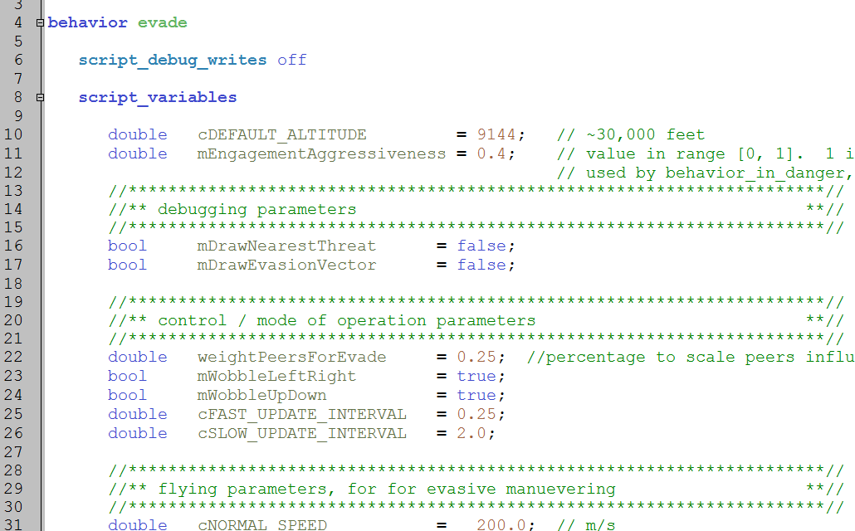
Evade Behavior
processors/quantum_agents/aiai/behavior_evade.txt
Notes:
Significant variable – mEngagementAggressiveness. This determines just how suicidal it will be. It is based on the arrival time of the threat and the impact time of own weapons.
Basically, if it is close to 1, you will let your weapons fly out. If it is close to zero, you will abandon your weapons.

Slide 9
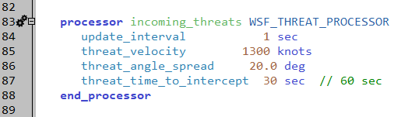
Threat Processor
platforms/striker.txt
Notes:
Here is the threat processor on the platform. Basically, Mach ~2.5, coming at you, and there in 60 seconds, is a threat.
Note that threat_angle_spread is the complete angle, 10 degrees circularly from the heading (cone).

Slide 10
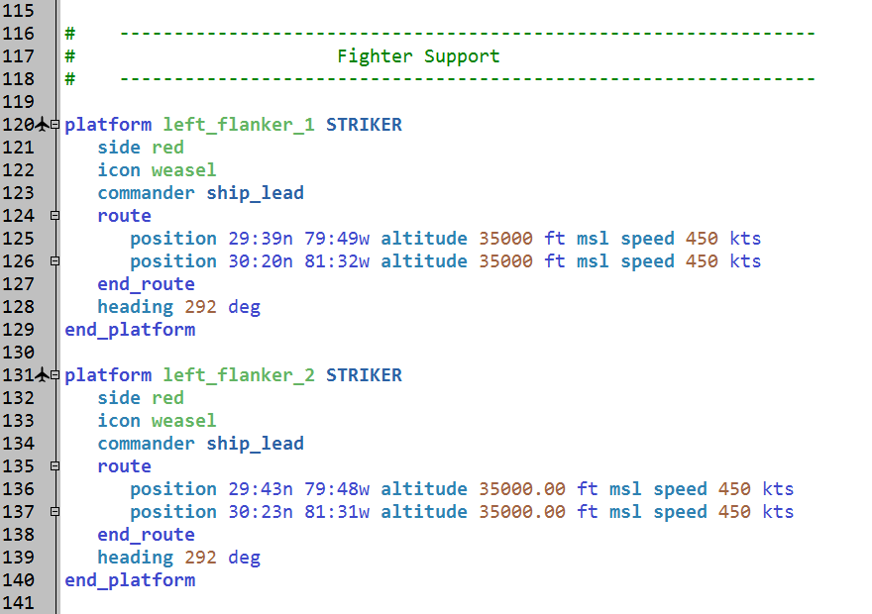
New Fighters
Scenarios/red_air_support.txt
NOTE: also moved other platforms
Notes:
Two new fighters, in the south, to show how this works.
Moved the other platforms one degree east, to let fighters get in there first.

Slide 11
Execution
RUN IT!!!
Now fighters evade
Notes:
However, it really doesn’t do them any good.

Slide 12
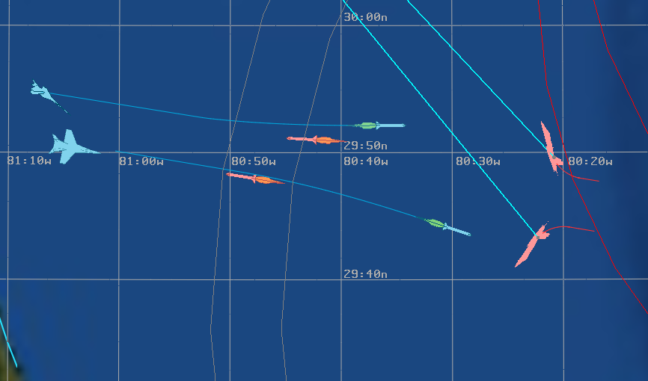
Red Evades Missile
Notes:
They do evade. But the weapons are fast and effective.

Slide 13
Exercise
Edit parameters to change the actions of the platforms
Change values in either the threat processor or the evade behavior
Should change for specific instances on platforms
Run the scenario to confirm changes
Specific things to try:
Cause the southern Red fighters to keep going, while the southern SOJ escort runs away
Change the relative aggressiveness between blue and red fighters.
Hints:
Isolate changes to specific instance of platforms

