Slide 1
AFSIM User Training
27- Clustering, C2, and Decomposing Tasks
AFRL/RQQD
Notes:
This version of the training has been tested with version 2.7

Slide 2
Clustering & Command/Control (C2)
Theory
Clustering
Hierarchy of agents
Application
Add Ground Control Intercept (GCI) agent
For cluster tasks
Use different flight lead quantum tasker
Interpret cluster tasks into target (weapon) tasks
Improves the commander
Notes:
The GCI will create cluster tasks, and send them to the flight leads. The flight leads will de-construct the cluster tasks into individual tasks.

Slide 3
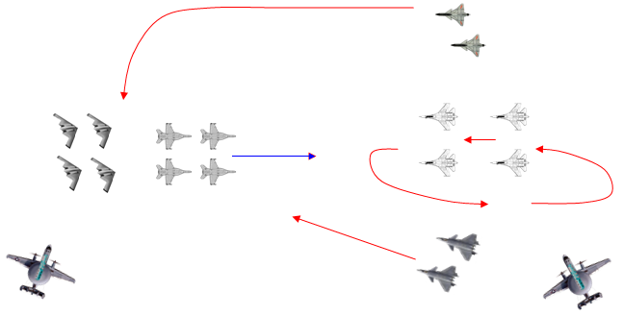
GCI Agent Purpose
GCI agent processes Situation Awareness (SA) to manage the battle
Want more information about a group of threats
Can reason and make decisions on subsets of a list
We do it automatically – visually (how many groups do you see?)
Notes:
The GCI (Ground Control Intercept) agent has the ability to look at all the threats, and make decisions after grouping them.

Slide 4
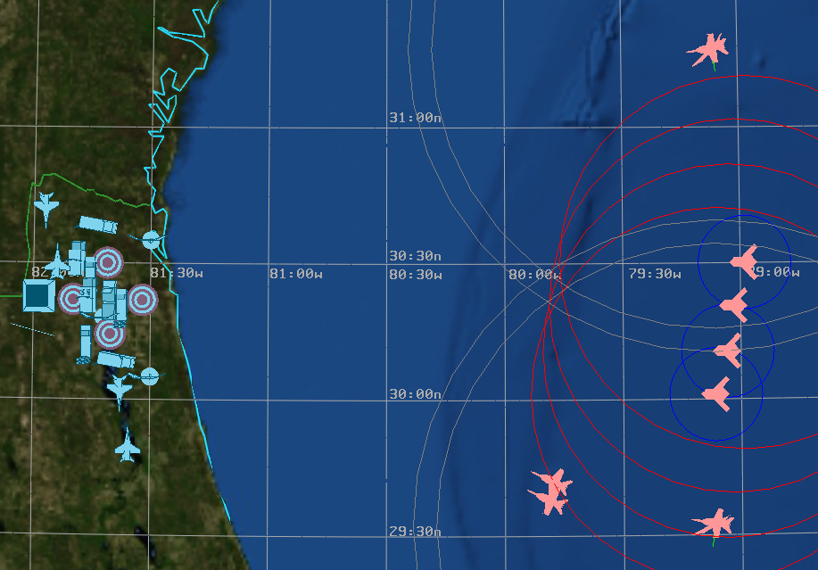
Grouping Platforms
We do it automatically – visually (how many groups do you see?)
Notes:
In our case here, there are 3 or 4 groups on the red side.
However, when we run this, we will see that the number of groups gets funny in a hurry.

Slide 5
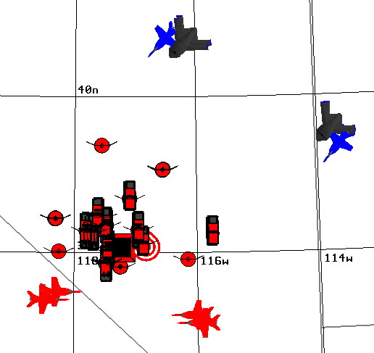
Clustering Example
Existing representation of threats
WsfTrackList : whatever sensors can see
MasterTrackList =
[ blue01,
blue02,
blue03,
blue04,
blue05,
blue06]
No particular order
Whole group data?
Notes:
What is the real problem – the MTL is just a set of tracks. In this case, there are six items in the MTL. How do we allocate our four fighters to them?

Slide 6
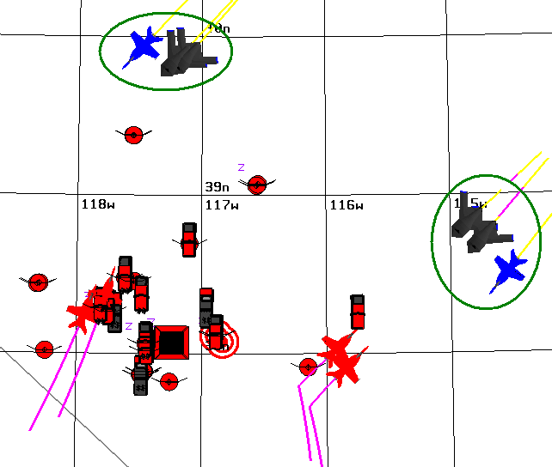
Clustered Threats
We’d like to see:
Groupings “make sense”
Useful for tasking
Cluster01=
[blue01,
blue03,
blue04]
Cluster02 =
[blue02,
blue05,
blue06]
Notes:
But if we group them, it would make sense to send them in pairs to each group.

Slide 7
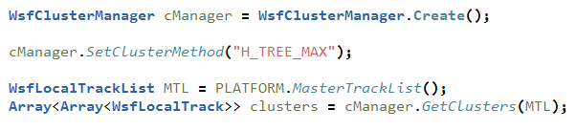
AFSIM Cluster Objects
Creating clusters is simple:
Control their creation:
Set cluster method, threshold value, cluster count, etc…
See documentation for WsfClusterManager
Use the cluster:
Access its members: WsfTrack Entry( index )
Access its aggregate attributes: location, convex hull, & bearing
Notes:
The cluster manager object allows us to make clusters. The clusters are sets of tracks. (future version will allow us to cluster anything with location.)
We can control how they are made.
And we can get the clusters.
With the cluster, we can access individual tracks.

Slide 8
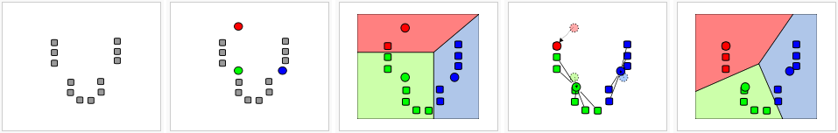
K-Means Clustering
Process for K-Means clustering method:
data set
create initial “means”
associate with nearest mean
centroid of each group becomes new mean
repeat last two steps until quiescence
Strengths
Easy to understand; simple iterative process; always terminates
Weaknesses
Have to provide a way to initialize the means (randomly?)
A set closest to a mean could be empty
Doesn’t necessarily find the optimal configuration
How many means should we use? What is “K”?
Notes:
K-means: you start with “K” points, and it iterates through finding the closest ones. It will eventually stop. It might not be the best solution, but it will be a solution. Also, some groups might be empty.

Slide 9
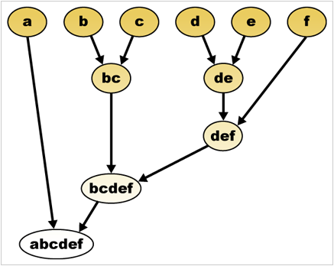
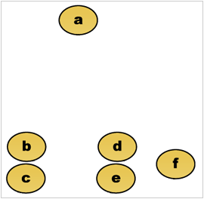
H-Tree Clustering
Agglomerative Process for H-Tree clustering method:
Clusters
Increasing Distance Threshold
Strengths
Easy to define a similarity threshold; similarities computed relatively
Optimal configuration more likely if you want “K” clusters
Weaknesses
Doesn’t scale as well: time complexity O(n^2)
Notes:
H-tree: group according to some criteria, keep going until everything is grouped. Good if you know how many clusters you want. And it will finish.

Slide 10
H-Tree Methods
Question: What clusters with ‘a’?
H_TREE_MAX
H_TREE_MIN
Looking at ‘a’, what other platforms fall within the distance threshold? Stop there!
Looking at ‘a’, what other platforms fall within the distance threshold? Repeat for those platforms as well!
Notes:
H-tree-min – at least one element must be within range.
H-tree-max – all elements must be within range.

Slide 11
H-Tree Methods
Threshold
1
2
3
4
5
6
7
8
9
H_TREE_MAX
1
2
3
4
5
6
7
8
9
H_TREE_MIN

Slide 12
Interactions
Clusters used in Agent Interaction:
Tracks are passed around, maybe the GCI has no local sensors
Asset Perceptions are passed around
The GCI agent creates & assigns cluster tasks
It uses the WsfClusterManager
When evaluating it uses it’s subordinate’s subordinate information
The FL agent(s) interpret cluster tasks into weapon tasks
One weapon task for each cluster member
It uses subordinate info to evaluate
The AI agent(s) is assigned a weapon task
GCI
cluster
FL
FL
weapon
AI
AI
AI
AI
Notes:
This is how it works – tracks are passed up to the GCI. The GCI groups them into clusters, and sends them down to flight leads. The flight leads break them apart, and then assigns them to the fighters.

Slide 13
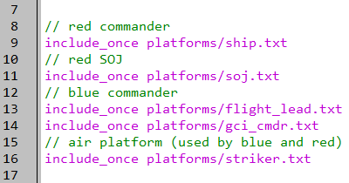
GCI Commander
setup.txt
Notes:
Adding a GCI commander.

Slide 14
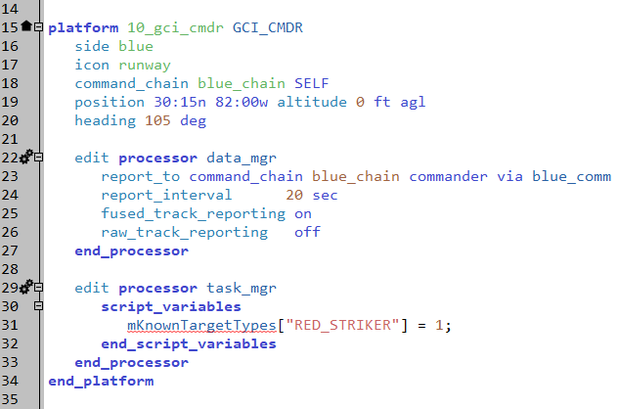
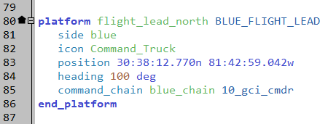
Instantiate GCI
scenarios/blue_air_cap.txt
Notes:
The GCI commander is added, and the flight lead commander is changed.

Slide 15
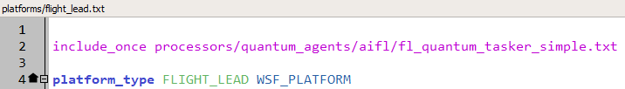
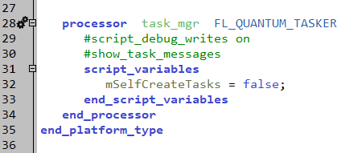
Modify Flight Leads
platforms/flight_lead.txt
Notes:
The flight leads have new quantum tasker.
It needs to reset this parameter so that it won’t create its own tasks.

Slide 16
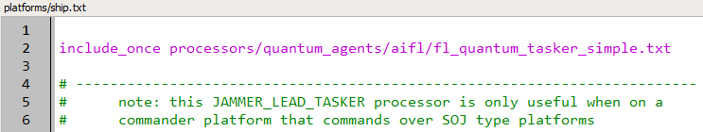
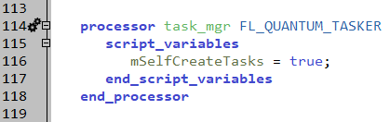
And the Ship
platforms/ship.txt
POP QUIZ: what is one way I can enhance the FL_QUANTUM_TASKER so that I don’t need to use a “mSelfCreateTasks” variable???
Notes:
And the ship has the same tasker – but it can still create its own tasks.
How could we fix the tasker so we don’t need to do this?

Slide 17
Execution
RUN IT!!!
Now Blue GCI is clustering threats
Notes:
Look at the clustering of Red.
Pay attention to the “clustering” of “dead” platforms. This is caused by the tracks still being in the GCI – it has a 60 second purge interval.

Slide 18
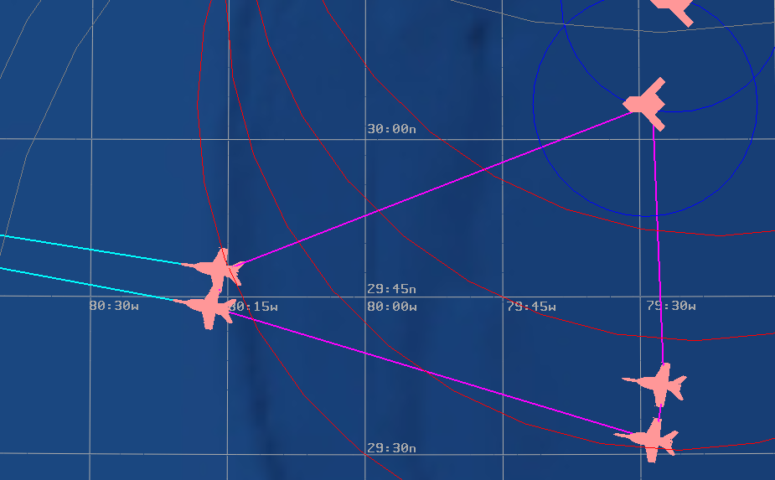
Boundaries “Around” Clusters
Notes:
It does show boundaries. If there is only one thing in the cluster, it draws a small circle.

Slide 19
Debugging Assignment Issues
Basics for debugging issues with squadrons of AIs, FLs, and GCIs:
Assert that the FLs and GCIs have tracks to work with
Use the “debug_quantum_tasker” behavior on commander’s behavior tree
Do assets exist? (columns) Do tasks exist? (rows) Are evaluations zero? (body)
Turn on script_debug_writes for agents that don’t make sense
Check event file or GRIT visual to see what behaviors the agents are doing
One flight lead wins all the targets, what now?
Is there only one cluster? Lower the clustering distance threshold on the GCI
Is he winning multiple cluster tasks?
Confirm that evaluation script produces positive values on tasks for other flight leads
Lower the cluster threshold so even more tasks are available
Notes:
These are some concepts for debugging what is going on.

Slide 20
Debugging Assignment Issues
One cluster of targets is ignored, what now?
Not enough subordinates? Two options:
Increase your clustering distance threshold on the GCI
Reorganize the flights for smaller squadrons of AIs
Some squadrons idle?
Try different job allocation mode on GCI
I don’t like that “track N” was clustered with “group X”
Try a different cluster method, distance function, &/or distance threshold
Notes:
And yet more.

Slide 21
Exercise
Modify the clustering parameters
Create these four clusters: south fighters, south SOJ and escort, north SOJ and escort, and UCAV’s
Create a single cluster
Cause the UCAV’s to be in two or more clusters.
Hints:
Look at the H-tree min and max options
Look at thresholds
Notes:
I’m not sure these will work.

