Slide 1
AFSIM User Training
28- Integrated Air and Ground Defenses
AFRL/RQQD
Notes:
This version of the training has been tested with version 2.7

Slide 2
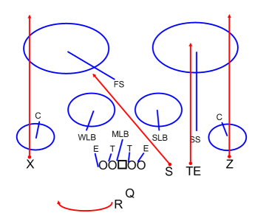
Integrated Air and Ground Defense
We’re a team! Let’s work together!
Notes:
The slide says it all

Slide 3
Ground-Based Air Defense
Uses WSF_TASK_PROCESSOR
iads cmdr
radar company
N * ew radar
sam battallion
acq radar
ttr radar
N * sam launcher
Notes:
This is what we had after the first part.

Slide 4
Airborne Air Defense
Uses WSF_QUANTUM_TASKER_PROCESSOR
gci cmdr
flight lead 1
cap 1
cap N
cap 1
flight lead N
cap N
Notes:
This is what we’ve added.

Slide 5
Combined Air Defense
SOC uses WSF_QUANTUM_TASKER_PROCESSOR
GCI
Flight Lead 1
CAP 1
CAP N
Flight Lead N
CAP 1
CAP N
IADS Cmdr
radar company
N * ew radar
sam battallion
acq radar
ttr radar
N * sam launcher
SOC
Class Activity
How should they coordinate?
Notes:
Putting it all together.
There are many options for how to allocate forces. 2 Samuel 11 has one suggestion – send the people you want to get rid of.
Random is another reasonable choice. If you use random, you probably want to use STATIC allocation. Also, it might be a good time to script your own allocator.
But, of course, we are going to use the traditional WEZ approach.

Slide 6
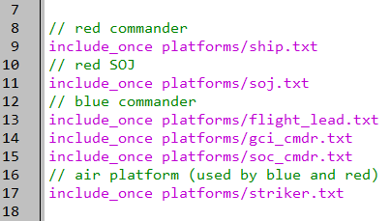
Sector Operations Command
setup.txt
Notes:
Include SOC_CMDR type

Slide 7
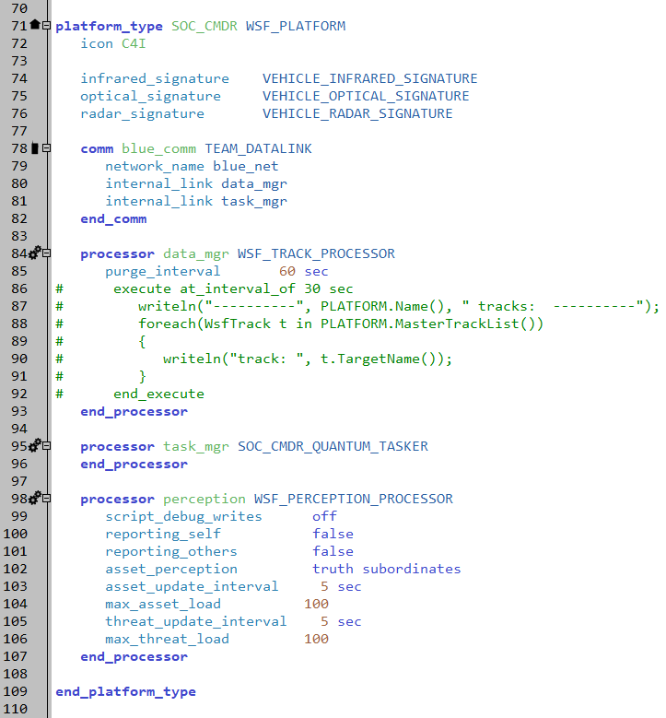
SOC Commander
platforms/soc_cmdr.txt
Notes:
This is the SOC commander. All of the important stuff is in the tasker.
Notice, however, the perception processor limits. This is a building with lots of people with grease pencils and glass walls.

Slide 8
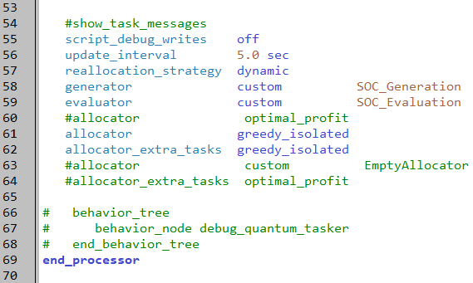
SOC Quantum Tasker
platforms/soc_cmdr.txt
The greedy allocator will only allocate the first two tasks
The extra task allocator will then allocate the remaining tasks
Because of the binary nature of the evaluator, every task will be allocated
Notes:
This tasker is really cool.

Slide 9
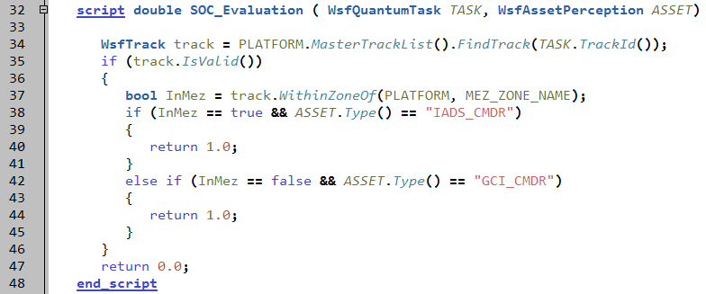
SOC Evaluator
platforms/soc_cmdr.txt
Notes:
There are only two assets – the IADS commander and the GCI. The evaluation is easy – each row gets a 1 and a 0. If the track is in the SAM range, then the IADS gets the 1 and the GCI gets the 0. If it is outside of the SAM range, then the GCI gets a 1 and the IADS gets a 0.
Beautifully simple.

Slide 10
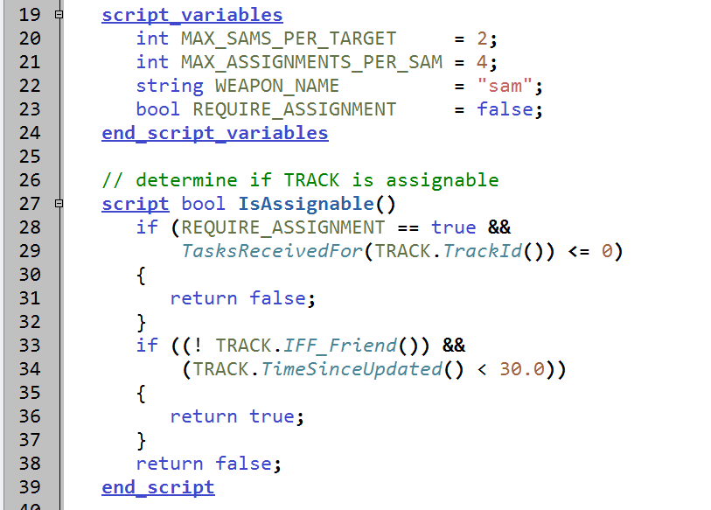
IADS Commander Requires Assignments
platforms/iads_cmdr.txt
Notes:
Modify IADS_CMDR type so it has option to listen for tasks instead of operate independently

Slide 11
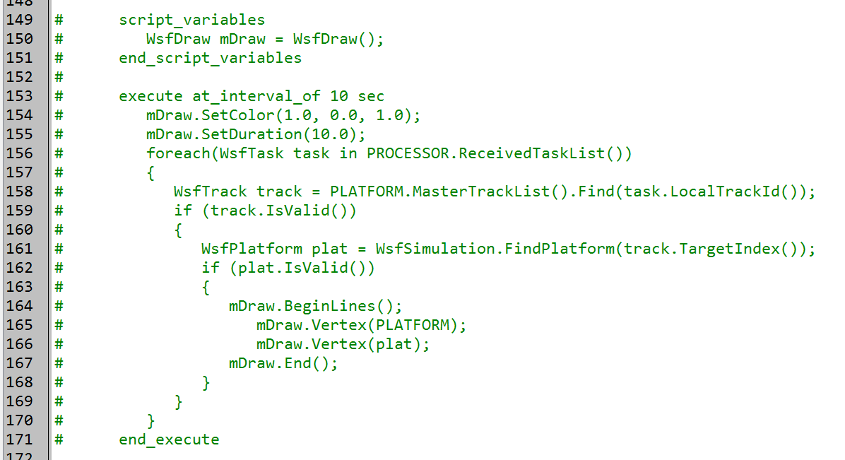
Utility Script
platforms/iads_cmdr.txt & platforms/gci_cmdr.txt
Draws lines to all assigned tasks
Notes:
Both the IADS and the GCI have utility script to draw lines to all assigned tasks
You can uncomment it if you like

Slide 12
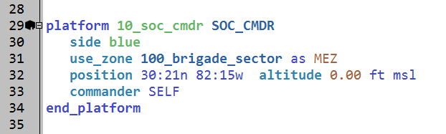
Instantiate the SOC Commander
scenarios/small_blue_iads.txt
Notes:
Add SOC_CMDR platform to scenario,
modify IADS_CMDR to be subordinate to SOC, to listen for tasks, and to perform track reporting

Slide 13
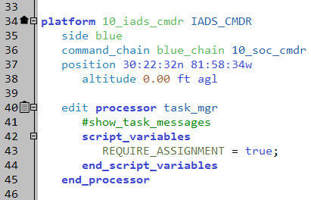
Modify IADS Commander
scenarios/small_blue_iads.txt
Notes:
Add SOC_CMDR platform to scenario,
modify IADS_CMDR to be subordinate to SOC, to listen for tasks, and to perform track reporting

Slide 14
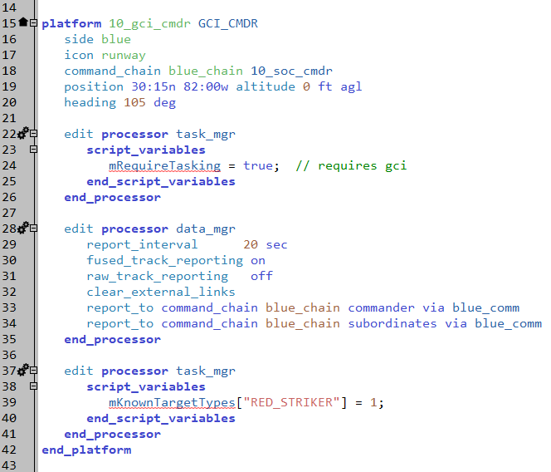
Modify GCI Commander
scenarios/blue_air_cap.txt
Notes:
Modify GCI to be subordinate to SOC, to listen for tasks, and to perform track reporting

Slide 15
Integrated Air and Ground Defenses
RUN IT NOW!!!

Slide 16
Exercise
Current scenario does not actually show that this works ☹
Change the scenario to demonstrate that it does
Hint: There are many ways to do this

Slide 17
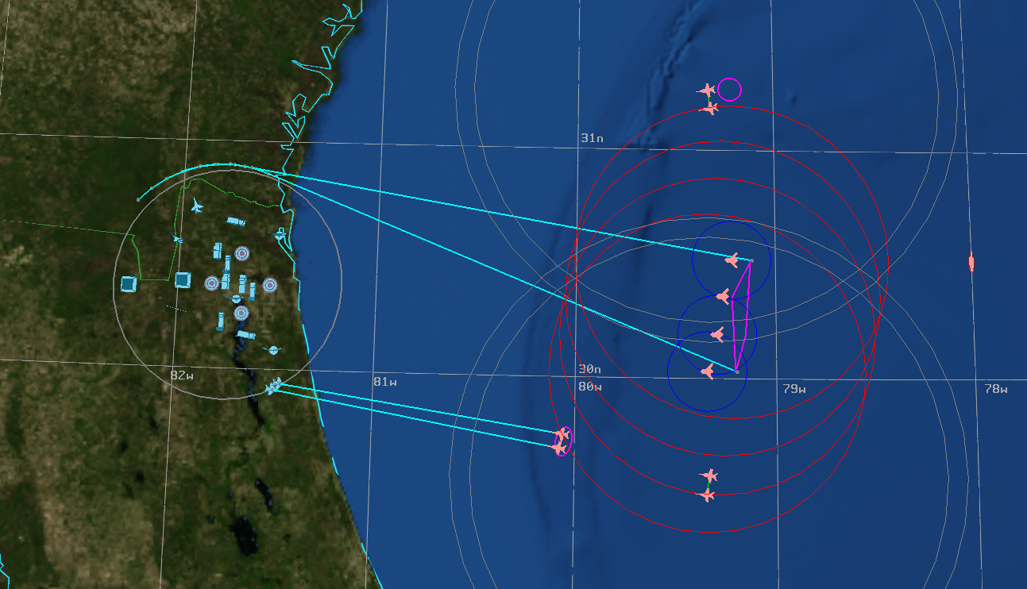
Finished!
Training Questions:
Afrl.rq.afsim-training@infoscitex.com
Any (easy) questions?
Contact AFSIM group:
afrl.rq.afsim-help@us.af.mil
Evaluations

