Slide 1
AFSIM User Training
4 –Movers and Routes
AFRL/RQQD
Notes:
This version of the training has been tested with version 2.8
This Lesson should take around 1 hour

Slide 2
Learning Objectives
You will
Learn about the different movers in AFSIM
Add and edit movers on platform_types and platforms
Add routes to different platforms
Command platforms to move in a desired way using ‘Platform Movement’ in Warlock

Slide 3
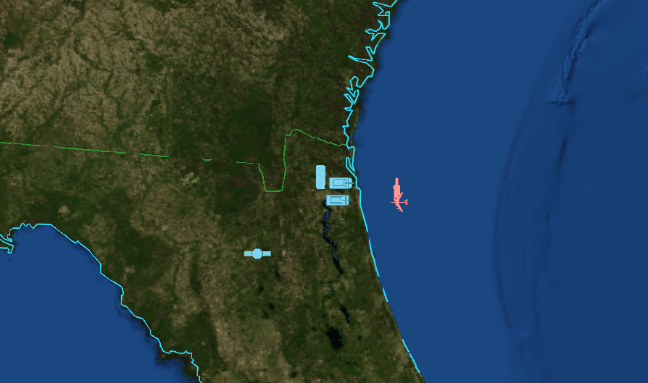
Current scenario
6 different platforms:
1 on water
1 in the air
3 on land
1 in space
Nothing moves or interacts with each other
We need to add components onto our platforms (like movers) in order for them to perform operations.

Slide 4
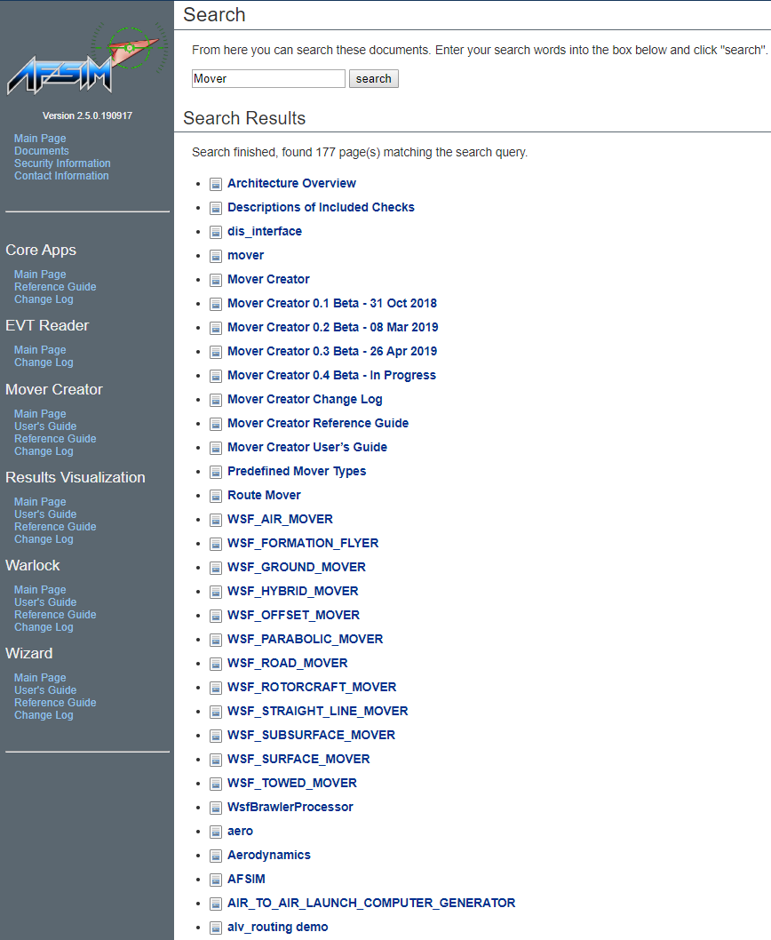
When in doubt, search the Documentation

Slide 5
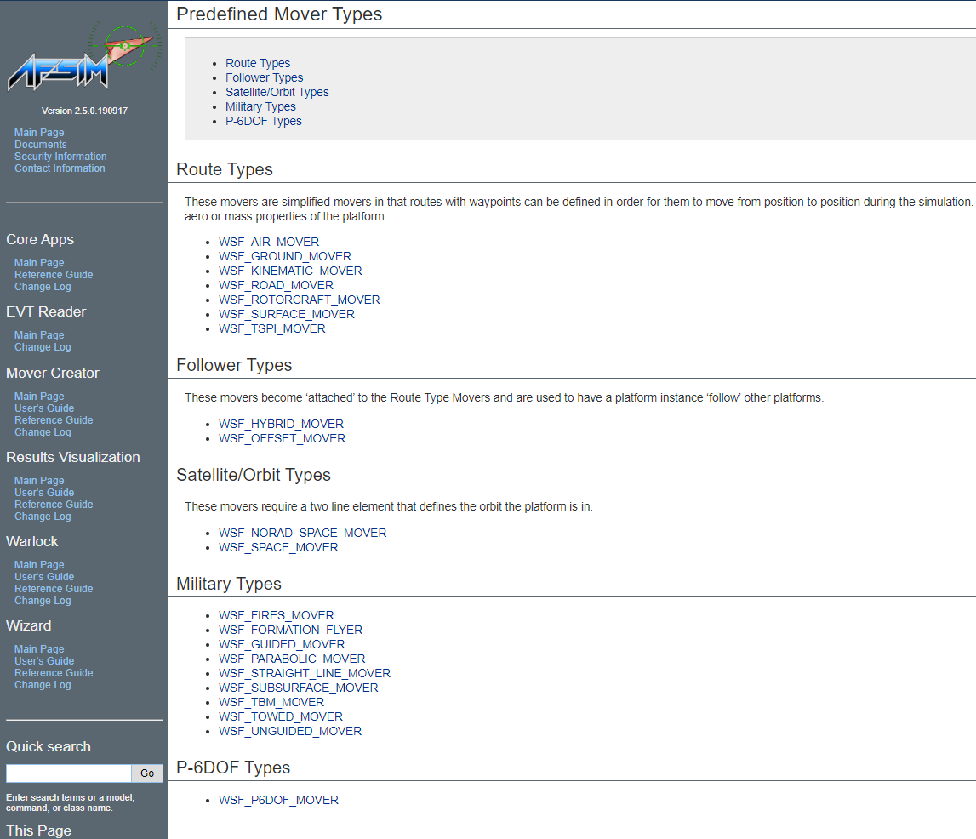
Predefined Mover Types
We want to pick a mover that matches the type of platform we are putting it on. Some movers are more sophisticated than others

Slide 6
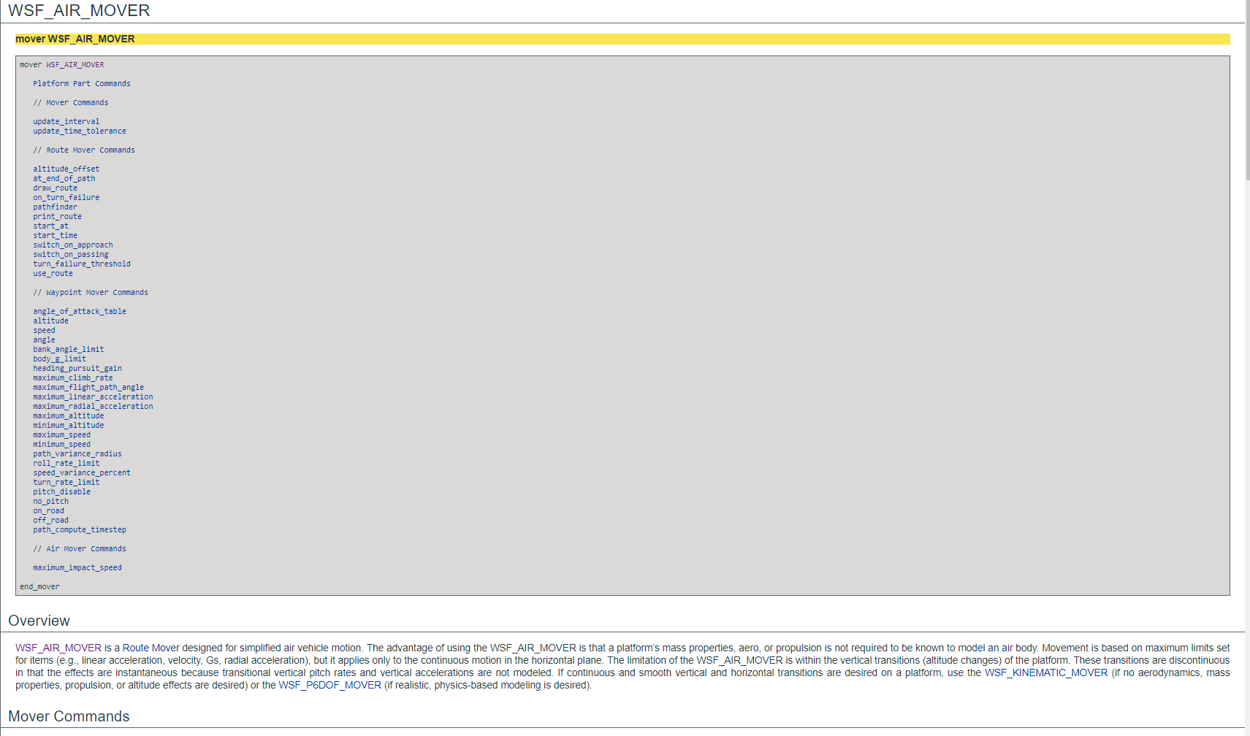
WSF_AIR_MOVER
Each mover has documentation giving an overview with what commands can be given to it

Slide 7
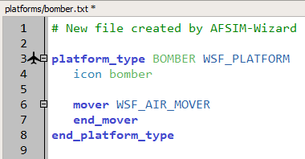
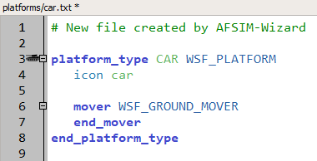
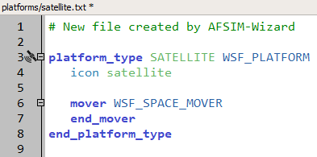
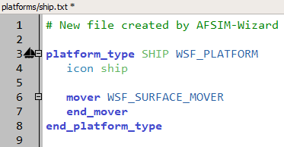
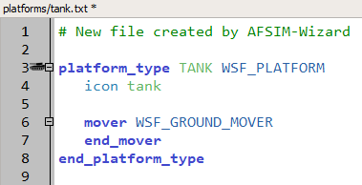
Add movers onto platform types
Add a WSF_AIR_MOVER onto the bomber type
Add WSF_GROUND_MOVER to the tank and car types
If you create a road network, you can use a WSF_ROAD_MOVER for the car.
Add a WSF_SURFACE_MOVER to the ship type
Add a WSF_SPACE_MOVER to the satellite type
Notes:
Helpful Hint: ctrl + space allows you to select from autocomplete options, and when you autocomplete ‘mover, end_mover’ WIZARD populates all the available mover options to choose from.
Notice that when we add specific movers to the platform types, Wizard gives each platform type a corresponding icon to the side.

Slide 8
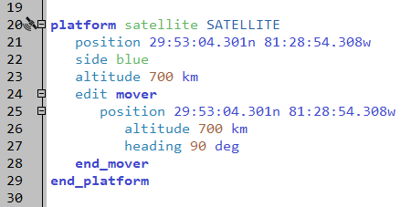
Editing a Platform Part
Air, Ground, and Surface movers are route movers.
WSF_SPACE_MOVER requires more inputs.
Edit mover on the satellite platform
Put position, altitude, and heading
inside edit mover block
Run!!!
scenarios/blue_laydown.txt
Notes:
Note: if you already have Mystic open, it will prompt you with a reload option if you edit input files and rerun.
Notice we now have position and altitude defined in two different location on our satellite platform definition. The position and altitude defined outside the mover block is used to visualize the starting location of the platform in Wizard’s map display. The information inside the mover block is used by mission to determine orbit.

Slide 9
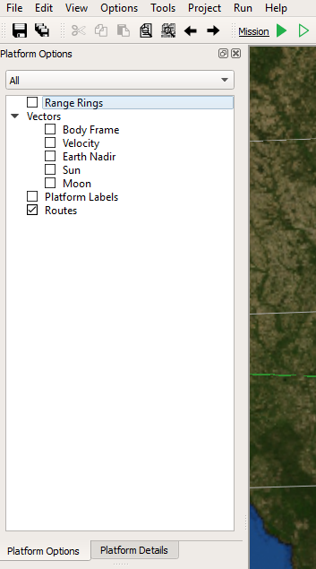
Adding a route to a platform
First, in Wizard, make sure routes are enabled for all platforms in Platform Options
Notes:
So right now, only our satellite is moving (orbiting). Our other platforms have the ability to move, now that we have given them movers, but we still have to tell them to move.

Slide 10
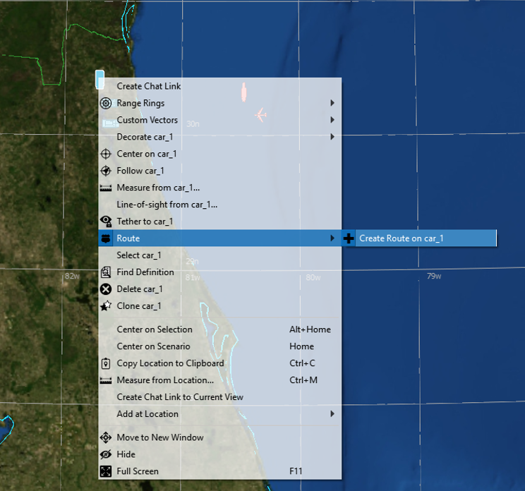
Add a route to the car
Select and then right-click the car
Under ‘Route’ click ‘Create Route on car_1’

Slide 11
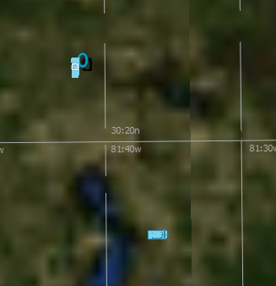
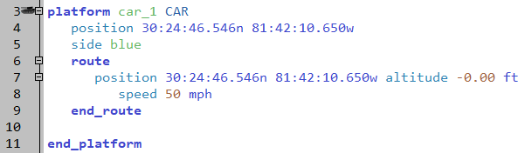
What Happens?
Waypoint-0 is added at the car’s current location
A route is added to the car in the text editor
Default speed for WSF_GROUND_MOVER is 50 mph
scenarios/blue_laydown.txt

Slide 12
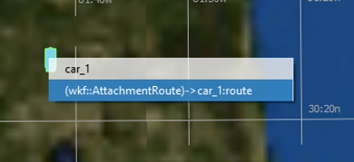
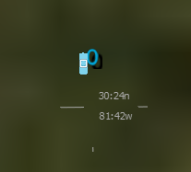
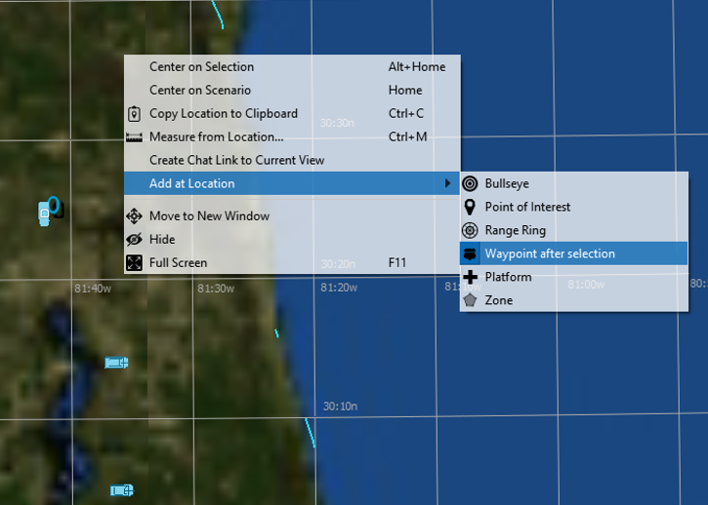
Add a new point
Make sure Waypoint-0 is selected
The small circular waypoint on top of the car should be highlighted
Right-click where you want the next waypoint
Select ‘Add at Location -> Waypoint after selection’

Slide 13
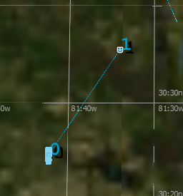
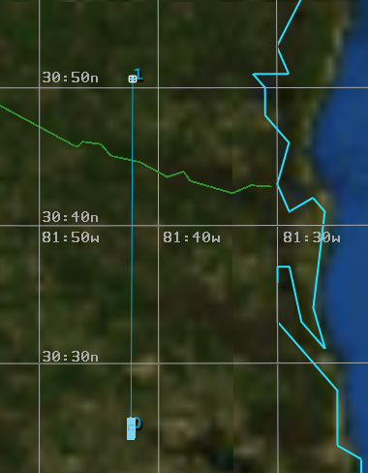
Bring the car north out of Floridistan
Waypoint-1 should be added where you right-clicked
If Waypoint-1 is selected, you can hold ‘ctrl’ and drag the waypoint where you want it.

Slide 14
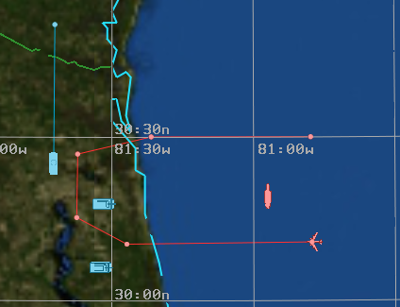
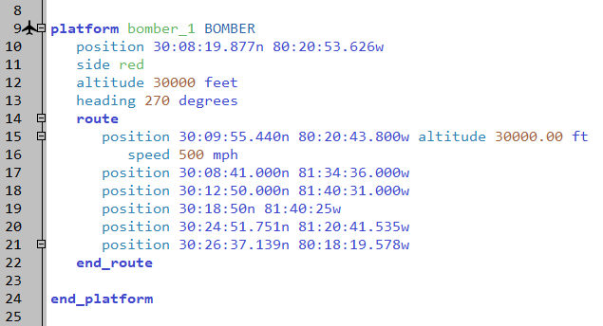
Give the bomber a route
Have the bomber come inland, turn north, and then turn back out to sea.
Default speed for WSF_AIR_MOVER is 500 mph
Every waypoint inherits the speed and altitude of the previous point unless changed
Run!!!
scenarios/red_laydown.txt
Notes:
Note: If a platform has a route that just ends at a point, it will continue in that direction at the given speed past the end of the route unless told otherwise.

Slide 15
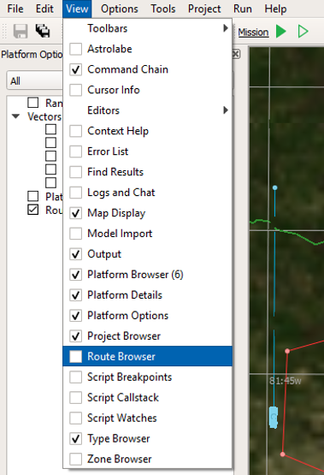
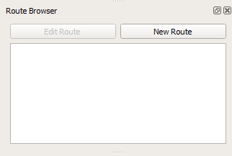
Route Browser
Enable the Route Browser
View -> Route Browser
Route Browser gives the user much more control over creating routes

Slide 16
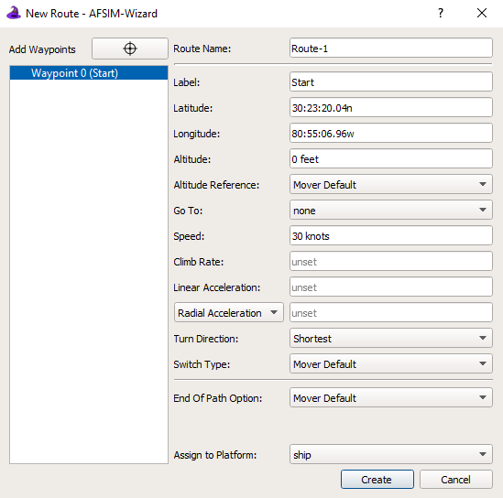
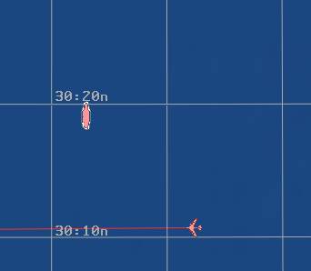
Give the Carrier a Loitering Route
Select the carrier
Click ‘New Route’
Give Waypoint-0 an initial altitude of 0 ft and speed of 30 knots
Label Waypoint 0, ‘Start’

Slide 17
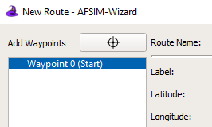
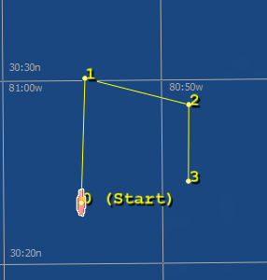
Give the Carrier a Loitering Route
Click the locator
Add three new points, looping back around
Notes:
Either click the locator again when you are done, or right-click to get out of selection mode.

Slide 18
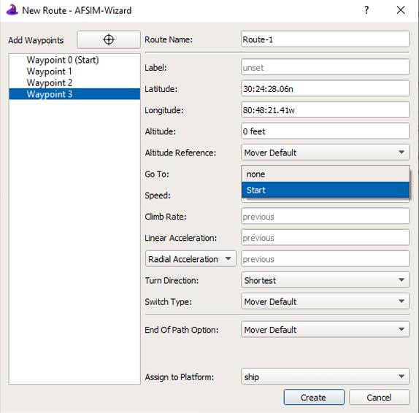
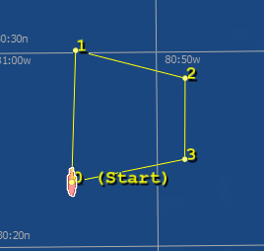
Give the Carrier a Loitering Route
Click the ‘Go To’ drop down menu on Waypoint 3
Go To Start
Click Create

Slide 19
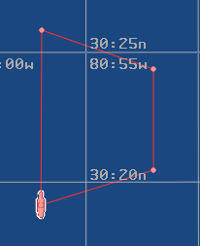
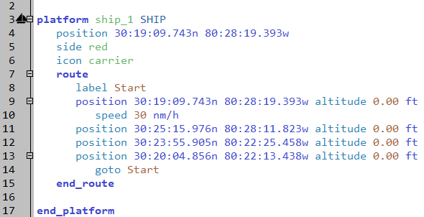
Give the Carrier a Loitering Route
Route should be closed now
Commands such as ‘label’ and ‘goto’ are added appropriately
Run!!!

Slide 20
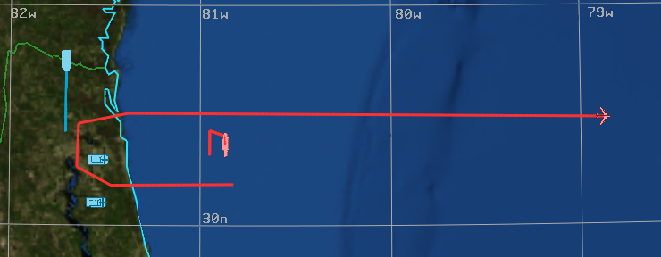
Now we have movement!
Trace lines can be turned on in Platform Options Browser in Mystic
Length and Thickness of trace lines can be adjusted in Options → Preferences → Map → Platform History

Slide 21
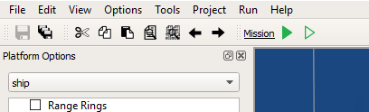
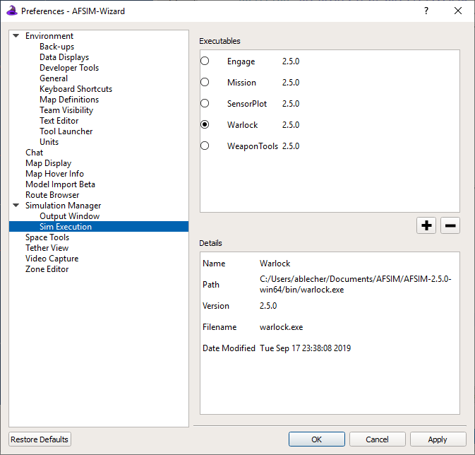
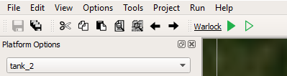
Running in Warlock
Click ‘Mission’
Select ‘Warlock’ and Click ‘OK’
Run!!!

Slide 22
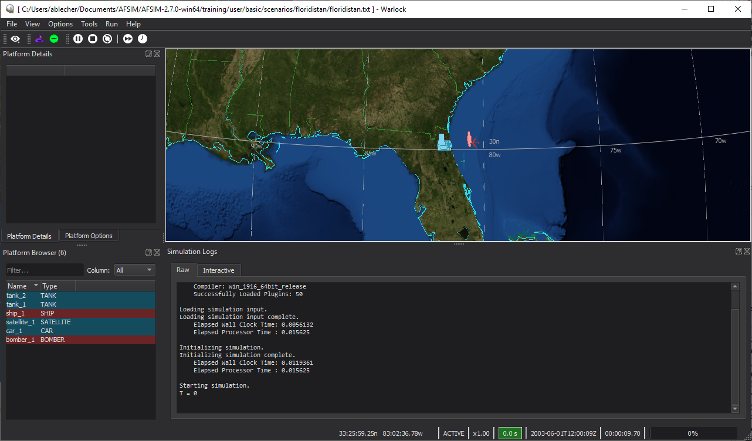
Real Time
Scenario should start playing right away

Slide 23
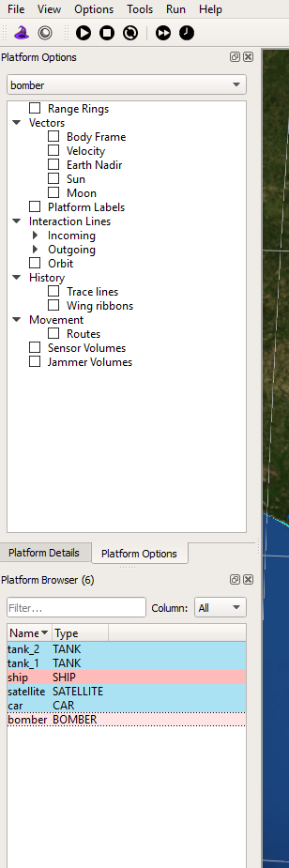
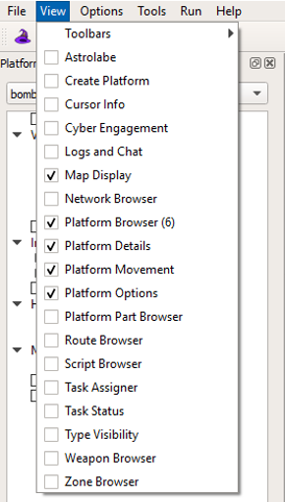
Controls
Many of the same features and controls as Mystic and Wizard.
‘View’ menu allows you to choose different Browsers
Enable Platform Movement

Slide 24
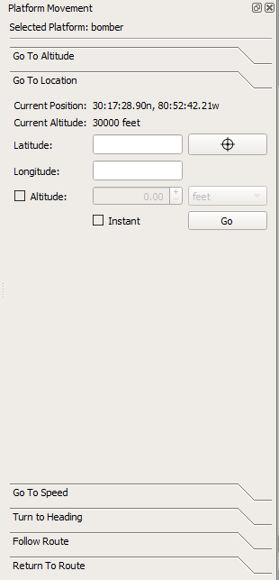
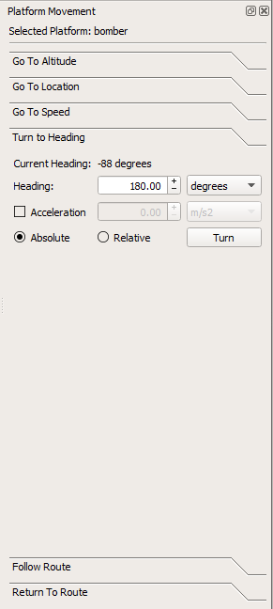
Platform Movement
Select the bomber while running
Select Turn to Heading
Give it a heading of 180 degrees
Click ‘Turn’

Slide 25
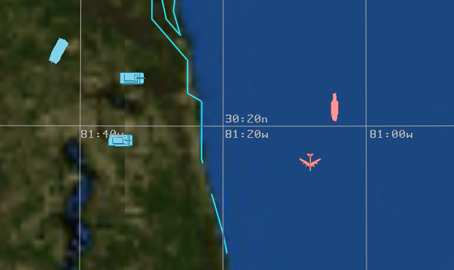
Warlock is virtual
Changes made in Warlock do not save or change the files used in the scenario.
Notes:
Warlock doesn’t change input files, but will change an .aer file.

Slide 26
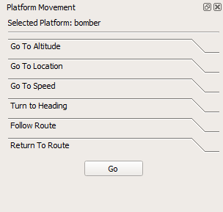
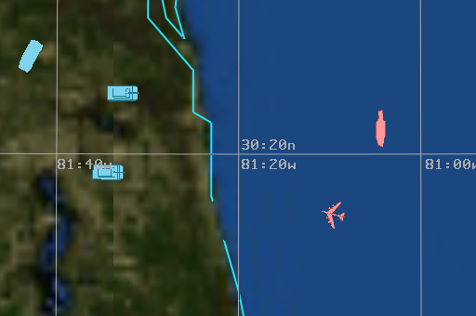
Return To Route
Under Platform Movement, Select ‘Return to Route’
Hit ‘Go’

Slide 27
Play around in Warlock
Try commanding a Tank to go to a certain Altitude
Does it?
Why not?
Because it has WSF_GROUND_MOVER
Certain movers limit how platforms can be commanded to move (as they should)

Slide 28
Learning Objectives
You will
Learn about the different movers in AFSIM
Add and edit movers on platform_types and platforms
Add routes to different platforms
Command platforms to move in a desired way using ‘Platform Movement’ in Warlock

