Slide 1
AFSIM User Training
5 – Weapons and Execute
AFRL/RQQD
Notes:
This version of the training has been tested with version 2.8
This Lesson should take about 1.5 hours

Slide 2
Learning Objectives
You will gain hands-on knowledge about:
Building a weapon
Adding a weapon to a platform
Using the “track” command
Using the “execute” command
Notes:
We’re going to blow stuff up.
And we’ll see the beginning of scripting.

Slide 3
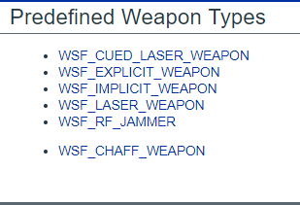
Weapon Types
An explicit weapon physically leaves the launching platform
An implicit weapon does not leave the launching platform
Laser and RF jammers are implicit weapons
Notes:
Explicit weapons make new platforms in the simulation.
Implicit weapons just reach out and touch.

Slide 4
Weapon Description Aggregates Weapon Components
The Launched Platform
(The Missile)
Weapon Definition Block
(Aggregates Weapon Components)
Mover
Launching Platform
(The Fighter)
processor tracker
Launched Platform
Description
processor fuse
Weapon
Definition
Block
icon definition
Weapon Effect
Weapon Effects
quantity
Weapon Effect
Notes:
These are the parts to define a new weapon object class.
First, we define a platform type. They typically have movers (but don’t have to – what happens if they don’t?), icons, etc. They can have comms and sensors. They can have processors to make decisions. They can have weapons – why? (submunitions, MIRVS, airbases/aircraft carriers).
Two special processors – tracker and fuse. Perfect tracker works on truth, and produces a miss distance around a millimeter. Fuse causes it to blow up, and defines time of flight.
Weapon effects is the boom. This is an attribute, not a object class (looks just like one….) Because it is an attribute, it can be overwritten.
The platform type and the effect are brought together into the weapon object class. You can add other things, such as quantity. THIS IS WHAT IS INSTANTIATED ON THE PLATFORM!
This image will be on all of the remaining charts, as a point of reference.

Slide 5
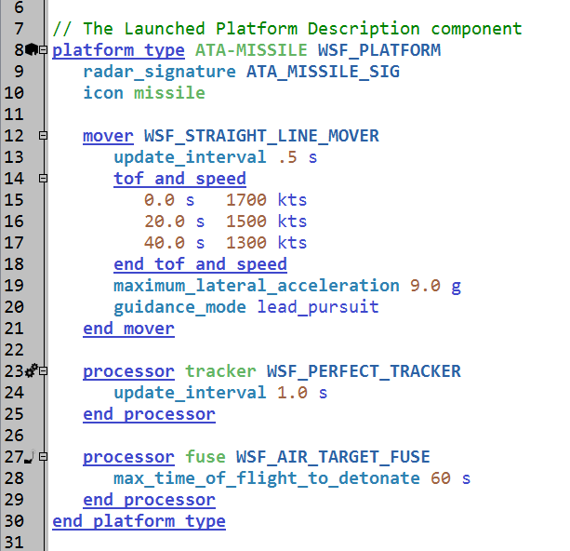
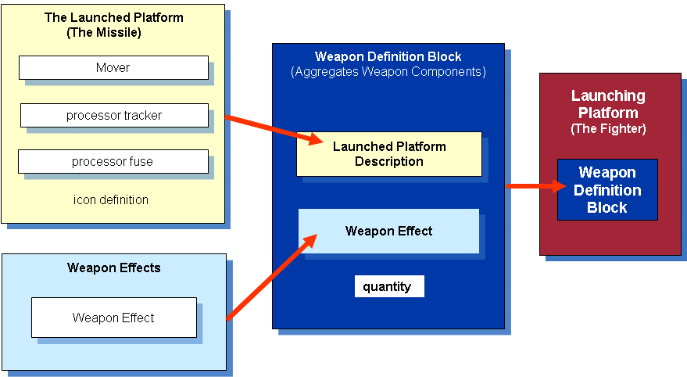
Example: Step 1 – Create the Launched “platform_type”
Weapon Example: Launched Platform
Create a launched platform_type to describe the moving weapon
Typically in separate weapons folder
Contains necessary platform parts
Signature and icon attributes
Mover for flyout characteristics
Track processor to manage tracks
Fuse processor unique to weapons
Controls arming, detonation and termination of weapon
Notes:
Here is an example of a platform type – it has a mover, and a perfect tracker, and a fuse.
Note: if this has the kinematics, it WILL hit the target. This is important on the next slide.

Slide 6
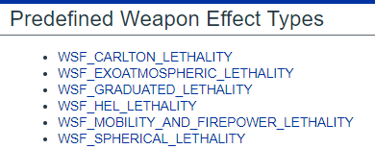
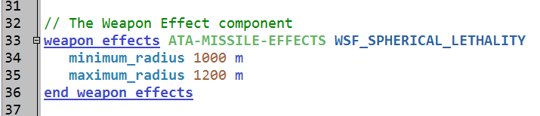
Example: Step 2: Create the “weapon_effects”
Weapon Example: Weapon Effects
Defines a weapon’s effectiveness to make a platform ineffective or neutralized
Effect on target can be probabilistic, physics based, or a combination of both
Attribute of the final weapon (not an object class)
Can be overwritten!
Defined in weapon_effects / end_weapon_effects block
“Unique” reference name
See Documentation for types for weapon effects from which to choose.
Define the lethality radii.
Kill Radii
Notes:
Here is a weapon effect. It uses spherical lethality.
Using this with the previous platform, if it can get there, it will kill its target.
Special Note: You can attach a weapon effect in the weapon block, or on the launched platform type.
For incidental damage to work in distributed operations, you need to define the weapon effect to the launched platform type.

Slide 7
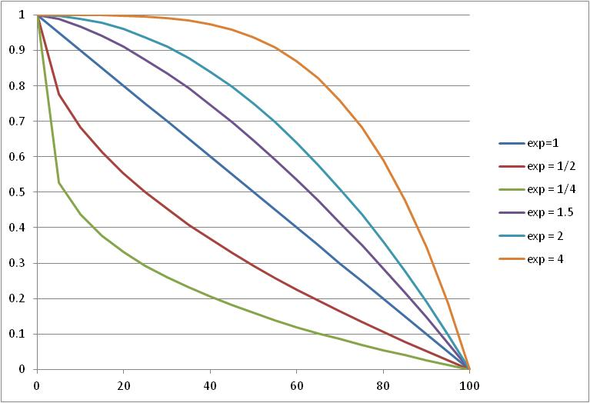
Spherical Lethality
Damage Factor
Distance from minimum_radius (m)
Notes:
This shows how different values of the exponent on the spherical lethality affect the shape of the curve.
For a platform: Damage Factor = 1, dead. Default damage factor is 0, but can be changed with initial_damage_factor command. Damage factor is cumulative across hits!

Slide 8
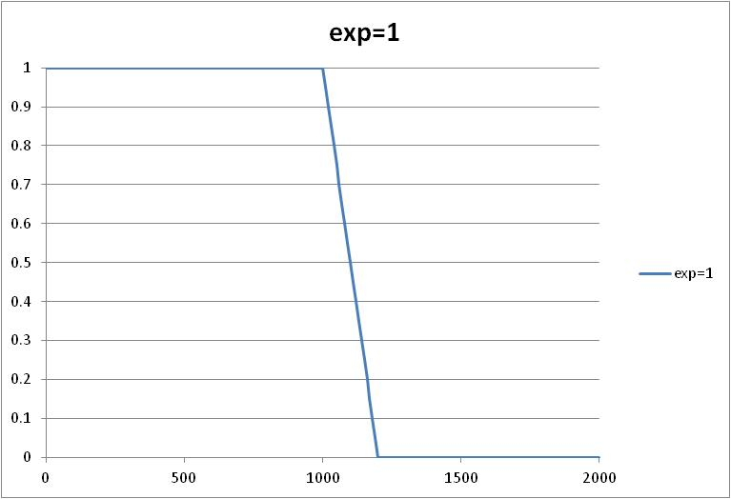
Specified Parameters
Damage Factor
True Distance From Target (m)
Notes:
For the previously defined effect, it is a straight line from 1000 to 1200 meters.

Slide 9
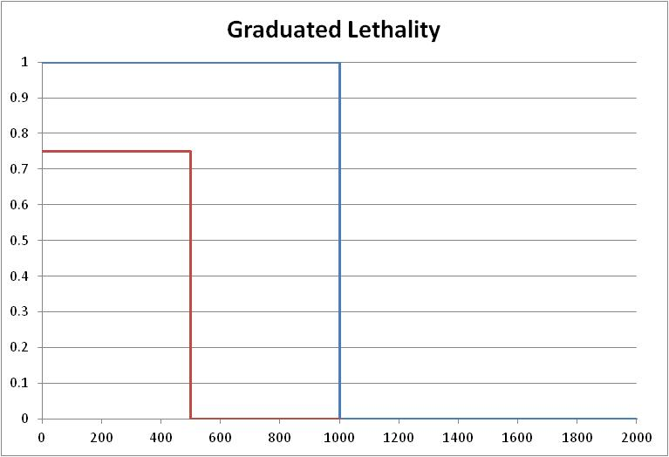
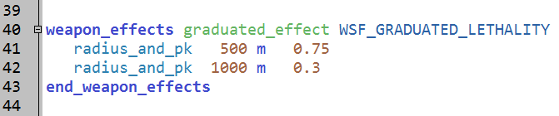
Graduated Lethality (discrete)
Probability of Kill (PK)
damage_factor = 0
(Miss)
damage_factor = 1
(Kill)
True Distance From Target (m)
Notes:
I prefer to use graduated lethality – you can specify steps. This works really well with a perfect tracker, if you have a known PK value.
For example, if you know that the general PK is 0.75, if the weapon can reach the target, then you can use the red line to give you that effect.

Slide 10
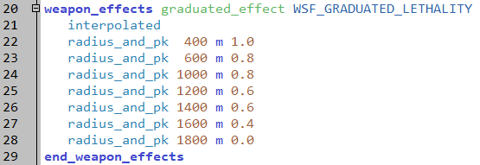
Graduated Lethality
Probability of Kill (PK)
True Distance From Target (m)
Notes:
You can give multiple radii and pk. Discrete is default, but you can use the command ‘interpolated’ to gradually reduce the PK from one radius to the next.

Slide 11
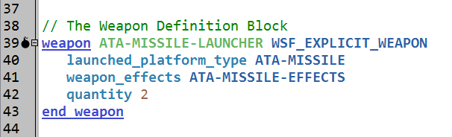
Example: Step 3: Create a “weapon” Block
Weapon Example: Explicit Weapon
Create a unique weapon object class
This will be attached to a platform as a platform part
Multiple weapons can be attached to the same platform
The weapon class created is derived from another class
WSF_EXPLICIT_WEAPON is used if the launched platform type is released from the launching platform
A weapon object contains
Launched platform type
Weapon effects
Quantity (optional)
Notes:
This shows the parts brought together. It also has the quantity here.
THIS IS WHAT IS PUT ON THE PLATFORM.
Note: We’re still teaching an example here and not actually typing anything in our scenario.

Slide 12
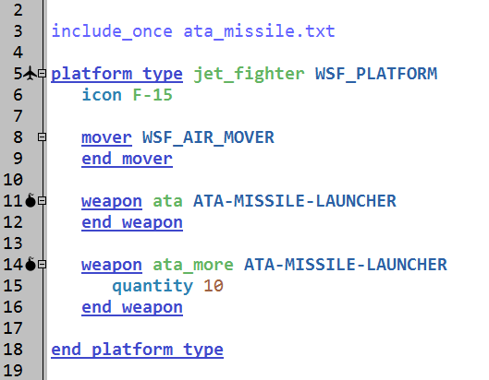
Example: Step 4: Load the “weapon”
Weapon Example: Instantiation on a Platform
A weapon is a platform part
Weapon block adds the weapon to the platform
Can be added to platform_type or platform
Quantity is an attribute, which can be changed on instantiation
Notes:
Here the weapon is instantiated on the platform. Twice.
How many shots can this platform take?
2 from “ata”, and 10 from “ata_more”
Adding multiple weapons of the same type to a platform allows us to shoot multiple targets at the same time.

Slide 13
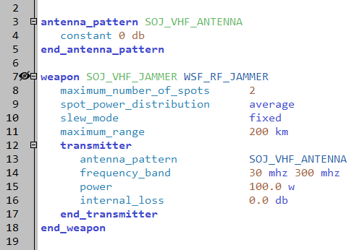
Example: Jammer Weapon
Weapon Example: Jammer
The weapon block creates a weapon object class
Similar to explicit weapon
Can be put on a platform as a platform part
Can be added to platform_type or platform
Does not have “quantity” per se
Notes:
Here is an example of a jammer weapon. It is implicit.

Slide 14
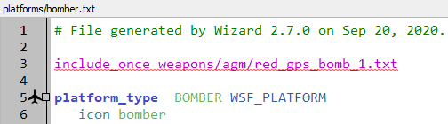
Include a weapon definition file
Steps to include a new weapon file:
In the “bomber.txt” file in Wizard, above the “platform_type” line, add the following line
“include_once weapons/agm/red_gps_bomb_1.txt”
This file exists in a models library
platforms/bomber.txt
Notes:
Now we do stuff!
Go to the bomber.txt file. We’re going to put a weapon on it.
Why are we including the file here? Because when we go to use this platform in another model, this will serve as a reminder to bring this file along too.
We could put this included file in the setup.txt file, but then the connection would be lost.
If you want to talk about include_once vs. include, now is the time. I wait until someone asks, but this often prompts the question.
BTW, this is also why we are using include_once. If we had another platform that is using this weapon, we want the file called only one time. Each file creates (or defines) a weapon object class (and a platform type). If it was included twice, AFSIM would blow up.

Slide 15
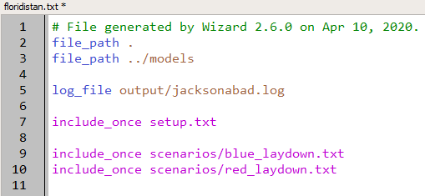
file_path
Add a file_path to our models library in floridistan.txt
This should allow Wizard to find our weapon file
floridistan.txt
Notes:
This can be very useful and time-saving, but also very dangerous. If you put all your models in the same directory, you can create multiple different scenarios that all point to and use the same models.
Be careful though, because if you edit one of those models when working on one scenario, you can break a different scenario.
I prefer to just pull all the models I want to use locally. That way, if I want to change one, I can do so knowing I won’t break anything else.

Slide 16
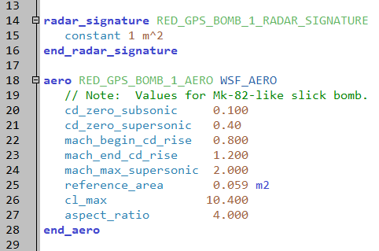
RED_GPS_BOMB_1 Attributes
Radar signature
Aero
weapons/agm/red_gps_bomb_1.txt
Notes:
This is the beginning of the file: the radar signature and the aero block.
Yes, it’s ok to use m^2 and m2. The next slide leads to that.
Note: if you right click commands, you can select “command documentation” and this will bring up the ‘context help menu.’

Slide 17
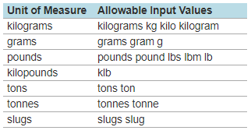

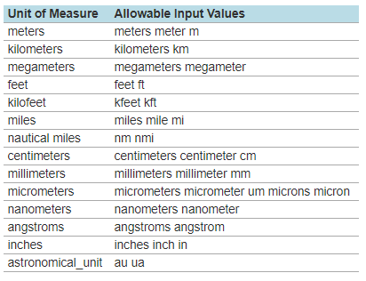

Data Unit Examples
See Documentation search: “Argument Types”
Notes:
The allowed formatting IN COMMANDS are shown on this page.
When we get to scripting, everything is in MKS – meters, kilograms and seconds. There are methods to do the common conversions.

Slide 18
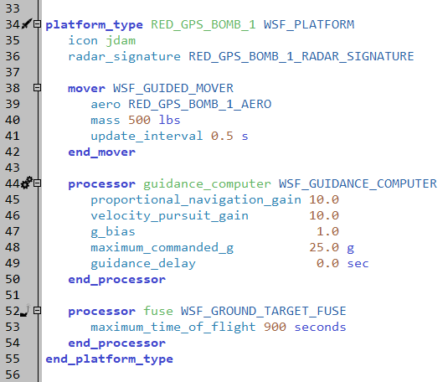
RED_GPS_BOMB_1 Platform Type Definition
The Guided Mover requires a Guidance Computer
weapons/agm/red_gps_bomb_1.txt
Notes:
This is the weapon platform type. It uses the signature and aero defined previously.
Yes, this is the same file.

Slide 19
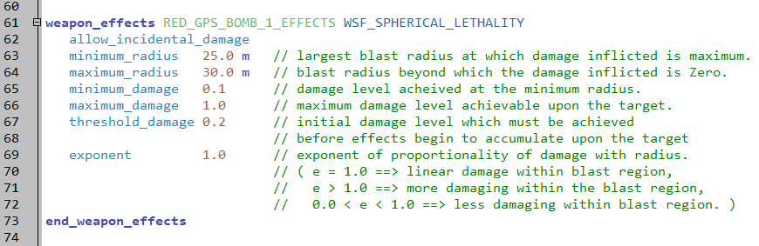
RED_GPS_BOMB_1 Weapon Effects
Spherical lethality is a common effects model
Equation provided in the Documentation
weapons/agm/red_gps_bomb_1.txt
Notes:
This is the “boom” for this weapon. Again, it is using spherical lethality. The shape of this is shown in the next slide.
As a reminder, the weapon effect is an attribute, not an object class. Yes, it looks just like an object class. It’s not my fault.

Slide 20
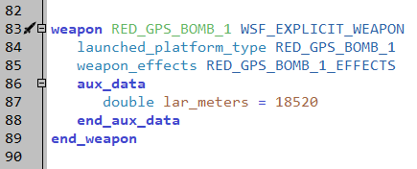
RED_GPS_BOMB_1 Weapon Definition
May also define Quantity here
weapons/agm/red_gps_bomb_1.txt
Notes:
This brings it all together. The platform type and the weapon effects that are defined above.
This also adds an “aux data” element to it. Aux Data is a way to put “post-it” notes on something.
Might want to mention that there is no quantity mentioned, so it must be put in the instantiation.

Slide 21
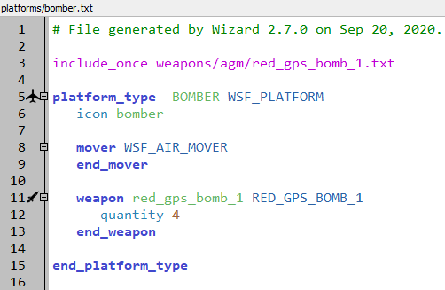
Incorporation in the Launching Platform
platforms/bomber.txt
Add the weapon to the BOMBER platform type
Can now run this!
Switch back to ‘Mission’ if still set to ‘Warlock’
WE NEED TRACKS!
Notes:
This is the instantiation of the weapon on the platform.
Running it doesn’t cause them to be fired. But it does provide a good check to see if everything else is good.

Slide 22
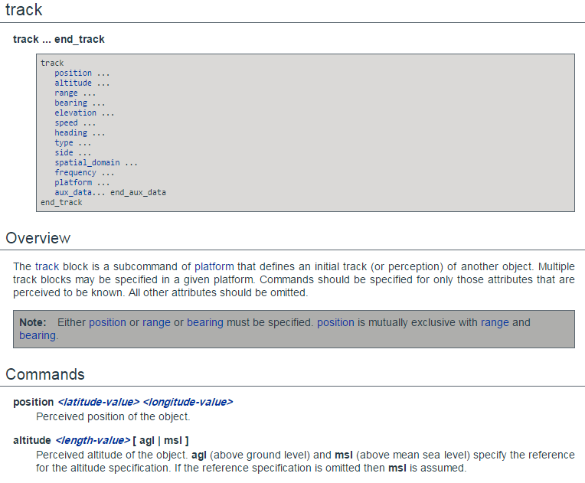
“track” Command
Notes:
The track command allows us to pre-brief a target.
Note: this is only pre-briefing a target. We are not actually tracking the target using any sensor yet. We will get into Tracks in AFSIM later.
Pre-briefed tracks might be useful when firing upon a stationary ground target.
WARNING: when pre-briefing a track from one platform to another, the platform being “tracked” must be instantiated first in the simulation
This unfortunately prevents us from having two platforms pre-brief tracks to each other.

Slide 23
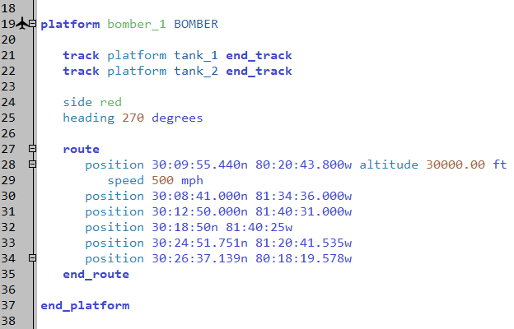
Initialize Tracks on Platforms
In the “red_laydown.txt” file, add tracks to bomber_1
scenarios/red_laydown.txt
Notes:
This is how we pre-brief the tracks. This must be done on bomber.
NOTE: when using this form, the platform must be instantiated before this command is used.
Order matters when you include your platforms.
Also, this is a track “block” written out in a single line. This is OK to do.

Slide 24
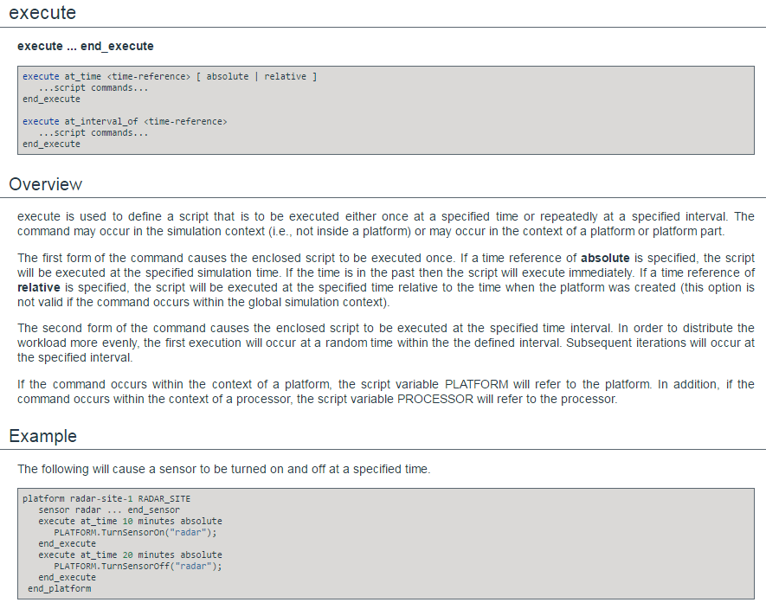
“execute” Command
Notes:
The execute command lets us run some script, based on timing.
Note: the at_interval version randomly starts sometime in the interval. If you insist on something happening at a given time, you need to use on_update in a processor. Or get the CCB to add an “absolute” option to it….

Slide 25
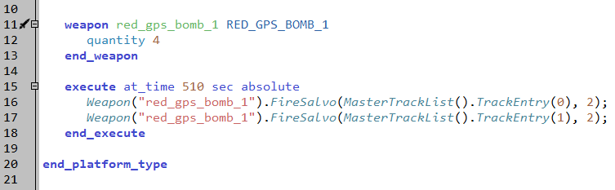
Execute Block in BOMBER
Add this execute block in the Platform TYPE definition
Make sure you have mission selected
Run!!!
Do we fire?
What’s wrong?
platforms/bomber.txt
Notes:
This will cause it to fire.
“Weapon” is actually a platform method, and should be PLATFORM.Weapon. It returns a pointer to a weapon on the platform.
“FireSalvo” is a weapon method. It needs two parameters, a track and a quantity. The quantity is easy – it’s 2.
“MasterTrackList” is another platform method, and really should be “PLATFORM.MasterTrackList”.
“TrackEntry” pulls the specific entry in the master track list.
NOTE: everything counts from zero in AFSIM. With on exception – platform ID numbers. They start with 1.
So, line 16 gets a weapon, and tells it to fire twice at the first (zeroth) track.
Line 17 gets that same weapon, and tells it to fire twice at the second (oneth) track.
Because this is in the platform definition, it will work, as long as there are two things in the master track list, regardless of the actual contents.
WARNING: if you’re using autocomplete (ctrl + space), be careful to select ‘MasterTrackList’ and not ‘MasterRawTrackList’

Slide 26
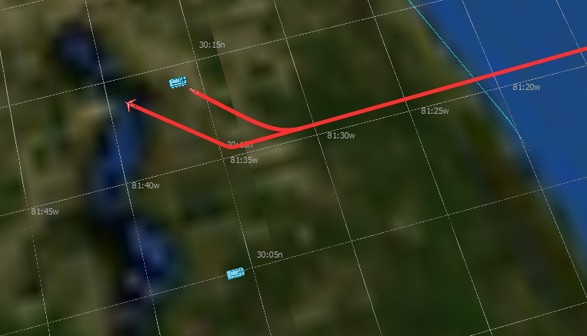
Why do we only fire at tank_1?
Maximum Request Count on the weapon defaults to 1.
You might have to adjust your execute timing, tank locations, or bomber route to have your weapons reach your target
Notes:
You should have a dead tank.
If not, find out why. You can’t continue until everyone is caught up.

Slide 27
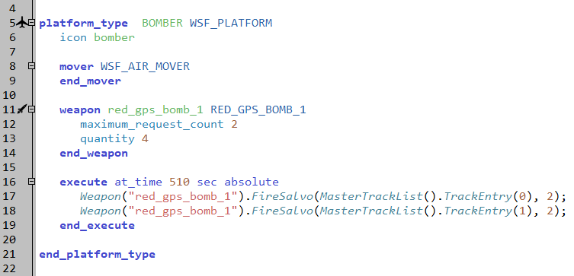
Maximum Request Count
Change the maximum request count on our weapon to 2
Run!!!
Notes:
Another option is to write two different execute blocks to fire at our two targets at different times.

Slide 28
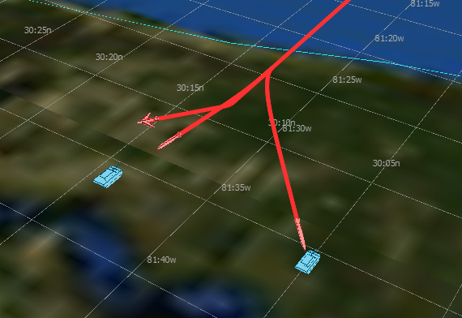
Kill Both Tanks

Slide 29
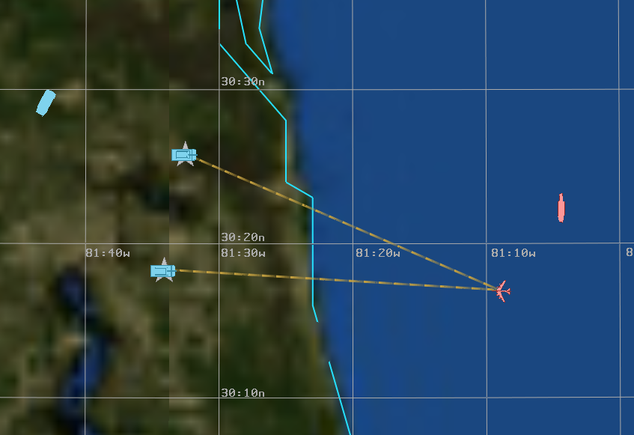
Warlock
Switch to the Warlock executable and run!!!
If we don’t change anything, we should still fire at the time our execute block is set for

Slide 30
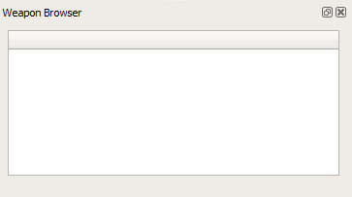
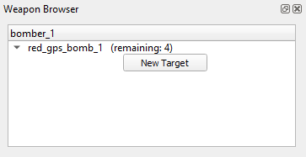
Weapon Browser
Enable the weapon browser
View → Weapon Browser
Select the Bomber
Doing so should populate the weapon browser with available weapons

Slide 31
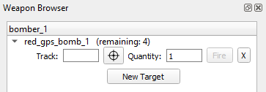
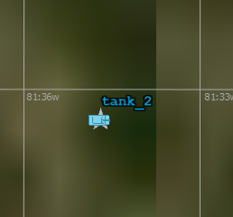
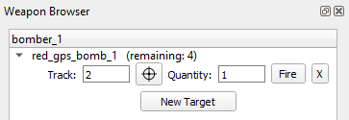
Weapon Browser
Select ‘New Target’
Select a Track
Click the locator icon
Click the track wedge on tank_2
We should now see ‘2’ in the Track field

Slide 32
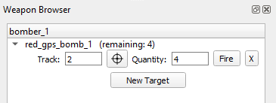
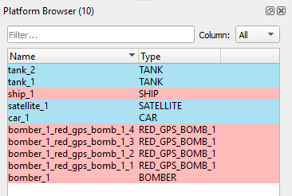

Weapon Browser
Give a quantity of 4
FIRE!!!
4 weapons should be added into the Platform Browser
Weapon Browser should now show 0 weapons remaining
Notes:
Notes: We cannot select more weapons than we have available to fire. Also, you can just type the number of a track, but if the track number doesn’t exist, nothing will happen when you click ‘Fire’

Slide 33
Weapon Firing?
Restart Warlock and try firing at the car.
Can you do it?
Why not?
No Track

Slide 34
Learning Objectives
You will gain hands-on knowledge about:
Building a weapon
Adding a weapon to a platform
Using the “track” command
Using the “execute” command
Notes:
This looks like a bunch, but it all goes together.

