Slide 1
AFSIM User Training
6 – Signatures and Part Manager
AFRL/RQQD
Notes:
This version of the training has been tested with version 2.8
This Lesson should take about 45 minutes

Slide 2
Learning Objectives
You gain hands-on knowledge about:
Defining a platform signature
Adding a signature to a platform
Using the Platform Part Manager
Using Pattern Visualizer
Notes:
This looks like a bunch, but it all goes together.

Slide 3
Signature
Platforms have parts, such as sensors, processors, and movers
Platforms also have attributes, such as icon or side
Platform signatures are attributes on the platform object
It can be defined within the platform.
Alternately, it can be defined externally and referenced in the platform.
Signature can be defined with:
Spatial attributes:
Azimuth (angle in horizontal plane)
Elevation (angle in vertical plane)
Electronic attributes:
Frequency
Polarization (orientation of electric wave)
State
platform
Signature
sensor 2
sensor 1
processor
route
Notes:
Signature is an attribute

Slide 4



Platform Coordinate System
AFSIM has a platform-relative coordinate system
Azimuth values are from -180 to 180 degrees
Elevation values are from -90 to 90 degrees
For both, 0 deg. is the nose of the platform
0º
Relative to nose of the platform
-30º
30º
90º
-60º
60º
-90º
90º
0º
-120º
120º
-150º
150º
-90º
180º
-180º
Notes:
This coordinate system seems obvious to me. Basically, the pointy part of the platform is 0,0.
But there are others out there – ESAMS uses something completely different.

Slide 5

Simple Constant Radar Signature Example
To return a Single Cross Section
Block starts with radar_signature
Block ends with end_radar_signature
Name given to signature
This defines a constant RCS of 10 square meters
Roughly a 6 ft. ball
The constant value is returned for all azimuths, frequencies, and polarizations
Notes:
(the words are all here)

Slide 6
Concept of a 2-dimensional Inline Table
Enables complex signatures to be defined
Data points defined in azimuth/elevation coordinates
Values interpolated between data points
The table definition needs this information:
Units
Size of each dimension (azimuth and elevation)
Azimuth and elevation coordinates
Data values for each azimuth/elevation coordinate
Notes:
2D tables allow us to make something more complex.

Slide 7
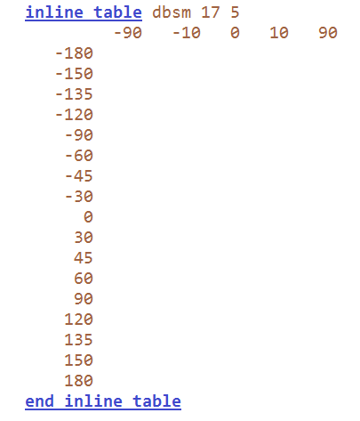
Set Up of a 2-dimensional Inline Table
Inline Table Definition
Dimensions are defined by azimuth and elevation angles (degrees)
To define the table:
Provide units
Provide the size of each dimension
The azimuth coordinates run down the table
The elevation coordinates run across the table
Put the azimuth and elevation coordinates in ascending order
Notes:
This defines the table parameters. The azimuth and elevation values don’t need the same jumps, but they do need to be increasing.

Slide 8
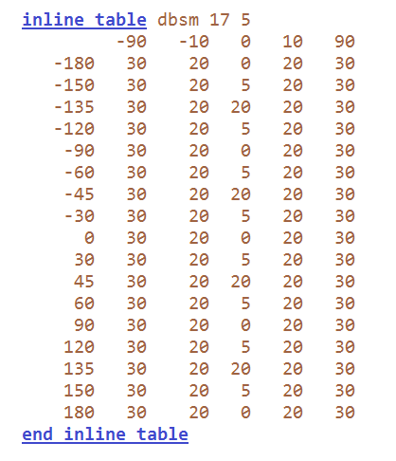
Set Up of a 2-dimensional Inline Table
Inline Table Data
Values for each elevation run vertically
Values for each azimuth run horizontally
Single data value for each azimuth and elevation pair
Notes:
This shows data in the table.
Note: when accessing values between items, AFSIM will linearly interpolate IN METER SPACE between values. That first step (degree) is a doozy!

Slide 9
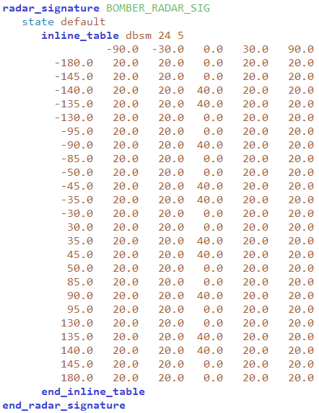
Using a Signature Table for RCS Definition
To return a Radar Cross Section at an azimuth & elevation Angle
Use a table or a set of tables
Each table defines a signature
Begin with radar_signature; end with end_radar_signature
Name the radar signature
Add the inline table
See the Documentation for additional information on defining signatures for multiple frequencies and polarizations using multiple tables
Notes:
This shows how the table would be used in a signature block.
This is still for any polarization and frequency. Those can be specified, with different tables for each.

Slide 10
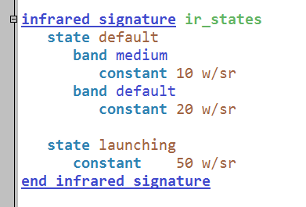
Defining Signature States and Bands
Can define multiple states for a signature
Change state using script
Can also define frequency characteristics
Bands for IR
Frequencies for acoustic and RF
Notes:
This shows how multiple states can be defined. You can access different states using script.

Slide 11
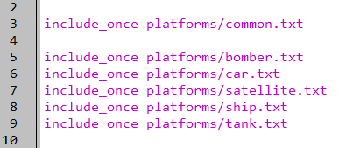
Target Signatures
Add this line to the setup.txt file
Should be found in our models library
Open the file to see its contents
setup.txt
Notes:
If you include something that doesn’t exist at first, you’ll have a red underline. If you go copy and paste a file that matches your include, I’ve found that you then have to either hit space or enter to force Wizard to reparse and find the file.
This file has several things in it.

Slide 12
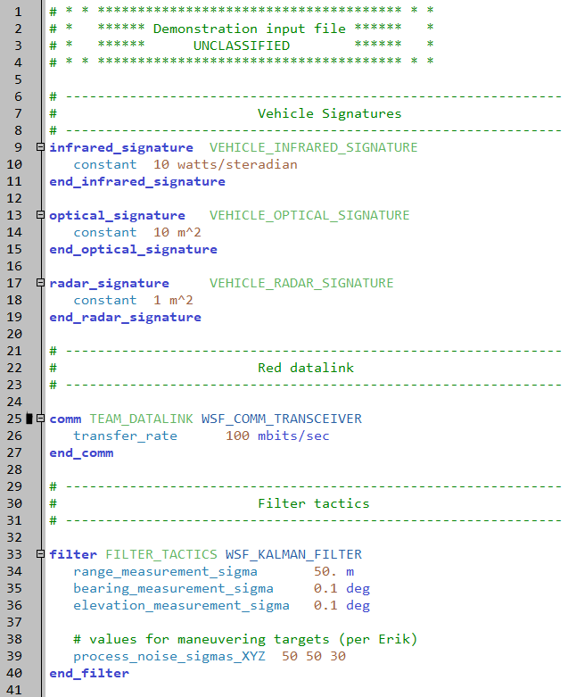
Signatures Defined Here
common.txt
Notes:
In particular, it has some signatures defined.

Slide 13
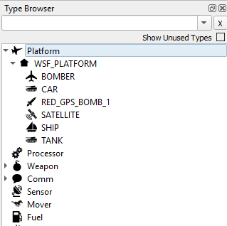
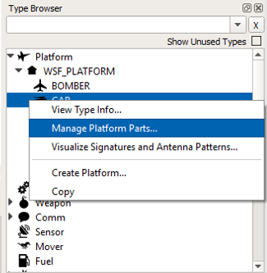
Platform Part Manager
NOTE: DO THIS IN THE PLATFORM TYPE BROWSER!
In Wizard, go to View -> Type Browser
Expand Platform, WSF_PLATFORM
Right-click on CAR, select Manage Platform Parts
Notes:
Use the part manager to open the car definition.
If you do this in the platform browser, it will only do this for a single instantiation.

Slide 14
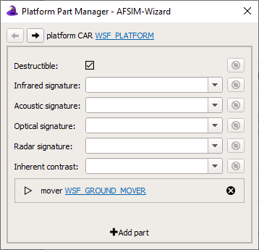
Platform Part Manager
Notes:
This is what the window looks like.

Slide 15
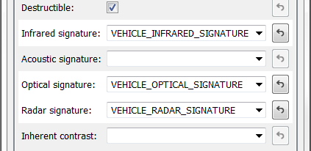
Add Signatures
Use drop-downs to add new signatures
Infrared signature
Optical signature
Radar signature
Close Platform Parts Manager and SAVE ALL FILES
Notes:
Add the signatures.

Slide 16
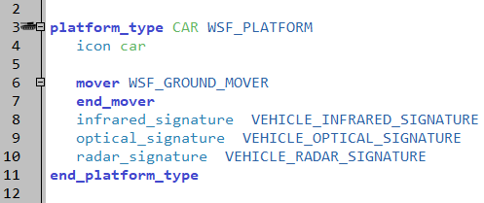
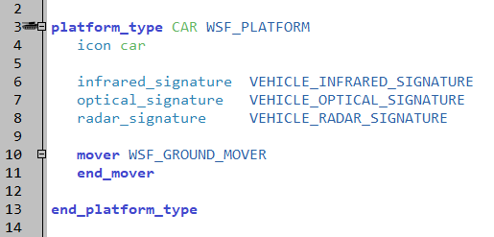
New CAR Definition
Signatures now attached to the platform_type
Adding signatures this way seems to put them at the end of a platform_type definition
This is fine, but signatures are generally at the top of a definition after icon and side
Feel free to clean up
platforms/car.txt
platforms/car.txt
Notes:
It tends to put things at the end of the definition.

Slide 17
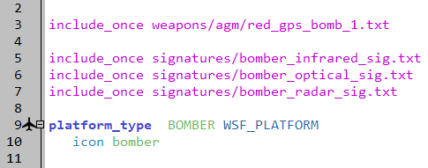
BOMBER Signatures
In the “bomber.txt” file in Wizard, add the following lines
“include_once signatures/bomber_optical_sig.txt”
“include_once signatures/bomber_infrared_sig.txt”
“include_once signatures/bomber_radar_sig.txt”
These can also be found in the models directory
platforms/bomber.txt
Notes:
Include the signature files for the bomber.

Slide 18
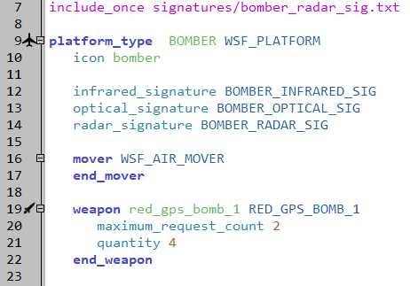
Put Signatures onto Platform
Add the signatures on our BOMBER type
Auto Complete populates available signatures
Switch back to “Mission” and Run!!!
platforms/bomber.txt
Notes:
Add them to the platform – either type them in, or use the platform part manager.
Where they end up in the file doesn’t really matter.
Feel free to add vehicle signatures onto your tanks as well to avoid ‘using default signatures’ warnings moving forward

Slide 19
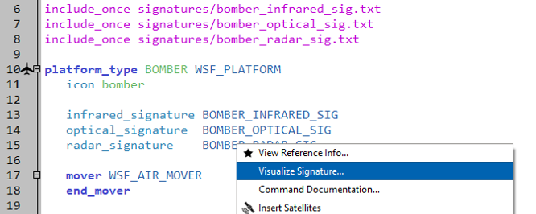
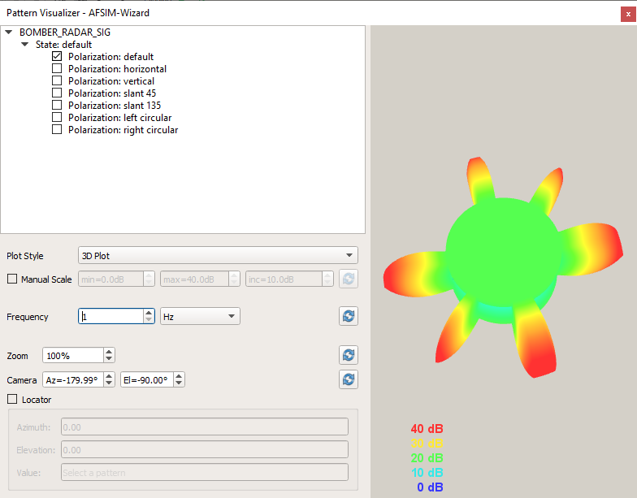
Pattern Visualizer
platforms/bomber.txt
Right-click on BOMBER_RADAR_SIG
Select “Visualize Signature”
Notes:
We can visualize it. This is really cool.

Slide 20
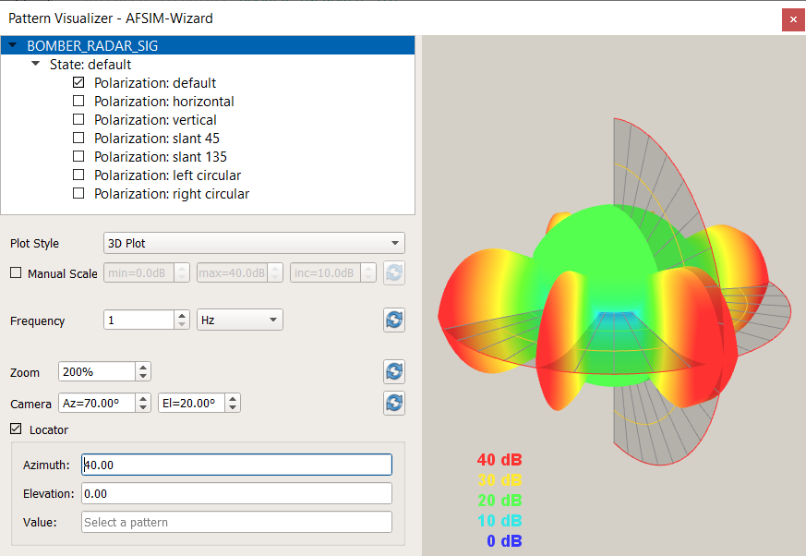
Pattern Visualizer
Controls:
Click-drag to change perspective
Scroll center mouse to scale
Locator plane provides value
Shift-click-drag moves planes
Notes:
Locator plane should show the value of the highlighted and selected polarization

Slide 21
Platform Signature Defaults
Every Platform has the following default values:
Signatures
Acoustic 100 dB-20uPa at 1kHz
Infrared 1000 w/sr
Inherent Contrast 0.5 (Used by IR sensors)
Optical 1000 m^2
Radar 1000 m^2
WARNING messages will be written to command window when using default signatures.
Notes:
These are the default values. I know that the radar, IR and optical signatures are huge. I assume that the acoustic is similarly big.
Note: the warning message will only happen the first time any platform in the simulation needs to use the signature for that platform. If your platform stays below the horizon or outside of FOV limits the entire time, it will never give you this warning. See the next section.

Slide 22
Learning Objectives
You gain hands-on knowledge about:
Defining a platform signature
Adding a signature to a platform
Using the Platform Part Manager
Pattern Visualizer
Notes:
This looks like a bunch, but it all goes together.

