Slide 1
AFSIM User Training
7 – Sensors and Tracks
AFRL/RQQD
Notes:
This version of the training has been tested with version 2.8
This Lesson should take 1.5-2 hours

Slide 2
Learning Objectives
You will gain hands-on knowledge about:
Defining a sensor
Adding a sensor to a platform
Adding a task processor and a track processor to a platform
Creating Event Output files
Notes:
This looks like a bunch, but it all goes together.

Slide 3
A Few Coordinate Conventions
AFSIM utilizes the coordinate systems as defined by ‘IEEE Std. 1278.1-1995; Standard for Distributed Simulation – Application Protocols’.
The origin is at the center of the Earth.
The +X axis passes through 0N, 0E
The +Y axis passes through 0N, 90E
The +Z axis passes through 90N (the north pole).
World Coordinate System (WCS)
Earths surface is modeled as an oblate ellipsoid as defined by the WGS-84 standard (NIMA TR-8350.2). This is a right-handed Cartesian system, Earth Centered Earth Fixed (ECEF)
Entity Coordinate System (ECS)
Local coordinate system attached to the entity (platform). This is also a right-handed Cartesian system
Entity Part Coordinate System (PCS)
Local coordinate system of parts that are attached to an entity (e.g.: sensor, weapon, etc). This is also a right-handed Cartesian system
The origin is at the centroid of the entity.
The +X axis goes out the front of the entity.
The +Y axis goes out the right side of the entity
(looking down the +X axis)
The +Z axis goes out the bottom of the entity.
Yaw is a rotation about the Z axis. Positive yaw is to the right.
Pitch is a rotation about the Y axis. Positive pitch raises the +X axis.
Roll is a rotation about the X axis. Positive roll drops the +Y axis.
Notes:
There are coordinate systems. The ECI causes some problems for ballistic missiles.
The entity parts are assumed to be centered on the platform, facing the same direction, unless otherwise specified.

Slide 4
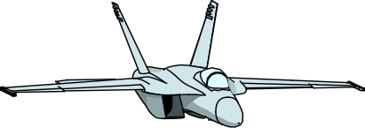
Entity Coordinate System
+X is forward
+Y is to the right (when looking forward)
+Z is down.
Yaw is rotation about the Z axis. Positive yaw moves the 'nose' right.
Pitch is rotation about the Y axis. A positive pitch moves the 'nose' up.
Roll is rotation about the X axis. Positive roll drops the 'right wing'.
+ Pitch
+Y
+ Yaw
+ Roll
+X
+Z

Slide 5
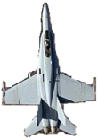
Sensor Specific Conventions
Slew Limits, sometimes called gimbal limits or field-of-regard, define the extent the articulated part can slew relative to ECS.
Beam Width
Center of antenna’s Beam Width is bounded by the Slew Limit.
Half beam’s width can go over Slew Limit.
Scan Limits
Defines a sensor mode’s search-zone coverage left and right of the mode’s center.
Cue Limits
Usually less than slew limits.
Field-of-View Limits
Greater than or equal to scan limits.
Coverage left and right of mode’s center.
Serves as a filter to ignore targets that are not within defined field_of_view_limits.
Prevent unwanted detections; sim runs faster.
Several parameters affect sensor’s azimuth and elevation coverage.
Left
Field of View Limit
Right
Field of View Limit
Left
Cue Limit
Cue
Right
Cue Limit
Left
Scan Limit
Right
Scan Limit
Beam Width
Left Slew Limit
Right Slew Limit
Notes:
Mention the coordinate frame page in the documentation!
The FOV limits are like a filter to cull out sensor detections before processing. You can use them to speed up processing.

Slide 6
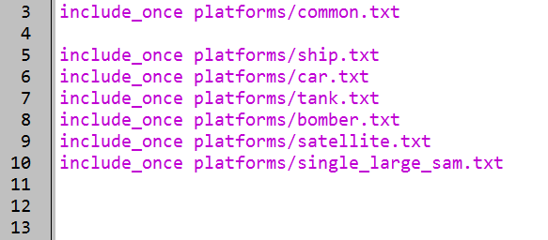
Adding Another Platform Type
In setup.txt, add
“include_once platforms/single_large_sam.txt”
This is found in the models directory
Make a local copy of the file
Copy the file from the models directory and paste the file into our floridistan scenario’s platforms directory
Open this file
setup.txt
Notes:
Going to add a new platform.
We’re bringing the file locally because we plan to edit it. If we edit the file in the models library, it could affect another scenario. (hypothetically)
Be sure to have Wizard reparse in order to find the local file instead of the one found in models.

Slide 7
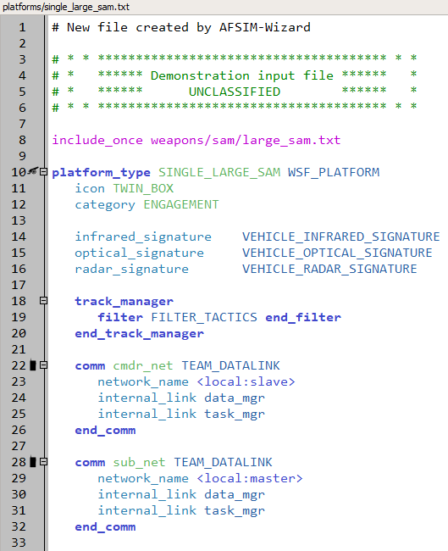
Single Large SAM
Notes:
This is the beginning of the platform.

Slide 8
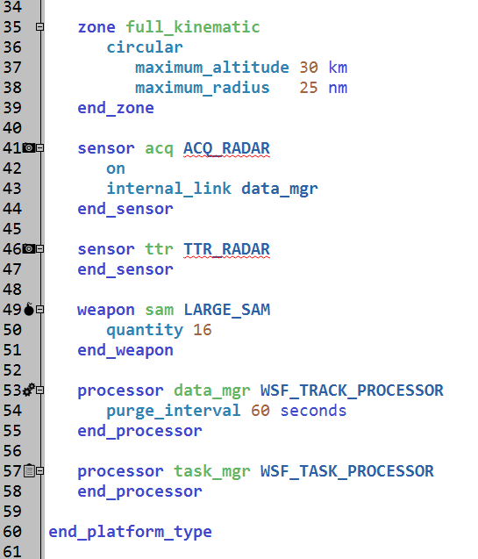
Single Large SAM (cont.)
platforms/single_large_sam.txt
Notes:
But the platform has issues – it thinks there are two sensors, and we need to add them.
Also, the quantity for the weapon is specified here.
Notice the internal_link to the data_mgr on the ACQ_RADAR.

Slide 9
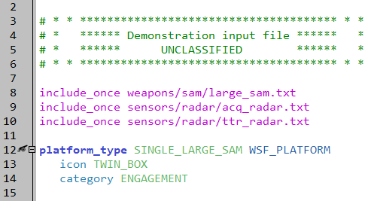
Include the Sensor Files
The ttr_radar should be found in the models library
Create and open the acq_radar file
Be sure to choose our floridistan directory when creating the file as opposed to creating the file in the models directory
platforms/single_large_sam.txt
Notes:
Add these two lines, and create the new one.
Creating our new file should also create a radar directory inside a sensors directory for floridistan

Slide 10
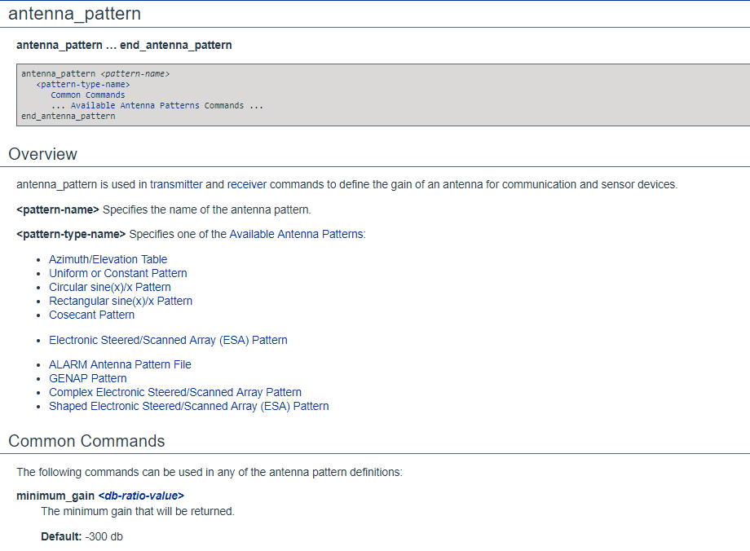
Antenna Pattern Documentation
Notes:
Antenna page – types we can specify.

Slide 11
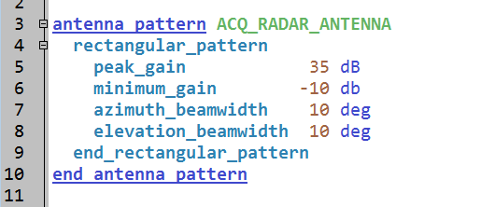
Define a Radar Sensor
Starting with the antenna pattern
sensors/radar/acq_radar.txt
Notes:
This is the one we will use.
Note: at the time of creating this, ‘end_rectangular_pattern’ doesn’t auto-complete when you auto-complete ‘rectangular_pattern’

Slide 12
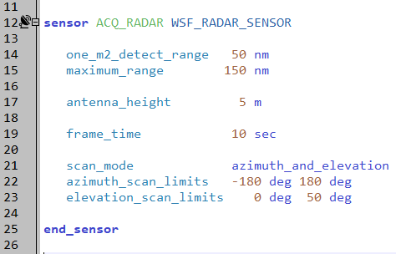
Define a Sensor
Name: ACQ_RADAR, built from WSF_RADAR_SENSOR
Specific commands
Detection range overrides other parameters
Frame time determines reporting times
sensors/radar/acq_radar.txt
Notes:
This is the beginning of the sensor.
The one square meter free space detection range will override a later parameter. Also, be careful with the units – “m” instead of “nm” will make it very short range.
Maximum range filters out things too far away. Antenna height changes the radar horizon. Remind them of the radar and optical horizon equations.
This is a “roundy round” – the azimuth limits show that it goes around. The elevation limits do leave a small hole above the radar.
Frame time – this is the hard one. Explain how AFSIM distributes the detections over the frame time. This also drives the time to establish tracks and to maintain them.
Auto complete will work, but you need to have the end_sensor command. But that confuses some people, so I don’t put it on the slide.

Slide 13
Exercise: Transmitter / Receiver
sensors/radar/acq_radar.txt
Add Transmitter and Receiver to sensor
Both use antenna pattern defined above
Noise will be adjusted to match specified detection range
Transmitter
Antenna Pattern
Transmit Power:
1000 kilowatts
Operating Frequency:
3000 megahertz
Internal Loss
2 decibels
Receiver
Antenna Pattern
Operating Bandwidth:
2 megahertz
Noise Power:
-160 decibel watts
Internal Loss
7 decibels
Notes:
Add a transmitter and receiver to our sensor.

Slide 14
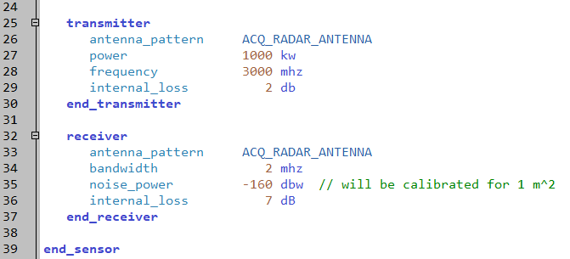
Solution: Transmitter / Receiver
Both transmitter and receiver use same antenna pattern
Noise will be adjusted to match specified detection range
sensors/radar/acq_radar.txt
Notes:
This defines the transmitter and receiver. The noise power will be reset for the one square meter detection range.
Yes, it’s still in the same file.

Slide 15
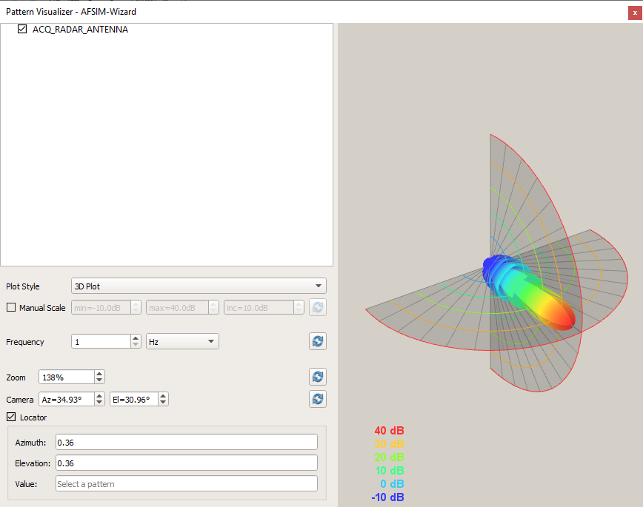
Visualize Antenna Pattern
SAVE ALL THE FILES and right-click ACQ_RADAR_ANTENNA to visualize
Notes:
We can visualize the pattern.

Slide 16
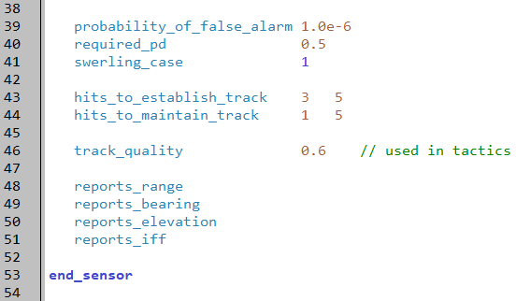
Track Commands
Define track requirements
Define what the sensor reports
Closes sensor definition with the end_sensor block
sensors/radar/acq_radar.txt
Notes:
These commands create the track. The first three are easy.
The “reports” commands define what the sensor creates when it creates a track. This information is sent in the track message to….
Track quality is an arbitrary value for this sensor. It can be accessed through script, and used to make decisions.
Hits to establish and hits to maintain (these are normal values.) Default is 1 out of 1 for both.
It takes three successful hits, out of five attempts, for this sensor to declare that it now has a track. When this happens, it then sends a track message (raw track) to….
Every frame time, if it has a new hit, it will send an update.
If it fails to get a single hit in five tries, then it will send a drop track message to ….

Slide 17
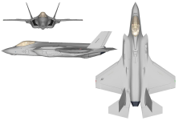
CONSIDERED
1
IGNORED
2
5
3
6
4
Max Detect Range
✓
✓
1
1
3
2
4
1
3
2
4
✓
✓
1
3
2
4
3
2
1
3
2
4
1
3
2
4
4
0.0
2.5
5
7.5
1 2 3 4 5 6
Notes:
Slide tells story:
Some friendly with a set of adversaries.
His max_detect_range is set to so far.
So he’s able to detect these, but not those.
Detections occur in an unpredictable order…
…and are spaced evenly within the update period.
Here are the results of detection attempts for 6 update periods (6 sec). When does he detect A/C (1)?
What about A/C (2)?
(3)?
And (4)?
<end>
Assumes:
1 sec update for detects. (frame time)
3 out of 5 hits for track. (hits to establish track)

Slide 18
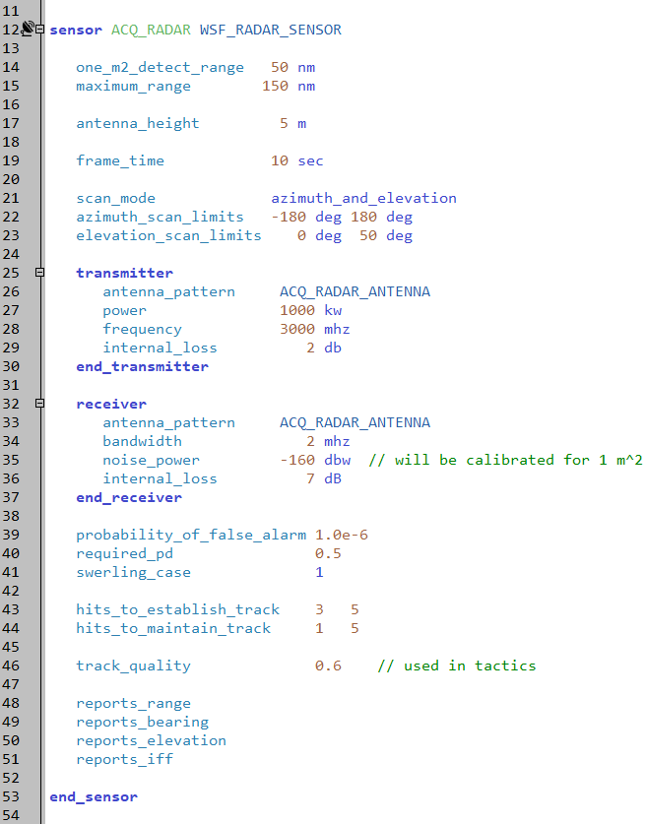
ACQ_RADAR Sensor Definition
sensors/radar/acq_radar.txt
Notes:
This is what the entire sensor looks like.

Slide 19
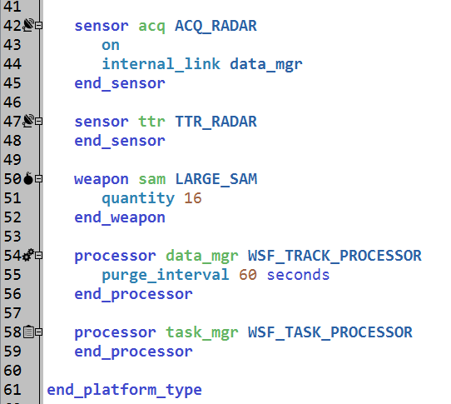
Sensor Reporting
platforms/single_large_sam.txt
Must explicitly define where the sensor sends tracks
Default is that no tracks are sent
Track processor maintains Master Track List
Task Processor watches Master Track List
Will discuss later
The internal_link (or processor) command is used to connect components within a platform.
This link is one-directional!
Notes:
Connecting the sensor to the data manager creates a local track. Without local tracks, the platform really does not know that the object has been detected, so it can not act on the detection.
The track processor takes the raw tracks and correlates them into local tracks. These local tracks are the master track list.
Without the internal link, nothing happens.

Slide 20
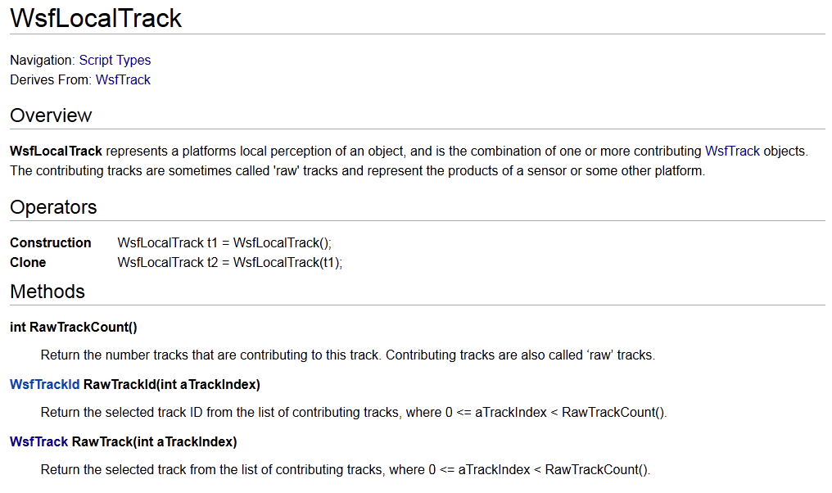
Raw Tracks
Track representation on a platform is actually a WsfLocalTrack
Combination of one or more WsfTrack objects, called “raw tracks”
The raw tracks can be accessed
Notes:
Remember, a correlated LOCAL track is a collection of raw tracks. You can access those raw tracks.

Slide 21
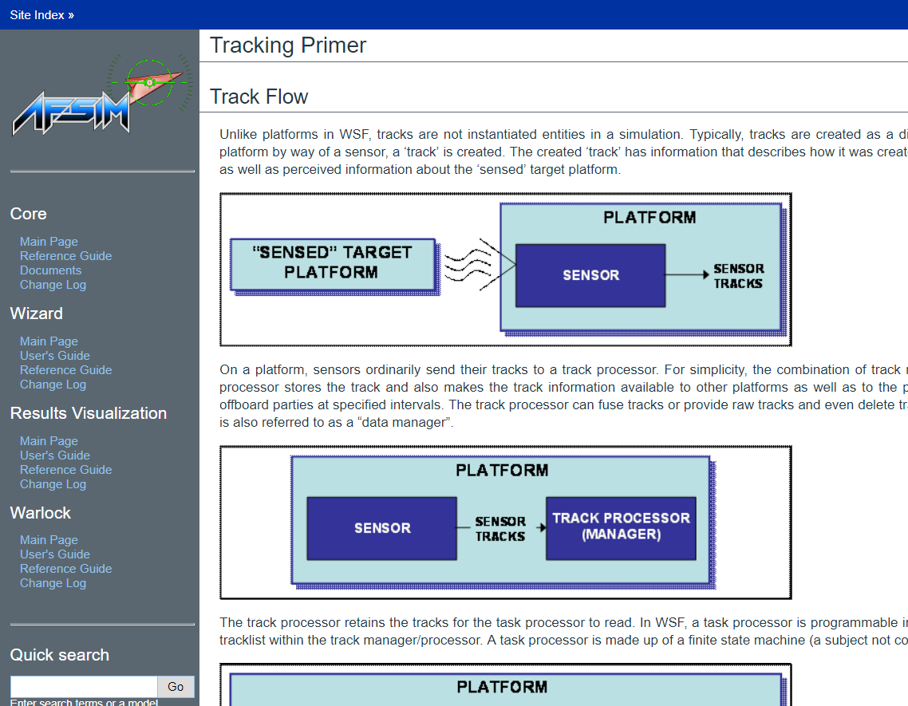
Great Source on Tracks

Slide 22
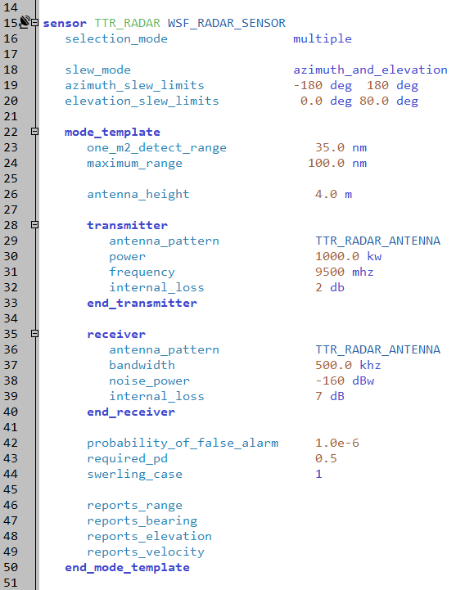
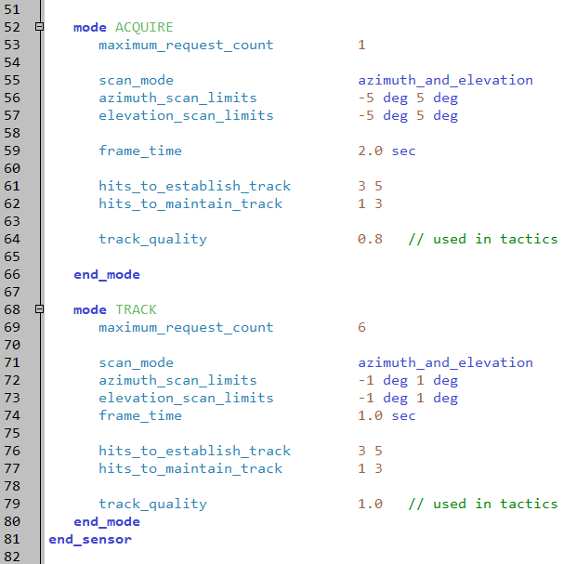
More Detailed Sensor (TTR_RADAR)
sensors/radar/ttr_radar.txt
sensors/radar/ttr_radar.txt
Notes:
Here is an example of a more complex radar. It has a mode template, and two different modes – ACQUIRE and TRACK.

Slide 23
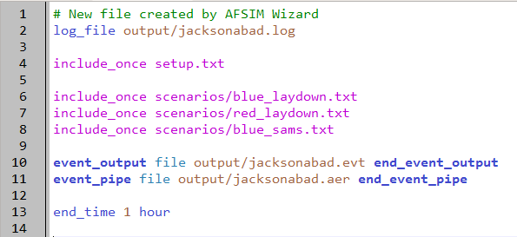
New Scenario File
Create new scenario file in top level floridistan.txt file.
floridistan.txt
Notes:
A new scenario file, for the new platform.

Slide 24
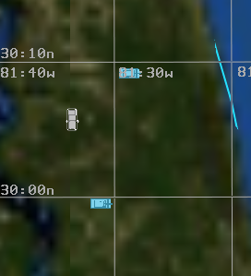
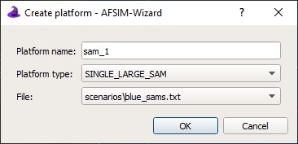
Put SAM in Scenario
Use the Map Display to put sam_1 in scenario file.
Place the new SINGLE_LARGE_SAM close to your tanks.
Create a new platform
Select type, call it “sam_1”
Select Platform Type ‘SINGLE_LARGE_SAM’
Select scenarios/blue_sams.txt file
Click OK
Notes:
Be sure to select “SINGLE_LARGE_SAM” as the platform type. A common mistake is selecting “LARGE_SAM” as the platform type, but that is the actual weapon we want to fire, not the platform that fires it.

Slide 25
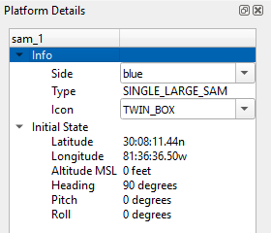
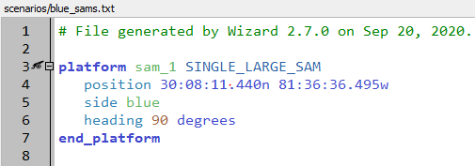
Change SAM Side
Change side to blue
Change heading to 90 deg
Run this!!!
scenarios/blue_sams.txt
Notes:
Note: We want the SAM to defend the tanks.
If you have not defined signatures on your tanks, you might get ‘using default signature’ warnings from your SAM.
You could also just have your SAM’s ACQ radar ignore same side…

Slide 26
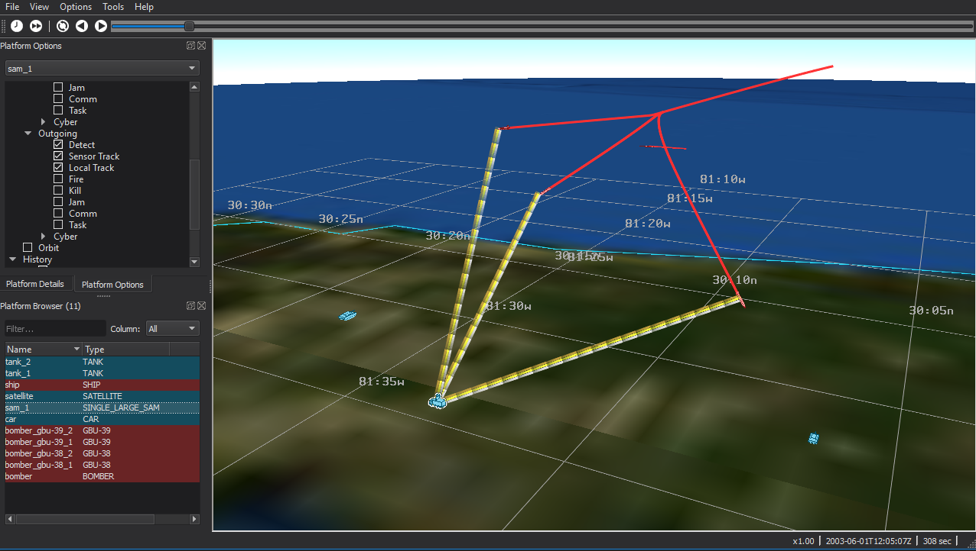
Mystic Shows Interactions
Notes:
This is what happens.
Need to show them how to make the track lines show up.
Should also talk about the ability to select what lines show and what ones don’t. This is a very powerful feature in big scenarios.

Slide 27
Flow of Sensor and Comm Processing
General flow of a sensor or communications attempt from a geometric point of view excluding the system-specific processing.
Compute range to target and compare against mode-specific minimum_range and maximum_range. Suppress the rest of the detection processing if not within the limits.
Compute altitude of target and compare against mode-specific minimum_altitude and maximum_altitude. Suppress the rest of the detection processing if not within the limits.
Update the orientation of the subsystem to reflect any potential cuing (computes the Part Coordinate System and Cued Coordinate System).
Compute the aspect of the target with respect to the Scan Coordinate System and compare to the azimuth_field_of_view and elevation_field_of_view. Suppress the rest of the detection processing if not within the limits.
Set the transmitter/receiver beam positions (i.e.: compute the Beam Coordinate System for the beams, and the Antenna Coordinate System).
Beyond this the processing gets sensor specific. For something like a radar, the aspect of the target with respect to the transmitter and receiver BCS (and perhaps the ACS for electronically steered systems) will be used to derive the antenna gain.
Notes:
This is how sensor processing flows. It does the easy stuff first, and then the hard stuff.
It doesn’t check for signature until the last one.

Slide 28
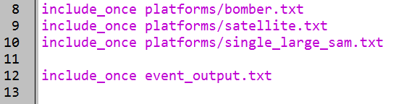
Specifying Event Output Entries
In the “setup.txt” file add the following:
“include_once event_output.txt” and create it
setup.txt
Notes:
Back to our scenario.

Slide 29
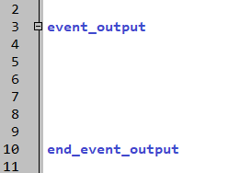
Exercise: Enable Event Output
Enable Event Output:
Whenever a track (local and sensor) is dropped/initiated
Whenever a message is transmitted/received
event_output.txt
Notes:
Turning on detection attempts will create a HUGE file!

Slide 30
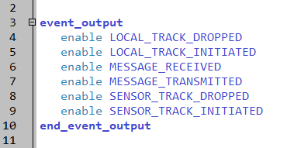
Solution: Enable Event Output
Note: there are now two event_output blocks
If conflicting values provided, last one is used
Use EXTREME CAUTION when specifying outputs!
Run!!!
event_output.txt
Notes:
Turning on detection attempts will create a HUGE file!

Slide 31
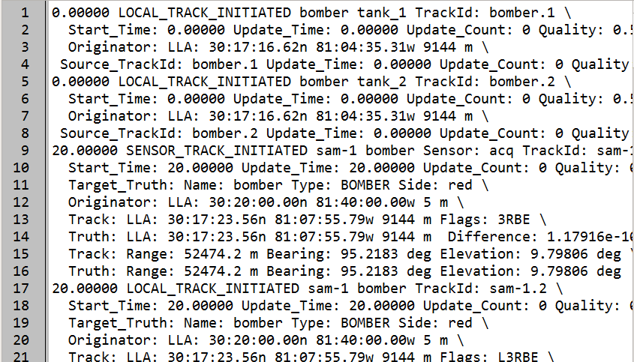
Example Event Output File
output/jacksonabad.evt
The “track” command “pre-defines” tracks for the platform, which are initiated in the master track list at the beginning of the simulation
Notes:
These are the pre-briefed local tracks.
REMINDER: if you use the ‘track’ command, the platform your prebrief a track to has to be initialized before the platform using the track command.

Slide 32
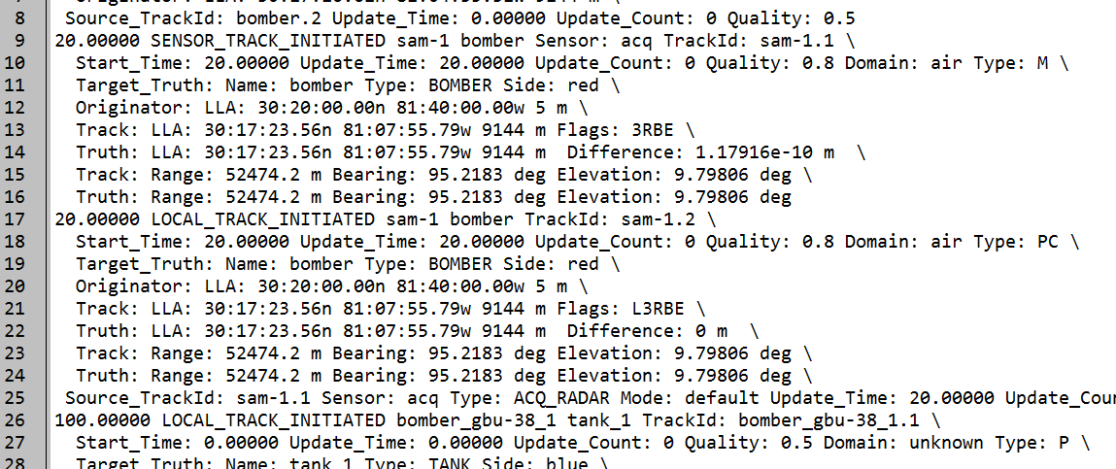
Example Event Output File
output/jacksonabad.evt
Notes:
If there is no data manager, and no connection from the sensor, then the track messages don’t show up.
Notice that the sensor initiates the track, and then it is immediately sent to the track processor, when it becomes a local track.

Slide 33
Master Track List
Each platform has a single Master Track List
Receives inputs from multiple sources
Created and maintained by the track processor
Platform 1
Platform 2
Sensor 1
Comm 1
Comm 1
Sensor 1
Track Proc 1
Track Proc 1
MTL
MTL
Task Proc 1
Notes:
This is what we’ve been doing so far – tracks come in, and they go to the track processor to be correlated into the master track list.
This is not the only way.

Slide 34
Multiple Track Lists
A platform can have multiple track lists
One is the Master Track List
Each task processor acts on just one track list
Platform 1
Platform 2
Sensor 1
Comm 1
Comm 1
Sensor 1
Track Proc 1
Track Proc 2
Track Proc 1
MTL
2nd TL
MTL
Task Proc 2
Task Proc 1
Notes:
We can have a second track processor, creating its own track list. These two track lists will be different.
Why would we want to do this? Maybe the second one controls the sensor. Or the flight path of the platform.

Slide 35
Processors Can Filter Messages
Sensors produce track messages
Comm devices receive messages from external sources
Both then send to processors
These messages can be sent to other processors before reaching their destination
The on_message block catches the message
Message can be changed, delayed or suppressed
Platform 1
Sensor 1
Comm 1
Script Proc 2
Script Proc 1
Track Proc 1
MTL
Task Proc 1
Notes:
We can also put script processors between the sensor/comm devices and the track processor.
Remember – the sensor creates a track message, and that track message is what is sent to the track processor via the internal link.
Why would we want to do this? Maybe we want to delay or filter the tracks. Maybe we want to alter them. Or add data to some of them.

Slide 36
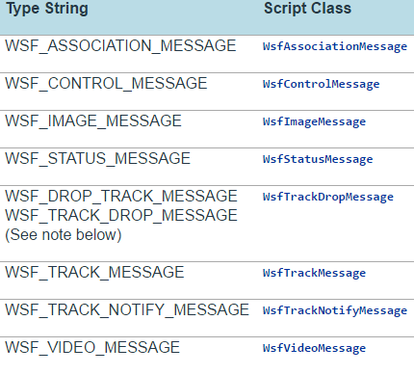
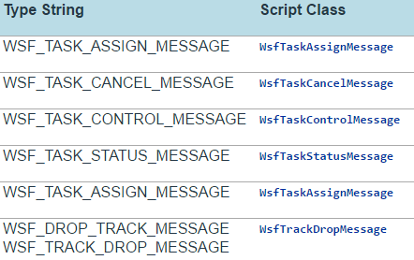
Script Processor – on_message
From “WSF_SCRIPT_PROCESSOR” documentation page
A block of script that triggers when a message arrives to the processor.
Via “internal_link” from comm, sensor, or other processor.
Can be conditional based on type of message.

Slide 37
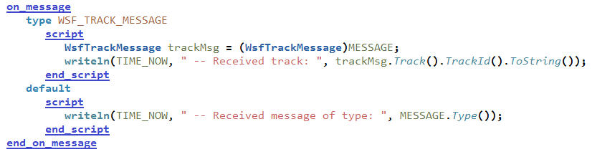
Script Processor – on_message
Can have many “type” sections.
“default” (optional) runs if message doesn’t match any listed type.
Operates like a switch/case/default statement.
This is a valid context to use MESSAGE.
Note that we can cast from WsfMessage (MESSAGE) into the incoming type.
This allows us to access script methods for that type.
Notes:
This is a very powerful tool for debugging comms and seeing the messages coming into a platform.
Track and task messages can be printed immediately.

Slide 38
Sensor Tracks
The sensor detects the target, and then creates a track
When does the detection become a track?
The track is then sent to the Track Processor
How does the track get there?
Where is the Master Track List maintained?
Notes:
Answers:
A detection becomes a track when m out of n detection attempts is met.
The track is sent to the Track Processor through ‘internal_link’.
The Master Track List is maintained in the track_manager.

Slide 39
Learning Objectives
You will gain hands-on knowledge about:
Defining a sensor
Adding a sensor to a platform
Adding a task processor and a track processor to a platform
Creating Event Output files
Notes:
This looks like a bunch, but it all goes together.

