Slide 1
AFSIM User Training
8 – Scripting Language and Script Processors
AFRL/RQQD
Notes:
This version of the training has been tested with version 2.8
This lesson should take 1.5-2 hours

Slide 2
Learning Objectives
You gain hands-on knowledge about:
The AFSIM scripting language
Using a script processor
Notes:
The short ones have the important stuff.

Slide 3
Overview
AFSIM provides a custom scripting language
Users can execute complex instructions based upon simulation events.
Similar to C# and Java in syntax.
Requires basic programming skills.
Block-structured
No rules about indentation, newlines, etc.
Lines end with semicolons.
Variables must be declared before using.
Comment lines start with a pound sign (#) or C++ style (//, /*...*/)
Scope
Levels: Global, Platform, Processor, or Behavior.
Valid insertion points for script blocks in many locations throughout the simulation input.
Notes:
I try to use (#) to comment out lines that I don’t always want to use like ‘show_state_transitions’.
You can comment/uncomment large sections of code by highlighting what you want to comment and hitting ‘shift + 3’
I try to use (//) to provide helpful comments related to the code.

Slide 4
Basic Types and Operators
Basic Types
int – A 32-bit integer (i.e. int prime5 = 11; )
bool – A boolean value (true or false)
double – A double-precision floating-point value
string – A string of characters
Operators
Methods ., ->
Unary !, +, -
Arithmetic *, /, +, -
Relational, Equality <, <=, >, >=, ==, !=
Logical &&, ||
Assignment = ,+=, -=, *=, /=
Notes:
There are basic types.
String is a basic type, but it has methods too.
There are the operators that you would expect.

Slide 5
Static Complex Types
_BUILTIN_
Calendar
Earth
Math
Moon
Sun
System
Notes:
BUILTIN gives us things like “writeln” to write to the common output device.

Slide 6
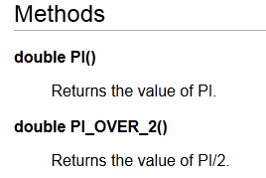
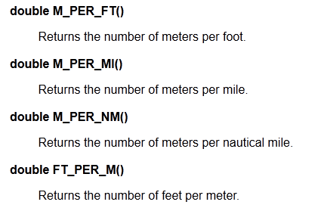
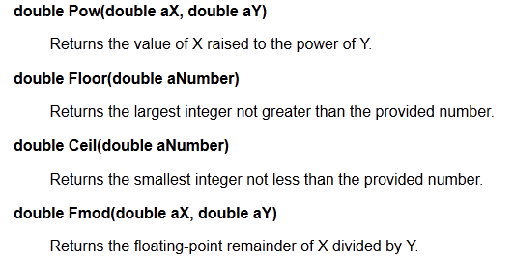
Math
Notes:
MATH provides constants, converters and the usual math functions you would expect.

Slide 7
Variable Complex Types
Containers
Array
Map
Set
Vec3
Other
QuadTree
Calendar
Signal
Struct
FileIO
string
Notes:
And complex variable types
An array is a collection of like things, indexed on integers. A map is a collection of like things, indexed on any orderable type. Very powerful.
FileIO lets you read and write to files.
Struct lets you define a “box of things” that travel together.

Slide 8
Containers
Array < T >
Similar to C++ Standard Template Library (STL) vector.
Template type T specifies the type of the elements stored in array.
Map < T1, T2 >
Similar to C++ STL map.
Template types T1 and T2 specifies the type of the key and data.
Set < T >
Similar to C++ STL set.
Stores a sorted range of elements of type T.
Array < int > myIntArray = Array < int >();
myIntArray.PushBack(42);
writeln(“Array size= “, myIntArray.Size(),
“ and the first value= “, myIntArray.Front());
// Array size= 1 and the first value= 42
Notes:
Really said this on previous slide.
Default Constructor example for complex types.

Slide 9
More Script types …
string sValue;
int iValue = 42;
iValue = iValue + 4;
sValue = (string) iValue; // sValue now contains the string "46"
iValue = (int) sValue; // iValue now contains the integer 46
dValue = 12.345;
dValue = dValue - 2.0;
sValue = (string) dValue; // sValue now contains the string "10.345" dValue = (double) sValue; // dValue now contains the double 10.345
string
FileIO
script_variables
FileIO gOut = FileIO();
end_script_variables
script void RecordPlatformName(string aFileName, WsfPlatform aPlatform)
gOut.Open(aFileName, “append”);
gOut.Writeln(aPlatform.Name());
gOut.Close();
end_script
Notes:
We will use FileIO later.

Slide 10
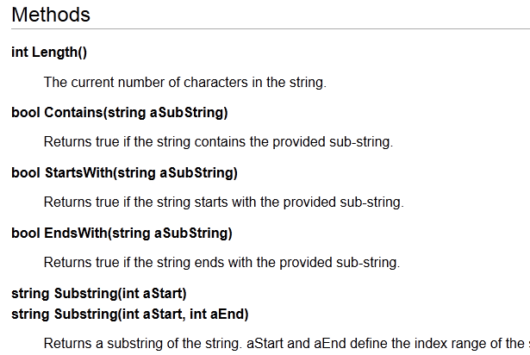
String Methods
Notes:
I’m partial to the “contains” method on strings.

Slide 11
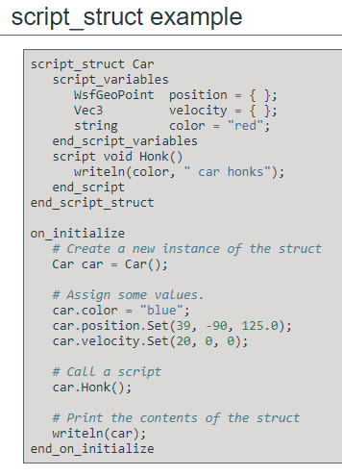

Script Structs
Defines an object type that can be used in other scripts.
Must be Global
Notes:
Structs are neat! They have to be defined at the global level.
WARNING: changing a struct mid run is possible but can be quite dangerous. A nice capability to have, but use with great caution.

Slide 12
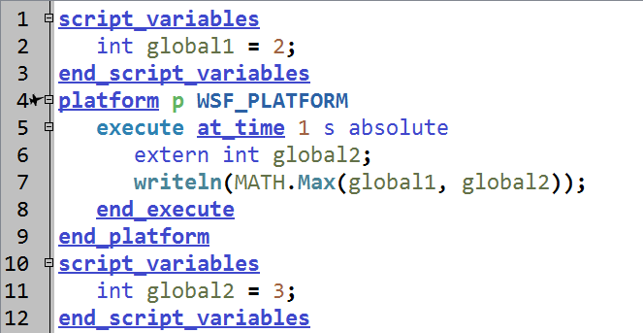
extern
extern required only if variable declared later
Notes:
This is the example from the Documentation, but is not necessary any more as this will run without line 6 (try commenting it out and see if it works).

Slide 13
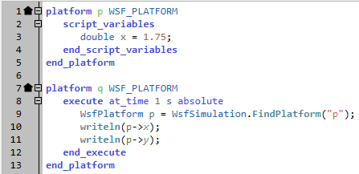
Arrow (->) operator
Used for accessing user variables
Output: 1.75
ERROR: Attribute does not exist (y).
0 -> void _execute_1() File: demo3.txt Line: 11 Col: 19
…
Notes:
This lets me reach into something and get values. It is a really good way to cheat.
I can reach into another platform, find a processor, and change a variable value in that processor.

Slide 14
Conditionals and Loops
Map<string, double> myMap = Map<string, double>(); myMap[“a”] = 1.1;
myMap[“b”] = 2.2;
// If two loop variables are declared
// (separated by a colon), the first must be
// the key and the second must be the data.
foreach (string aKey : double aData in myMap)
{
print(“key, data “, aKey, “, “, aData);
}
// If one loop variable is declared
// it must be the data.
foreach (double aData in myMap)
{
print(“data “, aData);
if (aData > 2.0) break;
}
if , else if, else
while, do while
for, foreach
break, continue
string name = “platform-1”;
if (name == “platform-2”)
{
print(“Found platform-2”);
}
else if (name == “platform-1”)
{
print(“Found platform-1”);
}
else
{
print(“Couldn’t find platform 1 or 2”);
}
for (int i = 0; i < 10; i = i + 1)
{
if (i == 5)
{
continue;
}
}
Notes:
What you would expect from a programming language.

Slide 15
Script Blocks
Context is important … Where you place these blocks matters!
Script Methods
Script Variables
Execute
script <type> <script-name>([<variable-declaration-list>])
<script-commands...>
end_script
script bool IsScriptingFun()
return true;
end_script
script_variables
double x = 1.0;
end_script_variables
execute at_time <time-reference> [ absolute | relative ]
...script commands...
end_execute
execute at_interval_of <time-reference>
...script commands...
end_execute
Notes:
Scripts, variables and execute. We’ve already seen execute blocks.

Slide 16
Common Script Interface
AFSIM components currently implementing the common script interface
Simulation, platforms, processors, weapons
Elements of the interface
Script variable block
Script method block
Script control commands
Common Script Blocks
execute
on_initialize
on_initialize2
on_update
on_message
Predefined Variables
Notes:
You can put script elements at the simulation level, in platforms, in processors, and in weapons.

Slide 17
Predefined Variables
WsfSimulation – access to simulation level methods (see Documentation)
TIME_NOW – current time in the simulation
MATH – access to specialized math functions (see Documentation)
These are context specific!
PLATFORM – current platform
WEAPON – the current weapon (similar to PLATFORM)
PROCESSOR – the current acting processor
TRACK – current track being processed in the state machine
MESSAGE – current message in on_message block
Notes:
These are the predefined variables that are available.
SIMULATION, TIME_NOW and MATH are available all the time.
PLATFORM refers to the current platform. WEAPON is the same as PLATFORM, and I never use it.
PROCESSOR is the current processor. It used to be called “this”, and you will see that in some places, particularly error messages.
TRACK and MESSAGE are specific to the location

Slide 18
Platform Initialization
Per Each Platform in the order they appear in the scenario
Initial position from input file (LLA with terrain, orientation NED)
Reference earth angle for ECI coordinate frame
Organize any groups that exists (optional)
on_initialize
Signatures, height, length, width, mass (empty, fuel, payload) (optional)
Command chains
Track manager (All platforms have a track list)
Mover (assume land domain if no mover is attached!)
Fuel (optional)
Navigation Error (optional)
Platform parts initialization
on_initialize2
Notes:
Note: if you want to do something like “how many shots can I take?”, that can’t be done in on_initialize, because the weapons don’t exist yet.
There is nothing can be done in on_initialize that can’t be done in on_initialize2.
Really?

Slide 19
Launch Weapon When Within Range
Launch weapons at tanks when the BOMBER is within range
Use a script processor to do this
Check range to target
Launch weapon
Remember engagement
Notes:
Now, we are going to use all of this scripting stuff to change how the BOMBER fires at targets.
The targets will still be pre-briefed, but we won’t just pull the trigger on a time hack – we’re going to fire when we are within weapon range.
There are four parts to the processor.

Slide 20
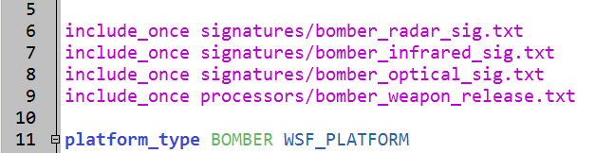
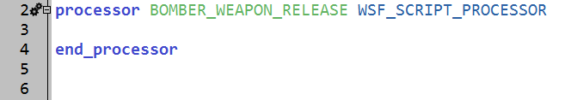
New Script Processor Definition
Steps to create a new processor file:
In the “bomber.txt” file in Wizard, add the following line “include_once processors/bomber_weapon_release.txt”
Create and open the new file
Type: WSF_SCRIPT_PROCESSOR
Name: BOMBER_WEAPON_RELEASE
Contains four blocks
Variables
Initialize2
Script
On update
platforms/bomber.txt
processors/bomber_weapon_release.txt
Notes:
New file – processor. It’s going to create / define a script processor. Coincidentally, it has four sections. They aren’t the same as the four steps from before.

Slide 21
Exercise: Script Variables
processors/bomber_weapon_release.txt
Add script_variables block with:
string named weaponName
Value: “red_gps_bomb_1”
string named LARmeters
Value: “lar_meters”
array of booleans named tgt_engaged
initialize with the default constructor (must call explicitly!)
Notes:
Script variables. One that has the weapon name, a temporary track variable, and an array to remember if we have engaged a target yet.
Putting them here enables us to access them externally.

Slide 22
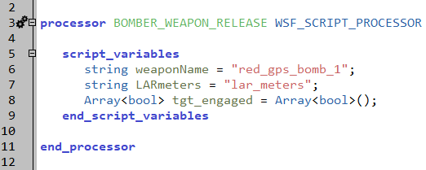
Solution: Script Variables
Variables “global” to the processor
processors/bomber_weapon_release.txt
Notes:
Script variables. Two that have the weapon names, a temporary track variable, and an array to remember if we have engaged a target yet.
Putting them here enables us to access them externally.

Slide 23
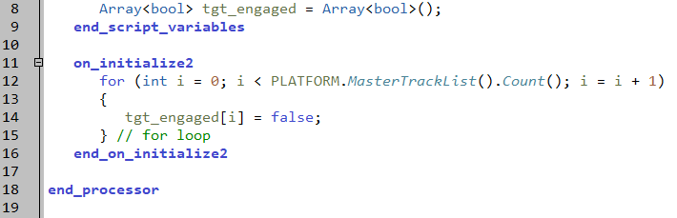
on_initialize2
Initializes “target engagement” array
Sets “false” for each track
Used “initialize2” to ensure that tracks were set up
processors/bomber_weapon_release.txt
Notes:
Be careful when auto completing methods to select ‘MasterTrackList’, and not ‘MasterRawTrackList’

Slide 24
Script fireWeapon
Fires a weapon
Confirms weapon valid, range to target
Returns status of firing attempt

Slide 25
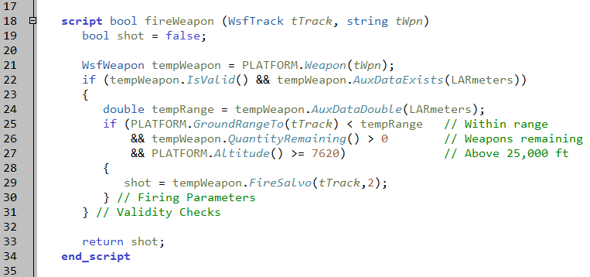
Script fireWeapon
processors/bomber_weapon_release.txt
Notes:
This script does all of the work. It receives two parameters – the track, and the name of the weapon to be used. Since it is Boolean, it sets a parameter to return later.
It gets the weapon on the platform, and confirms that it is valid.
If it is valid, then it gets the range, stored as an aux_data element, and checks against the range. If it is in range, has weapons left, and is above a certain altitude, then it tries to Fire. The result of the Fire is stored in the Boolean variable.
It then writes something if the shot occurred.
Note: FireSalvo will succeed even if there are not enough shots as requested. So, if there was only one round left, and the salvo was two, then it would fire the one and return true.
Note: this should also check to confirm that the track is valid.
The Bomber needs to be above 25,000 ft traveling 500 mph for gbu-38 to reach its target.

Slide 26
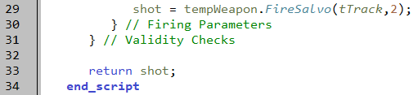
Exercise: fireWeapon Output
processors/bomber_weapon_release.txt
Add if statement
Condition: shot (true/false)
Print to output:
Name of firing platform (current platform)
Name of weapon fired
Desired Target
Current Time
Notes:
The ‘if’ may be the hardest part for most people.
Feel free to get creative here with your output formatting.

Slide 27
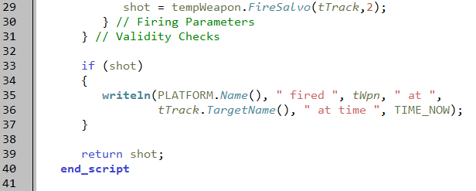
Solution: fireWeapon Output
processors/bomber_weapon_release.txt
Notes:
A basic solution. Note that multi-lines are ok.
You can try running here to make sure this doesn’t throw errors before moving on.

Slide 28
On Update Block
Processes every 3 seconds
Loops through all of the current tracks
Confirms target not already engaged
Tries to fire weapon
Records that target is engaged
Notes:
This is what the update block does

Slide 29
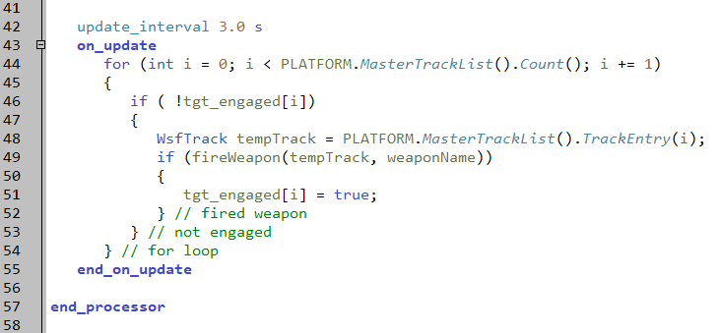
On Update Block Script
processors/bomber_weapon_release.txt
Notes:
Here is the loop that does the work.
It processes through the current tracks, and checks each one. If it fires, then it records it as done.

Slide 30
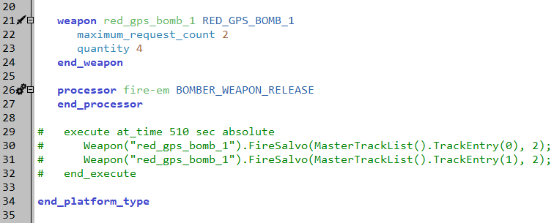
Attaching Processor to Platform
Processor name: fire-em
Processor type: BOMBER_WEAPON_RELEASE
Comment out the execute block
Run !!!
platforms/bomber.txt
Notes:
Add the processor to the platform, and delete / comment out the execute block.
It should work better now.
HELPFUL HINT: When commenting large sections, highlight the section and click “shift + 3”
Uncommenting works the same way

Slide 31
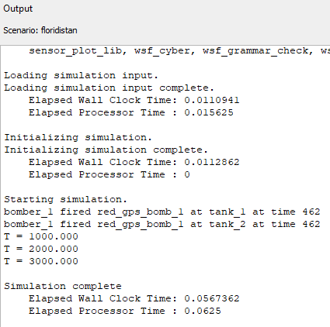
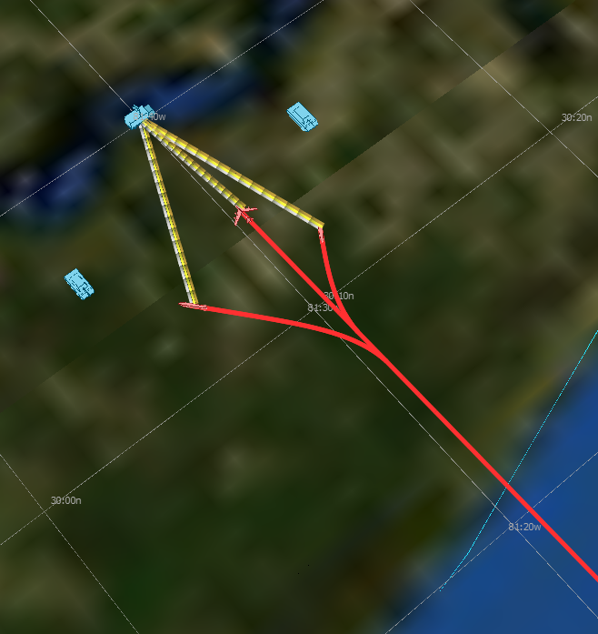
Scenario Execution
Notes:
You might get something like this

Slide 32
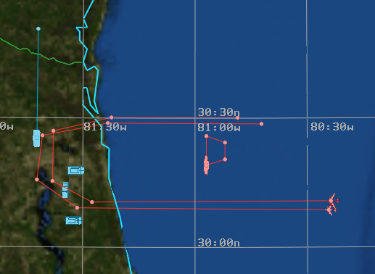
Add another bomber
Add ‘bomber_2’ to the Map Display in Wizard
Select file scenarios/red_laydown.txt
Change side to ‘red’
Altitude 30,000 ft
Heading 270 deg
Give it a route similar to
bomber_1

Slide 33
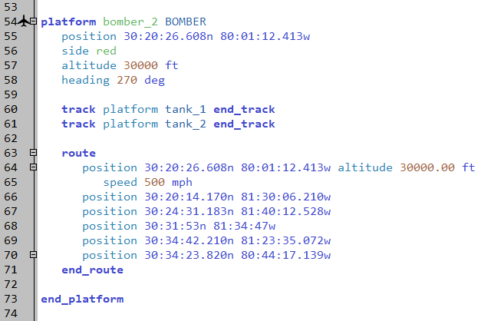
Add tracks
Pre-brief tracks to both tanks again.
Run!!!
scenarios/red_laydown.txt

Slide 34
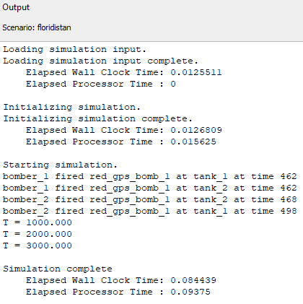
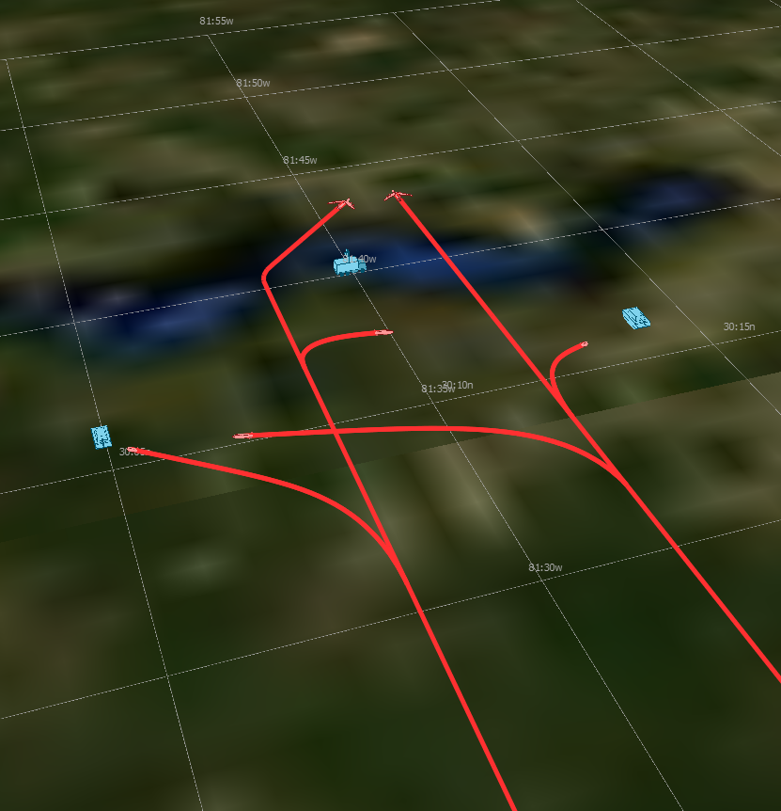
Results
Notes:
NOTE: currently, when we destroy a target with one weapon, our other weapon will detonate in the air soon after. This is because by default, we have a ‘coast_time_on_loss_of_target’ of 2 seconds.

Slide 35
Learning Objectives
You gain hands-on knowledge about:
The AFSIM scripting language
Using a script processor

