Slide 1
AFSIM User Training
9 – WsfDraw and Script Observers
AFRL/RQQD
Notes:
This version of the training has been tested with version 2.8
This lesson should take about an hour

Slide 2
Learning Objectives
You will gain hands-on knowledge about:
Using the WsfDraw capability
Creating a script observer

Slide 3
WsfDraw
Mystic and Warlock can be used to visualize these commands from an .aer file or real-time DIS exercise
Three primary types of methods:
State: change the state of the WsfDraw object
Color, line type, duration, etc.
Begin: specify type of geometry to draw
Lines, circles, ellipsoids, icons, etc.
Vertex: positions to draw items
Platform location, LLA, etc.
Notes:
WsfDraw enables us to send things to the DIS stream, which Mystic will display.
DIS = Distributed Interactive Simulation

Slide 4
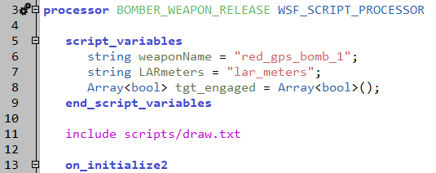
Create WsfDraw Objects
Open “processors/bomber_weapon_release.txt”
Start by adding this line after the script variables block
Create and open the file
processors/bomber_weapon_release.txt

Slide 5
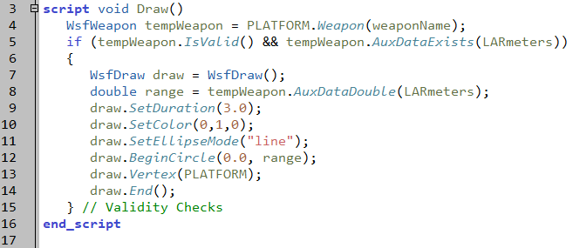
Draw Script
scripts/draw.txt
Notes:
This script sets the duration for the circle. This is not necessary, except it will cause the circle to disappear when the platform is killed.
It sets the color – RGB.
The ellipse mode says to draw an unfilled circle.
The circle will be out to the range of the weapon.
The Vertex is attached to the platform.

Slide 6
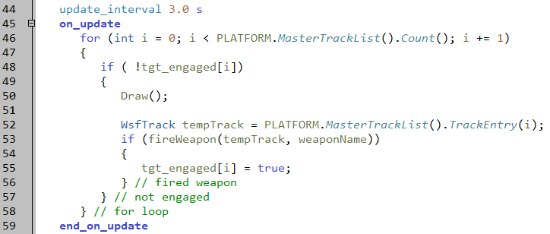
Draw Circles in the on_update Block
Draw circles while there are still targets
Run!!!
processors/bomber_weapon_release.txt
Notes:
Call the script inside of the check for the target being engaged. This way, if all targets have been engaged, the circle won’t be drawn again.

Slide 7
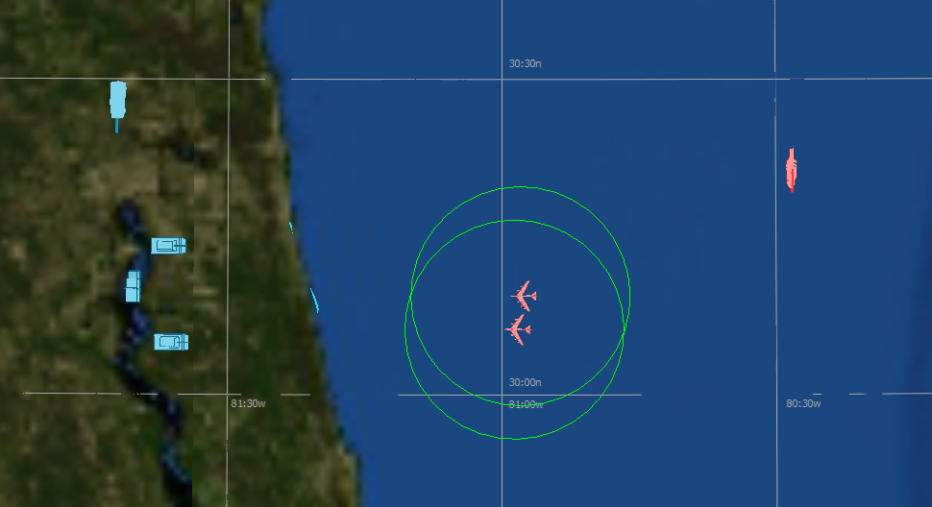
Results

Slide 8
Script Observers
Custom user-defined event output data at the simulation level.
Used as an alternative to the event_output.
Users must create the necessary scripts to capture the events
Notes:
Much better than event output. Can actually control what comes out.
For example, I can say “I want every detection attempt between this particular sensor platform and that particular target.”
But the user has to write script.

Slide 9
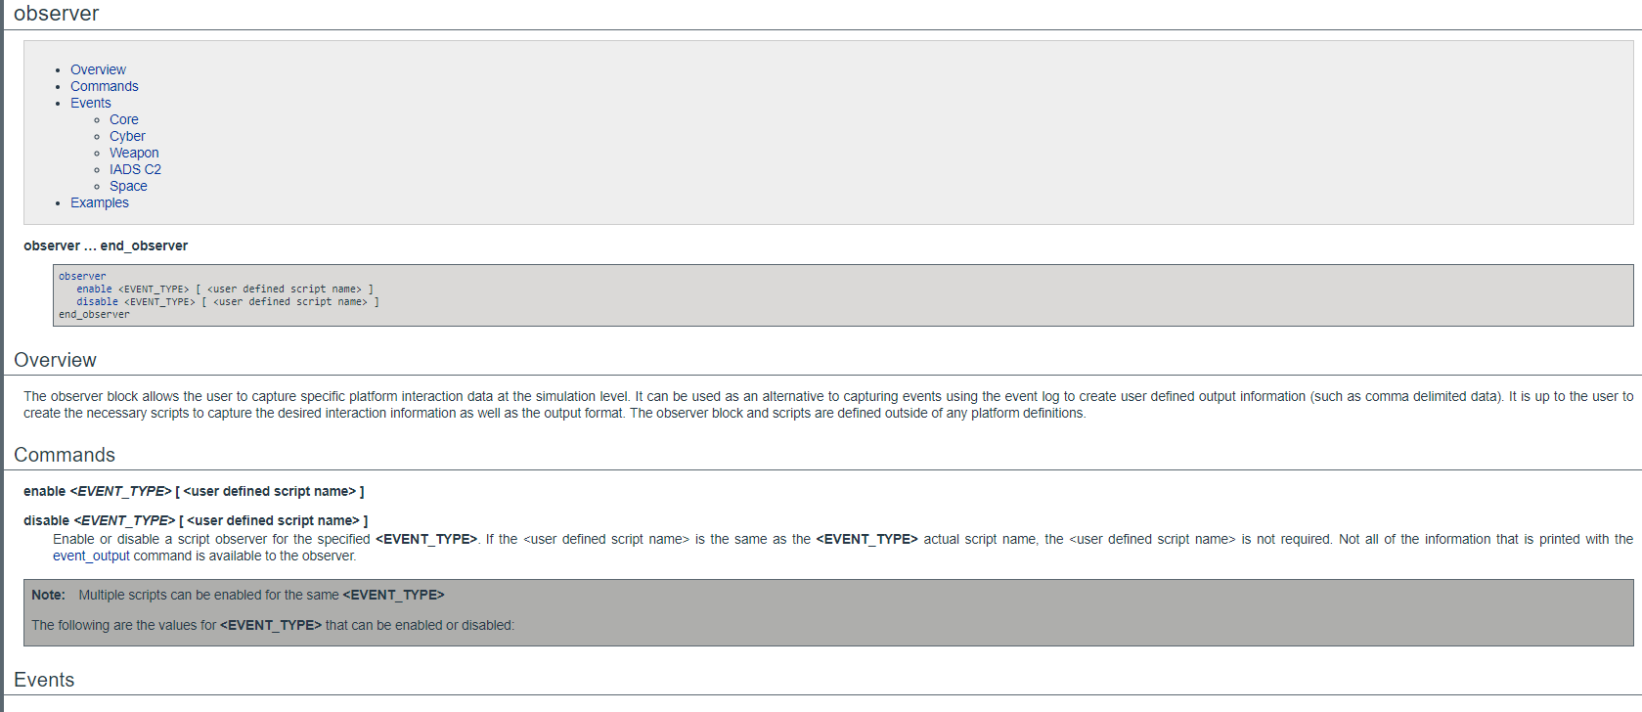
Script Observers
Currently available events to trigger a script observer found on Observer Documentation Page
9
Notes:
The list of events is not exactly the same as the event output list.
This is the script observer page. You enable and/or disable events, similar to event output.

Slide 10
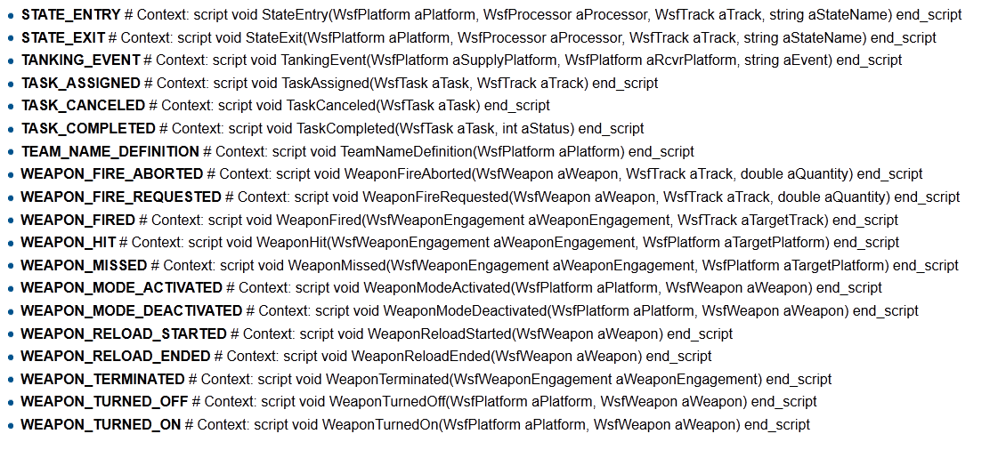
Script Observer Context
Notes:
This shows some of the events, and their associated script context.
I cheat – instead of typing these out, I copy from here and paste into Wizard.
I’m lazy that way.

Slide 11
Counting and Reporting Hits
Will use two observers:
First observer counts each hit for each platform
WEAPON_HIT event
Second observer reports results at end of simulation
SIMULATION_COMPLETE event
Will use a global Map to associate hits with a platform
The index of the Map will be the platform name
FileIO object has methods to create, open and write to a file
Notes:
The weapon hit observer will count the hits.
The simulation complete observer will print the results.
A map, indexed on platform names, and containing integers, will count the hits.
The FileIO object will write to the file.

Slide 12
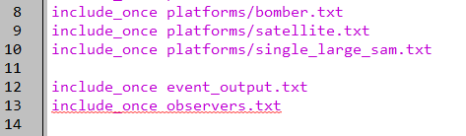
Creating Script Observers
In the “setup.txt” file in Wizard, add “include_once observers.txt”
Create and open the file
setup.txt
Notes:
Yet another file!

Slide 13
Exercise: Observer Scripts
observers.txt
Add script_variables block with:
Map named samHits
Key type: string
Value type: int
initialize with the default constructor
Add Script block for WEAPON_HIT observer
Add Script block for SIMULATION_COMPLETE observer
Add observer block and enable events
Notes:
Easy to copy and paste these script blocks from documentation.

Slide 14
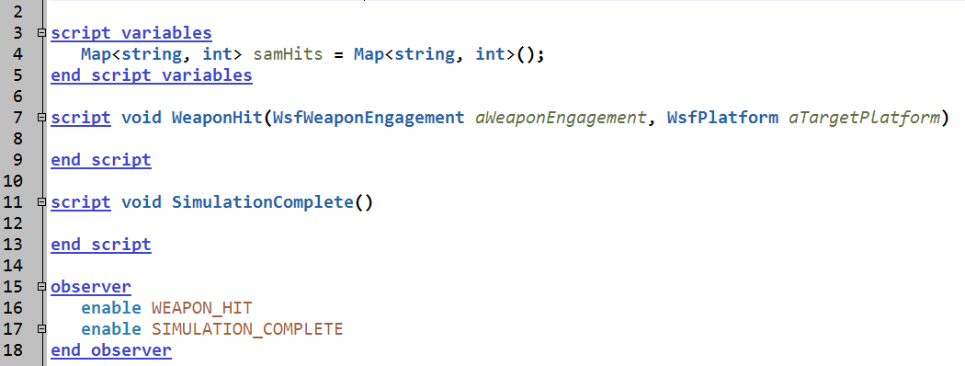
Solution: Observer Scripts
observers.txt
Notes:
When you enable WEAPON_HIT in observer, the script WeaponHit will be activated at each weapon hit.
You can create custom script names for different observer EVENTS. Just type the custom script name after the EVENT in observer.

Slide 15
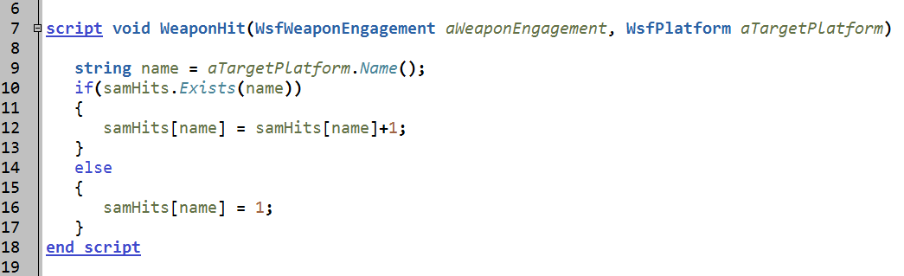
Creating Script Observers
Create/update record in samHits for every WEAPON_HIT event
Use target name as “key”
observers.txt
Notes:
The weapon hit script gets the target name, and looks at the map. If there is a value there, it increments it ( the Exists method). If there isn’t a value, then it creates one.

Slide 16
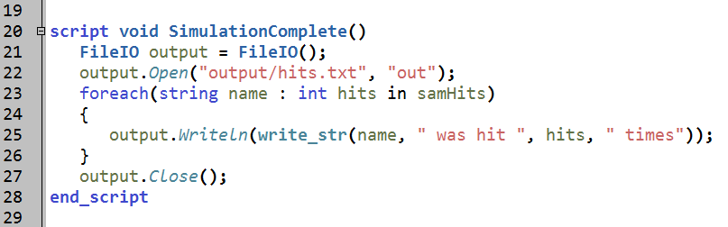
FileIO
Uses FileIO to write results to a file
Run!!!
observers.txt
Notes:
By the time they get here, it should be OK.
This opens the file – the “out” parameter causes it to create a new file.
It then parses through the map, and prints out the index and the value at that index.

Slide 17
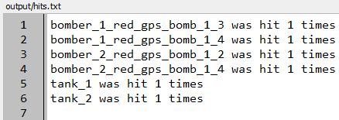
Observer Output File
Open up hits.txt
Notes:
This is what the output file looks like.

Slide 18
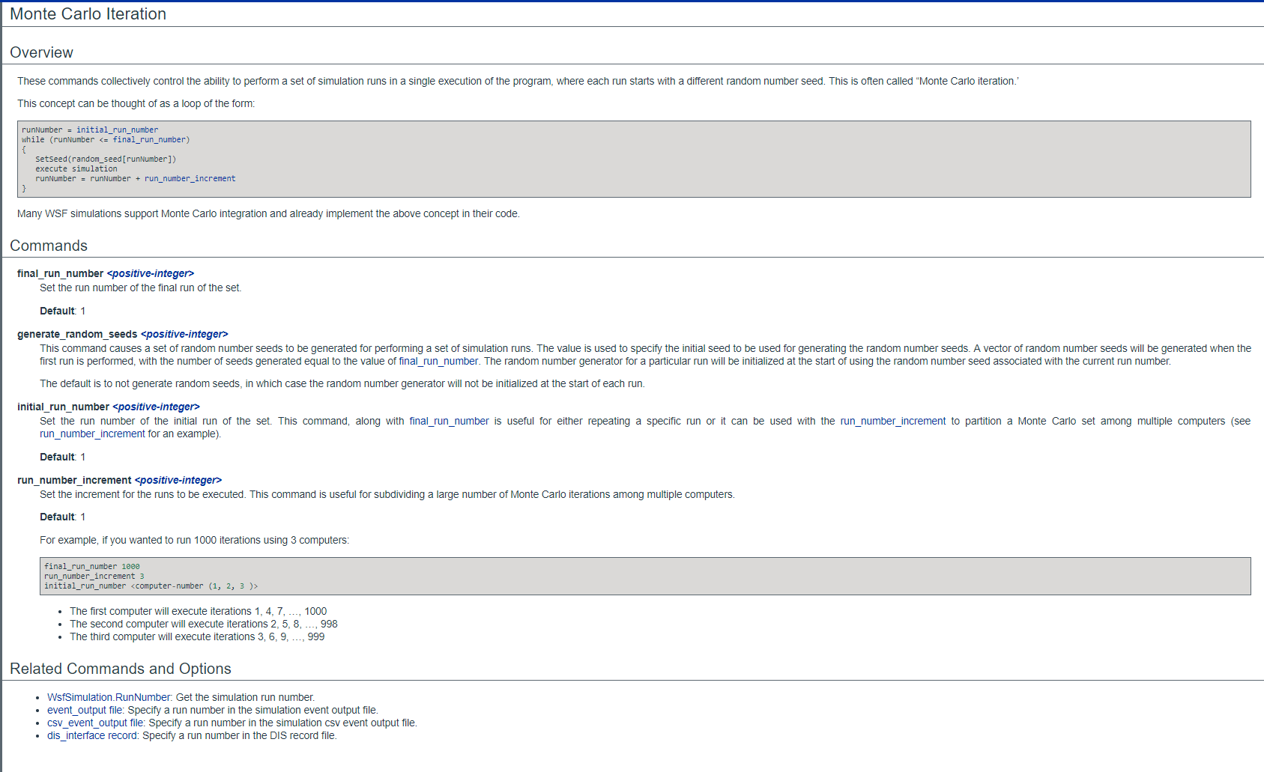
Monte Carlo Iteration
Notes:
Monte Carlo methods or experiments rely on repeated random sampling to obtain numerical results. We can do this is AFSIM!

Slide 19
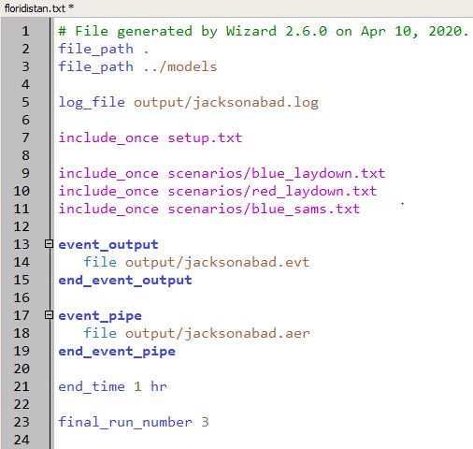
Monte Carlo Runs
floridistan.txt
Notes:
So let’s do more than one replication.

Slide 20
Issues With Replications
What problems did this create?
Overwrites the files!
Only one event and .aer files
Also, observer over-wrote its file
How to address this?
.aer and .evt files easy
Using “_%d” makes copy for each replication
Notes:
It created problems. Let’s fix them.

Slide 21
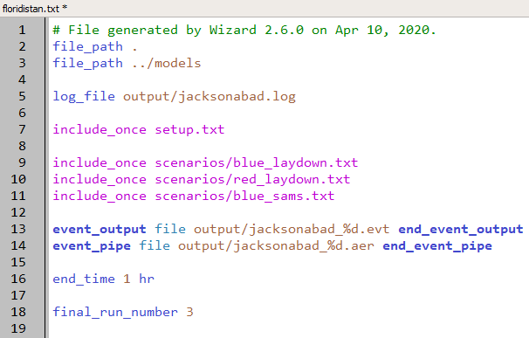
Multiple .aer & .evt Files
floridistan.txt
Notes:
The _%d will create a new file for each rep.
No, this doesn’t work in script (to the best of my knowledge.)

Slide 22
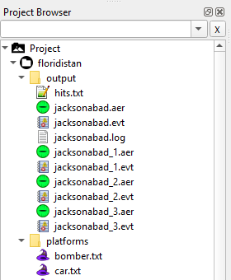
Multiple .aer & .evt Files
Notes:
We are no longer overwriting our original files.
However, we are now numbering out output files starting with 1. So our old unnumbered .aer and .evt files are still there.

Slide 23
Observer
How do you stop the observer from over-writing the files?
Hints:
Look at Documentation for the FileIO Open method
Look at Documentation for WsfSimulation methods
Notes:
So, we need to fix the output file.

Slide 24
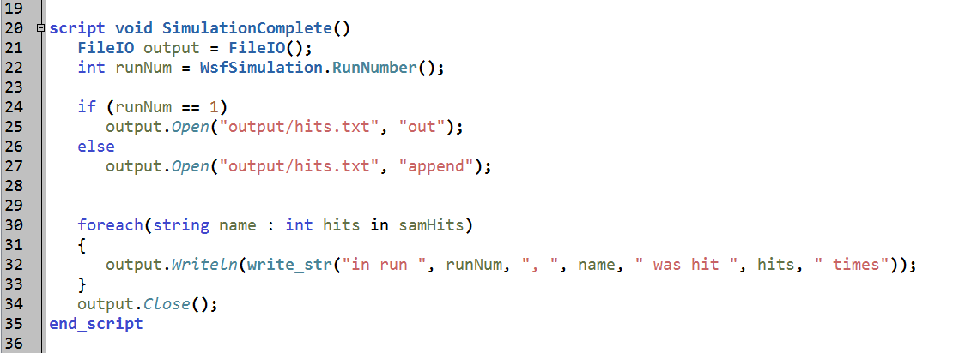
One Possible Solution
observers.txt
RUN!!!
Notes:
Get the run number, and use it to decide how to open the file – “out” to create a new one on the first run, “append” to not create a new one on the subsequent runs.
Update the write statement to include the run number
Notice that if and else statements don’t need braces if only one line.

Slide 25
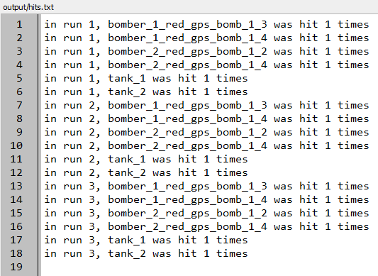
Observer Output File
Hits.txt

Slide 26
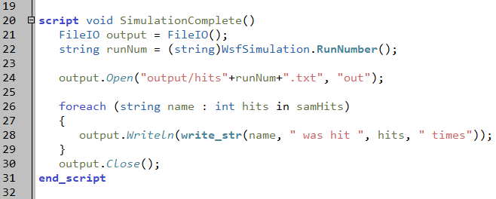
Another Solution
observers.txt
Notes:
Cast the RunNumber to a string and add it to the name of the output file.

Slide 27
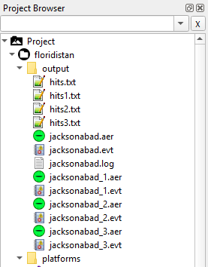
Now we have multiple observer files

Slide 28
Learning Objectives
You will gain hands-on knowledge about:
Using the WsfDraw capability
Creating a script observer
Notes:
This looks like a bunch, but it all goes together.

