Slide 1
AFSIM User Training
10 – Task Processor State Machines
AFRL/RQQD
Notes:
This version of the training has been tested with version 2.8
This Lesson should take 1.5-2 hours

Slide 2
Learning Objectives
You will gain hands-on knowledge about:
Building a TASK Processor state machine
Attaching a state machine to a platform
Notes:
It’s the short ones that get you into trouble!

Slide 3
State Machine Example – Vending Machine
Default
Not enough coins
Idle
Count Coins
Coin inserted
Reject coins
Default
Give Change
Cancel
Enough coins
Default
No selection
Dispense
Cancel
Select Soda
Selected
Notes:
Popular example of a state machine – the vending machine. It sits in the idle state, waiting for someone to put coins in it. It then counts the coins, until 1) there are enough coins, 2) the cancel button is hit, or 3) a bad coin shows up. If there are enough coins, then it waits until a selection is made or cancel is hit. When a selection is made, then something is dispensed, and change is given. It then returns to the idle state.
If reject or cancel occurs, change is given and it returns to idle.
This is not a perfect example for AFSIM, but we will use it nonetheless.

Slide 4
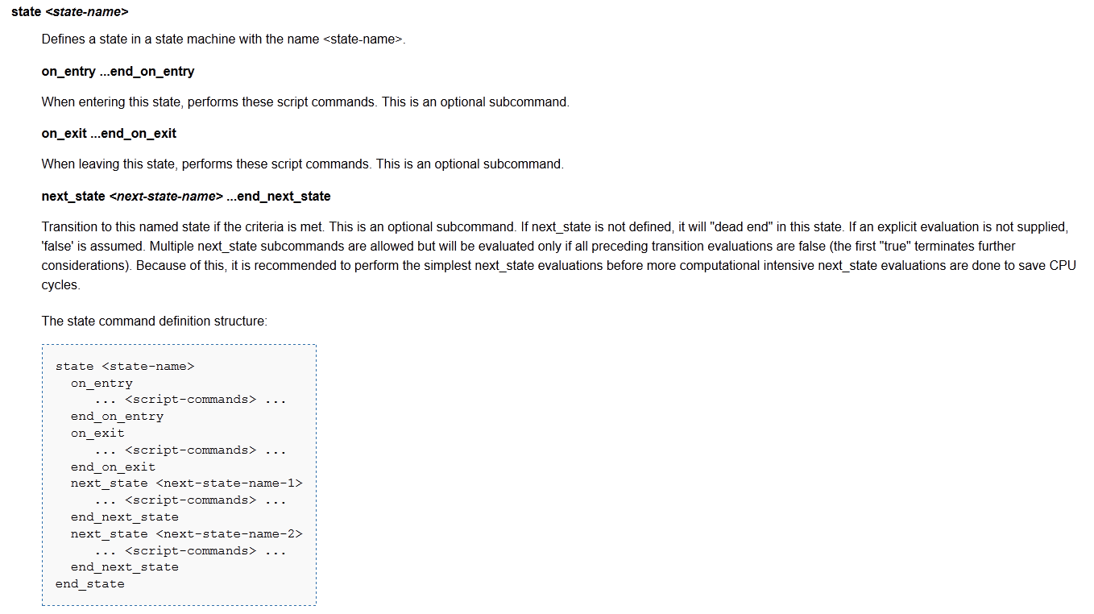
State Format
This might not always be possible!
Notes:
From the Documentation, this is the structure of a state in the task processor state machine.
It suggests that the next state blocks be arranged in order of increasing computational complexity. This is a good idea in theory, but maybe not in practice.

Slide 5
Pictorial View of a State
on_entry block
next_state block
NS_1
next_state block
NS_2
next_state block
NS_3
on_exit block
Notes:
This is a pictorial view of the state.
For every line going out of the state, you need a next_state block.

Slide 6
How the State Block Works
on_entry block
evaluation_interval
next_state block
NS_1
next_state block
NS_2
next_state block
NS_3
on_exit block
Notes:
This is how the state works. A TRACK enters the state, and immediately does whatever is in the on_entry block. The TRACK then proceeds immediately to the first next_state block (unless there is a processing time on the state, and/or a limit to the number of things that can be processed at one time.)
The next_state block is essentially a Boolean script, so it returns true or false. NOTE: if you don’t have a return, it will not transition. If it returns true, then it processes the contents of the on_exit block, and then goes to that next state.
State transitions are essentially instantaneous. In reality, there is a default time of 0.001 seconds between them.
If the next_state evaluates to false, then processing proceeds to the next next_state block. Again, true or false, out or next. This repeats until the final one is reached.
If the last one evaluates to false, then the TRACK waits for the evaluation interval, and repeats the process.
The TRACK will remain in this state until one of five things happens:
One of the next_state blocks evaluates as true
The TRACK is dropped
The processor is turned off
The platform containing the processor leaves the simulation
The simulation ends

Slide 7
Terminal State
on_entry block
Notes:
A terminal state does not have any lines leaving it, so if doesn’t have any next_state blocks. A TRACK enters this state, and just sits here until….
NOTE: even though there is not any next_state blocks, there still must be an evaluation interval for the state.

Slide 8
Task Processor State Machine Basics
The state machine works on tracks.
Each track “kicks off” the state machine.
The track starts on the first state listed in the file!
Each track is processed independently.
Timing is based on track arrival time and evaluation intervals.
When a track is purged, processing simply stops.
Notes:
This is the most important slide in the entire course.
Remember, AFSIM is TRACK centric. And the TASK processor works on tracks.
Specific examples of each of these will follow.

Slide 9
Task Processor State Machine Basics
The state machine works on tracks.
Each track “kicks off” the state machine.
The track starts on the first state listed in the file!
Each track is processed independently.
Timing is based on track arrival time and evaluation intervals.
When a track is purged, processing simply stops.
Notes:
The state machine works on tracks.

Slide 10
Task Processor State Machine Basics
The state machine works on tracks.
Each track “kicks off” the state machine.
The track starts on the first state listed in the file!
Each track is processed independently.
Timing is based on track arrival time and evaluation intervals.
When a track is purged, processing simply stops.
Notes:
Each track kicks off the state machine.

Slide 11
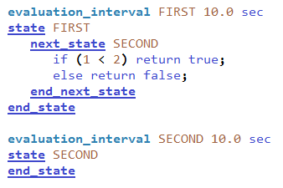
Task Processor State Machine Basics
In this example, each new track that gets created will enter the FIRST state initially.
FIRST is listed before SECOND in this processor, so it will be the first state evaluated

Slide 12
Task Processor State Machine Basics
The state machine works on tracks.
Each track “kicks off” the state machine.
The track starts on the first state listed in the file!
Each track is processed independently.
Timing is based on track arrival time and evaluation intervals.
When a track is purged, processing simply stops.
Notes:
And they can step on each other.

Slide 13
Timing Example (Part One)
State X has an evaluation interval of 10 seconds. It is used to direct the motion of a platform. Specifically, it turns directly towards the current location of the track.
Track A enters X at 21 seconds; Track B enters at 26 seconds. Both will remain until the platform reaches the track location.
Where will the platform go?
A
26
36
46
56
21
31
41
51
B
Notes:
So this shows what happens when you use a state to drive a platform, and two tracks enter that state.

Slide 14
Task Processor State Machine Basics
The state machine works on tracks.
Each track “kicks off” the state machine.
The track starts on the first state listed in the file!
Each track is processed independently.
Timing is based on track arrival time and evaluation intervals.
When a track is purged, processing simply stops.

Slide 15
Timing Example (Part Two)
State X has an evaluation interval of 10 seconds
Track A enters X at 21 seconds; Track B enters at 26 seconds. Both fail the Next State blocks
At Time 50, something happens so that the Next State block is true.
Track A will go to the Next State at 51 seconds
Track B will go to the Next State at 56 seconds
Time
A
21
31
41
51
B
26
36
46
56
Notes:
In this case, the first one that comes into the machine is the first one that comes out.

Slide 16
Timing Example (Part Three)
State X has an evaluation interval of 10 seconds
Track A enters X at 21 seconds; Track B enters at 26 seconds. Both fail the Next State blocks
Instead, at Time 45 the release event occurs allowing the tracks to go to the Next State
Now, which one is first?
Track B leaves at 46, then A at 51
Time
A
21
31
41
51
B
26
36
46
Notes:
However, in this case, the second one comes out first.

Slide 17
Task Processor State Machine Basics
The state machine works on tracks.
Each track “kicks off” the state machine.
The track starts on the first state listed in the file!
Each track is processed independently.
Timing is based on track arrival time and evaluation intervals.
When a track is purged, processing simply stops.
Notes:
A dropped track can get you into real trouble, particularly if you use the track to drive your platform.

Slide 18
Dropped Tracks
State X has an evaluation interval of 10 seconds. It is used to direct the motion of a platform. Specifically, it turns directly towards the current location of the track.
Track A enters X at 21 seconds. It is dropped at 40 seconds.
Where will the platform go?
A
41
B
31
21
Notes:
The platform continues to head towards the last known location, because there isn’t a track to change its direction any longer.
Depending on the exact nature of the commands used (go to location or turn to heading), the platform will either stop or continue moving in the last direction. This shows what happens with go to location.

Slide 19
Task Processor State Machine Basics
The state machine works on tracks.
Each track “kicks off” the state machine.
The track starts on the first state listed in the file!
Each track is processed independently.
Timing is based on track arrival time and evaluation intervals.
When a track is purged, processing simply stops.
Notes:
As a reminder….

Slide 20
State Machine Design
Sam Logic:
Detect target
If it is friendly, ignore it
If engagement parameters are met, engage it
Engage target
Fire at target
Wait to see if target is killed
If engagement parameters are still met, re-engage
Detected
Engage
Wait
Ignore
Notes:
It looks like this – four states.
I like to start with detected, even if it doesn’t actually do anything. However, in this case, it is the place where we wait until engagement parameters are met.
The engage state takes the shot.
The wait state waits until the missile flyout is finished, and then goes back to engage
The ignore state is a place for things we don’t want to handle.

Slide 21
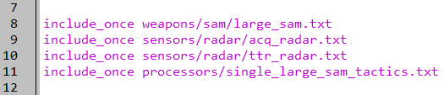
Create a Task Processor
Create a new processor file:
In the “single_large_sam.txt” file in Wizard, add the following line “include_once processors/single_large_sam_tactics.txt”
Create and open the new file
platforms/single_large_sam.txt
Notes:
Create the new file.
All of the states we type out coming up will go inside this processor (before end_processor command).

Slide 22
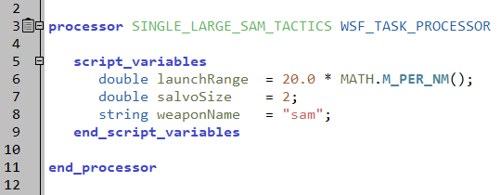
Script Variables
WSF_TASK_PROCESSOR for SAM
What script variables do we need?
Launch range
Salvo Size
Weapon name
processors/single_large_sam_tactics.txt
Notes:
We need some script variables. Putting them here enables us to access them later.

Slide 23
Script “CanEngage()”
We want to write a script that checks the following engagement parameters and returns a bool
Valid weapon
Enough weapons to fire a salvo
Valid Target
Target is within range
We aren’t currently shooting at the target
Notes:
There are MANY solutions to this. Because it’s just going to output, we don’t need to worry about their particular formatting.
If you wanted, you could add the processor to the SAM platform and run it to test (you’ll get some fun errors). Otherwise you’ll have to wait until the processor is done to test it.

Slide 24
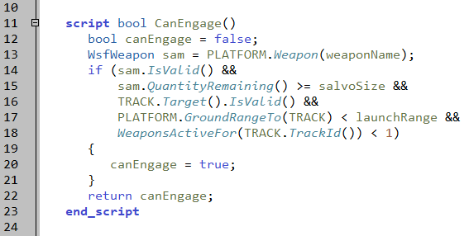
CanEngage()
processors/single_large_sam_tactics.txt
Notes:
WeaponsActiveFor() is a Weapon Task Method. You can read more in the documentation for WsfTaskManager

Slide 25
Exercise: State Layout
processors/single_large_sam_tactics.txt
Mock up states with all necessary next_state blocks
No logic – just empty blocks!
DETECTED is the entry-point (first state)
Define evaluation interval of 10 sec for all states except IGNORE (24 hours)
DETECTED
ENGAGE
WAIT
IGNORE
Notes:
Just like in our earlier examples, the arrows correspond with state transition conditions (i.e. next_state blocks).
States go *inside* processor.
Order of states in solution MATTERS. Location of eval intervals does not.

Slide 26
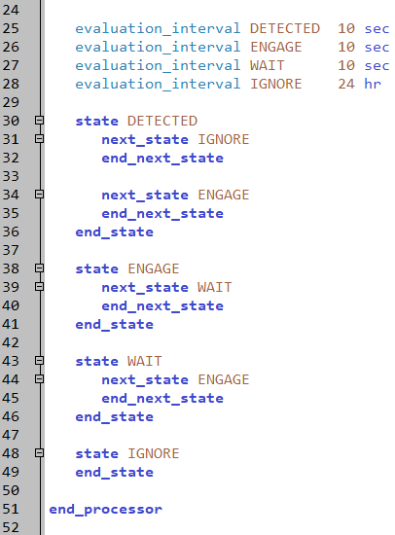
Solution: State Layout
processors/single_large_sam_tactics.txt
DETECTED
ENGAGE
WAIT
IGNORE
Notes:
It looks like this – four states.
I like to start with detected, even if it doesn’t actually do anything. However, in this case, it is the place where we wait until the target is in range.
The engage state takes the shot.
The wait state waits until the missile flyout is finished, and then goes back to engage
The ignore state is a place for things we don’t want to handle.

Slide 27
State #1 Code - DETECTED
evaluation_interval determines how often the next_state blocks are evaluated
First next_state block determines friendly status
If it is friendly, we go to the terminal state “IGNORE”
Second next_state block calls our CanEngage() script
Go to ENGAGE state if we can
Notes:
The first state – it has two next_state blocks.

Slide 28
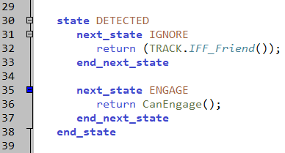
State #1 Code - DETECTED
processors/single_large_sam_tactics.txt
next_state IGNORE
Return true/false:
track is friendly
next_state ENGAGE
Return true/false:
If we can engage
Notes:
First next_state block – if it’s friendly, ignore it.
Second next_state block – when engagement parameters have been met, go to ENGAGE.

Slide 29
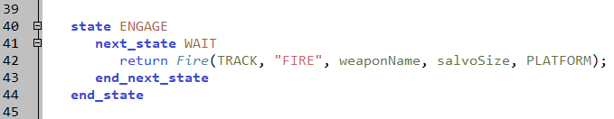
State #2 Code - ENGAGE
Fire is a task processor method
Returns true if successful task assignment is made
processors/single_large_sam_tactics.txt
Notes:
Again, Fire creates an assignment, and sends it to the weapon “weaponName” (which is “sam” in this case) on the platform PLATFORM. The assignment contains the track TRACK, the current track being processed at this state.
The second parameter, a string, is the type of the assignment. This can be used for sorting assignment in script.

Slide 30
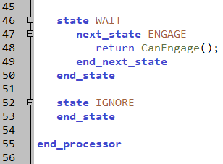
State #3 Code - WAIT
next_state block is identical to the one we wrote in our DETECTED state
Notes:
Nothing happens in our IGNORE state

Slide 31
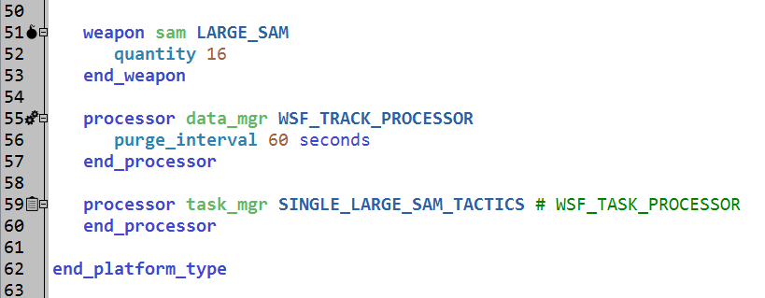
Update SAM Platform Definition
Task manager is now SINGLE_LARGE_SAM_TACTICS type
Run!!!
platforms/single_large_sam.txt
Notes:
This doesn’t do anything unless you put it on the platform.
This should cause things to be shot.

Slide 32
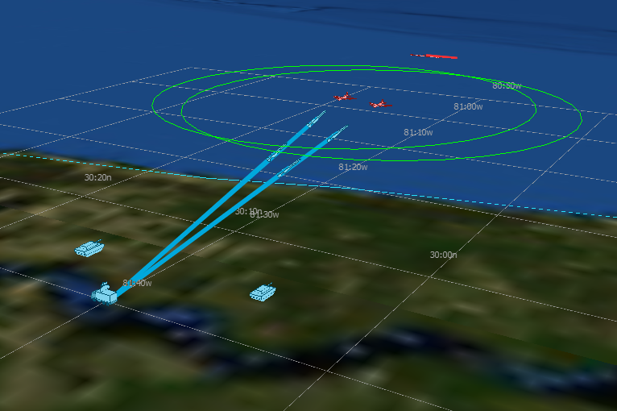
Program Execution
Notes:
Like this.

Slide 33
Learning Objectives
You will gain hands-on knowledge about:
Building a state machine
Attaching a state machine to a platform
Reminder: For task processors…
The state machine works on tracks.
Each track “kicks off” the state machine.
The track starts on the first state listed in the file!
Each track is processed independently.
Timing is based on track arrival time and evaluation intervals.
When a track is purged, processing simply stops.
Notes:
Last time for the state machine basics.

Slide 35
Backup Slides

Slide 36
State Machine Example – Landline Telephone
Default
Dialing
Pick-up
Number Accepted
Timeout
Number
Rejected
Hang-up
Hang-up
Default
Timeout
Idle
Dead Line
Ringing
Busy
Default
Timeout
Hang-up
Call Answered
Incoming Call
Call
Dropped
Ringing
In-Call
Hang-up
Pick-up
Default

Slide 37
Vending Machine – Transactional View
Default
Not enough coins
Idle
Count Coins
Coin inserted
Reject coins
Default
Give Change
Cancel
Enough coins
Default
Dispense
Cancel
Select Soda
No selection
Selected
“Transaction” starts and ends with coins entering and leaving machine
Notes:
The vending machine is not really a good “track based” example.
However, if we view the transaction as the track, then we do have a view that works. But, in this view, the vending machine is never idle, so we don’t need this state. The transaction – dropping coins in the machine, starts the state machine.

Slide 38
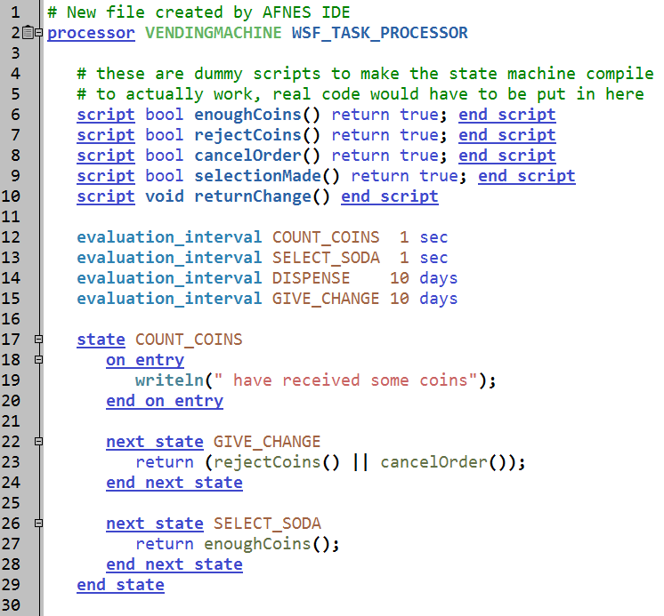
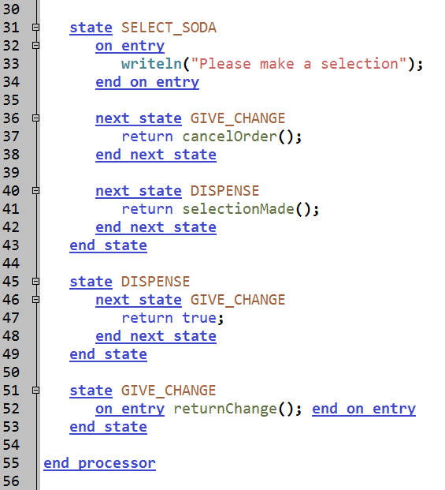
Transactional View Code
Notes:
This is what that would look like as an AFSIM processor.
The evaluation_intervals are put all in one place. Notice that they are not the same length. Also notice that they do not go inside the state.
All of the hard work is done in the scripts at the beginning.
The first state counts the coins. It also includes two options for reaching the cancel state. Although the picture has two arrows, they are, in reality, the same arrow, with just different conditions.
The next state waits until something happens – selection or cancellation.
The dispense state automatically advances to the give change state.

Slide 39
Code Details
The “object” being “tracked” is a transaction.
This processor assumes that the transaction will be “dropped” shortly after it is finished, i.e., drink is dispensed
The actual state machine is only 37 lines long
The processing has been moved to scripts
Different states have different evaluation intervals
Terminal nodes don’t have to re-evaluate
Every state MUST have an evaluation interval
Evaluation intervals are usually put near the state
What kind of machine does this processor assume?
Single product type, all with the same price
Notes:
The TRACK is the transaction.

Slide 40
Task Processor State Machine Basics
The state machine works on tracks.
Each track “kicks off” the state machine.
The track starts on the first state listed in the file!
Each track is processed independently.
Timing is based on track arrival time and evaluation intervals.
When a track is dropped, processing simply stops.
Notes:
Each track kicks off the state machine.

Slide 41
Vending Machine – Customer View
Default
Not enough coins
Idle
Count Coins
Coin inserted
Reject coins
Default
Give Change
Cancel
Enough coins
Default
No selection
Dispense
Cancel
Select Soda
Selected
Notes:
There is another way to build the vending machine – assume it has some type of sensor that detects the presence of a person. The TRACK would then be the customer.
In this case, the idle state would remain, representing the machine waiting for something to happen.

Slide 42
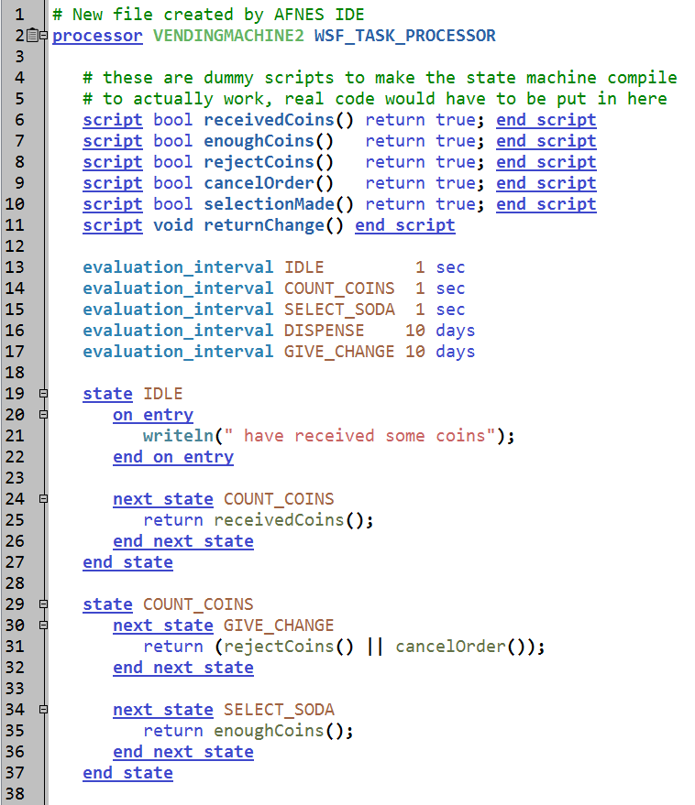
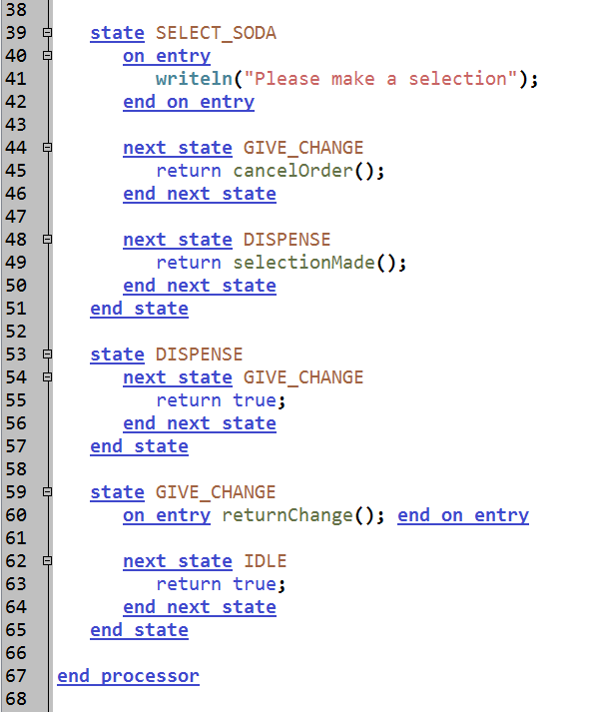
Customer View Code
Notes:
This first state is now the IDLE state.
The rest of this works just like the previous example.
Note: the on_entry in the IDLE state is wrong – it should be in the COUNT_COINS state.

Slide 43
Customer View Code Details
The “object” being “tracked” is a customer
Enables the customer to continue putting coins back into the machine
When customer leaves, it will be dropped
The state machine code is only 47 lines
What problems would need to be considered in either model?
What happens when a second “track” shows up?
What happens when a customer walks away?
Notes:
What happens when there are two people detected? Whose money is counted?
Also, if someone walks away before completing the transaction, what happens to their money?

Slide 44
Another State Machine Example
Human
Bitten
Bitten
Zombie
Bitten
Vampire
World War Z
Walking Dead
Werewolf
Go fast
Go slow
Staked
Silver Bullet
Brains blown out
Cursed - Soul
Wait for the Daughter…
Own Series
Dead
Happily Ever After
Notes:
Here is another example. Zombies are very popular these days. You start as human, get bitten, and become a zombie. Your brains get blown out, and you are dead.
There are other supernatural creatures – vampires and werewolves.
There are other possible outcomes for these creatures besides death.

Slide 45
“state” vs “next_state” blocks
States correspond with “state” blocks
Human
Transitions correspond with “next_state” blocks
Human
Bitten
Bitten
Bitten
Bitten
Bitten
Zombie
Bitten
Zombie
Vampire
Vampire
World War Z
Walking Dead
Werewolf
Werewolf
Go Fast
Go Slow
Staked
Staked
Silver Bullet
Brains blown out
Brains blown out
Silver Bullet
Wait for the Daughter…
Cursed - Soul
Wait for the Daughter…
Cursed - Soul
Own Series
Own Series
Dead
Dead
Happily Ever After
Happily Ever After
Notes:
To tie this in with our Bites Example:
-States are state blocks
-Transitions are next_state blocks

Slide 46
BITES State Machine Example
Human
Bitten
Bitten
Zombie
Bitten
Vampire
World War Z
Walking Dead
Werewolf
Go Fast
Go Slow
Staked
Brains blown out
Silver Bullet
Cursed - Soul
Wait for the Daughter…
Own Series
Dead
Happily Ever After
Notes:
Back to the vampires!
The TRACK will be the person.

Slide 47
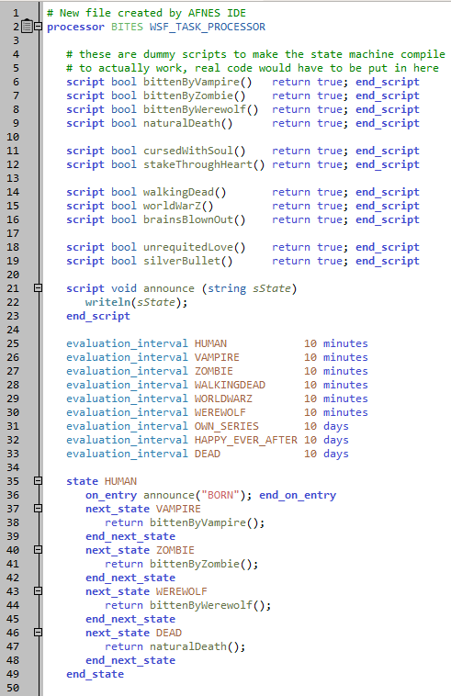
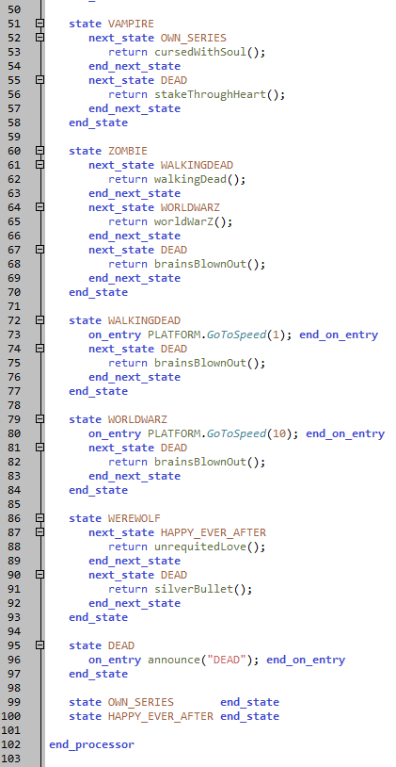
BITES Processor Code
Notes:
This is the processor.

Slide 48
BITES Code Details
The “object” being “tracked” is the victim
The state machine code is 65 lines
Specific example:
A boy is born at 10:00 pm one evening. His parents keep him in the house his entire life. On his 21st birthday, decides to walk down to the corner pub for a pint. It is eight minutes away.
He leaves the house at 10:01 pm. He has a VERY bad walk. He is bitten three times by three different types of creatures. They do not, however, delay his walk.
He enters the bar at 10:09, feeling fine.
At 10:11, what does he order when he walks up to the bartender?
Beer, TruBlood™, Brain Smoothie, or Piña Colada
Notes:
Only one next_state block can have an effect, regardless of how many might evaluate to true.
And for the youngsters in the room, the song is Werewolves in London by Warren Zevon.

