Slide 1
AFSIM User Training
11 – Command Chains,
Reporting, and Communication
AFRL/RQQD
Notes:
This version of the training has been tested with version 2.8
This Lesson should take 1.5-2 hours

Slide 2
Learning Objectives
You gain hands-on knowledge about:
Defining a command chain
Defining communications and links

Slide 3
AFSIM Comms: 3 Pieces
Command Chains
Hierarchical Map
Can be used for addressee: Commander, Peer, etc.
Comm Devices
Allows external platform communications
Reporting
Specifies where messages go – who tells what to whom
Uses external linkage, can leverage command chain, but isn’t required
2
1
3
2
1
3
2
?
Notes:
Command chains are just a way of organizing platforms hierarchically. They can also get confusing very quickly when multiple command chains are used.
Comm devices enable communications and reporting EXTERNAL to a platform. Reporting is not just command chains, although they can help a user specify where they want their messages to go.

Slide 4
Command Chains
commander <commander-name>
command_chain <command-chain-name> <commander-name>
Platform subcommands that specify the immediate superior of a given platform, used to direct orders and / or reports
Command chains consist of commanders, subordinates and peers
Each chain must have a commander (could be SELF)
A platform can be in multiple command chains
A platform can have multiple commanders (on different chains)
Will not produce compile error if commander does not exist
Wizard will flag the platform name, but program will execute
Notes:
Command chains are defined by the boss, not the subordinates.
A command chain must exist to assign commanders on it.

Slide 5
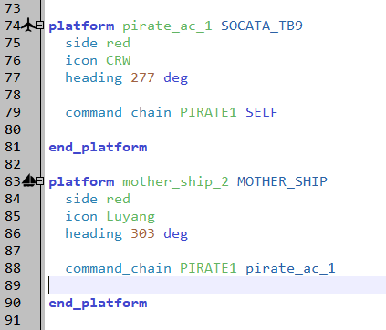
Commander Command Example
Defines the commander of the platform
Notes:
This is an example from the distribution.

Slide 6
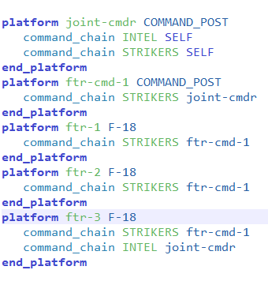
Command Chain Example (from Documentation)
joint-cmdr
ftr-cmd-1
ftr-1
ftr-2
ftr-3
STRIKERS
INTEL
Notes:
This is from the wiki. The strikers chain has five items in it.
There is a second command chain, INTEL, with only two platforms.
When you look at “joint-cmdr” subordinates, you must specify which command chain. In the STRIKERS chain, his subordinate is ftr-cmd-1. In the INTEL chain, his subordinate is ftr-3.

Slide 7


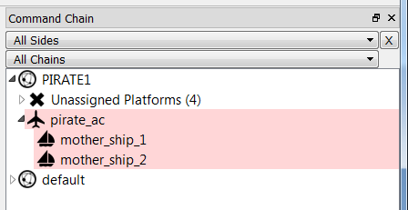

Command Chain Browser
Same command chain for all three platforms
Aircraft commander is SELF
Top of command chain
Ships subordinate to aircraft commander
Notes:
The command chain browser lets you build and look at command chains. This is really powerful.
As a specific example, if you consider a model with many radars, commanders and SAM systems, spread out over many different files, then the command chain browser lets you trace through the command chains very easily (once you find the platform in the chain, of course.)

Slide 8
Platform Defaults
Every Platform has the following default values:
Command Chain
Commander name SELF
Command Chain name “default”
Use caution when parsing a command chain
Test for top of chain:
if( PLATFORM.Commander().Name() == PLATFORM.Name() )
Notes:
Every platform has a default chain, with itself as the commander.
When parsing up a chain, the last item will have a commander. So, you can’t just look for a platform without a commander. You must look for a platform that has, as its commander, itself. That is the top of the chain.

Slide 9
AFSIM Comms: 3 Pieces
Command Chains
Hierarchical Map
Can be used for addressee: Commander, Peer, etc.
Comm Devices
Allows external platform communications
Reporting
Specifies where messages go – who tells what to whom
Uses external linkage, can leverage command chain, but isn’t required
2
1
3
2
1
3
2
?
Notes:
Command chains are just a way of organizing platforms hierarchically. They can also get confusing very quickly when multiple command chains are used.
Comm devices enable communications and reporting EXTERNAL to a platform. Reporting is not just command chains, although they can help a user specify where they want their messages to go.

Slide 10
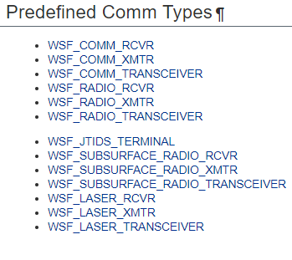
Pre-defined Communication Devices
COMM represents a perfect (wired) communication device
JTIDS TERMINAL is a built-in Link-16 device
RADIO is a radio device, limited to line-of-site communication
SUBSURFACE enables comms with platforms below the surface (see the Documentation for details)
TRANSCEIVER is two-way
RCVR only receives
XMTR only transmits
Notes:
These are the pre-defined communication devices. The words say it all.

Slide 11
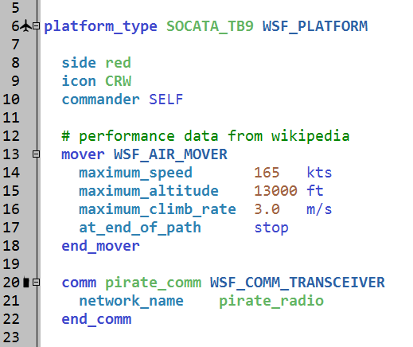
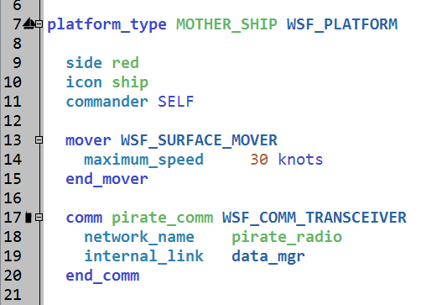
Defining Comm Devices
Communications devices are platform parts.
Same network_name indicates these comms can communicate with each other, by default
Link to other parts on the platform or messages don’t go anywhere
Notes:
The network name is the crucial part. Because these two communication devices have the same network name, they can talk to each other.
WSF_COMM_NETWORK_MESH_LEGACY is the default comm network topology.

Slide 12
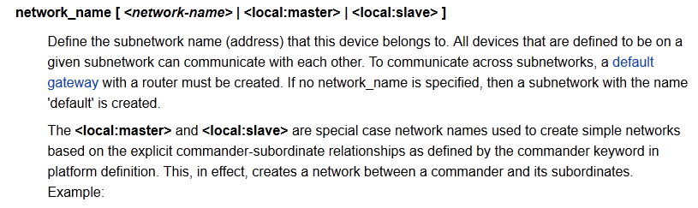
Simple Commander-Subordinate Networks
DO NOT use DEFAULT and “named” networks on the same platform.
Notes:
There is another option – the master/slave approach. This works well for large tree structures. It is used in many of the distributed cases.
However, it has a problem. If the command chain structure changes in the run, this does not work anymore.
Personally, I don’t see the need to use master/slave. If the command structure is set up correctly, and the processors well-defined, you don’t need this.
Clarification: Command chain usage with comms in general is only provided for legacy support, typically because this is how SUPPRESSOR scenarios work.
Continued modelling of scenarios in this way should be highly discouraged due to the difficulties in maintaining such scenarios and adding additional capabilities/functionality.
Suggestion:
Usage of master/slave should be removed from all training to avoid continued ‘bad habits’ in scenario development.

Slide 13
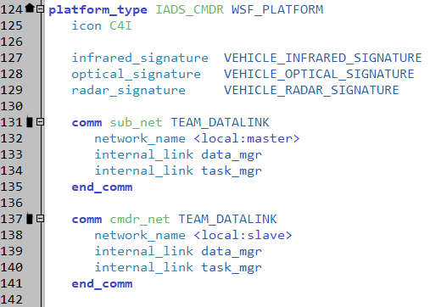
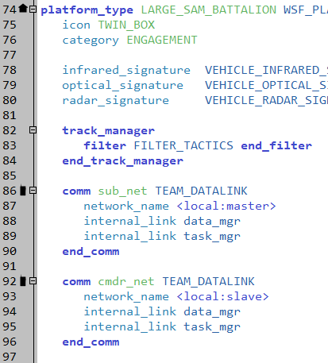
Built-in Network Example
Using <local:master> and <local:slave> as the network_name creates a network piggybacking on the defined command chain.
Powerful when comm device is included in a file across many scenarios.
<local:master> = “I am the commander on this datalink.”
<local:slave> = “I am the subordinate on this datalink.”
Maximum 255 comms on networks created using <local:master> and <local:slave>
Notes:
This shows how the master/slave is used. The IADS_CMDR talks to the subordinate, the LARGE_SAM_BATTALION, using the sub_net device. It is received on the cmdr_net device on the LARGE_SAM_BATTALLION, which it uses to talk back to its commander.
Notice that these two platforms have two identical blocks of commands. This suggests the use of the “include” command.
Clarification for potential questions:
All the local master/slave commands provide is a way of substituting a common string network_name value across comms s.t. they share the same network.
The string name in such instances is “master:<commander-platform-name>”.
Because all networks that aren’t defined in AFSIM use default settings, the dynamic addressing of this network only allows 255 members, and is mesh.
This can be changed while still using the master/slave mechanism if the user defines this network in the scenario:
network “master:<commander-platform-name>” WSF_COMM_NETWORK_STAR ← Different network type instead of mesh
network_address 192.168.0.0/16 ← Larger subnet addressing for more comm members
hub_named <commander-platform-name> <commander-platform-comm-name>
end_network

Slide 14
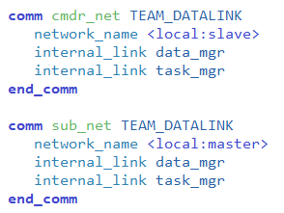
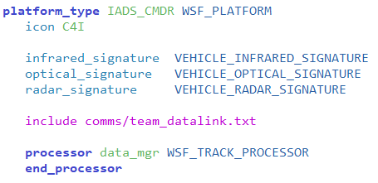
Alternate Approach – Using “Include”
Include causes code to be inserted in each file:
Notes:
Include will include the contents of the file every time it is hit. This works well for some applications. This is just one.
Some people use “include” to include common scripts in processors, platforms, etc.

Slide 15
AFSIM Comms: 3 Pieces
Command Chains
Hierarchical Map
Can be used for addressee: Commander, Peer, etc.
Comm Devices
Allows external platform communications
Reporting
Specifies where messages go – who tells what to whom
Uses external linkage, can leverage command chain, but isn’t required
2
1
3
2
1
3
2
?
Notes:
Command chains are just a way of organizing platforms hierarchically. They can also get confusing very quickly when multiple command chains are used.
Comm devices enable communications and reporting EXTERNAL to a platform. Reporting is not just command chains, although they can help a user specify where they want their messages to go.

Slide 16
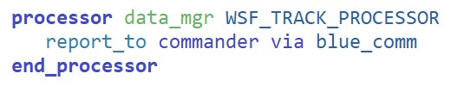
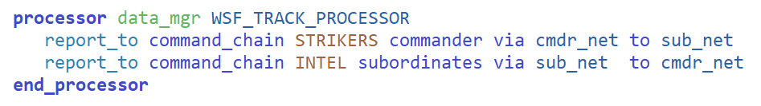
Reporting Commands: external_link & report_to
Routes messages to specified recipients via comm
Identify:
Command Chain (if not specified, “default” will be used)
Recipients (commander, peers, or subordinates)
Sending comm (expects receiving comm name to match sending comm name)
Receiving comm (optional)
Required on Script & Track processors, but not Task processor
2
1
3
5
4
Notes:
The PLATFORM.SetCommander() does not work completely: it will not update the comm device links.

Slide 17




Reporting Commands: alternatives to using command chain
Command chain usage is not required.
Explicit linkage using platform name and comm name
Addresses (more advanced comm usage)
Groups (not covered in training, see in documentation)
2
1
3
5
4
Notes:
Command chains are just one way of helping dictate where a message goes. Depending on use case, there are other methods to accomplish reporting without involving command chains at all.

Slide 18
AFSIM Comms: 3 Pieces
Command Chains
Hierarchical Map
Can be used for addressee: Commander, Peer, etc.
Comm Devices
Allows external platform communications
Reporting
Specifies where messages go – who tells what to whom
Uses external linkage, can leverage command chain, but isn’t required
2
1
3
2
1
3
2
?
Notes:
Command chains are just a way of organizing platforms hierarchically. They can also get confusing very quickly when multiple command chains are used.
Comm devices enable communications and reporting EXTERNAL to a platform. Reporting is not just command chains, although they can help a user specify where they want their messages to go.

Slide 19
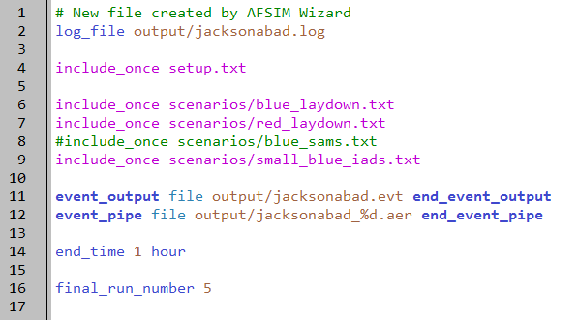
Replace blue_sams Scenario File
small_blue_iads.txt found in models directory
Go grab this file and bring it locally
floridistan.txt
Notes:
So, all that work we did on the single large SAM is being thrown out now. It is being replaced with an IADS.
Again, make sure to have Wizard reparse after bring the file locally, so that when you open it, you’re opening the local version as opposed to the one found in models

Slide 20

Blue IADS Hierarchy
10_iads_cmdr
100_radar_company
3500_large_sam_battalion
200_ew_radar
300_ew_radar
3510_acq_radar
3520_large_sam_ttr
3530_large_sam_launcher
3540_large_sam_launcher
3550_large_sam_launcher
Notes:
This is what the IADS will look like. The IADS works like this:
The EW radars detect something, produce a track, and send it to the radar company. The radar company correlates those tracks, and sends them to the IADS commander.
The IADS commander selects a subordinate, the large SAM battalion, to engage the track.
The large SAM battalion assigns the acquisition radar to the TRACK, and then assigns the large SAM TTR to it as well. When the battalion knows where the track is, and it is in range, it uses one of the large SAM launchers to fire at it.
Let’s go through each of those steps in detail.

Slide 21
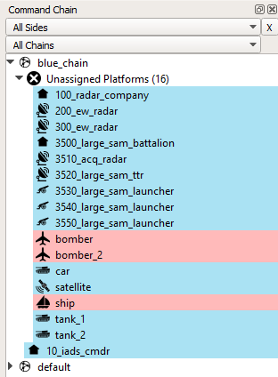
Command Chain Browser
Open Command Chain browser
Just click and drag platforms on blue_chain
Notes:
So, now it’s time to do things.
Create the command chain so this will work. You will need to approve it when you are finished.

Slide 22
Exercise: Blue IADS Hierarchy
10_iads_cmdr
100_radar_company
3500_large_sam_battalion
200_ew_radar
300_ew_radar
3510_acq_radar
3520_large_sam_ttr
3530_large_sam_launcher
3540_large_sam_launcher
3550_large_sam_launcher
Notes:
This is the hierarchy you are building. It is in your handout.

Slide 23
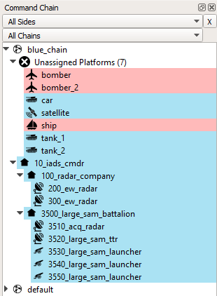
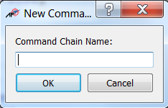
Solution: Command Chain
Can also use this panel to define command chain with names
Notes:
Running should produce errors and warnings.

Slide 24
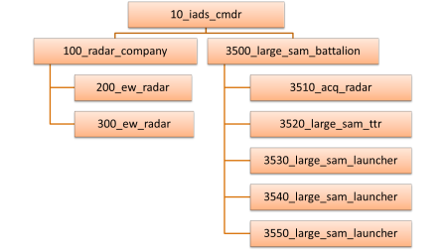
Exercise: Comm Devices scenarios/small_blue_iads.txt
Add comm devices to “commanders”
Name comm blue_comm
For each comm:
Inherit TEAM_DATALINK
Add network_name blue_net
Add internal_links to track & task processors
Notes:
Most (all?) of the platforms in this IADS have these links.
This IADS works by passing assignments around. ANY platform that can send or receive assignments must have a track and task processor.

Slide 25
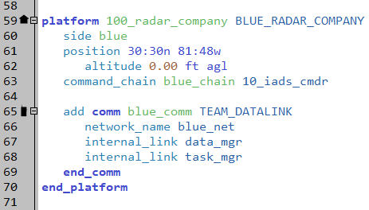
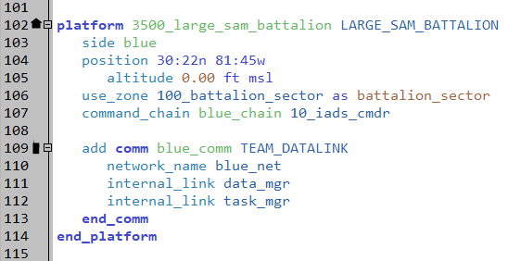
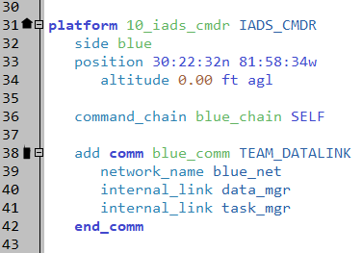
Solution: Comm Devices scenarios/small_blue_iads.txt
Add comm devices to “commanders”
Why go to both processors?
Notes:
Most (all?) of the platforms in this IADS have these links.
This IADS works by passing assignments around. ANY platform that can send or receive assignments must have a track and task processor.

Slide 26
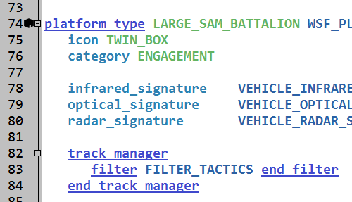
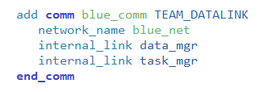
Two Internal Links platforms/large_sam_battalion.txt
This comm device has two internal links
Where do they go?
Track Processor (data_mgr)
Task Processor (task_mgr)
Why go to both processors?
How does this SAM system work?
Notes:
Most (all?) of the platforms in this IADS have these links.
This IADS works by passing assignments around. ANY platform that can send or receive assignments must have a track and task processor.

Slide 27
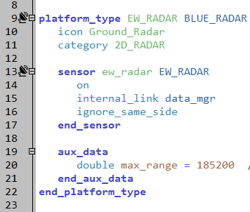
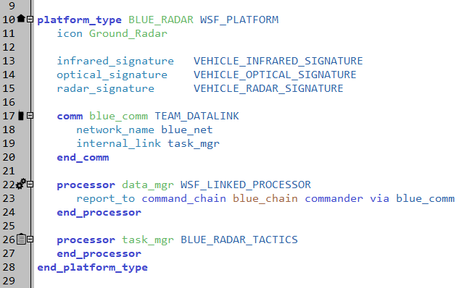
EW Radars platforms/ew_radar.txt, platforms/blue_radar.txt
The Early Warning (EW) radar:
Object class EW_RADAR, derived from BLUE_RADAR object class
EW_RADAR object has an EW_RADAR sensor called ew_radar
This sensor is on
Linked to the data_mgr
The WSF_LINKED_PROCESSOR data_mgr reports automatically to commander
All sensor tracks go to the commander
Notes:
The EW radar is derived from the BLUE_RADAR. The BLUE_RADAR has a linked processor, which sends tracks to its commander. The task processor controls when the radar turns on and off.
The EW_RADAR defines the specific sensor, and the aux_data element defining the range of the sensor.
This approach allows us to make many different specific radars, that will all act the same.
Note: the linked processor does not update the master track list. It just sends raw tracks to its commander. From the commander’s perspective, this platform is essentially the same as a sensor part on the platform. (There are some subtle differences, but I don’t want to go into them now.)

Slide 28
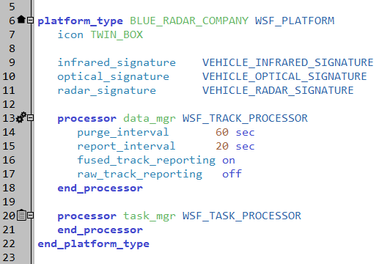
EW Radar Company Commander platforms/blue_radar_company.txt
The radar commander:
Object class BLUE_RADAR_COMPANY
WSF_TRACK_PROCESSOR data_mgr receives tracks from comm devices
WSF_TRACK_PROCESSOR derived from WSF_LINKED_PROCESSOR
The data_mgr processor performs two tasks:
Fuses tracks
Reports tracks automatically to IADS commander
Notes:
The commander receives the (raw) sensor tracks, via sub_net, and sends them to the track processor. The track processor correlates them, and sends the fused (correlated) tracks to its commander.
It has a simple task processor, for receiving assignments.

Slide 29
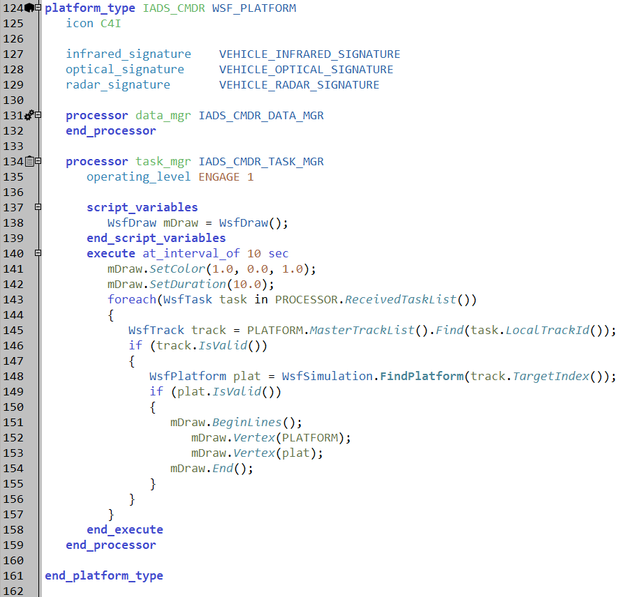
IADS Commander platforms/iads_cmdr.txt
The IADS commander:
Object class IADS_CMDR
IADS_CMDR_DATA_MGR data_mgr receives tracks from comm devices
WSF_TRACK_PROCESSOR
Processor task_mgr assigns targets to subordinates
Based on tracks in the Master Track List
Notes:
The IADS commander receives the tracks and puts them in its track processor for correlation. The task processor assigns targets to the subordinates, the SAM battalion.

Slide 30
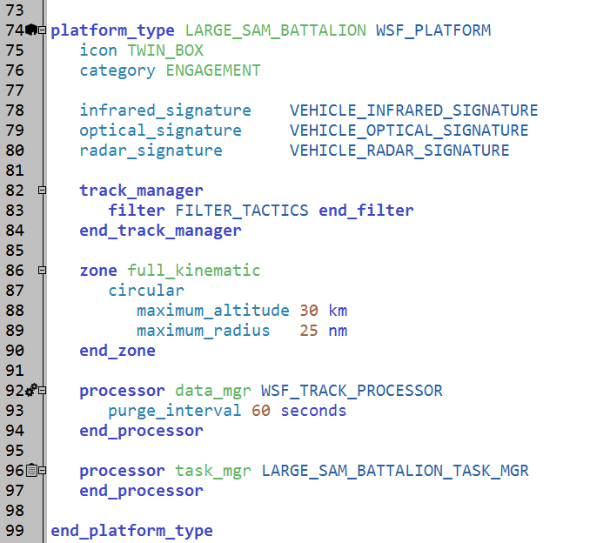
Large SAM Battalion platforms/large_sam_battalion.txt
The Large SAM Battalion:
Object class LARGE_SAM_BATTALION
Standard data_mgr receives tracks from comm devices
From commander and subordinates
Purges tracks after 60s.
WSF_TRACK_PROCESSOR
LARGE_SAM_BATTALION_TASK_MGR task_mgr turns on sensors and orders missiles firing
BLUE_SAM_BATTERY_TASK_MGR
Replaces two scripts in the parent processor class
Notes:
The large SAM battalion receives the assignment; the track goes to the track processor, and the assignment goes to the task processor.
Under the hood, the task processor sends a message back to the commander acknowledging receipt of the assignment. If this doesn’t happen for some reason, the assignment will time out at some later point in time.
Also, because there is an active assignment, the track will not be dropped as long as the assignment is active, regardless of purge intervals set on the track processor. A “task complete” or “cancel” is necessary for the track to be dropped.

Slide 31
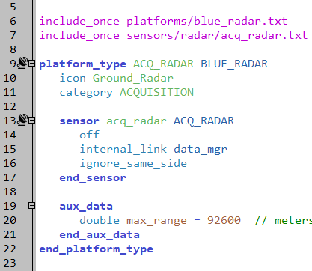
SAM Acquisition Radar platforms/acq_radar.txt, platforms/blue_radar.txt
The SAM Acquisition Radar:
Object class ACQ_RADAR
BLUE_RADAR is parent class
comm, data_mgr and task_mgr defined in parent
data_mgr reports to commander
Sensor defined on ACQ_RADAR
Linked to data_mgr
What does this setup allow us to do?
Can define multiple platforms that will all act the same way, just with different sensors
.
Notes:
The acquisition radar is set up the same was as the EW radar, using the same base type. It obviously works the same way.

Slide 32
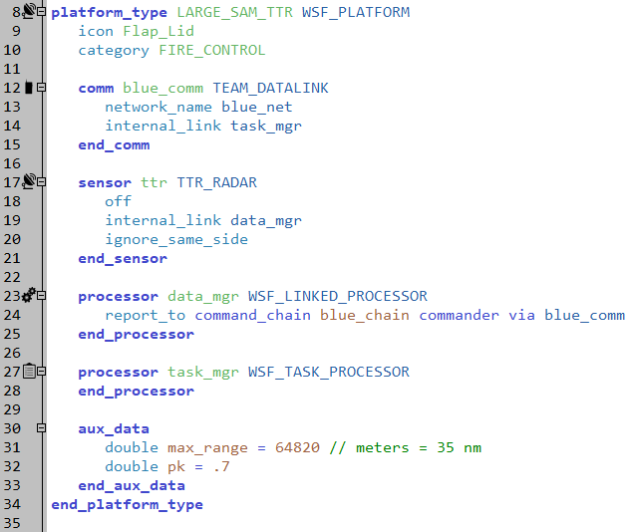
SAM Target Track Radar platforms/large_sam_ttr.txt
The Target Track Radar (TTR):
Object class LARGE_SAM_TTR
Sensor ttr defined here
TTR_RADAR object class
Standard data_mgr receives tracks from ttr sensor
Sends tracks to commander via comm device
Notes:
The TTR is different.

Slide 33
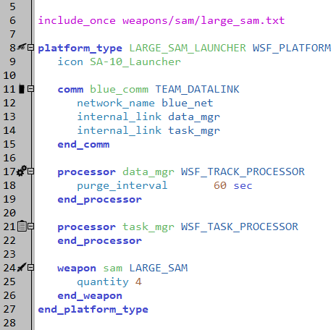
Large SAM Launcher platforms/large_sam_launcher.txt
The Large SAM Launcher:
Object class LARGE_SAM_LAUNCHER
Weapon sam instantiated here
LARGE_SAM object class
Weapon firing performed in the task manager in the SAM Battalion
Standard data_mgr and task_mgr
No logic to actually launch weapons!
How do weapons get launched?
.
Notes:
The launcher is very simple – just a weapon and some processors. However, the task processor does not have any script associated with it to actually do the shooting.
How does shooting happen????

Slide 34
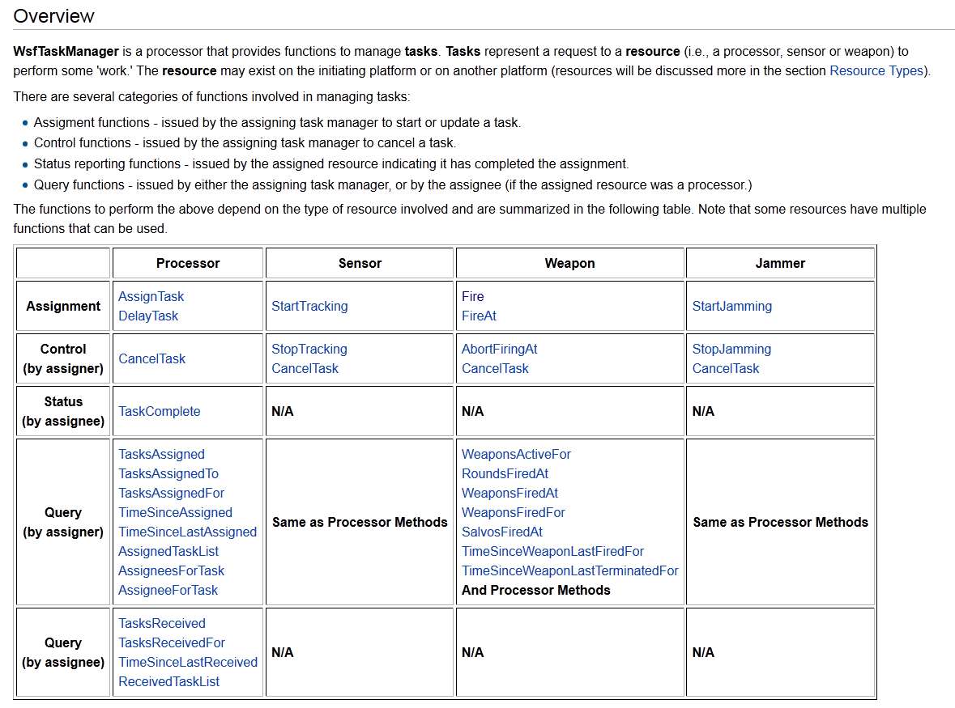
WsfTaskManager
Notes:
Assignments!

Slide 35
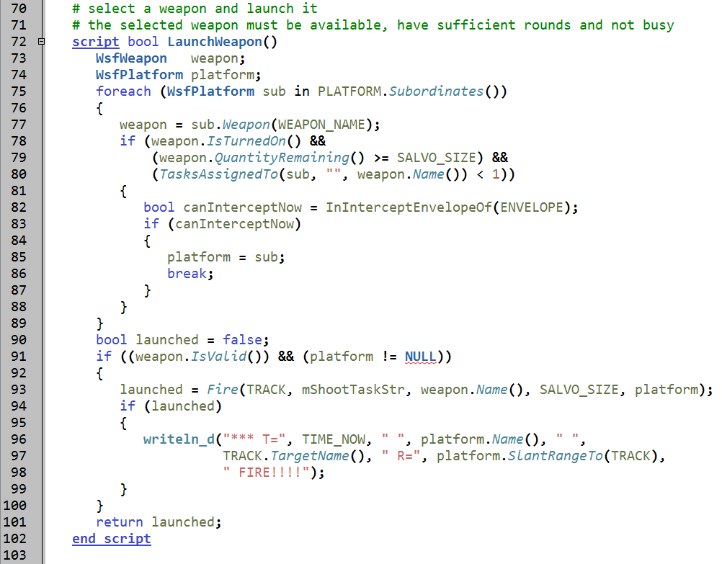
Fire Assignment, Not Method, Used processors/blue_sam_battery_tactics.txt
Notes:
This is where the magic starts – in the battalion task processor, with the Fire assignment.
It finds a subordinate that can shoot, and then ASSIGNS that subordinate to Fire.

Slide 36
How This Really Happens
The Fire method creates a task assignment
This assignment is sent to the launcher
The assignment contains the track
The launcher receives the assignment and attempts to fulfill it
The task processor on the launcher will tell the weapon to fire
When the weapon fires, the task is complete
When the task is complete, the task processor sends a WsfTaskComplete message
NOTE: the task processor has no script!
The task complete message is sent automatically
Notes:
Under the hood, the subordinate takes the shot, and sends back two messages: 1) I received the assignment, and 2) I completed the assignment.

Slide 37
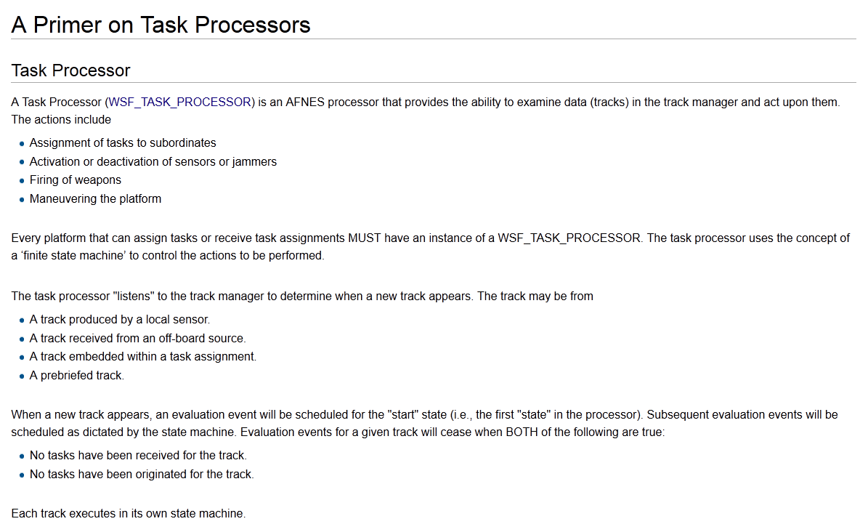
Task Processor Primer
Notes:
Important note regarding use of ASSIGN

Slide 38
Exercise: external_link scenarios/small_blue_iads.txt
Add report_to on track processor
edit track processor
Use command_chain blue_chain
Report to commander
via appropriate comm device
Notes:
Most (all?) of the platforms in this IADS have these links.
This IADS works by passing assignments around. ANY platform that can send or receive assignments must have a track and task processor.

Slide 39
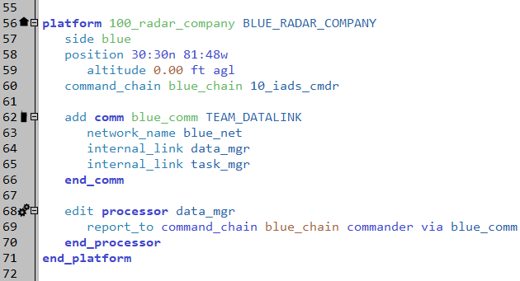
Solution: external_link scenarios/small_blue_iads.txt
Forwards all tracks reported by EW to 10_iads_cmdr
RUN !!!
Notes:
Most (all?) of the platforms in this IADS have these links.
This IADS works by passing assignments around. ANY platform that can send or receive assignments must have a track and task processor.

Slide 40
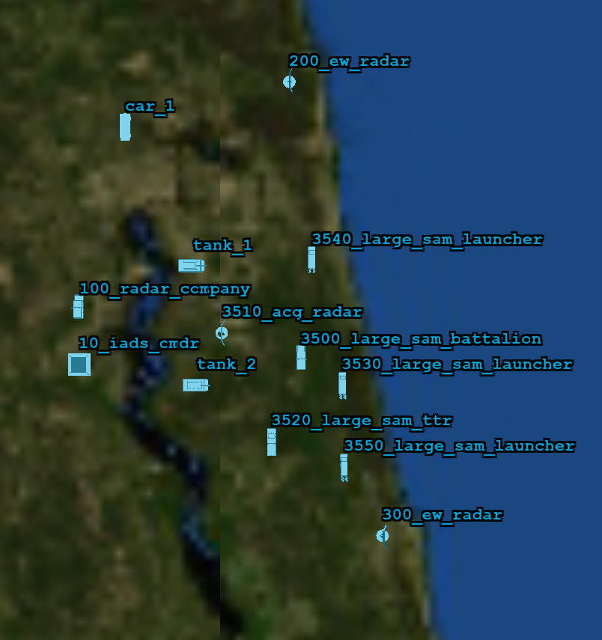
Small Blue IADS Placement
You might want to move the new platforms around your tanks

Slide 41
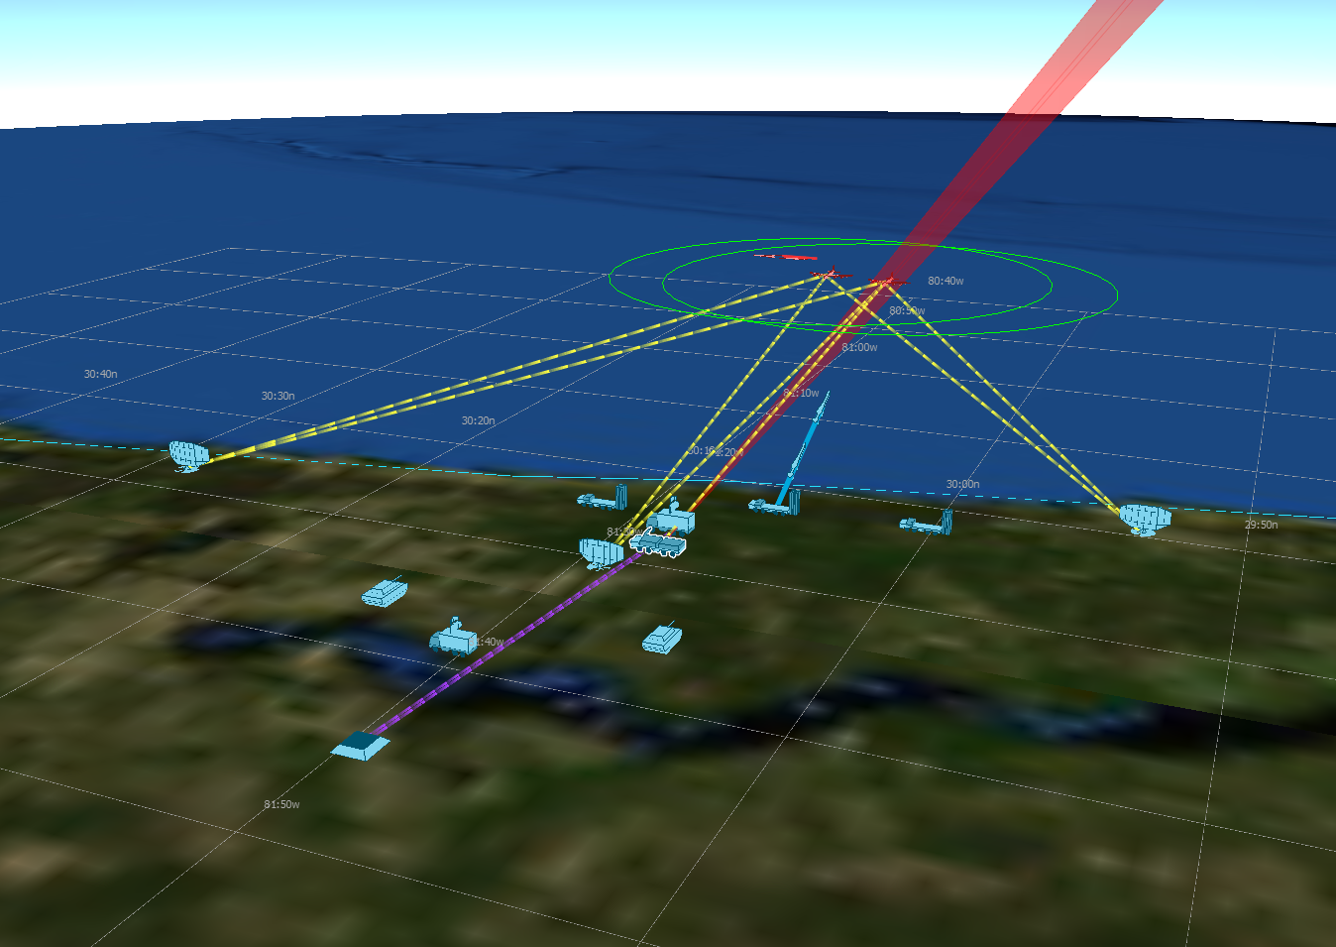
Execution
Notes:
Does your IADS protect your tanks? If not, what can you do to improve your IADS?
Possible Solutions:
Allow incidental damage on your large sam
Increase your pk on your large sam
Up your maximum request count on TRACK mode for your TTR
Only shoot 1 weapon at a time to conserve weapons for other targets

Slide 42
Learning Objectives
You gain hands-on knowledge about:
Defining a command chain
Defining communications links
Notes:
This looks like a bunch, but it all goes together.

Slide 44
Final Note: AFSIM Comms
Command Chain
Named network
DEFAULT network
command_chain iads_chain cmdr
commander cmdr
network_name my_network
network_name <local:master>
network_name <local:slave>
2
2
2
1
3
1
3
1
3
5
4
5
4
5
4
Links: none
Hierarchy: command_chain or commander
Routing: none w/o links
Links: network_name
Hierarchy: none
Routing: none w/o hierarchy
Links: none w/o commander
Hierarchy: none
Routing: none w/o links & hierarchy
Notes:
NOTE: This is wrong – local/master local/slave is NOT the default network – everything in the default network is connected
Red lines represent connections between comms; blue arrows represent command chain (hierarchy) connections.
These illustrate (from left-to-right):
-what links/hierarchy/routing capability we get with a command chain
- “ with a Named network
- “ with the DEFAULT network
The report_to_group may enable the “named network” example to send messages, but the others are impaired.

Slide 45
Final Note: AFSIM Comms
Named chain + Named network
DEFAULT chain + DEFAULT network
network_name my_network
command_chain iads_chain cmdr
network_name <local:master>
network_name <local:slave>
2
1
1
3
2
3
4
5
4
5
Links: network_name
Hierarchy: command_chain
Routing: external_link
Links: <local:…> + commander
Hierarchy: commander
Routing: external_link and/or <local:…>
Notes:
Red lines represent connections between comms; blue arrows represent command chain (hierarchy) connections.
These illustrate (from left-to-right):
-what links/hierarchy/routing capability we get with a Named chain and Named network
- “ with the DEFAULT chain and DEFAULT network

