Slide 1
AFSIM User Training
13-Warlock Overview
AFRL/RQQD
Notes:
This version of the training has been tested with version 2.8

Slide 2
Learning Objectives
You gain hands-on knowledge about:
What Warlock is
How Warlock compares to Mission
Basic Features of Warlock

Slide 3
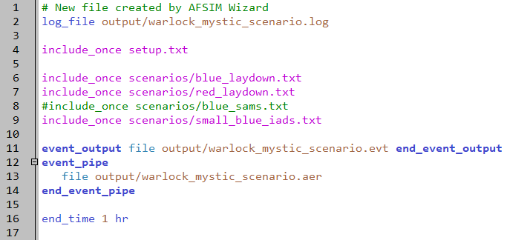
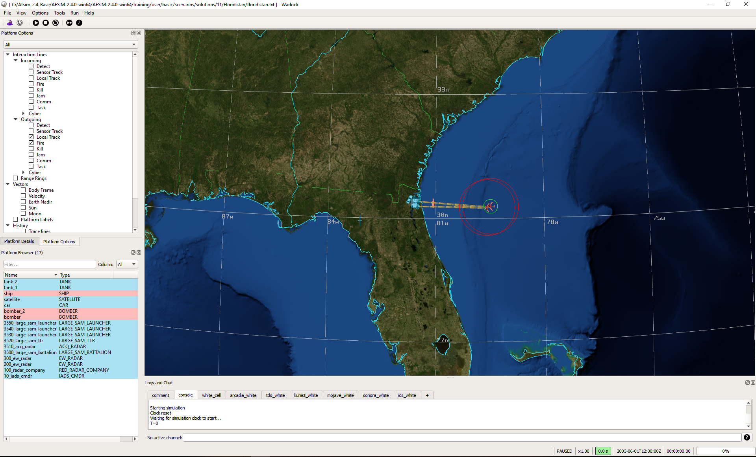
What is Warlock?
An Operator-in-the-Loop (OITL) tool that is integrated with AFSIM into a single executable
Provides data visualization to gain insights into AFSIM decision making and execution
Has the ability to control AFSIM entities for both war-gaming and analysis
Human Interaction

Slide 4
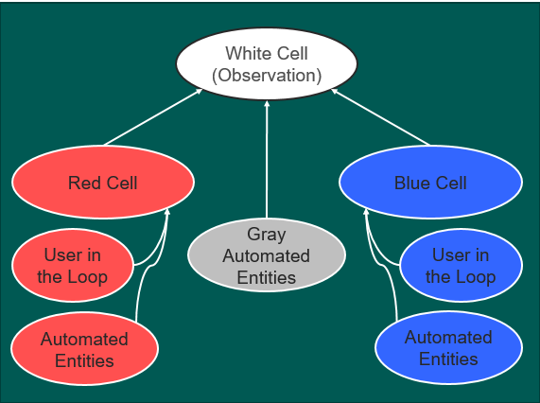
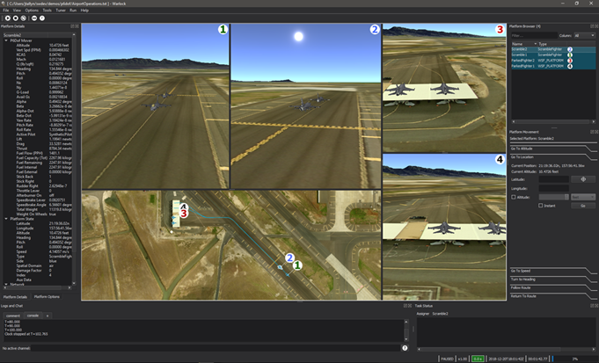
Practical Applications of Warlock
Supports a variety of simulation and analysis domains
Engagement
Mission
Operational
Supports white/red/blue cell analysis
Unrestricted and restricted views/controls
Distributed Operations
Allows for multiple views/sides to be run at the same time and interact

Slide 5
Warlock vs. Mission
Mission
User Interface & Data Displays
Warlock

Slide 6
Warlock vs. Mission
Warlock | Mission
Only runs real time or multiples of real time Does not support Monte Carlo mode | Runs constructively by default Does support Monte Carlo mode
Can run as an independent application, through Wizard, or via the command line | Can be executed through Wizard or via the command line
Loads Warlock plugins as well as AFSIM/Mission Plugins | Only loads AFSIM/Mission Plugins
Notes:
Virtual Simulation: the operator can modify the behavior of the simulation
Constructive Simulation: the operator puts inputs into the simulation but isn’t involved in determining outcomes

Slide 7
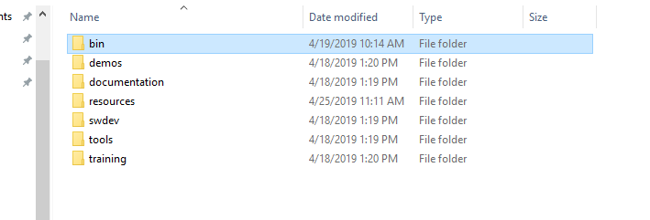

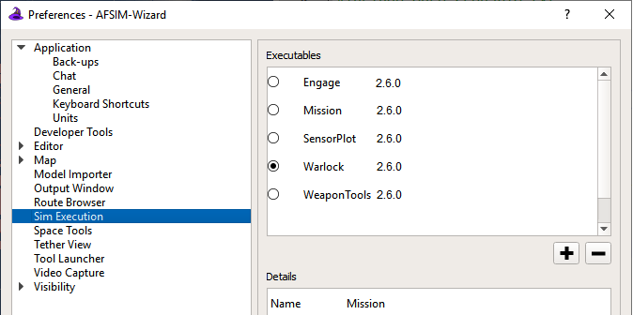
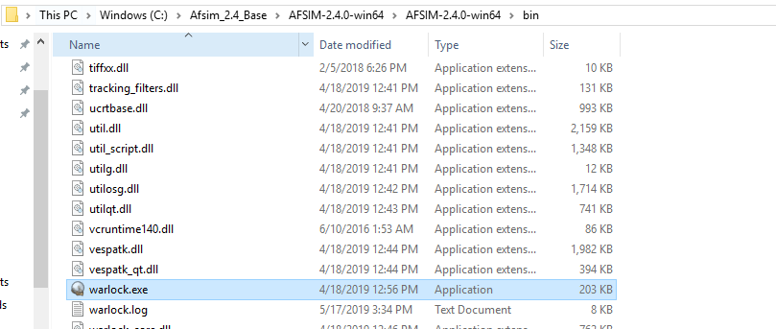

How to Open Warlock
From Wizard
From AFSIM bin Directory
Click on the current executable in the top toolbar
Select Warlock
Press Play

Slide 8
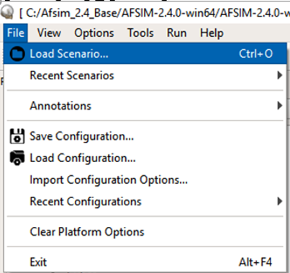
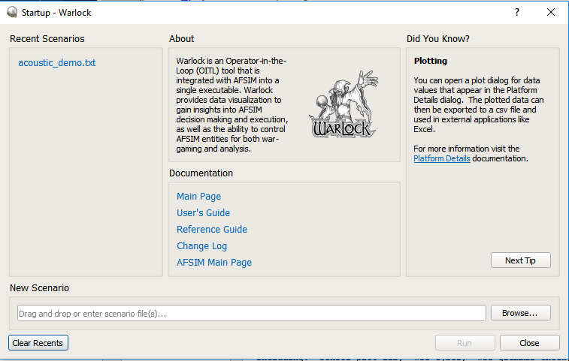
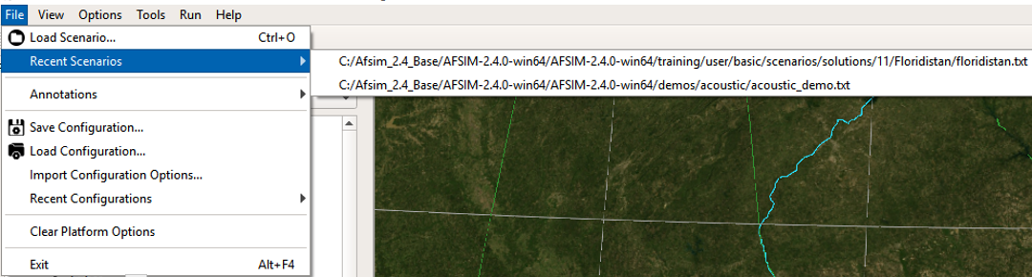
How to Choose a Warlock Scenario
From Startup Dialog
From Open Warlock Window
Browse for the scenario file
Or, select a recently run scenario file
Open the File menu
Select “Load Scenario” to browse for a scenario file
Select “Recent Scenarios” to select a recently run scenario file

Slide 9
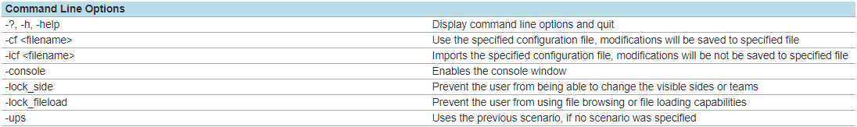
Opening Warlock from the Command Line
Like with Mission, you can open a scenario in Warlock from the Command Prompt desktop app
Include the addresses of warlock.exe, the scenario input file(s), and the configuration files to be opened
You can add one or more command line options to the command line:
Example:
warlock.exe address
Configuration File address (to be applied to Warlock when opened)
scenario address
Command Line Options

Slide 10


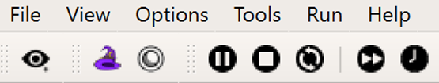
Ending a Warlock Simulation
Method 1: Click “X” in upper right of window
Completely closes Warlock
Method 2: Terminate Button in Toolbar
Ends the current simulation
Startup dialog reappears
Method 3: Restart the Scenario
Method 4: Reload the Scenario
Re-reads the input files

Slide 11
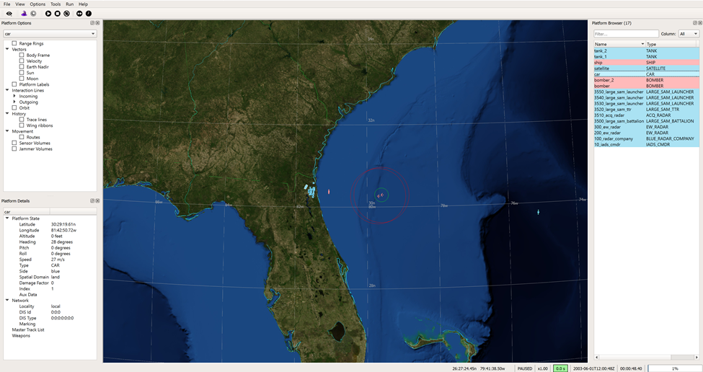
Basic Layout
Menus
Capture View/Application Launcher/Simulation Controller
Map Display
Platform Options
Platform Browser
Platform Details
Status Bar

Slide 12
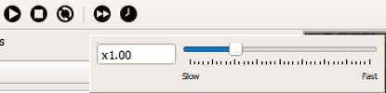
Time Controller
Adjust Simulation Run Time Multiplier
Advance to Simulation Time
Terminate Simulation
Play/Pause Simulation
Restart Simulation
Simulation Run Time Multiplier

Slide 13
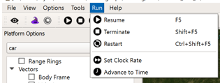
Run Menu
Gives same options as the Time Controller in the Toolbar
Note the Keyboard Shortcuts associated with some of the controls

Slide 14
Simulation Status Bar
Active/ Paused/ Complete
Simulation run time multiplier
Time ahead (green) or behind (red) of real time
Wall Time
Simulation Time Elapsed
% of simulation time elapsed
Notes:
Helpful Hint: The time ahead/time behind box is the easiest way to tell if simulation is ahead or behind

Slide 15


Application Launcher
Wizard Application Launcher
The Wizard icon brings you directly to a new Wizard instance
This window shows the scenario currently being run in Warlock
Mystic Launcher
The Mystic icon opens the scenario replay file in Mystic
This only works if the scenario writes an .aer file
Notes:
This feature is designed for when you have launched Warlock independently. It doesn’t make sense to open another Wizard window if you already have Wizard open.

Slide 16
Learning Objectives
You gain hands-on knowledge about:
What Warlock is
How Warlock compares to Mission
Basic Features of Warlock

