Slide 1
AFSIM User Training
16 – Warlock Features
AFRL/RQQD
Notes:
This version of the training has been tested with version 2.8

Slide 2
Learning Objectives
You gain hands-on knowledge about:
Features that are unique to Warlock
How to utilize these features

Slide 3
Introduction
Warlock Features Highlighted in This Presentation
1) Preferences | 7) Task Assigner/Task Status Browser*
3) Platform Part Browser | 8) Script Browser
4) Platform Movement Dialog | 9) Dialog Builder*
5) Route Browser | 10) WsfPrompt*
6) Weapon Browser | 11) Misc. Features
* denotes that a hands-on activity is included
Notes:
Clarify to students that in this deck, only slides labeled “Activity” are interactive. Other times, they are not required to follow along in Mystic/Warlock

Slide 4
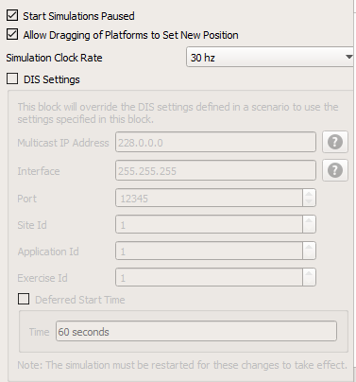
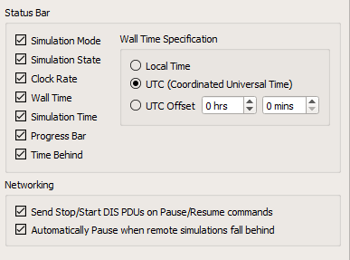
Warlock-Specific Preferences
Simulation
Enable/Disable start simulations paused
Allow dragging of platforms to change location
DIS Settings
Simulation Controller
Choose which items are displayed in the status bar and how they are displayed
Distributed Operations Networking settings
Simulation
Simulation Controller

Slide 5
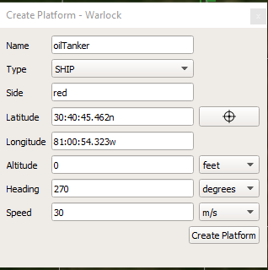
Create Platform Dialog
Allows you to create platforms of an existing platform type during the execution of a simulation
Notes:
Note: this can be disabled in the plugin manager. There are some situations (ex: operator-in-the-loop distributed exercises) where you might not want people to “cheat” by using this function.

Slide 6
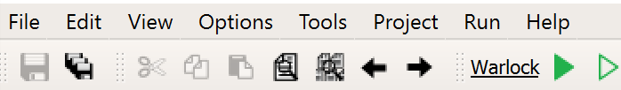
Activity: Create Platform Dialog
Navigate to the Warlock_Mystic_Scenario folder
Open warlock_mystic_startup.txt, found within this folder, in Wizard. Make sure it is set as the startup file
Run the scenario in Warlock
AFSIM-2.8.0-win64 > training > user > 7_Warlock_Features > scenarios > floridistan

Slide 7
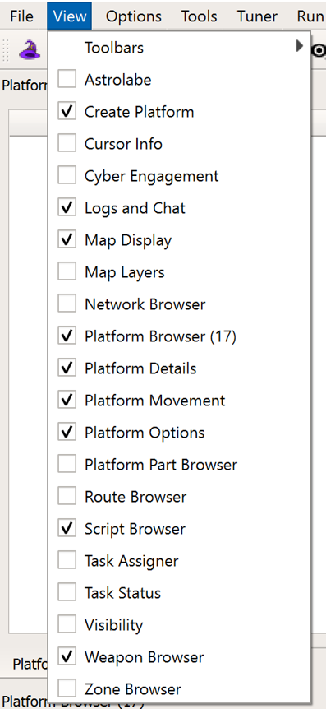
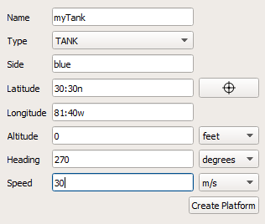
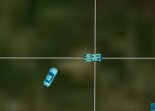
Activity: Create Platform Dialog
Enable the ‘Create Platform’ dialog from the View menu
Populate with the information shown
Click ‘Create Platform’
A new tank appears in the simulation

Slide 8
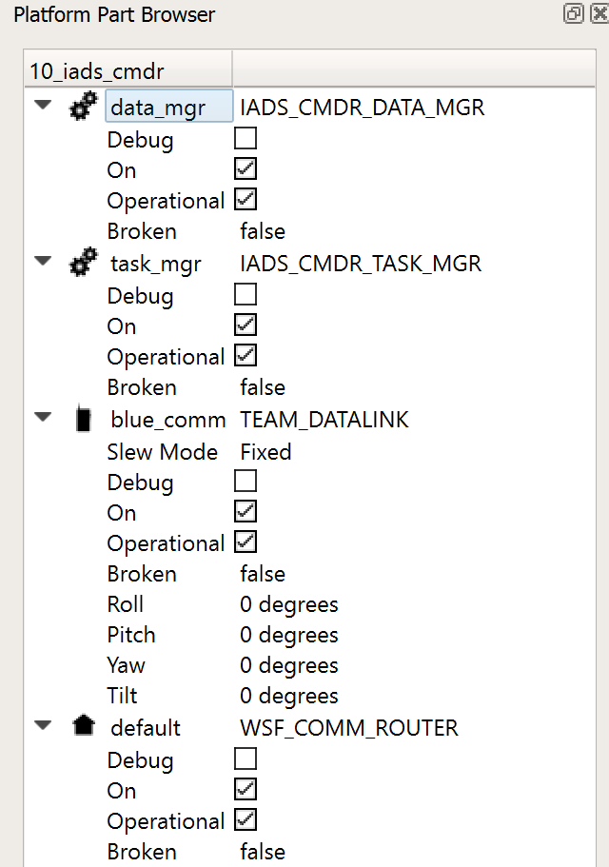
Platform Part Browser
Displays Platform Parts included on a Selected Platform
Weapons, Comms, Sensors, Processors, Movers
Shows the states of various platform part properties
Different properties are shown for different parts
Updated as the simulation progresses
Some properties can be changed from the browser
Ex: Turning sensors on and off

Slide 9
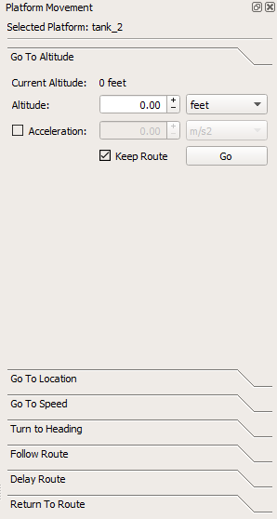
Platform Movement Dialog
Allows you to give basic movement commands to a selected platform or group of platforms
Go To Altitude
Go To Location
Go To Speed
Turn to Heading
Follow Route
Select a Global Route for the platform to follow
Delay Route
Platform makes a 180 degree turn, then returns to its original route after a specified time
Return to Route
Platform returns to its original route
Only works on platforms that have movers

Slide 10
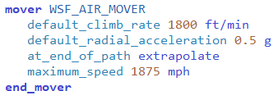
Platform Movement Dialog Cont.
The movers on some platforms have constraints:
Altitude
Speed
Climb rate
Linear Acceleration
Radial Acceleration
What happens if you try to move the platform outside of these limits using the Platform Movement Dialog?
Over a Maximum: Platform will move at the maximum allowed value
Below a Minimum: Platform will move at the minimum allowed value

Slide 11
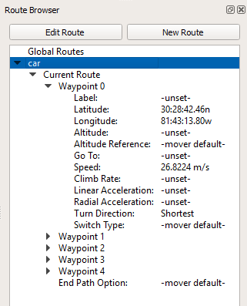
Route Browser
Provides four primary functions:
Displays the route of a selected platform
Displays all global routes in a scenario
Provides a way to edit existing routes
Provides a way to create new routes and assign them to platforms

Slide 12
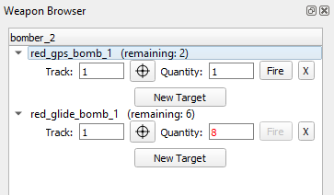
Weapon Browser
Provides a way to view and fire explicit weapons at tracks
You must specify a valid weapon quantity when using the weapon browser
Valid Quantity <= Quantity Remaining
If invalid, text turns red and the fire button is disabled
The weapon to be fired must also be on the selected platform in order to use the weapon browser
Ex: You can’t use the weapon browser to make a launcher fire if the IADS Commander is selected
Valid Quantity: 1 < 2
Invalid Quantity: 8 > 6
Notes:
Note: To use the weapon browser, a platform has to have two things: A local track, and an available weapon onboard.

Slide 13
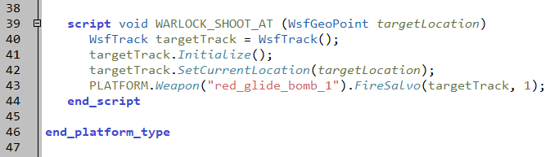
Weapon Browser Cont.
With the Weapon Browser, you can only fire at a local track on a platform
You can’t fire at a location, WsfPlatform, etc. using this browser
You must write your own Warlock Script to do this
The weapon browser won’t work if the specified track is invalid
If written on platforms/bomber.txt:
Notes:
Beware of the relationship between the weapon browser and maximum request count. A slide about this relationship is included in the appendix.

Slide 14
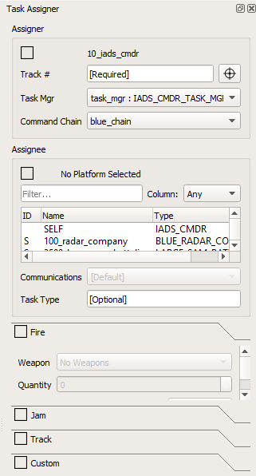
Task Assigner
Provides a way for a commander to make task assignments
Functions by using WSF_TASK_PROCESSOR
Deals with 4 Task Types, correlated to several WsfTaskManager methods
Fire
Jam
Track
Custom
Notes:
The appendix of this slide deck contains more detail about task types.

Slide 15
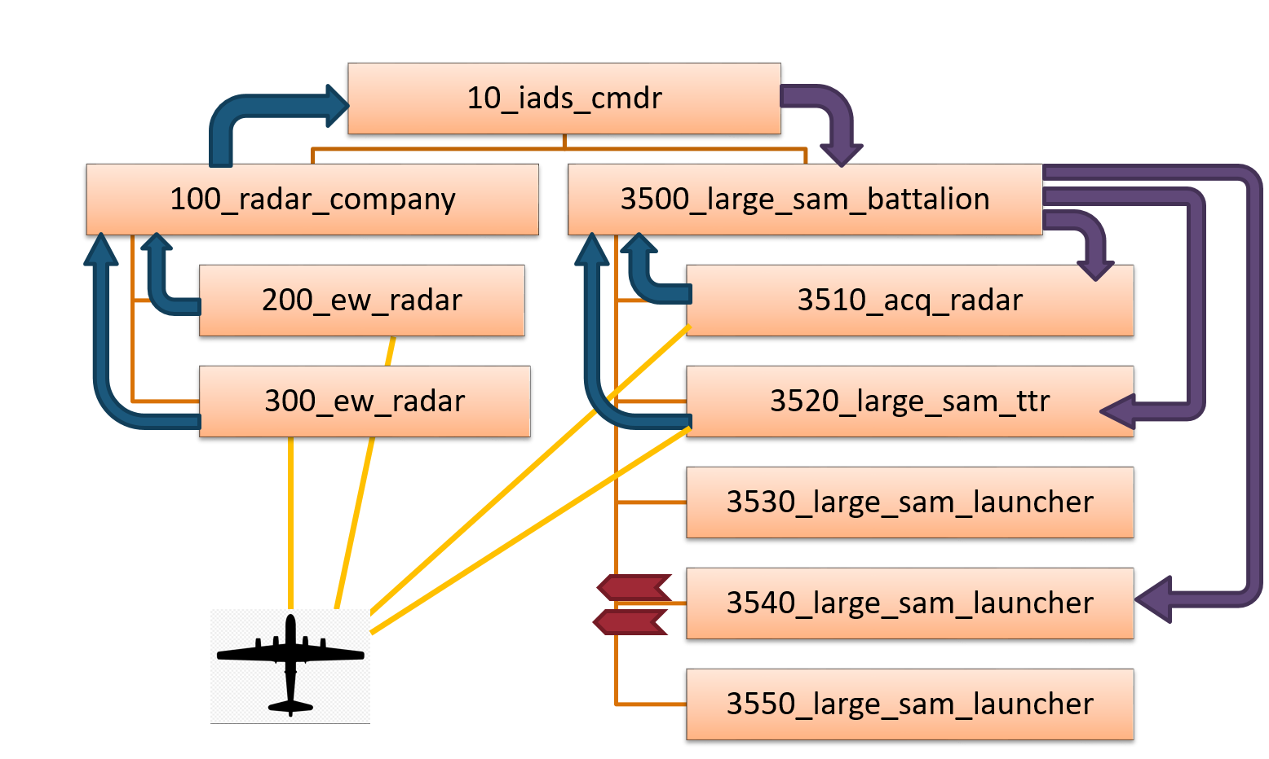
Task Assigner Cont.
Recall from the comm and command chain training:
Task Processors allow a commander to assign tasks to subordinates
We previously saw these assignments being automatically made using task processor logic
The Warlock task assigner allows the operator to make assignments!

Slide 16
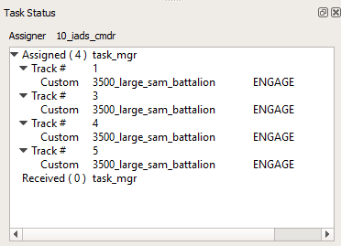
Task Status Browser
Provides a user interface for reviewing and canceling task assignments for selected platforms
Shows both assignments made in script and assignments made using Task Assigner
Deals with the same 4 task types as the Task Assigner

Slide 17
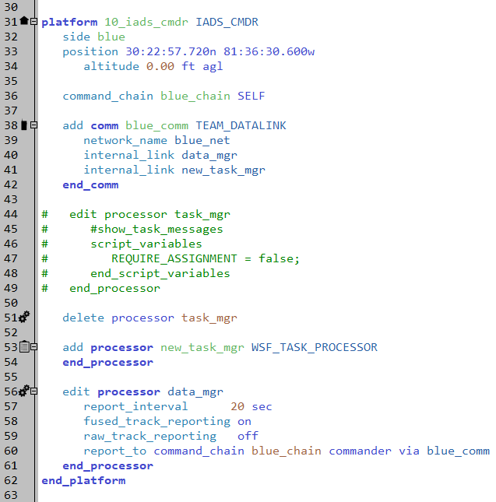
Activity: Task Assigner/Task Status Browser
small_blue_iads.txt
Back in Wizard, make the following edits to small_blue_iads.txt in the scenarios directory
For platform 10_iads_cmdr, comment out the edited task_mgr block
Delete the task_mgr processor
Add a new_task_mgr WSF_TASK_PROCESSOR
Edit the link in the Comm
Run with Warlock!!!
Notes:
We do this so that the IADS commander won’t make any assignments constructively. We will then be forced to play the role of the commander.

Slide 18
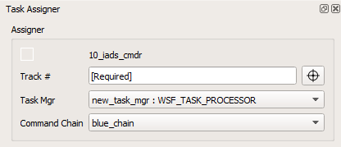
Activity: Task Assigner/Task Status Browser Cont.
Enable Task Assigner and Task Status Browser in the View Menu
Advance to simulation time 50 seconds
Find and select 10_iads_cmdr
Notice in the Task Assigner, the Assigner has changed to 10_iads_cmdr

Slide 19
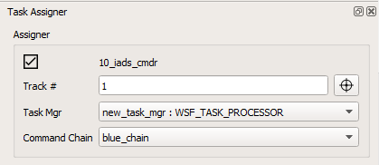
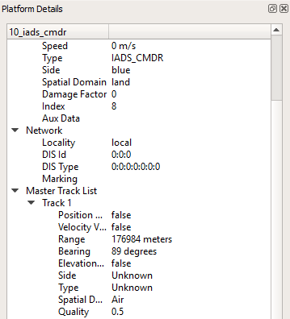
Activity: Task Assigner/Task Status Browser Cont.
Look at the Assigner block within the Task Assigner
In the “Track #” box, type “1”
We know this track is valid because it’s listed in Platform Details
When you make this selection, the box at the top of the Assigner block is checked
This means the block is fully defined and you can move on
But, let’s review the other parts of the block…

Slide 20
Activity: Task Assigner/Task Status Browser Cont.
The Task Mgr box lets you select the processor used to make the task assignment
Hint: the assigning platform must have at least one WSF_TASK_PROCESSOR
The Command Chain box lets you select the chain associated with the assignment
What if the assigner has more than one task processor or is in more than one command chain?
All task processors/command chains are listed in their respected drop downs

Slide 21
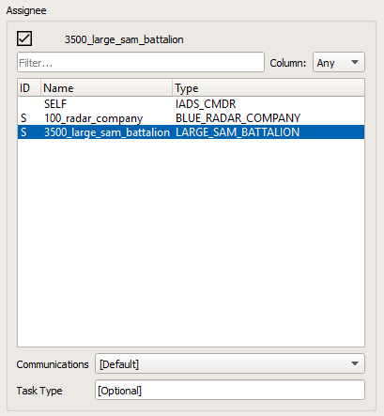
Activity: Task Assigner/Task Status Browser Cont.
Look at the Assignee block within the Task Assigner
The Assignee Table shows all subordinates and peers of the selected assigner
In the table, select “3500_large_sam_battalion”
This is the platform to which the task will be assigned

Slide 22
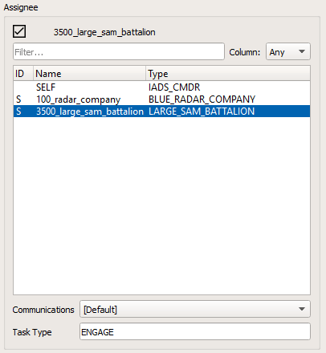
Activity: Task Assigner/Task Status Browser Cont.
Stay in the Assignee block
Leave “[Default]” selected in the Communications drop down
In the Task Type block, type “ENGAGE”
This simply assigns a name for the task
This field is optional and can be left blank

Slide 23
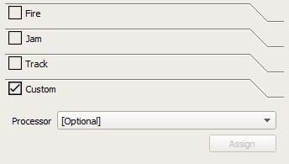
Activity: Task Assigner/Task Status Browser Cont.
Look at the Task blocks within the Task Assigner
There is a block for each task type discussed previously
What do the checkboxes mean?
Symbolize available task types based on an assignee’s resources
Ex: If the assignee is a launcher, Fire and Custom will be options

Slide 24
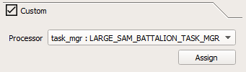
Activity: Task Assigner/Task Status Browser Cont.
In this example, you can only assign a Custom task
The assignee has no weapons, sensors, or jamming capability
Expand the Custom task block
The Processor drop down menu lets you select the assignee’s processor to send the task to
Select “task_mgr: LARGE_SAM_BATTALION_TASK_MGR”
Click “Assign”

Slide 25
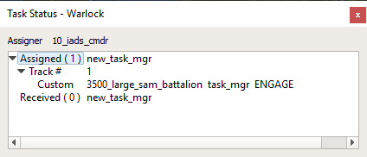
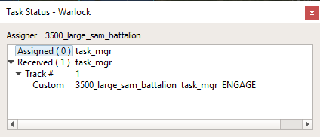
Activity: Task Assigner/Task Status Browser Cont.
With 10_iads_cmdr still selected, look at the Task Status Browser
Notice that the task is in the Assigned section
Now, select 3500_large_sam_ battalion
Notice that the task is in the received section
When done with this slide, close the Warlock window but keep Wizard open
Notes:
If you allow the scenario to play through, we should only take shots at the platform “bomber”

Slide 26

Task Activity: Final Points
We’ve only played the role of the IADS commander
We left the scripted behaviors and task processors of the battalion alone
It’s OK to have a mix of platforms with and without scripted behaviors.
Notes:
It would actually be a very difficult and laborious process to take out all the scripted behaviors for all of the platforms in this scenario. Using the Task Assigner for each part would require a lot of attention and focus from the operator.

Slide 27
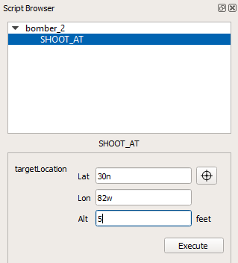
Script Browser
If included in platforms/bomber.txt:
Allows the user to execute AFSIM scripts included in .txt files
Displays both global and platform-level scripts that include the “WARLOCK_” prefix
Notes:
The script shown is an easy way to allow a platform to shoot at a location instead of a track. Refer to the appendix for directions for using the script browser.

Slide 28
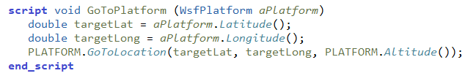
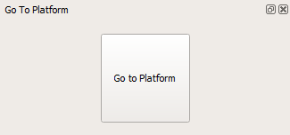
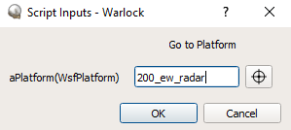
Dialog Builder
If included in platforms/bomber.txt:
Enables users to create, edit, and delete custom dialogs which execute AFSIM scripts
Is especially useful in creating user-friendly ways to execute scripts that are not built-in functions/ applications

Slide 29
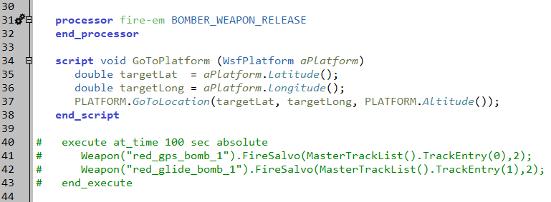
Activity: Dialog Builder
Open the file platforms/bomber.txt in Wizard
Type the script pictured below in the platform_type BOMBER block
platforms/bomber.txt
Notes:
The script shown makes the platform move toward a selected stationary platform. Notice that there aren’t any built-in functions or applications that serve this purpose.
Q: Why does the script only work properly with a selected stationary platform?
A: The target location is not updated

Slide 30
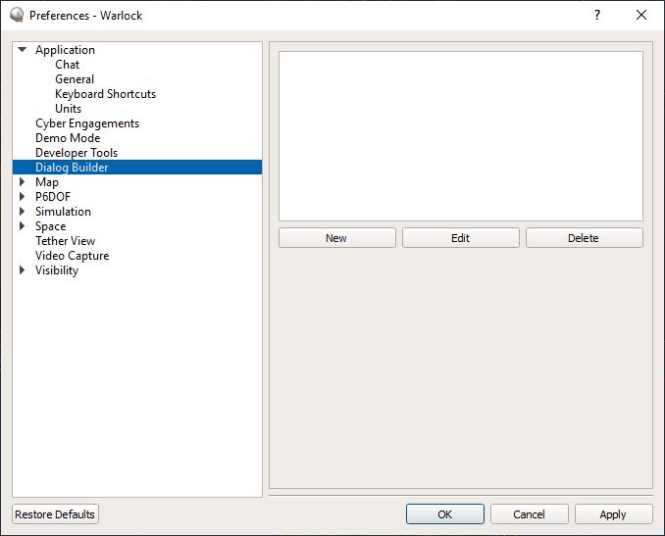
Activity: Dialog Builder Cont.
Run with Warlock!!!
Go to Options -> Preferences -> Dialog Builder
Select New

Slide 31
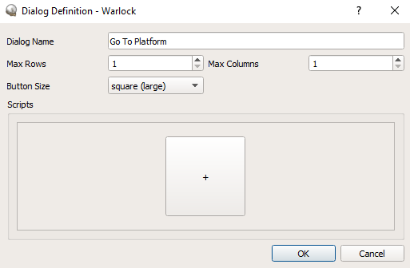
Activity: Dialog Builder Cont.
Make Dialog Name “Go To Platform”
Make both Max Rows and Max Columns equal to 1
Notice that this changes the number of boxes in the bottom section
Change Button Size to “square (large)”
Notice that this changes the shape of the box in the bottom section
Click on the box with the plus sign

Slide 32
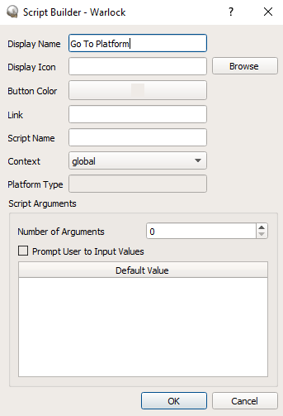
Activity: Dialog Builder Cont.
Change Display Name to “Go to Platform”
Notes:
Display Icon allows you to browse for an image to display with the dialog. We will not use this

Slide 33
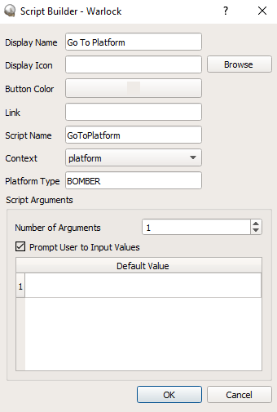
Activity: Dialog Builder Cont.
The fields in this slide must match up with the script in Wizard for which you are building the dialog
Change script name to “GoToPlatform”
Change context to platform
Change Platform Type to “BOMBER”
Change the number of arguments to 1
Check Prompt User to Input Values
Click Ok in the script builder and dialog definition popup windows
Click OK in the Preferences Popup
platforms/bomber.txt
Notes:
If you put in this information incorrectly, the dialog won’t run anything when it is executed. Instead, a warning message will be displayed.

Slide 34
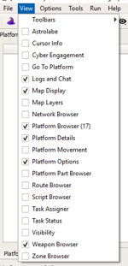
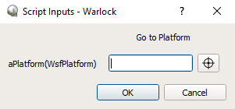
Activity: Dialog Builder Cont.
In the View menu, find and enable ‘Go To Platform’
Select bomber_2
Click on the dialog box
In the Script Inputs pop-up, use the crosshairs to select 200_ew_radar in map display
Click OK

Slide 35
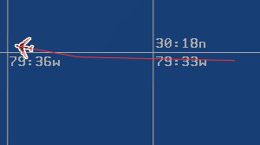
Activity: Dialog Builder Cont.
The bomber turns toward the selected radar
When done with this slide, close the Warlock window, but keep the Wizard window open

Slide 36
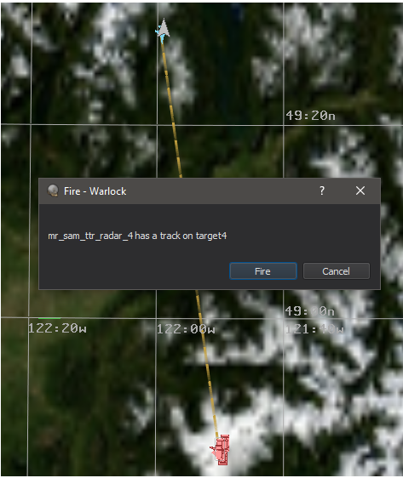
WsfPrompt
Scripts can be used to create dialog boxes within Warlock
“Pop-up” to display information to the user
You can choose to execute scripts from the dialogs when prompted
Notes:
Q: Suggest some ways that a prompt may be useful in guiding the user through the simulation
A: Warnings to users if they try to take illogical actions using Warlock scripts or dialogs, Directions that pop-up during a training scenario, notifications when a track is in firing range, etc.

Slide 37
WsfPrompt Cont.
These WsfPrompt methods will display a prompt:
You can also pause the simulation when the prompt pops up
The simulation begins playing again once the user makes a selection within the prompt
Use one of these WsfPrompt methods:
Scripts are executable from the dialog
No scripts are executable from the dialog
Scripts are executable from the dialog
No scripts are executable from the dialog

Slide 38
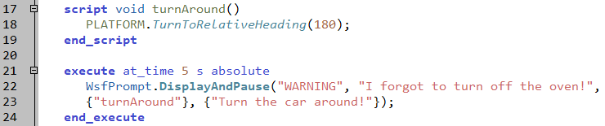
Activity: WsfPrompt
Open the file scenarios/blue_laydown.txt in Wizard
Add the script and execute blocks shown below to the car platform definition
Save your changes
Run with Warlock!!!
scenarios/blue_laydown.txt

Slide 39
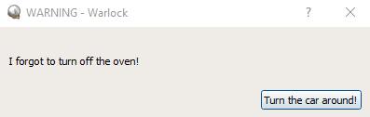
Activity: WsfPrompt Cont.
At simulation time 5 seconds, the dialog below appears
The dialog pauses the simulation
Click “Turn the car around!”
Result: the car begins traveling in the opposite direction
When you are finished with this slide, close Warlock

Slide 40
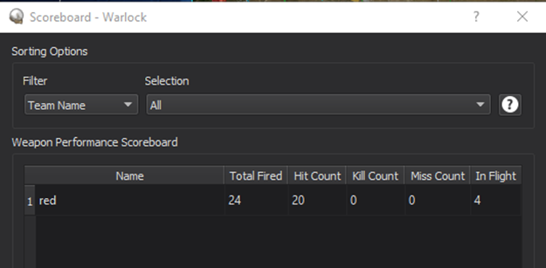
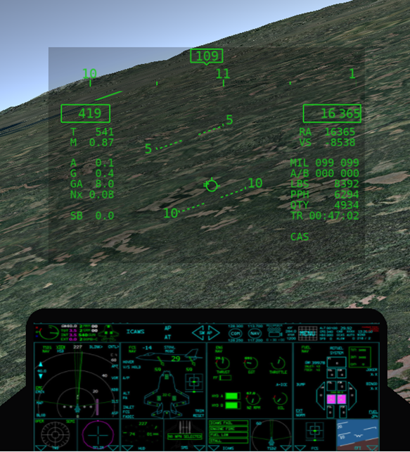
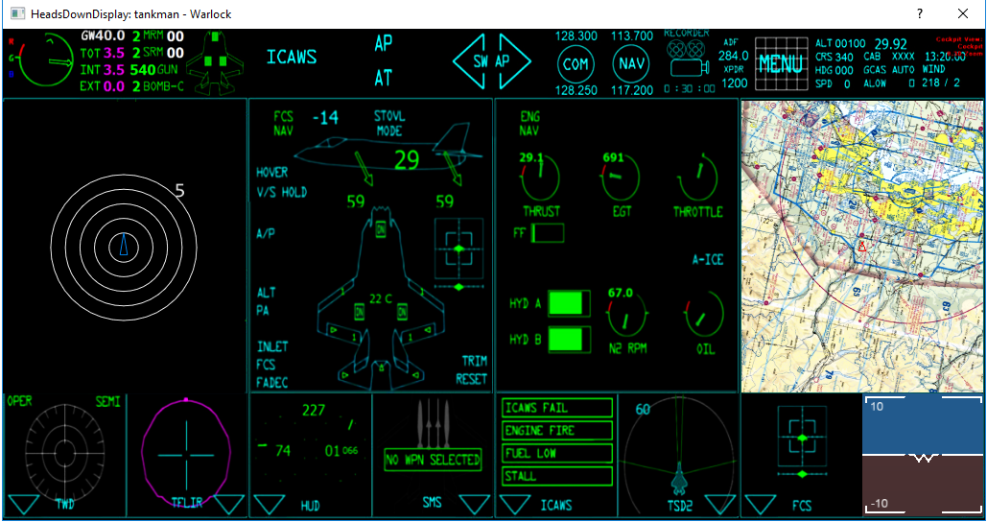
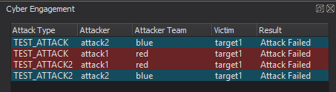
Misc. Warlock Features
Demo Mode
Allows you to automatically restart the scenario upon completion
Scoreboard
Displays statistics for weapon performance
P6DOF
Allows the user to take manual control of the sim
P6DOF is a high-fidelity mover type
Heads Down Display
Glass cockpit-like display for a selected platform
Cyber Engagement Browser
Table summarizing current cyber engagements
Scoreboard
Heads Down Display
P6DOF
Cyber Engagement Browser

Slide 41
Learning Objectives
You gain hands-on knowledge about:
Features that are unique to Warlock
How to utilize these features

Slide 43
Appendix
Weapon Browser and Maximum Request Count
Task Assigner/Task Browser Details
Steps to Using Script Browser

Slide 44
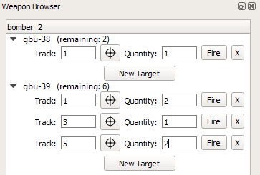
A) Weapon Browser and Maximum Request Count
Common Issue: I’m trying to fire the same weapon using multiple commands simultaneously, and firing isn’t working
Look at maximum_request_count on the weapon (in Wizard weapon definition)
If the request count is too low, it could be limiting the number of firing requests on the weapon
AFSIM ignores the command and fails to fire
The max request count should be at least large enough to handle the number of requests you have at once
Multiple Requests on Same Weapon

Slide 45
B) Task Assigner/Task Status Browser: Task Types
The Task Status Browser and Task Assigner deal with the same 4 kinds of Tasks
Task Type | Description
Fire | The assignee, which has one or more weapons, will fire a weapon at the track
Jam | The assignee, which must have jamming capabilities, will start jamming the track
Track | The assignee, which has at least one sensor, will start tracking the track
Custom | Any other task; allows you to write your own task type

Slide 46
B) Task Types in the Task Status Browser
Each task type shows different information in the Task Status Browser:
Task Type | Info in Column 1 | Info in Column 2 | Info in Column 3 | Info in Column 4 | Info in Column 5 | Info in Column 6
Fire | Assignee | Weapon Name | Task Type | N/A | N/A | N/A
Jam | Assignee | Jammer Name | Task Type | Frequency | Bandwidth | Beam #
Track | Assignee | Sensor Name | Task Type | N/A | N/A | N/A
Custom | Assignee | Processor Name | Task Type | N/A | N/A | N/A

Slide 47
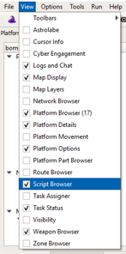
C) Steps to Using the Script Browser
In Wizard, write a global or platform level script with “WARLOCK_” at the beginning of its name
The script shown here is included on the bomber platform type
After running the scenario in Warlock, enable the Script Browser in the View Menu

Slide 48
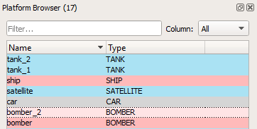
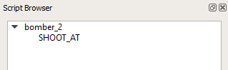

C) Steps to Using the Script Browser (Cont.)
Select a platform that the script applies to
You will see the script appear in the script browser
Select the script name within the browser
Populate your input arguments
Select Execute

