Slide 1
AFSIM User Training
15- Mystic Features
AFRL/RQQD
Notes:
This version of the training has been tested with version 2.8

Slide 2
Learning Objectives
You gain hands-on knowledge about:
Features that are unique to Mystic
How to utilize these features

Slide 3
Introduction
Category | Features
Adjust Visualization of Results | Preferences
Post-Process Analysis | *Platform Details Plot
 | Script Data
 | Bookmark Browser
 | Waterfall Plot
 | *Sensor Detection Report
 | Event List
 | *Engagement Statistics
 | *Event and Track Tracing
 | Result Statistics
* Denotes an associated hands-on activity
Mystic is a tool that achieves the following:
Visualizes recorded results of a simulation
Provides post-process analysis capabilities
Features unique to Mystic aid in providing this functionality (see table)
Notes:
Clarify to students that in this deck, only slides labeled “Activity” are interactive. Other times, they are not required to follow along in Mystic/Warlock

Slide 4
Mystic-Specific Preferences
Preference | What can be controlled?
Map -> Interpolation | Adjust the method used to determine new platform positions/orientations
Application -> Memory Usage | Controls how much result data to load at a time
Time Controller | Adjust information shown in the simulation clock Edit formatting of displayed wall time Choose what occurs at the end of the event file

Slide 5
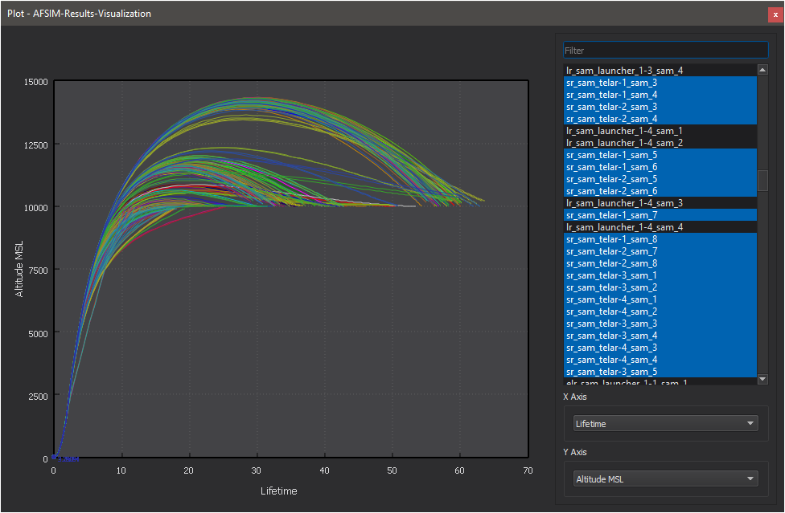
Platform Details Plot
Analysis of numerical platform details can be completed using the Plot tool
Notes:
Options include creating a visual plot, analyzing data in a table view, and exporting data to a .csv file

Slide 6

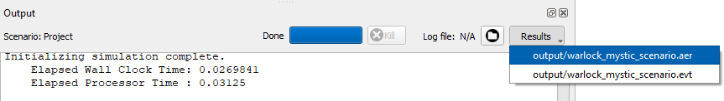
Activity: Platform Details Plot
If you do not have the warlock_mystic_scenario open in Mystic, follow these steps
Navigate to the Mystic Features folder
Open warlock_mystic_startup.txt, found within this folder, in Wizard. Make sure it is set as the startup file
Run warlock_mystic_startup.txt using Mission and open the aer file in Mystic
AFSIM-2.8.0-win64 > training > user > 8_Mystic_Features > scenarios > floridistan

Slide 7
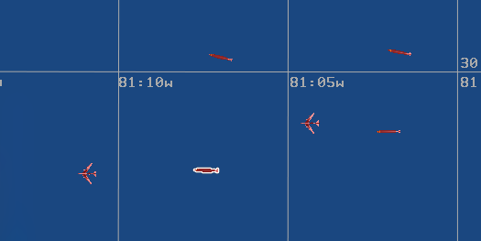
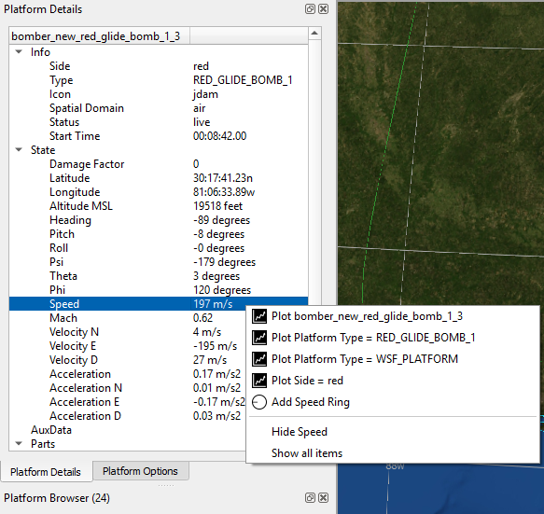
Activity: Platform Details Plot Cont.
Advance to time 675 s, then pause the simulation
Select the platform “bomber_new_red_glide_bomb_1_3”
Right-click on Speed in Platform Details
Select the option
“Plot bomber_new_red_glide_bomb_1_3”
The Plotting tool can also be accessed through the Tools menu

Slide 8
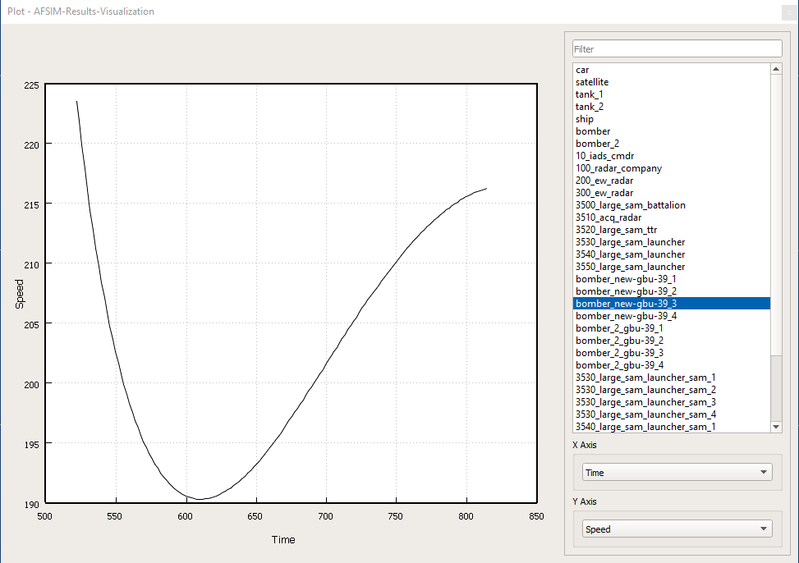
Activity: Platform Details Plot Cont.
Notes:
The resulting plot of the bomb’s speed over time is shown here.

Slide 9
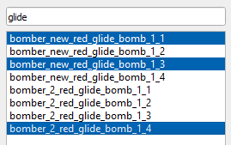
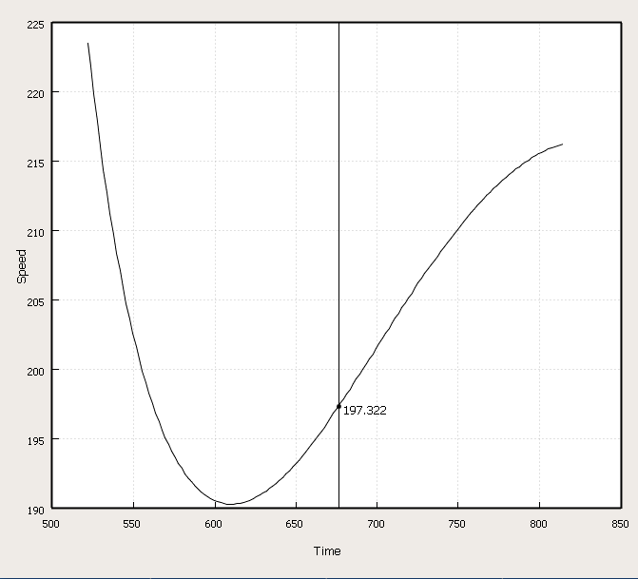
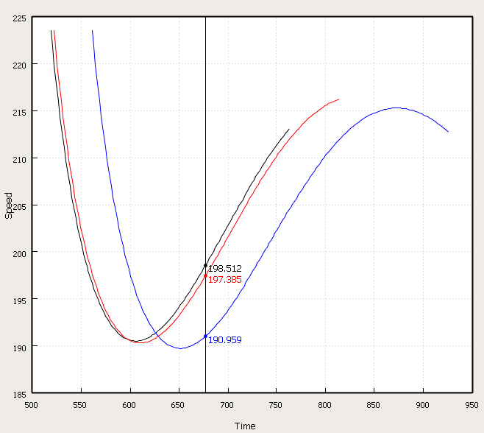
Activity: Platform Details Plot Cont.
Play the simulation
Vertical line movement represents current simulation time
Pause the simulation
Type “glide” in the Filter text box
Ctrl + click on the first, third, and last results
The third result is the originally plotted platform
Now, multiple platforms are included in the speed vs. time plot
Current Simulation Time
Value of Y axis (speed)

Slide 10
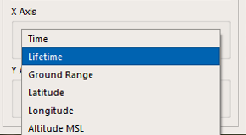
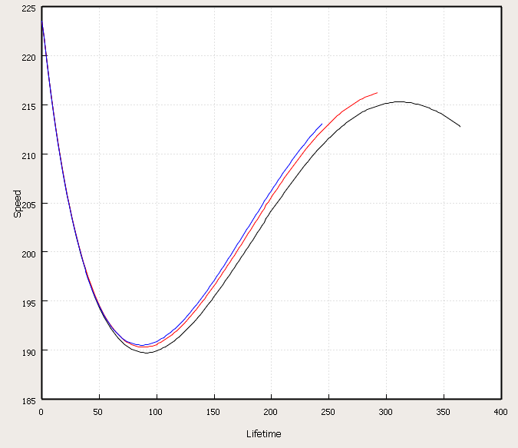
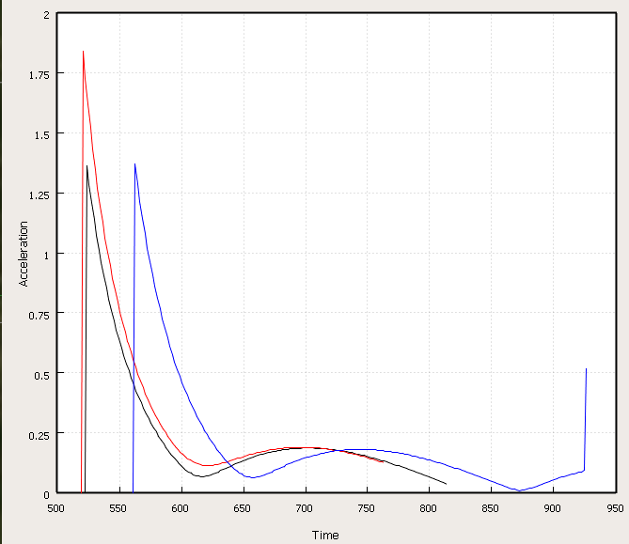
Activity: Platform Details Plot Cont.
In the X Axis drop-down menu, select “Lifetime”
Plots based on age of platform, NOT simulation time
What is the significance of the Axis drop-down menu contents?
Each option is a different platform detail numerical entry
Meaning: you can switch the platform detail you’re plotting from the plot window
Change Y axis to Acceleration. Change the X axis back to Time.

Slide 11
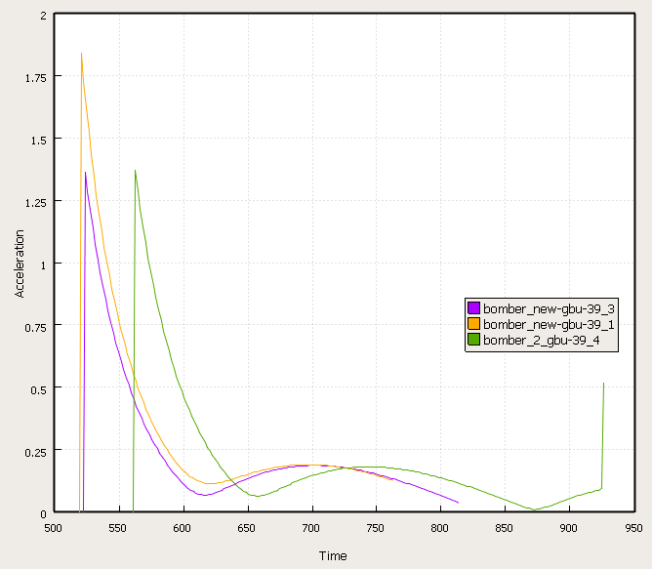
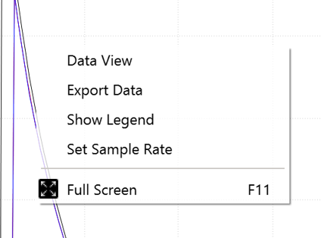
Platform Details Plot: Export Data, Show Legend, Series Colors
Various options appear when you right-click on the plot
Export Data
You can export the data in this plot (and many others in Mystic) to CSV
Show Legend
Series Color(s)
You can change the color of each individual plotted series

Slide 12
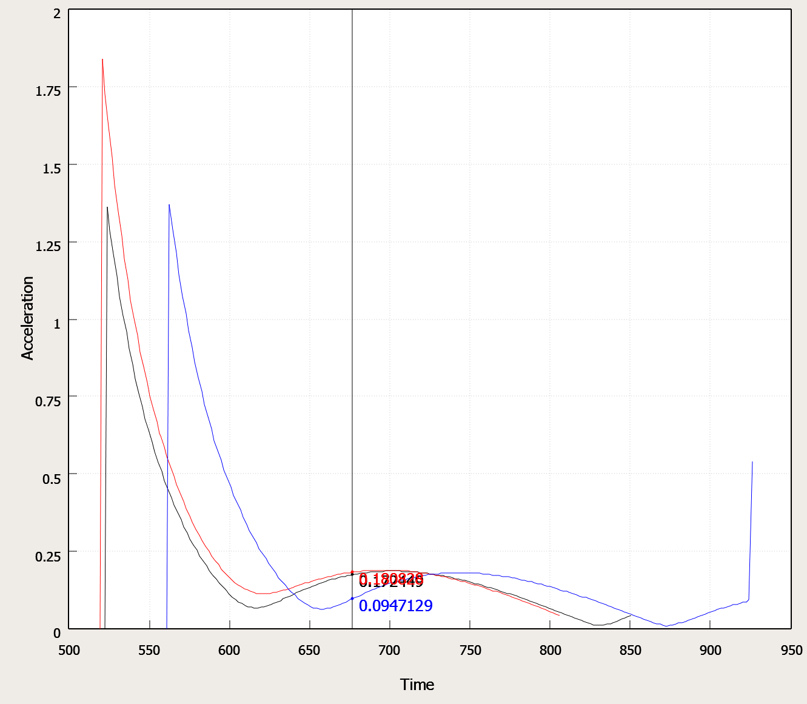
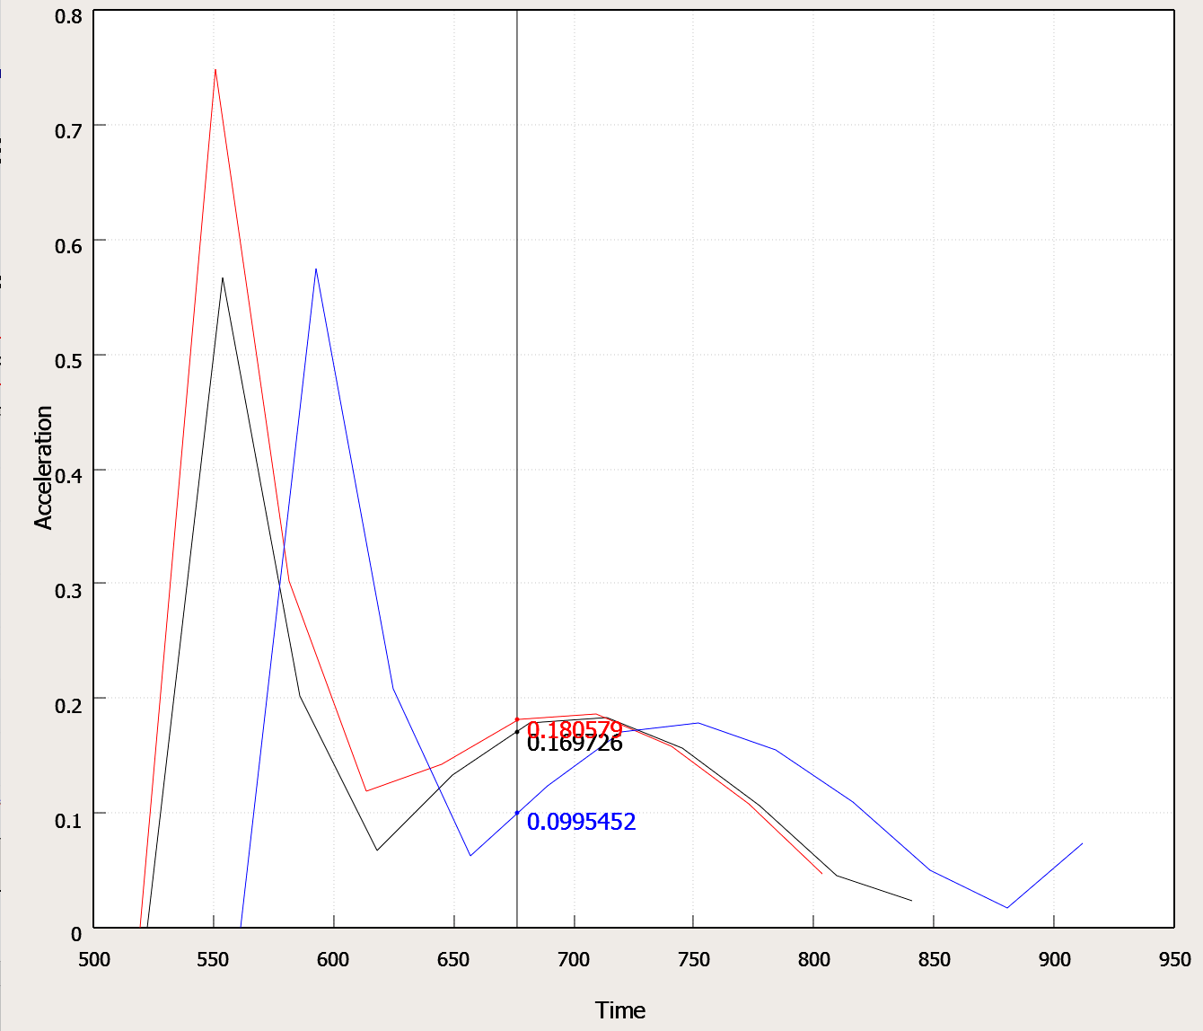
Platform Details Plot: Set Sample Rate
Sets the desired sample rate (in seconds) for plotted data.
Default = 0 sec (all possible data is presented)
Sample Rate = 0 s
Sample Rate = 30 s

Slide 13
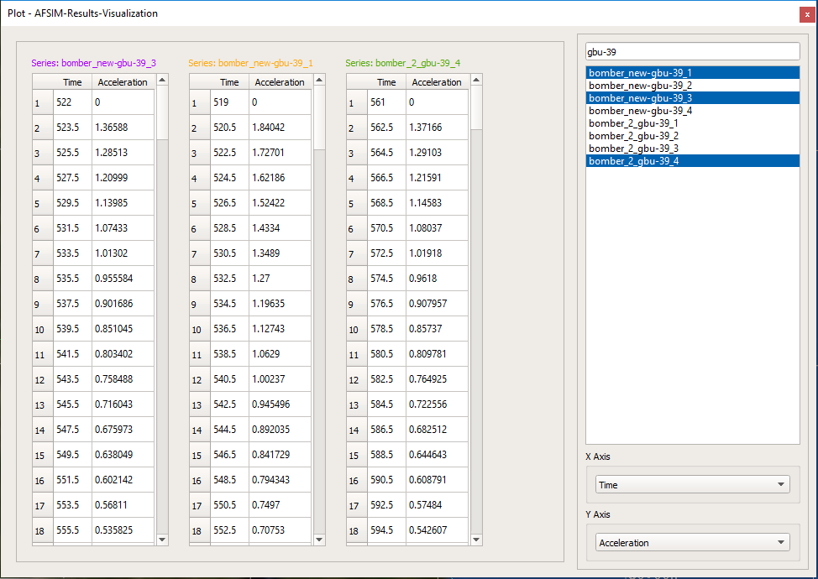
Activity: Platform Details Plot Cont.
Right-click in body of the plot
Select Data View
Shows values for all points displayed on the plot
Separated by Platform, just like the different colored series in the plot
You can utilize filter and axis features just like in Plot View
You can also export data from Data View
Close out of the plot

Slide 14
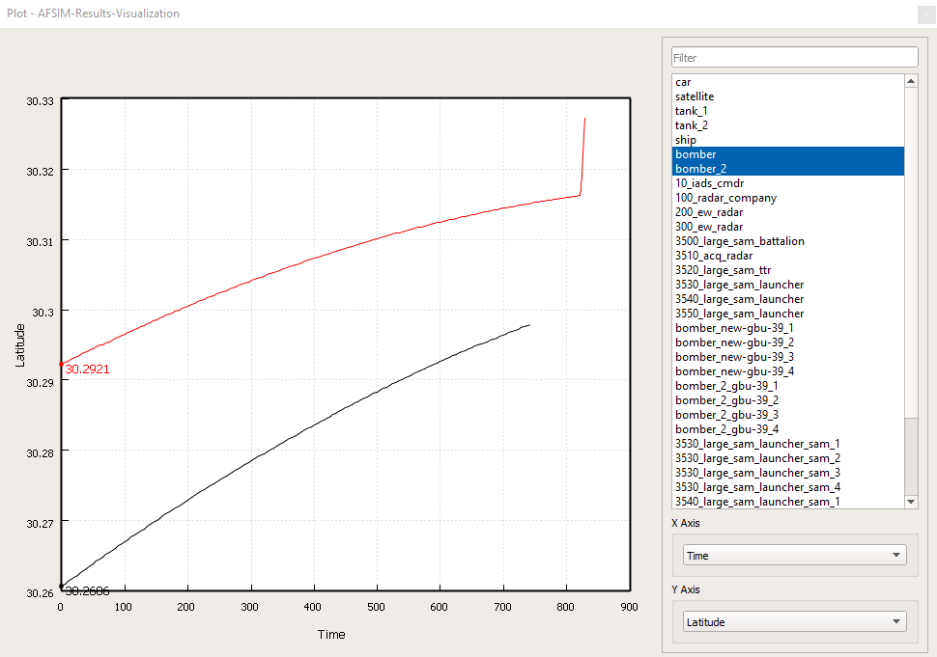
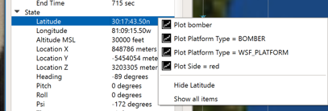
Activity: Platform Details Plot Cont.
Find and select bomber in the Platform Browser
In Platform Details, right-click on Latitude
Click “Plot Platform Type = BOMBER”
A single latitude vs. time plot is created
Shows information about both platforms of type BOMBER

Slide 15
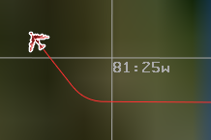

Activity: Platform Details Plot Cont.
Q: What does the black line ending represent?
Q: What does the sudden increase in the red line represent?
Answers
The end of the black line represents the shooting down of the platform “bomber”
The sudden increase in the red line represents the platform “bomber_2” turning
When done with this slide, close out of Mystic but keep Wizard open
Notes:
If students are stuck, recommend scrolling forward in time and observing events in the map display in order to answer the questions.

Slide 16
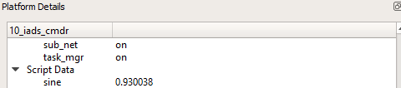
Platform Details: Script Data
WsfEventPipe.Record() can push information to Platform Details through script
This information is updated and can be plotted just like default Platform Details information
If included on the Platform Definition for 10_iads_cmdr
Should appear in Platform Details in the Script Data Section
Notes:
WsfEventPipe.Record Method:
Static void Record(double aSimTime, WsfPlatform aPlatform, string aKey, double aValue)
*Publish a key/value pair associated with the platform and time. Here, “sine” is the key and the value is the sine of the current time

Slide 17
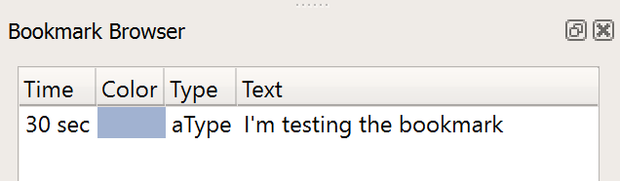
View: Bookmark Browser
WsfEventPipe.AddBookmark() can add bookmarks to an AER file via script
The bookmark browser shows a time-ordered list of bookmarks
Allows you to advance the simulation to a bookmark’s time

Slide 18
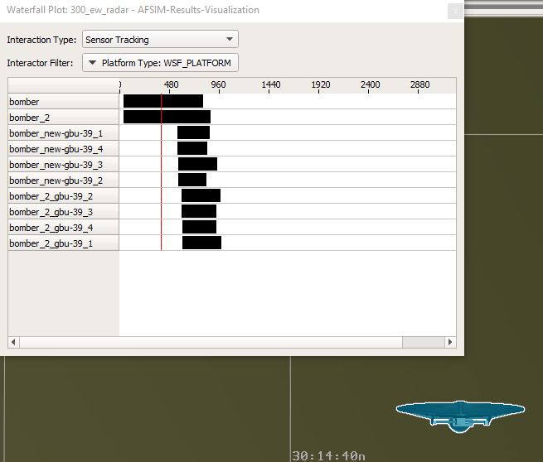
Waterfall Plot
For a selected platform, interaction type, and interactor filter:
Shows the times at which the interactions were active
Event Types:
Detected/Detecting
Sensor Tracked/Sensor Tracking
Local Tracked/Local Tracking
Jammed/Jamming
Interactor Filters (use 1 filter at a time):
Side
Platform Type
Category
Platform

Slide 19
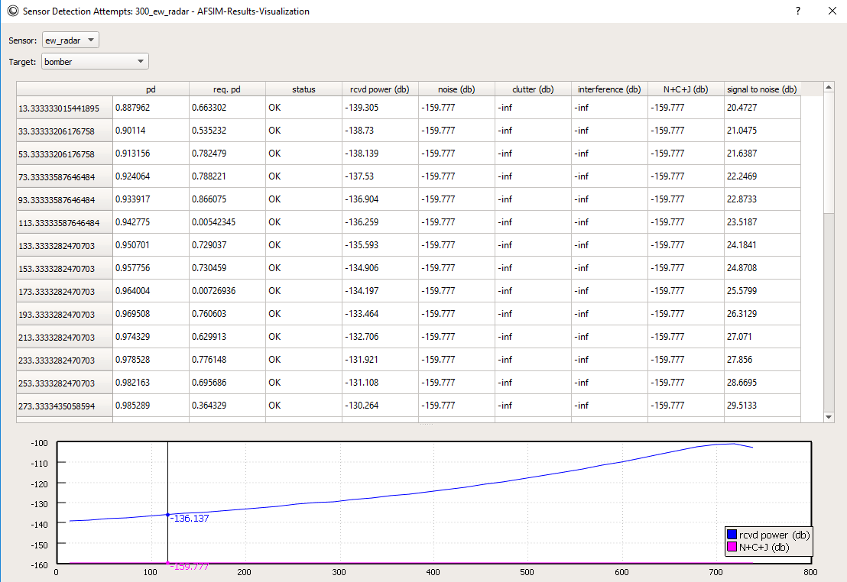
Sensor Detection Report
Provides table and graph views of sensor detection data
Answers questions like:
What happened to my detection interaction line?
Why isn’t jamming working?
Notes:
To see this report, you must add either use_preset full or enable DETECTION_ATTEMPT in the event pipe block in your scenario

Slide 20
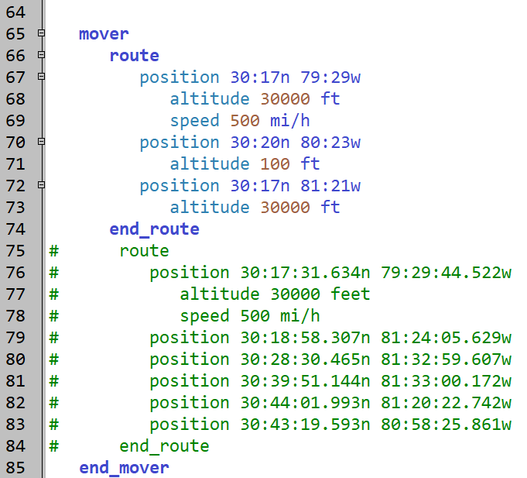
Activity: Waterfall Plot & Sensor Detection Report
In Wizard, open the file scenarios/red_laydown.txt
Find the platform definition for bomber_2
Comment out its current route
Type in the new route block as shown
scenarios/red_laydown.txt

Slide 21

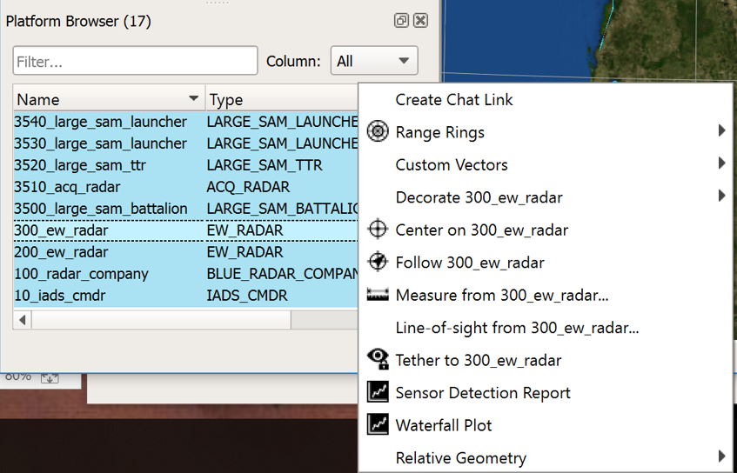
Activity: Waterfall Plot & Sensor Detection Report Cont.
Run the simulation in Mission and open the .aer file
Right-click on 300_ew_radar in the Platform Browser
Select Waterfall Plot

Slide 22
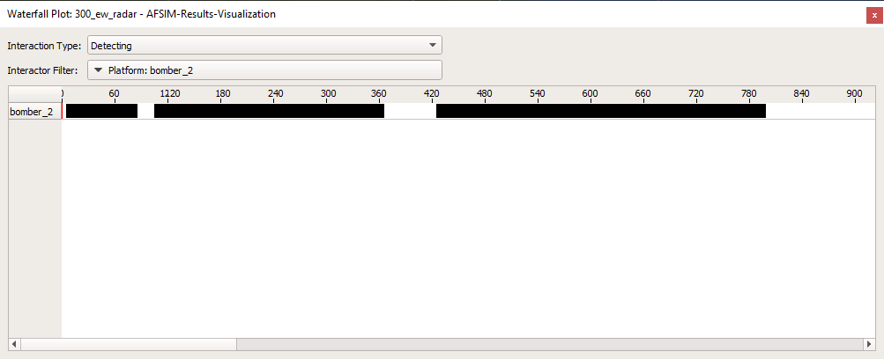
Activity: Waterfall Plot & Sensor Detection Report Cont.
In the plot window, choose “Detecting” as the interaction type and choose “Platform: bomber_2” as the Interactor Filter
Notice the gaps
This shows when the radar stopped detecting bomber_2
Notes:
Note: You might have to scroll in to see both gaps

Slide 23
Activity: Waterfall Plot & Sensor Detection Report Cont.
The Sensor Detection Report gives further insight into sensor behavior
Right-click on 300_ew_radar in the Platform Browser
Select Sensor Detection Report

Slide 24
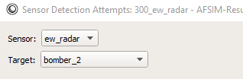
Activity: Waterfall Plot & Sensor Detection Report Cont.
In the Target drop down at the top of the Window, select bomber_2

Slide 25
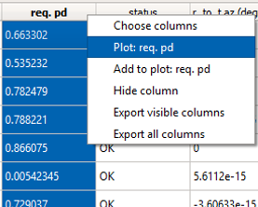
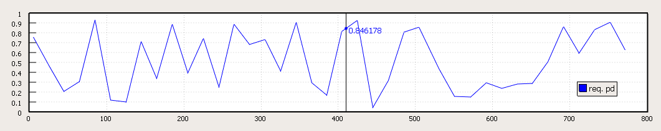
Activity: Waterfall Plot & Sensor Detection Report Cont.
“Plot:” allows you to plot ONLY the selected column
Right-click on the header of the req. pd column
Stands for Required Probability of Detection
Select “Plot: req. pd”
The plot shows only req. pd vs. simulation time
Notes:
You must mention these notes before going through the slide contents:
Req. Pd = required probability of detection
This is calculated based on the radar range equation (considers physical characteristics of the radar: transmitted power, antenna gain, radar wavelength, radar cross section, minimum detectable signal). For each detection attempt, the probability of detection is calculated and compared to req. pd.

Slide 26
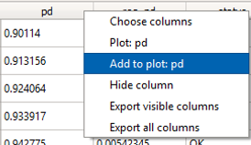
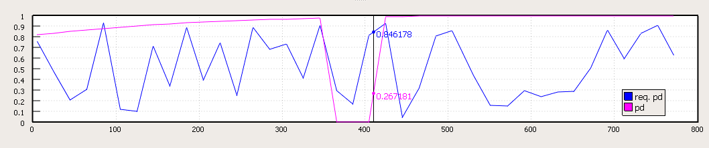
Activity: Waterfall Plot & Sensor Detection Report Cont.
Add to Plot: Plot the selected column alongside what’s already plotted
Right-click on the header of the “pd” column
Stands for Probability of Detection
Choose “Add to plot: pd”
Result: req. pd and pd are both shown in the plot

Slide 27
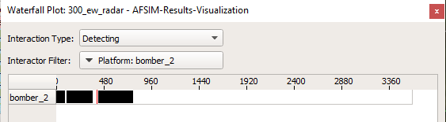
Activity: Waterfall Plot & Sensor Detection Report Cont.
Let’s compare the Waterfall Plot to the Sensor Detection Report Graph:
The points at which pd is below req. pd in the Sensor Detection Report graph coincide with the gaps in the Waterfall Plot
What is happening in the simulation to cause these changes?

Slide 28
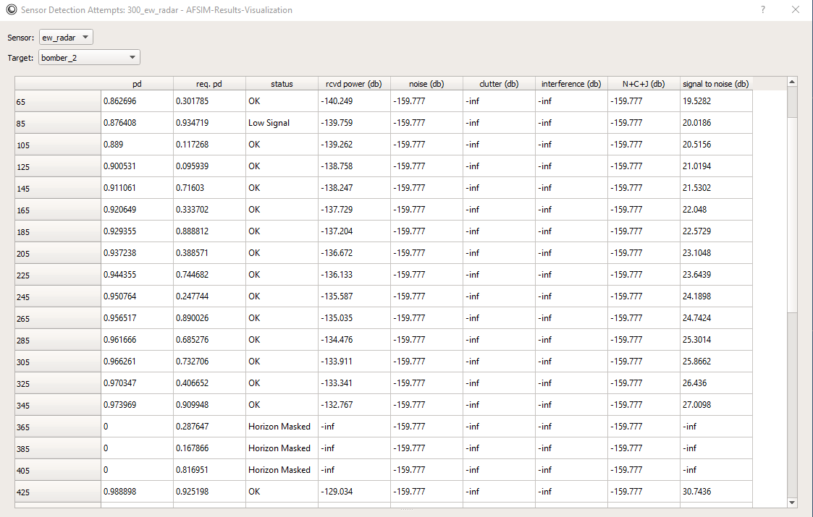
Activity: Waterfall Plot & Sensor Detection Report Cont.
The “status” column of the Sensor Detection Report explains why a detection has failed
Here we have failed to detect for both Low Signal and Masked Horizon

Slide 29
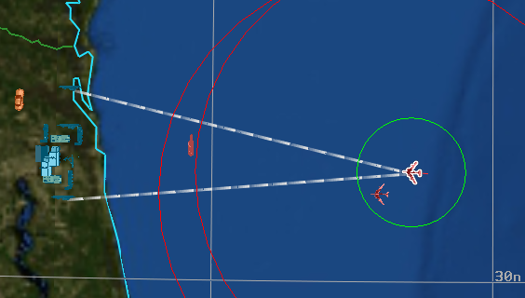
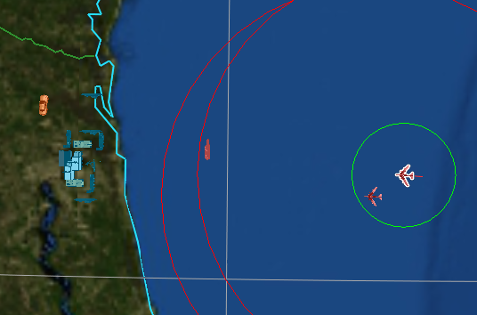
Activity: Waterfall Plot & Sensor Detection Report Cont.
Close out of both plots
Advance to time 350 seconds
Select bomber_2
Play the simulation
Turn on incoming Detection lines for bomber_2 in Platform Options
Notice the bomber’s dropping altitude in Platform Details
When the bomber is low enough, detection lines disappear
Detection failure in this case is due to the target being masked by horizon
Scenario Time = 344 seconds
Scenario Time = 367 seconds
Notes:
Note: This only shows the second gap in detection.

Slide 30
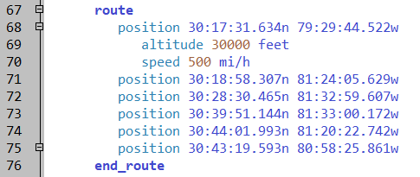
Activity: Waterfall Plot & Sensor Detection Report Cont.
Close out of Mystic
In Wizard, open the file scenarios/red_laydown.txt
Delete the new route you wrote in the bomber_2 platform definition
Uncomment the original route
The route on the platform should match the pictured route
Run the scenario in Mission and open the .aer file
scenarios/red_laydown.txt

Slide 31
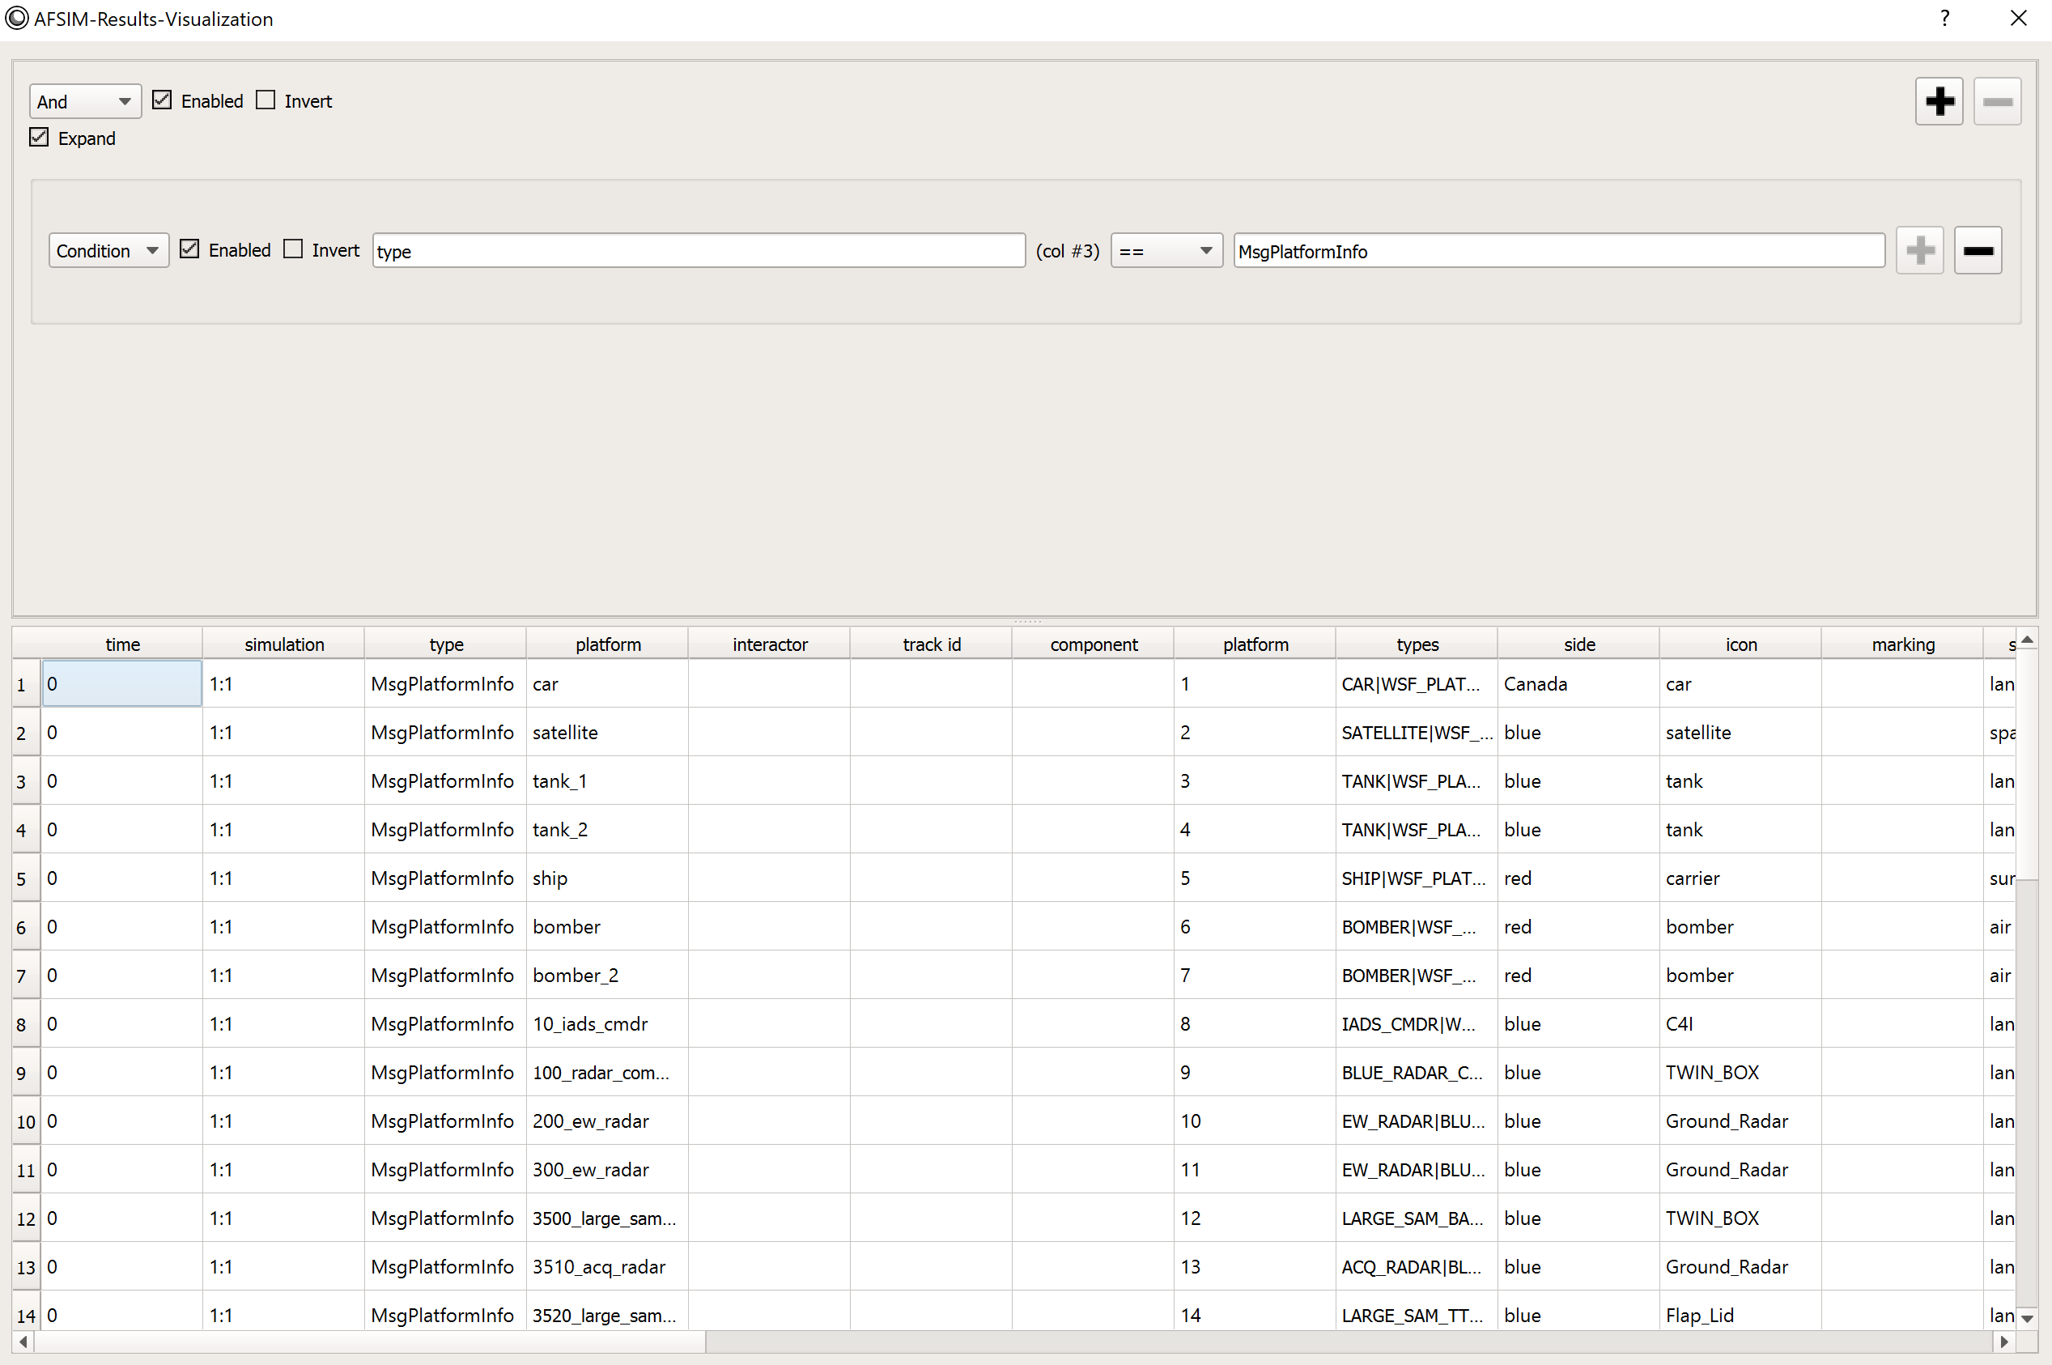
Event List
Tools → Show Event List
Shows all currently loaded simulation events in a filterable, exportable table
Currently Applied Filters
Event Information

Slide 32
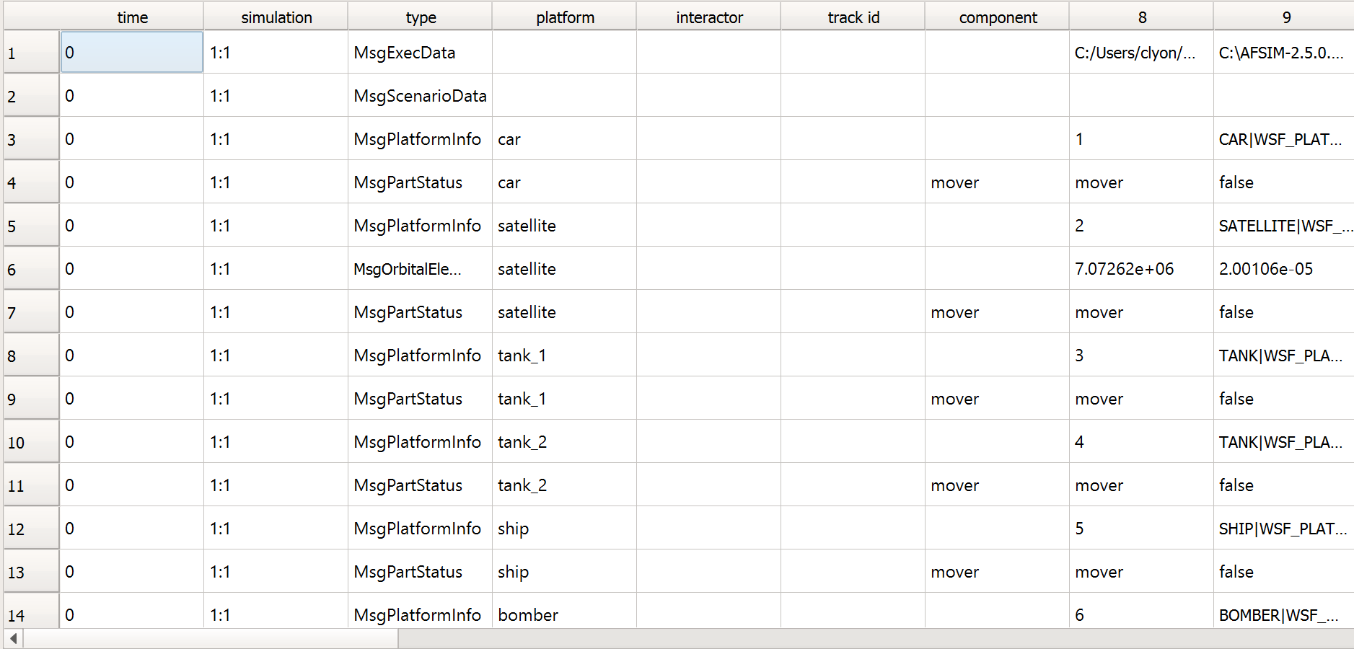
Event List: Numbered Columns
Q: Why are some columns given a number, not a label?
A: All events have common categories of information (ex: type, time, platform). But, different events also have unique information, which doesn’t have dedicated columns
If you hover over a cell in a numbered column, the field name will appear
If you filter to a single event type, any numbered columns will become named columns

Slide 33
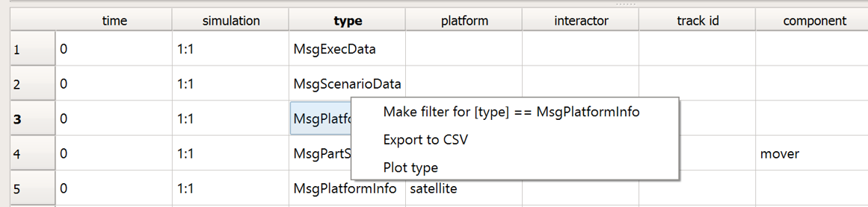
Event List: Exporting
Event List data can be exported to a .csv file
To export:
Right-click on any cell
Select “Export to CSV”

Slide 34
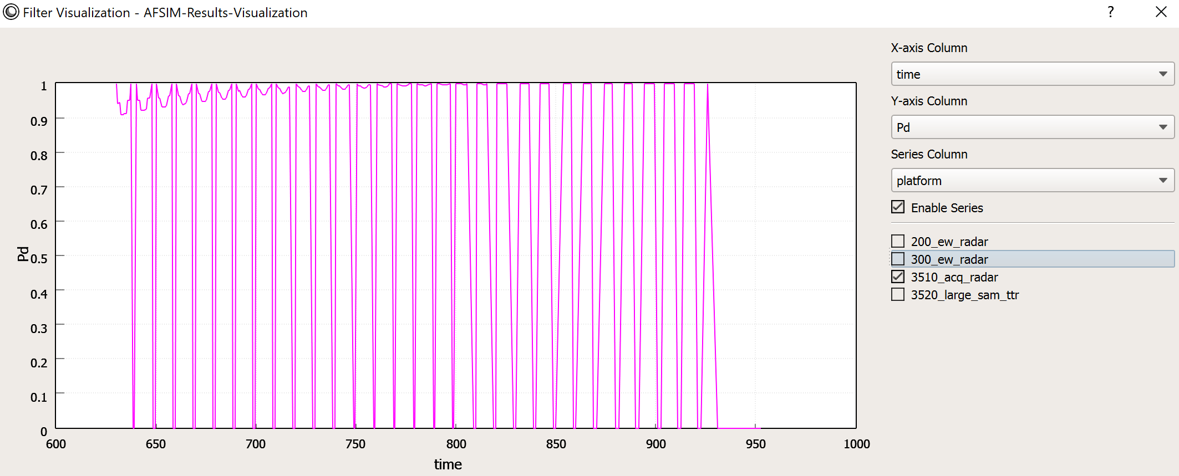
Event List: Plot Type
Right-click on a cell in the event list to plot its column
Allows you to plot the column vs. time, while adjusting the series shown in the plot

Slide 35
Event List: Adding a Filter
Option 1: Click the plus sign at the top of the list
Then, fill in the checkboxes, drop-down menus, and text boxes

Slide 36
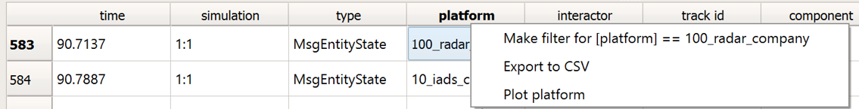
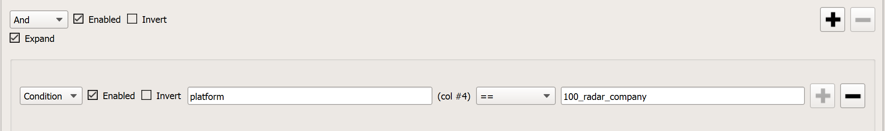
Event List: Adding a Filter (Cont.)
Option 2: Right-click on a cell to filter by column value
Result: Filter appears at the top of the event list.
You can also edit the filter from here
Delete a filter by clicking the minus sign beside it

Slide 37
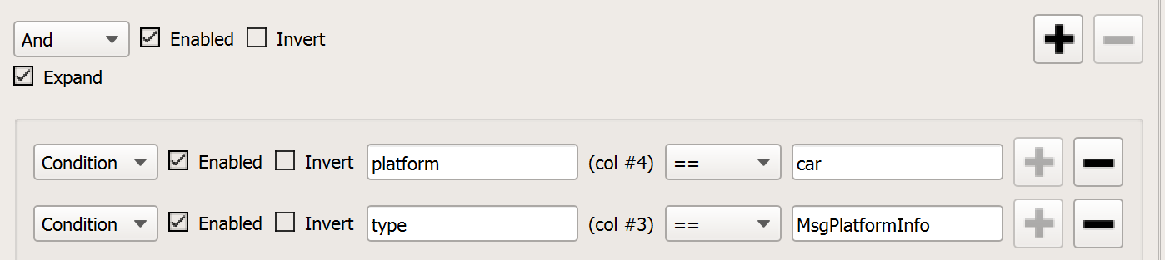
Event List: Enabled and Invert
Enabled:
At Top
Unchecked will show all rows
Checked will show only rows that meet all listed conditions
On Single Filter
Unchecked will ignore the condition
Checked will show only rows that meet the condition
Invert:
Everything that would be shown now isn’t shown and vice versa
At Top
Checked inverts all logic
On Single Filter
Checked inverts logic on only one filter

Slide 38
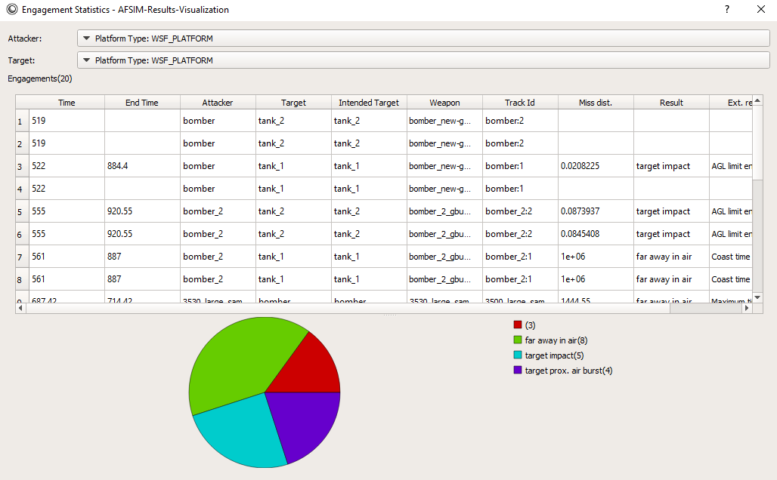
Engagement Statistics
Allows you to analyze data from all weapon engagements in a scenario using the following tools:
Plotting
Data Tables
Event Tracing

Slide 39
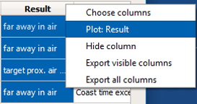
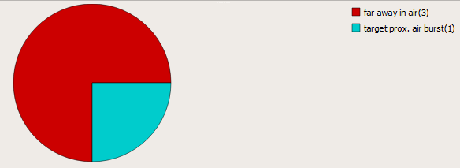
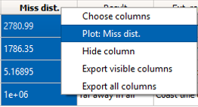
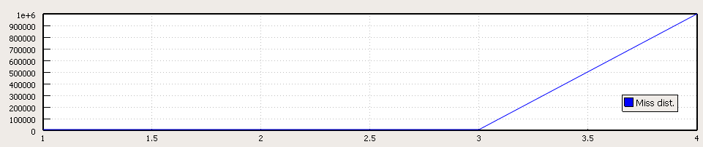
Engagement Statistics: Plotting
You can plot the data in one of the table’s columns by right-clicking on any cell in the column and selecting Plot:
Plotting columns containing categorical (non-numerical) data creates pie charts
Plotting columns containing numerical data creates line graphs
Notes:
The Choose columns, Plot, Add to Plot, and Hide options seen when you right-click on a column were discussed in the sensor detection report section

Slide 40
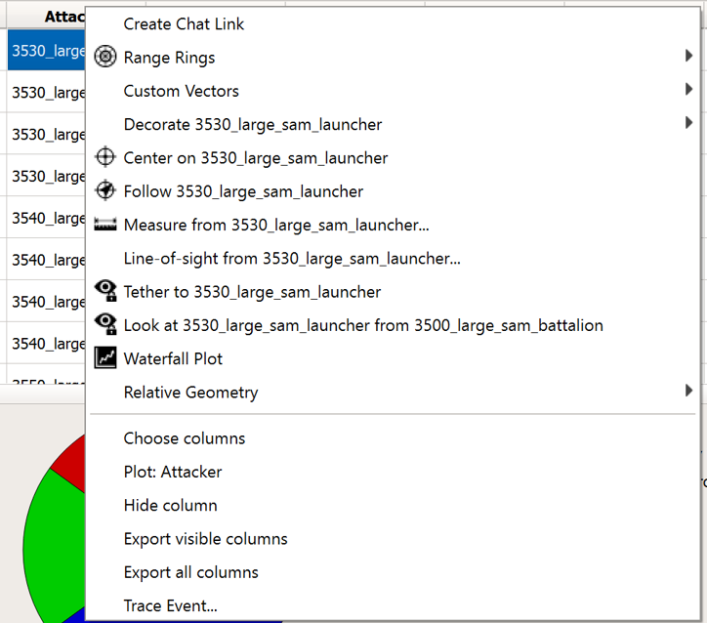
Engagement Statistics: Accessing Platform Context Menu
You can right-click on cells in any of these columns to access the Platform Context Menu:
Attacker
Target
Intended Target
Weapon

Slide 41
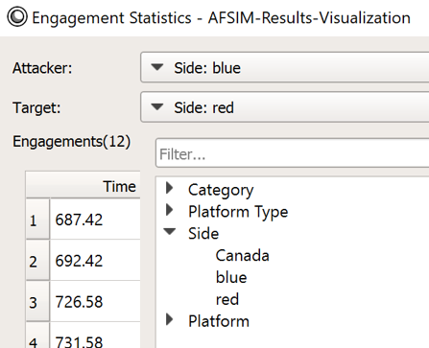


Activity: Engagement Statistics
Let’s analyze weapon engagement results to evaluate side blue’s weapon engagement performance
Go to Tools -> Show engagement Statistics
In the Attacker drop-down menu, select Side: blue
In the Target drop-down menu, select Side: red

Slide 42



Activity: Engagement Statistics Cont.
Right-click in the cell in row 1 of the Result column
Click “Plot: Result”
Creates a pie chart of the results of each engagement event
The Ext. result column gives more specific descriptions of each engagement event result

Slide 43


Event and Track Tracing
Tracing allows you to view the events leading up to an engagement event or track
To trace an engagement event:
Right-click on any cell in the Engagement Statistics table
Select “Trace Event”
To trace a track:
Right-click on a Master Track List entry in Platform Details
Select “Trace Track”
Notes:
The top picture is a trace of a weapon engagement event.

Slide 44

Activity: Track Tracing
Advance the simulation to time 840 seconds
Select 3540_large_sam_launcher
In platform details, right-click on Track 1 in the Master Track List
Select Trace Track
Track Acquisition and Correlation
Task Assignment and Shooting

Slide 45

Result Statistics
Tools → Show Result Statistics
Shows the contents of a loaded file by event type
Frequency, memory usage of each event
Pie chart of memory usage
Notes:
Answers these Questions:
Is my scenario outputting what I want to visualize?
Why is my aer file so big?

Slide 46
Learning Objectives
You gain hands-on knowledge about:
Features that are unique to Mystic
How to utilize these features

