Slide 1

AFSIM Space Training
3 – Space Situational Awareness (SSA)
AFRL/RQQD

Slide 2
Learning Objectives
You will gain knowledge about:
Combining Sensor Measurements to Determine Orbital Elements (Initial Orbit Determination, IOD)
Utilizing Sensor Measurements to Refine Initially Determined Orbital Elements (Orbit Determination, OD)
Configure the Track Manager to Enable IOD and OD
Utilize the Task Processor and Observer Callbacks to Configure a Simple Command and Control

Slide 3
Introduction
A Floridistani Satellite Trips the Orwacan "Space Fence"
The Space Fence Provides Initial Orbit Determination.
Orwacan Tracking Sensors Provide Further Orbit Determination
You will
Configure the Space Fence Sensor
Script a solution that ensures proper operation of the Space Fence
Configure a Track Manager for IOD / OD
Utilize the ORBIT_DETERMINATION_INITIATED Script Callback to Make a Task Assignment for further Orbit Determination

Slide 4

Getting Started
You will need to have the following applications installed:
AFSIM version 2.7
Wizard version 2.7 with the SpaceTools plugin enabled
Mystic version 2.7
Open Wizard
Create a new project called space_situational_awareness
Close Wizard startup window
File->New Project
Navigate to the 3_space_situational_awareness directory in scenarios/inwork directory.
Type in the new file name
Right click on space_situational_awareness.txt
Select “Set as Startup File”
Open space_situational_awareness.txt
Alternatively, drag and drop space_situational_awareness.txt onto the Wizard icon or shortcut (faster method)

Slide 5
Configure the Space Fence Sensor
Using Wizard’s Type Browser, or Directly in the platform_type Definition, Edit SPACE_FENCE
Type Browser -> WSF_PLATFORM -> SPACE_FENCE
Right Click and Select “Manage Platform Parts”
Click Add Part to Add new Sensors
From Wizard project browser, double click on ./platforms/space_fence.txt to edit
Type in sen then Ctrl-Space to auto-complete sensor…end_sensor block
Create two Sensors Called space_fence_1 and space_fence_2
Derive from SPACE_FENCE base sensor type
Default them on
Frame time of 5 seconds
Give them rectangular fields of view
Both have elevation fields of view 30 to 90 degrees
space_fence_1 azimuth field of view 85 to 95 degrees
space_fence_2 azimuth field of view -90 to -80 degrees
Make an internal_link to the processor one-shot

Slide 6
Script IOD Space Fence Operation
Want to Only Provide One Track Update from SPACE_FENCE sensors to red_command
Mandate that tracks from the two different SPACE_FENCE platforms needed to provide IOD
Provide this Effect by Completing the Script Logic in SPACE_FENCE’s “one-shot” Processor
In the on_message block:
Process messages of type WSF_TRACK_MESSAGE
Retrieve the track Id of the track in the message
If the track id exists in the script variable mTrackedTargets, the track has already been sent to red_command
Suppress sending the message again
Else, this is the first and only time we send the message to red_command
Insert the track id into the script variable mTrackedTargets

Slide 7
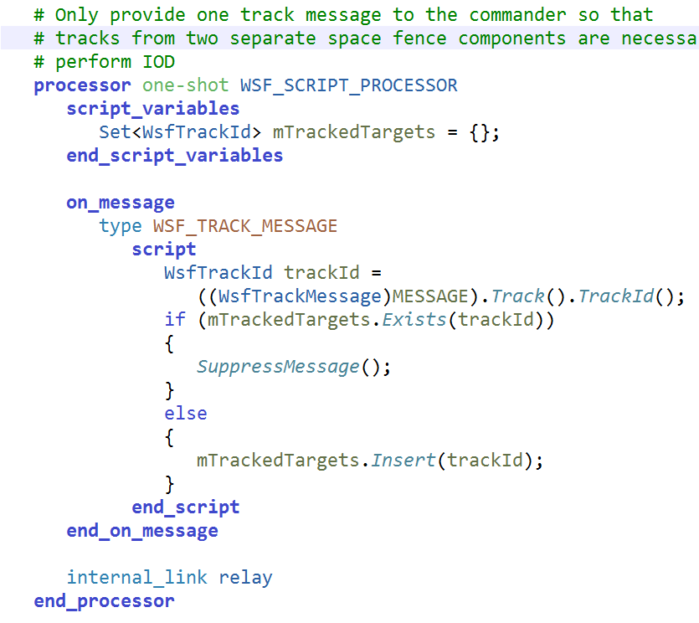
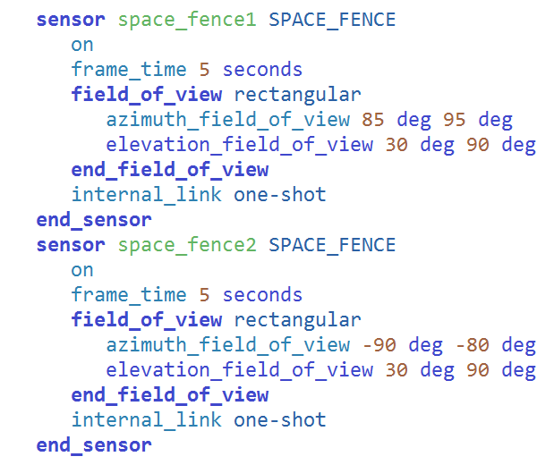
./platforms/space_fence.txt

Slide 8
Configure Red_Command’s Track Manager
Within Wizard’s Project Browser, Navigate to ./scenarios/red_command.txt and Open
Within red_command’s track_manager Block
Disable uncorrelated_track_drops
Keeps tracks in the track_manager that would otherwise be dropped
Specify retain_track_history
Provides the data to perform locations or angles-only IOD
Configure a fusion_method of type orbit_determination
Specify the debug keyword to provide diagnostic output
Specity process_noise_sigmas of 0.03 0.03 0.03
ECS xyz in m (per second)
Specify range_error_factors of 0.035

Slide 9
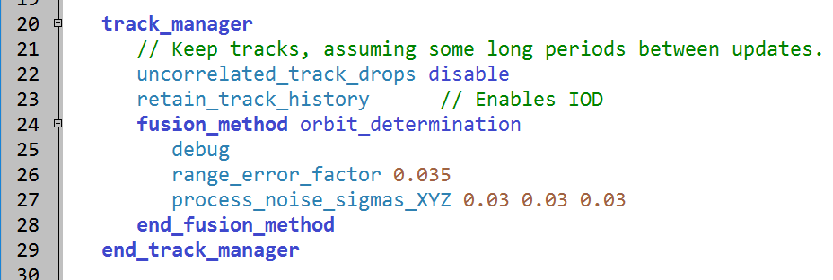
Completed Red_Command’s Track Manager Configuration
./scenarios/red_command.txt
Notes:
uncorrelated_track_drops and retain_track_history may become the defaults in the future when orbit determination fusion is specified.

Slide 10
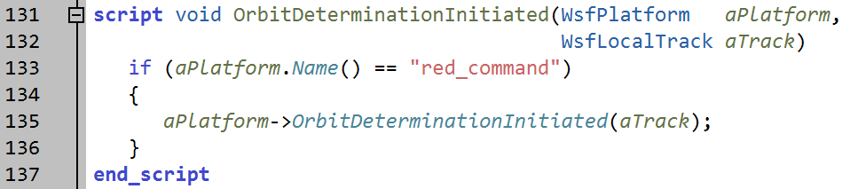
Script IOD Callback
In the ./scenarios/red_command.txt file, script the OrbitDeterminationInitiated Callback
Only execute the script if the platform (name) is red_command
Call red_command’s OrbitDeterminationInitiated script
Use the “->” operator
./scenarios/red_command.txt

Slide 11
Task Processors
Examine the task processors (WSF_TASK_PROCESSOR) for both red_command and tracking_sensor platforms
red_command
Understand DETECTED and ASSIGNED states
Review MakeAssigment script
Assigns a tracking sensor based on closest proximity to a target that has undergone initial orbit determination
tracking_sensor platforms
Understand WAITING, OBSERVING, TRACKING, COMPLETE states

Slide 12
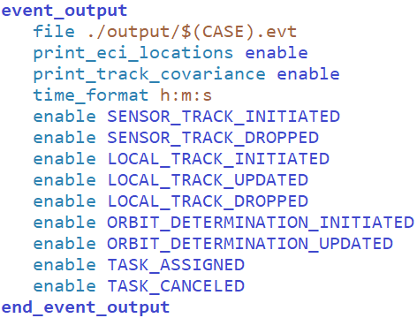
Space Tracking Options in event_output
Make Note of Useful Events and Options for Space Tracking in event_output
ORBIT_DETERMINATION_INITIATED event
ORBIT_DETERMINATION_UPDATED event
print_eci_locations option
print_track_covariance option
./space_situational_awareness.txt

Slide 13
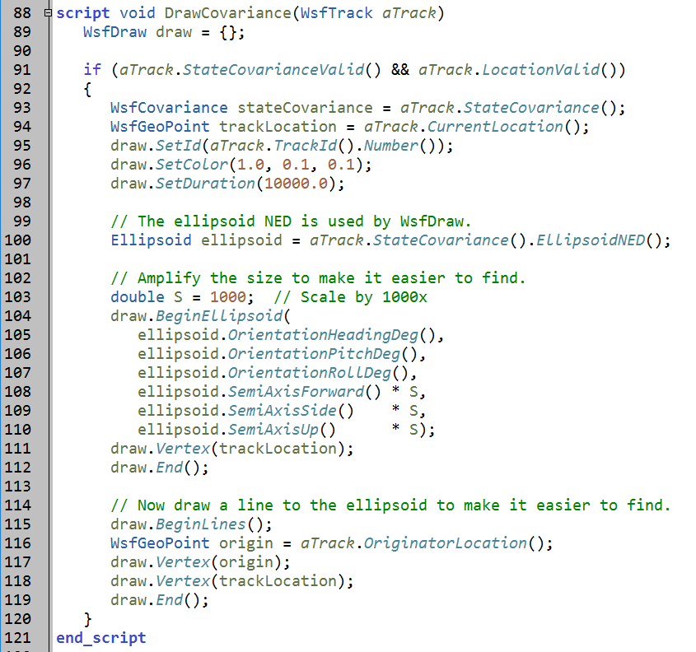
Examine the DrawCovariance Script Method
./scenarios/red_command.txt
Notes:
Valid State and Measurement Covariances can be visualized using the Ellipsoid object. This object is retrieved from the covariance, then used in the BeginEllipsoid(…) call in WsfDraw.

Slide 14
Scenario
Two Orbiting Objects
fls_133
Flordistani satellite designation #133
Fls_133_r_b
The expended rocket booster from fls_133
Space Fence Detects Both Objects
Tracks from Space Fence Collected by red_command
Performs initial orbit determination with large initial error
red_command Tasks the Co-Located TRACKING_SENSOR Nearest the “IODed” Track to Perform Orbit Determination
Significantly reduces the large initial errors in az/el

Slide 15
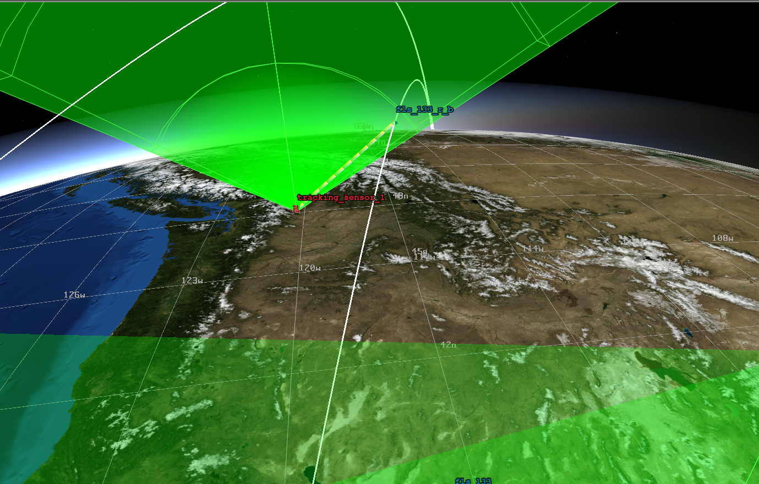
Scenario

Slide 16
Execution
RUN IT NOW!

