Slide 1
GIT
Complete Tutorial

Slide 2
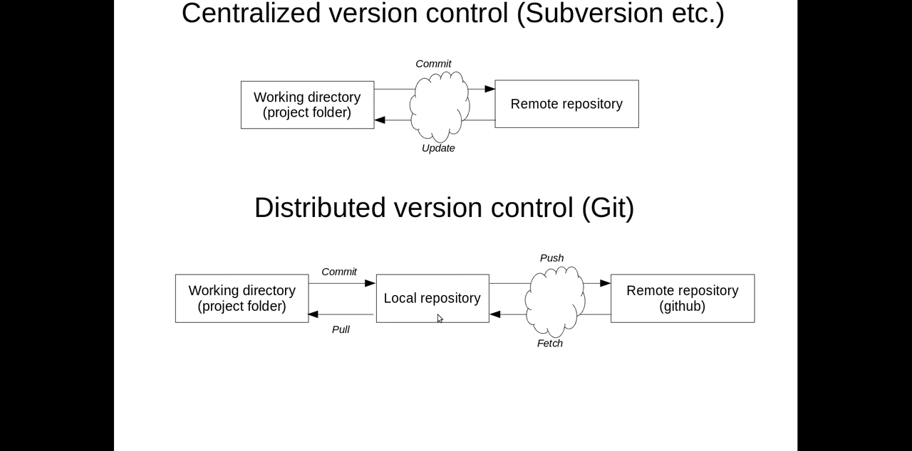
GIT Lifecycle vs. SVN

Slide 3
Repository
Click ‘New Repository’
Give ‘Repository Name’
Tick ‘Initialise this repository with Read Me’
Select ‘add .gitignore’ to ‘java’
Click ‘create repository’

Slide 4
Git - Eclipse
Navigate to Window | Show View | Other | Git | Git repositories
Click on ‘clone a git repository’ (for first time repository creation) else,
Click on ‘clone a git repository and add a clone to this view’ | clone URI |next
Fill URI | user | password (only for first time repository & fetch details from git account)
Next |next | Finish
In Package Explorer, right click project | Team | Share Project | Git | next | Select an existing repository or create a new one | finish (provide user credentials)
Observe the bracket ‘>’ icon for the code no committed

Slide 5
Git - Eclipse
In Package Explorer, right click project | Team | commit
Enter commit message and select required files and click commit(note bracket’>’ icon disappears)
In Git Repositories , note the hash code is different for local and remote tracking for branches
Two ways to push changes ,
In Package Explorer, right click project | Team | push Branch Master |next |finish (finish (provide user credentials)
note the hash code will be identical for local and remote tracking for branches

Slide 6
Multiple developer using git - eclipse
A developer already commited the project in GIT
2nd developer can import the project using,
In Git Repositories , follow for first time repository creation or latter steps
In Package Explorer, right click import | Git | Projects from git | next | cloneURI
Fill URI | user | password (only for first time repository & fetch details from git account)
Next | master | next | next | next | select project | finish
Project appears in Package explorer and Git Repositories.
1st Developer makes changes and does not commit
2nd Developer makes changes to the code and commit -push

Slide 7
Multiple developer using git - eclipse
Receives error while push ‘Rejected non-fast forward’
Aim now is to get latest code changes from the server,
In Package explorer, right click on project | team | pull | observe the conflict
Manually resolve
Window | Show view | other | git | git staging | Move file from unstaged changes to staged changes | commit and push
Note – before resuming work , check for pull.

