Slide 1
Effective Engine MVP
Variance alpha, neural BSDE hedging, and execution-aware walk-forward retraining
Xiaohao Ji · independent project C++ options trading engine + Python research pipeline · 2026
Notes:
30-45 minute project report. The spine: choose the right hedge objective, replay honestly, promote only after walk-forward gates.

Slide 2
Thirty-Five Minute Map
Part | Main message | Time
Motivation | Options alpha is signal, hedge, execution, and validation. | 5 min
State of art | From Black–Scholes to rough vol and deep hedging; deployment remains hard. | 7 min
Core idea | Use BSDE learning as a hedge operator, not an alpha destroyer. | 10 min
System | C++ replay plus Python walk-forward retraining makes the idea testable. | 8 min
Results | Delta-only BSDE preserves most of BS Delta's OOS VRP capture. | 7 min
Outlook | Mature pieces, research-grade pieces, and next steps. | 3 min
Talk spine
A research prototype for equity-index volatility trading: choose the right hedge objective, replay honestly, and promote only after walk-forward gates.
Effective Engine MVP
1

Slide 3
The Project In One Picture
Option panel
Variance alpha
Hedging models
SPY spot, ATM, 25Δ, SSVI
VRP + HAR-RV + skew / curvature
BS, rough delta, neural BSDE
retrain · re-export · re-gate
Promote or reject
Walk-forward retrain
C++ replay engine
balanced gates
train, export ONNX, replay
fills, PnL, lifecycle
Main design principle
The project treats alpha, hedge, execution, and model lifecycle as one coupled system — not four separate research problems.
Effective Engine MVP
2

Slide 4
01
Market Problem
What the trade is, and where the premium is supposed to come from.

Slide 5
What Is The Trading Question?
VRP ≈ σ²(implied) − σ²(realized)
Project implementation
SPY intraday option-chain replay.
Model-free VIX-style variance proxy, with an ATM fallback.
If implied variance is rich, short front variance can earn carry.
SSVI smile features from ATM and 25Δ quotes.
If realized volatility dominates, long gamma can profit from rebalancing.
Greek attribution and daily stability reports.
Both legs are quoted, so the spread you cross is the first thing that eats the edge.
Which of the two regimes you are in changes daily — the signal has to say which.
The constraint that decides everything
The signal is only useful if hedging and transaction costs do not erase it. That is why the hedge objective — not the pricing model — is the strategic choice in this project.
Market Problem
3

Slide 6
State Of Art: Volatility Trading Stack
Layer | Classical / current tools | Why it matters here
Pricing | Black–Scholes, local vol, Heston, stochastic vol | Gives deltas, vegas, and sanity checks.
Surface | SVI / SSVI, skew, curvature, variance swaps | Alpha lives in surface dislocations, not only ATM IV.
Dynamics | Rough volatility and Markovian lifts | Short-dated skew has rough-style scaling.
Learning | Deep BSDE and deep hedging | High-dimensional hedging without finite-difference grids.
Deployment | Walk-forward validation, execution replay, risk gates | Research signal must survive data drift and fills.
Where this project sits
The first four layers are well covered by the literature. The fifth — deployment — is where the prototype spends most of its engineering.
Market Problem
4

Slide 7
Data And Signal Construction
Composite alpha
Available panel
SPY spot recovered from the option-chain panel.
Signal | Weight
VRP | 50%
HAR-RV | 30%
Skew / curvature | 20%
ATM call / put quotes with bid and ask.
25Δ call / put quotes for skew and butterfly.
SSVI parameters (ρ, φ) and realized-vol features.
Important choice
Use the wings and the shape of the surface. ATM variance alone misses where index-option premium often hides — the 25Δ quotes are doing real work here.
Market Problem
5

Slide 8
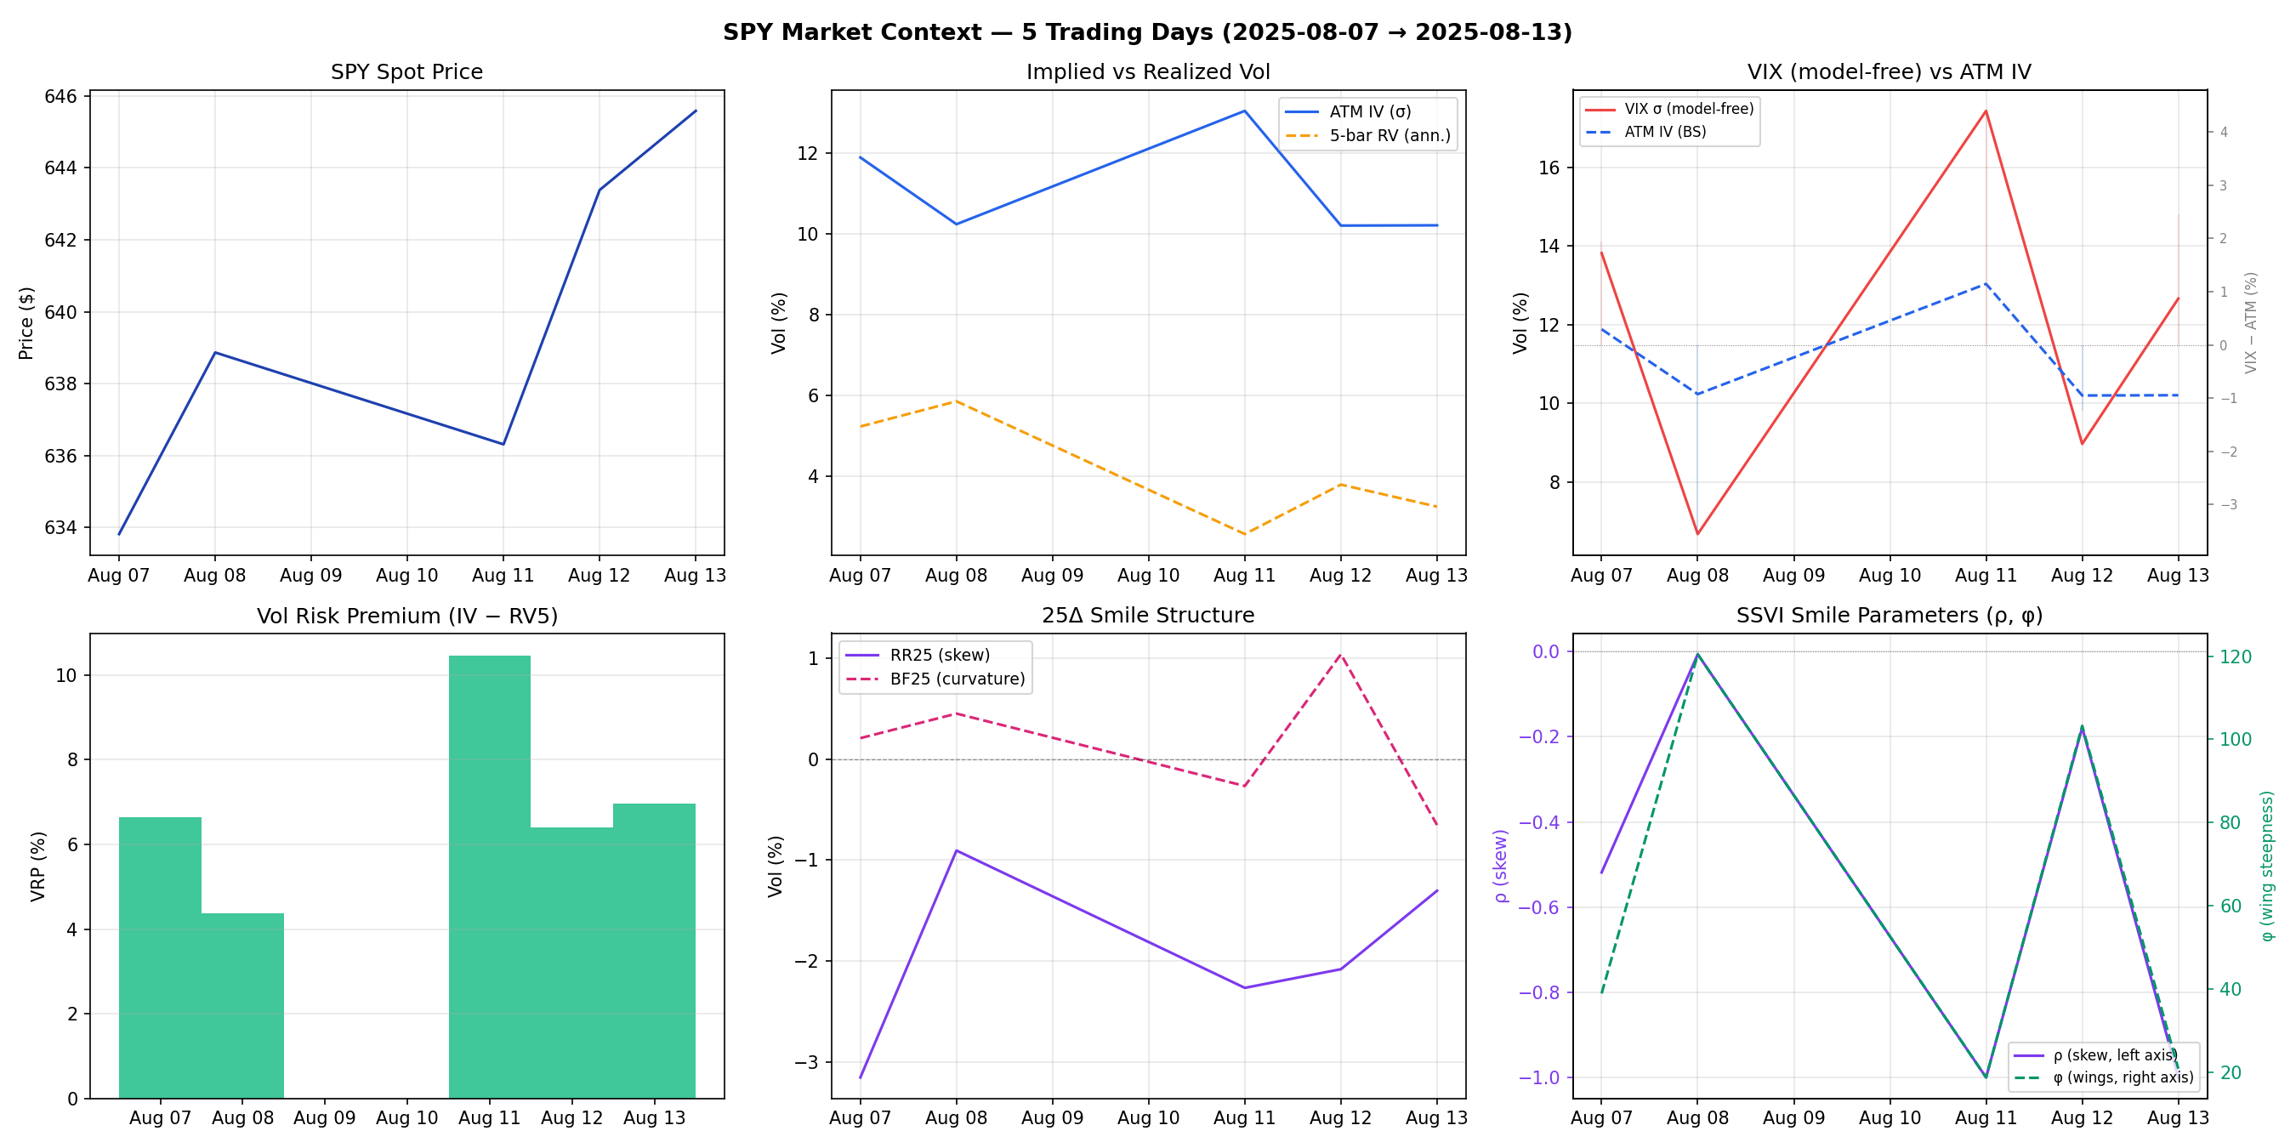
Market Context In The Current Panel
The dashboard tracks spot, ATM IV, realized vol, model-free VIX variance, 25Δ smile structure, and SSVI dynamics.
Market Problem
6

Slide 9
02
Hedging Models
Which risks the model should remove — and which residuals are the alpha.

Slide 10
PnL Anatomy: Alpha Versus Hedge
Delta-hedged option PnL, schematically
dΠ ≈ Δ dS + ½ Γ d⟨S⟩ + ν dσ + Θ dt − costs
Δ dS
½ Γ d⟨S⟩
ν dσ
Θ dt
costs
spot
gamma / realized variance
vega / surface move
decay
execution
The hedge should remove unwanted spot exposure.
It should not automatically remove the gamma / vega residual that carries the volatility premium.
Consequence
The hedging objective is a strategic choice, not a modelling detail.
Hedging Models
7

Slide 11
Four Hedgers Tested
Hedger | Delta computation
BSDelta | N(d₁) at market ATM IV and historical time-to-expiry.
RoughVolDelta | BS delta plus a Bergomi–Guyon smile-slope correction.
NeuralBSDE-Full | ONNX network trained to replicate the full discounted payoff.
NeuralBSDE-Delta | ONNX network trained to replicate only the BS delta hedge PnL.
Hypothesis
A neural hedge can be useful only if its training target matches the trading objective. Everything that follows is a test of that one sentence.
Hedging Models
8

Slide 12
Rough Volatility: Why It Enters
Xₜ = ( τ, log(S/K), Vₜ, U₁, U₂, U₃, U₄ )
Δ(rough) = Δ(BS) + Vega · ∂σₖ/∂S
Rough-vol models capture short-time skew scaling.
Four OU factors approximate the rough kernel in Markovian form.
A more complete hedge than the BS delta.
The network input is 7-dimensional — already beyond comfortable finite-difference grids.
But it can consume carry in a positive-VRP regime.
Why it is only a stepping stone
The rough correction is still a closed-form patch on a BS delta. The BSDE replaces the patch with a learned hedge operator on the full 7-D state.
Hedging Models
9

Slide 13
Deep BSDE Hedging: The Modelling Bridge
Y(t+Δt) = Y(t) + Z(t) · ΔW(t), Y(T) = Φ(X(T))
By Feynman–Kac, Y(t) = u(t, X(t)) and Z(t) is the Brownian hedge exposure.
A shared-weight MLP maps each normalized state to (Y, Z).
Export to ONNX makes the hedge available inside the C++ replay loop.
Training mode | Economic meaning
lrh | Full payoff replication — removes nearly all residual alpha.
lrh_delta | Delta-only target — leaves gamma + vega as VRP exposure.
One line of code, two different strategies
Same network, same state, same export path. Only the training target changes.
Hedging Models
10

Slide 14
The Key Discovery: Full Replication Can Kill Alpha
Y₀ + Σ ZᵢΔWᵢ ≈ e⁻ʳᵀ(S(T) − K)⁺
Φ(Δ) = Σ N(d₁,ᵢ) σᵢ Sᵢ ΔWᵢ
Full replication target
Delta-only target
The model learns to neutralize payoff risk.
The model learns the hedge component only.
That includes the gamma / vega residual the variance strategy wants.
The residual Γ + ν remains available as alpha.
The result this talk is built around
A theoretically cleaner hedge was economically worse. Full replication kept 26.9% of BS Delta's PnL; the delta-only target kept 83.6%.
Hedging Models
11

Slide 15
03
System Architecture
Replay, execution, and the retraining loop that makes the claim testable.

Slide 16
C++ Event-Driven Replay Architecture
Historical feed
IV + smile extractors
Composite signal
market + option quotes
ATM, VIX, SSVI
VRP / HAR / skew
Delta / neural BSDE
SimpleExecSim
StrategyController
hedge orders
order lifecycle
straddle orders
fills
AlphaPnLTracker
Greeks + daily CSV
Positions update only from execution fills — events, provenance, risk controls, and replayable PnL.
System Architecture
12

Slide 17
Execution Layer v2: Why It Matters
Area | Before | Now
Hedge fills | Hedgers could self-fill and update positions. | Hedgers submit orders; execution publishes fills.
Provenance | Alpha and hedge fills could blur. | Orders and fills carry producer and order id.
Lifecycle | One-shot fill assumption. | Accepted, rejected, partial, filled, canceled reports.
Risk gates | Mostly logging. | Block, cancel, and reduce-only behaviour in the router.
Accounting | Position updates could precede execution. | Positions update only from execution fills.
Research implication
Once execution is explicit, turnover and transaction costs become model-selection criteria — not footnotes.
System Architecture
13

Slide 18
Walk-Forward Retraining Is First-Class
Daily expanding schedule
Calibrate + train
Export ONNX
Neural + BS replay
Balanced gates
Promote or reject
next deploy date — the schedule advances one day and the loop repeats
Window 1
train
deploy
Window 2
Window 3
Window 4
train (expanding)
deploy day
demo/runs/walk_forward/<run_id>/windows/<deploy_date>/ stores artifacts, replay CSVs, logs, window manifests, and summary reports.
System Architecture
14

Slide 19
Promotion Gates
Gate | Checks
Causality | Train only on rows before the deploy date; record train and deploy row counts.
Artifact | Checkpoint, ONNX, normalization, Y₀ file, schema, hashes.
ONNX parity | PyTorch versus ONNX output agreement.
Delta sanity | ATM model delta finite and close to BS delta.
Replay health | Neural and BS replays complete and write a non-empty daily CSV.
Baseline guard | Neural hedge must not catastrophically underperform BS Delta.
Default behaviour
No live artifact is overwritten unless every window passes and --promote-if-pass is explicit.
System Architecture
15

Slide 20
04
Results
What the delta-only BSDE kept, and what full replication threw away.

Slide 21
OOS Four-Strategy Result
Out-of-sample, 2026-01-02 → 2026-02-06
OOS metric | BSDelta | RoughVol | BSDE-Full | BSDE-Delta
Hedge PnL | 1,059,605 | 698,612 | 290,817 | 892,723
Txn cost | 1,801 | 643 | 8,201 | 9,005
Total PnL | 1,060,036 | 700,201 | 284,847 | 885,950
vs BSDelta | 100.0% | 66.0% | 26.9% | 83.6%
Interpretation
Full replication is theoretically clean but economically wrong for this alpha. The delta-only BSDE keeps most of the variance-premium exposure — at a transaction cost still small next to the PnL.
Results
16

Slide 22
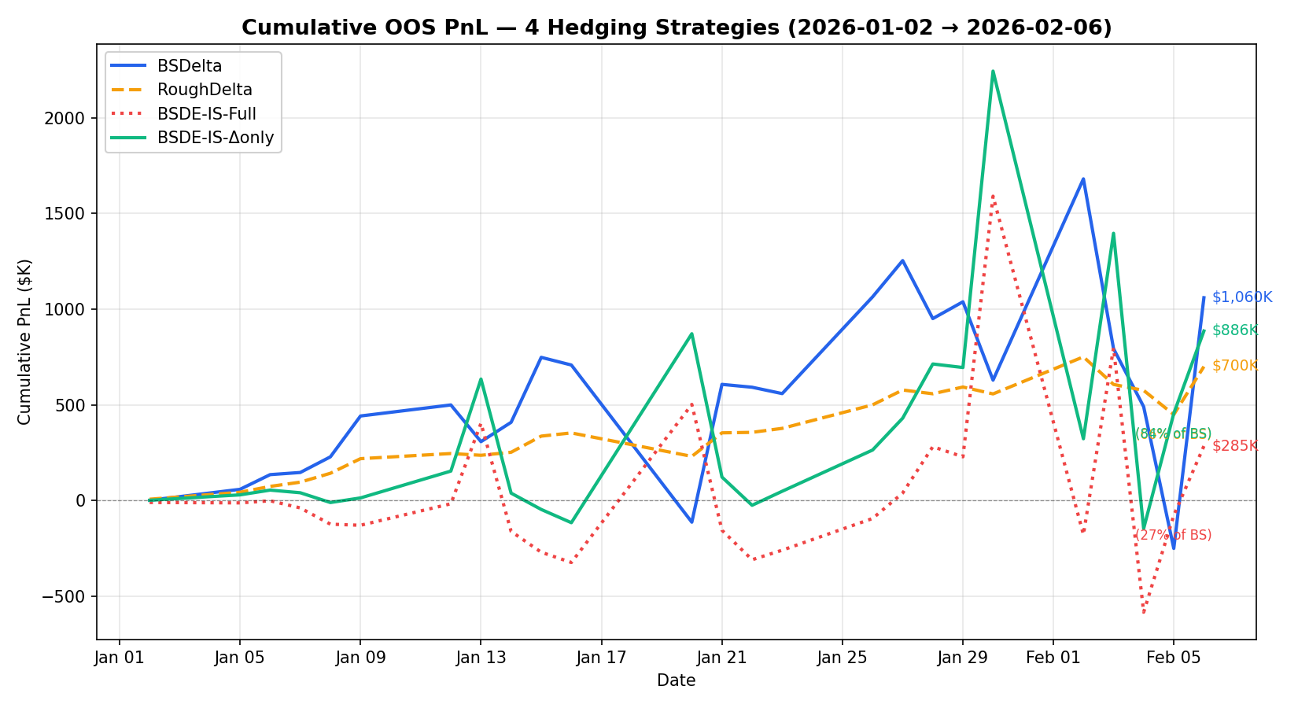
Cumulative OOS PnL
What it says
BSDelta and the delta-only BSDE track each other closely.
The full-replication BSDE spends much of the window near zero or negative.
RoughDelta is smooth but systematically lower — it hedges away carry.
Delta-only BSDE closes at 84% of BS Delta; full replication closes at 27%.
Results
17

Slide 23
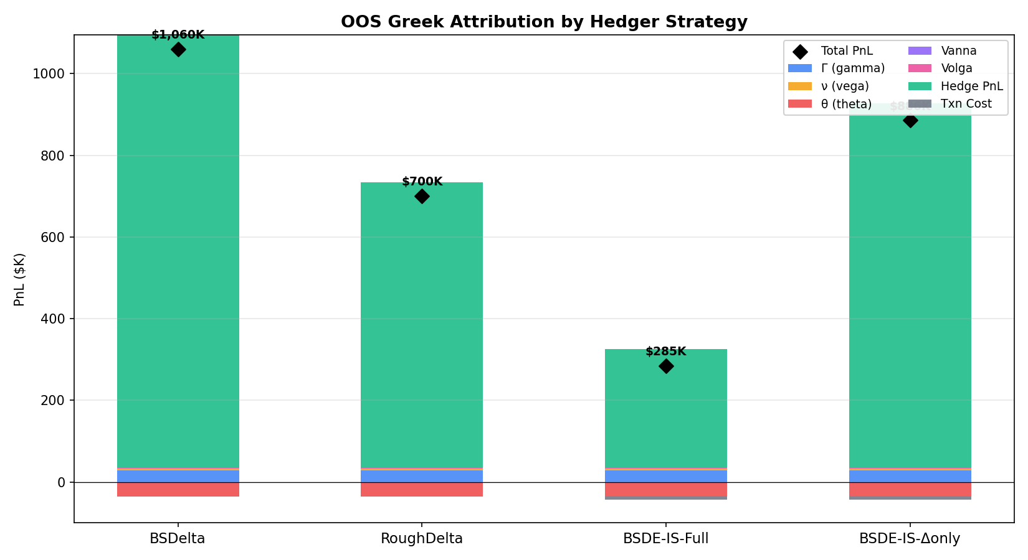
Greek Attribution Explains The Difference
Why the gap opens
Gamma and vega are the intended alpha sources.
A hedge objective that erases them also erases the strategy.
Transaction cost is visible but second-order next to the residual that was hedged away.
The difference between the four bars is not hedge quality — it is how much residual each objective left alive.
Results
18

Slide 24
Five-Day Walk-Forward Demo Result
$3.415M
3.18
138.8
0.537
Total PnL
Daily Sharpe
Turnover (fills / day)
Model delta (BS: 0.504)
Distribution | Mean daily | P5 | P50 | P95
Daily PnL | $682,958 ± $214,586 | $311K | $690K | $929K
Why walk-forward mattered
The unretrained synthetic model was out-of-distribution on SPY. SPY calibration fixed the scale of V(t), strike, maturity and skew — the same network went from unusable to a 3.18 daily Sharpe with no architecture change.
Results
19

Slide 25
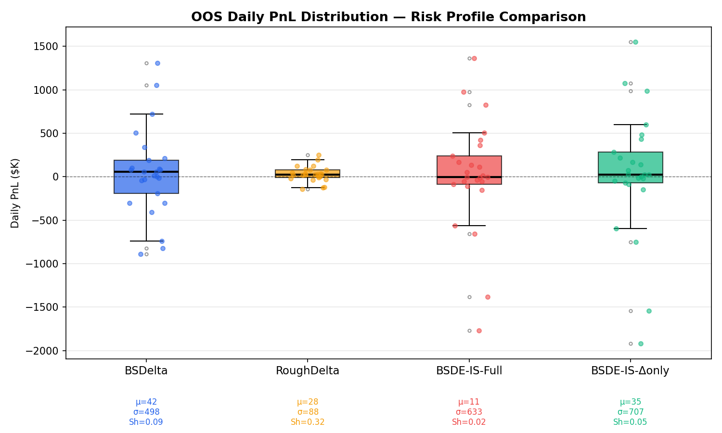
Daily PnL Stability
The model comparison is not only final PnL: daily dispersion, transaction costs, and residual risk matter.
Results
20

Slide 26
05
Status And Outlook
What is solid, what is still research-grade, and what comes next.

Slide 27
What Is Mature Now?
Solid prototype pieces
Still research-grade
Event-driven C++ replay path.
Small public / local panel in the repo.
Multi-strategy hedge comparison.
No live broker connectivity.
Greek attribution and daily CSV output.
Simplified execution simulator.
ONNX inference inside replay.
BSDE objective needs broader regime validation.
Walk-forward run manifests and gates.
Risk sizing and portfolio construction remain MVP-level.
How to read this project
It is a working prototype of a research process, not a live trading system.
Status And Outlook
21

Slide 28
Main Limitations
1
Data scale
The research claim needs more dates, more regimes, and stricter OOS splits.
2
Cost model
Fills are replay-realistic but not yet venue- or microstructure-realistic.
3
Model objective
Delta-only wins here, but it should be stress-tested against alternative hedge losses and residual-risk metrics.
4
Rough state inference
U-factors are retained but zeroed at inference to avoid learned confounds.
5
Promotion policy
Gates exist; production would need monitoring, rollback, and capital / risk budgets.
Status And Outlook
22

Slide 29
Roadmap
Next step | Goal
More data regimes | Test positive VRP, negative VRP, stress, quiet, high-rate and low-rate windows.
Better replay costs | Add latency, queue position, venue fee model, and spread impact.
Residual-risk gate | Evaluate hedge residual variance, not only total PnL.
Objective sweep | Compare full payoff, delta-only, residual variance, and cost-aware losses.
Portfolio layer | Move from one straddle engine to risk-budgeted multi-expiry / multi-strike books.
The next result worth having
An objective sweep on more regimes is the single experiment that would most change confidence in the delta-only finding.
Status And Outlook
23

Slide 30
Takeaway
Main message
A neural BSDE should be used as a hedging operator inside a full trading system — not as an isolated pricing model.
Which risks should the model hedge, and which residuals are the alpha?
Full replication can destroy the variance premium it was meant to trade.
A delta-only BSDE preserves most of the exposure — 83.6% of BS Delta's OOS PnL.
Both claims survive only because replay, execution, and gates are part of the experiment.
Status And Outlook
24

Slide 31
References
Black, F. and Scholes, M. (1973). The Pricing of Options and Corporate Liabilities. Journal of Political Economy 81(3), 637–654.
Heston, S. L. (1993). A Closed-Form Solution for Options with Stochastic Volatility. Review of Financial Studies 6(2), 327–343.
Dupire, B. (1994). Pricing with a Smile. Risk 7(1), 18–20.
Gatheral, J. (2006). The Volatility Surface: A Practitioner's Guide. Wiley.
Bergomi, L. (2015). Stochastic Volatility Modeling. CRC Press.
Gatheral, J., Jaisson, T. and Rosenbaum, M. (2018). Volatility is Rough. Quantitative Finance 18(6), 933–949.
Han, J., Jentzen, A. and E, W. (2018). Solving High-Dimensional PDEs Using Deep Learning. PNAS 115(34), 8505–8510.
Buehler, H., Gonon, L., Teichmann, J. and Wood, B. (2019). Deep Hedging. Quantitative Finance 19(8), 1271–1291.
Effective Engine MVP
25

Slide 32
Thank You
Questions & Discussion
Effective Engine MVP

Slide 33
06
Component Library
Blank, reusable versions of every layout above — for data-analysis talks and quant interviews.

Slide 34
How To Use This Kit
Every slide in this deck is four to eight lines of Python
from slidekit import *
d = Deck()
s = d.slide()
title(s, 'Does the signal survive costs?')
chart_with_readout(s, 1.5, 'Net Sharpe vs cost',
['Breaks even at 8bp.',
'Live cost is 3bp.'])
d.save('out.pptx')
What you get
One palette and type scale, applied everywhere.
Placeholders that become real figures by passing image=path.
Time-split geometry as data, not as hand-drawn boxes.
Tables, KPI tiles, flows and verdict blocks that already line up.
File | Role
slidekit.py | The components. Palette at the top — change three colours and the whole deck re-skins.
build_deck.py | This deck. Content only; no layout maths.
fig/ | Figures. plot_holder(..., image=fig('x.png')).
Component Library · how to use
C1

Slide 35
Time Splits — Why The Geometry Matters
The first thing an interviewer checks is whether your split could leak
Holdout
Train
Validation
Test
earliest date
latest date
What a random split does wrong
What the geometry must show
A shuffled split puts tomorrow in train and today in test.
Time runs one way, and train is always to the left of test.
Overlapping labels leak across the boundary.
Any gap between them is deliberate, and you can name its length.
Cross-sectional data leaks through whole dates, not single rows.
The number of folds is visible, not asserted.
The question behind the picture
“Could a row in train have been unknowable at the time the test row was scored?” If the diagram cannot answer that, redraw it.
Component Library · time splits
C2

Slide 36
Time Splits — Walk-Forward (Expanding Window)
split_walk_forward(s, x, y, w, folds=5)
Window 1
train
deploy
Window 2
Window 3
Window 4
Window 5
earliest date
latest date
train (grows each step)
deploy / test window
Use when
Say this out loud
You retrain on a schedule and want the deployed model each day.
“Each window trains only on rows strictly before its deploy date.”
History is short and you cannot afford to throw the early data away.
“The reported metric is the concatenation of the deploy windows.”
Component Library · time splits
C3

Slide 37
Time Splits — Rolling (Sliding) Window
split_rolling(s, x, y, w, folds=5, width=0.34)
Window 1
train
deploy
Window 2
Window 3
Window 4
Window 5
earliest date
latest date
train (fixed length)
deploy / test window
Use when
The trade-off to name
The data-generating process drifts and old regimes actively mislead.
Expanding uses more data; rolling adapts faster.
Choosing between them is an empirical question — show both curves.
You want every fold trained on the same amount of data.
Component Library · time splits
C4

Slide 38
Time Splits — Purged K-Fold With Embargo
split_purged_kfold(s, x, y, w, folds=5, purge=.045, embargo=.045)
Fold 1
test
Fold 2
train
train
Fold 3
train
train
Fold 4
train
train
Fold 5
train
train
test
purge
embargo
What the two gaps do
Set the widths from the data
Purge: drop training rows whose label window overlaps the test block.
Purge width = the label horizon (a 5-day forward return needs 5 days).
Embargo: drop training rows just after the test block, where serial correlation still carries test information.
Embargo width ≈ the autocorrelation decay of the residual.
Quote the numbers in bars, not as “some gap”.
Component Library · time splits
C5

Slide 39
Time Splits — Grouped Date Blocks (Cross-Section)
split_grouped(s, x, y, w, groups=6) — whole dates move together
Split 1
test
train
train
test
train
train
Split 2
train
test
train
train
test
train
train dates
held-out dates
The unit of analysis is the date
Metrics that fit this shape
One date contributes many rows — one per entity.
Daily rank IC, then the IC information ratio across dates.
If a date straddles the split, the cross-section is scored against itself.
Top-k minus bottom-k spread Sharpe.
Never a pooled R² — it hides which dates carried the result.
Group by date first, then apply purge and embargo between blocks.
In this repo
purged_date_splits and GroupTimeSeriesSplit in rvlab.pipelines implement exactly this geometry.
Component Library · time splits
C6

Slide 40
Plot Holder — Hero Chart With Readout
chart_with_readout(s, y, label, findings)
What it says
The one-sentence claim this chart supports.
The second-most important thing a viewer should notice.
The caveat you would rather raise yourself than be asked about.
If you cannot write these three lines, the chart is not ready.
primary chart
pass image=fig('name.png') to drop the real figure in
Default layout for analysis slides: evidence on the left, the claim it supports on the right.
Component Library · plot holders
C7

Slide 41
Plot Holder — Two-Up Comparison
plot_grid(s, x, y, w, h, ['A', 'B'], cols=2)
baseline
candidate
what the current model does
what the change does
Rules for an honest pair
Good pairings
Same axes, same scale, same window — or say why not.
In-sample versus out-of-sample. Before versus after costs.
Difference plotted directly beats two charts read side by side.
Model versus the naive baseline it has to beat.
Component Library · plot holders
C8

Slide 42
Plot Holder — Diagnostic Grid (Small Multiples)
plot_grid(s, x, y, w, h, [...], cols=2)
The four questions
Is the error structured where it should be noise?
residuals vs fitted
QQ / distribution
Are the tails what the model assumed?
Is there information left in the residual's own past?
Does the fit hold across the range, or only in the middle?
One panel per question. If a panel answers nothing, cut it.
residual autocorrelation
prediction vs actual
Component Library · plot holders
C9

Slide 43
Plot Holder — Strategy Tearsheet
The standard backtest read-out: curve, drawdown, and the numbers
00.0%
0.00
−00%
000
0 bp
Ann. return
Sharpe
Max drawdown
Turnover
Break-even cost
cumulative return
net of costs
drawdown
same x-axis as the curve above
Component Library · plot holders
C10

Slide 44
Stat Tiles
kpi_row(s, [(value, label), ...])
0.084
1.30
30
0
Rank IC
Spread Sharpe
Sweep cells
Cells that beat carry
+0.21
−0.40
Pair the number with its comparison
A statistic alone invites “compared to what?”
Fitted skew exponent
Implied by H = 0.10
Put the benchmark in the label, or in the tile beside it.
Use tiles for the numbers you want quoted back
Three to five per slide. Past five they stop being headlines and become a table — at which point use a table, where the reader can compare columns.
Component Library · blocks
C11

Slide 45
Claim → Test → Verdict
verdict_block(s, x, y, w, claim, test, verdict, passed=False)
Claim
How it was tested
Verdict
Volatility is rough, so the skew exponent should be near −0.40 with H = 0.10.
Fit the term structure of ATM skew on the panel; compare the exponent against the prior.
Rejected. The fitted exponent is +0.21 — the wrong sign, not merely the wrong size.
Claim
How it was tested
Verdict
A planted short-term reversal should be recoverable by a linear model.
Ridge on purged date splits, scored by daily rank IC against a naive reversal baseline.
Confirmed. Rank IC 0.084, spread Sharpe 1.30, beating the baseline.
A negative verdict presented cleanly is worth more than a positive one presented vaguely.
Component Library · blocks
C12

Slide 46
Before / After
compare(s, x, y, w, h, left, right)
Before
After
The behaviour, stated plainly enough to be recognisable.
The change, in the same terms as the left column.
The specific failure it caused.
The failure it removes.
What it cost — in time, in PnL, or in trust.
The new cost it introduces — there is always one.
Keep the columns parallel | Why
Same number of rows, same order | The reader compares by position; ragged columns break that.
Name the new cost | A change with no downside reads as a sales pitch, not an analysis.
Component Library · blocks
C13

Slide 47
Pipeline Flow
flow_row(s, x, y, w, h, steps)
Raw data
Features
Model
Evaluate
Decide
provenance, schema
leak-free lags
fit on train only
purged splits
promote or reject
Ingest
Audit
Split
Fit
Report
one loader, one contract
nulls, dupes, drift
before anything is fitted
inside the fold
with an interval
The ordering claim you are making
A pipeline diagram is an argument that nothing downstream touched anything upstream. The split box belongs before the fit box — if it is drawn after, an interviewer will ask why, and they will be right to.
Component Library · blocks
C14

Slide 48
Numbered Method Steps
numbered_steps(s, x, y, w, [(head, detail), ...])
1
State the estimand
1
Attribute
What number would settle the question, and in what units?
Which rows, dates, or features carried the result?
2
Fix the split
2
Stress it
Decide the geometry before looking at any score.
Costs, regimes, seeds, and one deliberately hostile subsample.
3
Build features
3
Report the interval
Every lag and rolling window closed at t or earlier.
A point estimate with no interval is an anecdote.
4
Fit and score
4
Say what would change your mind
Inside the fold. One metric, chosen in advance.
The sentence that separates research from advocacy.
Component Library · blocks
C15

Slide 49
Model Comparison Table
table(s, x, y, w, rows, highlight=2)
Model | OOS metric | vs baseline | Turnover | Verdict
Baseline (carry) | — | 100% | low | reference
Candidate A | — | — | — | promoted
Candidate B | — | — | — | rejected
Candidate C | — | — | — | needs more data
Column order is an argument
What gets asked next
Baseline first, so every later row is read as a difference.
“What is the baseline, exactly?” Have the definition ready.
Cost or turnover before the verdict — it is usually why the verdict went the way it did.
“Is that difference inside the noise?” Have the interval ready.
“How many models did you try?” Have the honest count ready.
Tint the row you want remembered; leave the others plain.
Component Library · blocks
C16

Slide 50
Palette And Type Scale
Change these six values in slidekit.py and the deck re-skins
NAVY
PINE
CLAY
INK
SLATE
RULE
191970
01796F
B85042
0F1633
5A6472
D3DAE6
Element | Size | Font
Slide title | 29 pt bold | Cambria
Standfirst | 13.5 pt italic | Calibri
Card header | 13 pt bold | Cambria
Body / bullets | 12.5 pt | Calibri
Stat tile value | 30 pt bold | Cambria
Caption / footer | 10.5 / 9.5 pt | Calibri
Why these two fonts
Both ship with Office, on Windows and macOS.
Both have metric-compatible substitutes on Linux, so a PDF rendered anywhere keeps its line breaks.
Serif headings, sans body — contrast without a third typeface.
Component Library · reference
C17

Slide 51
Component Library
Copy a slide. Change the words. Keep the geometry.
slidekit.py · build_deck.py

