Slide 1
FULL INDIE MONTHLY
Why Your Single-Player Game Might Still Want a Backend
Vincent
·
September 2026
Notes:
Cold open: the Games Link talk story. Stay on this slide the whole time — eyes on me, not the screen.

Slide 2
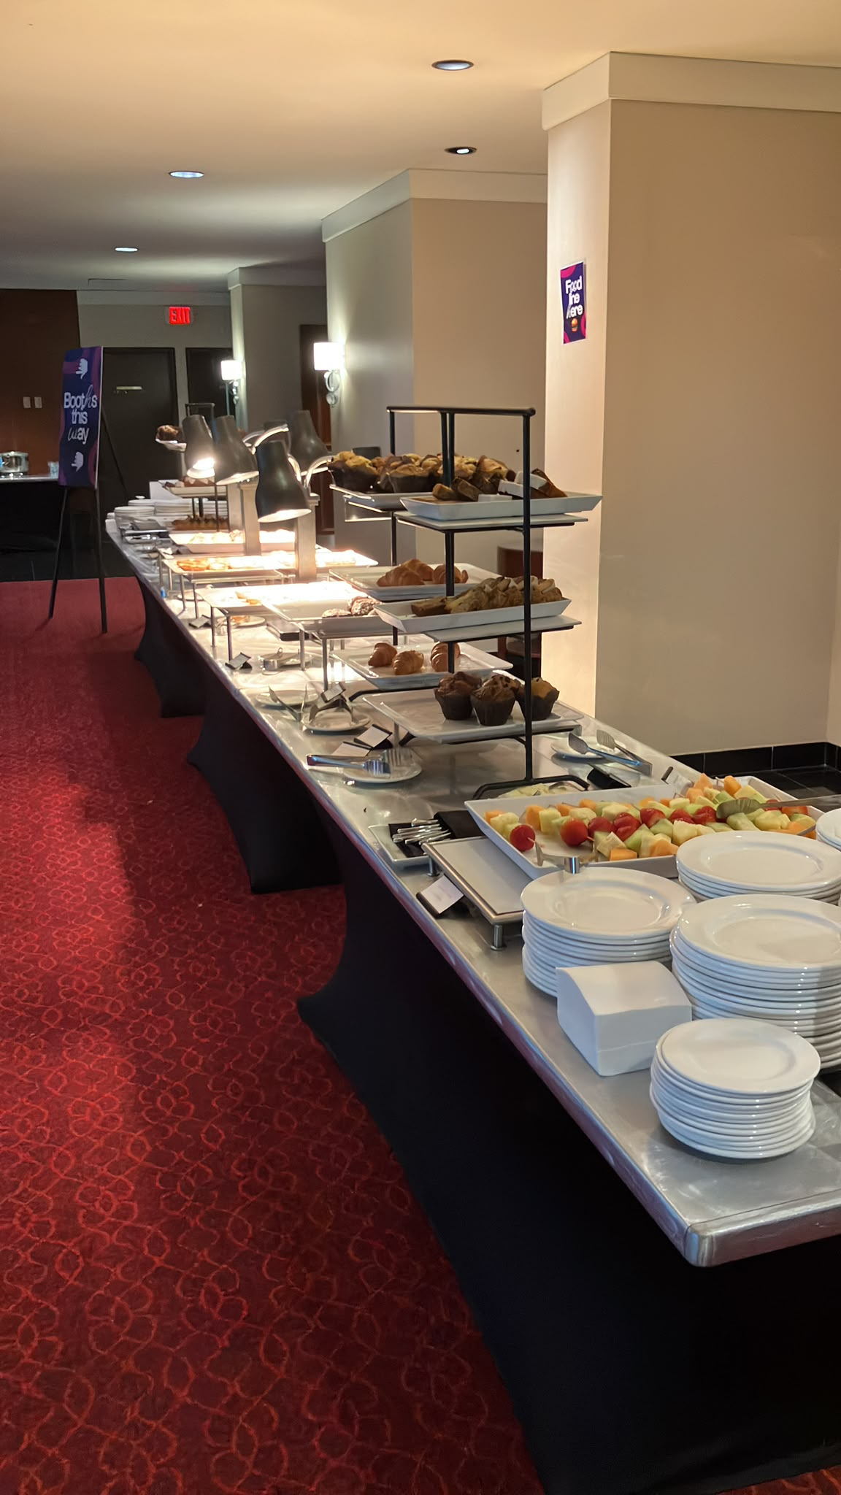
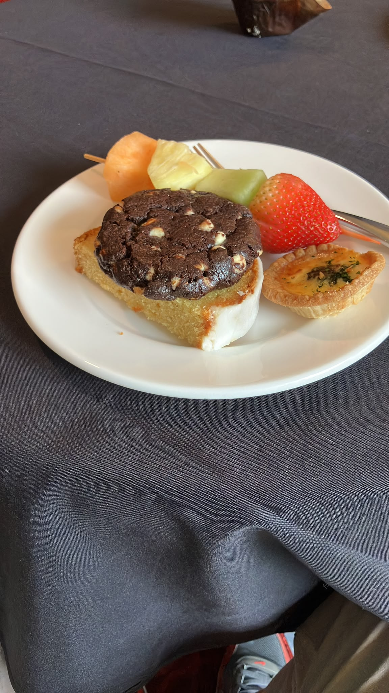
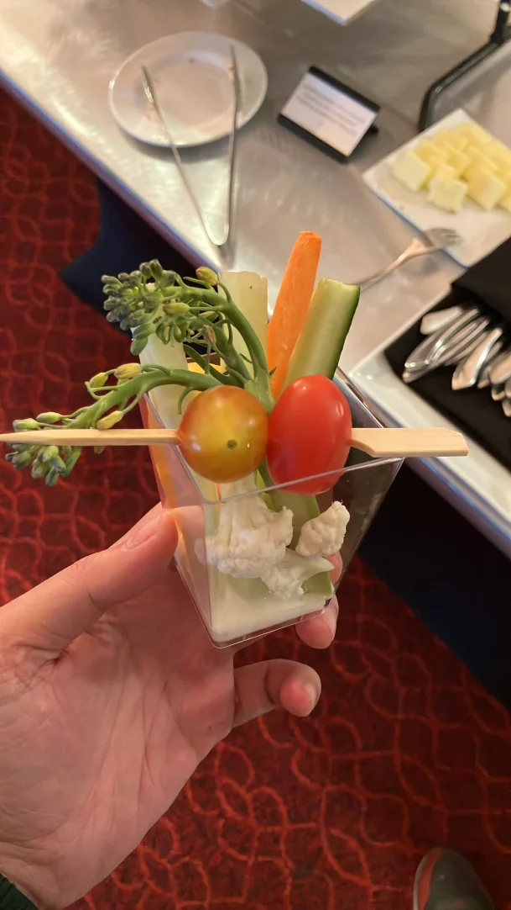
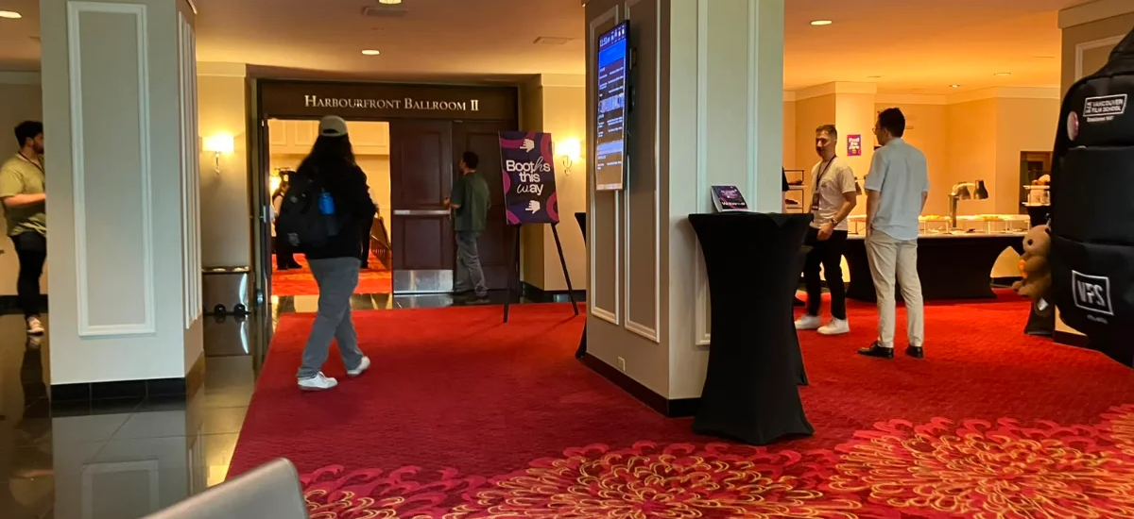
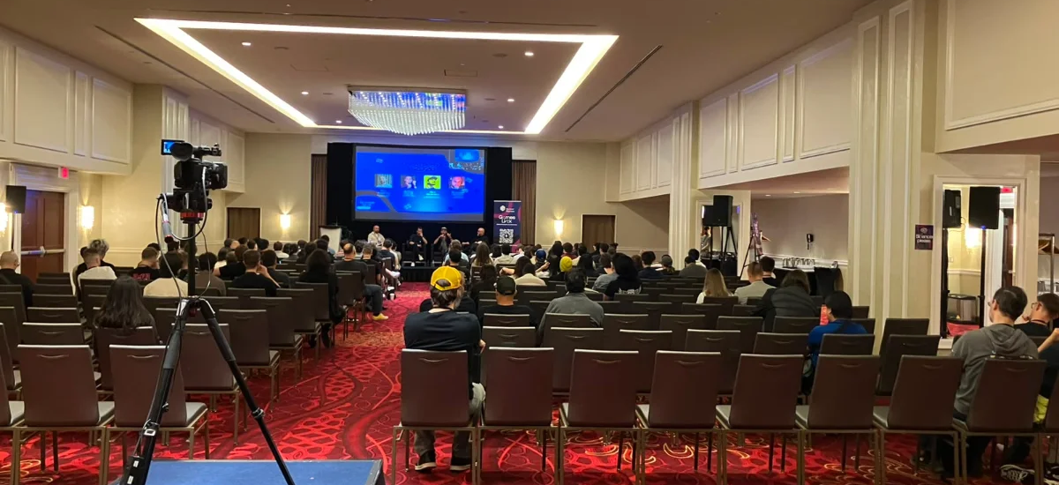
Games Link 2026
Notes:
Placeholder — script for this hook not yet shared. Pictures only, no copy.

Slide 3
THE DISTINCTION
“single-player”
≠
“offline”
how many people play
whether the game talks to a server
Notes:
The central reframe. Single-player is a count of players. Offline is a question about servers. They get used as synonyms; they are not.

Slide 4
What each categories gets you
Four kinds of online feature, and what a single-player game gets for taking each one.
Notes:
Framing the four rows. Each one is a separate decision — you can take any of them without taking the others.

Slide 5
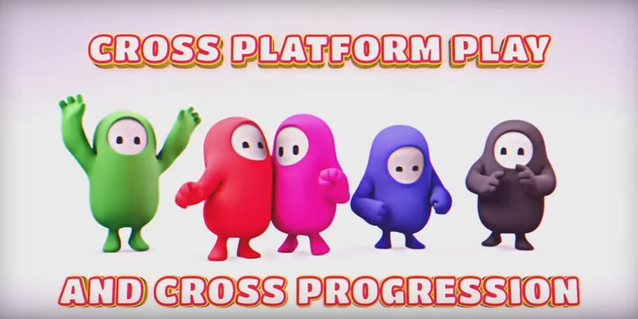
ROW 01 / 04
Convenience
Cloud saves. Cross-platform accounts and progression.
Notes:
Lowest-stakes row. Nobody argues with cloud saves. Players already expect their progress to follow them between devices.

Slide 6
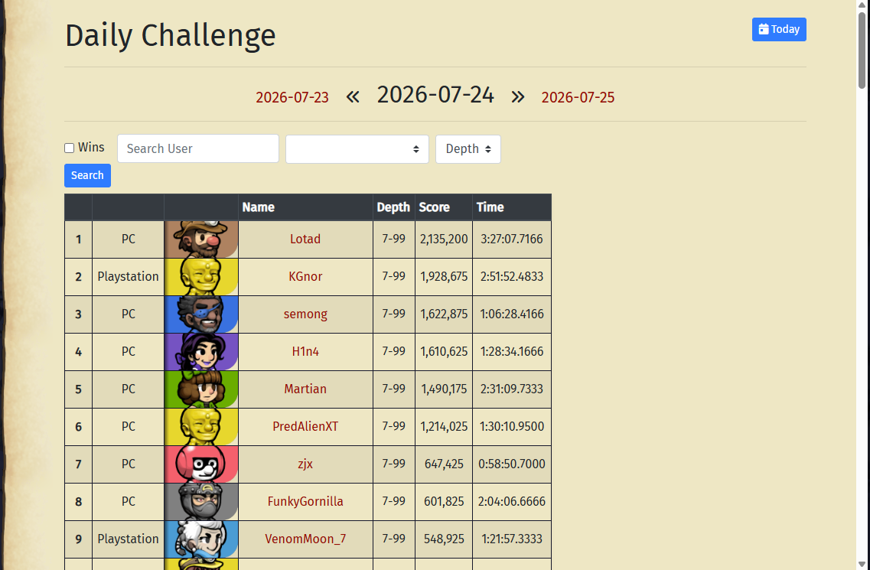
ROW 02 / 04
LiveOps & content
Run events, rotate content — without a client update.
Spelunky — Daily Challenge
Notes:
A finished, finite single-player game gets a reason to reopen. Spelunky's Daily Challenge: same seed for every player, one attempt, one leaderboard.

Slide 7
ROW 03 / 04
Analytics & remote config
PATCH PATH
BACKEND PATH
Confirm the boss fight is overtuned
Find the cause
Fix it
Build
Submit to the cert queue
Change the value server-side
Every player gets it next time they load the game
Days to weeks
Notes:
The money slide. One overtuned boss fight, two ways to fix it. Walk the left chain step by step, then let the right side land in one beat.g m

Slide 8

ROW 04 / 04
Accounts
A relationship with your player that survives the storefront.
Notes:
Accounts outlast the store you sold through. Platform shifts, storefront changes, next game — the relationship carries over.

Slide 9
WHAT'S THE CATCH
You are now a company that stores personal data.
Accounts, cloud saves or analytics tied to a person put you under GDPR and laws like it — whatever the size of the studio.
Notes:
The catch, part one. The moment accounts, cloud saves or analytics tie to a person, GDPR and its equivalents apply — studio size is not an exemption.

Slide 10
WHAT'S THE CATCH
…and: more to build. More to maintain.
The cost compounds if you support both an offline and an online mode.
Notes:
The catch, part two. Added dev and maintenance work, and it compounds if you support offline and online modes both.

Slide 11
Build it yourself? Or buy it?
Buy
Build
For most teams, an off-the-shelf backend platform. It is someone else's job to keep it up.
Only for a genuinely unique need — custom leaderboard rules no platform will express for you.
Notes:
For most teams: buy. Build only where the need is genuinely unique — custom leaderboard rules an off-the-shelf platform can't express.

Slide 12
THE REALITY
It takes a village to build and maintain a game backend platform properly.
Notes:
The GIF makes the point visually — a game backend isn't one box, it's a village of systems working together to keep a single-player game alive and healthy.

Slide 13
THE ASK
Spend an hour. Write down your no's.
Your game doesn't need all four categories on day one — but choose deliberately, not by default.
Notes:
The ask. Spend an hour with the four rows and write down which ones you're saying no to, and why. A no on the record is a decision; a no by default isn't.

Slide 14

FULL INDIE MONTHLY
Thanks
Happy to talk backends, cert queues or leaderboard rules after.
Vincent
·
linkedin.com/in/vincent-vincent-360b71104
Scan to connect
Notes:
Thanks. Point at the link, then open the floor.

Slide 15
Questions
linkedin.com/in/vincent-vincent-360b71104
Notes:
Hold this for the five minutes of Q&A.

