Slide 1
DS501 – Breast Cancer Project Vincent Wang

Slide 2
Agenda:
Background
Objective
Attributes
EDA
Modeling
Evaluation

Slide 3
Background and Objective
Objective:
Predict whether the cancer is benign or malignant
Dataset:
569 rows
30 features
Background:
Features are computed from a digitized image of a fine needle aspirate (FNA) of a breast mass. They describe characteristics of the
cell nuclei present in the image.

Slide 4
Attributes
Response:
Diagnosis (M = malignant, B = benign)
Features:
Ten real-valued features are computed for each cell nucleus:
radius
texture
perimeter
area
smoothness
compactness
concavity
concave points
symmetry
fractal dimension

Slide 5
EDA
Missing Value:
Delete feature “unnamed: 32”
All Numeric features without missing value
Data Visualization (seaborn library):
Bar chart
Correlation plot
Scatter plot
Violin plot
Swarm plot

Slide 6
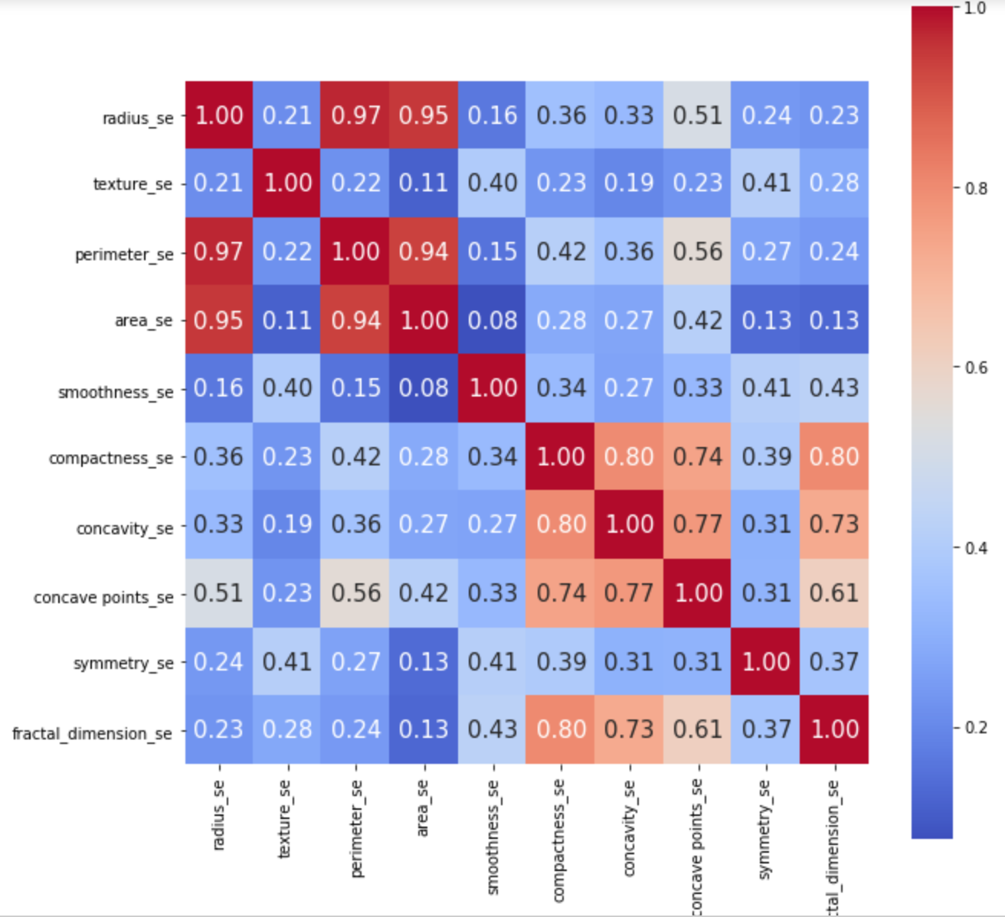
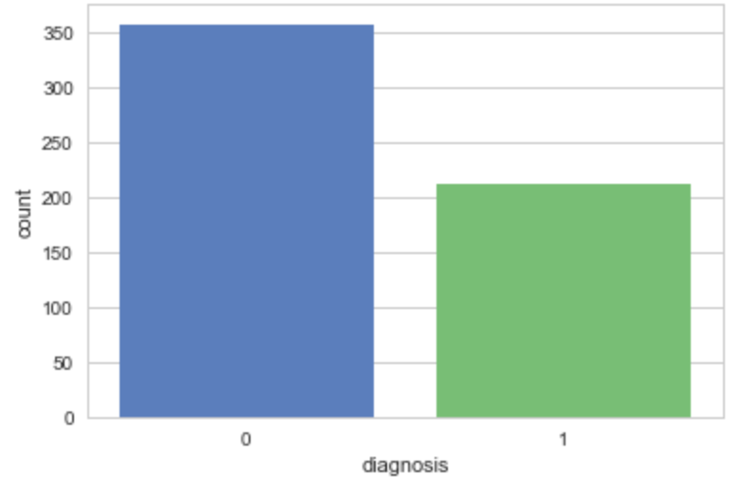
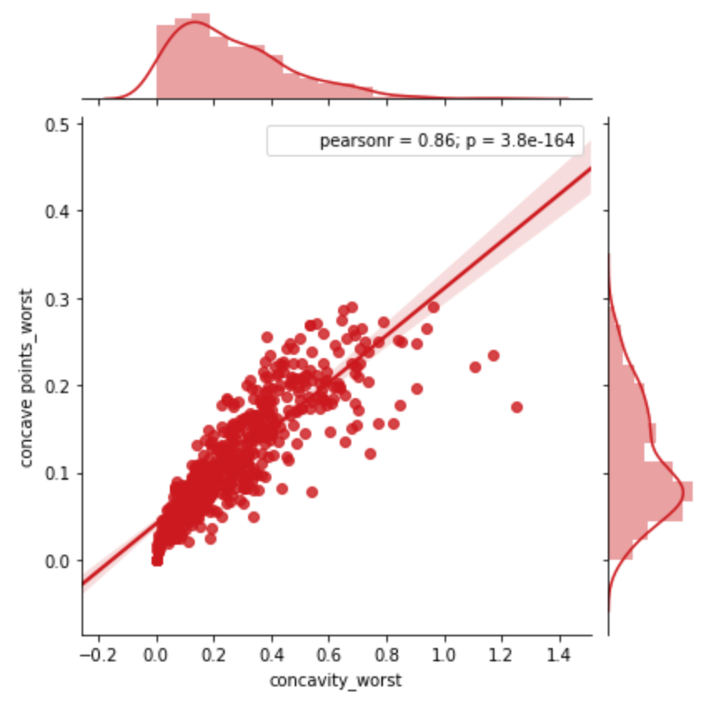
The frequency of cancer stages
benign malignant

Slide 7
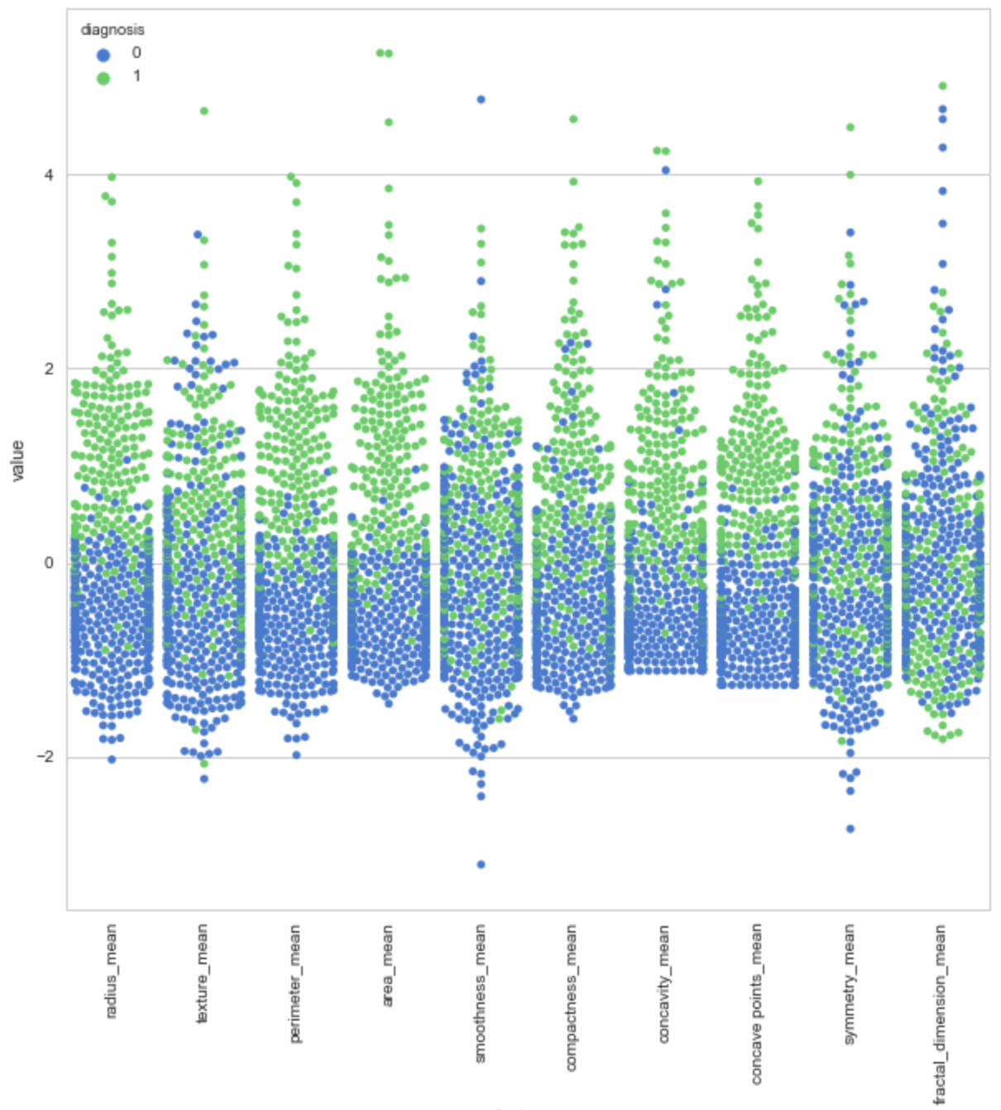
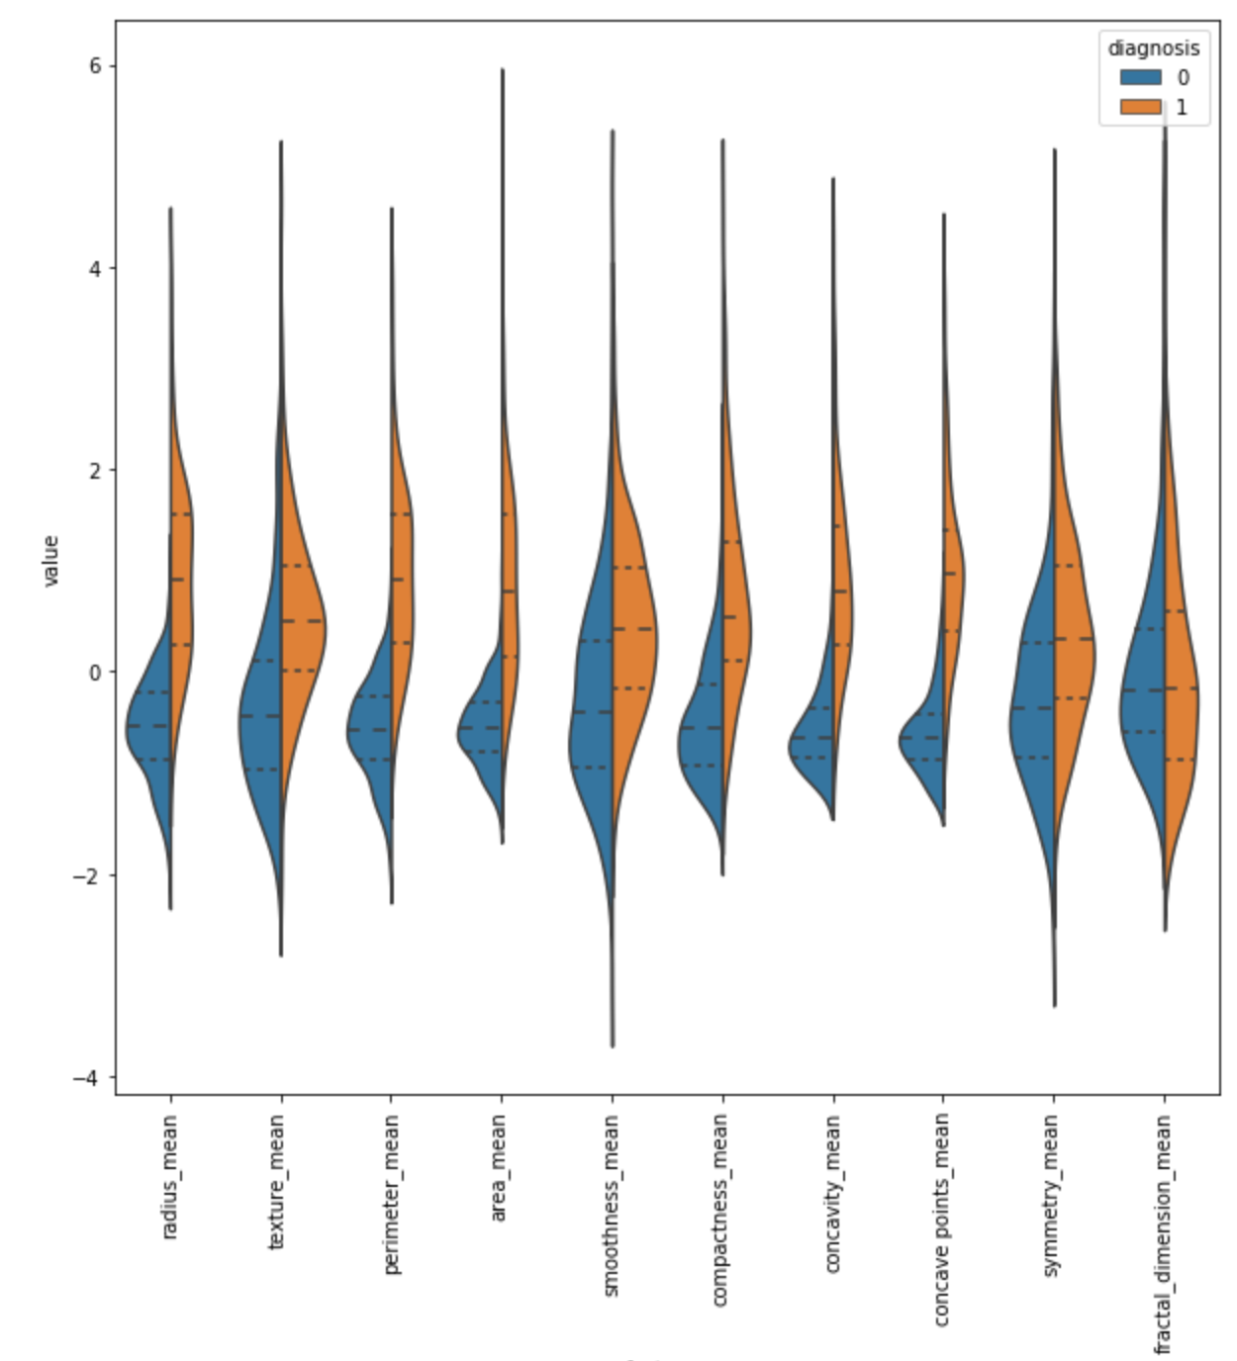
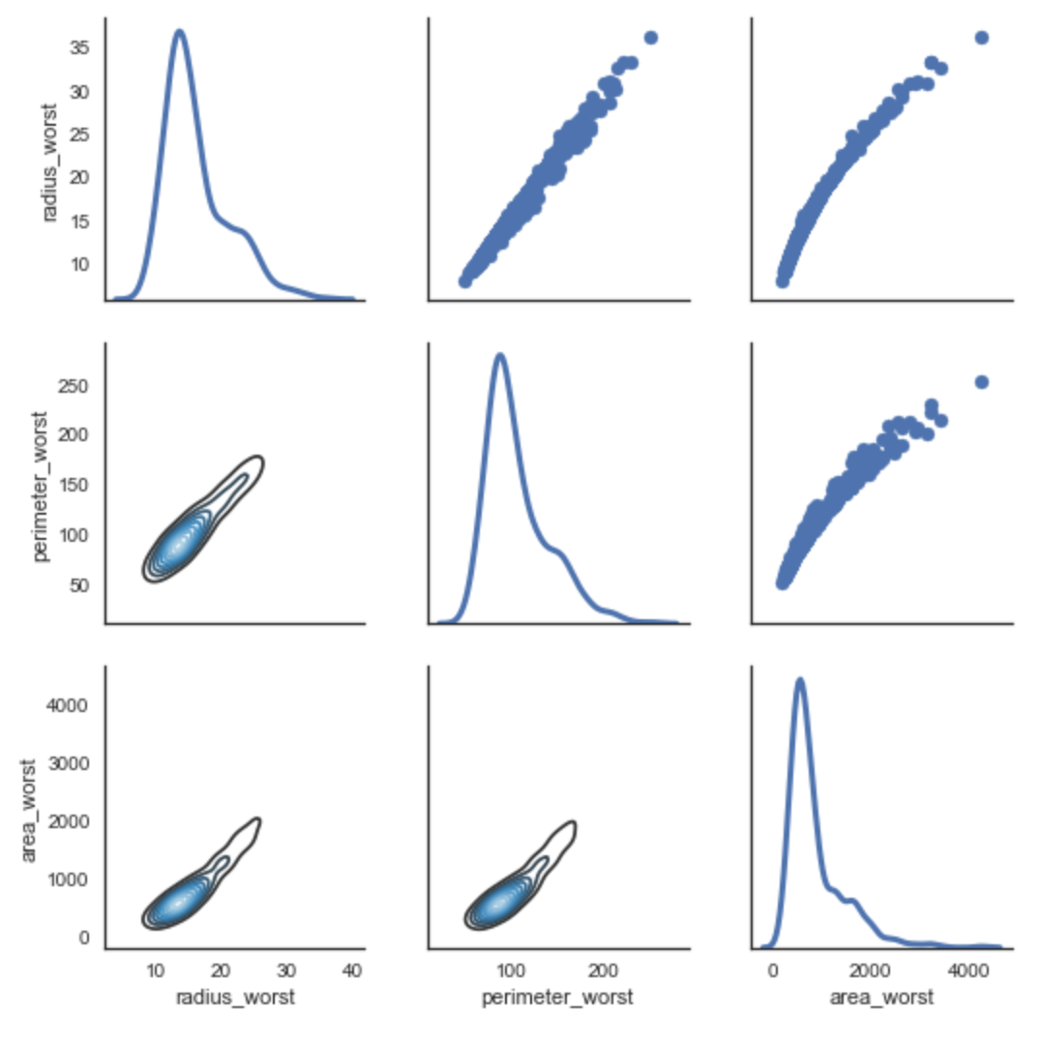

Slide 8
Correlation
the radius, parameter and area
compactness_mean, concavity_mean and concavepoint_mean
Classification
texture_mean feature - median of the M and B separated
fractal_dimension_mean feature - median not separated
smoothness_se in swarm plot - malignant and benign are mixed
Selected features:
perimeter_mean, texture_mean, compactness_mean, symmetry_mean

Slide 9
Modeling
Train/Test Dataset Split
(0.7/0.3)
Model (Matric - Accuracy)
Decision Tree: 83.333%
Random Forest: 85.965%
SVM: 56.140%
KNN: 76.316%
Logistic Regression: 78.070%

Slide 10
Model Improvement and Evaluation
Cross-validation
Decision Tree: 83.333% to 89.632%
Random Forest: 85.965% to 86.820%
SVM: 56.140% to 74.706%
KNN: 76.316% to 86.820%
Logistic Regression: 78.070% to 89.112%
Grid Search
Decision Tree: 95.226%
Random Forest: 95.477%
SVM: 94.724%
KNN: 93.719%

Slide 11
Conclusion
The Random Forest is working the best with the highest accuracy
Before the model tuning, the model was getting 91 % accuracy
After the model tuning, the model was getting 95 % accuracy

Slide 12
Q&A

Slide 13
Thank You

