Slide 1
User case: user can write for adding money to their account
Step1:: App show the UI
Step2: input date and click “+” button
Step3:History show the activity
Balance:$
Balance:$
Balance:$
Date___ Amount___ Event____
Date_2/2__ Amount_100__ Event_Salary___
Date___ Amount___ Event____
+
+
-
+
-
-
+
-
+
-
History
History
History
Date | Amount | Category
Date | Amount | Category
Date | Amount | Category
2/2 | 100 | salary

Slide 2
User case: user can write for spending money to their account
Step1:: App show the UI
Step2: input date and click “-” button
Step3:History show the activity
Balance:$
Balance:$
Balance:$
Date___ Amount___ Event____
Date_2/3__ Amount_-20__ Event_shopping___
Date___ Amount___ Event____
+
+
-
+
-
-
+
-
+
-
History
History
History
Date | Amount | Category
Date | Amount | Category
Date | Amount | Category
2/2 | 100 | salary
2/3 | -20 | shopping

Slide 3
User case: The history will maintain when user open app next time
History show the activity
Balance:$
Date___ Amount___ Event____
+
-
+
-
History
Date | Amount | Category
2/2 | 100 | salary
2/3 | -20 | shopping

Slide 4
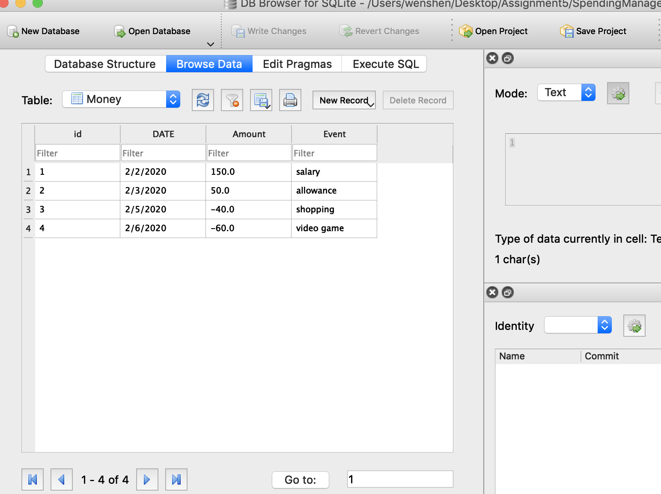
Database

