Slide 1
User case: user can write for adding money to their account
Step1:: App show the UI
Step2: input date and click “+” button
Step3:History show the activity
Balance:$
Balance:$
Balance:$
From ____to ____ (date)
From ____to ____(price)
From ____to ____ (date)
From ____to ____(price)
From ____to ____ (date)
From ____to ____(price)
search
search
search
Date___ Amount___ Event____
Date_2/2__ Amount_100__ Event_Salary___
Date___ Amount___ Event____
+
+
-
+
-
-
+
-
+
-
History
History
History
Date | Amount | Category
Date | Amount | Category
Date | Amount | Category
2/2 | 100 | salary

Slide 2
User case: user can write for spending money to their account
Step1:: App show the UI
Step2: input date and click “-” button
Step3:History show the activity
Balance:$
Balance:$
Balance:$
From ____to ____ (date)
From ____to ____(price)
From ____to ____ (date)
From ____to ____(price)
From ____to ____ (date)
From ____to ____(price)
search
search
search
Date___ Amount___ Event____
Date_2/3__ Amount_-20__ Event_shopping___
Date___ Amount___ Event____
+
+
-
+
-
-
+
-
+
-
History
History
History
Date | Amount | Category
Date | Amount | Category
Date | Amount | Category
2/2 | 100 | salary
2/3 | -20 | shopping

Slide 3
User case: The history will maintain when user open app next time
History show the activity
Balance:$
From ____to ____ (date)
From ____to ____(date)
search
Date___ Amount___ Event____
+
-
+
-
History
Date | Amount | Category
2/2 | 100 | salary
2/3 | -20 | shopping

Slide 4
User case: user can search based on the date interval
Step1:: App show the UI
Step2: input date interval and click “search” button
Step3:History show the activity
Balance:$
Balance:$
Balance:$
From ____to ____ (date)
From ____to ____(price)
From _2/1_to _2/10_ (date)
From ____to ____(price)
From ____to ____ (date)
From ____to ____(price)
search
search
search
Date___ Amount___ Event____
Date_2/3__ Amount_-20__ Event_shopping___
Date___ Amount___ Event____
+
+
-
+
-
-
+
-
+
-
History
History
History
Date | Amount | Category
Date | Amount | Category
Date | Amount | Category
2/2 | 100 | salary
2/3 | -20 | shopping

Slide 5
User case: user can search based on money interval
Step1:: App show the UI
Step2: input price and click “search” button
Step3:History show the activity
Balance:$
Balance:$
Balance:$
From ____to ____ (date)
From ____to ____(date)
From ____to ____ (date)
From __50__to_500__(date)
From ____to ____ (date)
From ____to ____(date)
search
search
search
Date___ Amount___ Event____
Date_2/3__ Amount_-20__ Event_shopping___
Date___ Amount___ Event____
+
+
-
+
-
-
+
-
+
-
History
History
History
Date | Amount | Category
Date | Amount | Category
Date | Amount | Category
2/2 | 100 | salary
2/3 | -20 | shopping
2/6 | 200 | alloance

Slide 6
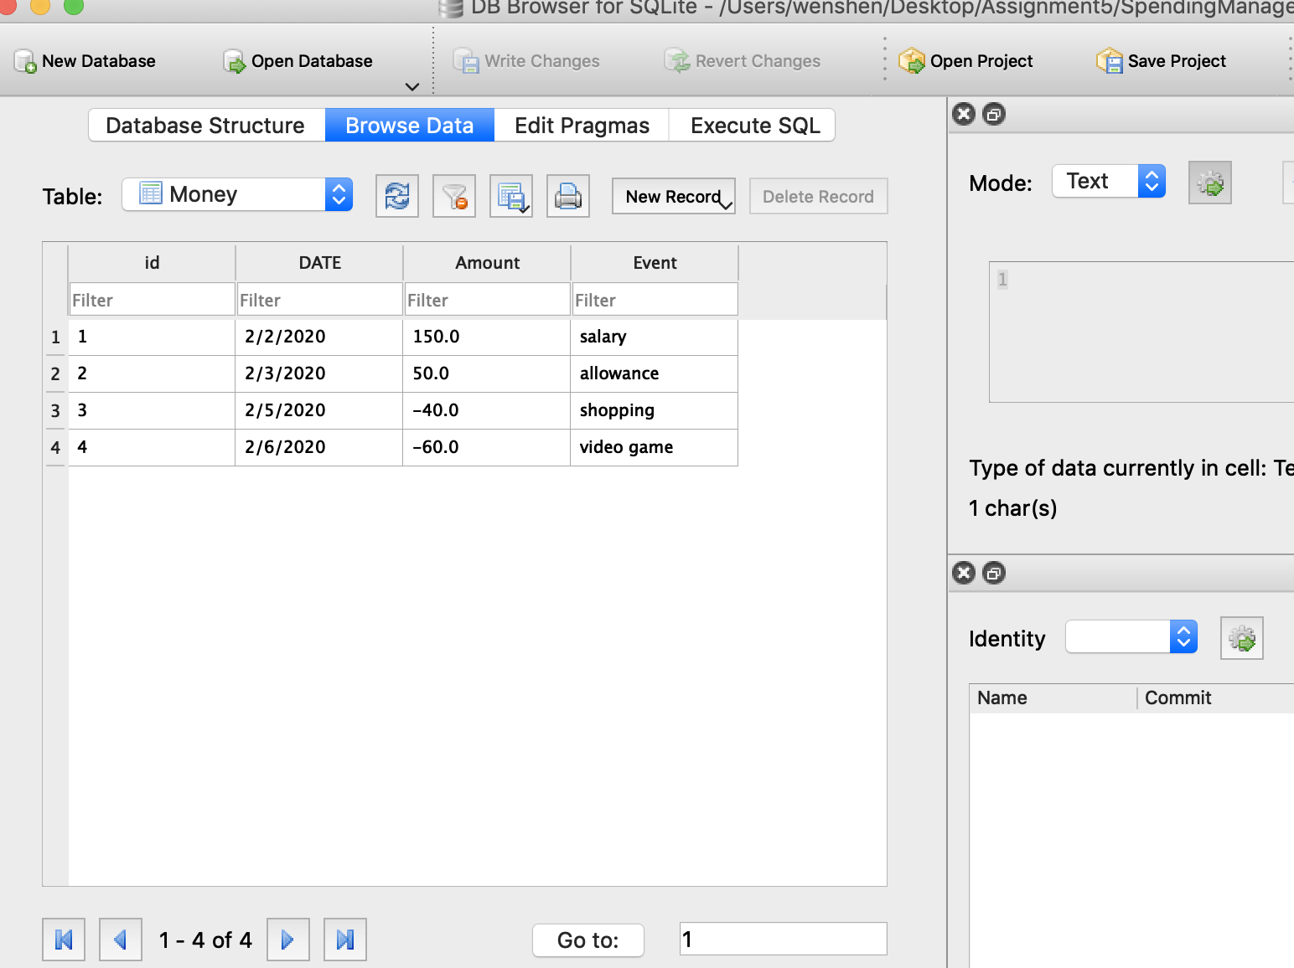
Database

