Slide 1
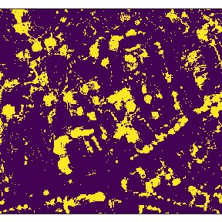
Detectree
DiSC Data Lab
Lucie, Vincent, Benjamin

Slide 2
Our Goal
Analyze satellite images from different cities to obtain the tree share
Match this variable to different life factors (environment, satisfaction, health, …)
Correlation between variables and importance of trees in cities

Slide 3
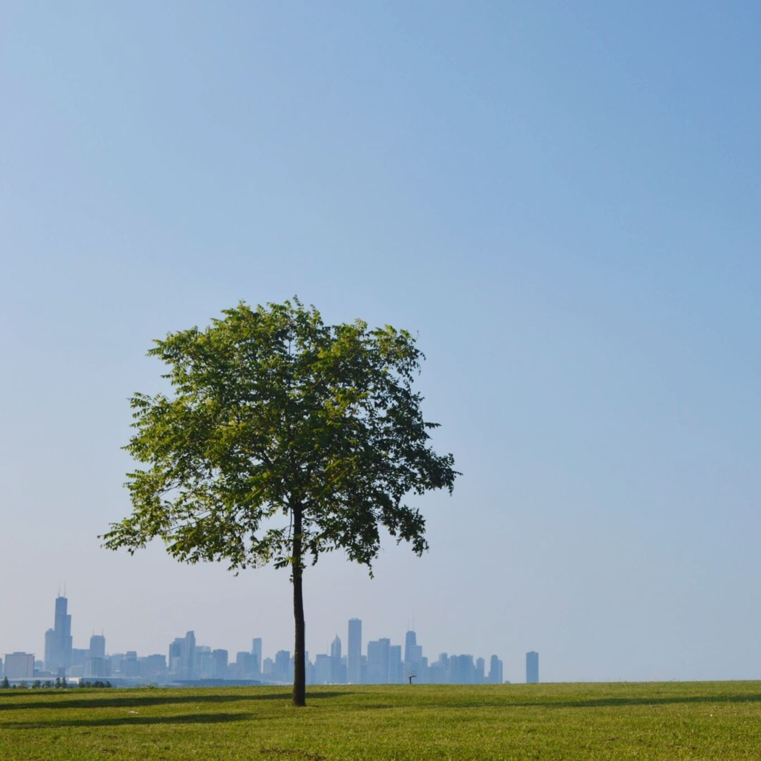
The importance of tree coverage
In cities as an environmental factor
The satisfaction and well-being of residents
Provides biodiversity and ecological quality

Slide 4




Data Flow
API
Detectree
Functions called →But own workflow adapted to our needs
Classification and evaluation of tree coverage in Python
Data Analysis

Slide 5
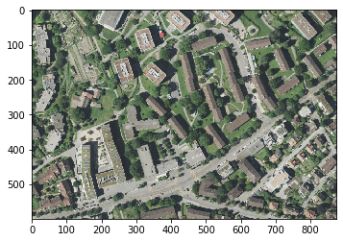
Select the desired area
Retrieve the satellite images via the Mapbox API
Download the individual tiles
Store the tiles

Slide 6

Detectree
Supervised learning problem
System must be trained on suitable data
The tiles selected for training must be linked to the ground truth of the tree/non-tree masks

Slide 7
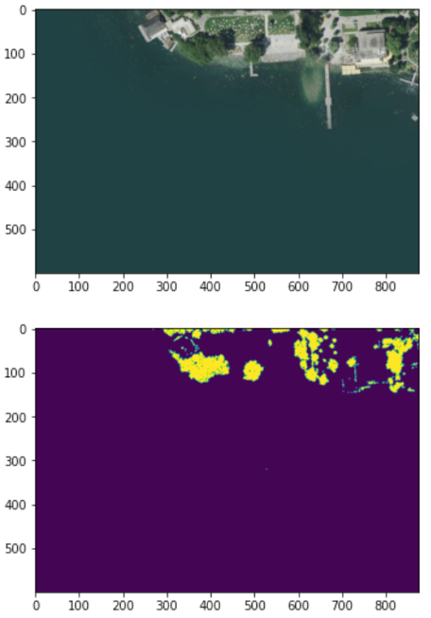
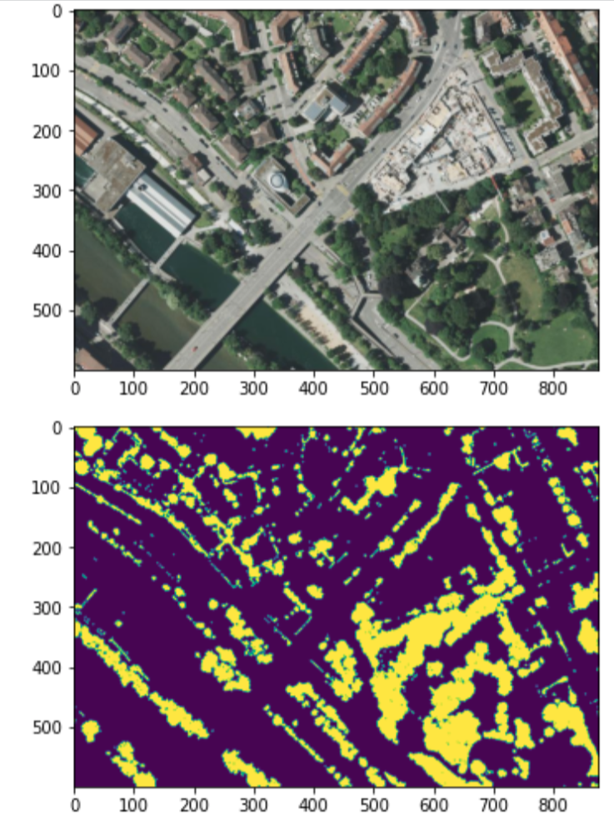
Detectree

Slide 8
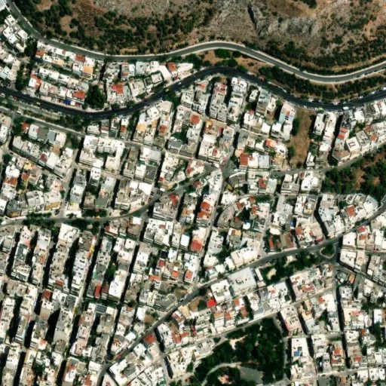

Detectree
Training of classifiers
Classifiers can be used to distinguish tree-like and non-tree-like pixels

Slide 9
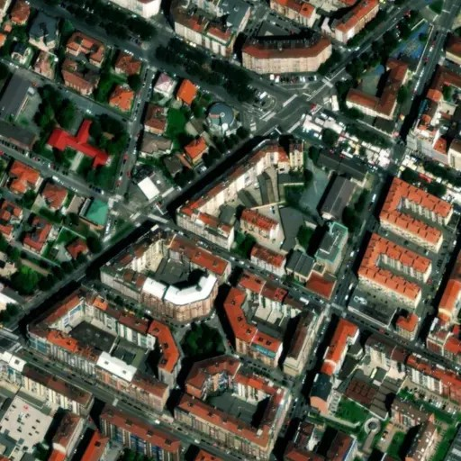
Detectree
Incorrect classifications:
Poor resolution
Photos are not recorded vertically from above

Slide 10
Detectree
Classification of tree-like and non-tree-like pixel for each tile
Determine the proportion of predicted tree-like and non-tree-like pixels for each tile
The accuracy is determined by comparison with manually created ground truth masks.

Slide 11
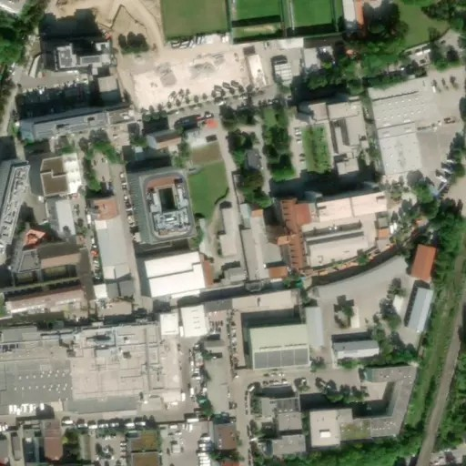


Detectree

Slide 12
Data processing
Folder for each city with raw and predicted tiles
Overall accuracy of 75%
Percentage of tree coverage
Secondary data from different cities with life satisfaction and environment indices

Slide 13
Data Analysis
Analysis 1 with detectree data (12 samples)
Boxplots
Linear Regression Modell
correlation matrix
Analysis 2 with European environment agency data (78 samples)

Slide 14
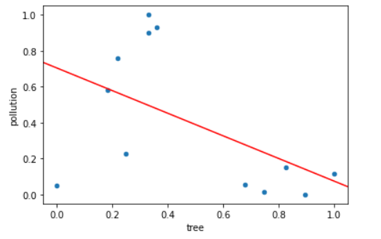
Data Analysis 1

Slide 15
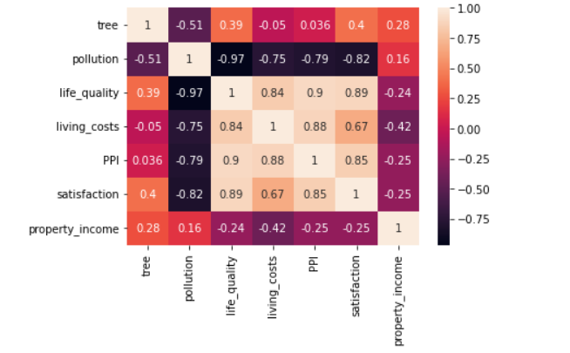
Data Analysis 1

Slide 16
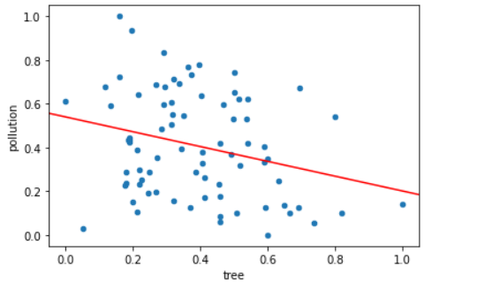
Data Analysis 2

Slide 17
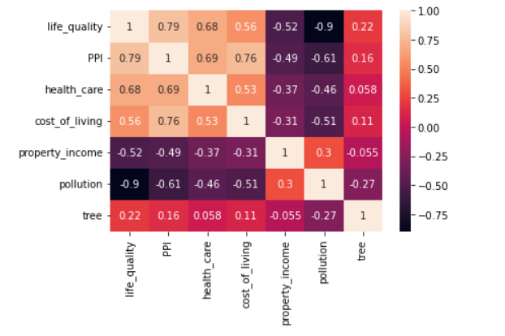
Data Analysis 2

Slide 18
Conclusion
Positive social influence on various life quality factors
Trees reduce air pollution
Data-driven analysis of environmental and social effects will be necessary to guide the future market

