Slide 1

Comp 472 project 3
PRESENTED BY: Vincent Chevrier (40045779)
Team: The AI

Slide 2
Github: https://github.com/vincentcvr6/MiniProject3

Slide 3
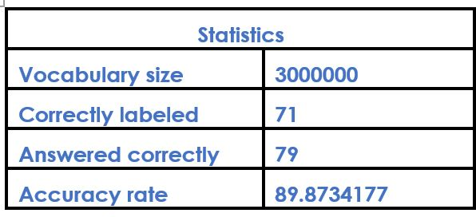
Word2vec google news 300
Biggest vocabulary size of all models
Best results obtained in terms of accuracy
Guessed 71 out of 79 correctly
Accuracy rate of 89.8734177%

Slide 4
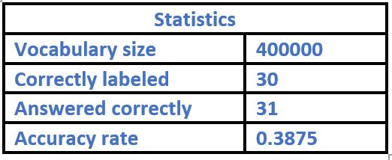
Glove wiki gigaword 200
Smallest vocabulary size
Worst results obtained in terms of accuracy
Accuracy rate of 0.3875%

Slide 5
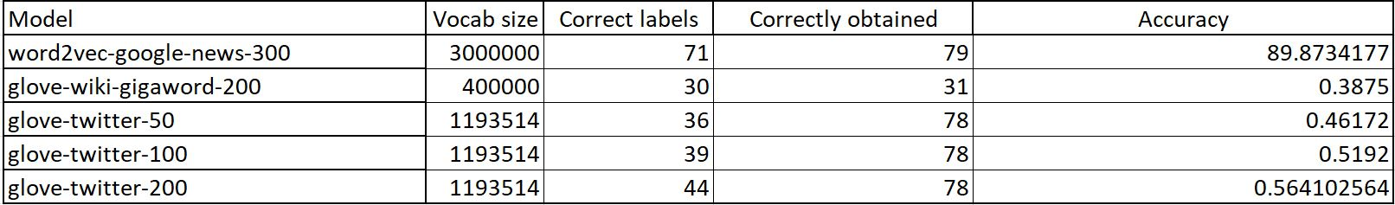
Summary

Slide 6
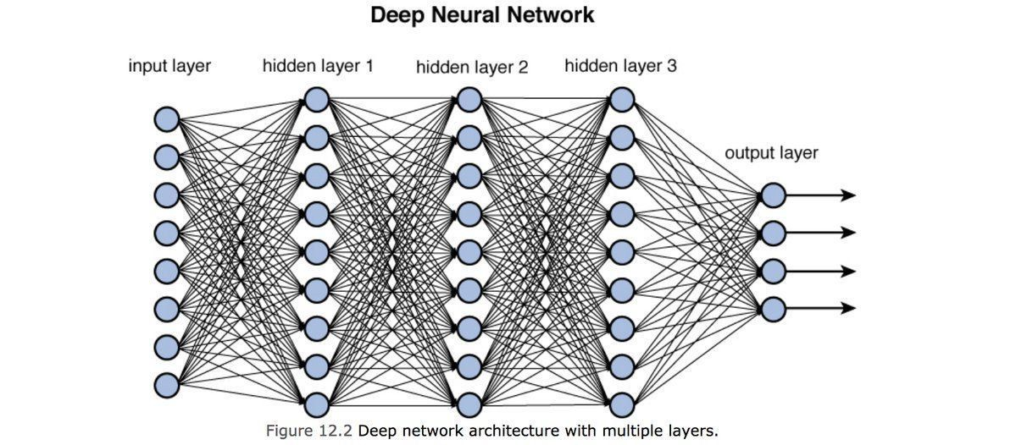
Difference in obtained results
Trained on better corpus
Trained with better functions
Trained with supervision

Slide 7
Thank you!

