Slide 1
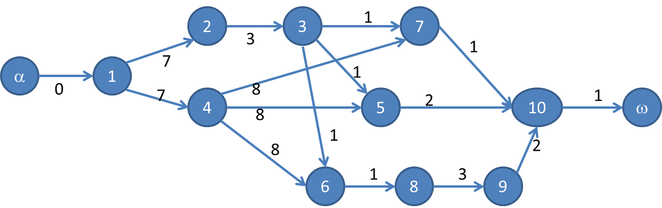
Théorie des graphes
Projet : Ordonnancement d’un graphe
L3
Groupe A
Vincent Dubois
Guillaume Hamel
Nathan Thomas

Slide 2
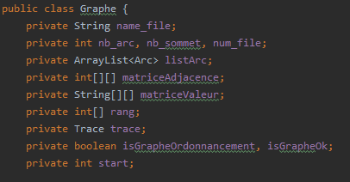
I : Structure des données
Programmation orientée objet => JAVA
3 objets distincts :
- Graphe = représentation d’un graphe en mémoire
- Arc = représentation d’un arc
- Source
- Cible
- Valeur
- Trace = permet l’écriture dans
- le fichier de trace du graphe testé
- la console
Figure 1 : Attribut de la classe Graphe

Slide 3
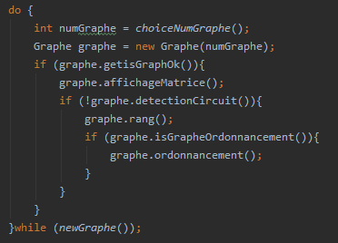
II : Structure général du programme
Faire
Choix utilisateur du graphe
Construction du graphe
Si graphe construit
Affichage des matrices
Si pas de circuit
Calcul du rang
si est un graphe d’ordonnancement
Ordonnancement
Tant que l’utilisateur veut choisir un graphe

Slide 4
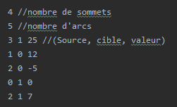
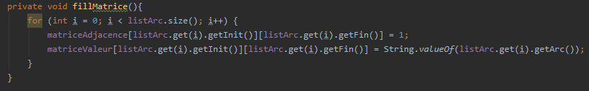
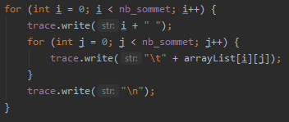
III : Travail sur le graphe
Lecture du fichier
+ gestion des erreurs du fichier
+ construction de la liste des arcs
1
2
Remplissage des matrices
3
Affichage des matrices

Slide 5
IV : Détection des circuits/Calcul du rang
Circuit

Slide 6
target and market
Entrepreneurial activities differ substantially depending on the type of organization and creativity involved. Entrepreneurship ranges in scale from solo. Entrepreneurial activities differ substantially depending on the type of organization.
target
T
entrepreneurial activities differ substantially depending on the type of organization and creativity involved. entrepreneurship ranges in scale from solo. entrepreneurial activities differ substantially depending on the type of organization and creativity involved.
A
R
market
entrepreneurial activities differ substantially depending on the type of organization and creativity involved. entrepreneurship ranges in scale from solo. entrepreneurial activities differ substantially depending on the type of organization and creativity involved.
G
E
M
A
R
K
E
T

Slide 7
our company values
Entrepreneurial activities differ substantially depending on the type of organization and creativity involved. Entrepreneurship ranges in scale from solo. Entrepreneurial activities differ substantially depending on the type of organization.
your title
your title
your title
entrepreneurial activities differ substantially depending
entrepreneurial activities differ substantially depending
entrepreneurial activities differ substantially depending

Slide 8
write here something
write a title in this section
entrepreneurial activities differ substantially depending on the type of organization and creativity involved. entrepreneurship ranges in scale from solo. entrepreneurial activities differ
write a title in this section
entrepreneurial activities differ substantially depending on the type of organization and creativity involved. entrepreneurship ranges in scale from solo. entrepreneurial activities differ
write a title in this section
entrepreneurial activities differ substantially depending on the type of organization and creativity involved. entrepreneurship ranges in scale from solo. entrepreneurial activities differ
write a title in this section
entrepreneurial activities differ substantially depending on the type of organization and creativity involved. entrepreneurship ranges in scale from solo. entrepreneurial activities differ
write a title in this section
entrepreneurial activities differ substantially depending on the type of organization and creativity involved. entrepreneurship ranges in scale from solo. entrepreneurial activities differ
write a title in this section
entrepreneurial activities differ substantially depending on the type of organization and creativity involved. entrepreneurship ranges in scale from solo. entrepreneurial activities differ

Slide 9
write here something
write another line here
entrepreneurial activities differ substantially depending on the type of organization and creativity involved. entrepreneurship ranges in scale from solo. entrepreneurial activities differ substantially depending on the type of organization and creativity involved.
write another line here
entrepreneurial activities differ substantially depending on the type of organization and creativity involved. entrepreneurship ranges in scale from solo. entrepreneurial activities differ substantially depending on the type of organization and creativity involved.

Slide 10
write another line here
entrepreneurial activities differ substantially depending on the type of organization and creativity involved. entrepreneurship ranges in scale from solo. entrepreneurial activities differ substantially depending on the type of organization and creativity involved.

