Slide 1
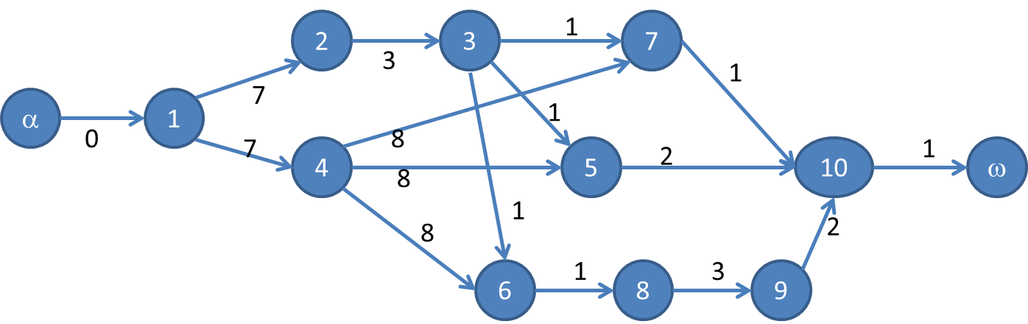
Théorie des graphes
Projet : Ordonnancement d’un graphe
L3 – Groupe A
Vincent Dubois
Guillaume Hamel
Nathan Thomas
Groupe 4

Slide 2
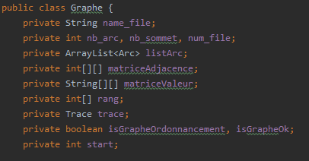
I : Structure des données
Programmation orientée objet => JAVA
3 objets distincts :
- Graphe = représentation d’un graphe en mémoire
- Arc = représentation d’un arc
- Source
- Cible
- Valeur
- Trace = permet l’écriture dans
- le fichier de trace du graphe testé
- la console
Figure 1 : Attribut de la classe Graphe

Slide 3
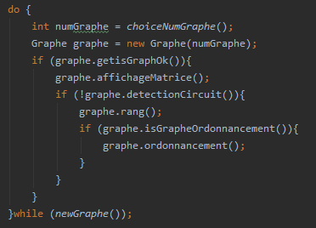
II : Structure général du programme
Faire
Choix utilisateur du graphe
Construction du graphe
Si graphe construit
Affichage des matrices
Si pas de circuit
Calcul du rang
si est un graphe d’ordonnancement
Ordonnancement
Tant que l’utilisateur veut choisir un graphe

Slide 4
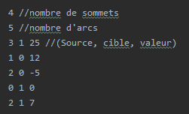
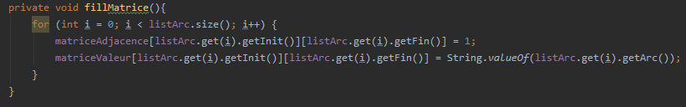
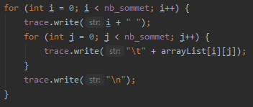
III : Travail sur le graphe
Lecture du fichier
+ gestion des erreurs du fichier
+ construction de la liste des arcs
1
2
Remplissage des matrices
3
Affichage des matrices

Slide 5
IV : Détection des circuits/Calcul du rang
Circuit

Slide 6
V : Méthode de l’ordonnancement
Plusieurs conditions sont nécessaires afin de pouvoir ordonnancer un graphe :
Un seul point d’entrée ;
Un seul point de sortie ;
Pas de circuit ;
Pas d’arcs à valeur négative ;
Valeurs identiques pour tous les arcs incidents vers l’extérieur à
un sommet ;
Arcs incidents vers l’extérieur au point d’entrée de valeur nulle ;

Slide 7
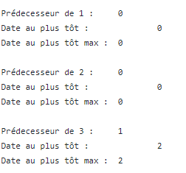
V : Méthode de l’ordonnancement
Une fois les conditions vérifiées on peut passer a l’ordonnancement.
Le calcul des dates au plus tôt se fait par rapport à la date au plus tôt la plus grande des prédécesseurs d’un sommet. Le calcul se fait en partant du point d’entrée (dont la date au plus tôt est 0).
Exemple pour le graphe 4

Slide 8
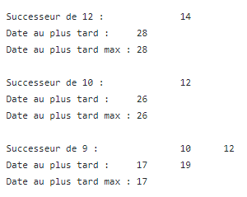
V : Méthode de l’ordonnancement
Le calcul des dates au plus tard se fait par rapport à la date au plus tard la plus courte des successeurs. Le calcul se fait en partant de la sortie. La date au plus tard de la sortie est la date au plus tôt de ce même sommet.
Exemple avec le graphe 4
Le calcul des marges se fait en faisant la différence entre la date au plus tard et la date au plus tôt de chaque sommet.

Slide 9
target and market
Entrepreneurial activities differ substantially depending on the type of organization and creativity involved. Entrepreneurship ranges in scale from solo. Entrepreneurial activities differ substantially depending on the type of organization.
target
T
entrepreneurial activities differ substantially depending on the type of organization and creativity involved. entrepreneurship ranges in scale from solo. entrepreneurial activities differ substantially depending on the type of organization and creativity involved.
A
R
market
entrepreneurial activities differ substantially depending on the type of organization and creativity involved. entrepreneurship ranges in scale from solo. entrepreneurial activities differ substantially depending on the type of organization and creativity involved.
G
E
M
A
R
K
E
T

Slide 10
our company values
Entrepreneurial activities differ substantially depending on the type of organization and creativity involved. Entrepreneurship ranges in scale from solo. Entrepreneurial activities differ substantially depending on the type of organization.
your title
your title
your title
entrepreneurial activities differ substantially depending
entrepreneurial activities differ substantially depending
entrepreneurial activities differ substantially depending

Slide 11
write here something
write a title in this section
entrepreneurial activities differ substantially depending on the type of organization and creativity involved. entrepreneurship ranges in scale from solo. entrepreneurial activities differ
write a title in this section
entrepreneurial activities differ substantially depending on the type of organization and creativity involved. entrepreneurship ranges in scale from solo. entrepreneurial activities differ
write a title in this section
entrepreneurial activities differ substantially depending on the type of organization and creativity involved. entrepreneurship ranges in scale from solo. entrepreneurial activities differ
write a title in this section
entrepreneurial activities differ substantially depending on the type of organization and creativity involved. entrepreneurship ranges in scale from solo. entrepreneurial activities differ
write a title in this section
entrepreneurial activities differ substantially depending on the type of organization and creativity involved. entrepreneurship ranges in scale from solo. entrepreneurial activities differ
write a title in this section
entrepreneurial activities differ substantially depending on the type of organization and creativity involved. entrepreneurship ranges in scale from solo. entrepreneurial activities differ

Slide 12
write here something
write another line here
entrepreneurial activities differ substantially depending on the type of organization and creativity involved. entrepreneurship ranges in scale from solo. entrepreneurial activities differ substantially depending on the type of organization and creativity involved.
write another line here
entrepreneurial activities differ substantially depending on the type of organization and creativity involved. entrepreneurship ranges in scale from solo. entrepreneurial activities differ substantially depending on the type of organization and creativity involved.

Slide 13
write another line here
entrepreneurial activities differ substantially depending on the type of organization and creativity involved. entrepreneurship ranges in scale from solo. entrepreneurial activities differ substantially depending on the type of organization and creativity involved.

