Slide 1
Model-based Testing with Graph Grammars
Vincent de Bruijn
22/05/12
Footer text: to modify choose 'View' or 'Insert' (for Office 2007 or later) then 'Header & Footer'

Slide 2
INTRODUCTION
AXINI
  In Amsterdam
  5 employees
  2 graduates
Model-based testing company with several large Dutch companies as clients.
Developed Test Manager (ATM) as their model-based testing tool.
22/05/12

Slide 3
INTRODUCTION
GROOVE
  Developed at the University of Twente
  3 team members
Tool for graph-based modelling, simulation and model-checking.
22/05/12

Slide 4
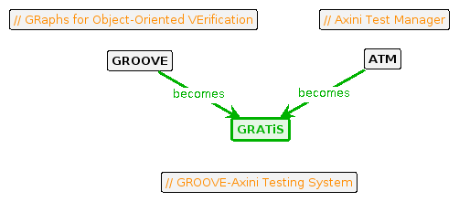
RESEARCH GOALS
  Design: Design and implement a system using ATM and GROOVE which performs model-based testing on graph grammars.
  Validation: Validate the design and implementation using case studies and performance measurements.
22/05/12

Slide 5
OVERVIEW
  Model-based Testing
  Symbolic Transition Systems
  Graph Grammars
  GRATiS Design
  Graph grammar to STS
  Case studies
  Current state
22/05/12

Slide 6
OVERVIEW
  Model-based Testing
  Symbolic Transition Systems
  Graph Grammars
  GRATiS Design
  Graph grammar to STS
  Case studies
  Current state
22/05/12

Slide 7
MODEL-BASED TESTING
The definition model is used here as the 'description of the behavior of a system',
most often a state-machine.
The model is tested against a System Under Test (SUT). Each transition in the model is either a stimulus or a response.
Two types of MBT:
  Offline or batch testing
  Online or on-the-fly testing
22/05/12

Slide 8
MODEL-BASED TESTING
OFFLINE OR BATCH TESTING
  Generate test cases from a model
  Run tests against the SUT
  Give pass/fail verdict based on correct responses
Insert picture here
22/05/12

Slide 9
MODEL-BASED TESTING
ON-THE-FLY TESTING
  Takes a possible transition (step) from the model
  Runs the step against the SUT
  Give pass/fail verdict based on correct response
  Repeat
22/05/12

Slide 10
OVERVIEW
  Model-based Testing
  Symbolic Transition Systems
  Graph Grammars
  GRATiS Design
  Graph grammar to STS
  Case studies
  Current state
22/05/12

Slide 11
SYMBOLIC TRANSITION SYSTEMS
  Used as model in ATM
  Separated in data and state machine
  Represents data symbolically as variables
add
N != 0
N := N + 1
add
N != 0
N := N + 1
N := 4
sub
N != 0
N := N - 2
dead
N == 0
dead
N == 0
22/05/12

Slide 12
SYMBOLIC TRANSITION SYSTEMS
LOCATION
  Locations used instead of states
  Represents the point in the control-flow of a software system
  Has location variables
add
N != 0
N := N + 1
add
N != 0
N := N + 1
N := 4
sub
N != 0
N := N - 2
dead
N == 0
dead
N == 0
22/05/12

Slide 13
SYMBOLIC TRANSITION SYSTEMS
SWITCH RELATION
  Switch relations used instead of transitions
  Gate used instead of label
  Has interaction variables (but not used here)
add
N != 0
N := N + 1
add
N != 0
N := N + 1
N := 4
sub
N != 0
N := N - 2
dead
N == 0
dead
N == 0
22/05/12

Slide 14
SYMBOLIC TRANSITION SYSTEM
GUARDS AND UPDATES
  Guard restricts the use of the switch relation
  Update gives new value to variables
add
N != 0
N := N + 1
add
N != 0
N := N + 1
N := 4
sub
N != 0
N := N - 2
dead
N == 0
dead
N == 0
22/05/12

Slide 15
OVERVIEW
  Model-based Testing
  Symbolic Transition Systems
  Graph Grammars
  GRATiS Design
  Graph grammar to STS
  Case studies
  Current state
22/05/12

Slide 16
GRAPH GRAMMAR
  Set of graph transformation rules
  Collections of sub-graphs which must or must not occur
N1
N2
L
R
N3
match
G
H
22/05/12

Slide 17
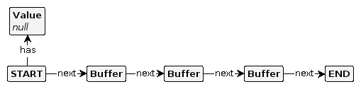
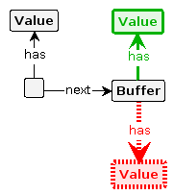
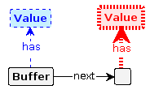
GRAPH GRAMMAR
EXAMPLE
Start graph
Rule: push
Rule: pop
22/05/12

Slide 18
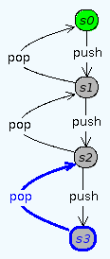
GRAPH GRAMMAR
GRAPH TRANSITION SYSTEM
  Given a start graph state, more graph states can be explored
  Rules reveal transitions between graph states
  Result is a state-machine (GTS)
22/05/12

Slide 19

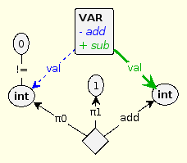
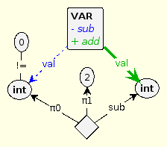

GRAPH GRAMMAR
VARIABLES
  Special type of nodes: data nodes (integer, real, boolean, string)
  Graph grammar with algebra
  Special type of operator nodes and edges
Start graph
Rule: add
Rule: sub
Rule: dead
22/05/12

Slide 20
OVERVIEW
  Model-based Testing
  Symbolic Transition Systems
  Graph Grammars
  GRATiS Design
  Graph grammar to STS
  Case studies
  Current state
22/05/12

Slide 21
GRATiS DESIGN
OFFLINE MODEL GENERATION
  Generate STS from the graph grammar
  Send STS to ATM
  Do the model-based testing
22/05/12

Slide 22
GRATiS DESIGN
ON-THE-FLY MODEL GENERATION
  Generate possible switch relations
  Send the switch relations to ATM
  Choose a relation and apply to SUT
  Return choice + observed response
  Apply graph transformations based on returned switch relations
  Repeat
GROOVE
choices
ATM
Choice + observation
22/05/12

Slide 23
GRATiS DESIGN
COMPARISON
 | Offline | On-the-fly
Coverage | + | -
Infinite models | - | +
Complexity | + | -
22/05/12

Slide 24
OVERVIEW
  Model-based Testing
  Symbolic Transition Systems
  Graph Grammars
  GRATiS Design
  Graph grammar to STS
  Case studies
  Current state
22/05/12

Slide 25
FROM GRAPH GRAMMAR TO STS
OUTLINE
Idea:
STS is an abstraction on the data values of the GTS.
  Explore the GTS from the graph grammar
  Remove data nodes from graph states
  Remove variable and operator nodes from rule transitions
  Cluster isomorphic graph states, create a location for each cluster
  Cluster equivalent rule transitions, create a switch relation for each cluster
22/05/12

Slide 26
FROM GRAPH GRAMMAR TO STS
LOCATION VARIABLES
Idea:
  The edges to data nodes with their source nodes in the start graph state are location variables.
val_0 := 4
22/05/12

Slide 27
FROM GRAPH GRAMMAR TO STS
GUARDS & UPDATES
Idea:
  Rules express constraints on values of variables with NACs and algebra
  Can create guards by inspecting the rule
  Rules 'update' the values of variables by deleting and creating edges
  Can create updates by inspecting the rule
Guard: val_0 != 0
Update: val_0 := val_0 + 1
22/05/12

Slide 28
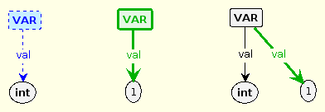
FROM GRAPH GRAMMAR TO STS
CONSTRAINTS 1
Rules creating and deleting variables themselves is non-sensical →
  Rules may not create or delete variables
  Rules may not create variables with the same label and source node
22/05/12

Slide 29
FROM GRAPH GRAMMAR TO STS
DATA FREE EXPLORATION
Problem:
Entire Graph Transition System has to be explored.
Solution:
Data free exploration: explore the Graph Transition System only matching the non-data nodes.
22/05/12

Slide 30
FROM GRAPH GRAMMAR TO STS
SYMBOLIC EXPLORATION
Result:
One graph state found per location generated
One rule transition found per switch relation generated
Note:
Location variables are still matched by rules, just not their values
Updates and guards can still be found by rule inspection
Data free exploration + rule inspection = Symbolic exploration
22/05/12

Slide 31

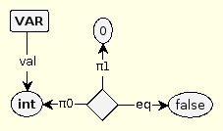
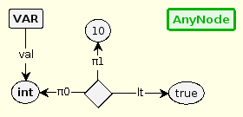
FROM GRAPH GRAMMAR TO STS
CONSTRAINTS 2
NACs on variables do not match anymore →
  Constraints on variables must be in left-hand side of rule
Data free exploration can lead to infinite exploration →
  Node creating rules must be 'structurally' constrained
1. Incorrect 1. Correct 2. Incorrect
22/05/12

Slide 32
FROM GRAPH GRAMMAR TO STS
POINT ALGEBRA
GROOVE has a special algebra: point algebra
1 value for each data type (integer, real, boolean, string)
Same effect as data free exploration
is matched by:
22/05/12

Slide 33
OVERVIEW
  Model-based Testing
  Symbolic Transition Systems
  Graph Grammars
  GRATiS Design
  Graph grammar to STS
  Case studies
  Current state
22/05/12

Slide 34
CASE STUDIES
Two case studies planned:
  Self-scan register
  Health-care system
Validation plan:
Create GROOVE models for both case studies
Do model-based test runs on original model (STS) and new model
Compare metrics
  Performance: negligible
  Maintainability: compare node/edge quantities
  Validity: compare generated STS to original STS
22/05/12

Slide 35
OVERVIEW
  Model-based Testing
  Symbolic Transition Systems
  Graph Grammars
  GRATiS Design
  Graph grammar to STS
  Case studies
  Current state
22/05/12

Slide 36
CURRENT STATE
GRATiS: mostly done
Case studies: self-scan register model almost done
Thesis: working on formalisms
22/05/12

