Slide 1
Predictive Maintenance for Smart Factory
Vincent Eng Ping Choon
Group Head of IT / Digital Transformation

Slide 2
Business Problem
Unplanned downtime is a major cost driver.
- Reactive maintenance: too late
- Time-based maintenance: inefficient
Impact:
- Production loss
- High maintenance cost
- Poor planning

Slide 3
Solution Overview
Machine learning predicts failure risk within 7 days.
- Converts sensor data into insights
- Provides risk score per machine
- Enables maintenance prioritization

Slide 4
Architecture
Sensors → Data → ML Model → Dashboard → Action
End-to-end data-driven maintenance pipeline

Slide 5
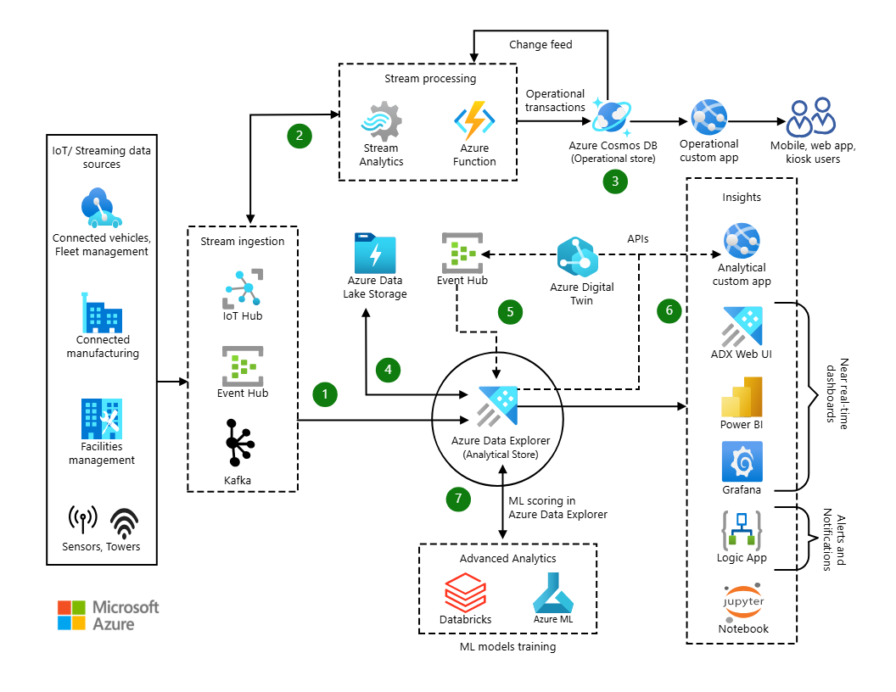
Azure Architecture

Slide 6
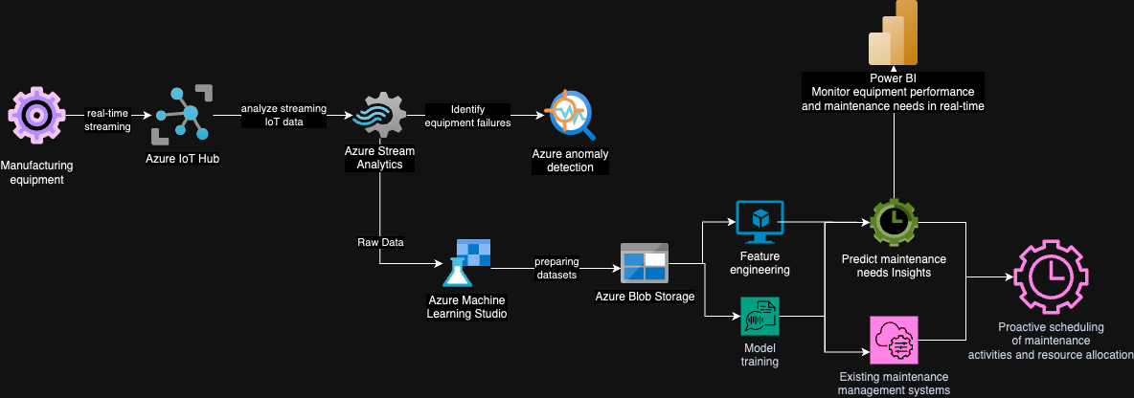
Azure Architecture

Slide 7
Business Impact
- 20–40% reduction in downtime
- 10–30% reduction in maintenance cost
- Improved asset utilization
- Better planning efficiency

Slide 8
Technology Stack
- Python (Pandas, Scikit-learn)
- Data processing
- Predictive modeling
- Visualization

Slide 9
Strategic Value
Supports Industry 4.0 transformation
- Smart Factory enablement
- Data-driven operations
- Operational excellence

Slide 10
Future Roadmap
- IoT integration (real-time data)
- Cloud deployment (Azure)
- Power BI dashboards
- MES / ERP integration

