Slide 1
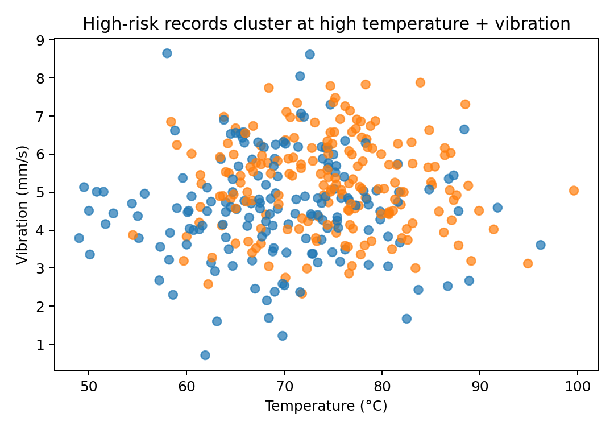
SMART MANUFACTURING AI USE CASE
Predictive
Maintenance
A portfolio-ready starter project with synthetic machine data, Python model training code, and an executive slide deck.
Dataset
Model
AUC
1,200 rows
RF
0.772
Designed to show how IT, OT, and maintenance teams can move from reactive repair to risk-based intervention.
Notes:
[Sources] - All metrics and visuals are generated from the synthetic sample dataset bundled with this project.

Slide 2
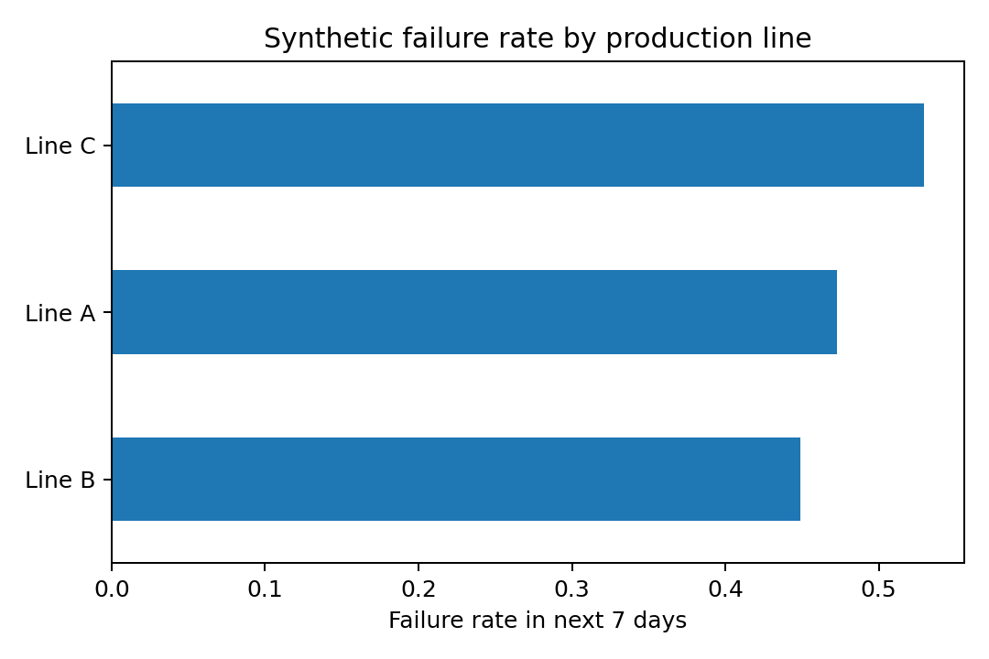
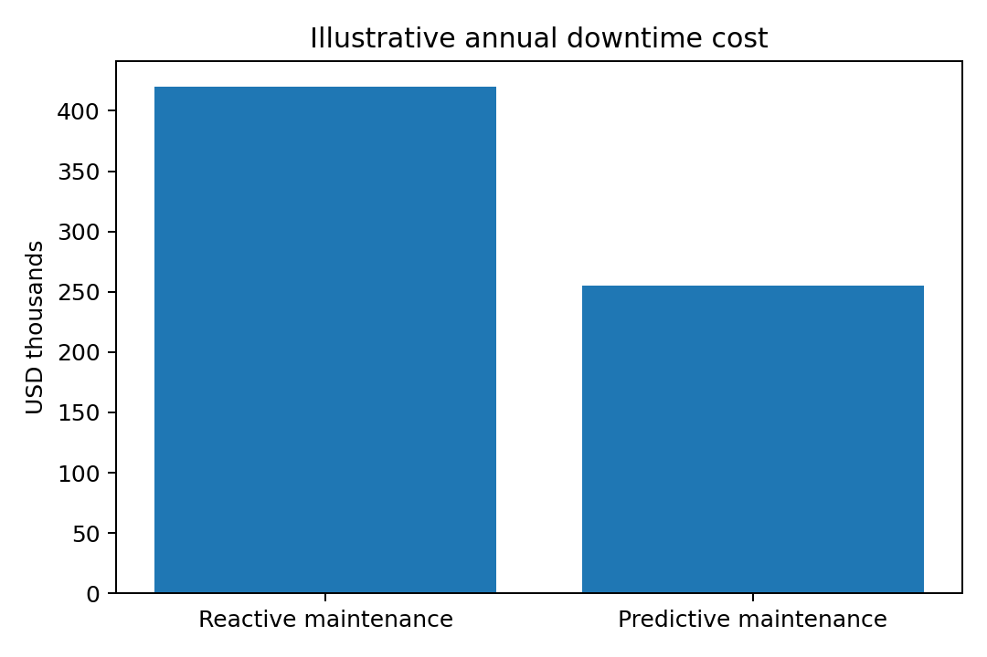
Why this use case matters
Move maintenance from calendar-driven tasks to probability-driven intervention.
Business pain points
Failure rate by line
Illustrative downtime cost
Unexpected asset failure causes missed output and overtime labor.
Maintenance planners do not have a ranked list of at-risk machines.
Sensor signals exist, but they are not converted into timely alerts.
The goal is to predict failure in the next 7 days and prioritize action.
Prediction window
Signals used
Starter outcome
Next 7 days
11 features
Rank risk daily
Target KPI
↓ unplanned downtime
↑ maintenance efficiency
This starter package uses synthetic sample data, so the cost chart is illustrative and intended for stakeholder storytelling.
Synthetic demo project • portfolio-ready starter package
Vincent Eng

Slide 3
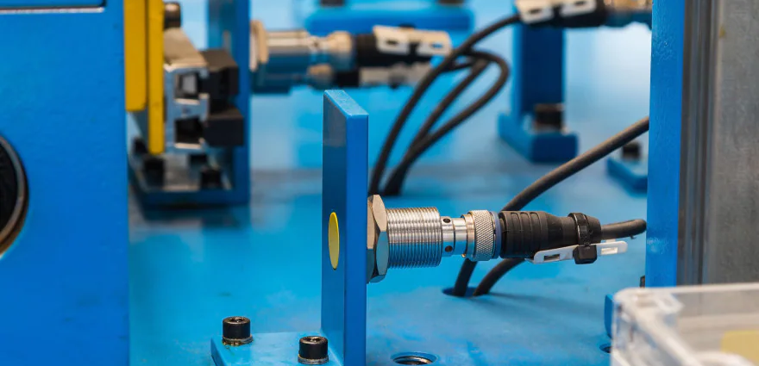
Data signals and feature engineering
Blend sensor, process, and maintenance context into one machine-level record.
Signal categories
Sample rows
Risk pattern
ID Temp Vib Days Line Fail
M-008 78.8 5.73 104 B 1
M-021 67.4 4.02 19 A 0
M-044 82.1 6.11 131 C 1
M-055 71.3 4.66 42 A 0
Sensor health: temperature, vibration, pressure, current Process context: production line, line speed, shift Maintenance state: days since maintenance, defect rate, energy spike
Feature engineering flow
Raw signals
Cleaning
Features
Label set
Sensors
CMMS
MES
Missing values
caps
unit checks
lags
rolling stats
risk flags
7-day failure
classification
Label: failure_next_7d = 1 if the machine is expected to fail within 7 days.
Synthetic demo project • portfolio-ready starter package
Vincent Eng
Notes:
[Sources] - Industrial sensors image: https://www.st.com/en/applications/factory-automation/industrial-sensors.html - All charts and table values are generated from the synthetic sample dataset bundled with this project.

Slide 4
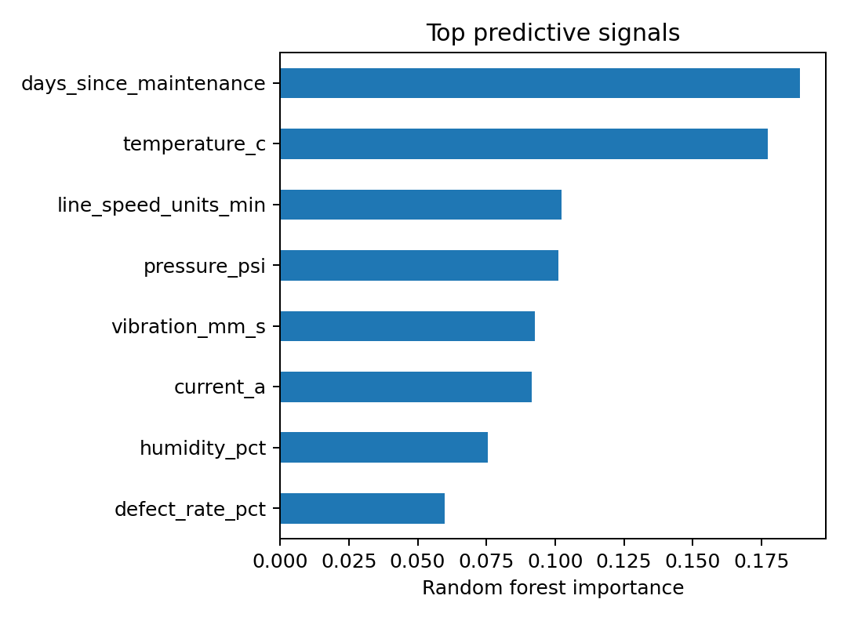
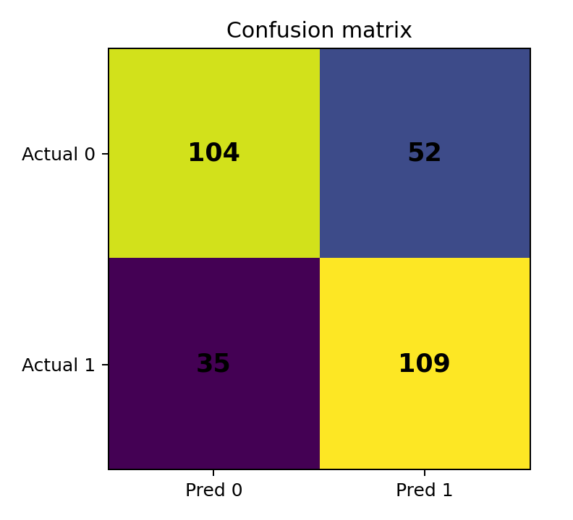
Model approach and starter results
A random forest baseline produces a ranked risk score and interpretable feature importance.
ROC AUC
Precision
Recall
F1 score
0.772
0.677
0.757
0.715
Top predictive signals
Confusion matrix
What this means
Strongest synthetic drivers: vibration, temperature, days since maintenance, current, and line speed. Use case value: maintenance can review the top-risk machines daily instead of treating every asset the same. Next improvement: add time-series drift features and machine-specific thresholds.
Synthetic demo project • portfolio-ready starter package
Vincent Eng

Slide 5

From model output to maintenance action
Operationalize the score through a simple data and alerting pipeline.
Deployment architecture
Suggested operating rhythm
1. Ingest machine and maintenance records daily. 2. Score each machine and rank the top 10 risks per line. 3. Review in morning maintenance huddle. 4. Feed outcomes back to improve thresholds and labels.
Edge data
Ingestion
Scoring
Action
PLC / sensor
telemetry
Historian /
data lake
Batch job or
API model
CMMS ticket
& alert list
Decision support output
Machine M-044 Risk score 0.84 • Line C
High vibration + overdue maintenance
Suggested action: inspect bearings and review spare-part stock.
Create ticket
Notify planner
Synthetic demo project • portfolio-ready starter package
Vincent Eng
Notes:
[Sources] - Technician image: https://auto.edu/industrial-maintenance

Slide 6
Project package and next steps
Everything included to turn this into a portfolio project or a plant pilot.
README
Python code
Sample data
Slides
Business problem, data dictionary, results, and extension ideas.
Training script with model fit, metrics, and output charts.
Synthetic machine sensor dataset with failure labels.
Executive-ready story for AI + maintenance stakeholders.
How to strengthen this project
Suggested portfolio headline
• Replace synthetic labels with real work-order outcomes. • Add rolling-window features from historian data. • Compare random forest with XGBoost or temporal models. • Integrate outputs with CMMS and planner dashboards.
Built an end-to-end predictive maintenance starter project for smart manufacturing, covering data design, model training, stakeholder storytelling, and deployment architecture.
Use this as a base repo for CIO / Head of IT / Digital Transformation interviews.
Starter project includes code, sample data, README, and executive deck
Vincent Eng

