Slide 1
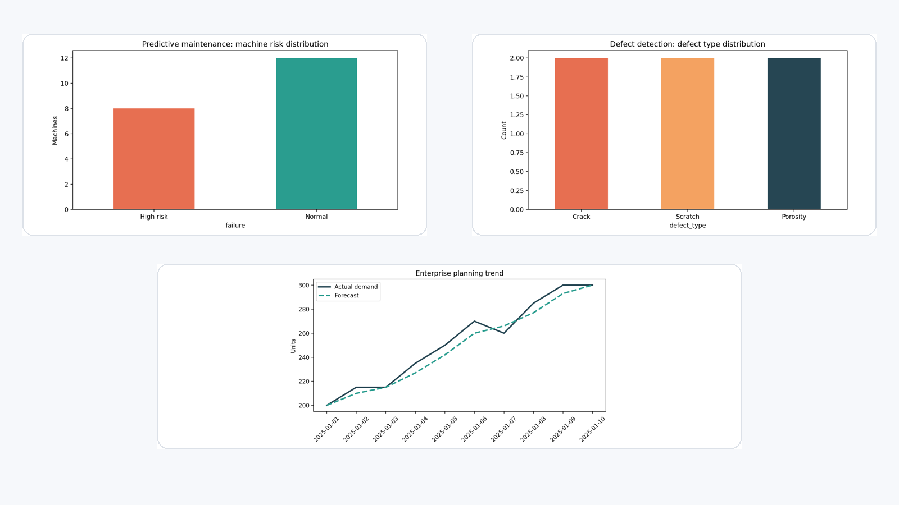
AI-Driven Smart
Manufacturing
Control Tower
Master board deck for the integrated platform spanning predictive maintenance, defect detection, and demand forecasting.
Risk exposure
Defect rate
$472K
3.2%
demo run
quality view
Forecast accuracy
87%
planning view
Board lens
•
One control tower, not three point solutions
•
Financial exposure translated from model outputs
•
Clear path from prototype to enterprise deployment

Slide 2
Board summary
Risk exposure
High-risk machines
Forecast accuracy
Defect rate
$472K
9
87%
3.2%
highest concentration in Plant TH
priority maintenance queue
room to improve before scale
quality signal is manageable
What was built
Why it matters
Board ask
•
Unified dashboard switching between maintenance, quality, and planning.
•
Moves the portfolio from isolated notebooks into a decision-support product.
Approve next phase
•
Connect live source systems (MES / ERP / image capture).
•
Project assets, sample models, and business logic packaged for GitHub publication.
•
Demonstrates platform thinking expected at senior digital leadership level.
•
Add monitoring, governance, and role-based workflows.
•
Interpretive layer converts model outputs into costs, actions, and cross-module observations.
•
Creates one narrative linking uptime, quality, and planning accuracy.
•
Pilot one plant, then scale to enterprise operations.
Bottom line: the prototype already shows how AI outputs can be translated into operational priorities and board-level economics.
Demo environment built from project sample data

Slide 3
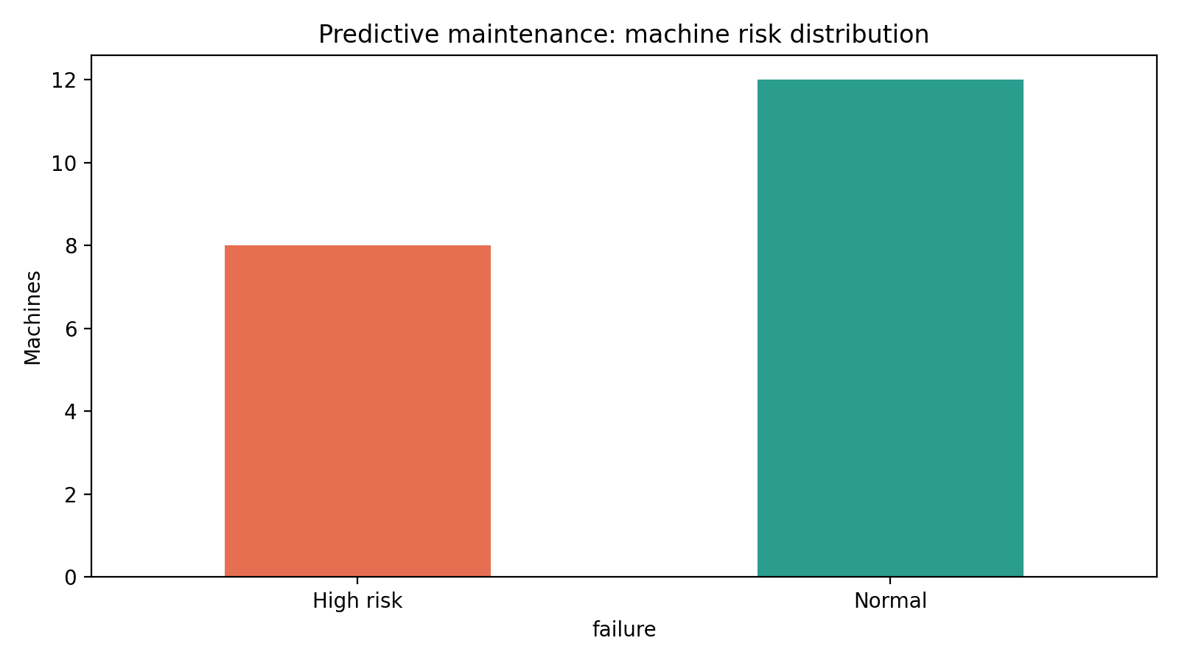
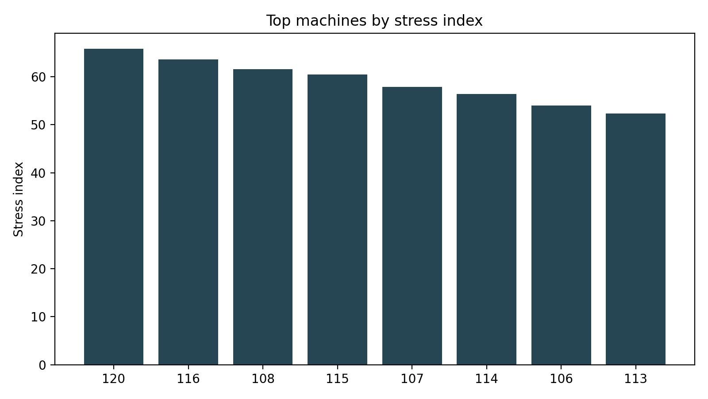
Predictive maintenance — from model score to maintenance decision
Machine risk distribution
Top machines by stress index
Decision implication
•
Escalate Plant TH first: it carries the largest share of simulated risk exposure.
•
Bundle the selected-machine view with work-order routing for the next release.
Interpretation
•
The demo run concentrates risk in a short queue rather than diffuse low-level noise.
•
Expose maintenance history in the same pane to strengthen engineering trust.
•
That pattern supports executive prioritization: focus scarce engineering time on assets most likely to disrupt operations.
Charts built from project sample maintenance data.

Slide 4
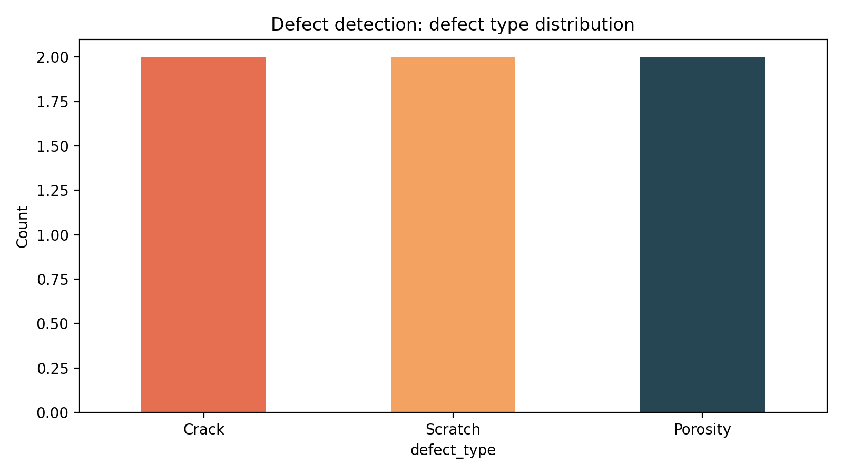
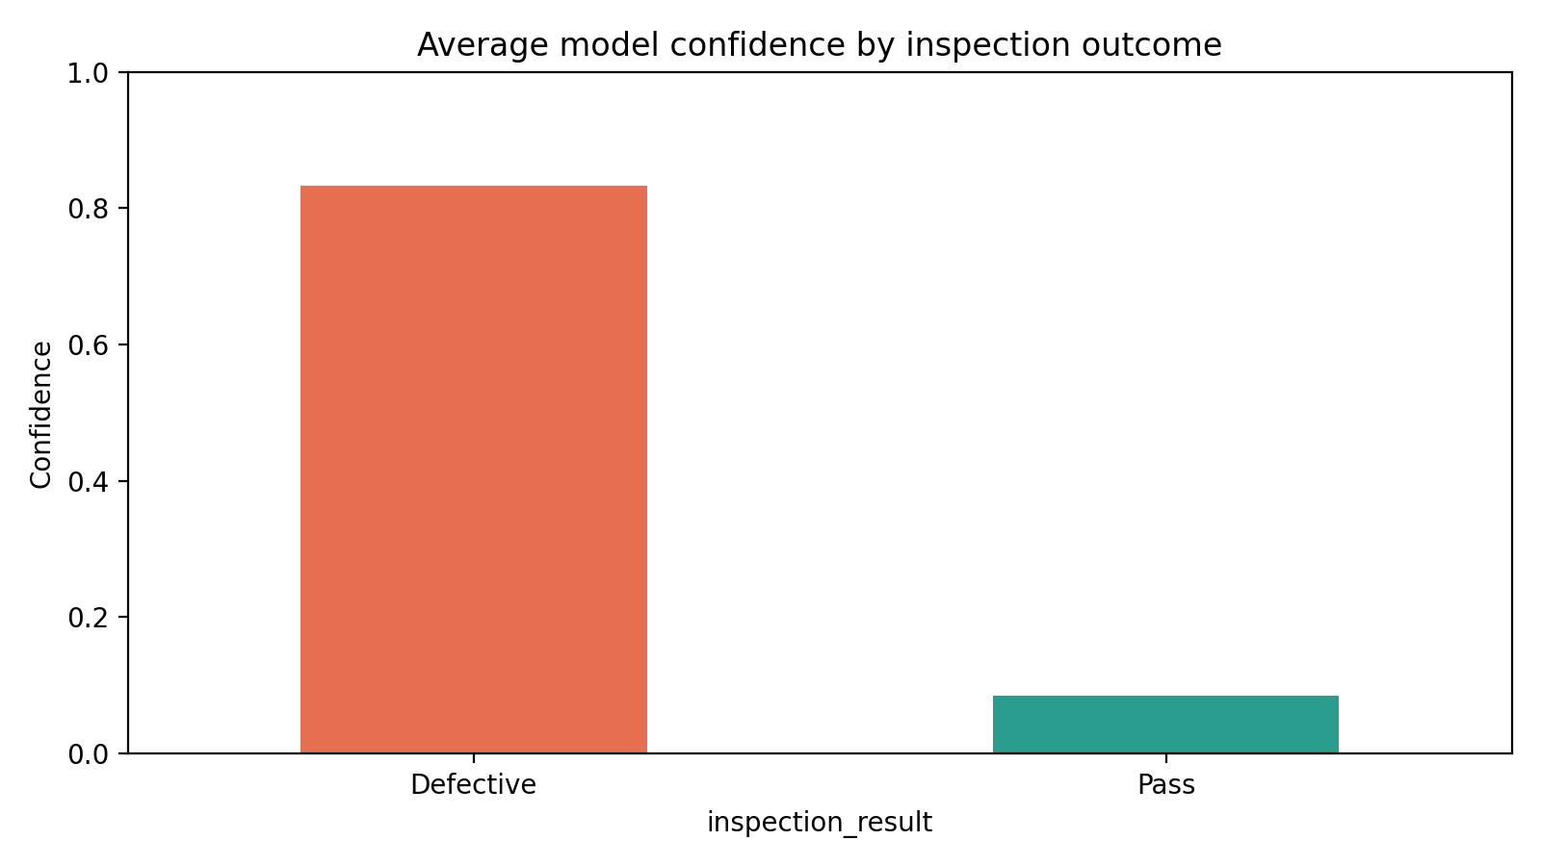
Defect detection — quality inspection as an operating lever
Defect type distribution
Average model confidence
Board takeaway
•
Inspection AI is framed as a business control: reduce scrap, shorten feedback loops, and improve yield.
•
Next step: connect inspection output to plant / line / shift context so quality events can be traced to upstream conditions.
Charts built from sample defect inspection data packaged for the control tower.

Slide 5
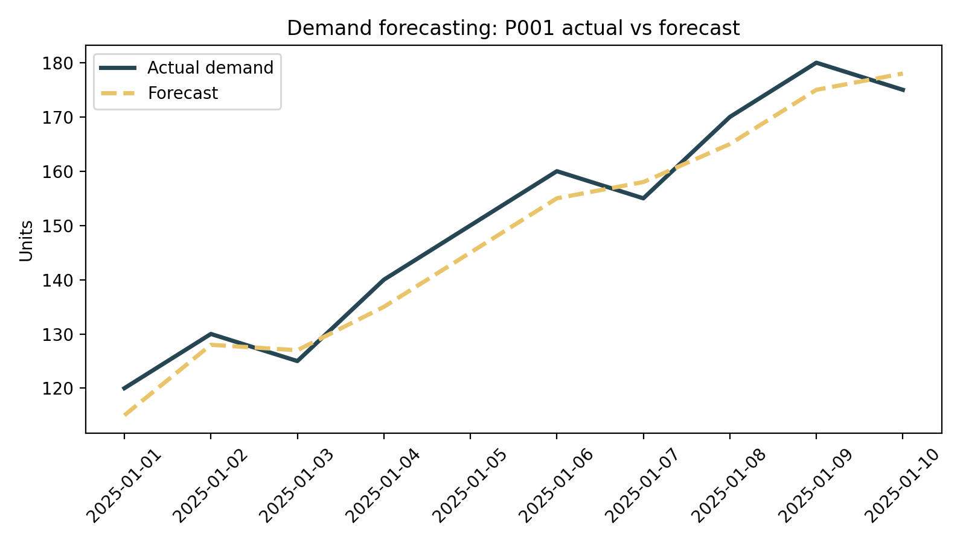
Demand forecasting — planning confidence before enterprise scale
Actual vs forecast (P001)
What the chart says
•
The forecast broadly tracks demand direction.
•
The remaining gap is small enough for a pilot, but still material for inventory timing.
AI-generated business insight
•
Trend: increasing demand over the observed period.
•
Bias: mild over-forecasting risk in the sample run.
•
Action: tighten stock policy only after accuracy clears the board threshold.
Demand chart built from sample forecasting data used in the dashboard.

Slide 6
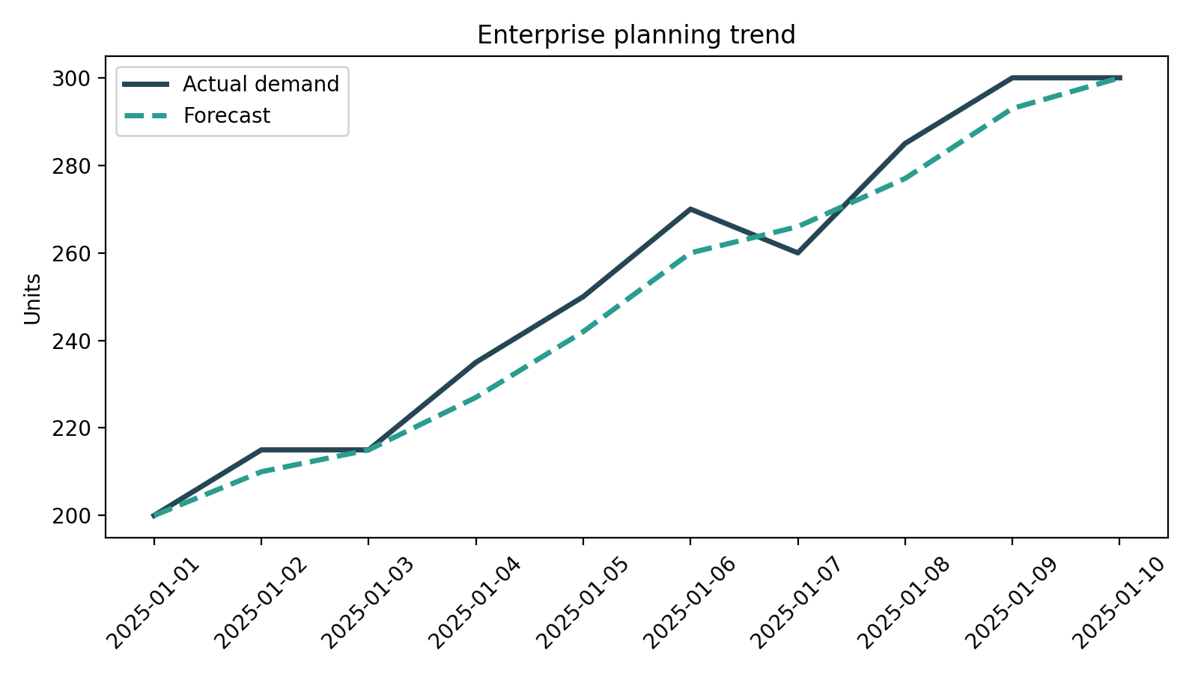
Unified executive control tower — the value is in the connections
Cross-module intelligence
•
If maintenance risk spikes in the same plant where defect rates worsen, leadership has a stronger signal that asset condition is impacting quality.
•
If maintenance instability coincides with weak forecasting, planners inherit a double risk: poorer output reliability and weaker inventory timing.
•
This is why the board should invest in one control tower: separate dashboards do not expose these operational linkages.
Maintenance signal
Quality signal
Planning signal
The board narrative improves as more live plant data is connected to the same decision layer.

Slide 7
GitHub and portfolio update — publish the platform, not just the code
GitHub package
Portfolio story
Repo title
Case study headline
ai-driven-smart-manufacturing-control-tower
Built an enterprise AI control tower for manufacturing operations
Recommended README sections
•
Business problem and why one control tower matters
Use these portfolio bullets
•
Integrated predictive maintenance, defect detection, and demand forecasting into one decision layer.
•
Module overview: maintenance, quality, demand
•
Architecture, screenshots, and setup instructions
•
Translated model outputs into business metrics such as risk exposure, defect rate, and forecast accuracy.
•
Roadmap from demo to enterprise deployment
•
Framed the product for board-level storytelling and enterprise scale-up.
01-Predictive-Maintenance
02-Defect-Detection
03-Demand-Forecasting
04-Executive-Deck
05-Architecture-Diagrams
06-Screenshots
README.md
Best positioning sentence
"I designed and prototyped an AI-driven smart manufacturing control tower that unifies maintenance, quality, and planning decisions into one executive view."

