Slide 1
Sentiment Analysis
Implemented in C
Vincent Hu, An Tran

Slide 2
Sentiment Analysis
Sentiment Analysis is a type of Natural Language Processing that tries to identify opinions within text.
Usually these systems try to obtain attributes such as
Polarity: if the speaker express a positive or negative opinion,
Subject: the thing that is being talked about,
Opinion holder: the person that expresses the opinion.
It is good to remember that sentiment analysis is not an exact science. Sentiment analysis is still bad at measuring things like sarcasm, skepticism, hope, anxiety, excitement, etc.
If you are interested in learning more, visit: https://monkeylearn.com/sentiment-analysis/

Slide 3
Rules Based Approach
Define lists of polarized words (list of lexicons)
Take a text (online reviews)
Count the number of positive words that appear in the text.
Count the number of negative words that appear in the text.
If the number of positive word appearances is greater than the number of negative word appearances return a positive sentiment, conversely, return a negative sentiment. Otherwise, return neutral.

Slide 4
Automatic Systems (General)
In the training process, models learn to associate an input (text/review) to a set output (label/tag) based on the test samples used for training.
Pairs of feature vectors and tags (e.g. positive, negative, or neutral) are fed into the machine learning algorithm to generate a model.
The first step in a machine learning text classifier is to transform the text into a numerical representation, usually a vector.
The classification step usually involves a statistical model like Naïve Bayes, Logistic Regression, Support Vector Machines, or Neural Networks.
The prediction process is used to transform unseen text inputs into feature vectors

Slide 5
Implementation IN C
We chose to start with the simplest algorithm: Word Counts
1. Find a dictionary that classifies words as positive or negative.
2. Study the example code that they provide in Python.
3. Import a Hashmap library to create a dictionary structure.
4. Preprocess the reviews (from JSON to txt)
5. Split the reviews by word and count the positive and negative words
6. Compare the word count algorithm to the reviewer's rating

Slide 6
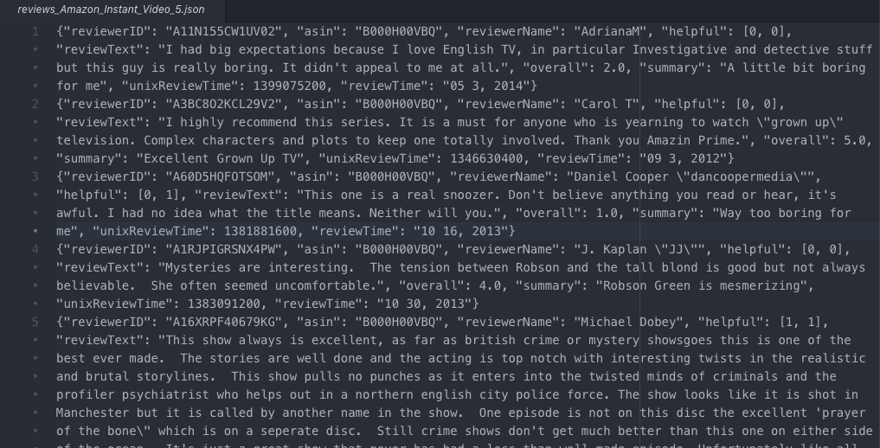

Slide 7
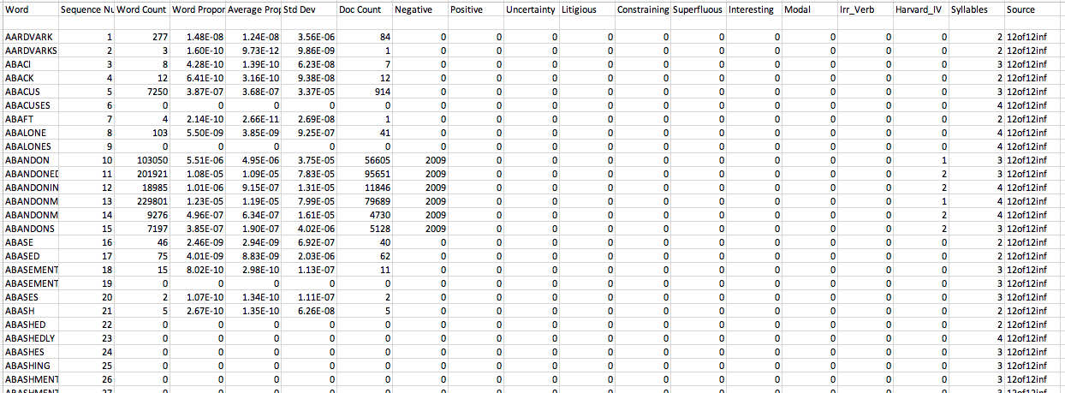

Slide 8
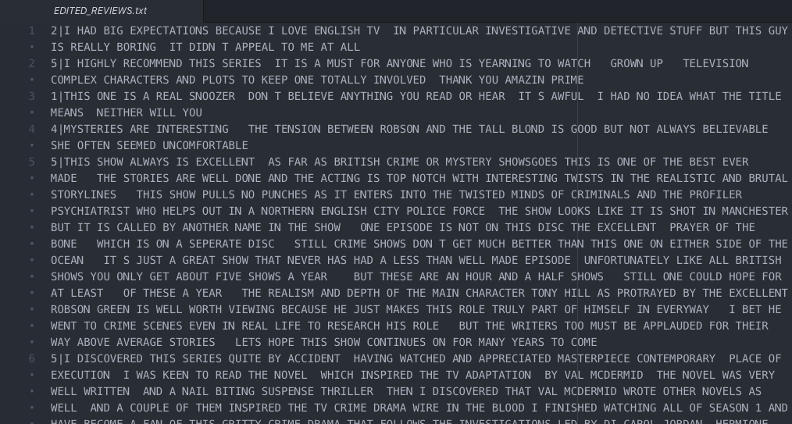

Slide 9
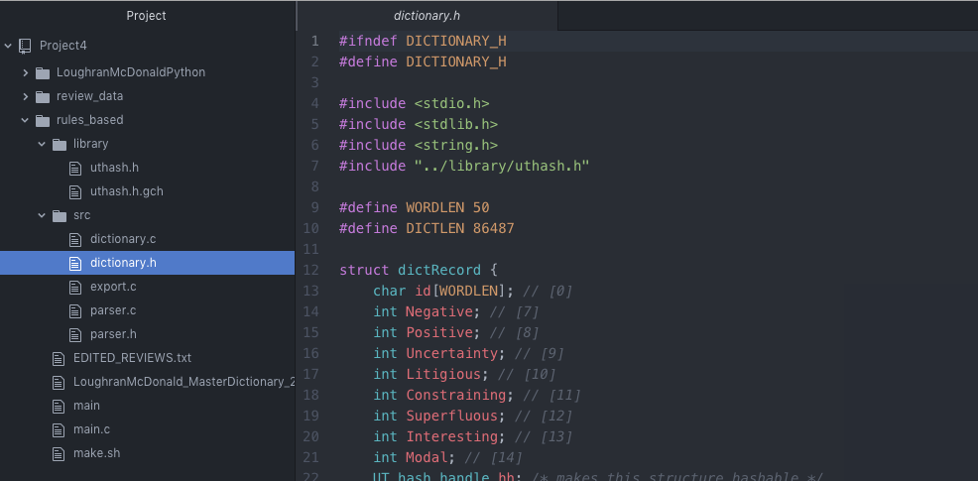

Slide 10
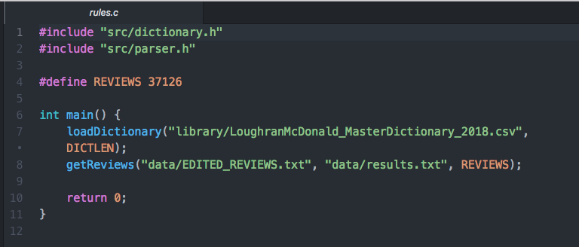

Slide 11
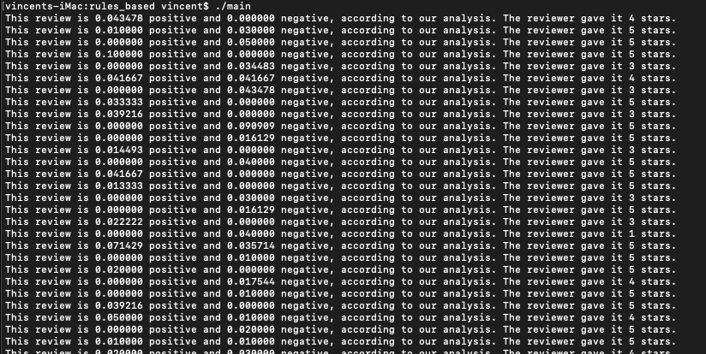

Slide 12
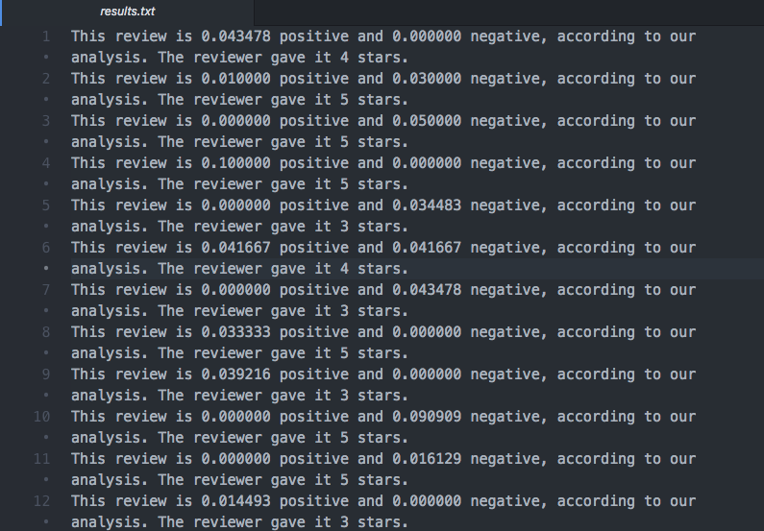

Slide 13
Scoring Algorithm
Import a certain number of reviews
Count the frequency with which each word shows up in the reviews
Use the review score to assign points to the words
Compare the average score for the words to the actual score of each review
Predict the next set of reviews based on the data created from this training set

Slide 14
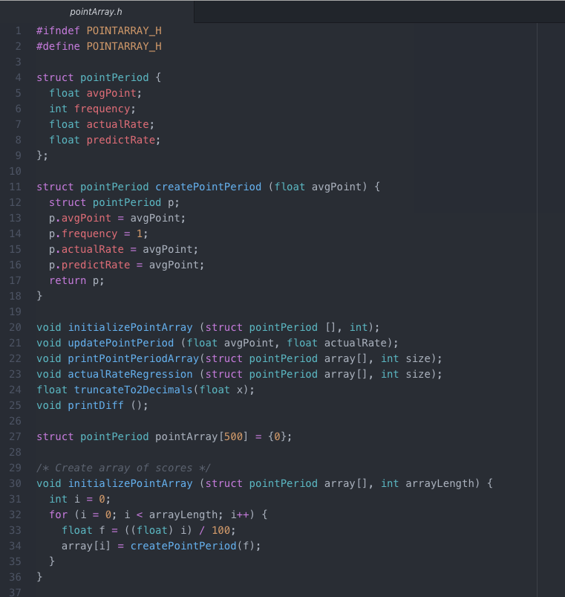

Slide 15
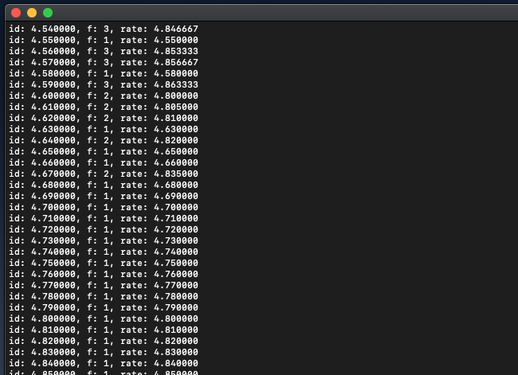

Slide 16
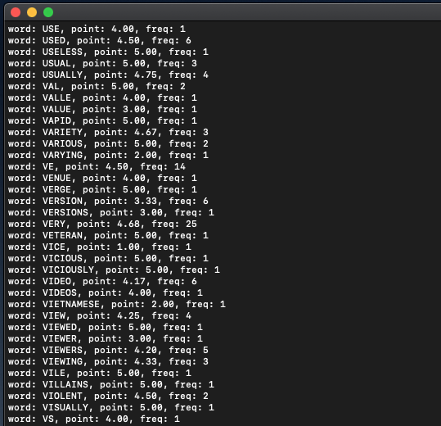

Slide 17
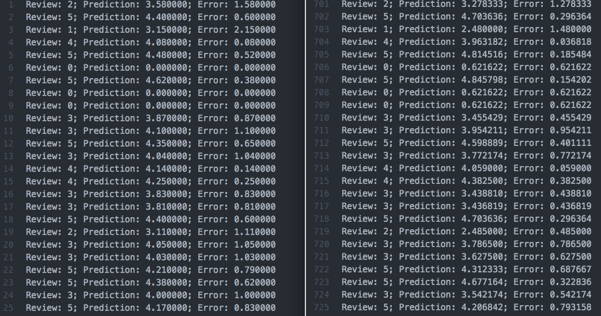

Slide 18
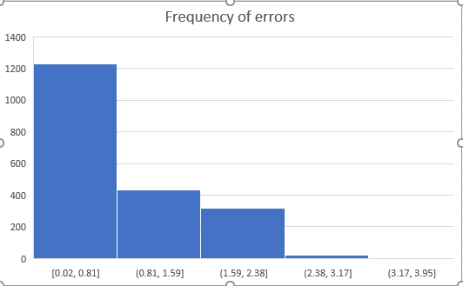

Slide 19
Citations
MonkeyLearn. (2019). Sentiment Analysis: nearly everything you need to know | MonkeyLearn. [online] Available at: https://monkeylearn.com/sentiment-analysis/ [Accessed 19 Apr. 2019].

