Slide 1




Open MOdeL Experiment

Slide 2
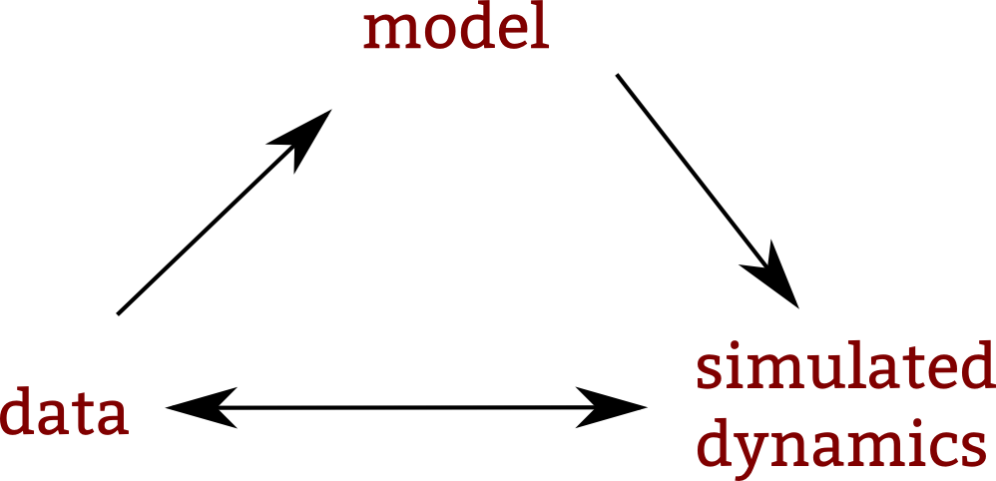

Slide 3
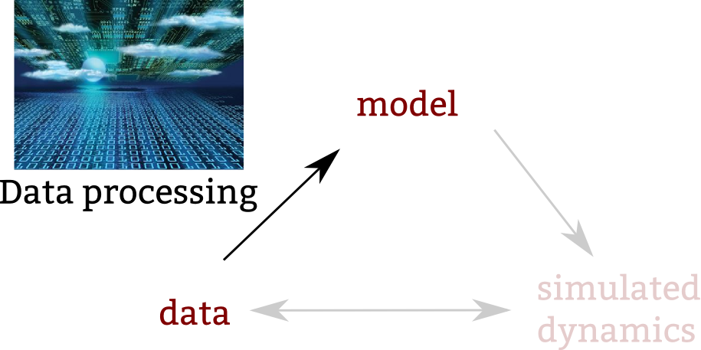

Slide 4
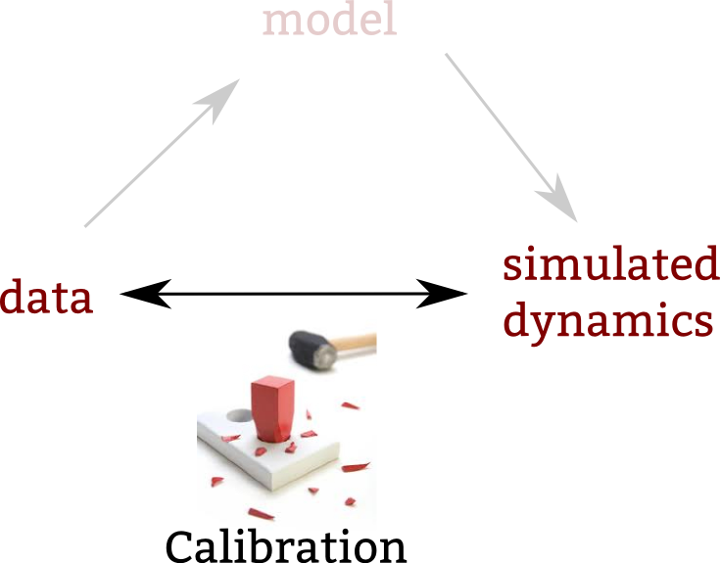

Slide 5
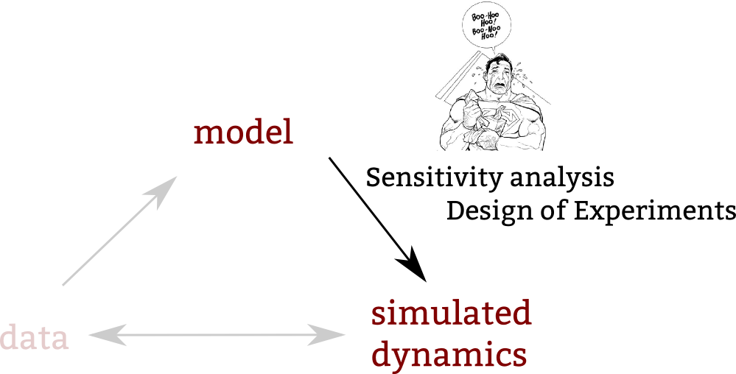

Slide 6

These methods are time consuming

Slide 7
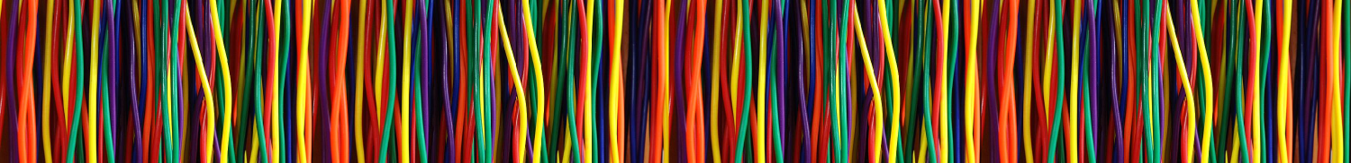
Naturally parallel algorithms permit to leverage parallelism

Slide 8
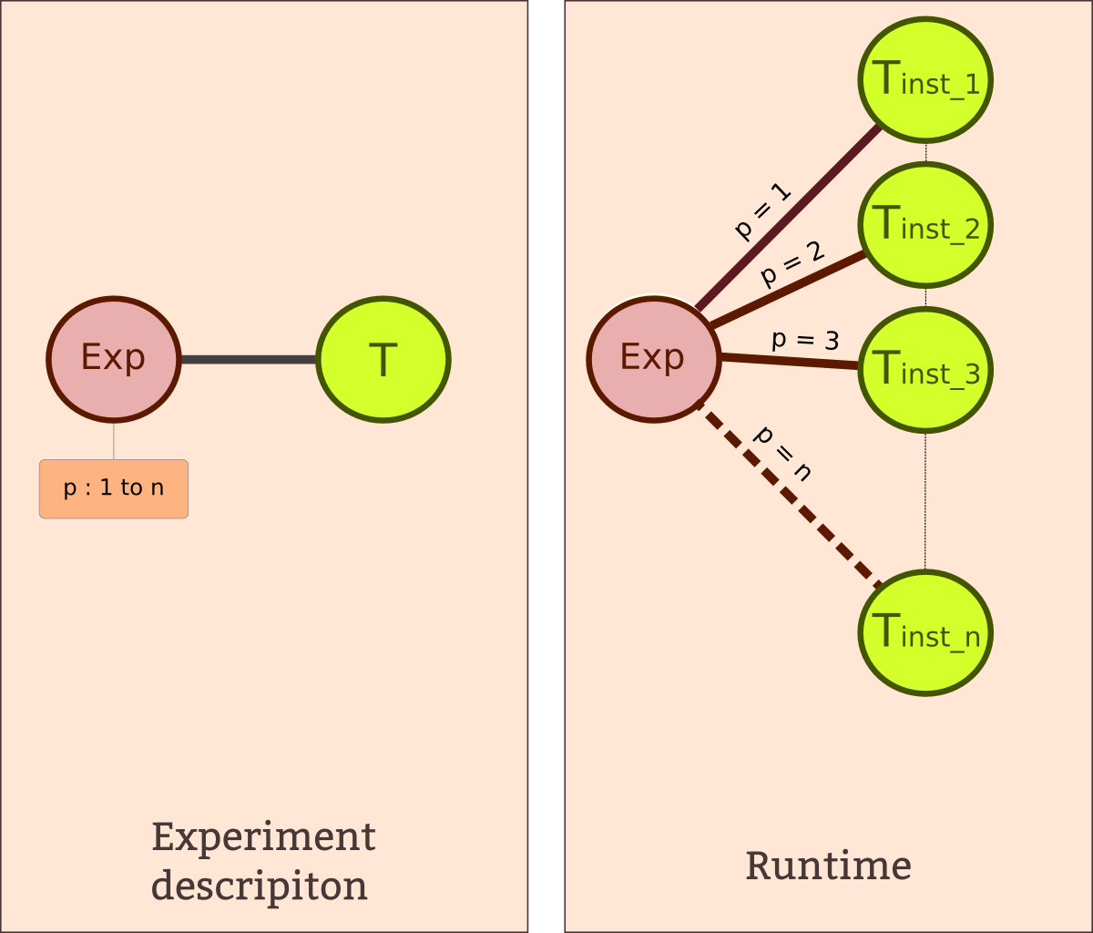
Data parallelism

Slide 9
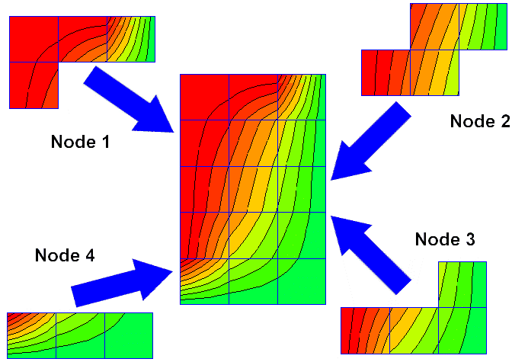
The parallelisation by message

Slide 10
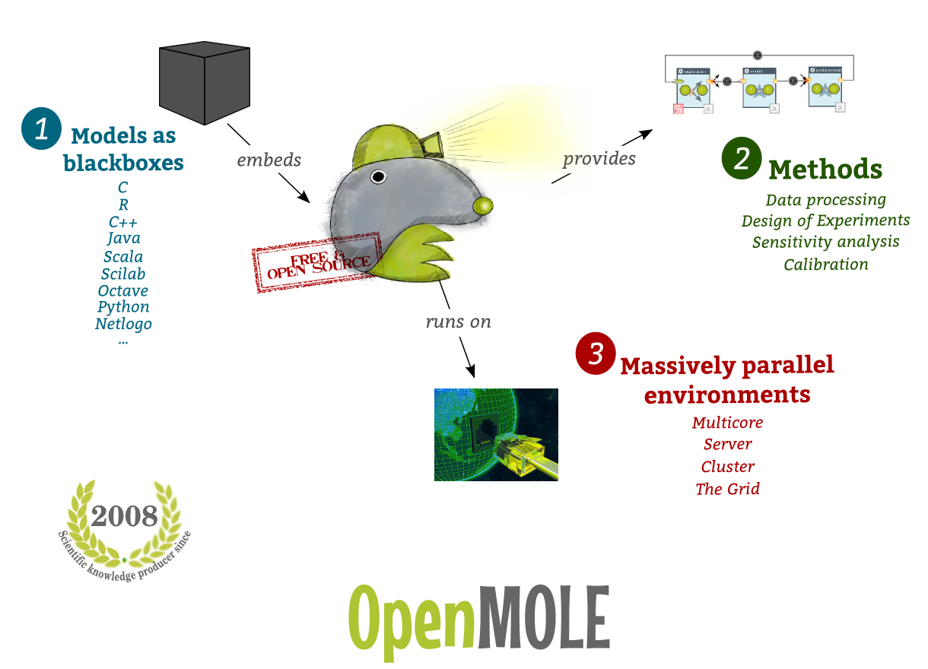

Slide 11
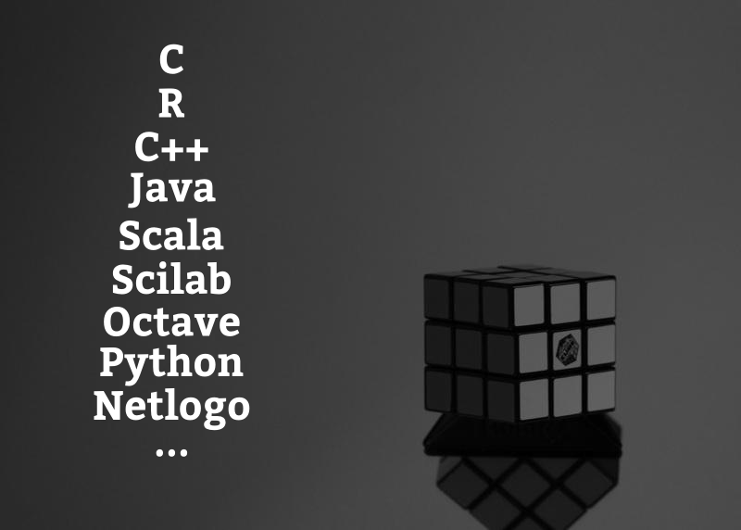
Embed your model as a black box

Slide 12
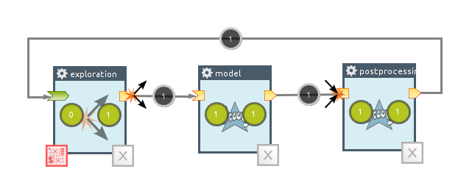
A naturally parallel formalism to design experiments

Slide 13
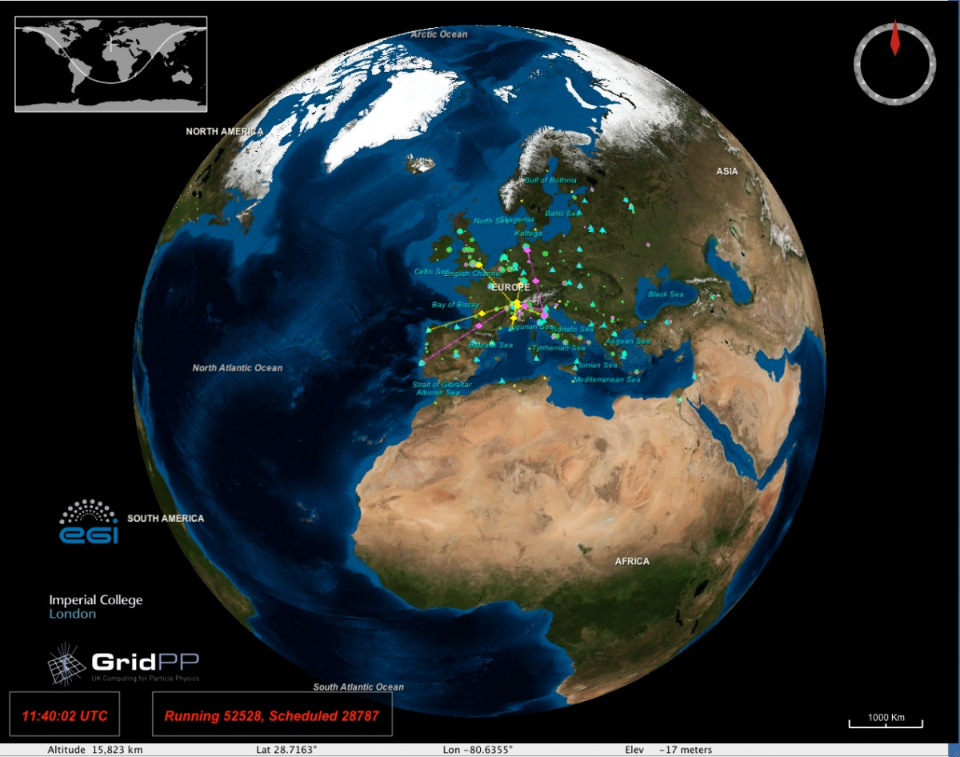
The Grid

Slide 14
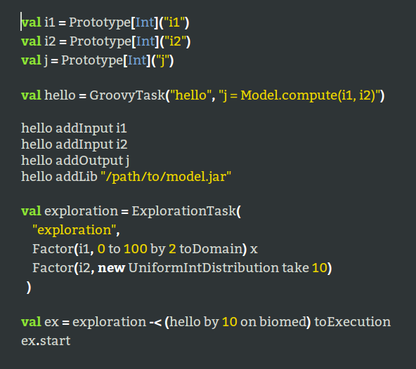
OpenMOLE from a DSL

Slide 15
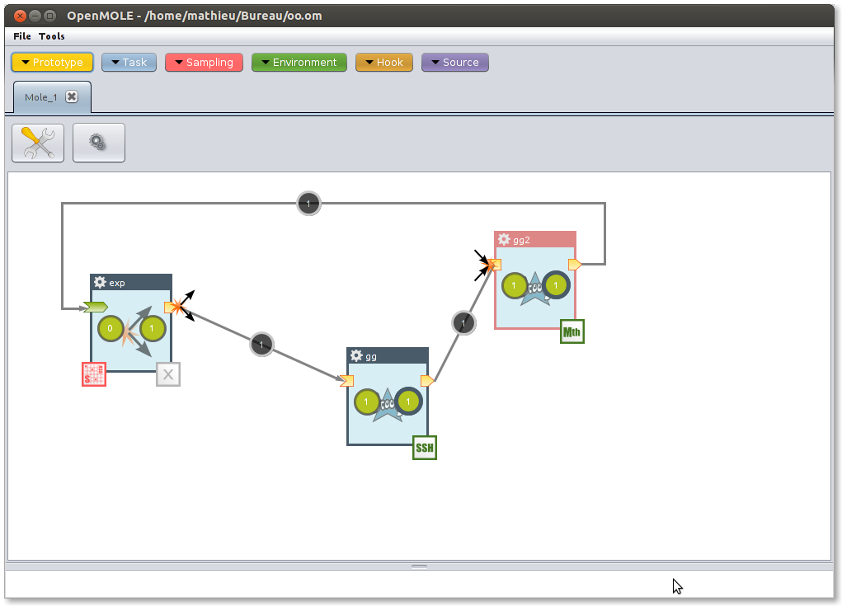
OpenMOLE from a GUI

Slide 16
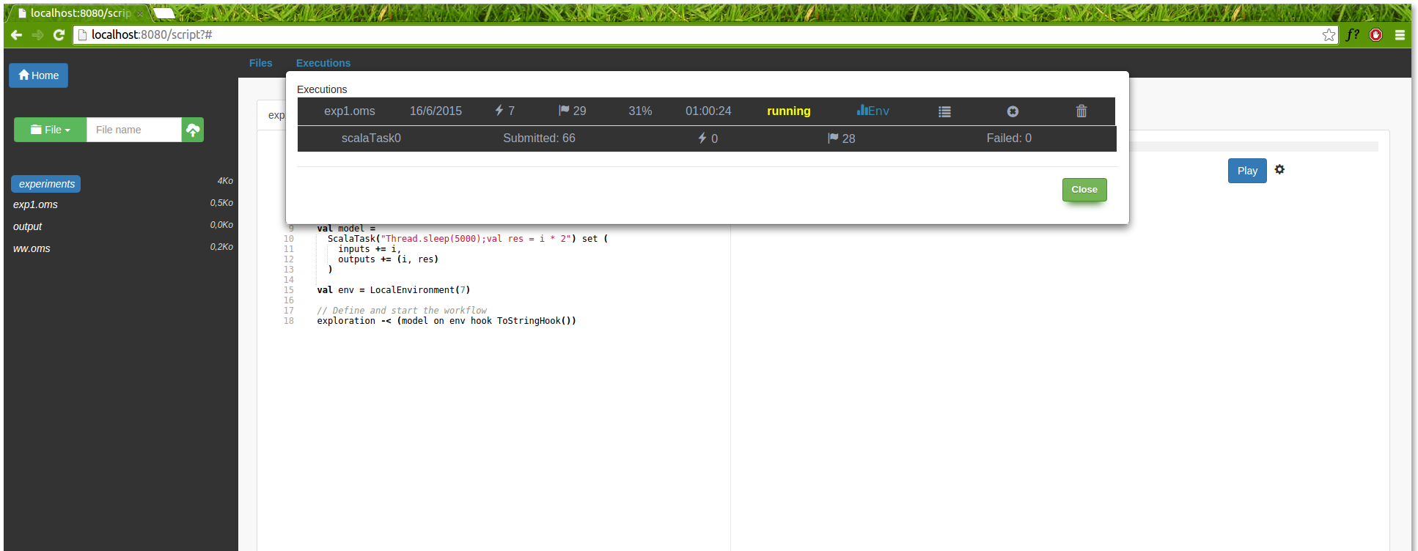
OpenMOLE online

Slide 17
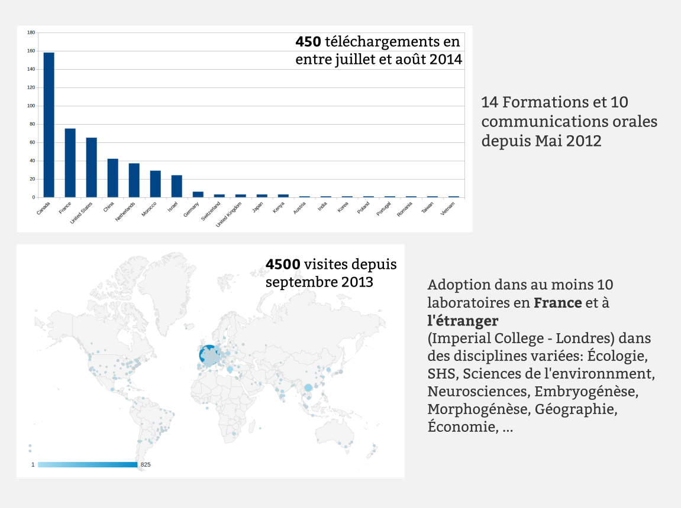

Slide 18
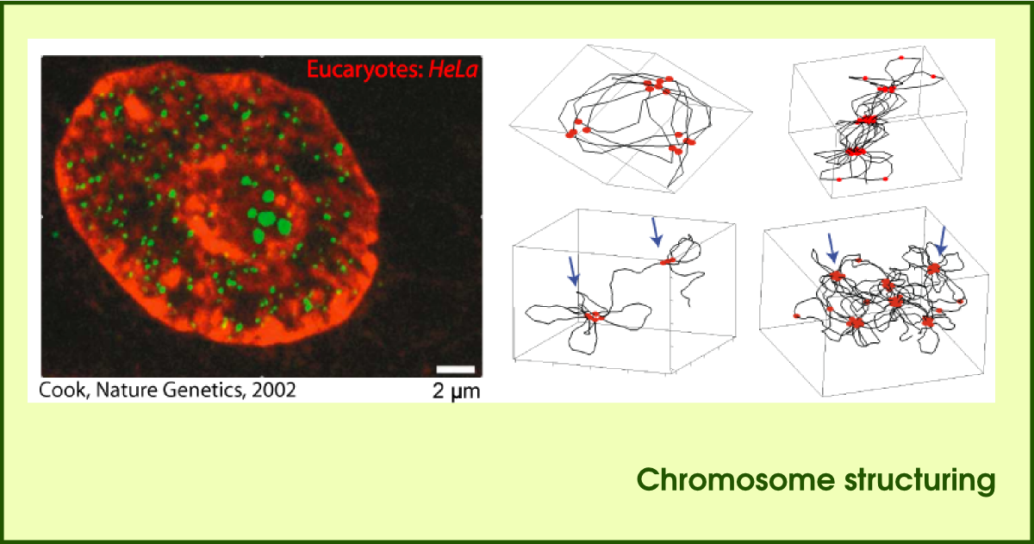
Chromosome structuring
C++ model
2 days per simulation for 1600 simulations: 8.5 years CPU time

Slide 19
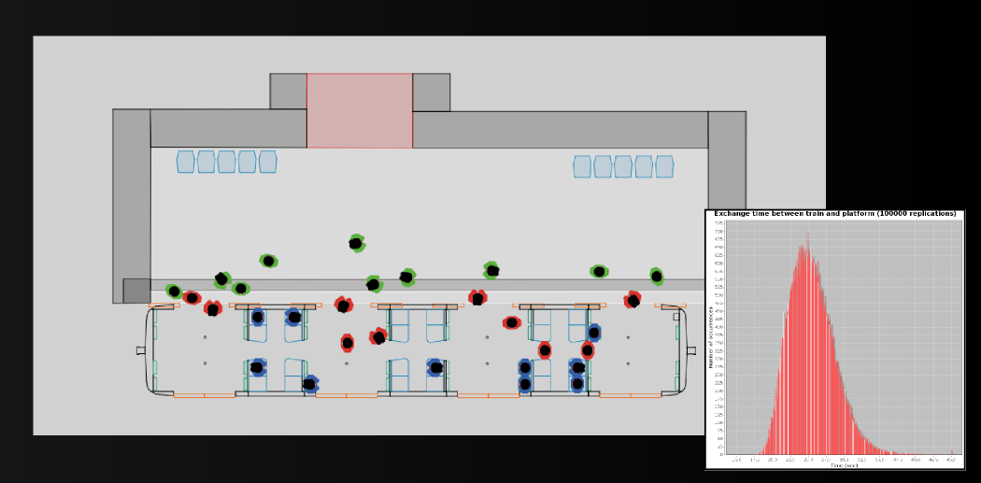
SimTrap
Netlogo model
5 min per simulation for 100000 simulations : 1 year CPU time

Slide 20

Simpop
Scala model // 5 min per simulation
for 500 000 000 simulations : 30 years CPU time

Slide 21
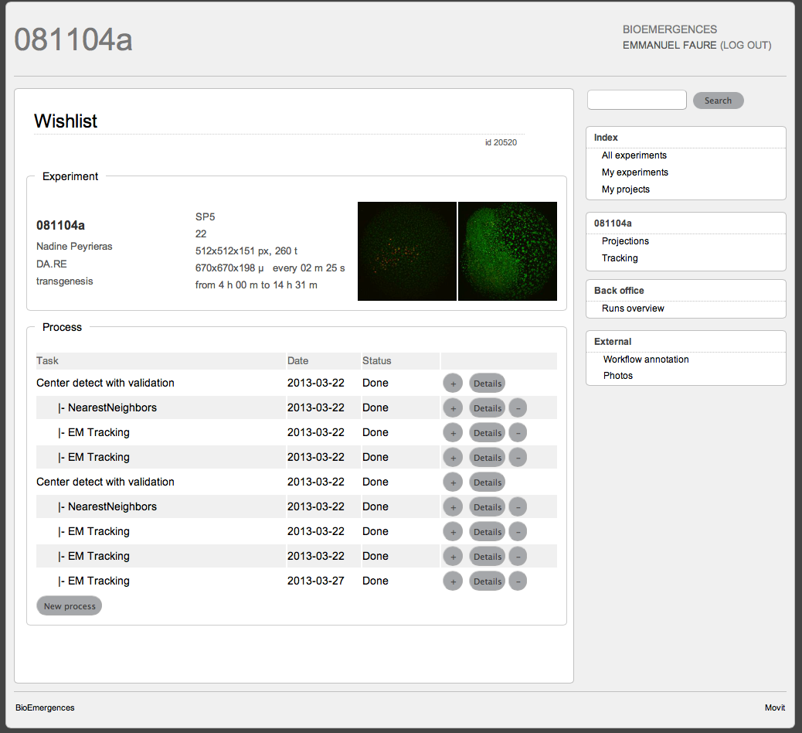
Bioemergences
C models // daily productions (10000 jobs / day)

Slide 22
