Slide 1
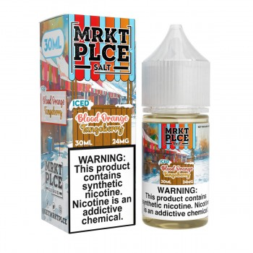
Blood Orange Tangoberry
Blood Orange, Grapefruit & Tangoberries
A bright and vibrant mix of sweet blood orange, juicy grapefruit, and fresh tangoberries!
Salt Nic 30ml · 24mg / 48mg | Sub-Ohm 100ml · 0mg / 3mg / 6mg
21+ · The Vapor Place

Slide 2
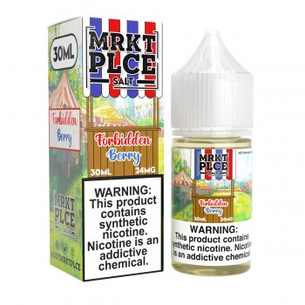
Forbidden Berry
Tropical Fruit & Mixed Berries
Perfectly captures the flavors of tropical fruit intermingled with a mixed berry combination – forbidden fruit tastes the best.
Salt Nic 30ml · 24mg / 48mg | Sub-Ohm 100ml · 0mg / 3mg / 6mg
21+ · The Vapor Place

Slide 3
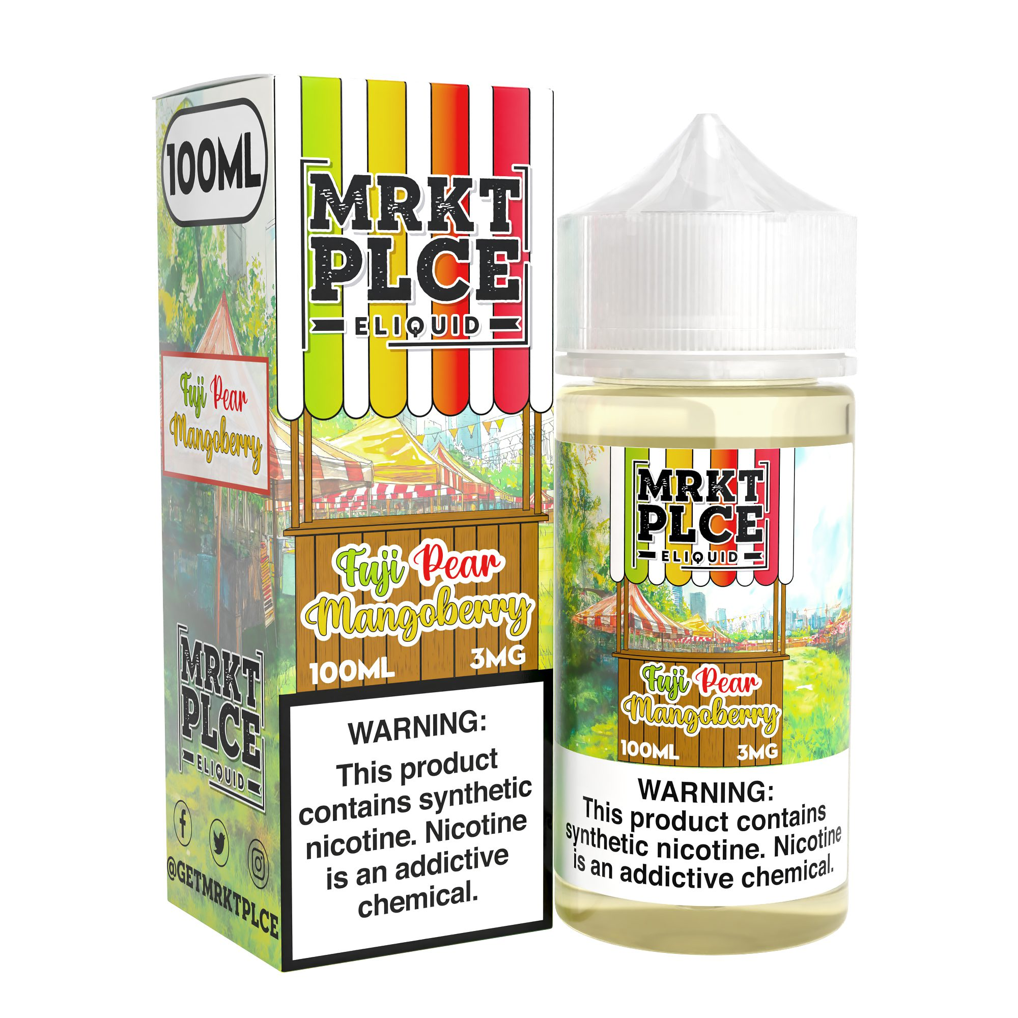
Fuji Pear Mangoberry
Fuji Apple, Pear, Mango & Berries
A blend of fresh fuji apples, sweet pears, ripe mangos, and succulent berries. A tropical fruit explosion!
Salt Nic 30ml · 24mg / 48mg | Sub-Ohm 100ml · 0mg / 3mg / 6mg
21+ · The Vapor Place

Slide 4
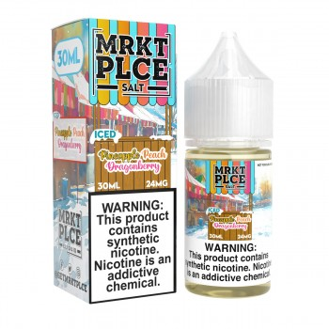
Pineapple Peach Dragonberry
Pineapple, Peach & Dragonfruit
Juicy pineapple infused with sweet peaches and a touch of dragonfruit.
Salt Nic 30ml · 24mg / 48mg | Sub-Ohm 100ml · 0mg / 3mg / 6mg
21+ · The Vapor Place

Slide 5
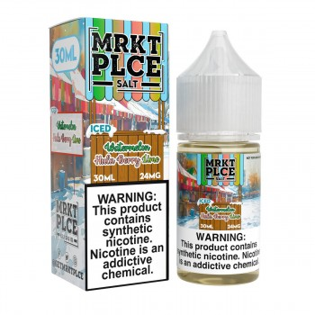
Watermelon Hula Berry Lime
Watermelon, Hula Berry & Lime
An infusion of sweet watermelon, hula berry, and fresh-squeezed lime.
Salt Nic 30ml · 24mg / 48mg | Sub-Ohm 100ml · 0mg / 3mg / 6mg
21+ · The Vapor Place

Slide 6
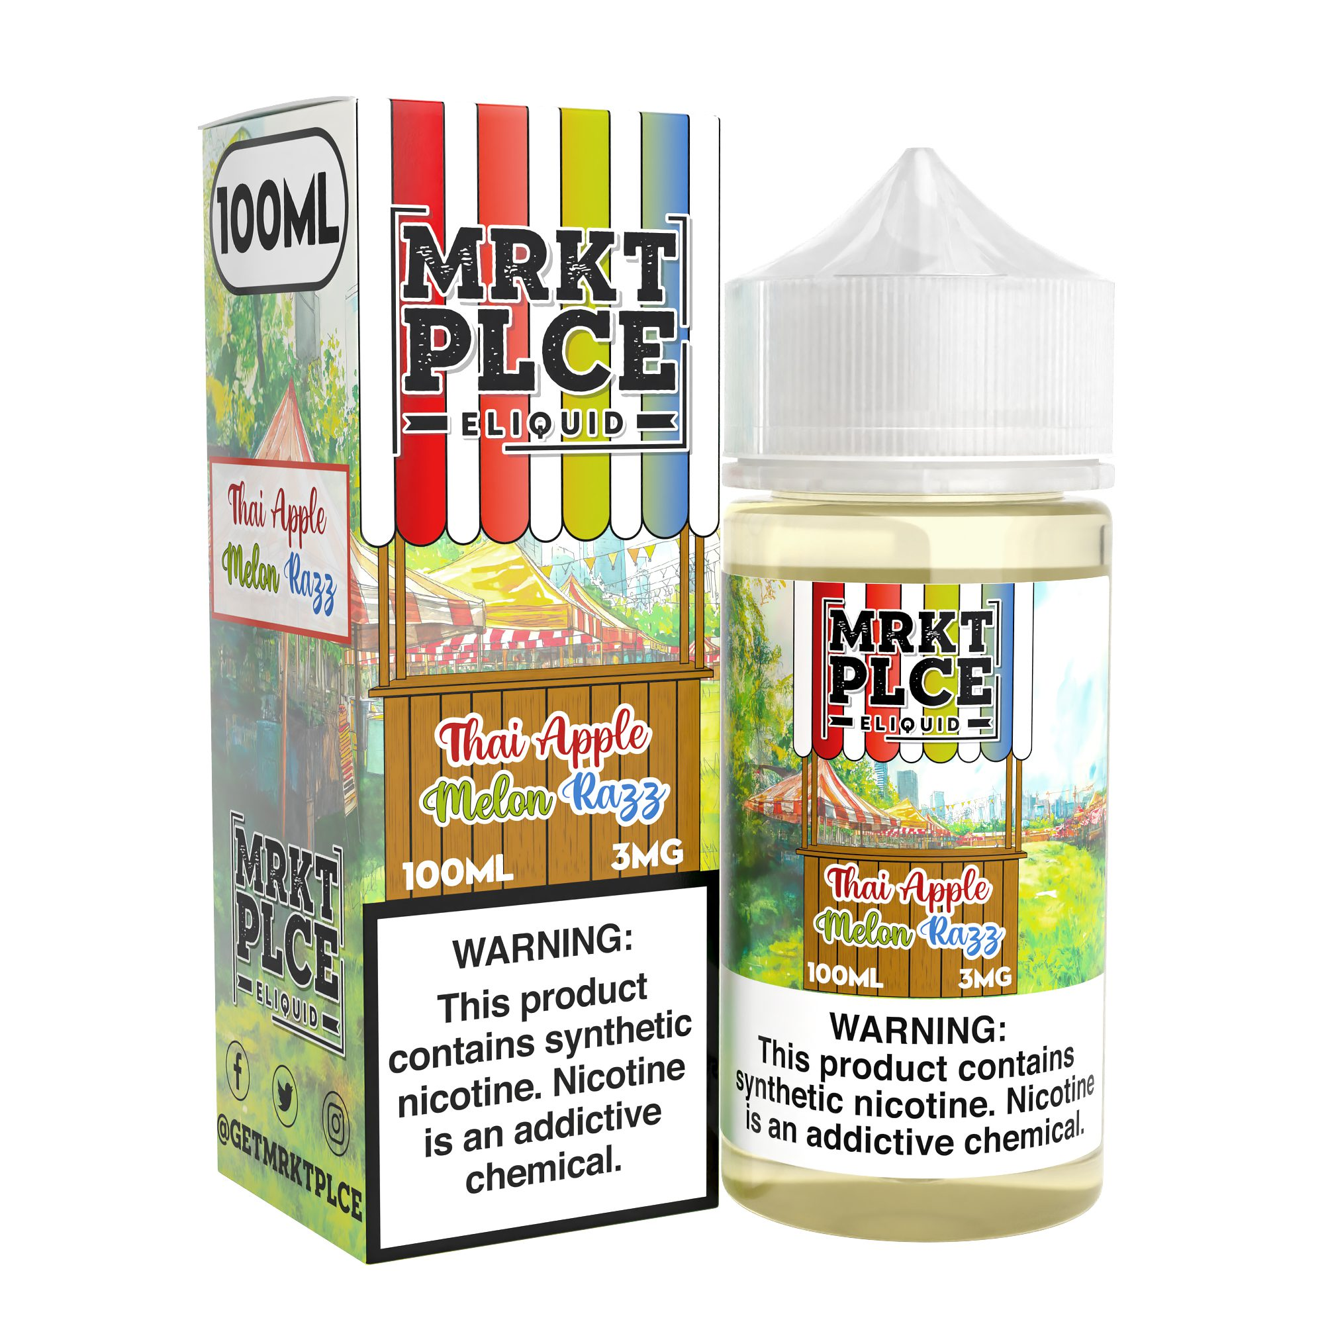
Thai Apple Melon Razz
Apple, Melon & Raspberry
Bold apple, lush melon, and zesty raspberry come together in a lively, flavorful vapor.
Salt Nic 30ml · 24mg / 48mg | Sub-Ohm 100ml · 0mg / 3mg / 6mg
21+ · The Vapor Place

Slide 7
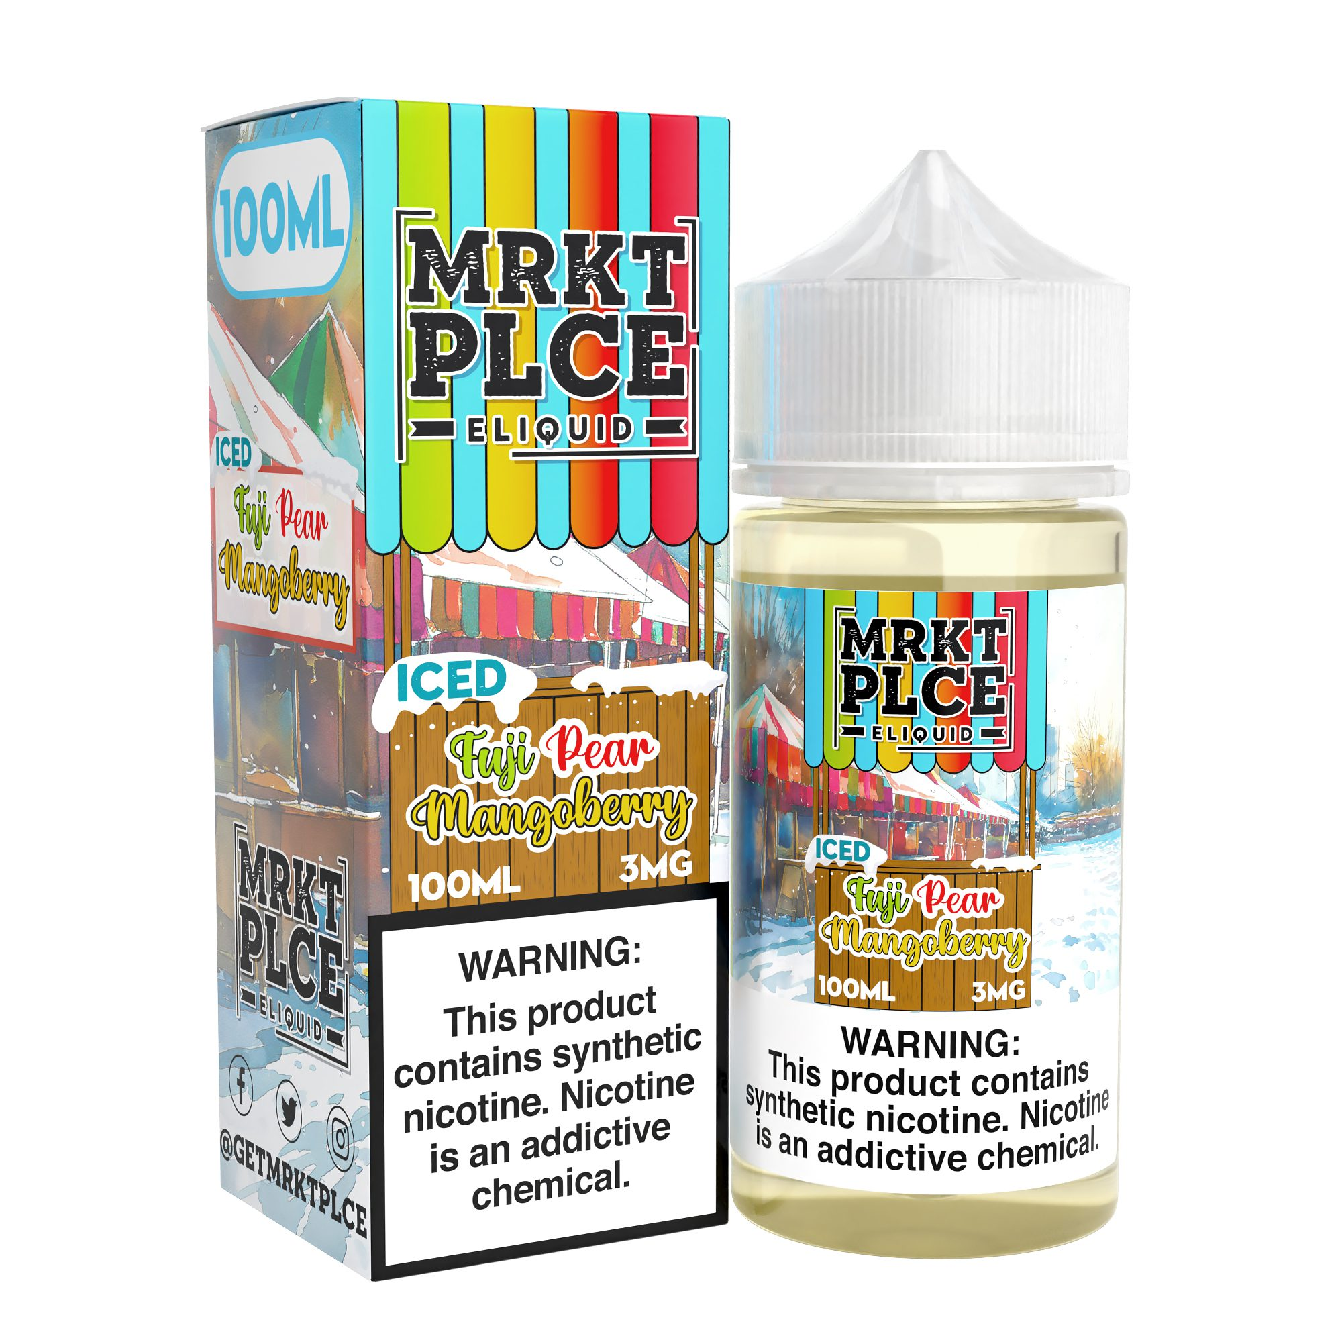
Iced Fuji Pear Mangoberry
Fuji Apple, Pear, Mango & Berries — Iced
All the tropical freshness of Fuji Pear Mangoberry, finished with a cool icy exhale.
Salt Nic 30ml · 24mg / 48mg | Sub-Ohm 100ml · 0mg / 3mg / 6mg
21+ · The Vapor Place

Slide 8
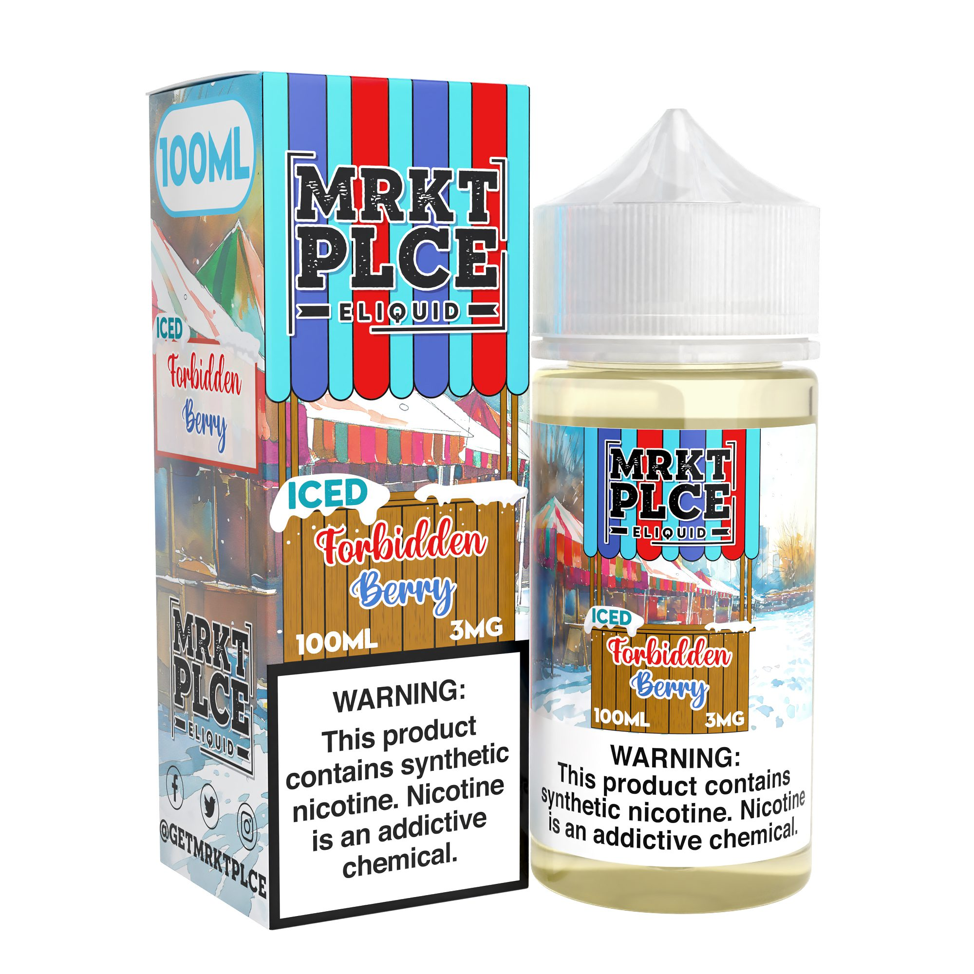
Iced Forbidden Berry
Tropical Fruit & Mixed Berries — Iced
The beloved Forbidden Berry blend elevated with a refreshing burst of ice.
Salt Nic 30ml · 24mg / 48mg | Sub-Ohm 100ml · 0mg / 3mg / 6mg
21+ · The Vapor Place

