Slide 1



IS2140 Information Storage and
Retrieval
Unit 3: Index Construction and Compression
Daqing He
School of Information Sciences
University of Pittsburgh
January 27, 2014
Many slides are based on Jamie Callan, James Allan and Jimmy Lin’s related courses

Slide 2
Muddiest Points
Controlled vocabulary
  What does "controlled vocabulary indexing" mean? What's the function of it? Can you give an example of it?
Multiple languages
  Multiple languages query could be a very changeable issue. How do we implement the algorithm in case we don't know these languages?
  In different languages, there are different stopwords. I wonder that they will occupy space to storage and spend time to recognize them in different languages. And as it said, sometimes they will lead to mistaken in some special phrases, so is it necessary to use them?

Slide 3
Muddiest Points
Stemming
  I wonder to know the meaning of recall in stemming. And I didn't followed two points about why we use stemming.
  Why the useful conflation such as "European/ Europe" and "matrix/ matrices" will miss in stemming?
Phrases
  If the word "white" is the last word of web page 1, the word "house" is the first word of consecutive web page 2, how could IR system identify the phrase "white house" as a whole not separate?

Slide 4
Questions about Stemming
Which of the statement about the effect of stemming is true?
  stemming never lowers precision (accuracy)
  stemming never lowers recall (coverage)
  Stemming increases the size of vocabulary
  Stemming should be used at indexing, but not at query processing

Slide 5
Muddiest Points
N-gram
  When we treat every character n-gram as a term, how can we decide he number n to make our indexing more efficiently? When query comes, for example, the query term is h*llo$, why should it changes to llo$h*, why we need to adjust the order of the characters?
  How do we decide the value of "N" when we are using N-Grams indexing? Can I say it doesn't matter as long as we use the same N-Grams to process the document and the query?
  I am so confused about bi-gram process. Although it can successfully treat ‘San Francisco’ as one token, it also stores so many words together, which are not consist of special meanings. Isn’t it waste a lot of space?

Slide 6
Muddiest Points
Wildcard queries
  using $ mark end of a term, and change to the same format with the query, then there are many results, like the example, query ca*le, the results are cable, cackle, capable......How does the search engine know which one is correct? or how to sort those results to user?
Word Sense Disambiguation
  Word Sense Disambiguation even has limited success and almost doesn't work. Since human themselves judge the meaning of a word by context, then why it's a big failure for WSD?
  But how to distinguish the phrase "White House" which stands for The executive mansion of the President of the United Statesfrom other "white house" which simply stands for a house with white wall?

Slide 7
Muddiest Points
Informal uses of words
  Nowadays, there're many abbreviations such as "you"-"u", "are"-"r", "please"-"plz", "thanks"-"tks", the abbreviated words are generally simple characters or not integrated words with no meaning. If using the indexing phrases to solve the polysemy problem, actually the context are also abbreviated words which would make it more confusing, such as "r u goin 2 c the film b4 tmr?" How can these words be automatically indexed?
Preprocessing
  Is it true that some pre-processing procedures are required for all IR, such as stop words removal, tokenization and normalization? Especially for tokenization, among the various tokenization approaches introduced in the class, how should we choose from them wisely to use in our Final Project?

Slide 8
Agenda
Index Construction
Index Compression

Slide 9
Class Goals
After this class, you should be able to
  know the basic ideas of constructing index
  Know the reasons why index is constructed into such inverted format with various components
  Know the basics of index compression
  Can design simple index construction and compression modules

Slide 10
Query Processing

Slide 11
Query Processing and Doc Indexing
Query processing is related to Doc Indexing
  These two have to be comparable
  Perform the exact steps as in indexing
    Remove stopwords if stopwords are removed in indexing
    Stemming query terms if stemming is used in indexing
Manual controlled vocabulary indexing
  Key problem: Searchers’ query terms may not be the one used for indexing documents
  How to solve the problem
    Searcher’s query terms are the indexed terms
    map searcher’s terms to indexed terms

Slide 12
Spelling Check
Is a query term misspelled? If so, make correction suggestion
Check misspell
  Based on dictionary (not in the dictionary)
  Based on search results (returned docs are lower than certain number)
Make correction suggestions
  Resources
    Based on dictionary
    Based index terms in the collection
    Based on query logs
  Methods
    Edited distance
    N-gram overlapping (see IIR book)

Slide 13
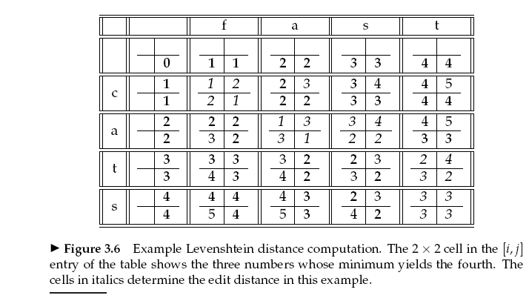
Edited distance – Levenshtein Distance
Three edit operations: delete, insert, replace
A dynamic programming problem

Slide 14
Codes for Levenshtein Distance
Rosetta codes
  http://rosettacode.org/wiki/Levenshtein_distance
NIST codes
  http://xlinux.nist.gov/dads/HTML/Levenshtein.html

Slide 15
Query Processing Steps
“stop-phrase” removal
  E.g. “I would like to find documents about …”
Stopword removal and stemming if they are done in indexing
Recognize noun phrases
  Using hyphenation: e.g., short-term => #1(short term)
  Using POS tagging: e.g., white house => #1 (white house)
  Using capitalization: e.g., Daqing He => #1(Daqing He), #1(Daqing He).Person
Weight query terms by frequency
  E.g., George Bush, Bush government => 1 George 2 Bush 1 government

Slide 16
Queries from TREC Topics - I
<topic>
<number>HARD-402</number>
<title>Identity Theft</title>
<description>How safe is your information on the Internet? </description>
<topic-narrative>
I am looking for an examination of the rising awareness and occurrence of identity theft. I would like to see information about how people can protect themselves, various ways people may have their identities stolen, and measures one can take to prevent identity theft. Is information safe on the Internet? I am looking specifically for Internet identity theft.
</topic-narrative>
</topic>
Resemble a user issued query
Resemble a one sentence question
Resemble a need statement

Slide 17
Queries from TREC Topics - II
Title only query, e.g. (not necessarily the best representation)
#combine(#PHRASE (identity theft) identity theft)
Query based on title and description fields
#wsum(1 4.0 #UW3(identity theft) 4.0 identity 4.0 theft
2.0 safe 2.0 information 2.0 Internet)

Slide 18
Index

Slide 19
A Search Scenario
Information Need: Identity Theft Protection Internet
Document Set:
  Doc 1: Apple introduces iphone via internet, iphone can access internet
  Doc 2: police uses internet to look for the identity of an armed killer. His photos are all over the internet.
  Doc 3: about 3 million cases of identity theft each year in US, most of them happened on the Internet. Consumers need more protections of their identities
  Doc 4: Credit card companies lose millions due to identity frauds on the Internet. Each company has millions of consumers

Slide 20
A Match between Query and Docs
Boolean Query: Identity AND Theft AND (Protection OR Internet)
  Processed query: ident AND theft AND (protect OR internet)
Document Representation: (after tokenization, normalization, remove stopwords, and stemming)
  Doc 1: appl, introduc, iphon, internet, iphon, access, internet
  Doc 2: polic, use, internet, look, ident, arm, killer, photo, internet
  Doc 3: 3, million, case, ident, theft, year, us, happen, internet, consum, need, protect, ident
  Doc 4: credit, card, compani, lose, million, ident, fraud, internet, compani, million, consum

Slide 21
Problems with This Approach
Very inefficient.
  Access docs multiple times to retrieve complete information about a query term
    Problem: all information about a query term is not put together
    Problem: no carefully designed structure to hold the information
  Need many unnecessary comparisons to find the query terms in docs
    Problem: do not know where the query terms are
    Problem: do not know which doc contain query terms
Very ineffective
  Hard to know the importance of the terms in docs
    Problems: do not know whether the term appear in a doc
    Problems: do not know how many docs contain a term

Slide 22
Index Construction

Slide 23
So Features of Index - I
requirement: given a term, all related information needs to be easily accessible
  Solution: create a vocabulary list, a dictionary like structure
Terms
…
compani
consum
…
ident
internet
…
protect
theft
…
year

Slide 24
So Features of Index - II
requirement: which documents contain a terms need to be available
  Solution: an array telling which docs contain the terms
Terms | Doc 1 | Doc 2 | Doc 3 | Doc 4
…
compani | 0 | 0 | 0 | 1
consum | 0 | 0 | 1 | 1
…
ident | 0 | 1 | 1 | 1
internet | 1 | 1 | 1 | 1
…
protect | 0 | 0 | 1 | 0
theft | 0 | 0 | 1 | 0
…
year | 0 | 0 | 1 | 0
Query:
ident AND theft AND
(protect OR internet)
So works, but can you see any
problem?

Slide 25
Problems
Observations:
  Still not quick to find which documents contain a term
  The term-document matrix is very sparse
  no information about some terms are more useful than others
Can we make this data structure even more efficient for fast retrieval?

Slide 26
So Features of Index - III
Postings: avoid data sparse and explicitly indicate docs
  Solution: an array of only the docs contain the terms
Terms | Doc 1 | Doc 2 | Doc 3 | Doc 4 | Postings
…
compani | 0 | 0 | 0 | 1 | 4
consum | 0 | 0 | 1 | 1 | 3,4
…
ident | 0 | 1 | 1 | 1 | 2,3,4
internet | 1 | 1 | 1 | 1 | 1,2,3,4
…
protect | 0 | 0 | 1 | 0 | 3
theft | 0 | 0 | 1 | 0 | 3
…
year | 0 | 0 | 1 | 0 | 3

Slide 27
A Simple Inverted Index
Terms | Postings
…
compani | 4
consum | 3,4
…
ident | 2,3,4
internet | 1,2,3,4
…
protect | 3
theft | 3
…
year | 3
Still can you see
any problem?
Notes:
15

Slide 28
Problems
Observations:
  no position information for proximate queries
  no information about some terms are more useful than others

Slide 29
A more Elaborated Inverted Index
Terms | Postings
…
compani | (4: 3, 14)
consum | (3 :19),(4 :18)
…
ident | (2:8), (3: 6,25), (4:8)
internet | (1:5,9), (2:3,19), (3:18), (4:12)
…
protect | (3:22)
theft | (3:7)
…
year | (3:9)
Query:
uw3(ident theft)
Notes:
15

Slide 30
Simple Exercise
A collection of two documents
  Doc1: Wrecked Roads and Bridges in Chile Hinder Rescue Effort in Chile Earthquake
  Doc2: Test for Chile’s Coalition in Presidential Election in Chile
After stopword removing and stemming
  Doc1: wreck road bridg chile hinder rescu effort chile earthquak
  Doc2: test chile coalit presidenti elect chile
What is the vocabulary? What is the inverted file looks like if we want to record how many times a term appears in a document?

Slide 31
A Solution
Terms | Postings
bridg | (1#1)
chile | (1#2), (2#2)
coalit | (2#1)
earthquak | (1#1)
effort | (1#1)
elect | (2#1)
hinder | (1#1)
presidenti | (2#1)
rescu | (1#1)
road | (1#1)
test | (2#1)
wrect | (1#1)
If want to record the
position of “bridg” in
Doc 1, is it 3rd words
Or 4th words?
So how big the index
would be?
Notes:
15

Slide 32
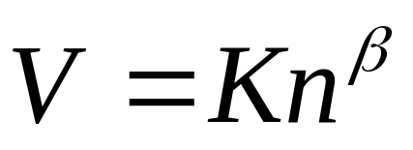

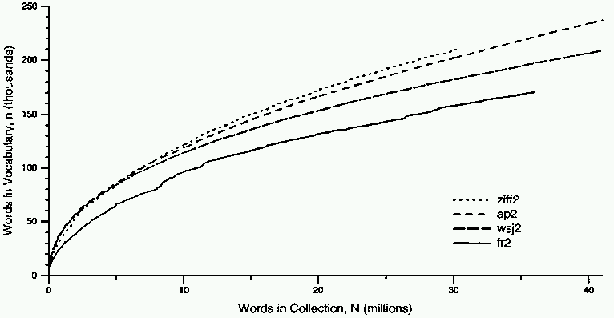

How big is the vocabulary?
Heap’s Law tells us about vocabulary size
  Depends on text, 10<= K <= 100
  In English, 0.4 <= <= 0.6
    approx. square-root
  when
    100,000 words, voc size = 6325
    1,000,000 words, voc size = 20000
V is vocabulary size
n is corpus size (number of words)
K and β are constants
Notes:
22

Slide 33
What could be the new words?
When adding new documents, the system is likely to have seen most terms already
But vocabulary does not really upper-bounded with the increase of the size of the collection

Slide 34


Zipf’s Law
Zipf’s law related a term’s frequency to its rank
  Rank the terms in a vocabulary by frequency, in descending order
  : frequency of term ranked R
  N: total number of words occurred
  Empirical observation, for English A = 0.1

Slide 35
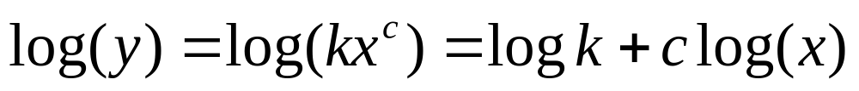
Does Real Data Fit Zipf’s Law?
A law of the form y = kx^{c} is called a power law.
Zipf’s law is a power law with c = –1
On a log-log plot, power laws give a straight line with slope c.
Zipf is quite accurate except for very high and low rank.

Slide 36
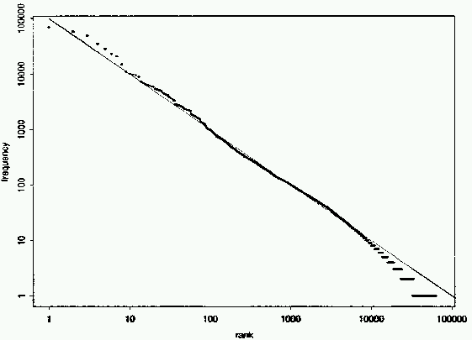
Fit to Zipf for Brown Corpus
k = 100,000

Slide 37
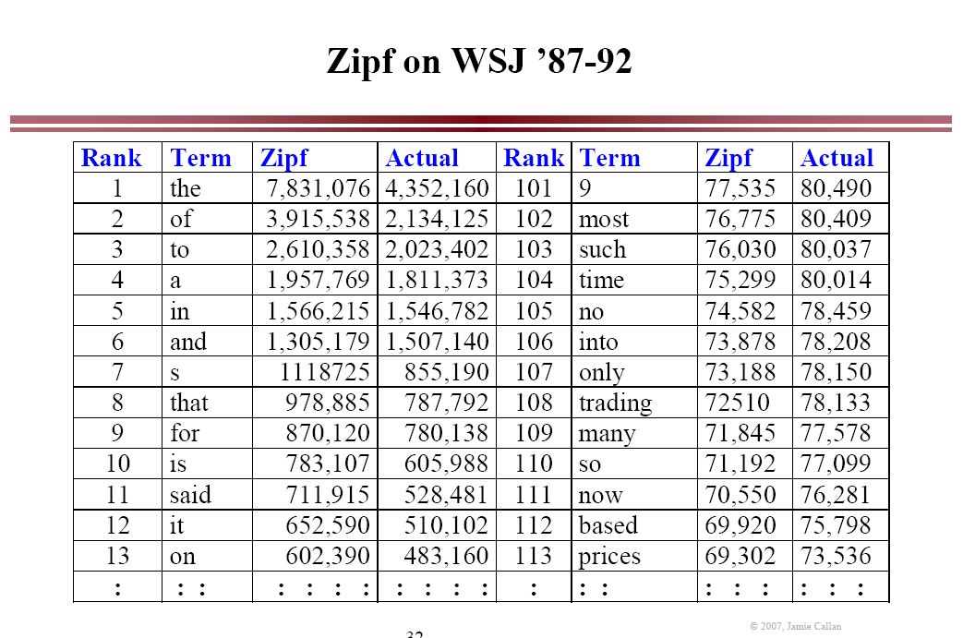

Slide 38
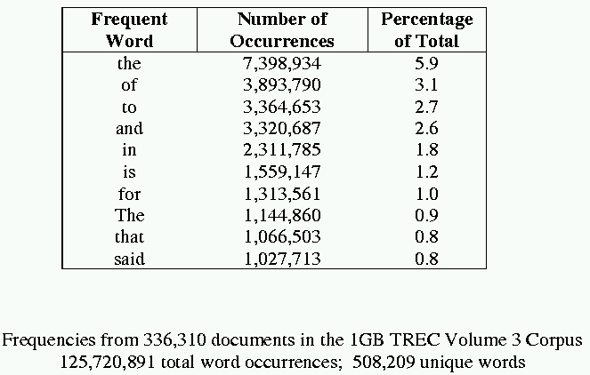
Sample Word Frequency Data
(from B. Croft, UMass)

Slide 39
Zipf’s Law Impact on IR
Good News: Stopwords will account for a large fraction of text so eliminating them greatly reduces inverted-index storage costs.
  take up 50% of the text.
Bad News: For most words, gathering sufficient data for meaningful statistical analysis (e.g. for correlation analysis for query expansion) is difficult since they are extremely rare.

Slide 40
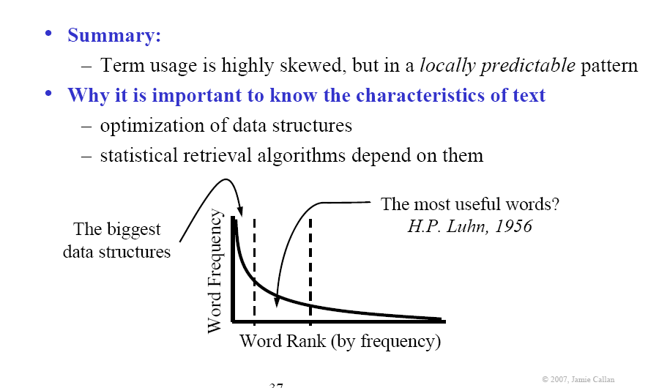
Statistical Properties of Text

Slide 41
How big are the postings?
Very compact when only consider which term in which doc
  About 10% of the size of the documents
Not much larger when also consider frequency of a term in a doc
  Perhaps 20% of collection size
Enormous for proximity operators when position is also needed
  Sometimes larger than the document collection
Terms | Postings
…
compani | 4
consum | 3,4
…
ident | 2,3,4
internet | 1,2,3,4
…
protect | 3
theft | 3
…
year | 3
Terms | Postings
…
compani | (4: 3, 14)
consum | (3 :19),(4 :18)
…
ident | (2:8), (3: 6,25), (4:8)
internet | (1:5,9), (2:3,19), (3:18), (4:12)
…
protect | (3:22)
theft | (3:7)
…
year | (3:9)
Notes:
18

Slide 42
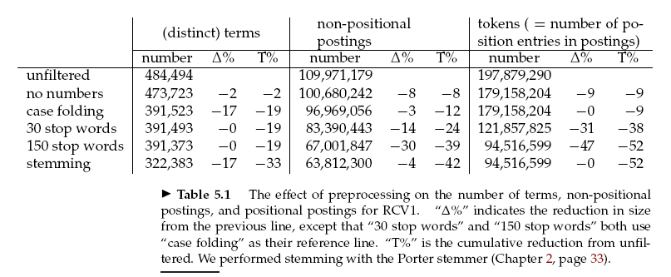
Effects of Doc Processing to Index Size

Slide 43
Hardware Issues
Storage Hierarchy
  Size: External storage > Hard drive > Main memory > CPU Caches
    Unlimited space to only few hundred MBytes
  Speed: External storage < Hard drive < Main memory < CPU Caches
    Very slow to as fast as CPU
  Implications to the storage of index?
Hard drive has seek time where the disk heads need to move to the part of the disk
  No data are transferred in this time
  Implications to the storage of index?

Slide 44
Why is size important?
RAM
  Typical size: 4 to 8 GB
  Typical access speed: 50 ns
Hard drive:
  Typical size: 500 to 1000 GB (my laptop)
  Typical access speed: 10 ms = 10,000,000 ns
Hard drive is 200,000x slower than RAM!

Slide 45
Hardware Issues - II
Operating system often read/write entire blocks of data
  The time to read/write a byte is equal to that of the whole block
    Block size can be 8, 16, 32, and 64 KBytes
  Implications to the storage of index?
Data transfer between disk and memory is handled by bus,
  so the CPU is available for use during the time
  Implications to the storage of index?

Slide 46
Some practical issues
Size of Index could be too big to be stored in RAM
  Too slow if stored on hard drive
  Need way to keep important and relevant index part in RAM
  Others are on hard drive
Operations needed to look for a term in term list can be huge
  better data structure

Slide 47
Decoupling the Inverted Index
Terms
aid
compani
consum
dog
ident
internet
lazy
protect
theft
us
year
Postings
4,8
2,4,6
1,3,5,7
3,5
2,4,6,8
3
2,6,8
1,3,5,7,8
6,8
1,5,7
2,5,6
Notes:
15

Slide 48
Basic components of Index
Term dictionary
  The vocabulary of the index terms
Posting lists
  Info about where each term occurs in the corpus
Document vector
  Info about every term in a document
Field mask (maybe)
  Info about each field in a document
And many other info

Slide 49
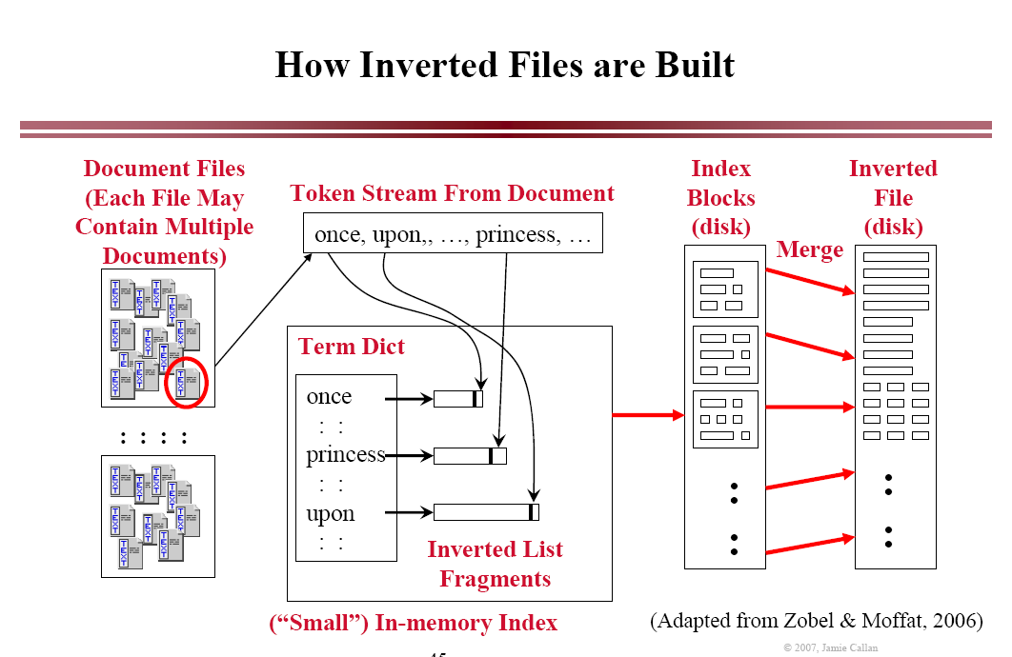

Slide 50
How Inverted Files are Built
The in-memory index stores
  A portion of the term dictionary, fragments of posting lists
The in-memory index is small compared to the full index
  Perhaps 1-5% the size of total
When in-memory index buffers are full
  Flush to disk
  Reinitialize in-memory index
  Continue parsing
When all document are parsed, all blocks of index are merged
  Very fast – essentially a merge sort

Slide 51
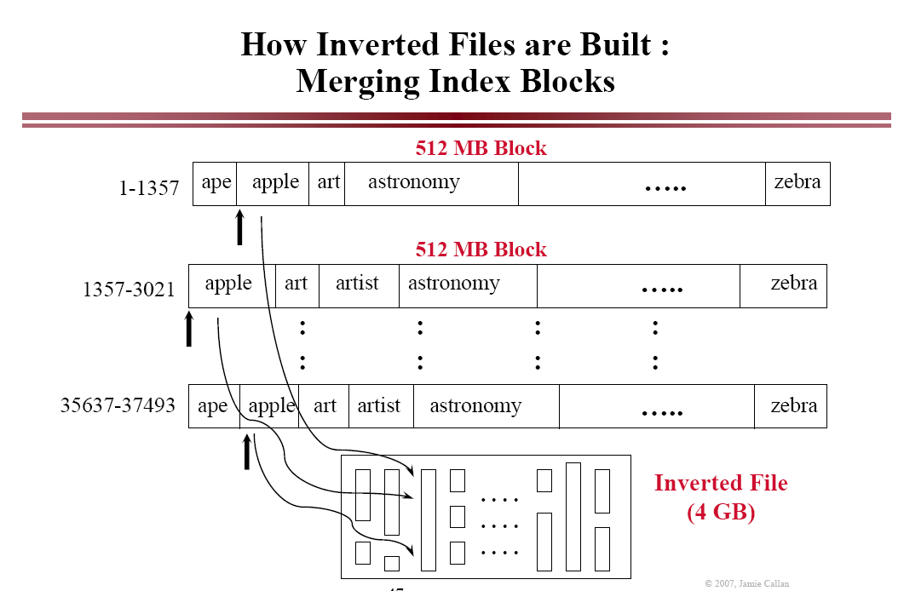

Slide 52
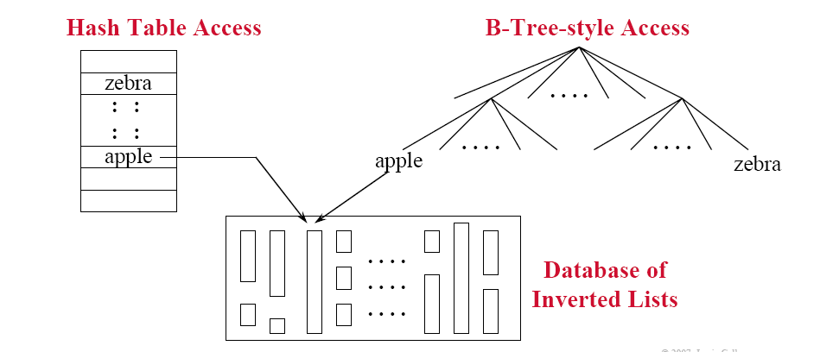
Access Methods to Inverted File
Enable accurate and efficient document retrieval
Organize the term list with efficient access methods

Slide 53
Data Structures for Access Method
Hash Table
  Very fast, O(1) look up, but could suffer if the terms not distributed evenly
  Usually a big in-memory data structure
  Could be complex to expand
B-Tree
  Fast, O(log n) lookup, but terms guaranteed to distribute evenly
  Often implemented as a two-stage data structure
    Frequent terms in memory, infrequent terms on disk
    Efficient use of RAM, occasional slow access

Slide 54
Binary Tree
A tree structure where
  Each node has at most two children
  The left child comes before the parent
  The right child comes after the parent
Input: elk, hog, bee, fox, cat, gnu, ant, dog
elk
bee
hog
ant
cat
fox
dog
gnu

Slide 55
Binary Trees
Advantages
  Can be searched quickly
  Easy to add an extra term
  Economical use of storage (although less so than linear term list)
Disadvantages
  The shape of a binary trees depends on insertion order of terms
    What’s the worst case scenario?
  Trees tend to become unbalanced
    So need to balance trees

Slide 56
Definition of a B-tree
A B-tree of order m is an m-way tree (i.e., a tree where each node may have up to m children) in which:
  1. the number of keys in each non-leaf node is one less than the number of its children and these keys partition the keys in the children in the fashion of a search tree
  2. all leaves are on the same level
  3. all non-leaf nodes except the root have at least ⎡m / 2⎤ children
  4. the root is either a leaf node, or it has from two to m children
  5. a leaf node contains no more than m – 1 keys
The number m should always be odd
B-Trees

Slide 57
An example B-Tree
26
A B-tree of order 5 containing 26 items
6
12
42
51
62
1
2
4
7
8
13
15
18
25
27
29
45
46
48
53
55
60
64
70
90
Note that all the leaves are at the same level

Slide 58
Constructing a B-tree
Suppose we start with an empty B-tree and keys arrive in the following order:1 12 8 2 25 5 14 28 17 7 52 16 48 68 3 26 29 53 55 45
We want to construct a B-tree of order 5
The first four items go into the root:
To put the fifth item in the root would violate condition 5
Therefore, when 25 arrives, pick the middle key to make a new root
1
2
8
12

Slide 59
Constructing a B-tree (contd.)
8
1
2
12
25
6, 14, 28 get added to the leaf nodes:
8
1
2
6
12
14
25
28

Slide 60
Constructing a B-tree (contd.)
Adding 17 to the right leaf node would over-fill it, so we take the middle key, promote it (to the root) and split the leaf
8
17
1
2
6
12
14
25
28
7, 52, 16, 48 get added to the leaf nodes
8
17
1
2
6
7
12
14
16
25
28
48
52

Slide 61
Constructing a B-tree (contd.)
Adding 68 causes us to split the right most leaf, promoting 48 to the root, and adding 3 causes us to split the left most leaf, promoting 3 to the root; 26, 29, 53, 55 then go into the leaves
3
8
17
48
1
2
6
7
12
14
16
25
26
28
29
52
53
55
68
Adding 45 causes a split of
25
26
28
29
and promoting 28 to the root then causes the root to split

Slide 62
Constructing a B-tree (contd.)
17
3
8
28
48
1
2
6
7
12
14
16
25
26
29
45
52
53
55
68

Slide 63
Index Compression

Slide 64
Index Compression
Problems:
  The size is still a problem
Opportunities
  Compress dictionary terms
  Compress posting lists

Slide 65
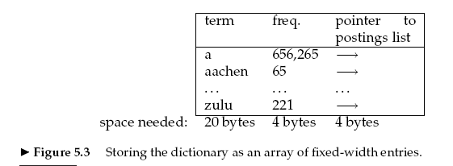
Why Compress Dictionary Terms
With 4 bytes for the pointer postings, how big the vocabulary can be
If we have a collection with 400,000 unique terms, how big the dictionary term list is?

Slide 66
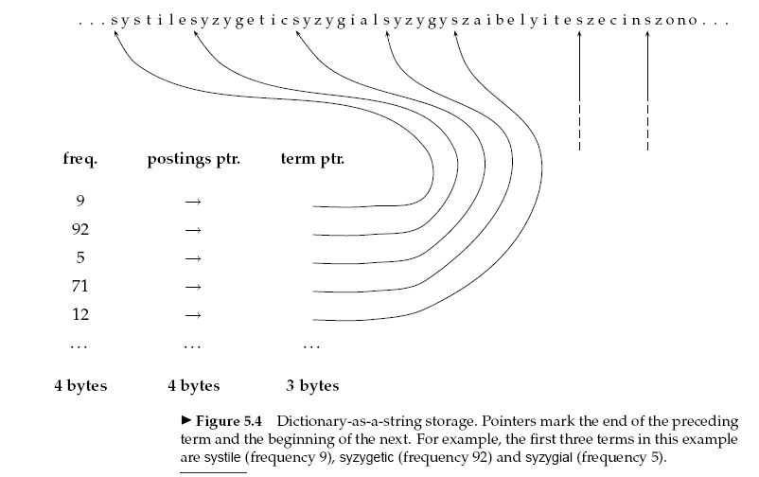
Compress Dictionary Terms
Opportunities
  Average English words only have 8 characters, so waste 12 character space in average for each word
Solutions
  View dictionary terms
  as a string
  400,000 words only need
  3 bytes for term pointer
    How this is determined?
  Many other solutions
    See IIR chapter 5

Slide 67
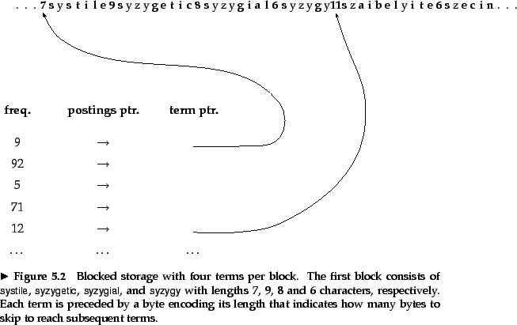
Blocked Storage

Slide 68
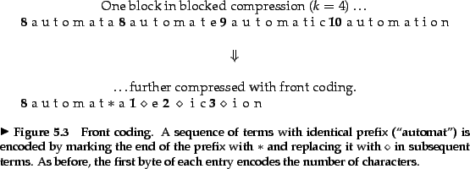
Front Coding
Consecutive entries in an alphabetically sorted list share common prefixes => front coding to further compress

Slide 69
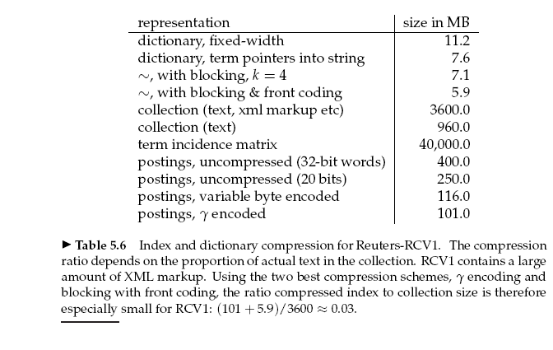
Effects of Dictionary Compression
Reduce the dictionary size from 11.2MB to 5.9MB

Slide 70
Compress Posting Lists
Opportunities
  Distribution of numbers is skewed
    Most numbers are small (word locations, term frequency)
  The longest lists take the most space, compressing them save the most space
Solutions
  Delta encoding
  Unary code
  Gamma code

Slide 71
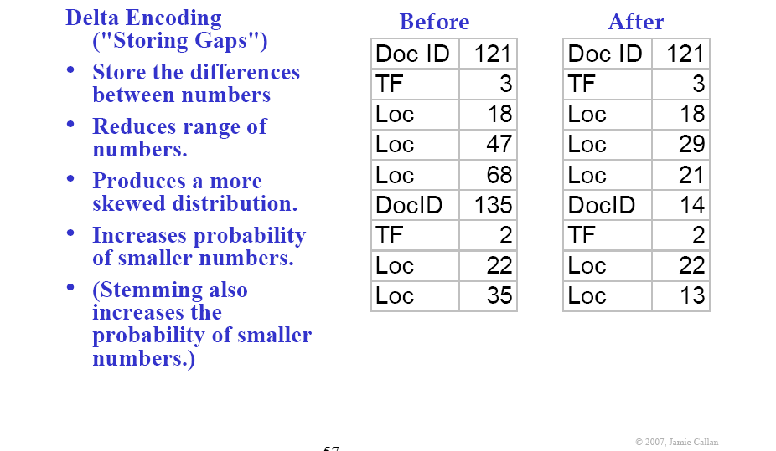
Delta Encoding
No Delta Encoding
Delta Encoding

Slide 72
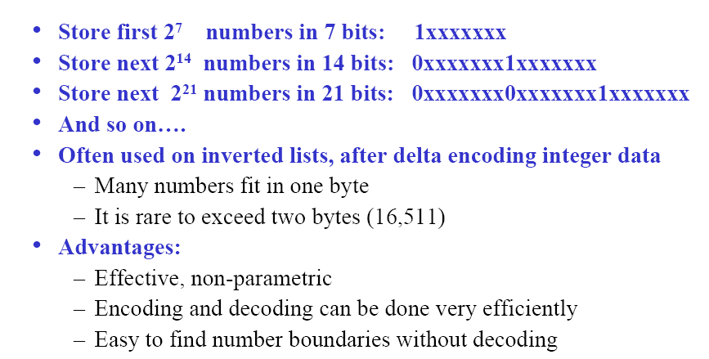
Variable Length Codes

Slide 73
Gamma Code (γ code) - I
Usages
  Used when the largest encoded value is not known ahead of time, or
  to compress data in which small values are much more frequent than large values.

Slide 74
Gamma Code (γ code) - 2
Unary code
  A number N₁₀ is coded with N one then is followed by a zero
    E.g. 3 is coded as 1110, 7 is coded as 11111110.
  1 and 0 can be switched in unary code
    So, 3 can be coded as 0001, 7 as 00000001
Gamma code contains two parts length and offset
  Offset is in binary, but with the leading 1 removed. For example, for 11 (binary 1011) offset is 011.
  Length encodes the length of offset in unary code. For 11, the length of offset is 3 bits, which is 1110 in unary.
  Now gamma code is the concatenation of length and offset. so for 11, its gamma code is 1110011

Slide 75
Compression of Index

Slide 76
So
We have discussed:
  The data structure for indexing documents
  The data structures for accessing the index
  Methods for compressing the inverted index
Most of our discussions focus
  Efficiency: how quickly and accurately build and access index
  We have not talk about the effectiveness of retrieval
    We will talk about this in our retrieval models

Slide 77
Assignment 2: index construction
Due Feb 17,
Task : construct a simple index
More information is in courseweb

