Slide 1
Terminal BMI
Vincent Lieu

Slide 2
What is it?
Body Mass Index(BMI) is a measurement of body fat based on height and weight that applies to men and women aged 18 and above.
It is a screening tool used to indicate whether an individual is under weight, heathly, over weight or obese.

Slide 3
Features
Personalisation (Measurement system selection): Allows the user to select their preferred measurement system - Imperial or Metric.
BMI calculation: Based on the preferred measurement system selected, it will calculate the user’s BMI score.
Weight category specification and assignment: Once the calculation performed it will display to the user their weight category based on their BMI score.

Slide 4
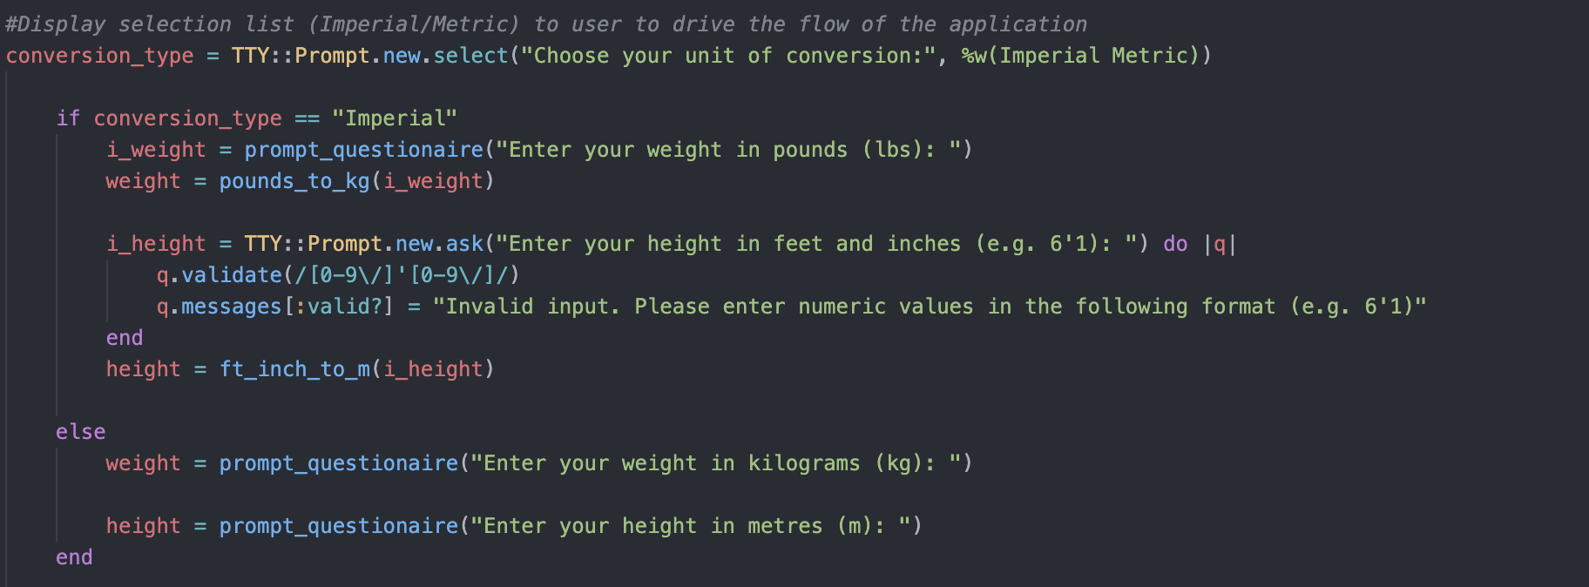
Measurement system selection
Notes:
Using TTY-Prompt ask the user to select either Imperial or Metric
If conversion is ‘Imperial’ then prompt the user to enter their weight in pounds and assign it to the variable i_weight to perform a conversion from pounds_to_kg.
Then ask the user to enter in their height in feet and inches using the specified format.
Otherwise if Metric is selected instead
Prompt user to enter their weight in kilograms and height in metres and store the values directly into the weight and height variables

Slide 5
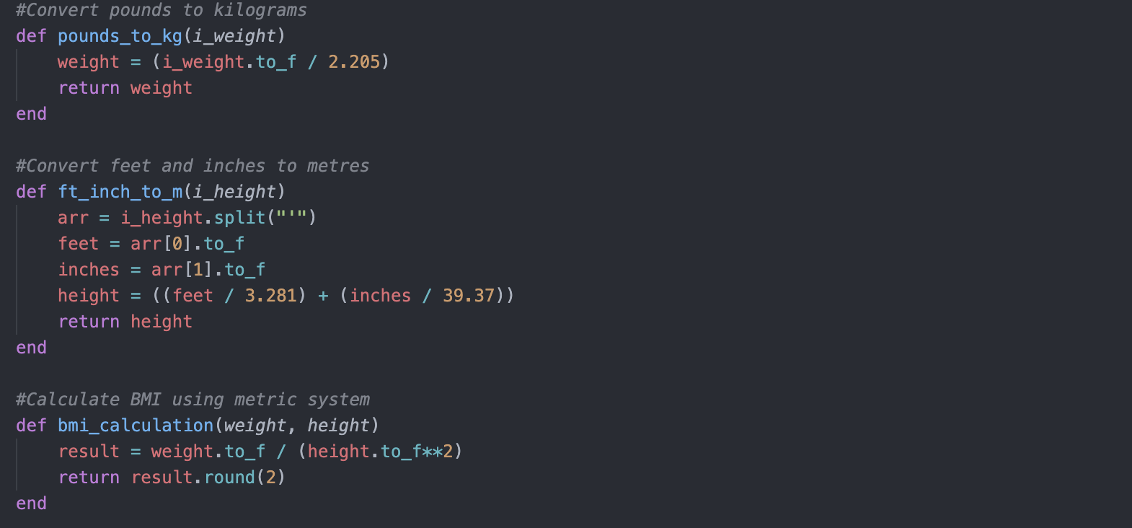
BMI calculation
Notes:
Defined a method to convert pounds to kilograms and return the weight
Defined a method to convert feet and inches - because i’m asking the user to enter a value in feet and inches (5’1) I had to put it into an array and split it by the apostrophe and convert it into a float; then store the height variable by converting the feet and inches to metres.

Slide 6
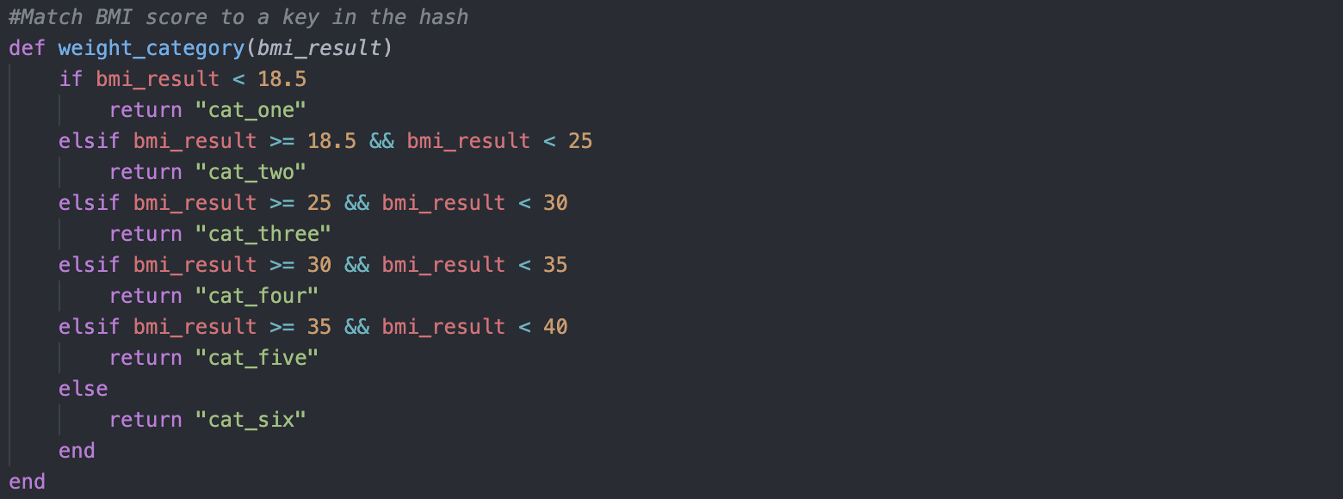
Weight category assignment

Slide 7
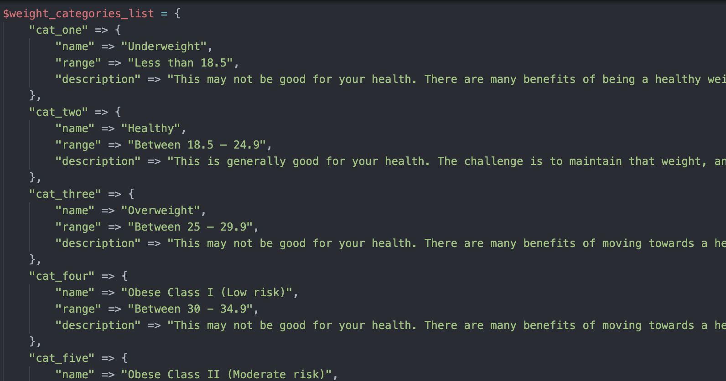
Weight categories list

Slide 8
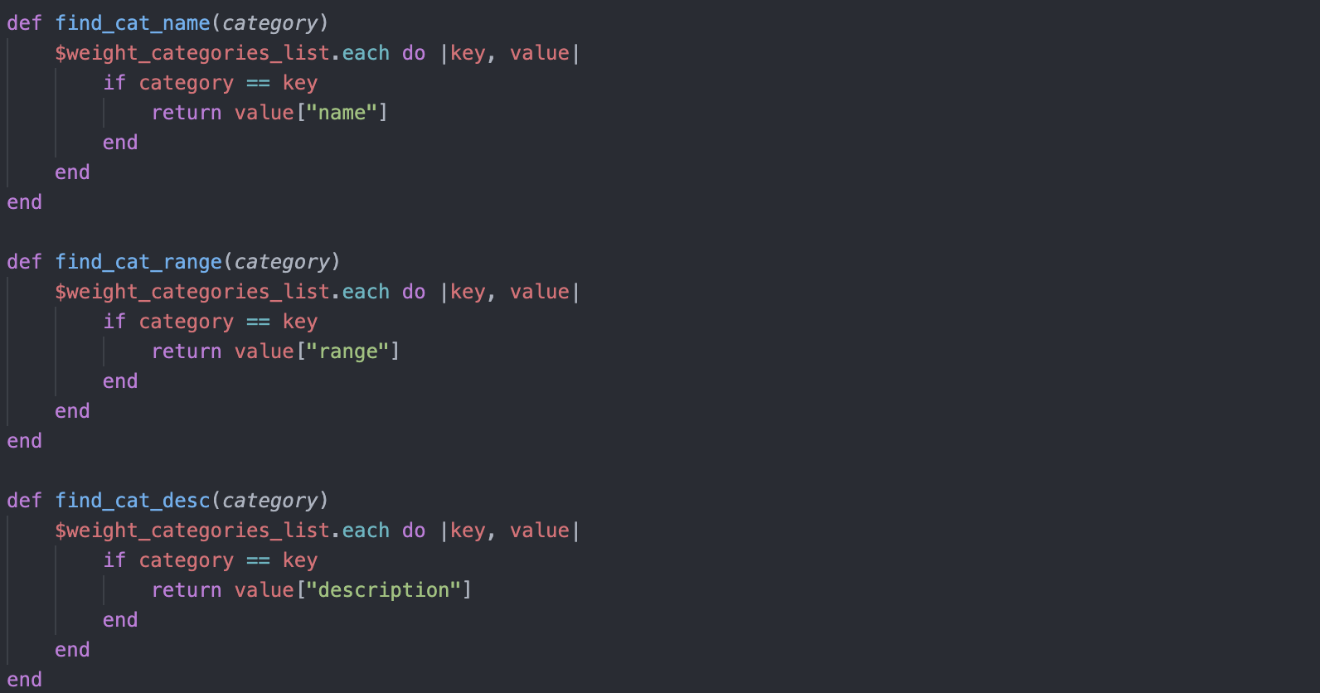
Obtaining the weight category name, range and description

Slide 9
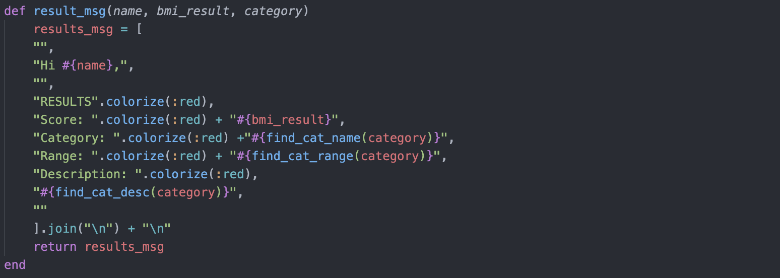
Output results

